Slide 1
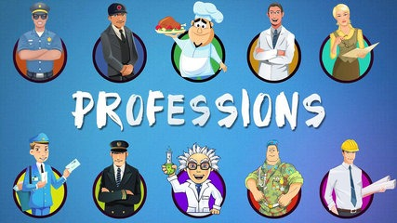
My Family. Professions.

Slide 2
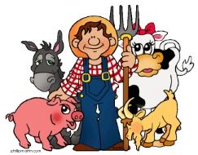
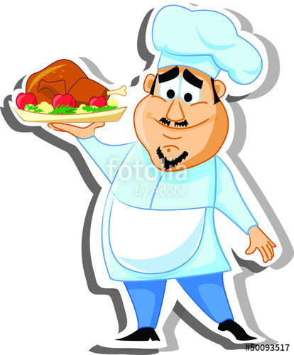
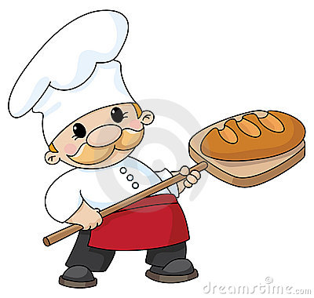
Professions
A doctor
A teacher
A farmer
A bus driver
A cook
A baker
A businessman
A policeman

Slide 3
What do these people do?
Help sick
people
Make bread
Drive a bus
Look after animals
Teach children
Do
business
Grow vegetables
Help people
Cook dinner

Slide 4
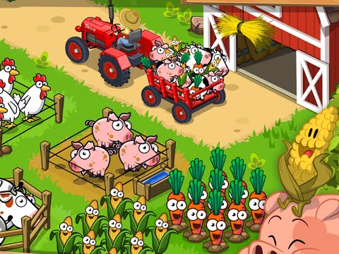
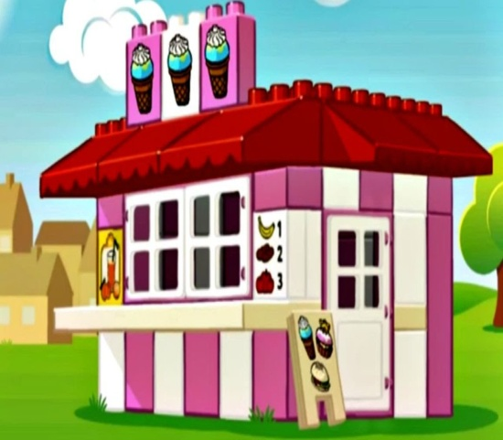
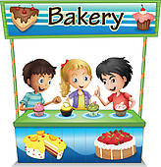
Where do these people work?
Hospital
School
Farm
Police office
Bus
Office
Cafe
Bakery

Slide 5
Jane’s Family

Slide 6
What is your profession?
1. I am a …
2. I work in the…
bake…
help…
3. I teach…
look after…
drive a …
cook…
4. I like my …

Slide 7
To be

Slide 8
Complete the sentences
1. I … a pupil.
2. My uncle …a baker.
3. Ann and Liz … cousins.
4. His father … a doctor.
5. They … farmers.
6. I … 9.
7 My grandparents … kind..

