Slide 1
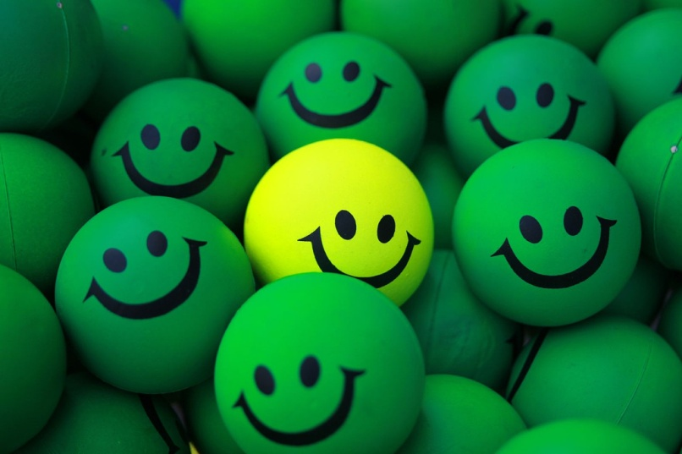
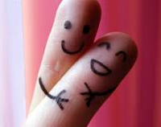
MODERN HOLIDAYS OF ENGLISH-SPEAKING COUNTRIES

Slide 2
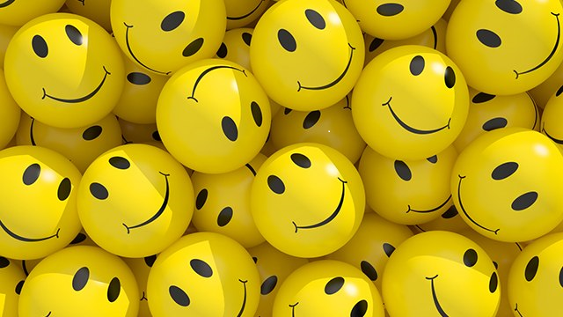
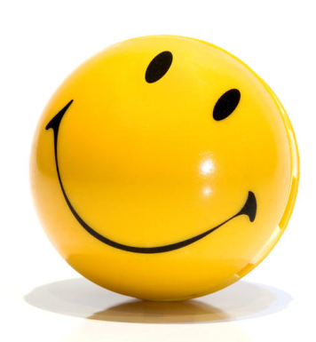
World Smile Day

Slide 3
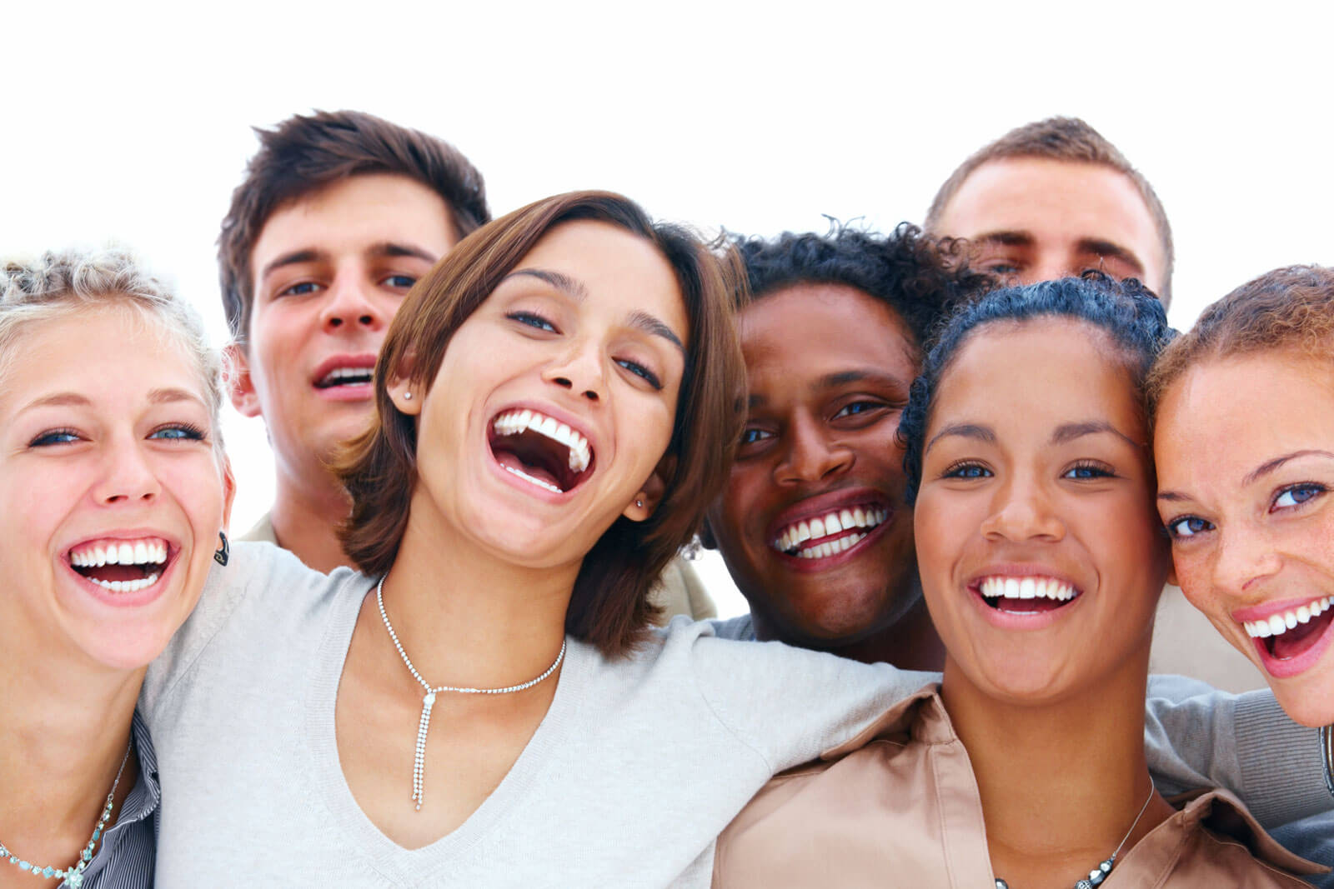
The first Friday of October each year marks World Smile Day.

Slide 4
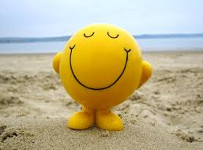
The idea of celebration was invented by Harvey Ball.
He created
the smiling face in 1963.

Slide 5
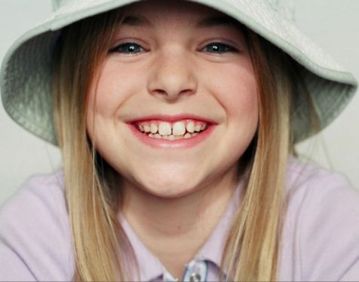
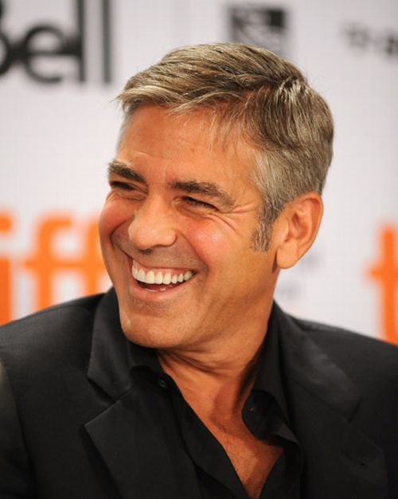
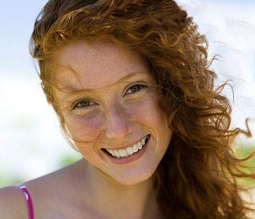
The first World Smile Day celebration was on October 1, 1999.

Slide 8
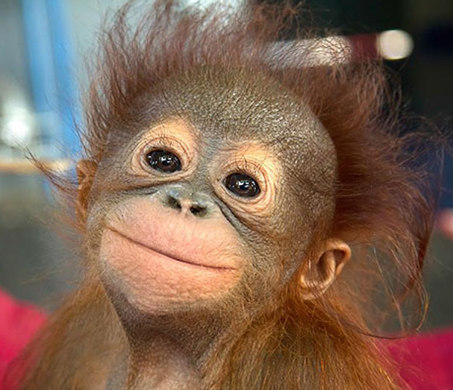
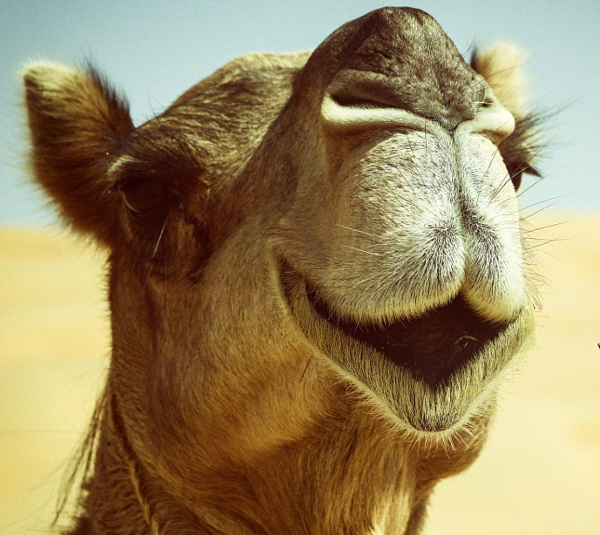
Your smile makes me smile!
If you don’t have a smile, I’ll give you one of mine.
When life gives you a hundred reasons to cry, show life the thousands of reasons you have to smile.

Slide 9
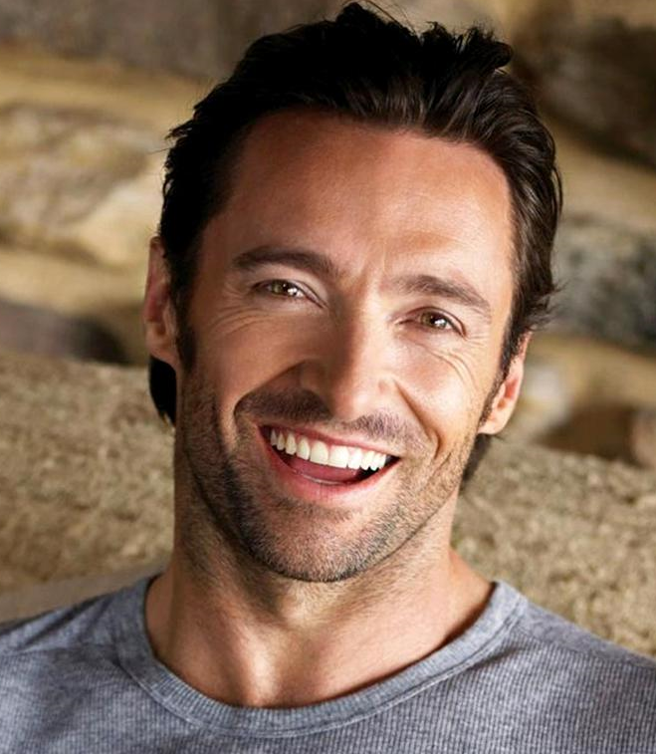
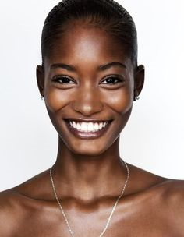
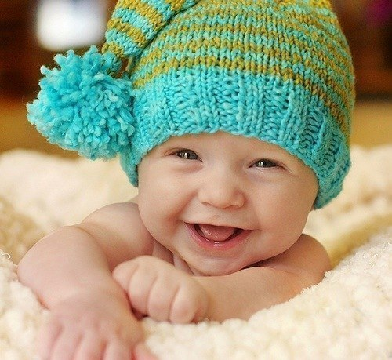
Life is like a mirror: It’ll smile at you if you smile at it.
Let your smile change the world but don’t let the world change your smile.
Let everyone know today, you’re a lot stronger than you were yesterday.

Slide 11
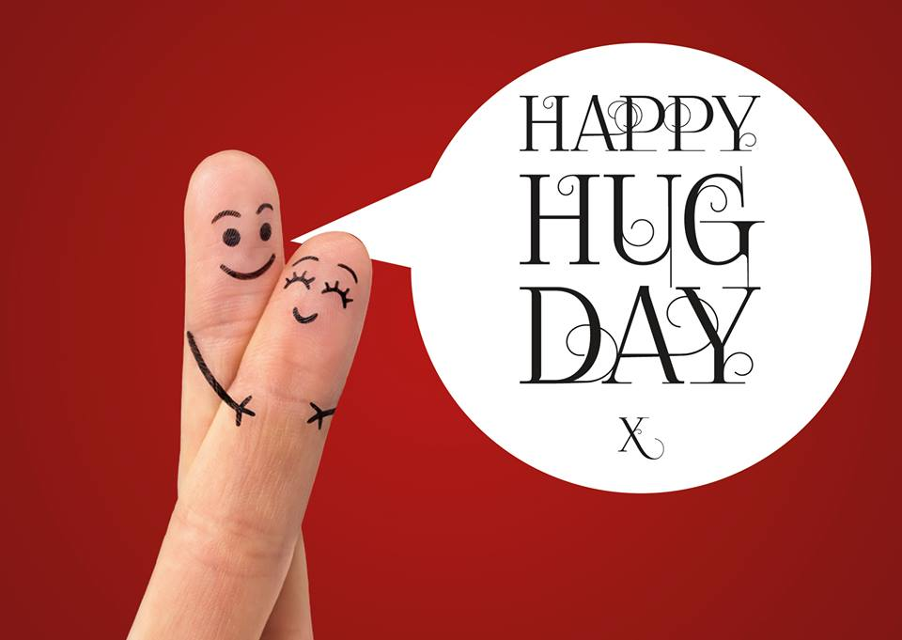
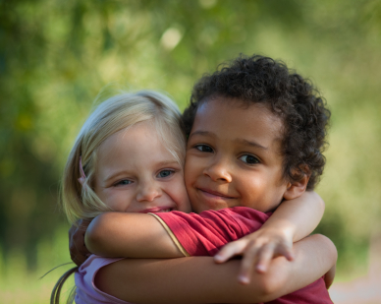
International Hugging Day

Slide 12
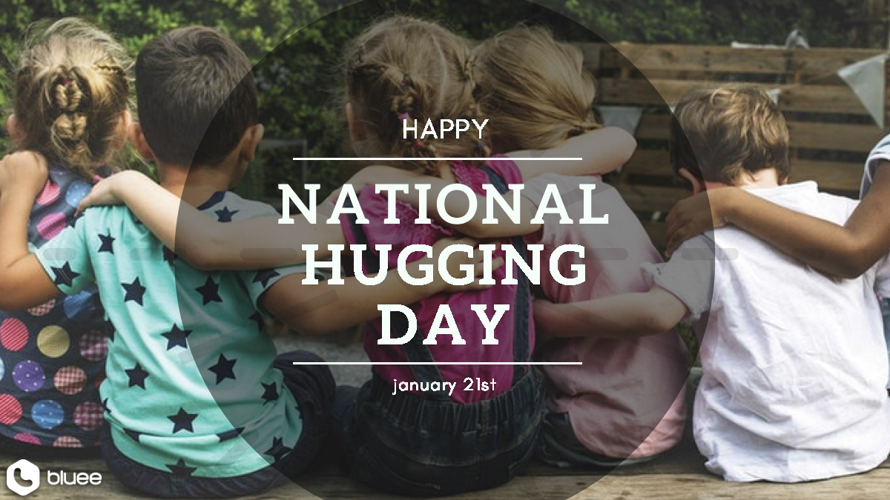
This holiday was born in the USA. Kevin Zaborney created National Hugging Day in 1986.

Slide 14
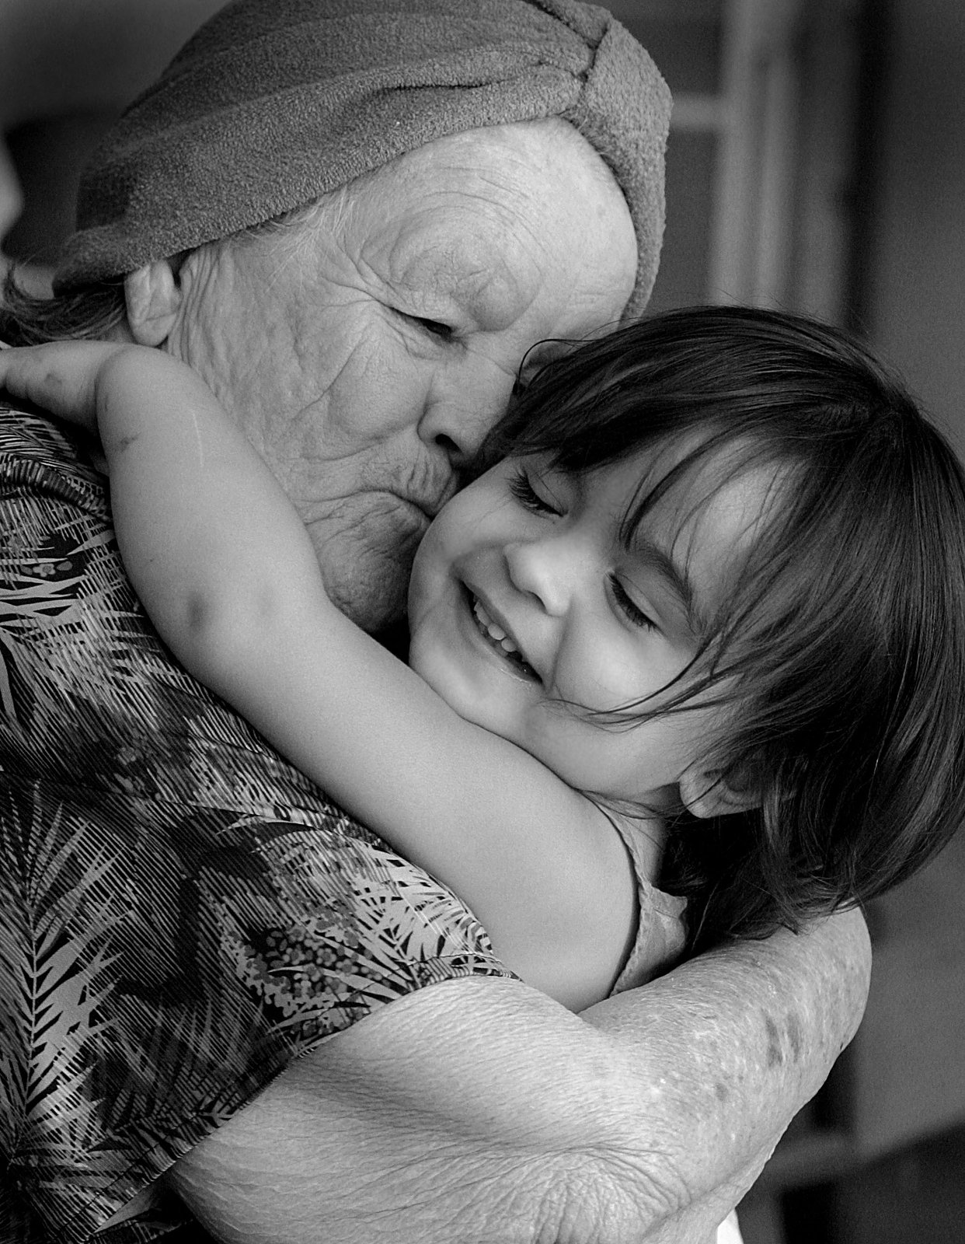
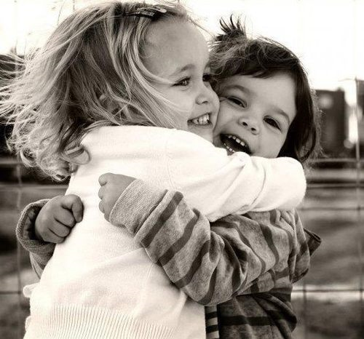
International Hugging Day is celebrated on January 21st

Slide 16
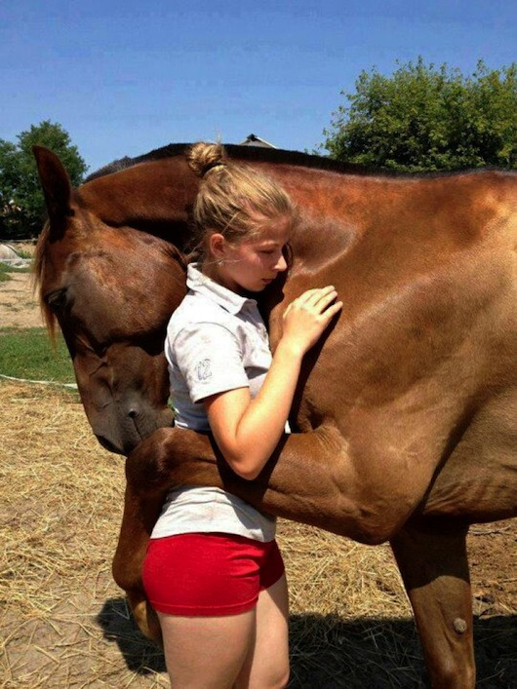
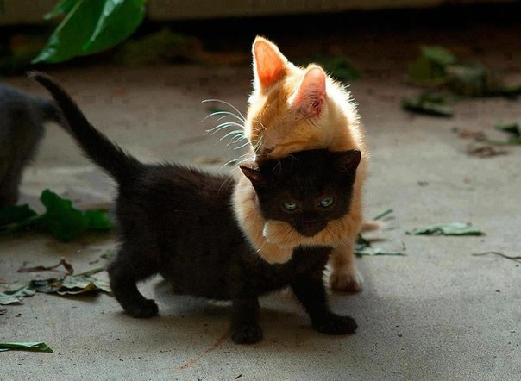

Slide 17
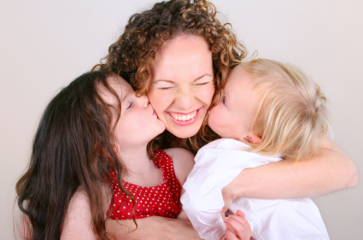

Slide 19
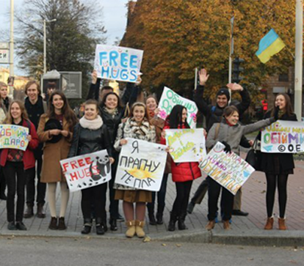
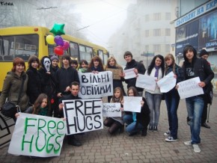
Hugging Day in Lviv

Slide 20
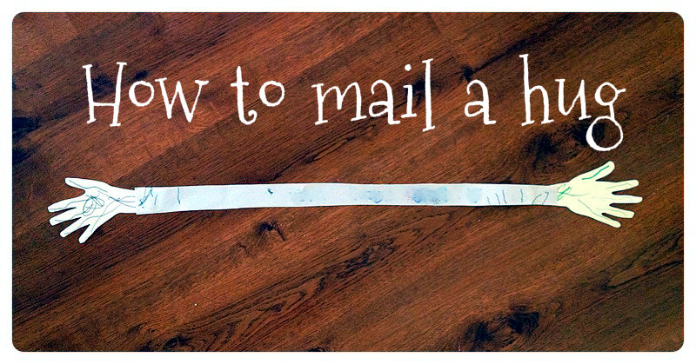

Slide 21
Compliment day is celebrated in January 24th

Slide 22
Зображення можуть бути захищені авторським правом.Надіслати відгук

Slide 25
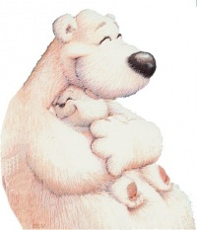
You inspire me.
You are like a big hug.
I like to hear your laugh.
You are treasure.

Slide 26
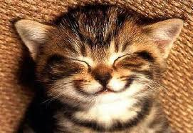
You have a gorgeous smile.
You are beautiful.
You make me crazy.
You light up my life.

Slide 27
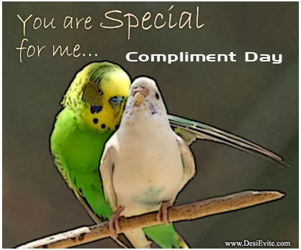
You look really good today.
You are nice.
You are amazing.
You have a beautiful soul.

