Slide 1
Безособові речення
Impersonal Sentences
-Не має суб’єкта дії (підмета).
-Означає явища природи, стан погоди, час та відстань.

Slide 2
Підмет ( subject)
виражається за допомогою
It
На українську мову
нe перекладається.
It is cold. – Холодно.
It is hot. – Спекотно.
It is slippery. – Слизько.

Slide 3
Слова можуть бути різними частинами мови:
RAIN
Verb
Дієслово
Іде дощ
Noun
Іменник
Дощ

Slide 4
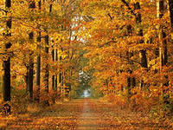
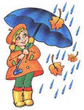
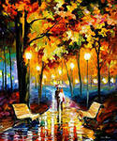
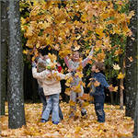
Відмінювання за часами
It often rains in autumn.
Восени часто йде дощ.
It is raining now.
Зараз іде дощ.
It rained yesterday.
Вчора йшов дощ.

Slide 5
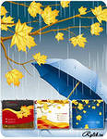
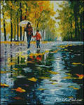
Present Simple Tense
+ It rains in autumn.
- It doesn’t rain in winter.
? Does it rain in autumn?
Yes, it does.
No, it doesn’t.

Slide 6
Past Simple Tense
+ It rained yesterday.
- It didn’t rain six days ago.
? Did it rain yesterday?
Yes, it did.
No, it didn’t.
did
Не потрібні:
ed /ІІ форма

Slide 7
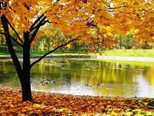
Present Continuous Tense
+ It is raining now.
- It is not raining now.
? Is it raining now?
Yes, it is.
No, it is not.

Slide 8
Choose the right word:
It always _____ in winter.
a) is snowing b) snows c) snowed
It _____ two weeks ago.
a) is snowing b) snows c) snowed
It is 4 o’clock. It _____ at this moment.
a) is snowing b) snows c) snowed

Slide 9
It _____ snow in summer.
didn’t b) doesn’t c) isn’t
It _____ snow last week.
didn’t b) doesn’t c) isn’t
It _____snowing at this moment.
a) didn’t b) doesn’t c) isn’t

Slide 10
____ it _____ in summer?
a) Did snow b) Does it c) Is snowing
_____ it _____ last Monday?
a) Did snow b) Does it c) Is snowing
Look! ____ it _______ at this moment?
a) Did snow b) Does it c) Is snowing

Slide 11
Make up the sentences:
Drizzle - моросити
It
drizzles
is snowing
drizzled
snows
rained
is drizzling
snowed
rains
in autumn
Two days ago
at this moment
in winter
now
last week
every February
yesterday

Slide 12
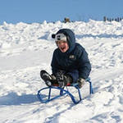
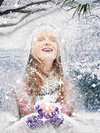
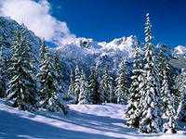
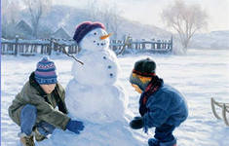
Describe the pictures with impersonal sentences
Monday
Tuesday
It is winter.
__________
Let’s go to the yard because…
____________
________

Slide 13
Thanks for your
attention

