Slide 1
Legend about Smila
(My Home Town)
Michurina Nadia

Slide 2
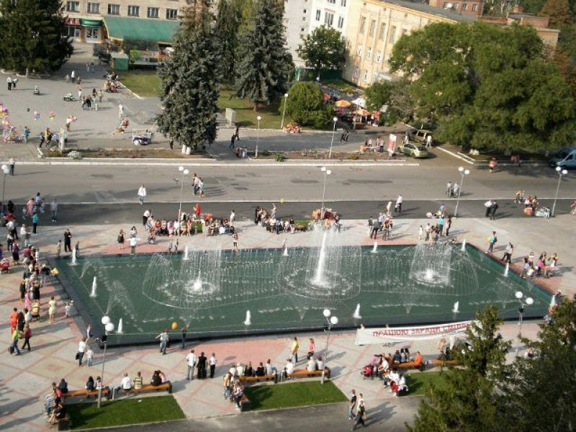
Smila or Smela is a city located in Cherkassy region of Ukraine.
The city was first established as a Cossack settlement in the late 16th century.
It is standing on the left bank of the Tyasmin River, about 30 km from Cherkasy.

Slide 3
Smila has been settled since the ancient times.
Archeologists discovered many ruins of ancient settlements and numerous mounds located in different parts of Smila and near the city.
Official foundation date of Smila is 1542.

Slide 4
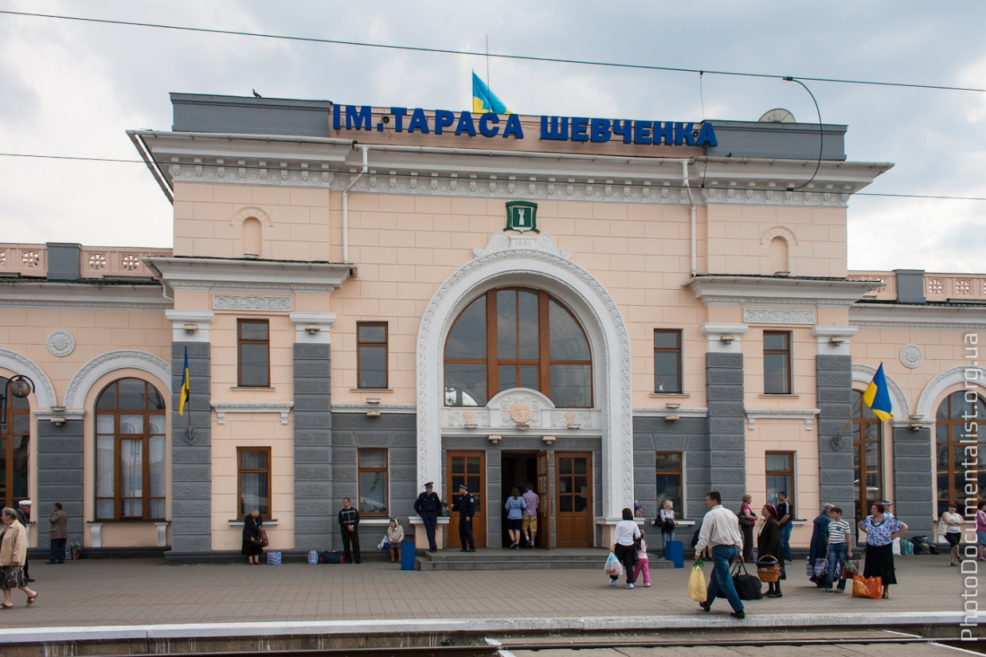
Railway station Shevchenko

Slide 5
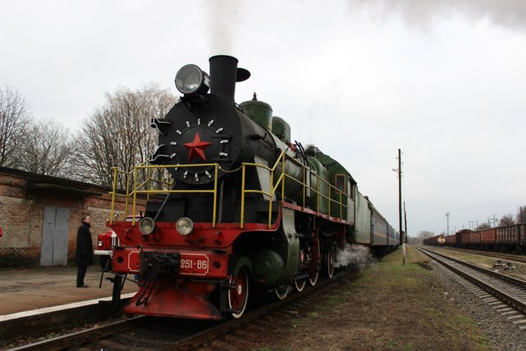
Smila has railway connections with Kiev, Dnepropetrovsk, Lviv and Odessa. It is an important transport and industrial center of the region.

Slide 6
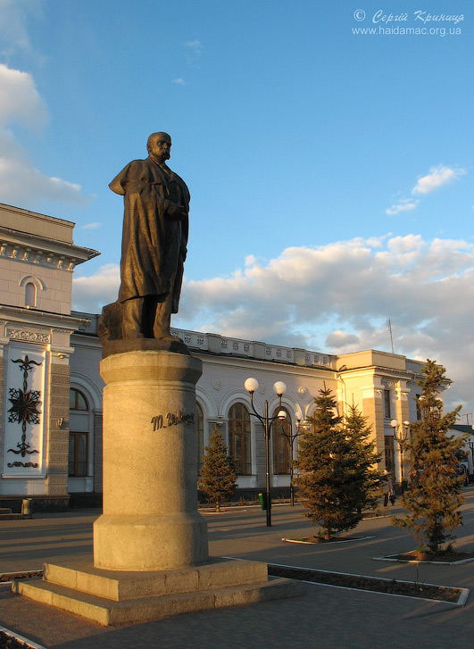
First name of the station - Bobrynska. Station was named so in the name of earl Bobrynsky, who built it, as well as developed the city. Soviets renamed it to Shevchenko.

Slide 7
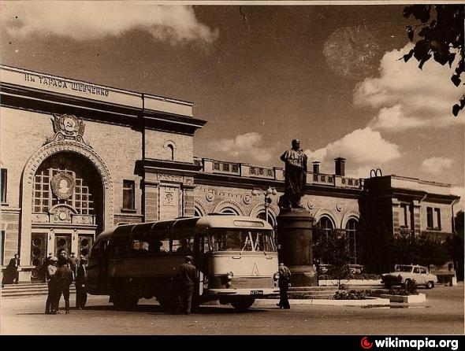
In early 1990th family of Bobrynsky (they live in France now) proposed to rename it back and they would invest in city economy. But Major of the city rejected.

Slide 8
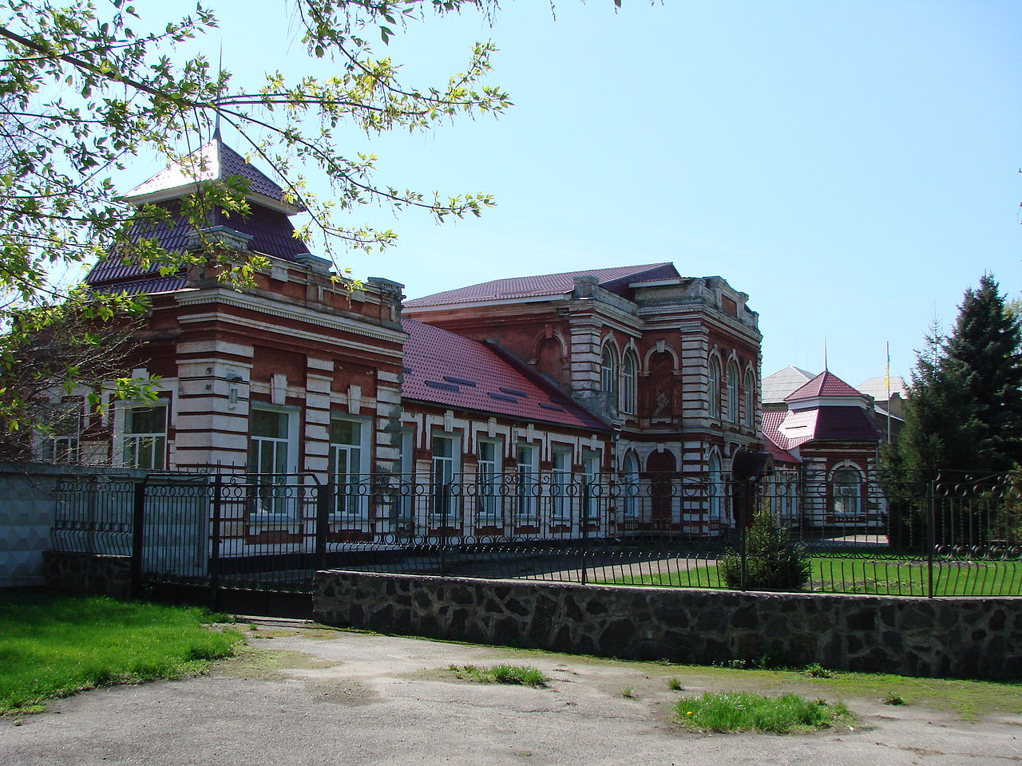
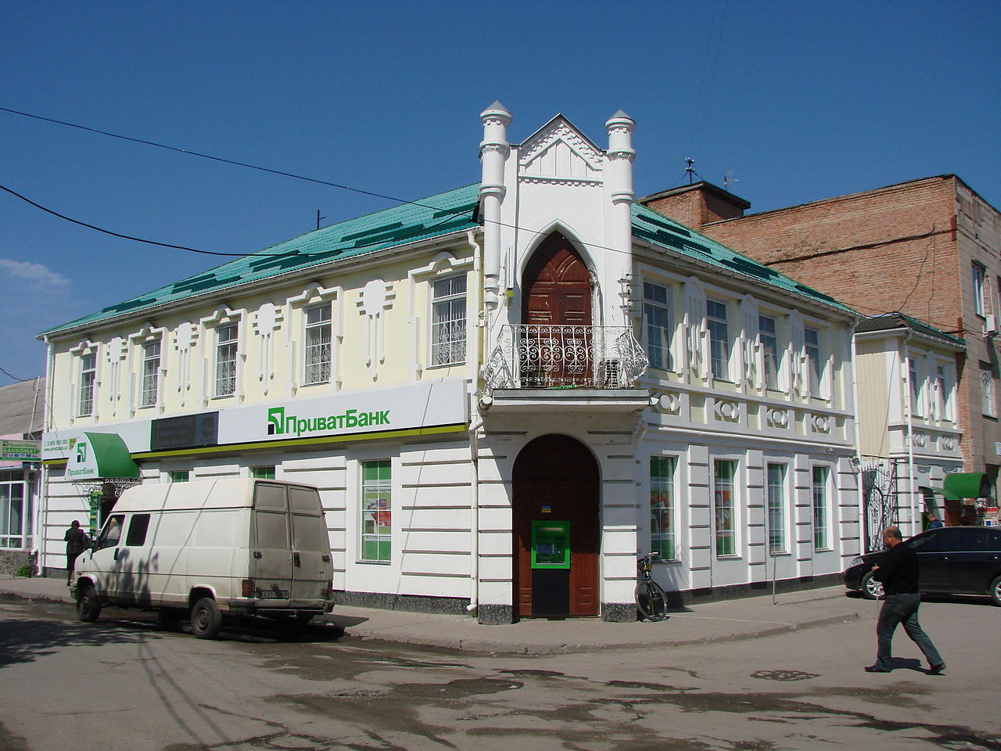
There are several ancient churches and monuments:
Female gymnasium building
Bank building in Smila

Slide 9
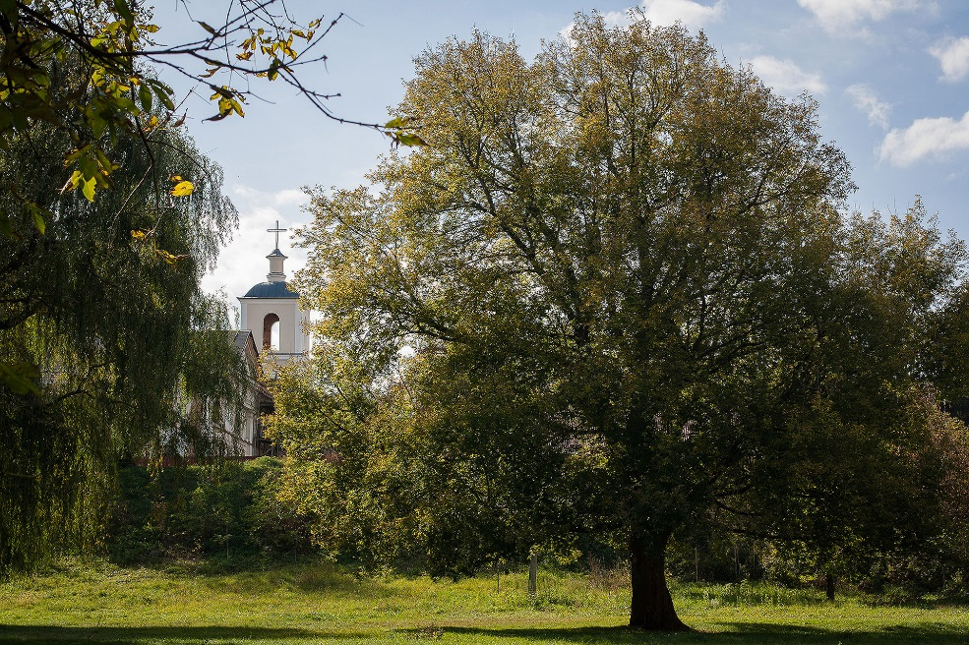
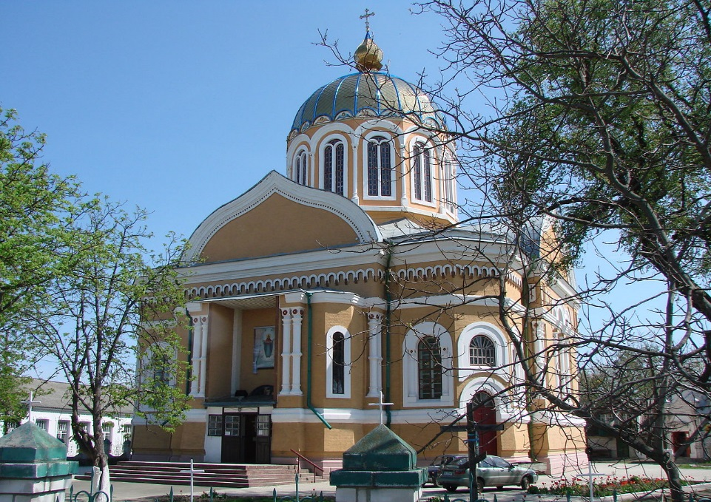
Church of the Holy Virgin
Assumption Church in Smila

Slide 10
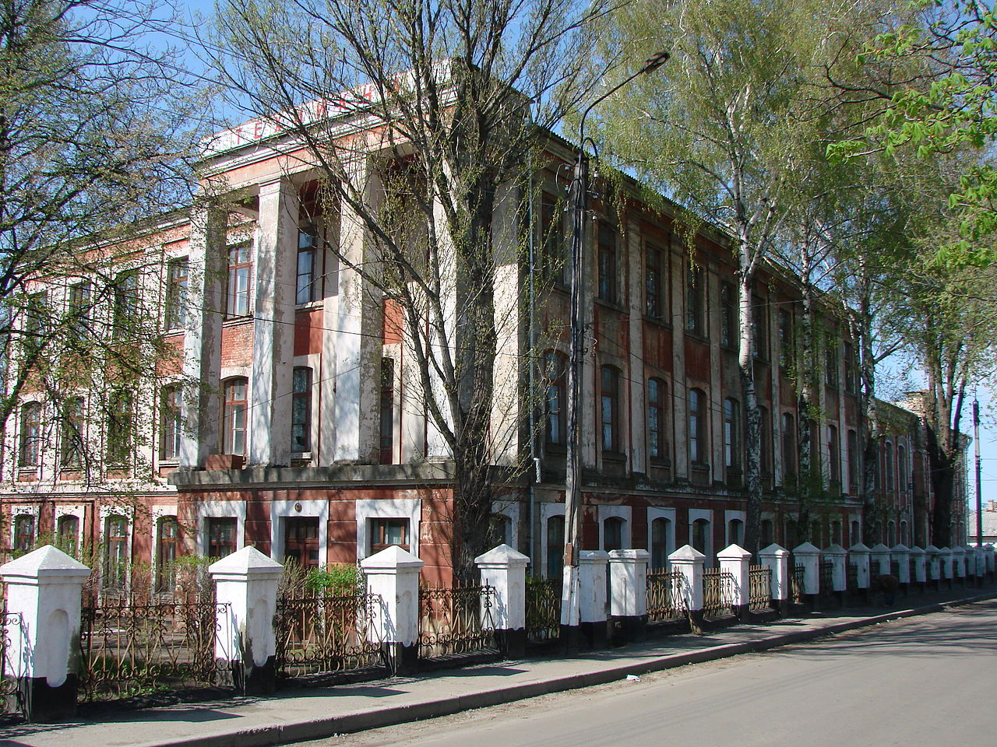
Technical Institute for Sugar Industry in Smila

Slide 11
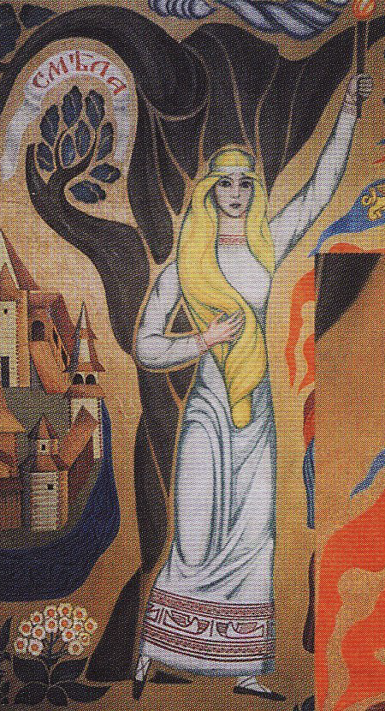
From heroic legend arise my own city Smila. The city was named in honor of very brave girl.
Like a black cloud, Tartars came to the land near the Dnieper. Then brave prince (knyaz) gathered his army and go on a crusade. A camp stopped in the densest part of the forest near Tyasmyn. And prince start to think how to pull a Jap.

Slide 12
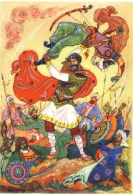
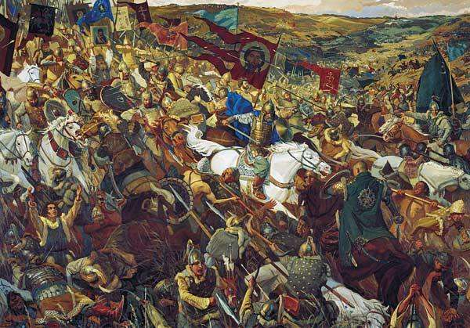
However, roundabout there was only thick wood and non-pedestrian backwater. Suddenly in front of prince appeared a girl.

Slide 13
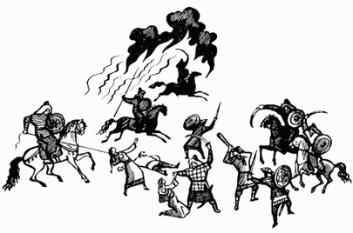
-Then girl said: “I know a secret way. I will help you. I show you the way to go. A girl guided the Russian army. The Russian army won the battle and killed a lot of Tatars. But then the girl was killed by an arrow.

Slide 14
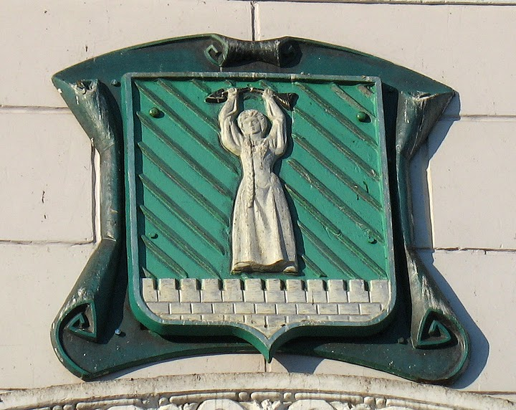
Russians buried her in the forest. No one knew the name of the girl and, later, when the settlement was established, it received the name “Smila” meaning “brave”.

Slide 15
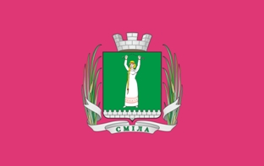
Smila city coat of arms
Smila city flag

Slide 16
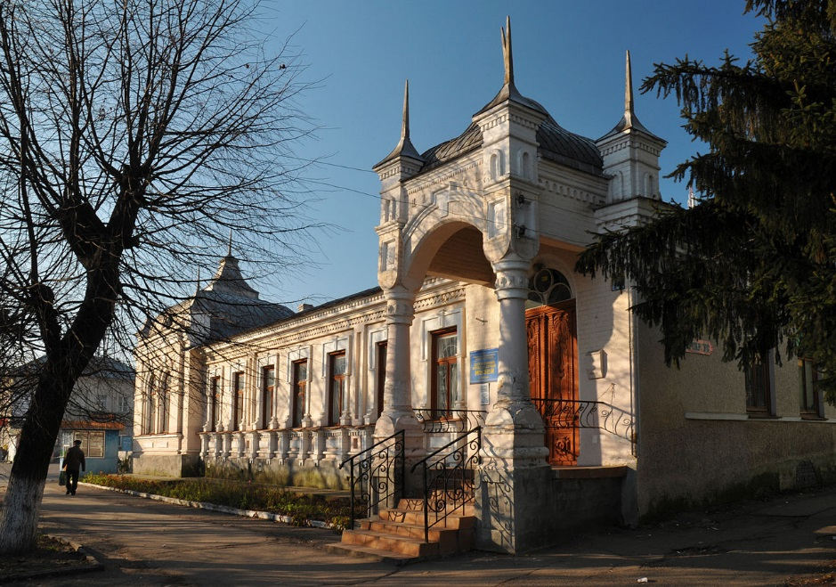
Museum of Local History
Smila - one of the largest cities in the Cherkasy region transport hub through which many travelers passed either by train or car. And it deserves to stay in it and consider more. The great age of the city, traditions, culture - what the city can boast. And to transmit this information past and the memory of future generations, the city has Smila City Museum.

Slide 17
The museum holds more than 3,500 different historical exhibits, most of which is exhibited.

Slide 18
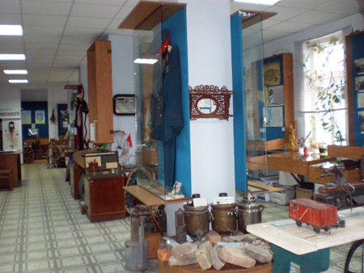
The museum consists of three rooms, serving Cartographic Heritage Smilyanschyny 19th - early 20th century;

Slide 19
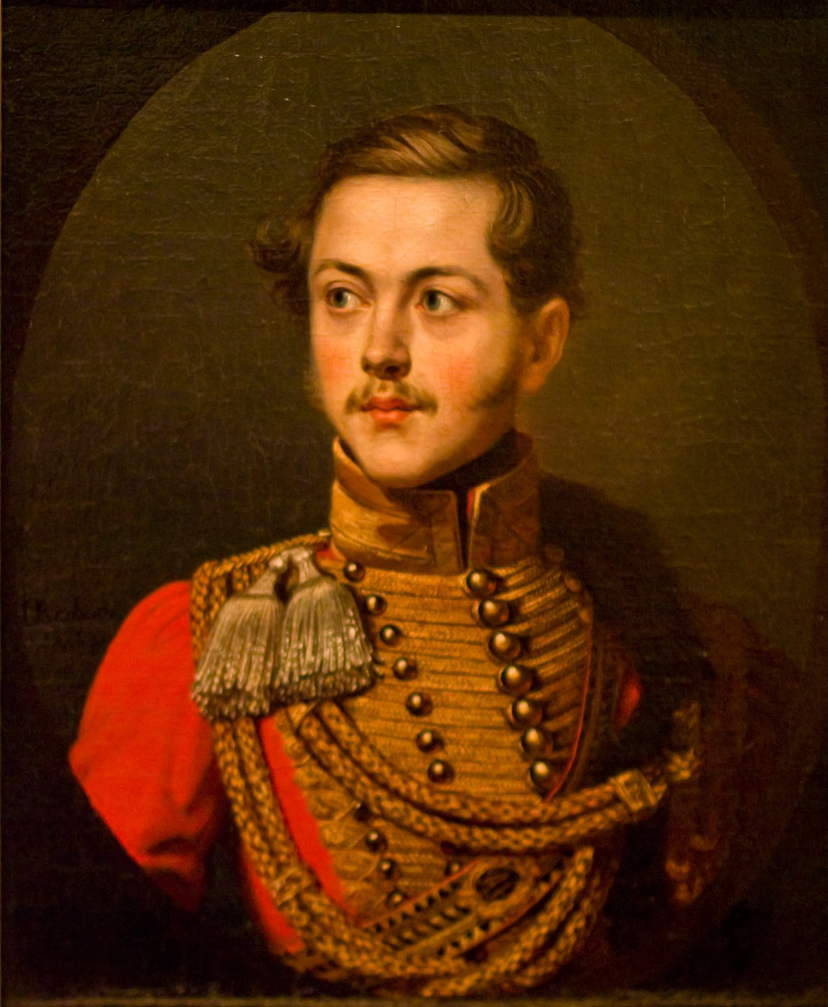
Family inheritance graph Bobrinsky, who had safely for a long time
prominent citizens as well - antiquities Dnieper.

Slide 20
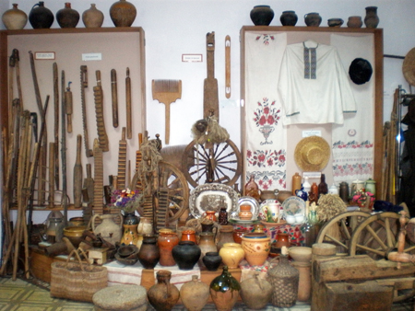
The museum not only serves as a permanent exhibition, but also carries out scientific research work among residents of the city and surrounding areas.

Slide 21
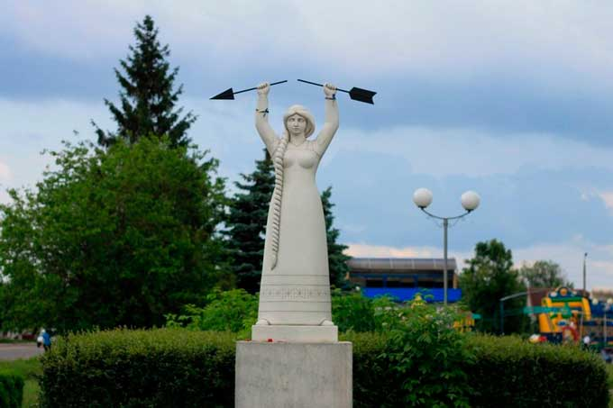

Slide 22
Materials: 1)https://en.wikipedia.org/wiki/Smila 2)https://uk.wikipedia.org/wiki/%D0%A1%D0%BC%D1%96%D0%BB%D0%B0#.D0.A2.D1.80.D0.B0.D0.BD.D1.81.D0.BF.D0.BE.D1.80.D1.82 3)http://invtur.com.ua/tour/dostoprimechatelnosti/1002005-Kraevedcheskij-muzej 4)http://ukrainetrek.com/smila-city 5)https://uk.wikipedia.org/wiki/%D0%A1%D0%BC%D1%96%D0%BB%D1%8F%D0%BD%D1%81%D1%8C%D0%BA%D0%B8%D0%B9_%D0%BA%D1%80%D0%B0%D1%94%D0%B7%D0%BD%D0%B0%D0%B2%D1%87%D0%B8%D0%B9_%D0%BC%D1%83%D0%B7%D0%B5%D0%B9 6)http://infosmila.ck.ua/news/nadija_vilentko_smiljanskij_kraeznavchij_muzej_ce_kulturno_dukhovnij_providnik_u_minule_i_sogodennja/2013-03-15-333 7) http://www.nacija.com.ua/?article=127

