Slide 1


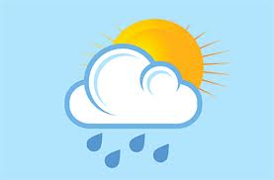
SEASONS AND WEATHER
Відкритий урок у 5 класі
Підготувала : Помогайко В.В.

Slide 2
Мета уроку
Розвивальна: розвивати пам’ять учнів, уяву, слухову і зорову пам’ять, розвивати навички аудіювання, говоріння.
Освітня: закріпити вивчену лексику й активізувати її, навчити діяти в нестандартних ситуаціях.
Практична: підвищити інтерес до вивчення англійської мови, практично використовувати набуті знання для досягнення перемоги , розширити кругозір учнів.
Виховна: прищеплювати любов до природи, виховувати в учнів мовну культуру, інтерес до іноземної мови , навички роботи в команді.

Slide 3


Round 1
«True/False sentenses»

Slide 4


TRUE

Slide 5

FALSE

Slide 6
FALSE

Slide 7
TRUE

Slide 8
FALSE

Slide 9
FALSE

Slide 10
TRUE

Slide 11
TRUE

Slide 12
FALSE

Slide 13
FALSE

Slide 14
Round 2
«Riddles about Seasons»

Slide 15
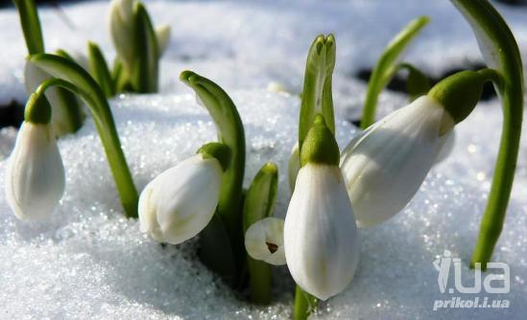
SPRING

Slide 16

SUMMER

Slide 17
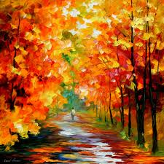
AUTUMN

Slide 18
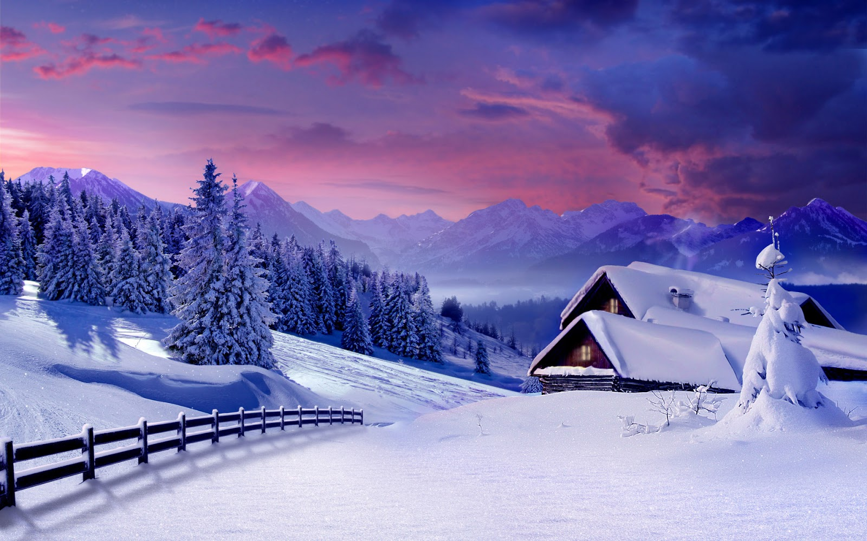
WINTER

Slide 19
***
This is the season when snowdrops bloom,
When nobody likes staying in the room.
This is the season when birds make their nests,
This is the season we all like best. (Spring)
This is season when nights are short,
When children are full of fun and sport.
Playing, swimming all the day,
With a happy song on a sunny day. (Summer)
Down, down!
Yellow and brown
The leaves are falling
Over the town. (Autumn)
This is the season when mornings are dark.
And birds do not sing in the forest and park.
This is the season when children ski
And Father Frost brings the New Year Tree. (Winter)

Slide 20
Physical Activity

Slide 21
Physical activity
Touch your shoulders! Look at the ceiling!
Touch your nose! Look at the flour!
Touch your ears! Look at the window!
Touch your toes! Look at the door!

Slide 22
Round 3
«Answer the questions»

Slide 23
How many seasons are there in a year?
How many months are there in a year?
How many days are there in January?
How many days are there December?
How many months are there in summer?

Slide 24
What month is the shortest?
What season is the coldest?
What are winter months?
What are spring months?

Slide 25
Round 4
«Stories about the Season»

Slide 26


Slide 27
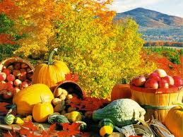

Slide 28
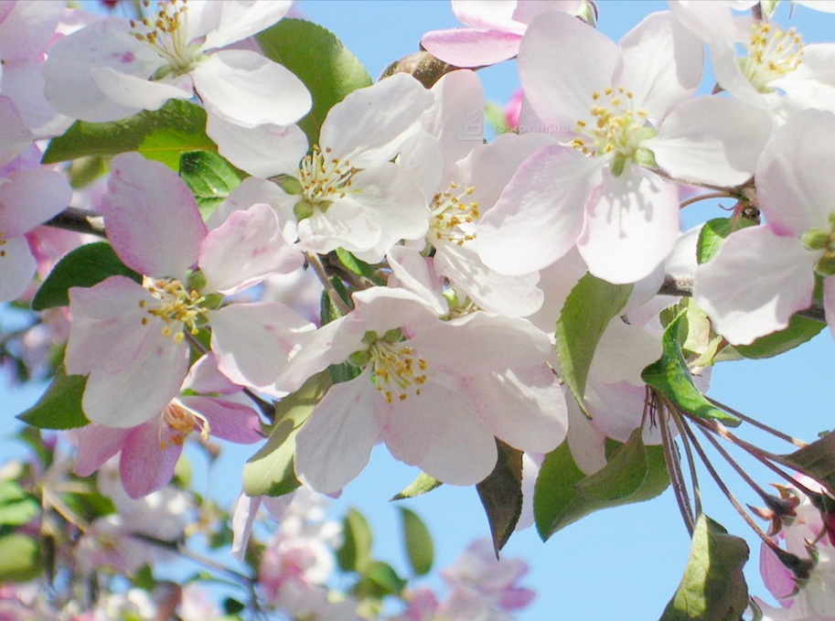

Slide 29
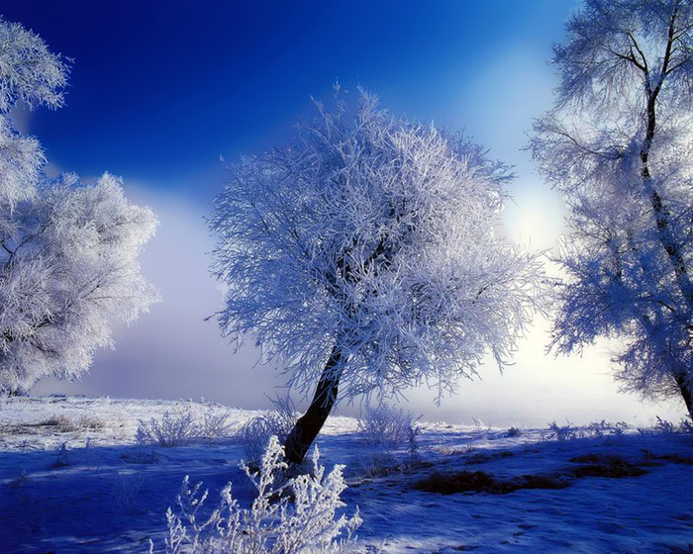

Slide 30
CROSSWORD

Slide 31
WEATHER & SEASONS
Fill in the crossword and find the hidden sentence.
1
2
3
4
5
6
7
8
9
’
10
11
12
13
14
15

Slide 32
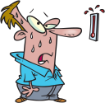
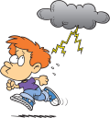




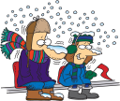







3
5
1
2
4
6
9
7
8
10
13
11
15
12
14

Slide 33
1
H
O
T
2
S
U
N
N
Y
3
S
T
O
R
M
Y
4
R
A
I
N
Y
5
A
U
T
U
M
N
6
C
L
O
U
D
Y
7
W
I
N
T
E
R
8
W
E
T
9
S’’
U
M
M
E
R
10
S
N
O
W
Y
11
S
P
R
I
N
G
12
F
R
E
E
Z
Y
13
I
C
Y
14
W
I
N
D
Y
15
F
O
G
G
Y

Slide 34


Slide 35


Slide 36


Slide 37


Slide 38
Round 5
Read the texts and guess what season is it.

Slide 39
Round 6

Slide 40
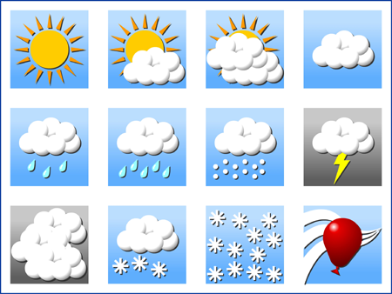

WEATHER

Slide 41
Answer choosing some expressions:
Cold
Warm
Cool
Hot
Calm
Windy
Foggy
Clear
Dry
Wet
Sunny
Cloudy
My favourite weather is
Heavy showers
a lot of snow
a lot of sunshine
a thick fog
Fine drizzle
Light rain
Hard hailstorm
Prolonged frost
Thunder and lightning
I like the weather with

Slide 42
What’s your favorite weather?

Slide 43
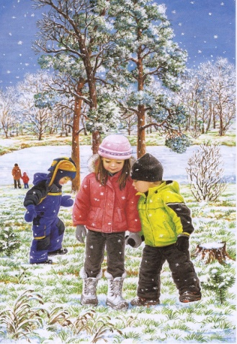
What season is it?
What is the weather like in winter?
What color is the sky?
Does the sun shine brightly?
Are the days short or long?
What can children do in winter?

Slide 44
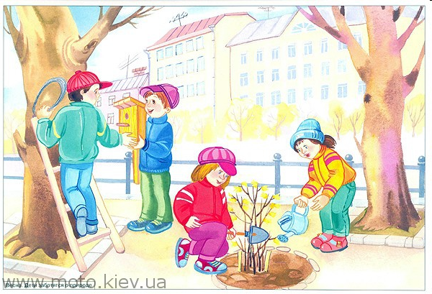
What season is it?
What is the weather like in spring?
What color is the sky?
Does the sun shine brightly?
Are the days short or long?
What can children do in spring?

Slide 45

What season is it?
What is the weather like in summer?
What color is the sky?
Does the sun shine brightly?
Are the days short or long?
What can children do in summer?

Slide 46
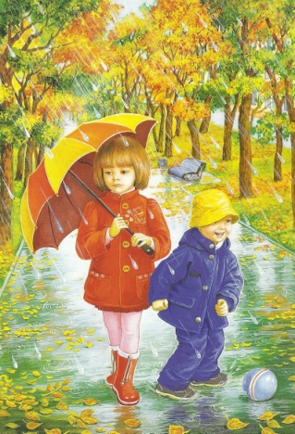
What season is it?
What is the weather like in autumn?
What color is the sky?
Does the sun shine brightly?
Are the days short or long?
What can children do in autumn?

Slide 47

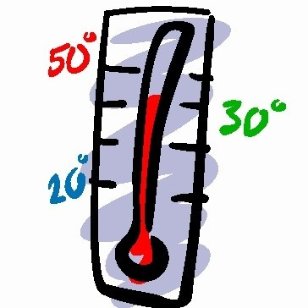
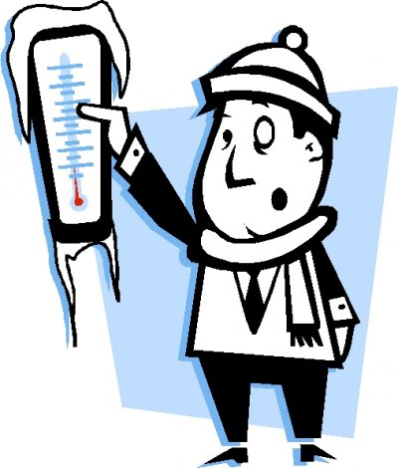

Slide 48
1.Above zero(+)
2.Below zero(-)
3. It’s ten degrees above zero(+10)
4. It’s five degrees below zero(-5)=
It’s five degrees of frost

Slide 49

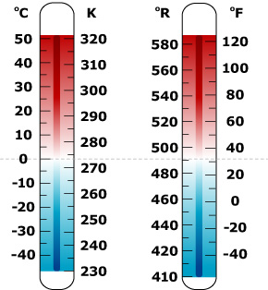
-12
+20
-4
-8
+16
+25
0
-30
+18

Slide 50

Temperature -5/-7(day),-8/-10(night)
Cloudy
No precipitation(snow or rain)

Slide 51

1.windy
2.sunny
3.foggy
4.cloudy
5.rainy

Slide 52
What is the weather like today?
It is … (fine, cloudy) today.
The atmospheric pressure is … (high, low…).
The sun is shining (It is raining).
It is … (warm, cold).
The temperature is …-… degrees (below, above) zero.
The wind is blowing from the (south, north, south-east…).
The wind is (warm, cold, strong, light…).

Slide 53
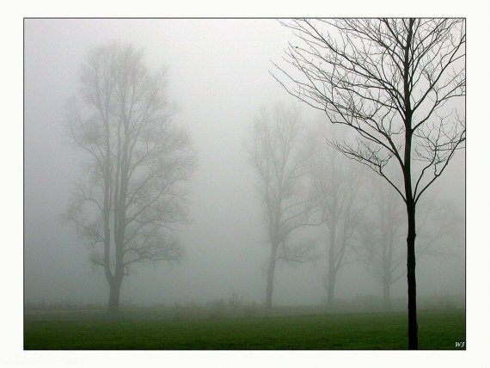
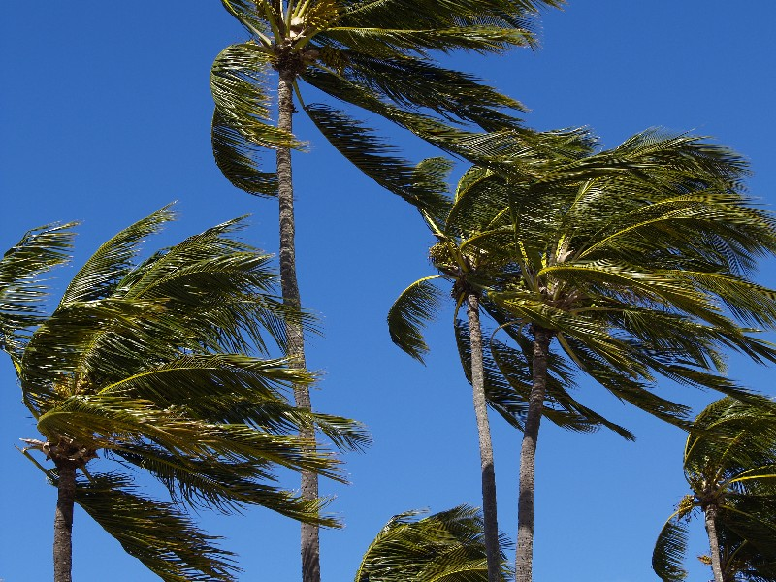

What is the weather in the pictures?

Slide 54
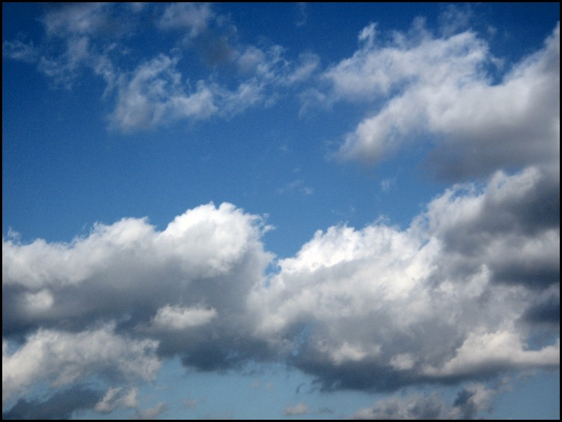


Slide 55
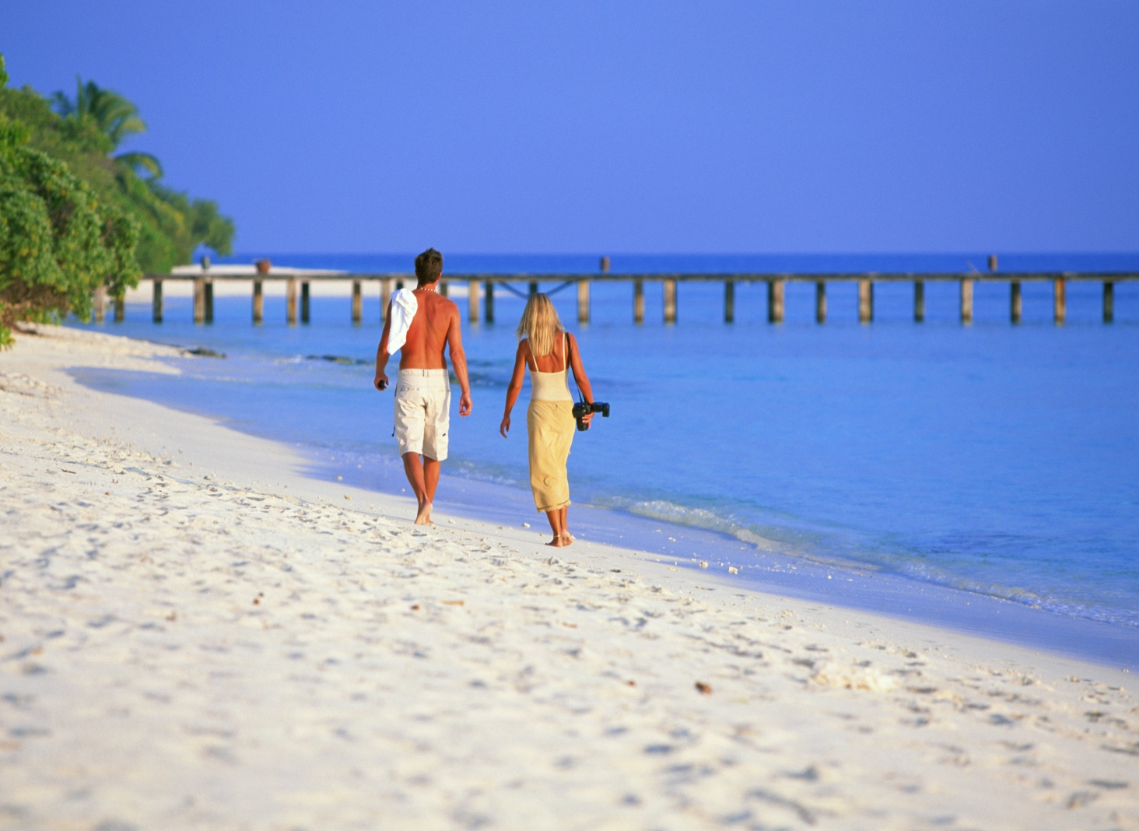


Slide 56



Slide 57
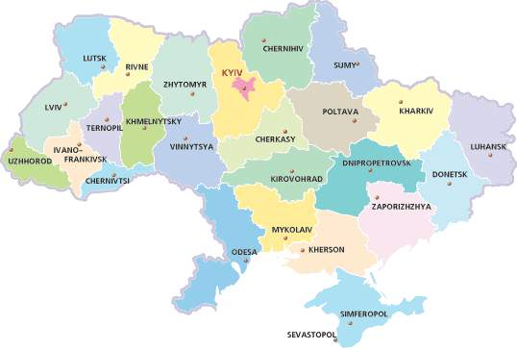
Ukraine

Slide 58

What is the weather like in Zaporizhzhia?
It’s
…

Slide 59

What is the weather like in Kyiv?
It’s …
cloudy

Slide 60
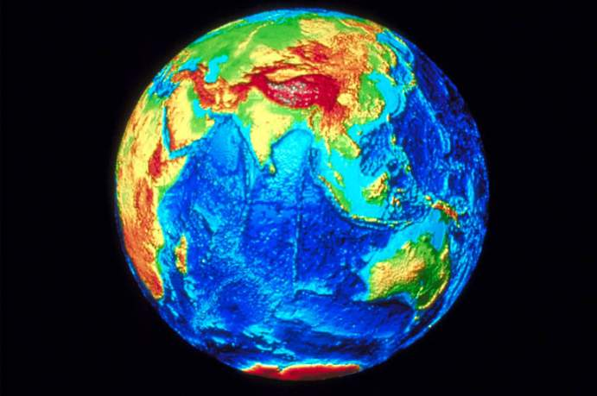
Listen to the world weather report

Slide 61


What’s the weather like in…
Athens
Buenos Aires
London

Slide 62
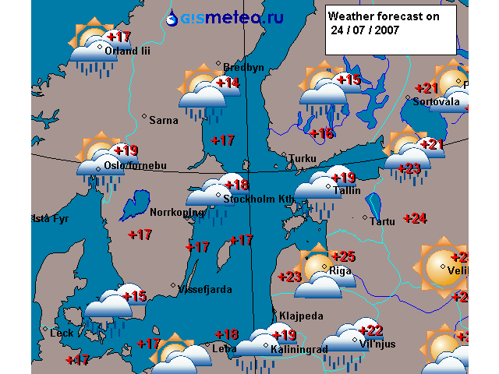

Slide 63
Let’s play: you are the weather forecast.
What will the weather be like
in our city tomorrow?
In Great Britain?
Use the verb structure: It will be…
The weather will be…

Slide 64
Thank you for your attention

Slide 65
Відкритий урок у 5 класі
Підготувала : Помогайко В.В.
КЗ «П’ятихатська Зош І-ІІ ступенів» Василівського району Запорізької області

Slide 66


