Slide 1
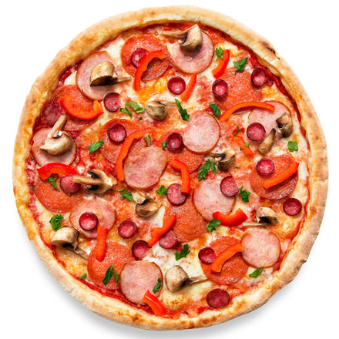
pizza

Slide 2
juice

Slide 3
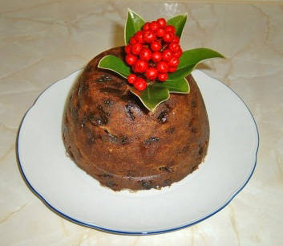
pudding

Slide 4
hot dog

Slide 5
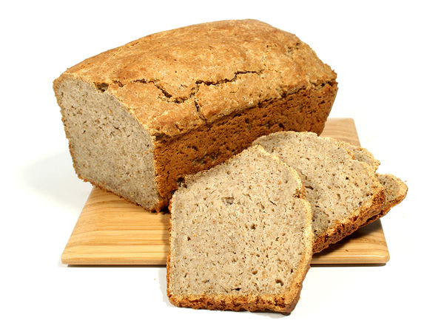
bread

Slide 6
banana

Slide 7
apple

Slide 8
sandwich

Slide 9
cheese

Slide 10
jam

Slide 11
toast

Slide 12
butter

Slide 13
cacao

Slide 14
milk

Slide 15
coffee

Slide 16
ice-cream

Slide 17
tea

Slide 18
water

Slide 19
chocolate

Slide 20
egg

Slide 21
ham

Slide 22
biscuits

Slide 23
yogurt

Slide 24
orange

