Slide 1
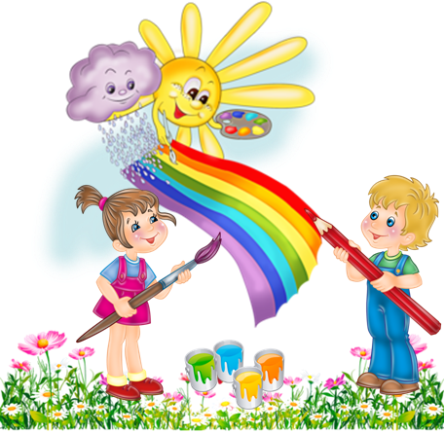
Квест з англійської мови для учнів 5- 6 класів
My school

Slide 2
Мета: вдосконалювати знання та навички, набуті на уроках англійської мови, розвивати мовленнєву діяльність, розширювати світогляд учнів, розвивати мовну здогадку та логічне мислення, формувати та розвивати навички співпраці ( робота в групі), виховувати позитивне ставлення та інтерес до вивчення англійської мови.

Slide 3
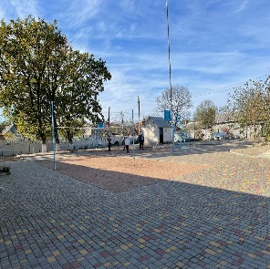
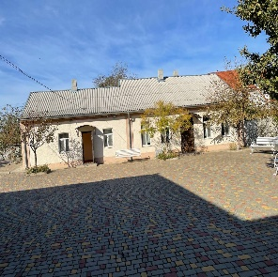
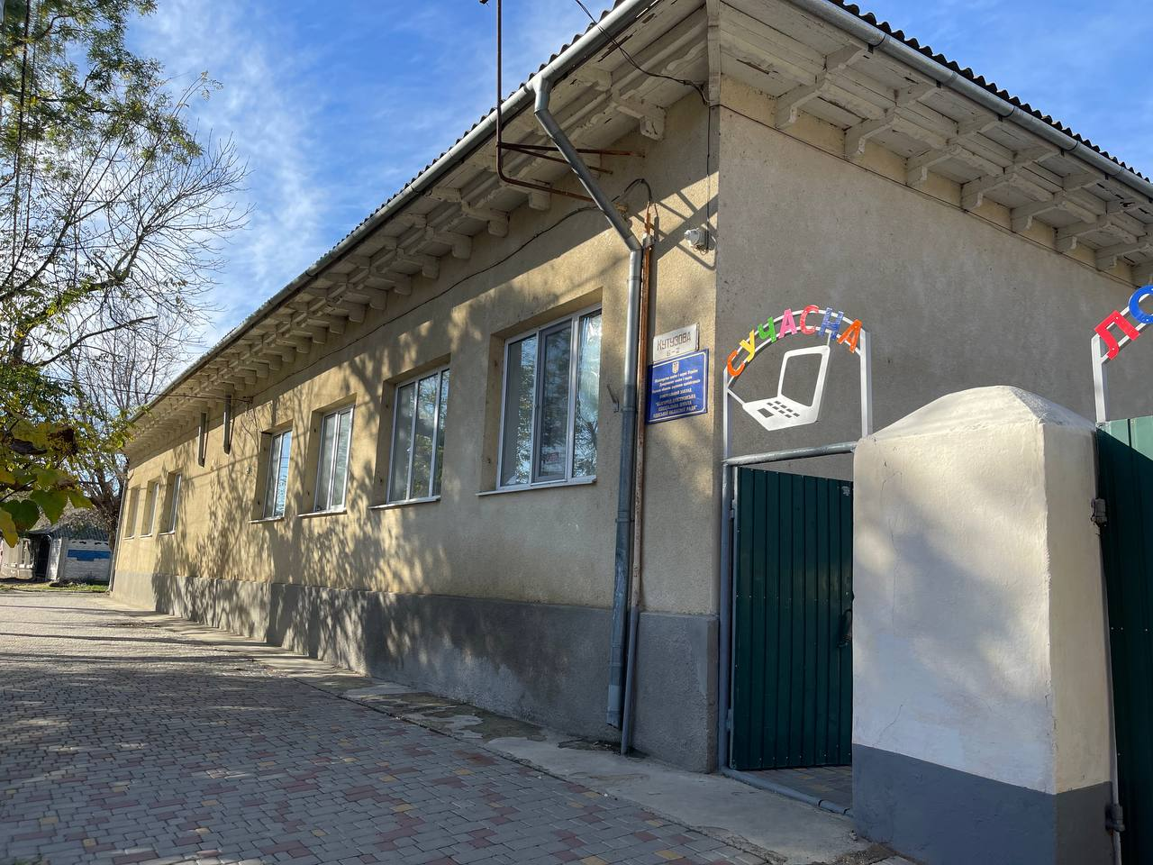
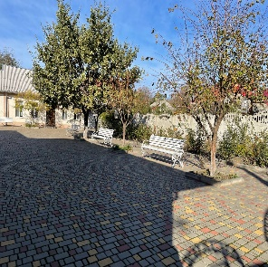
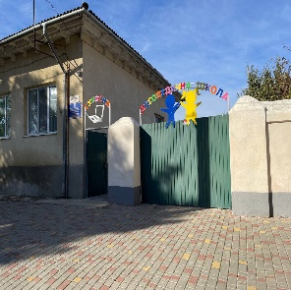

Slide 4
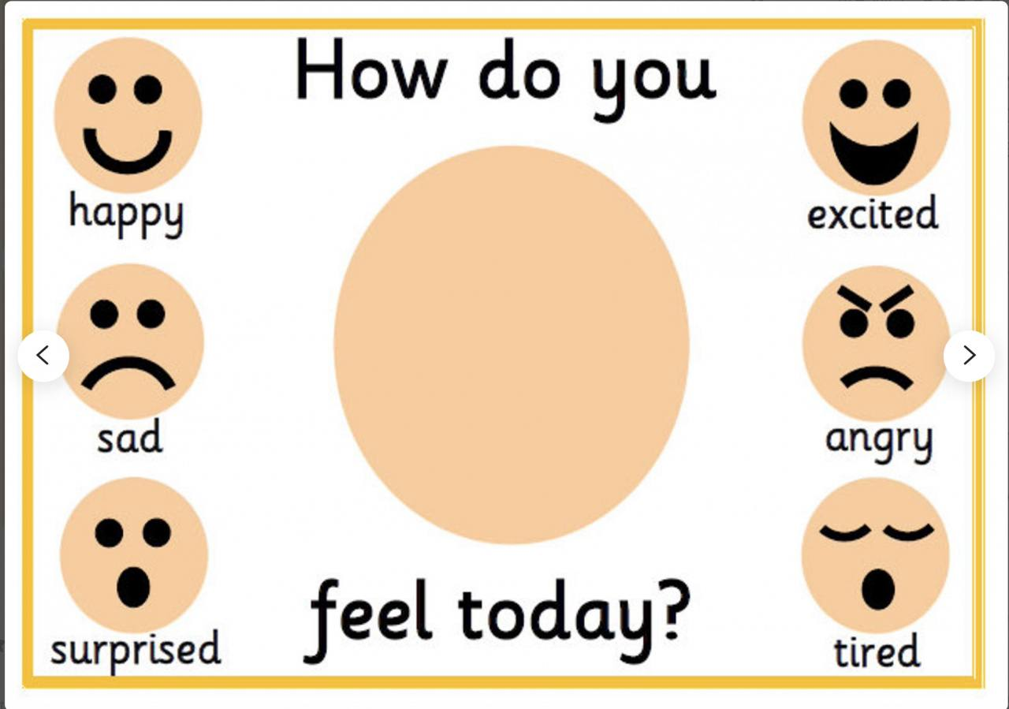
How do you feel today?
OUR MOTTO

Slide 5
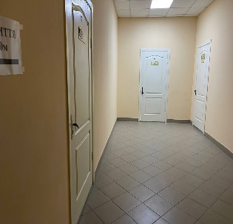
Station 1: School
1. Let’s count. How many doors are there on the first floor?______
2. How many classrooms are there in our school?________
3.How many desks are there in your classroom?__________
Well done! Find the envelope with the next task in the corridor near your classroom. Good luck!

Slide 6
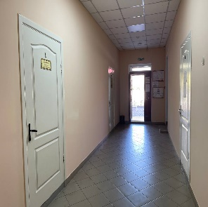
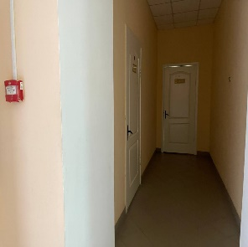
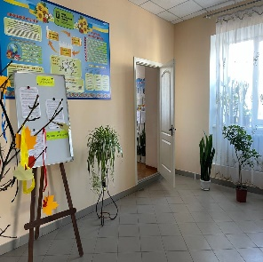
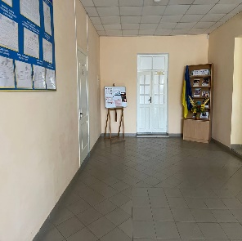

Slide 7
Station 2: LIBRARY
Go to the school library.
Do you know Ukrainian writers? Guess! Who is this famous Ukrainian writer?
He was born on 9 March 1814 in the village of Moryntsi. He is also known as Kobzar Taras, was an Ukrainian poet, writer, artist, public and political figure, folklorist and ethnographer. His literary heritage is regarded to be the foundation of modern Ukrainian literature
Find the envelope with the next task in one of his books

Slide 8
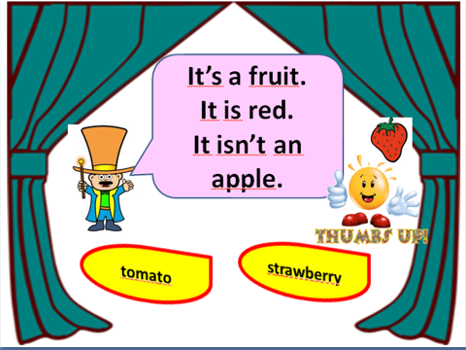
Station 3: In the canteen
Go to the canteen on the ground floor of our school.

Slide 9
Station 3 : In the canteen

Slide 10
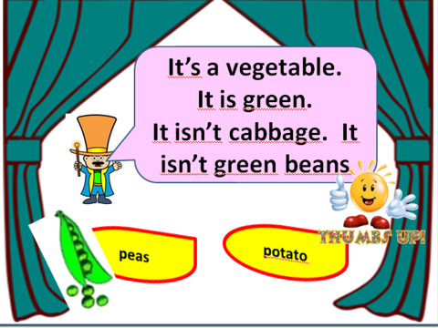

Slide 11
WHAT IS TRADITIONAL UKRAINIAN FOOD?
Borshch (sometimes written as borsch, borsht, bortsch, or borshch) is a sour soup with distinctive red colour. Usually, the ingredients are meat, beetroots, cabbage, carrots, onions, potatoes, and tomatoes. It can be served either hot or cold, and it can also be white or green, depending on the ingredients. It is traditionally done with smetana (sour cream), pampushky (tiny garlic buns), garlic, onion, and salo (pork lard).

Slide 12
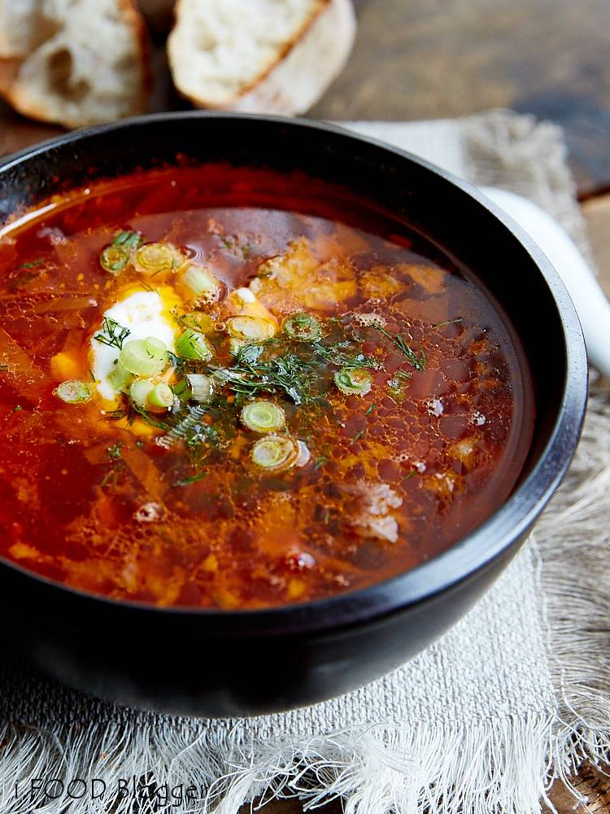
STATION 3: IN THE CANTEEN
Write down the list of food products for Ukrainian borscht

Slide 13
STATION 4: Doctor`s office
Let`s go to the doctor’s office on the first floor of our school.
Our school doctor will give you the envelope with the task.

Slide 14
Match the proverbs with their Ukrainian equivalents.
﻿﻿A sound mind in a sound body.
﻿﻿﻿An apple a day keeps the doctor away.
﻿﻿﻿Good health is above wealth.
﻿﻿﻿Early to bed and early to rise makes a man healthy, wealthy and wise.
﻿﻿﻿After dinner sit a while, after supper walk a mile.
а. Живи не для того щоб істи, а їж для того щоб жити.
b. У здоровому тілі здоровий дух.
с. Хто рано встає, тому Бог подає.
d. Після обіду посидь, а після вечері пройдись.
е. Здоров'я дорожче за багатство.

Slide 15
5 STATION ASSEMBLY HALL
Go to the place where children have their school parties. What is it? It’s our assembly hall.

Slide 16
Match the names of holidays with their dates.
New Year’s Day a. 19 December
Christmas Day b.1 January
St Valentine’s Day c.24 August
Easter d.7 January ( or 25 December)
Independence Day e.14 February
St Nicolas Day f. on Sunday in April (or May)

Slide 17
6 STATION POSTER “MY SCHOOL”
Let’s make a poster “My school”. Present our poster.

