Slide 1


Slide 2
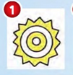





What’s the weather like today?
1.It’s sunny. .
2.It’s windy.
3.It’s cold.
4.It’s snowing.
5.It’s raining.
6.It’s cloudy.

Slide 3
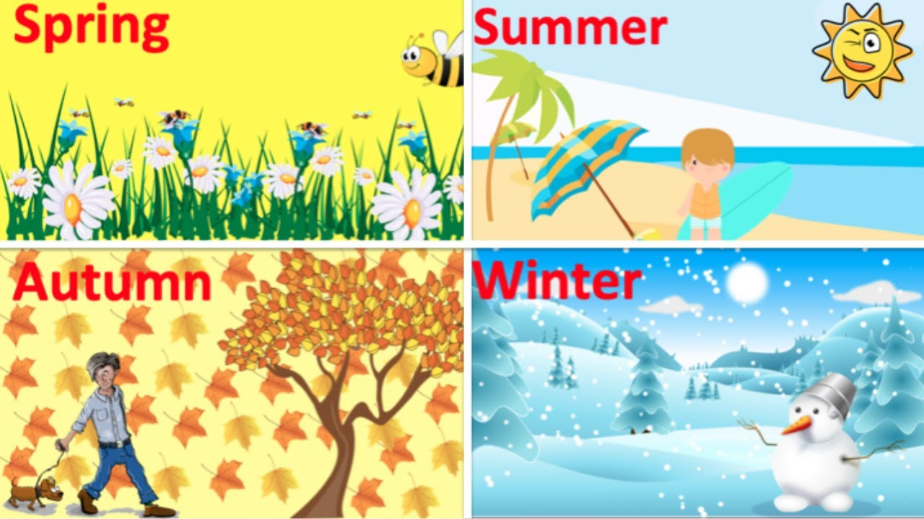
SEASONS

Slide 4

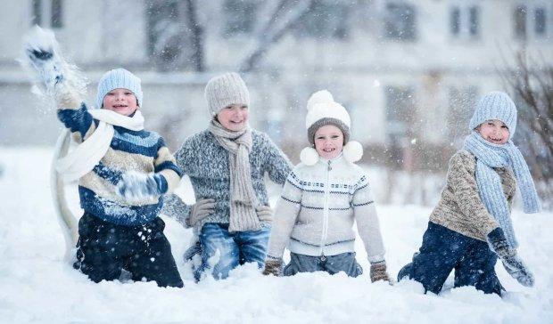
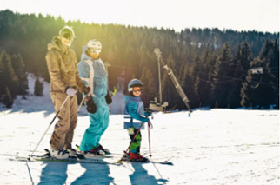
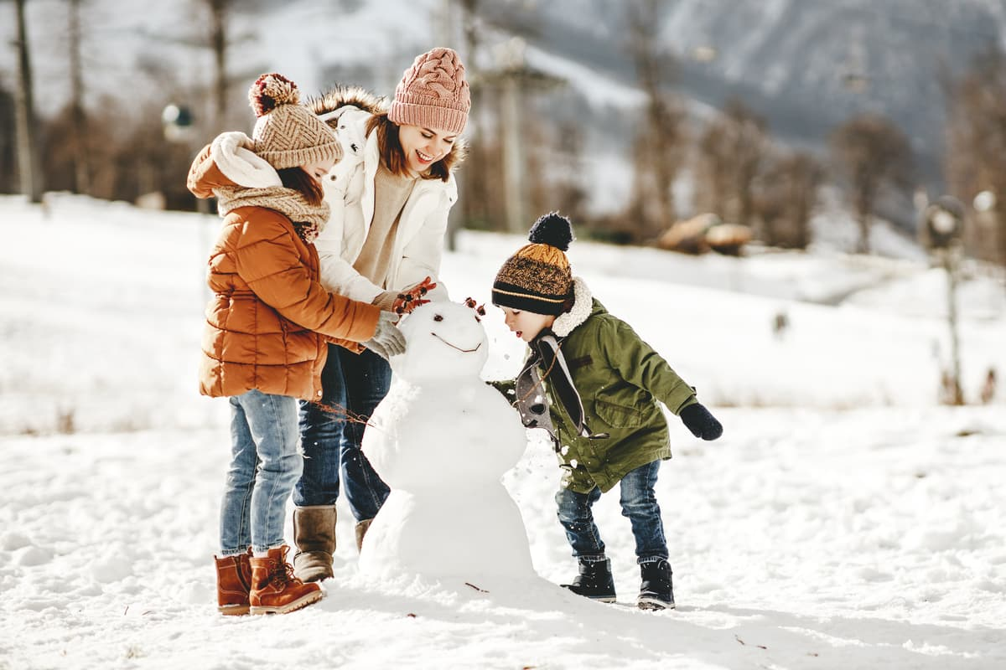
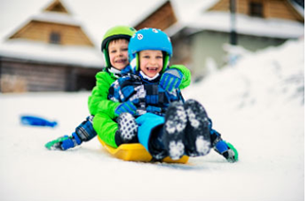
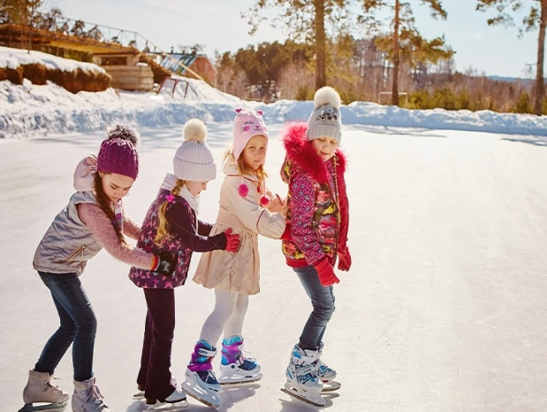
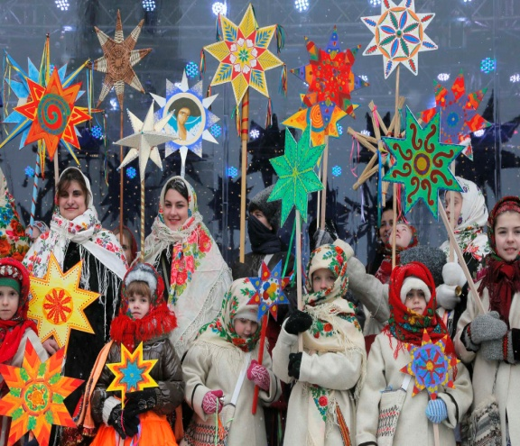
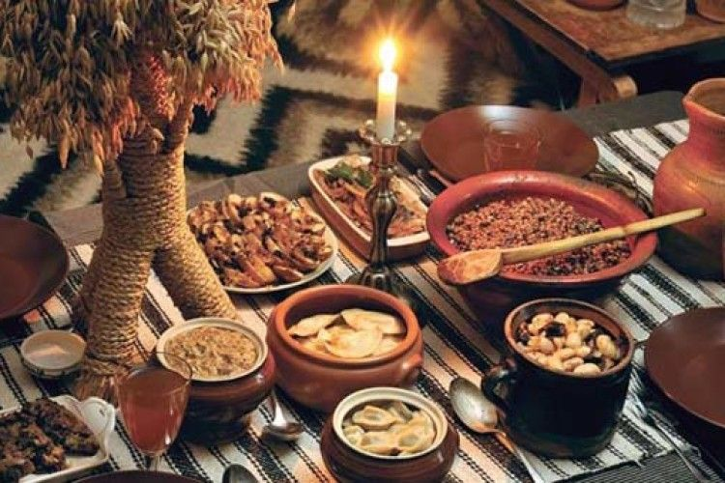
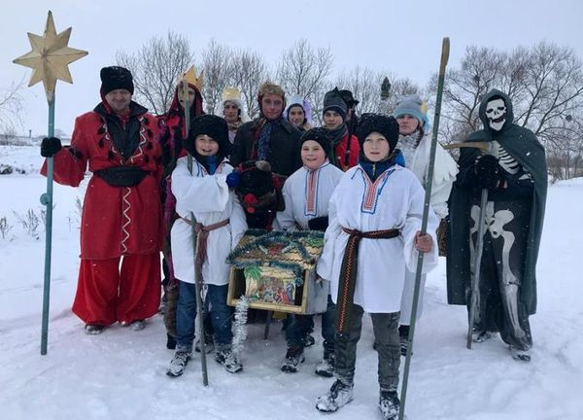

Slide 5
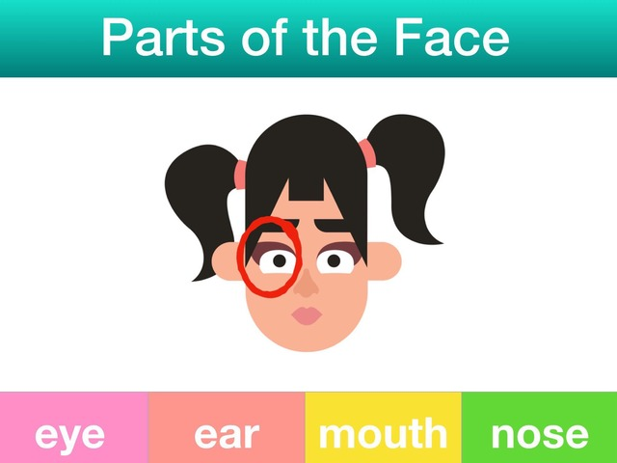

Slide 6
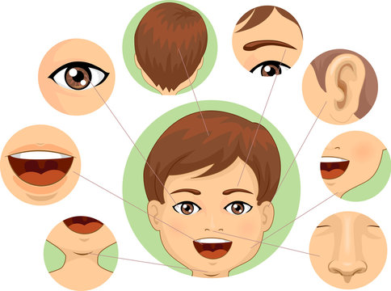
Parts of the Face

Slide 7
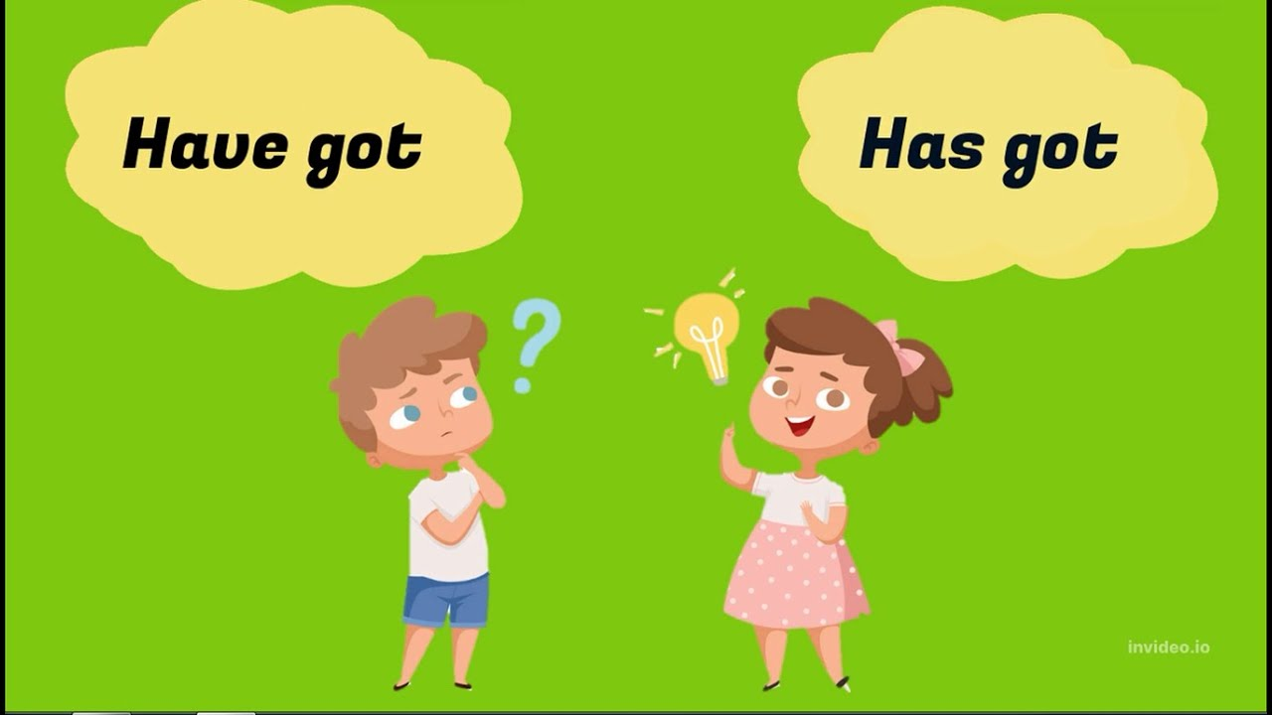

Slide 8
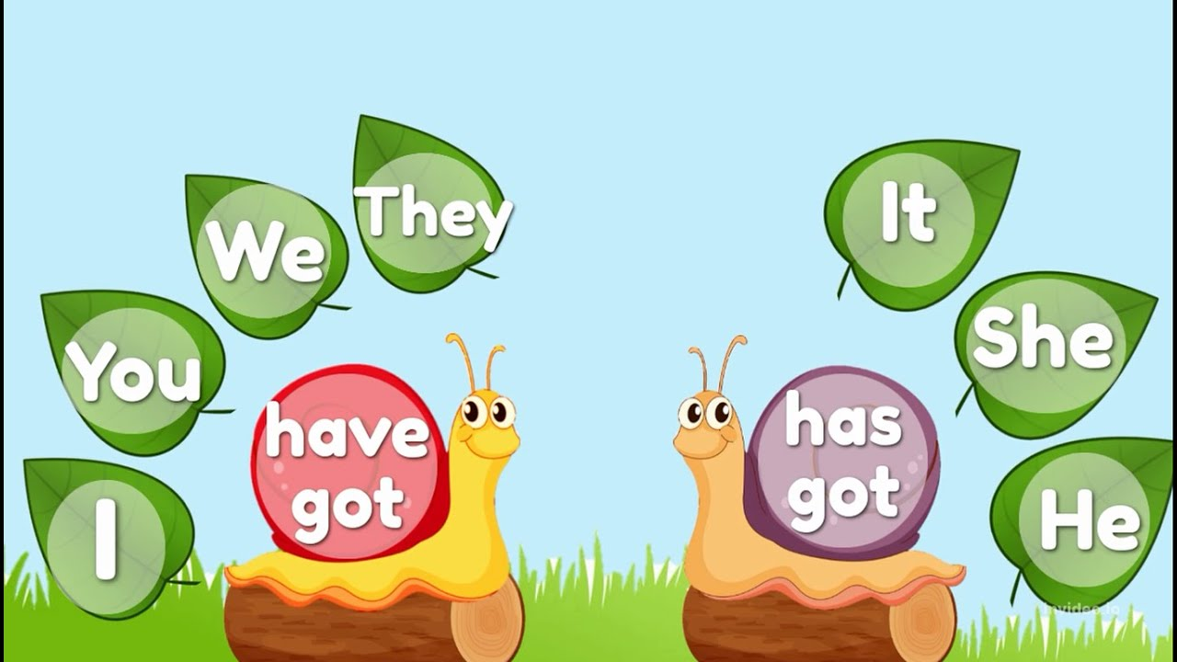

Slide 9
Complete the sentences
( have got / has got )
1.I ….. a small nose.
2.She ….. blond hair.
3.Tom …… a big mouth.
4.Bob and Ben ….. glasses.
5.My mum … blue eyes.
6.Barsik … a long tail.

Slide 10
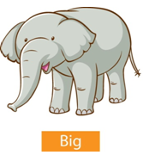



Match
1. long A B
2. big
3. short
4. small C D

Slide 11
Listen and choose the correct answer
1.
2.
3.
4.

Slide 12
Listen and choose the correct answer
1. He’s got a big nose.
2. He’s got glasses.
3. He’s got short hair. It’s black.
4. He’s got small ears.
1.B
2.B
3.A
4.B

Slide 13
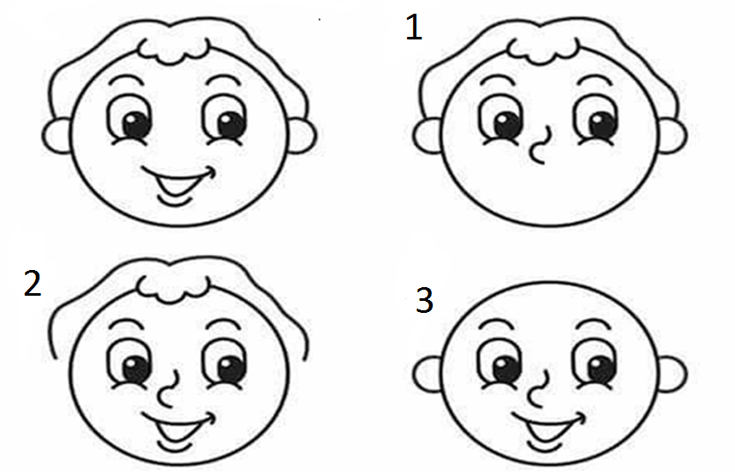
What is missing?

Slide 14
Read, draw and colour
Vira has got long brown hair and blue eyes. She has got red glasses and a small mouth.

Slide 15
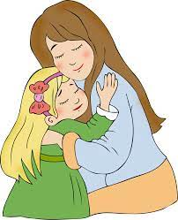
Read and circle
My mum.
My mum has got long / short
blond / fair / dark / brown / hair and
blue /green / grey / brown eyes.
She has got a big / small nose and
a big / small mouth.
I love my mum.

Slide 16
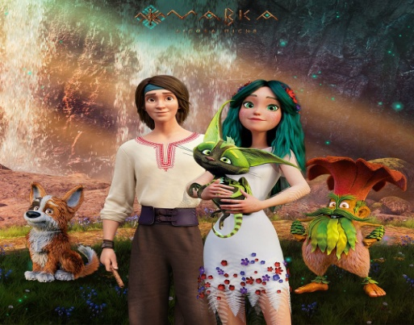
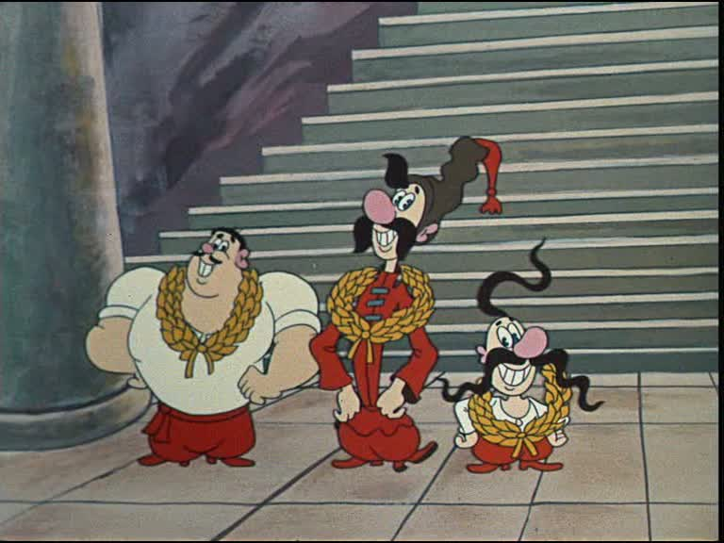
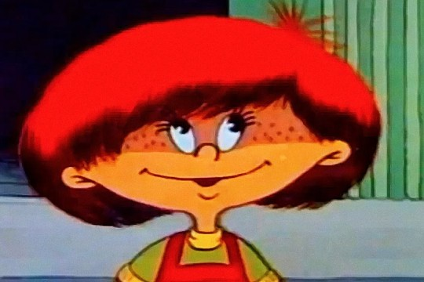
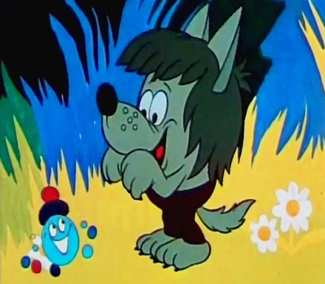
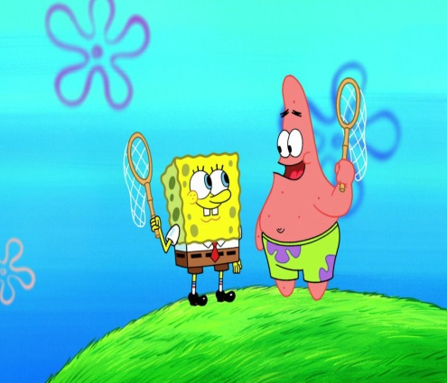
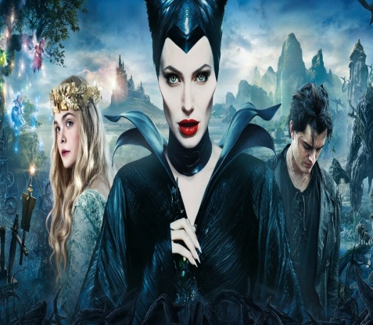
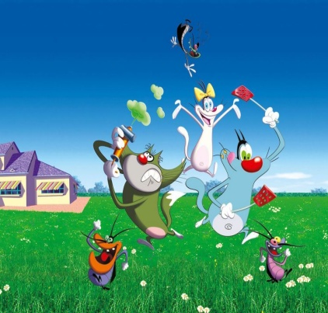
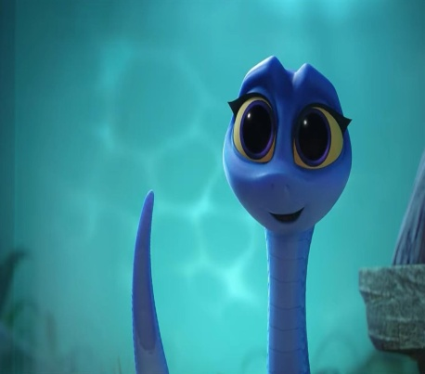
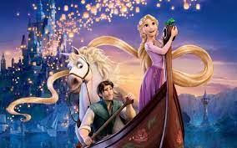
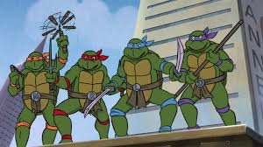
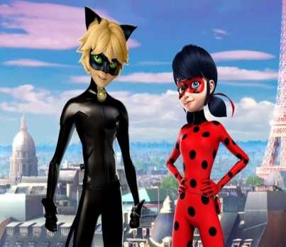
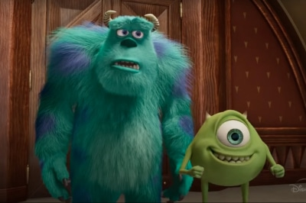
My favourire cartoon hero

Slide 17
