Slide 1


Slide 2
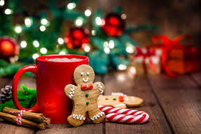

Slide 3
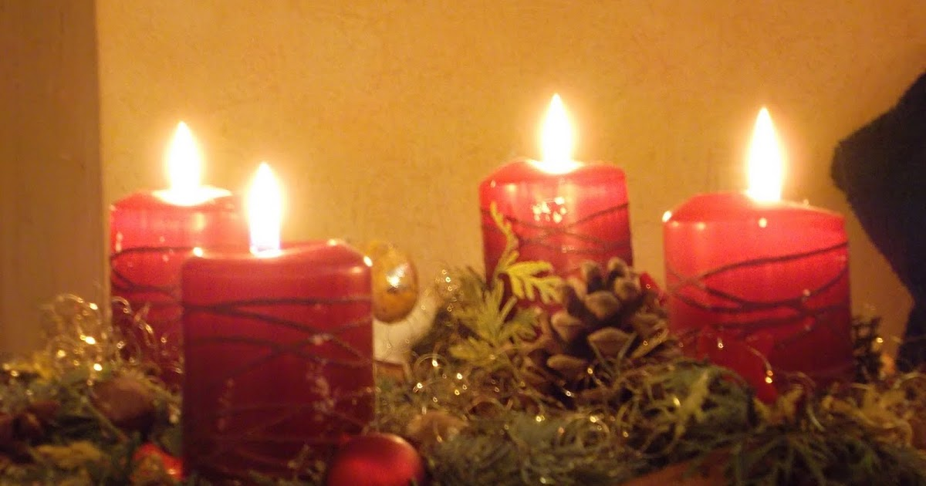
Video: Christmas Traditions in Great Britain
Https://www.google.com/search?q=christmas+customs+and+traditions+in+great+britain&sca_esv

Slide 4

Christmas Tradition in Great Britain

Slide 5
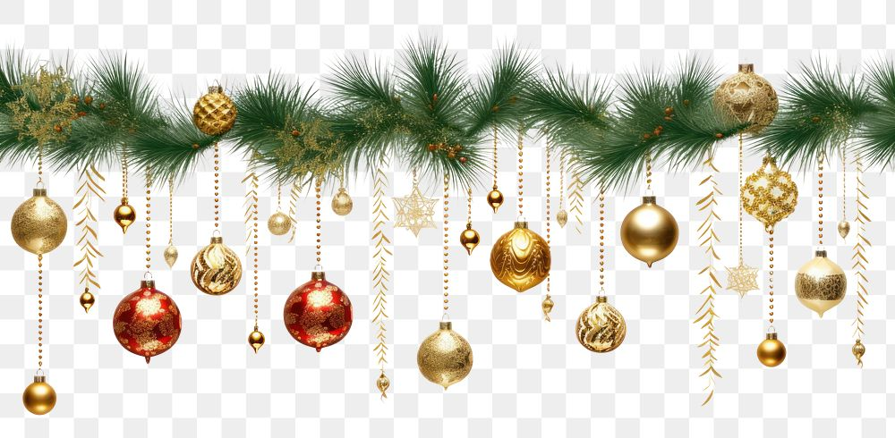
When do people start getting ready for Christmas?

Slide 6
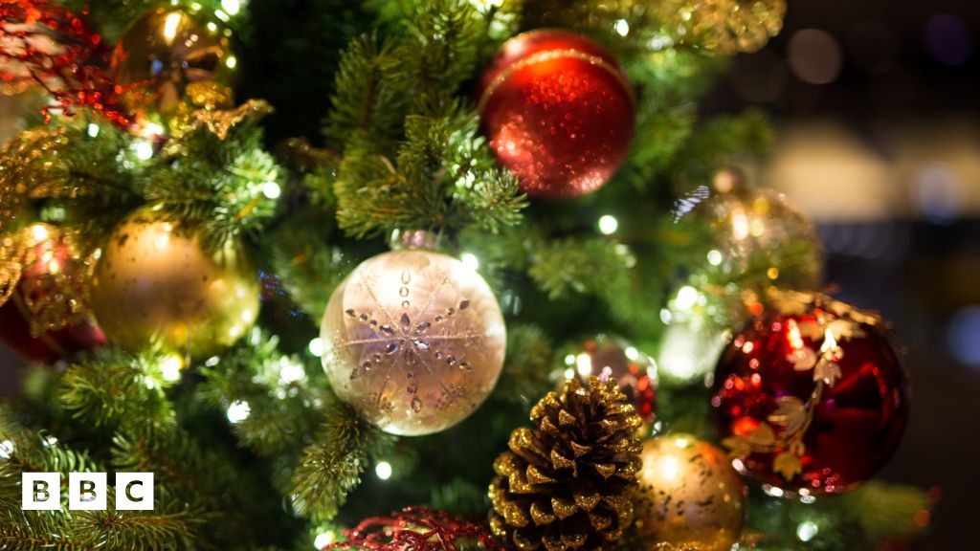
What do they usually decorate the shops with ?

Slide 7
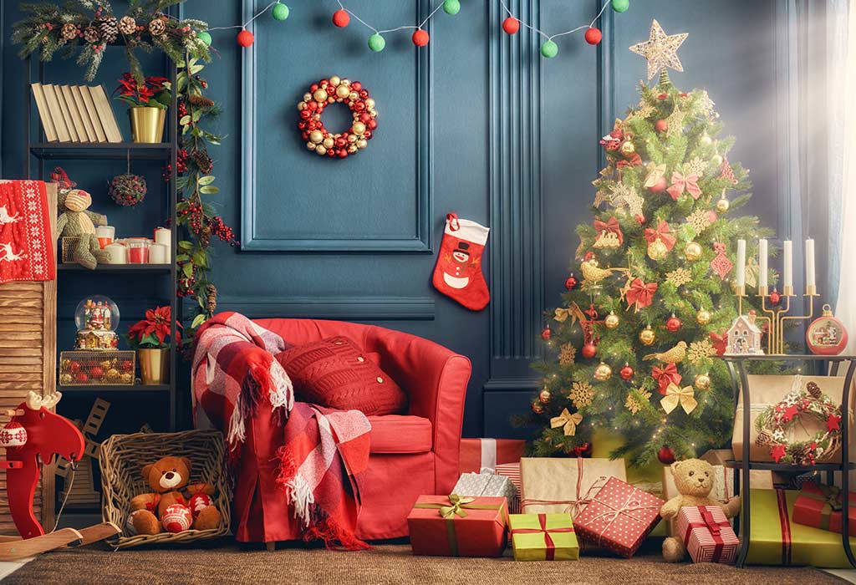
What do people buy in the middle of December?

Slide 8
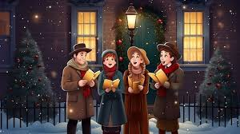
What are the names of Christmas songs?

Slide 9
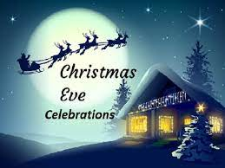
When is Christmas Eve?

Slide 10
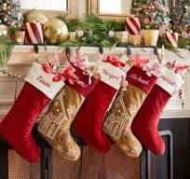
What do children leave for Santa Claus?

Slide 11
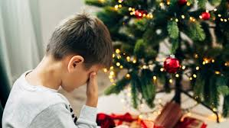
What does Santa leave for bad children?

Slide 12
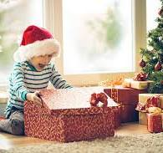
When do the children open their presents?

Slide 13
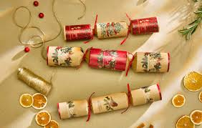
What is there inside the crackers?

Slide 14
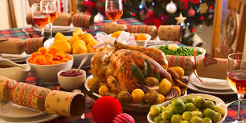
What is the main dish of Christmas dinner?

Slide 15

Фізкультхвилинка з Дебі Ду
s://www.youtube.com/watch?v=uFiWEZcVFzk&list=PL7G9h8-DwaBjaL4hmOle3WacNn8ug4pvH&index=10&ab_channel

Slide 16

Інтерактивна вікторина https://www.youtube.com/watch?v=oQu4QyFZijc&ab_channel=Games4esl

Slide 17
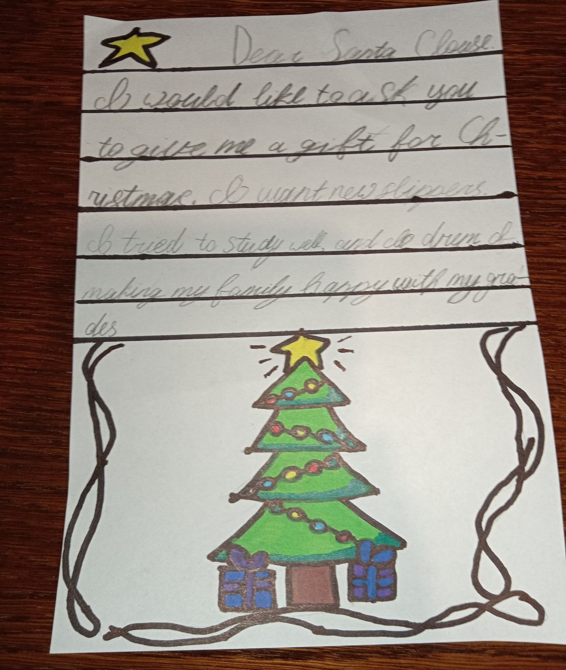

Slide 18
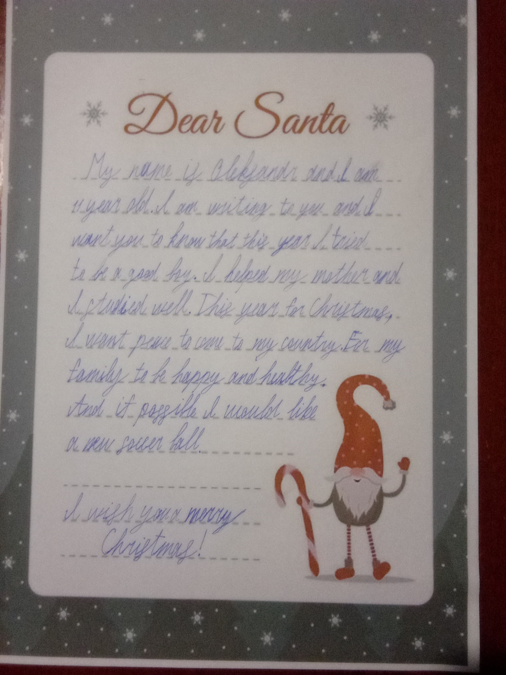

Slide 19
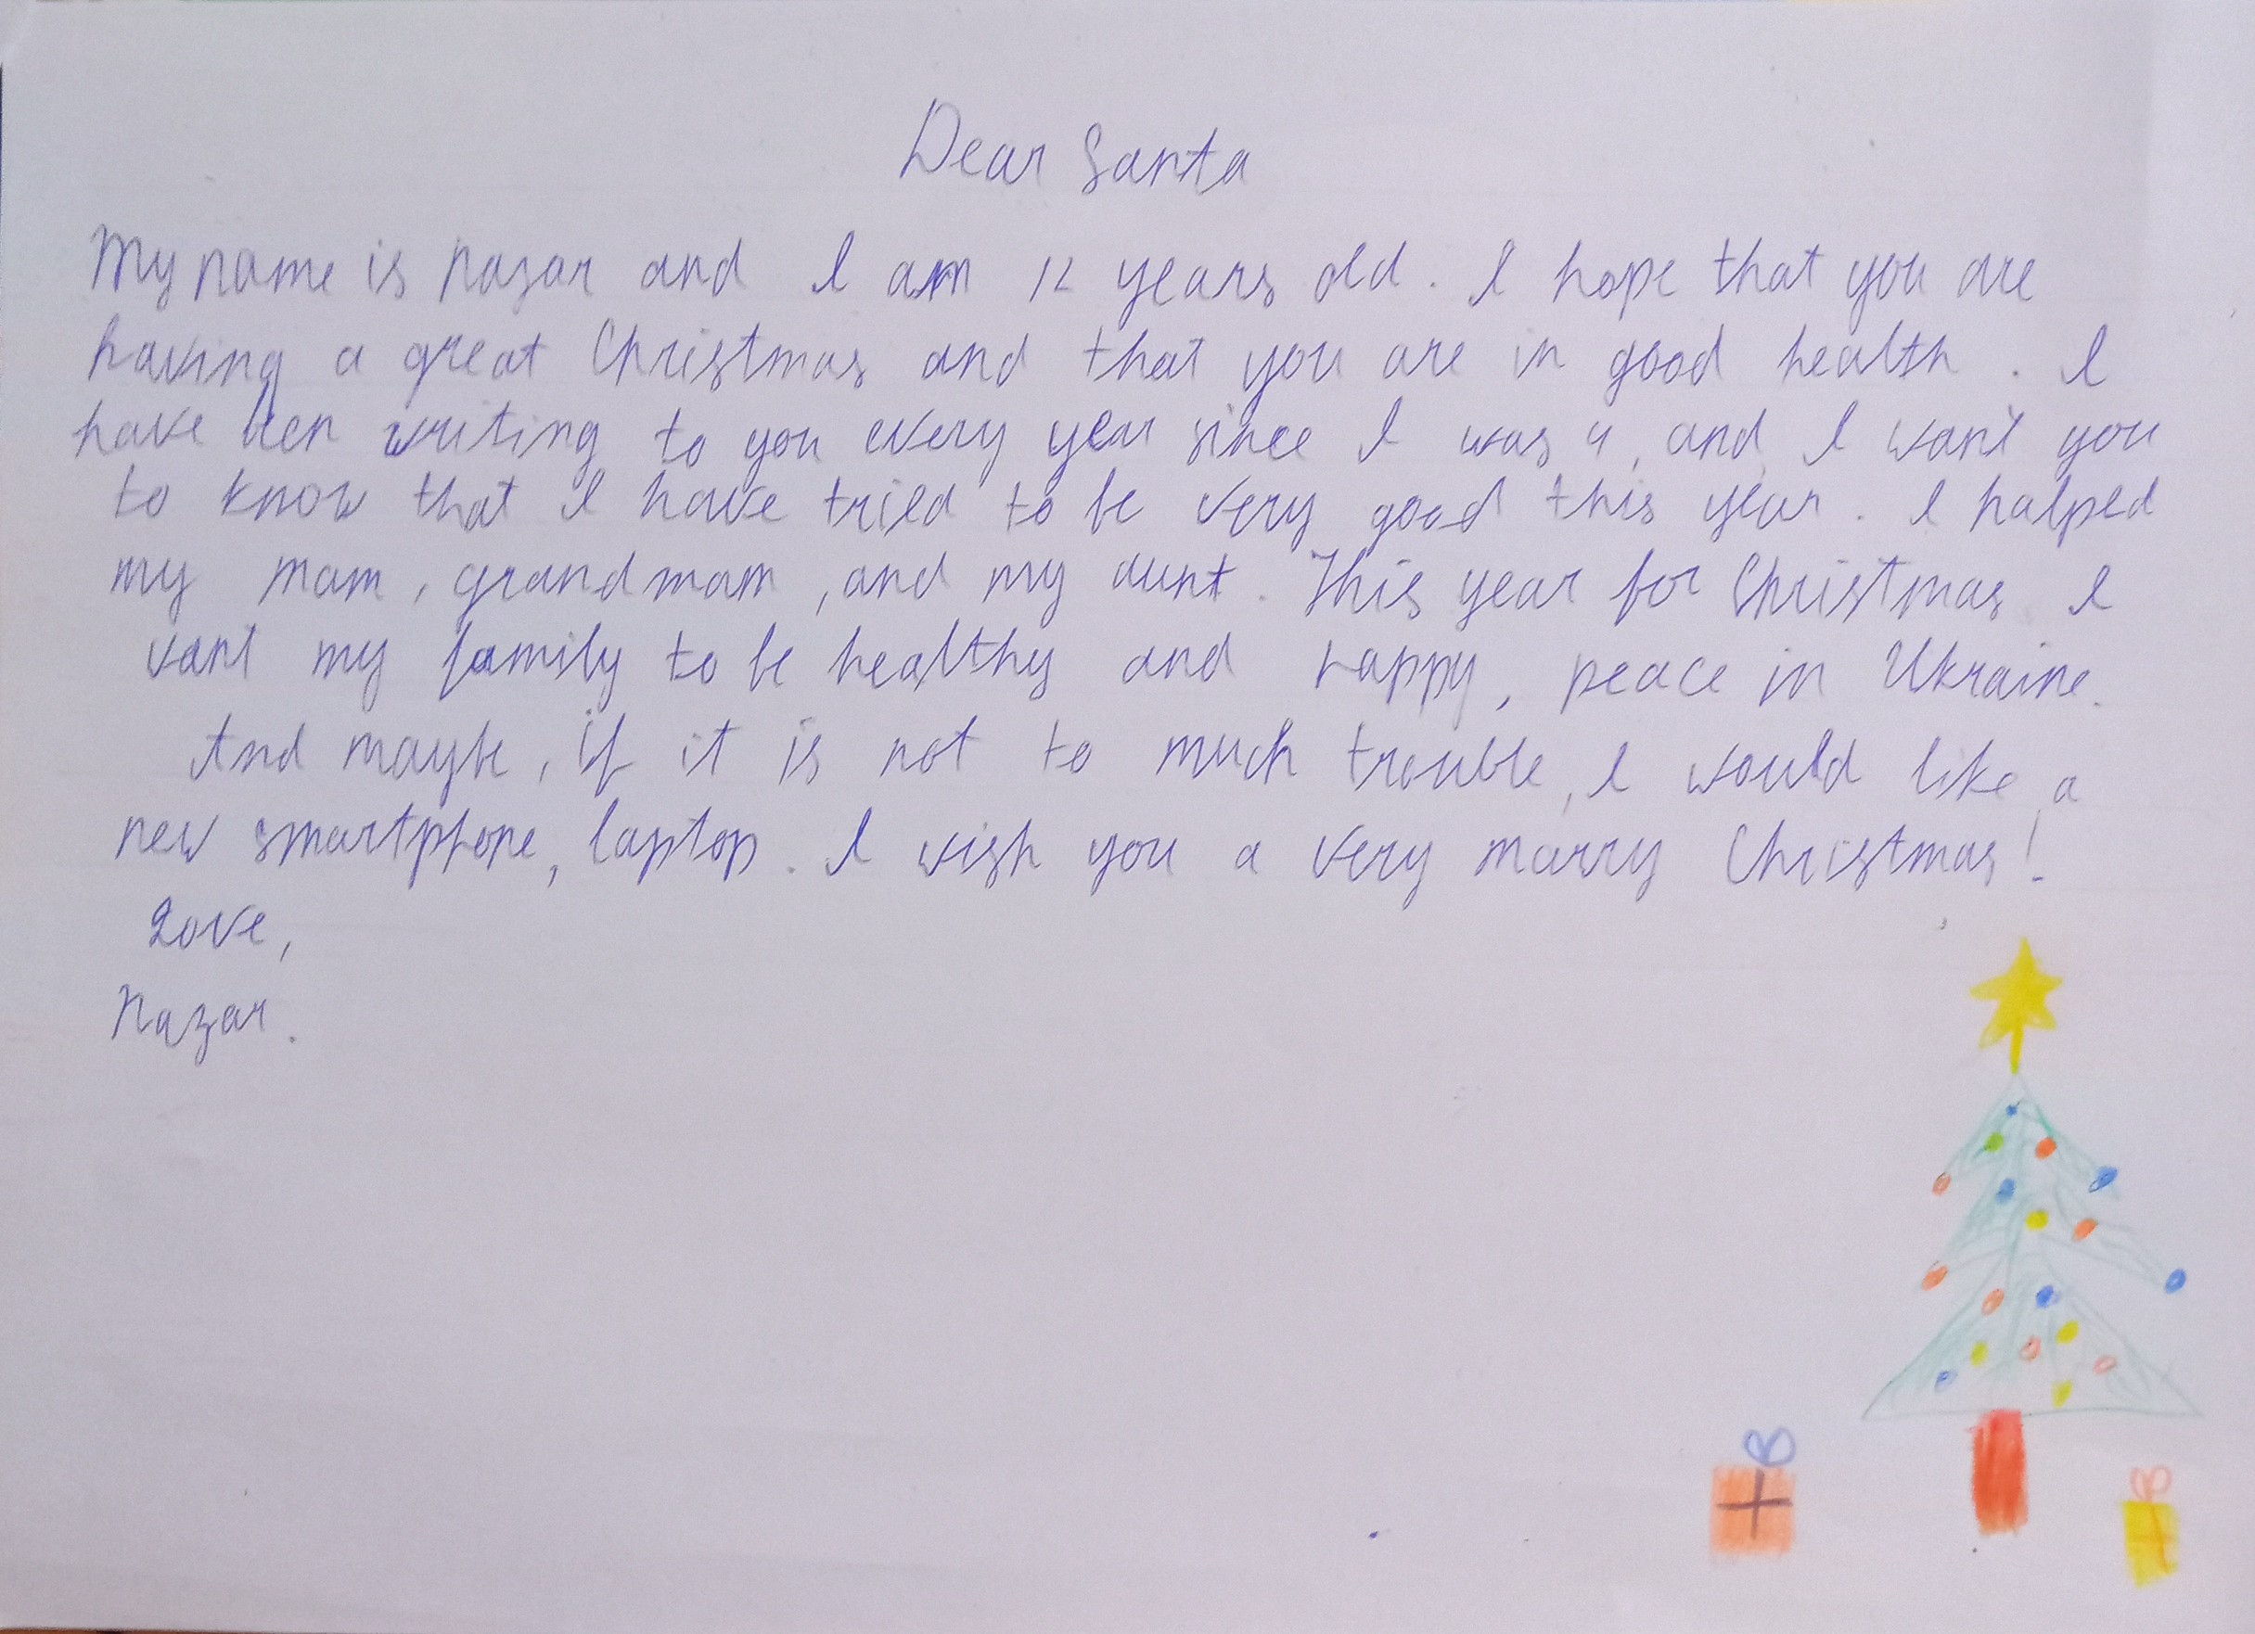

Slide 20
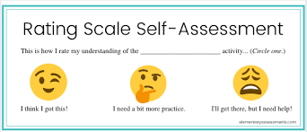

Slide 21
