Slide 1
UNUSAL CAFES IN KHARKIV

Slide 2

“Plasticine crow”
The motto of this art cafe is “Make it and stick it!"
Each visitor can create his own name, poem, picture, or any other thing and put a newly-made work of art on the wall of the café.

Slide 3
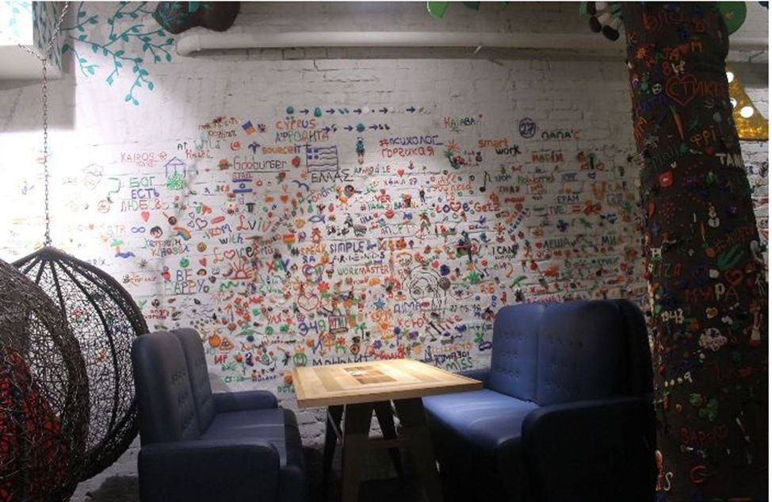

Slide 4
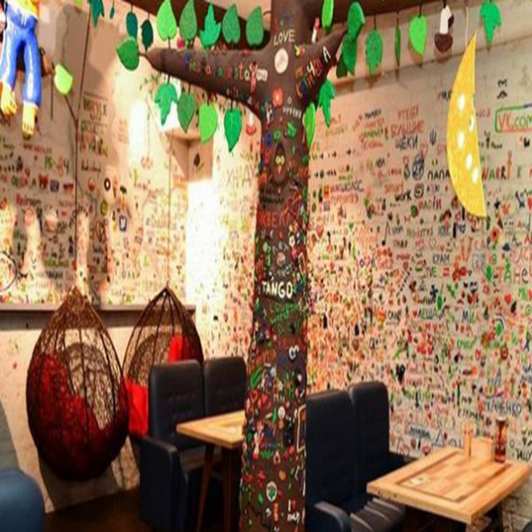

Slide 5
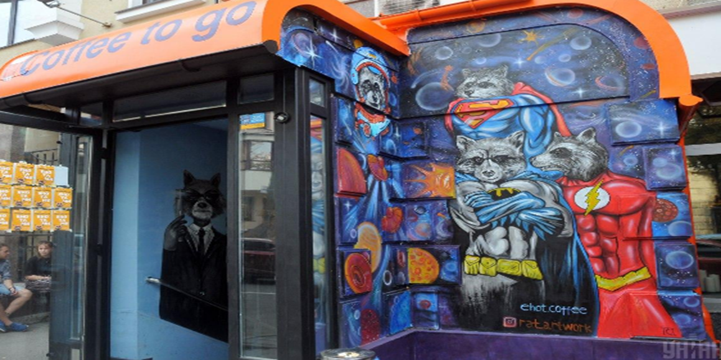

Slide 6
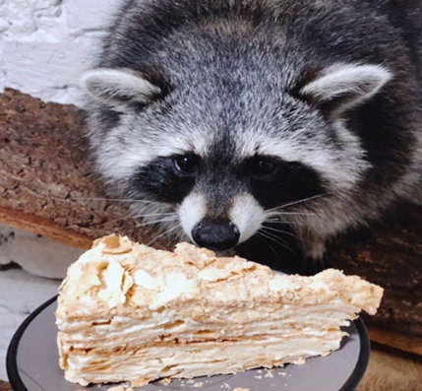
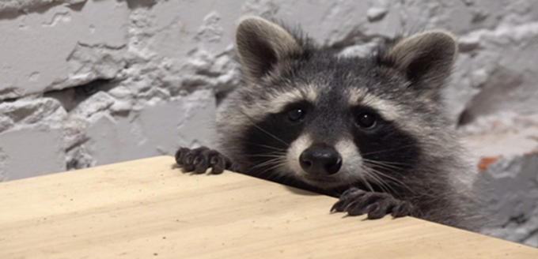
The first café in Kharkov with raccoons Barth and Lisa

Slide 7
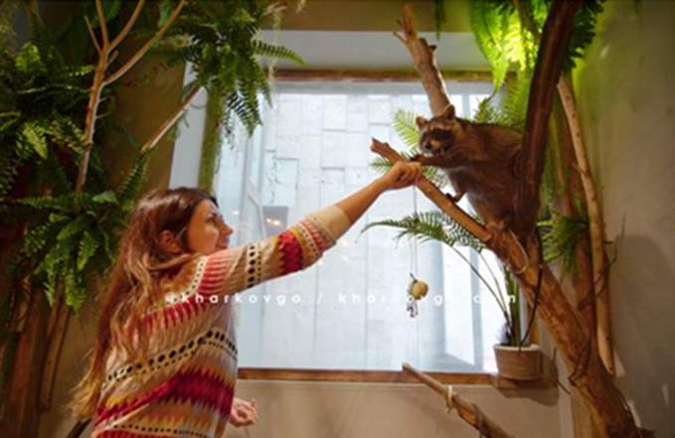

Slide 8
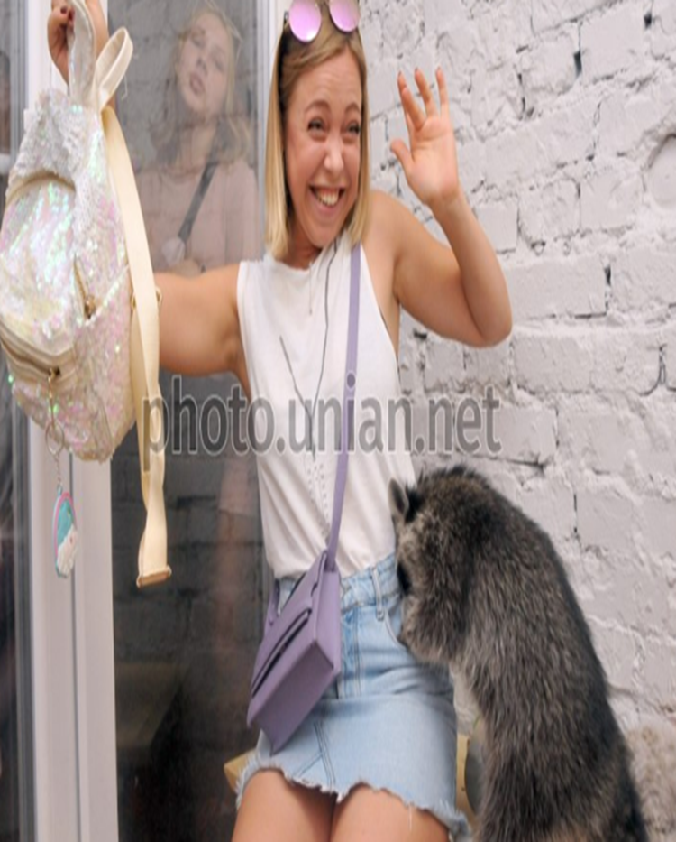

Slide 9
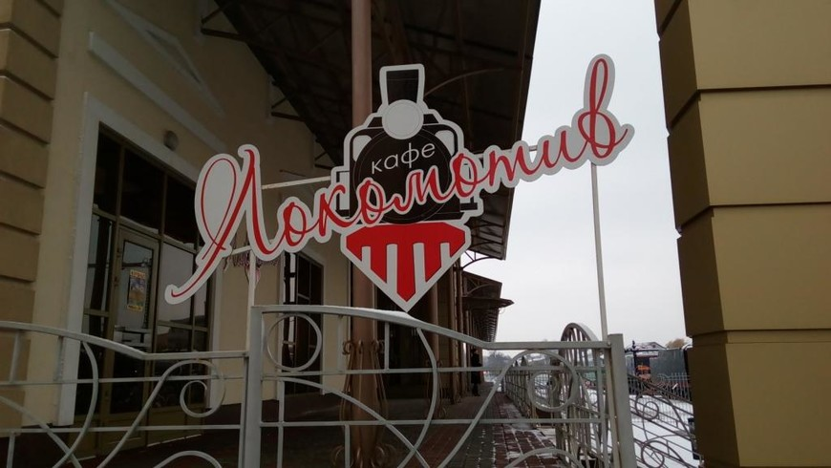

Slide 10
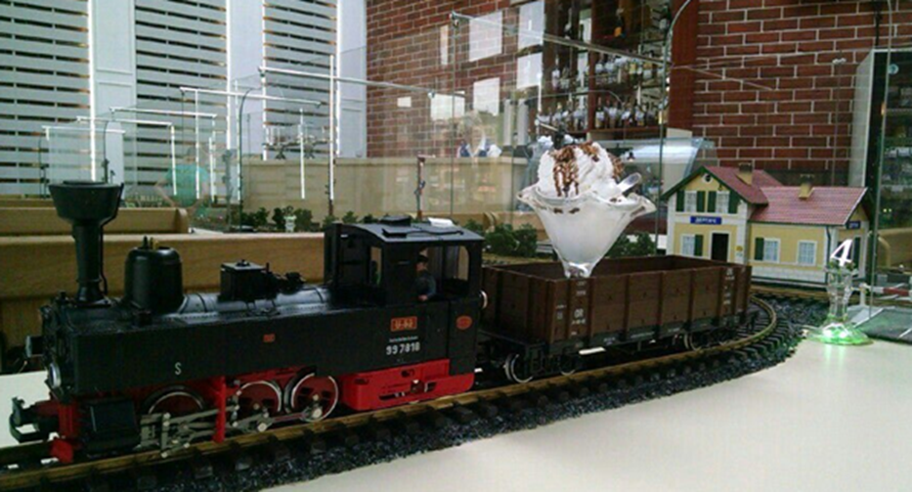
In our city there is a cafe in which you can see toy locomotives instead of waiters

Slide 11
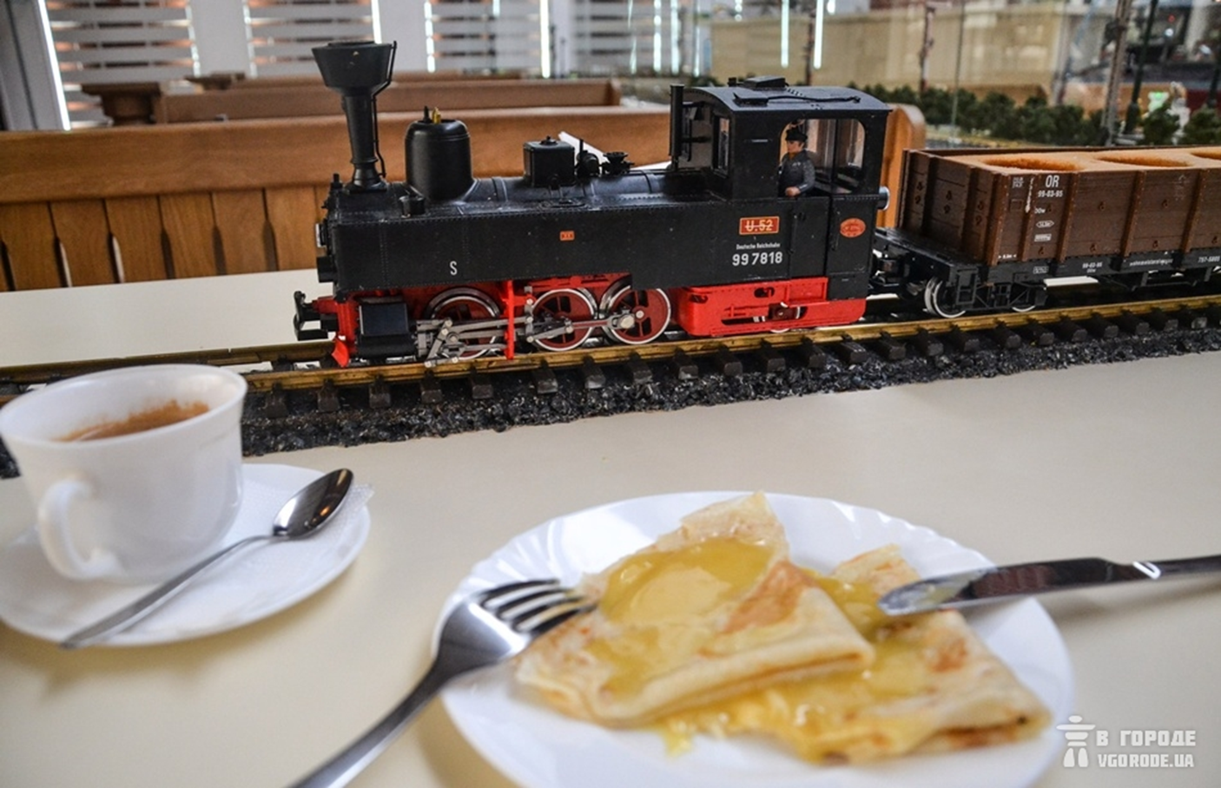

Slide 12
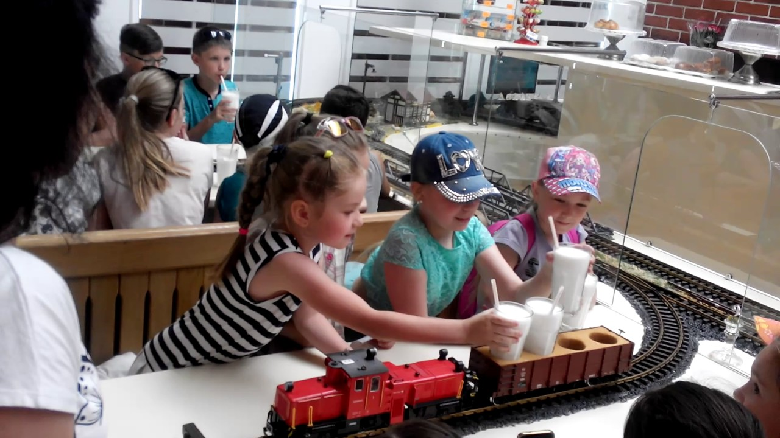

Slide 13
