Slide 1

Family
Unit 6. Lesson 2. This/That;Is that your…?
Prepared by Yana Driukova
Gymnasium 77 Zaporizhzhia

Slide 2


Slide 3



Who is this?

Slide 4
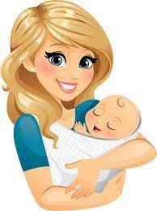
Who is this?

Slide 5

Who is this?

Slide 6
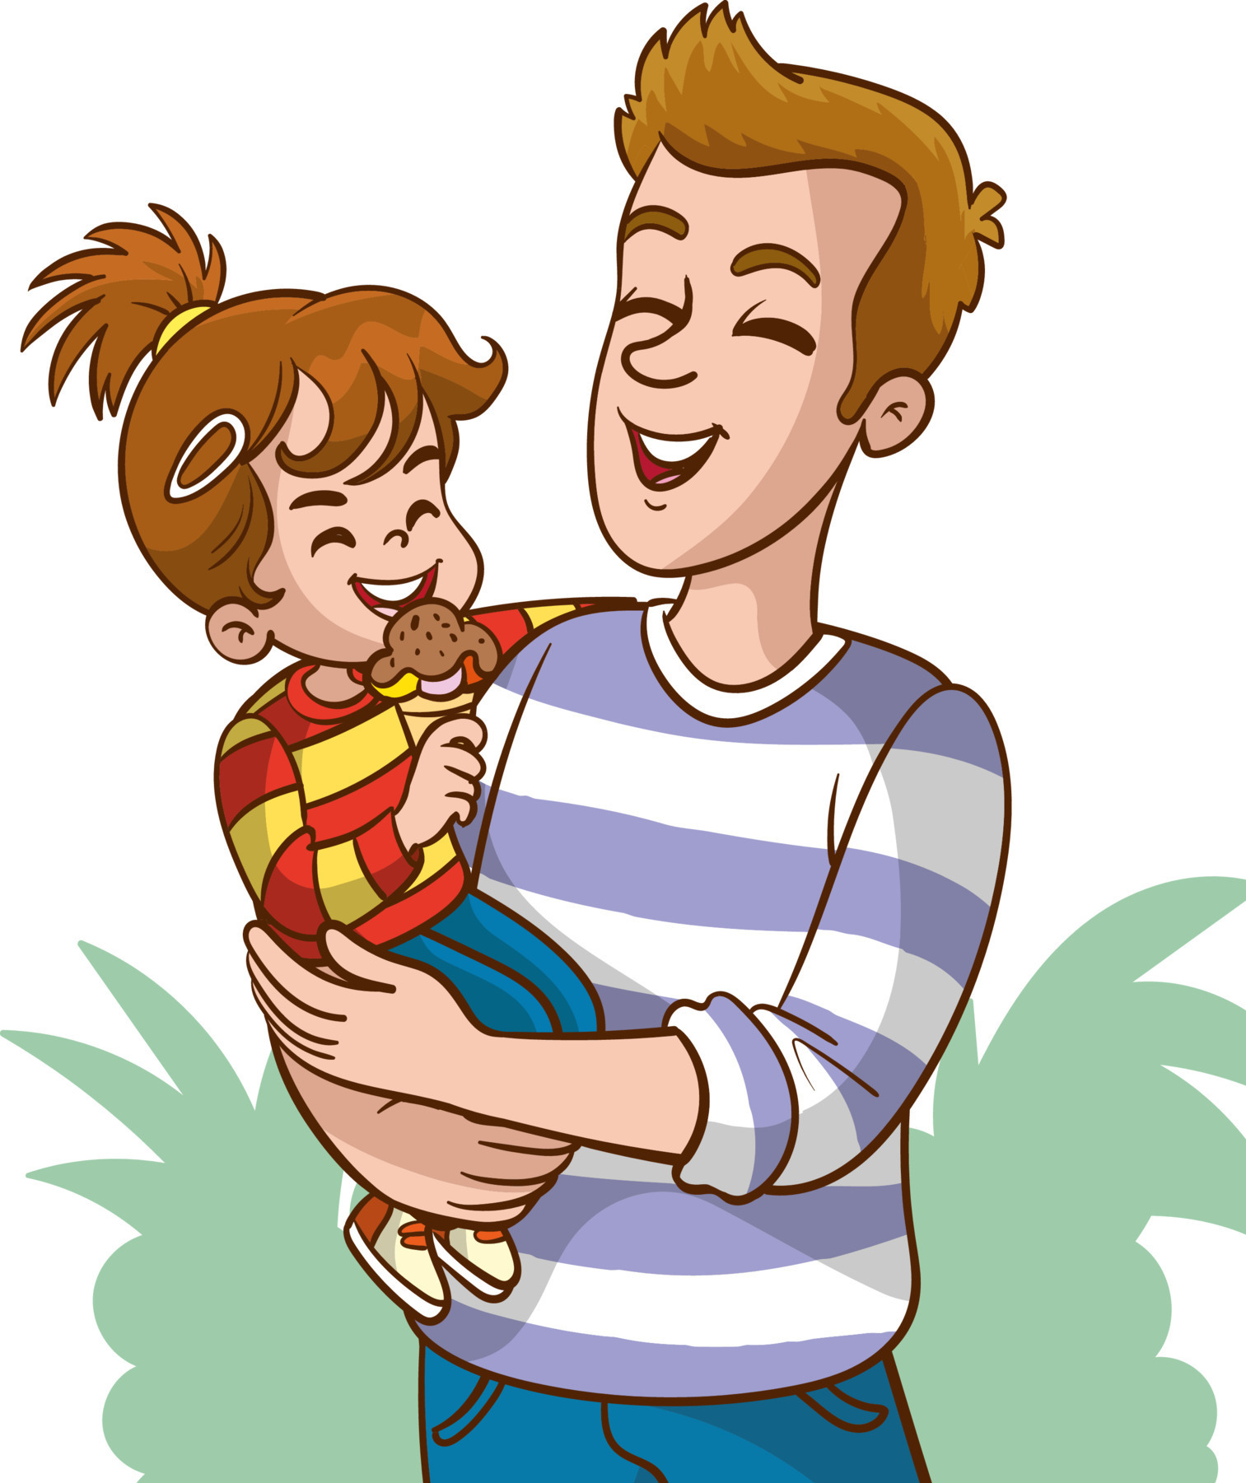
Who is this?

Slide 7
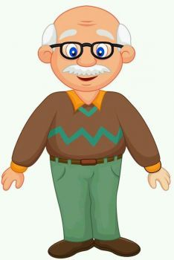
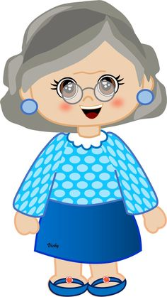
Who is this?

Slide 8
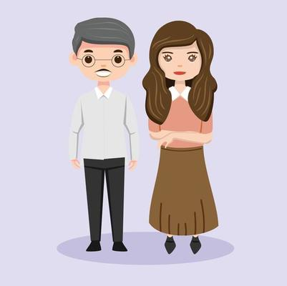
Who is
this?

Slide 9
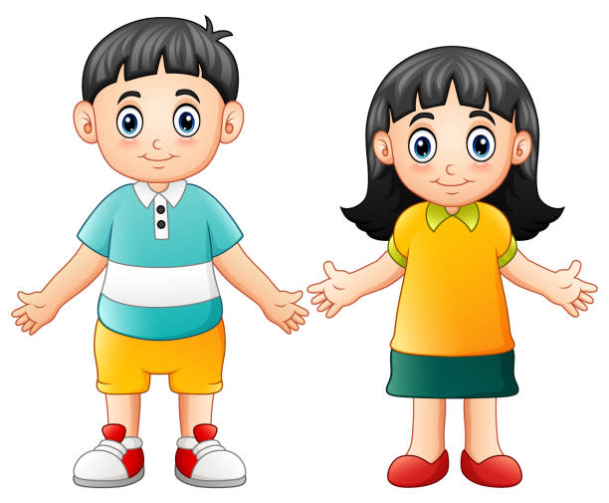
Who is
this?

Slide 10
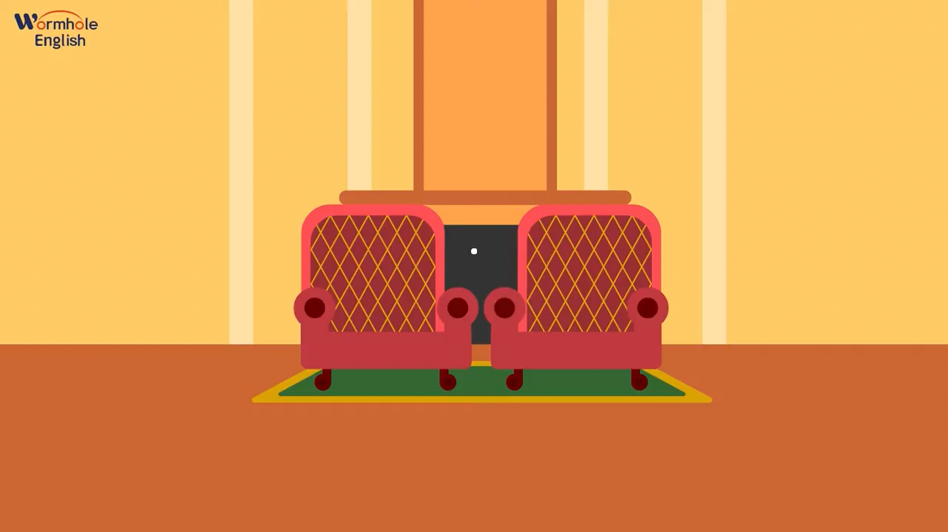


Slide 11

Hello!
I’m Kate.
This is my family.

Slide 12
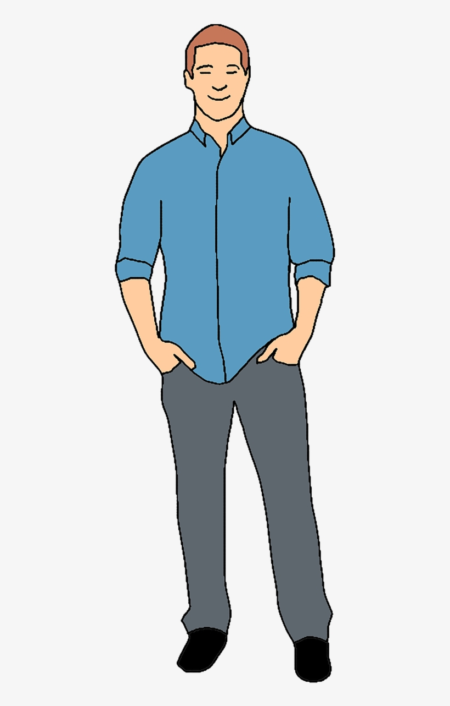
This is
my dad.

Slide 13
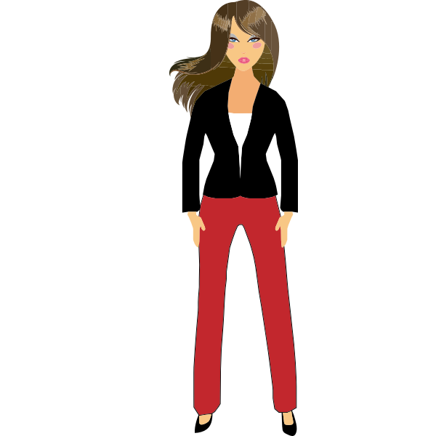
That is
my mum.

Slide 14
This is
That is

Slide 15
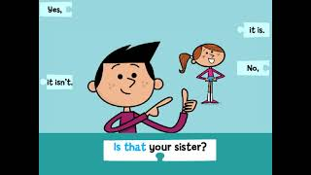

Slide 16

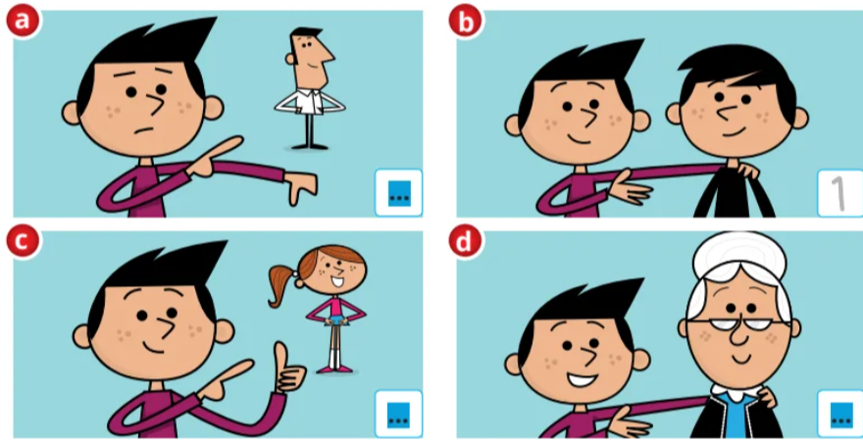

Slide 17


This is
That is

Slide 18


Slide 19
Список використаних джерел
Quick Minds 2. Підручник Англійська мова 2 клас Г. Пухта, П. Льюс-Джонс, Ґ. Ґернґрос 2019
Відео з youtube https://www.youtubeeducation.com/watch?v=r5h2k1QUdNk
https://www.youtubeeducation.com/watch?v=XqZsoesa55w
Ілюстрації з інтернету

