Slide 1
Farm and wild animals
Sara Hovorukha

Slide 2
On the farm or In the forest?

Slide 3
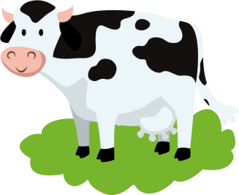
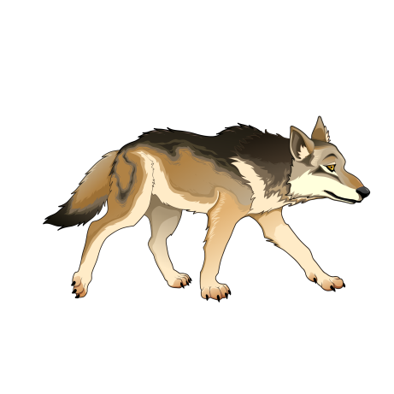
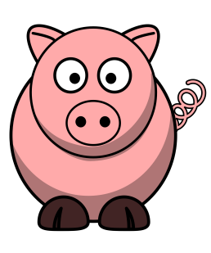
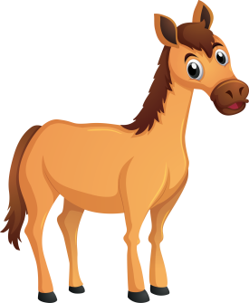
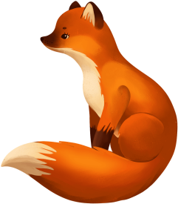

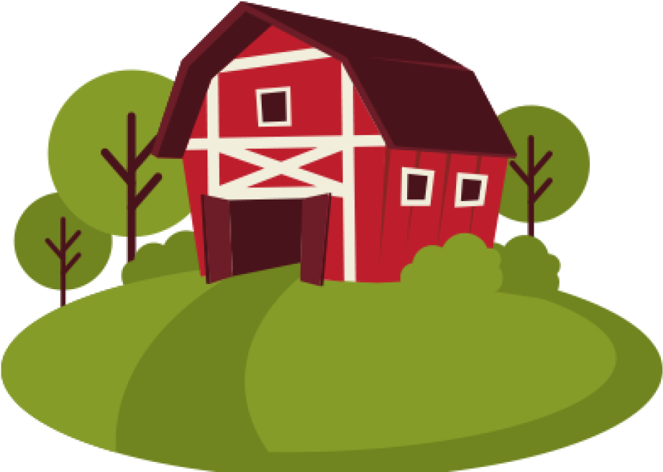
Well done!

Slide 4
Who Am I?
Read the clues and guess the animal. Write the name of the animal on the line.
1.I am red or brown. I have a big tail. I live in the forest and I am very clever.
Who am I? _______________ .
2.I am pink and round. I love to roll in the mud. I say "oink, oink."
Who am I? _______________ .
3.I have four legs and a long tail. People ride me. I can run very fast.
Who am I? _______________ .
4.I live in the wild and howl at the moon. I look like a big dog.
Who am I? _______________ .
5.I give milk. I say "moo." I live on a farm.
Who am I? _______________ .

