Slide 1
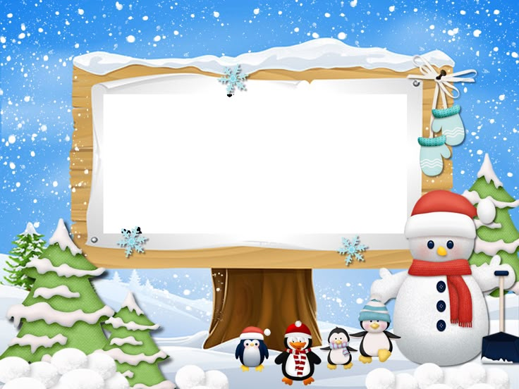
CHRISTMAS
IS COMING!

Slide 2
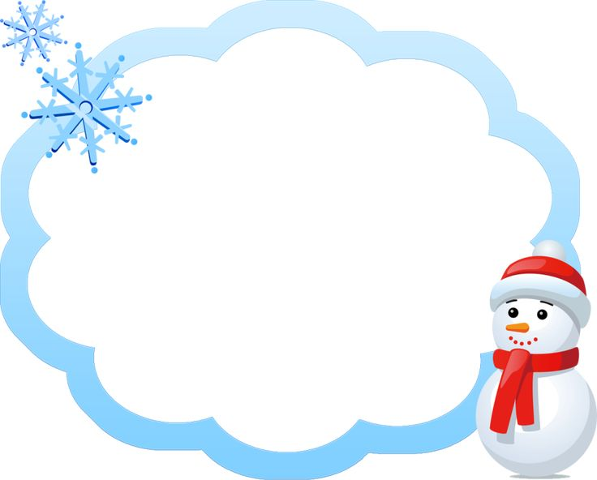
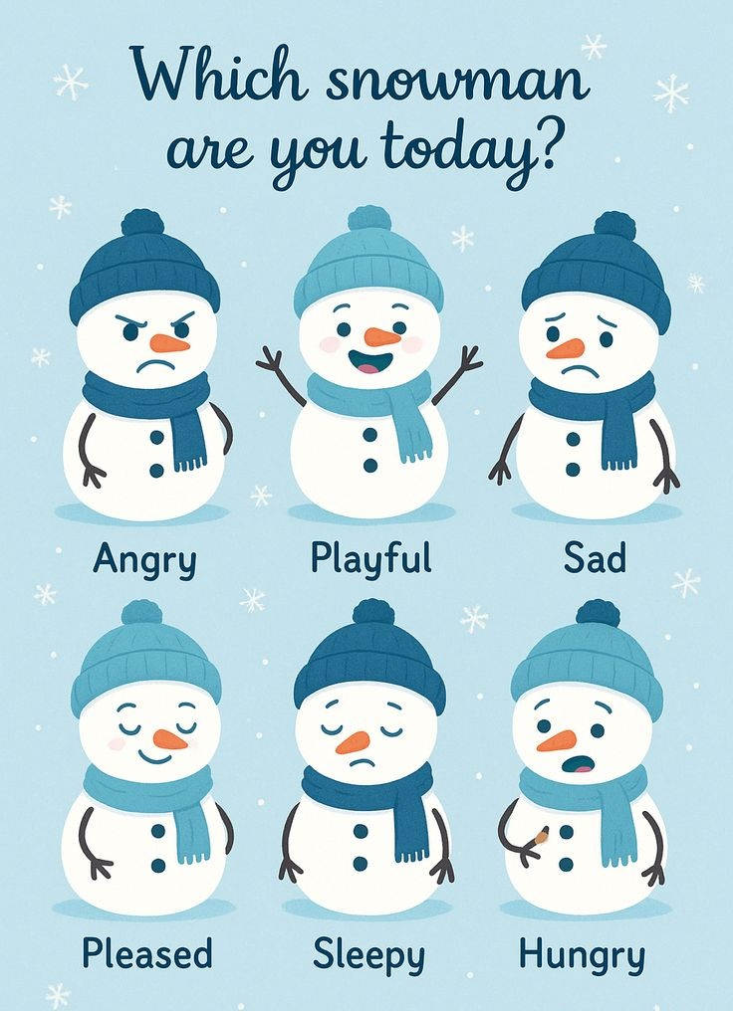

Slide 3
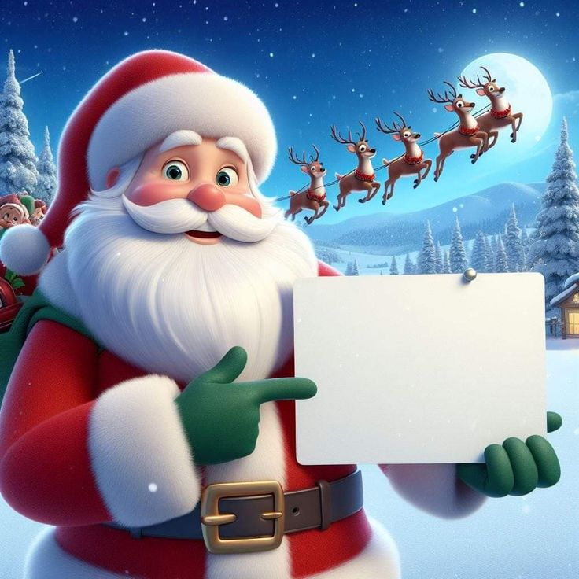
Today we will write a letter
to Santa Claus

Slide 4
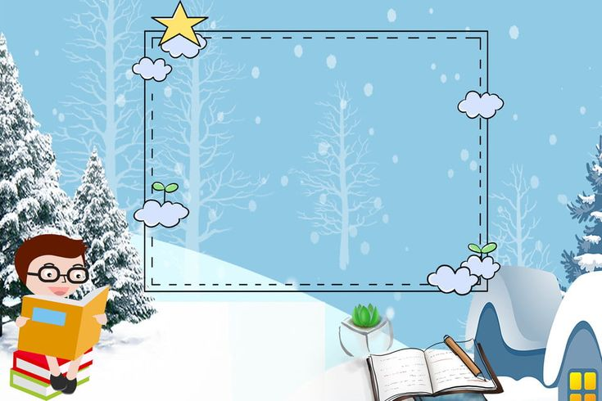
Let’s start from
Christmas vocabulary
https://learningapps.org/watch?v=pkofpbkb325
https://www.educaplay.com/learning-resources/27168607-christmas_vocabulary_challenge.html

Slide 5
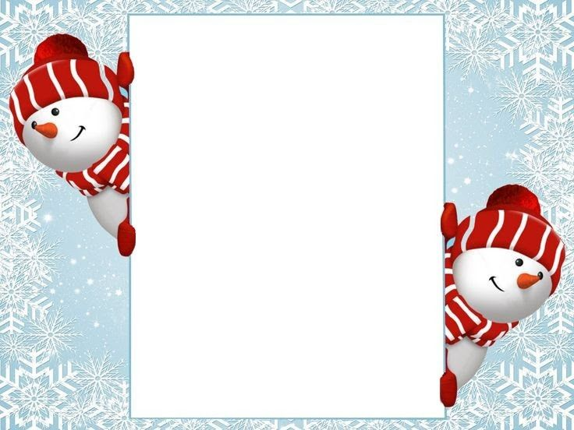
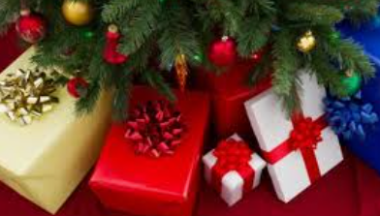
Christmas presents
What do you like best
get or give presents?

Slide 6
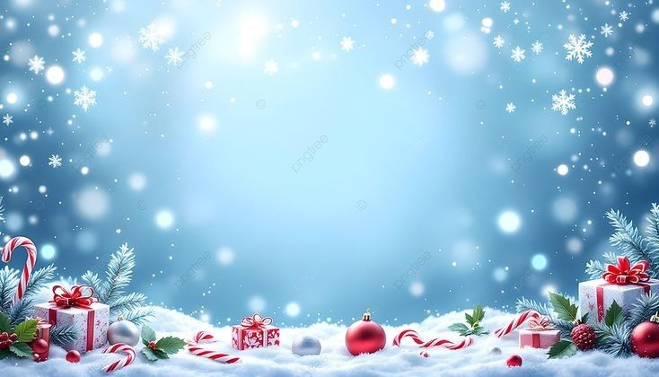
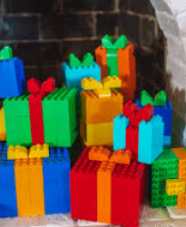
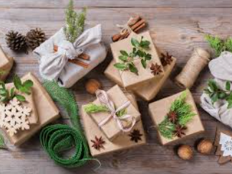
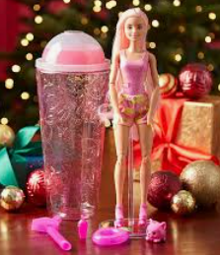
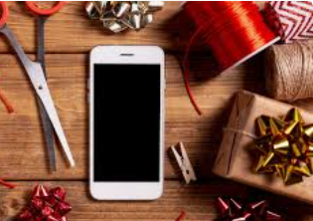
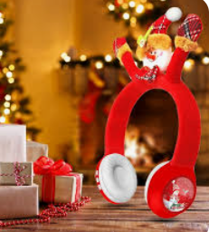
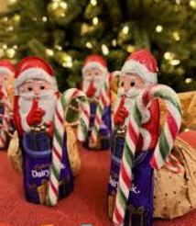
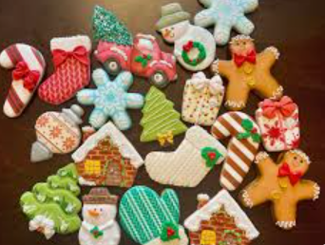
Ideas for Christmas presents
BARBIE DOLL
LEGO
PHONE
HEADPHONES
SWEETS
COOKIES

Slide 7
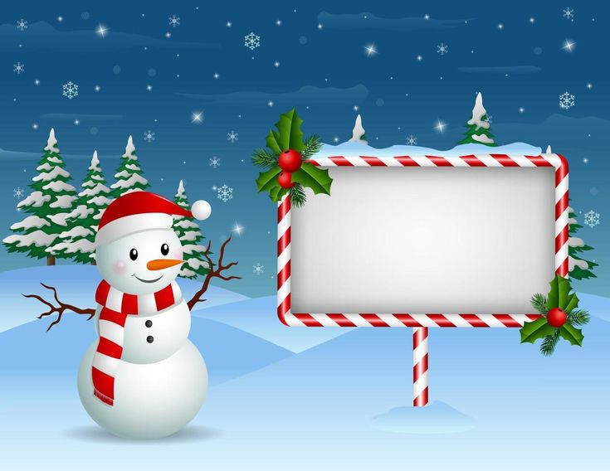
Watch the video.
While watching
make a list
of Christmas presents.

Slide 8
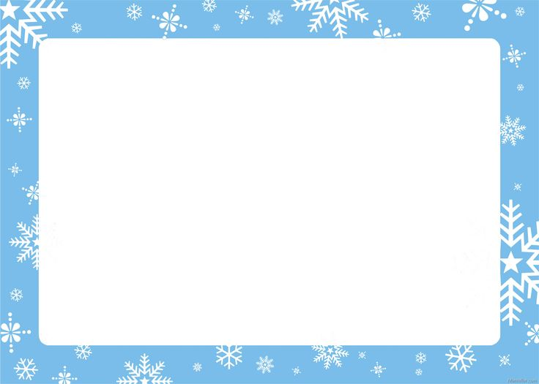
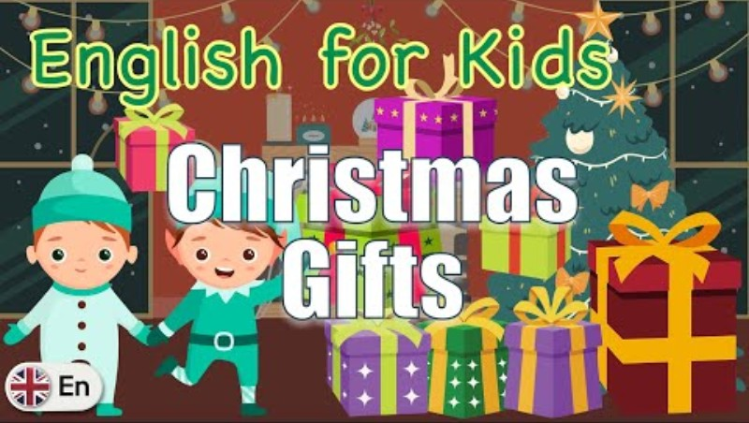

Slide 9
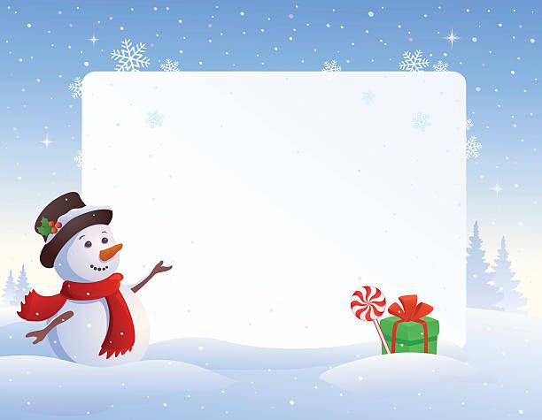

What Christmas present is it?
globe
Choose the right answer
A round model of Earth
Audio device you wear over or in your ears

Slide 10

What Christmas present is it?
headphone
Choose the right answer
A thing that creates a comfort light
Audio device you wear over or in your ears.

Slide 11
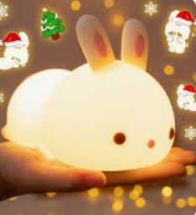
What Christmas present is it?
nightlight
Choose the right answer
A thing that creates a comfort light
A horse-like animal with a long horn

Slide 12
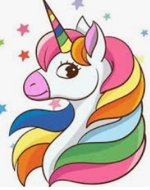
What Christmas present is it?
unicorn
Choose the right answer
A horse-like animal with a long horn
A colouful silicone toy with little bubbles
to push in and out

Slide 13
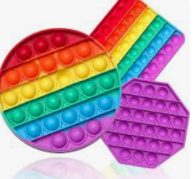
What Christmas present is it?
pop it
Choose the right answer
A mini-guitar
A colouful silicone toy with little bubbles
to push in and out

Slide 14
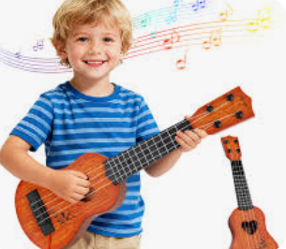
What Christmas present is it?
ukulele
Choose the right answer
A mini-guitar
A pig-shaped container to save money

Slide 15
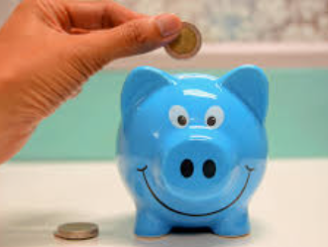
What Christmas present is it?
piggy bank
Choose the right answer
A pig-shaped container to save money
A round model of the Earth

Slide 16
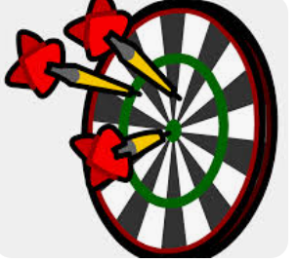
What Christmas present is it?
dartboard
Choose the right answer
A horse-like animal with a long horn
A game with darts to stick to a board

Slide 17
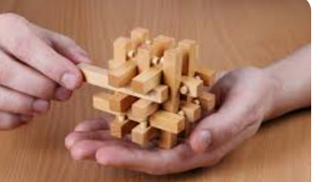
What Christmas present is it?
wooden puzzle
Choose the right answer
A game with darts to stick to a board
Small pieces of wood for matching

Slide 18
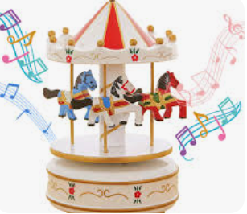
What Christmas present is it?
merry-go-round
Choose the right answer
A spinning platform with figures
A mini guitar

Slide 19
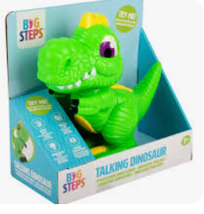
What Christmas present is it?
dinosaur
Choose the right answer
Small pieces of wood for matching
A toy animal that lived on Earth long ago

Slide 20
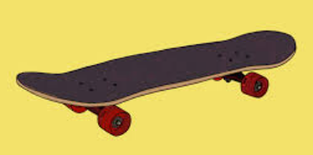
What Christmas present is it?
skateboard
Choose the right answer
A board for skating
A spinning platform with figures

Slide 21
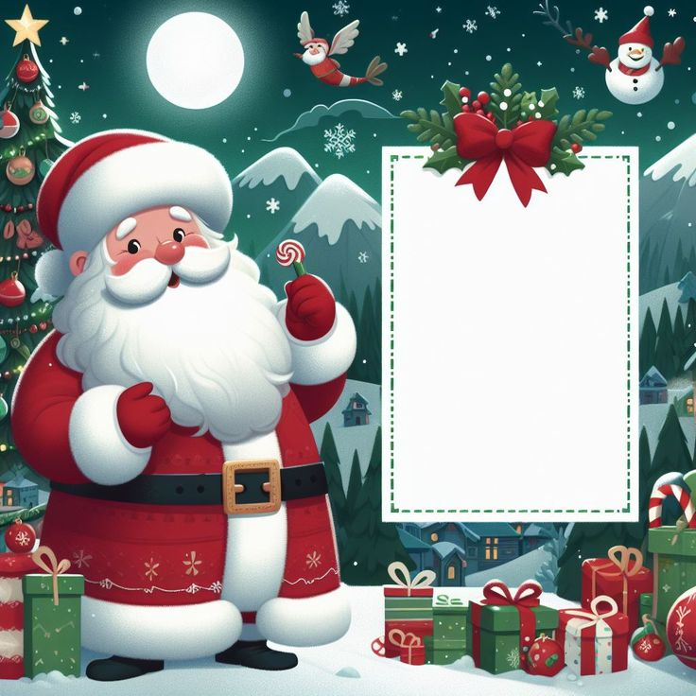
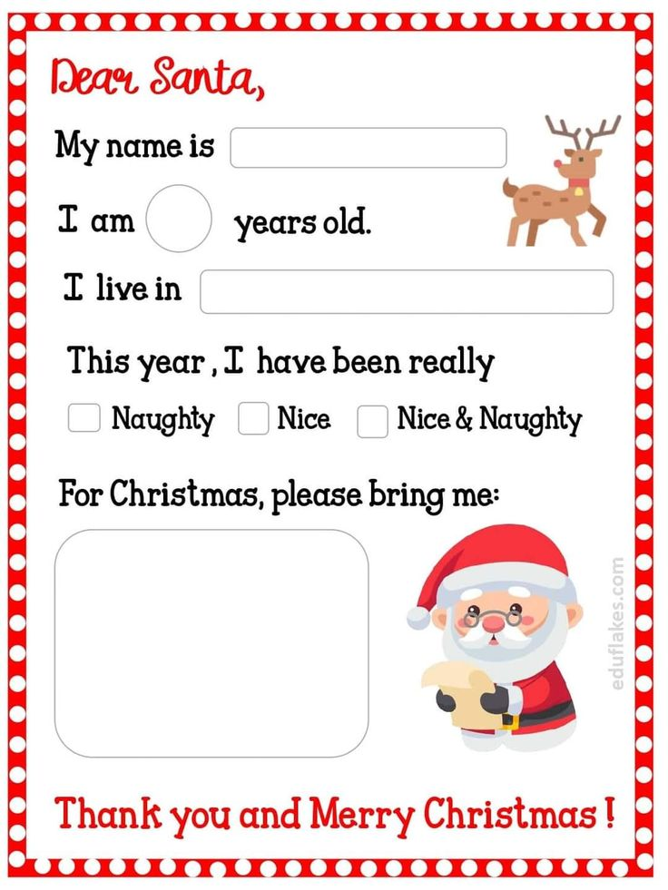

Slide 22
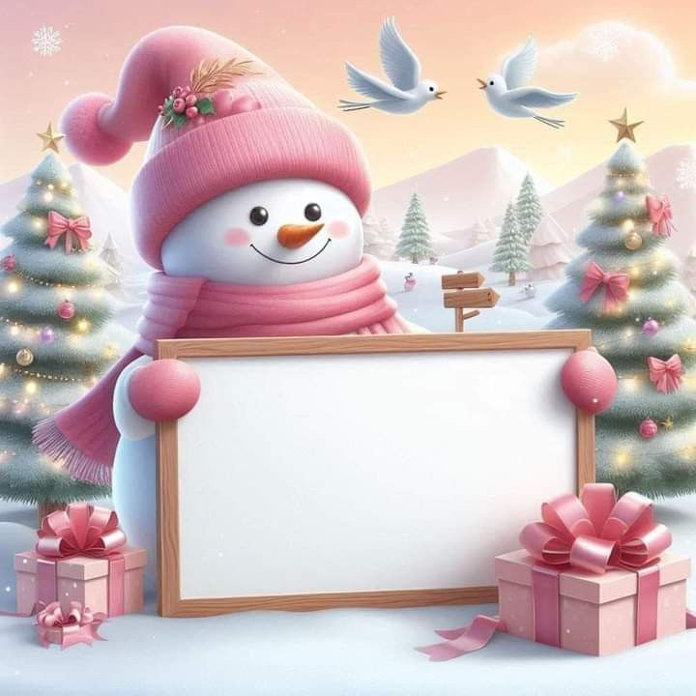
Hometask
Write a letter
to Santa Claus

Slide 23
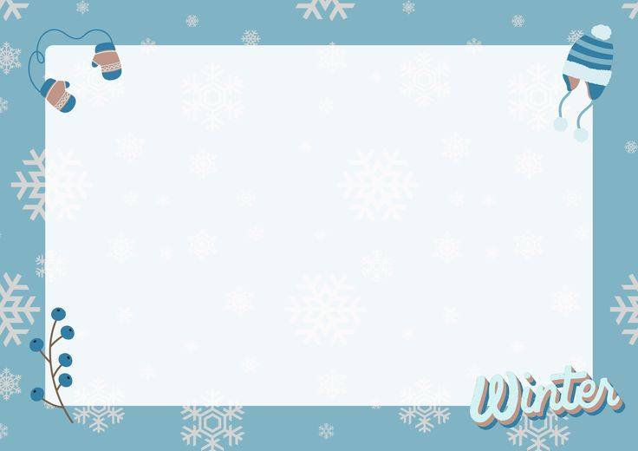


It’s time to say

