Slide 1
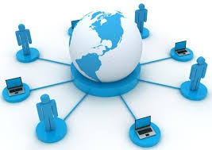
Modern Communication Technologies In Our Life
“Progress is impossible without change, and those who cannot change their minds cannot change anything.”
Bernard Shaw

Slide 2
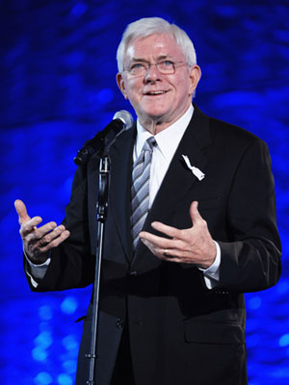
THE PHIL DONAHUE SHOW

Slide 3
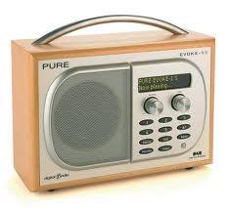
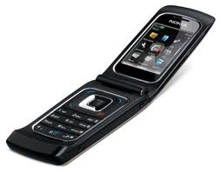
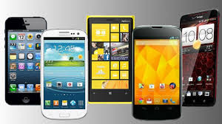
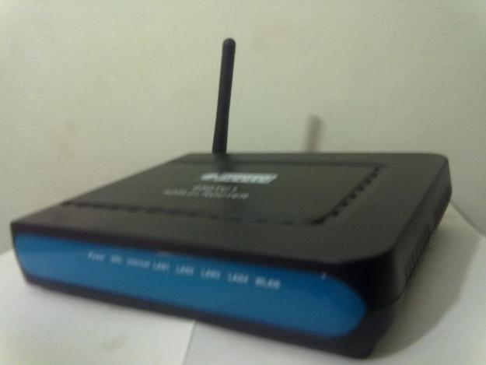
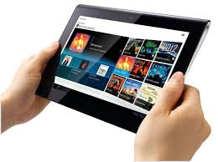
Try to guess. What’s this?
Digital radio
Smartphone
Mobile phone
Tablet
Wi-Fi modem

Slide 4
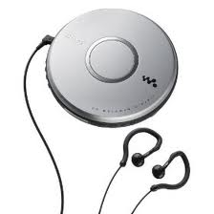
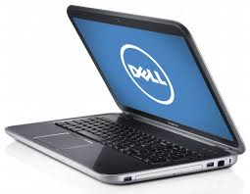
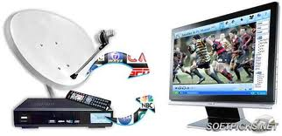
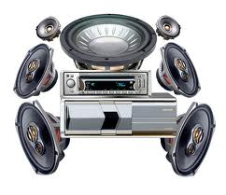
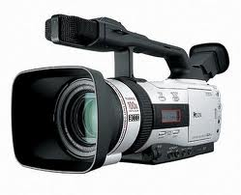
Portable CD player
Laptop
Satellite TV
Camcorder
Stereo

Slide 5
Try to find the Ukrainian equivalents
Searching for information
Текстове повідомлення
Communicating
Шукати інформацію
Спілкування
Webinar
Захід,що проводиться за допомогою Інтернету
Nanotechnology
Text messagе
Нанотехнології

Slide 6
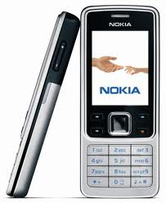
Complete the sentence
I cannot live without a
mobile phone because…

Slide 7
Read and discuss the text
Although texting is a convenient and cheap method of staying in touch with your friends, it can also bring problems. In 2005, a British teenager became the first person in the world to receive treatment for an addiction to text messaging. In one year, the nineteen-year-old spent about £4,500 on text. (He was sending about 700 texts a week.) He was also addicted to email, and sent 8,000 messages in one month from his computer at work. The treatment is working well, however, and he now spends no more than £10 a week on texts.

Slide 8
sending letters
communication
searching for information
Computers are used for
holding webinars
education
playing games

Slide 9
Complete the sentences
Technology will make the world a better place because:
- With the help of computers we can…
- With the help of the Internet we can…
With the help of mobile phone we can…
- Some nanotechnologies can help to …

Slide 10
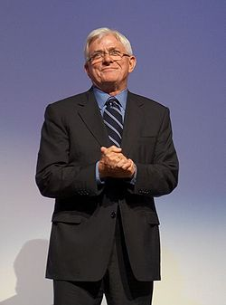
Surprise from Phil Donahue

Slide 11

Complete the sentences
Today at the lesson I have known…
I can…
I know such words as…
The lesson was
( wasn’t) interesting because …
I think my mark is…

Slide 12
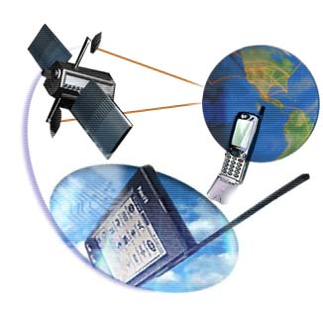
Home Assignment
Prepare your own report about the role of technology in our life, your own presentations

