Slide 1
Quiz
Around the English- Speaking World

Slide 2
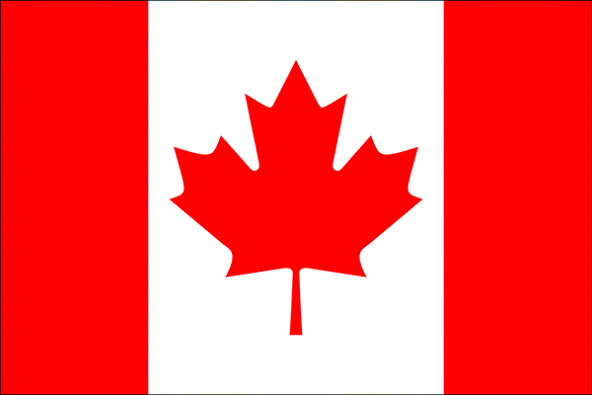
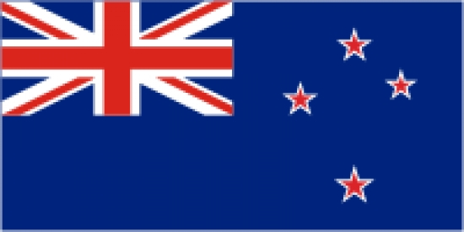
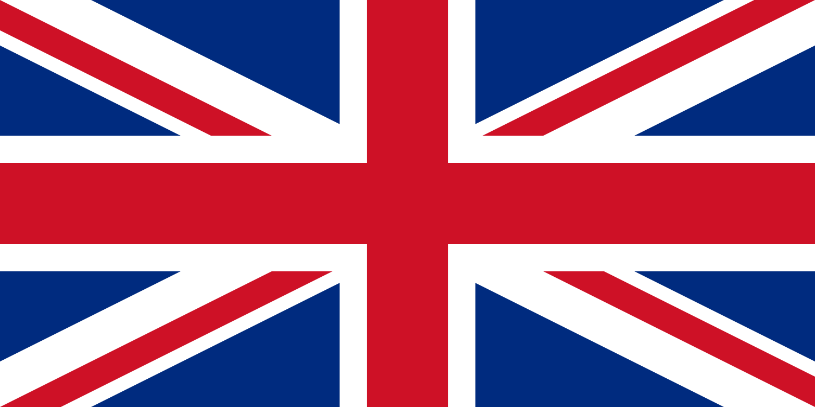
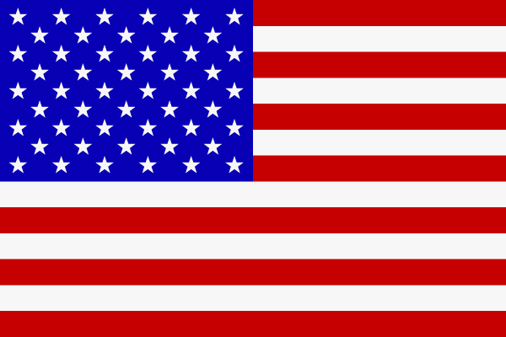
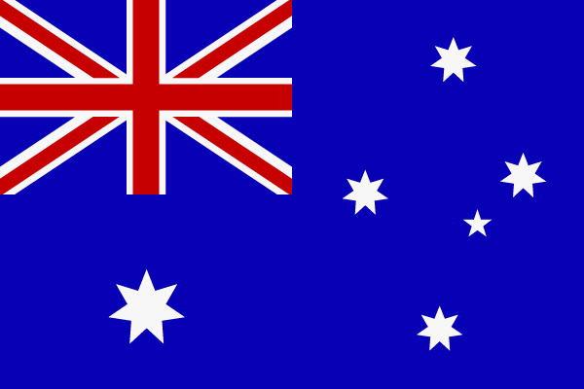
Name the country the flag belongs to

Slide 3
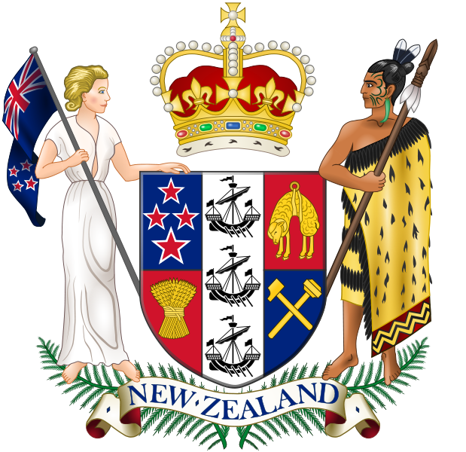
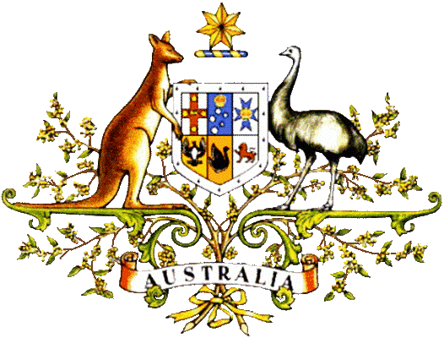
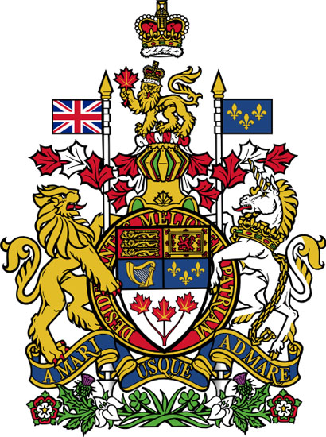
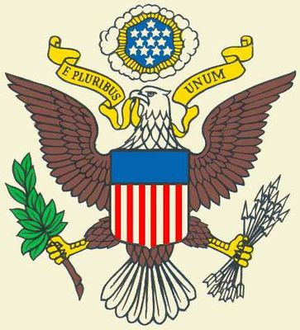
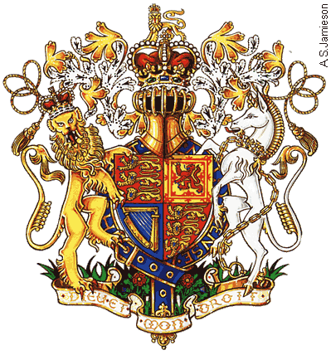
Name the country acc. to the national emblem

Slide 4
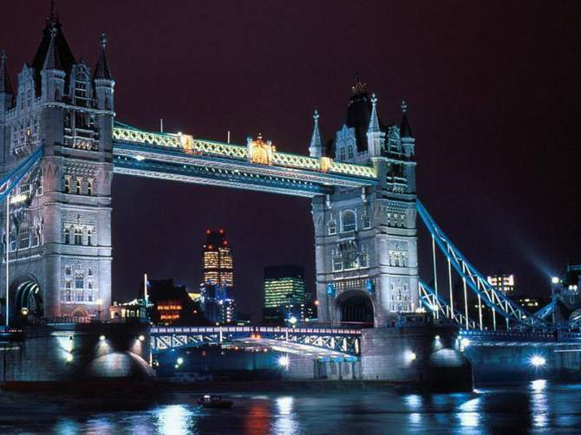
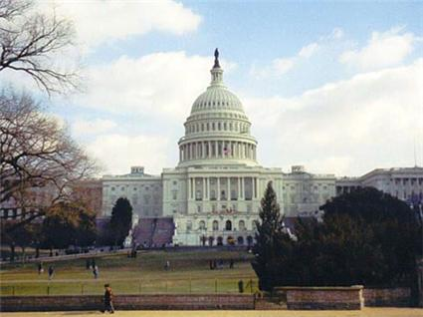
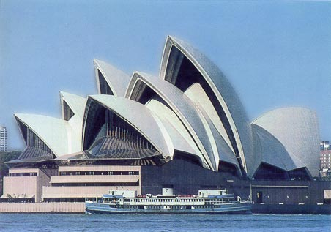
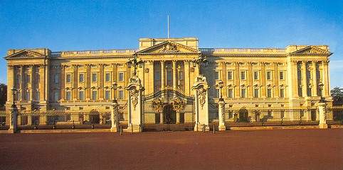
Name the famous places and the cities

Slide 5
Name the people living in the country
Wales
Canada
England
America
Scotland
Northern Ireland
Australia
The Welsh
Canadians
The English
Americans
The Scots
The Irish
Australians

Slide 6
Match the date with the month and name the British holidays
25th December
31st December
14th February
31st October
April or May
Halloween
Easter
New Year’s Day
Christmas Day
St. Valentine’s Day

Slide 7
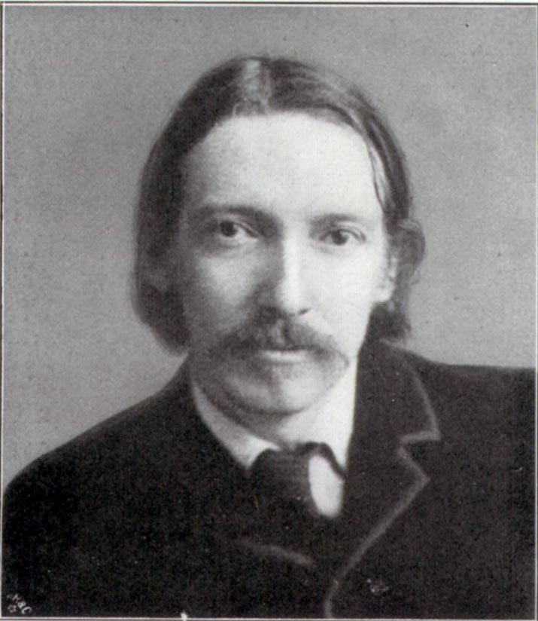
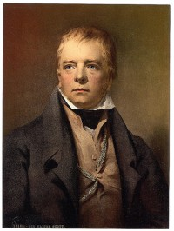
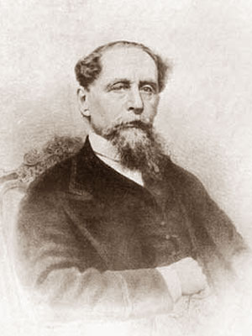
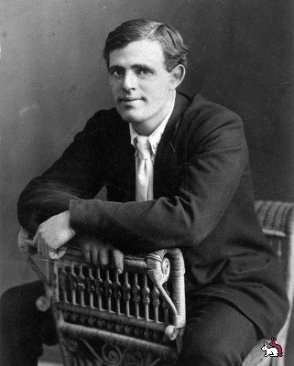
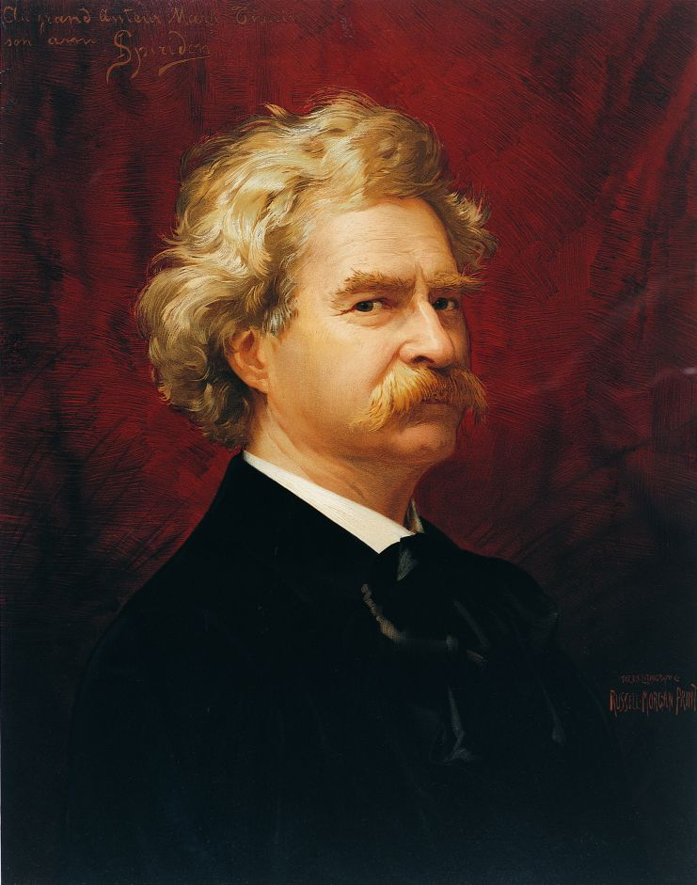
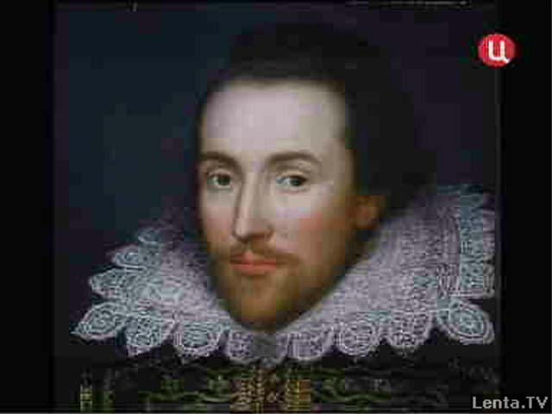
Guess the writer

Slide 8
Complete the sentences
1) In Britain the … reigns but has no real power.
2) The flag of the United States is called … and … .
3) … is the smallest land in the United Kingdom.
4) In London cars and buses travel on the … side of the road.
5) London … is the oldest and the longest in Europe.

Slide 9
Find the English equivalent for the American one
Penpal
Apartment
Railroad
Drug
Cookies
Fall
Penfriend
Flat
Railway
Medicine
Biscuits
Autumn

