Slide 1


GOOD MORNING!

Slide 2


OUR MOTTO:
A- Active
B- bright
C- creative

Slide 3

Whether the weather is hot
Whether the weather is not
We‘ll weather the weather
Whatever the weather
Whether we like it or not.

Slide 4
RRRRRRRRFRRRRR
UUUUUUUUUUAU
DDDRDDDDDDDD
NNNMNNNNNNN
F
A
R
M

Slide 5
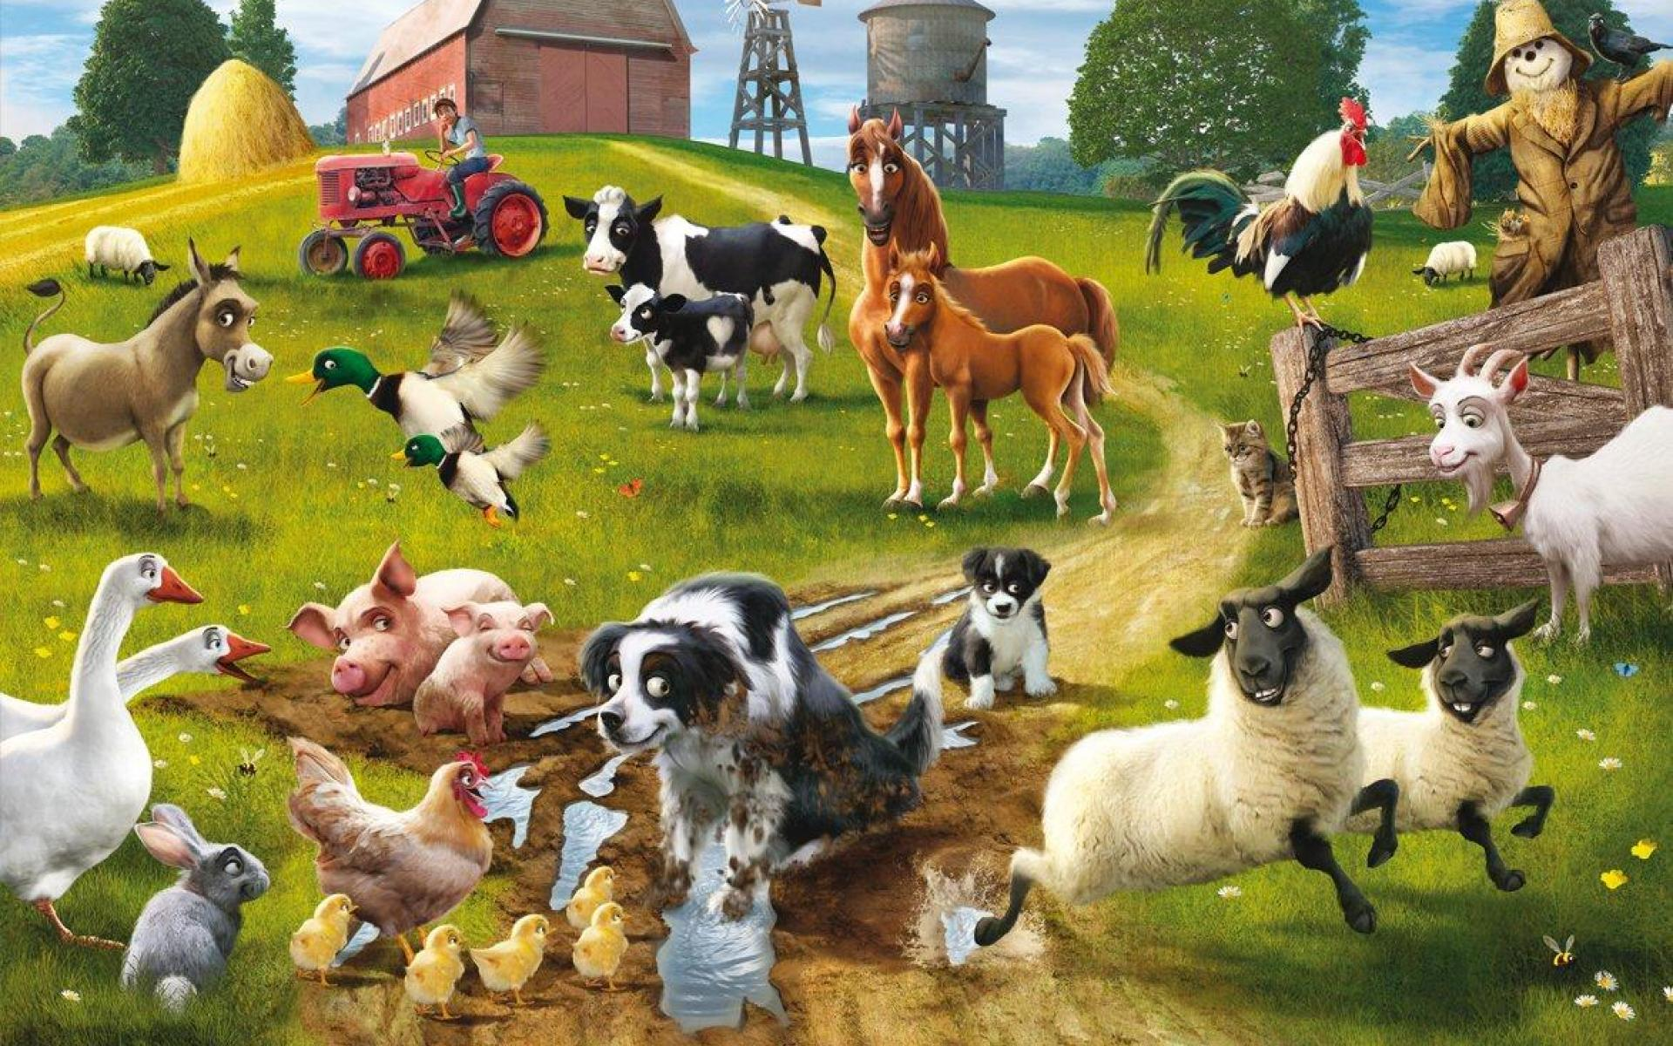
A cock
A cow
A duck
A horse
A cat
A goat
A pig
A goose
A dog
A hen
Sheep
A rabbit
Chicks

Slide 6
Let’s have a rest!

Slide 7

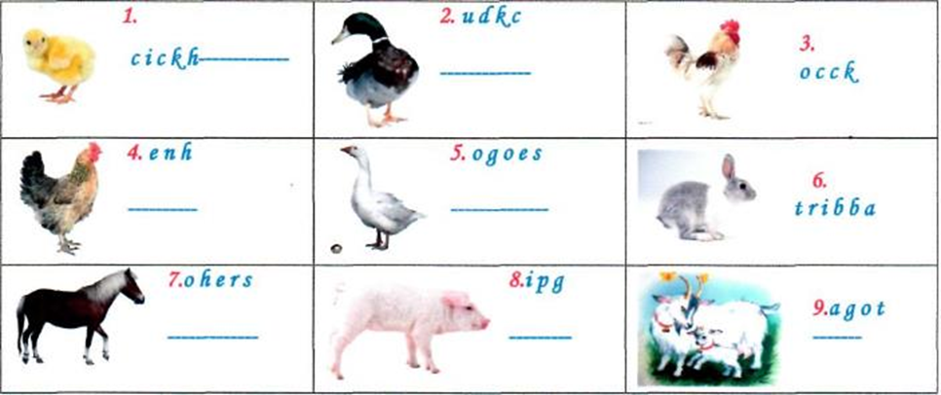
Гра "Jumbled letters"
Chick
Cock
Duck
Goat
Goose
Hen
Horse
Pig
Rabbit

Slide 8
P | G | О | A | T | U | P | F | G | G
I | F | C | О | W | P | I | D | J | O
G | D | J | A | F | A | G | О | U | O
В | V | S | H | E | E | P | G | K | S
В | B | E | H | О | R | S | E | D | E
I | N | N | G | О | О | S | E | L | P
T | M | F | F | D | U | C | K | B | O

Slide 9
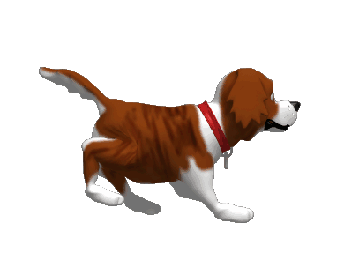
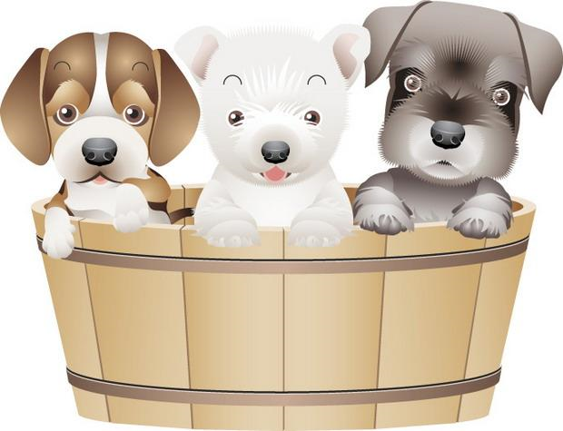
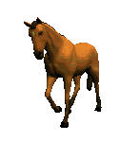
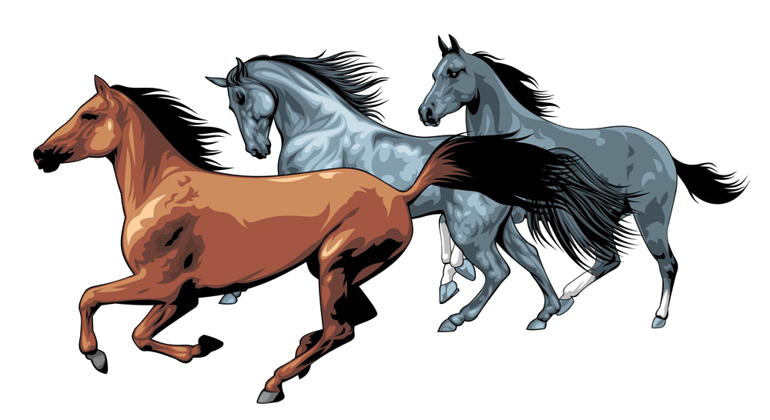
A dog
Dogs
Horses
A horse

Slide 10
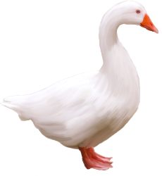
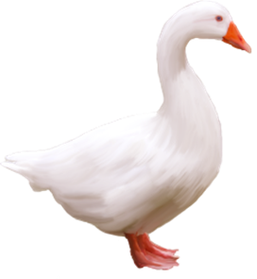
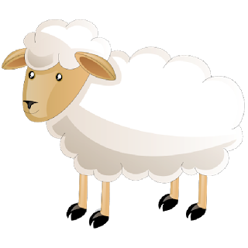
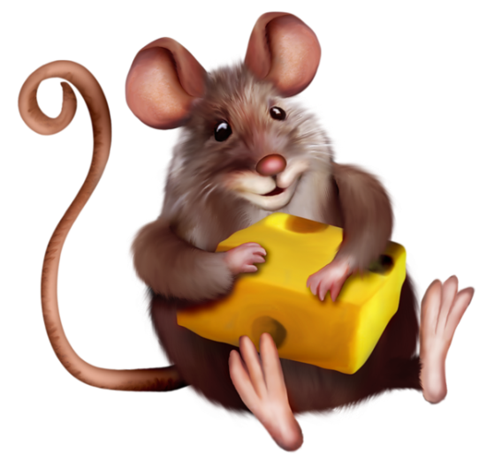
A goose - geese
A sheep - sheep
A mouse - mice

Slide 11
On Grandpa`s farm
farmer
horses
hens
goats
chicks
rabbits
pigs

Slide 12

Well Done!

