Slide 1


WELCOME TO OUR ENGLISH LESSON!

Slide 2


Slide 3
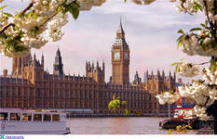
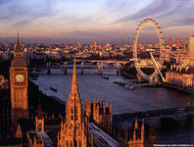
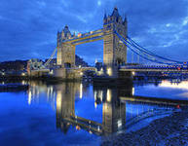
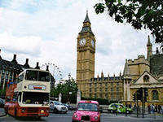
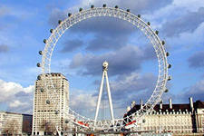
London

Slide 4
Thursday, the fourteenth of April
London. The places of interest

Slide 5
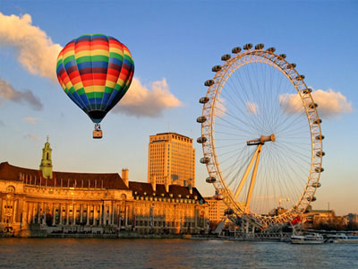

Slide 6
Museum
Bridge
Castle
Clock
Palace
Wheel
Queen
Square

Slide 7
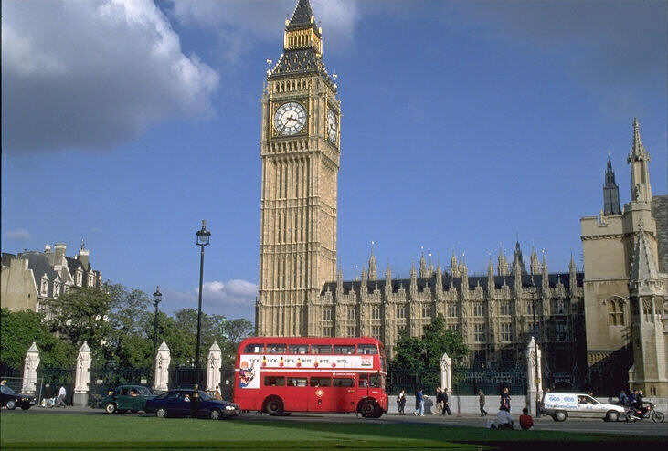
Big Ben

Slide 8
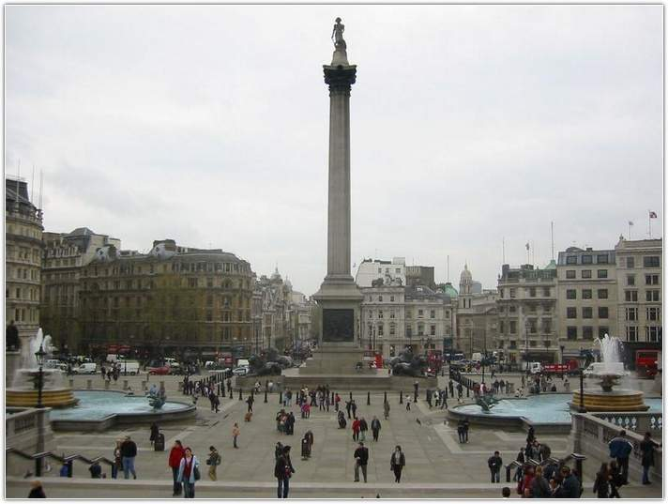
Trafalgar Square

Slide 9
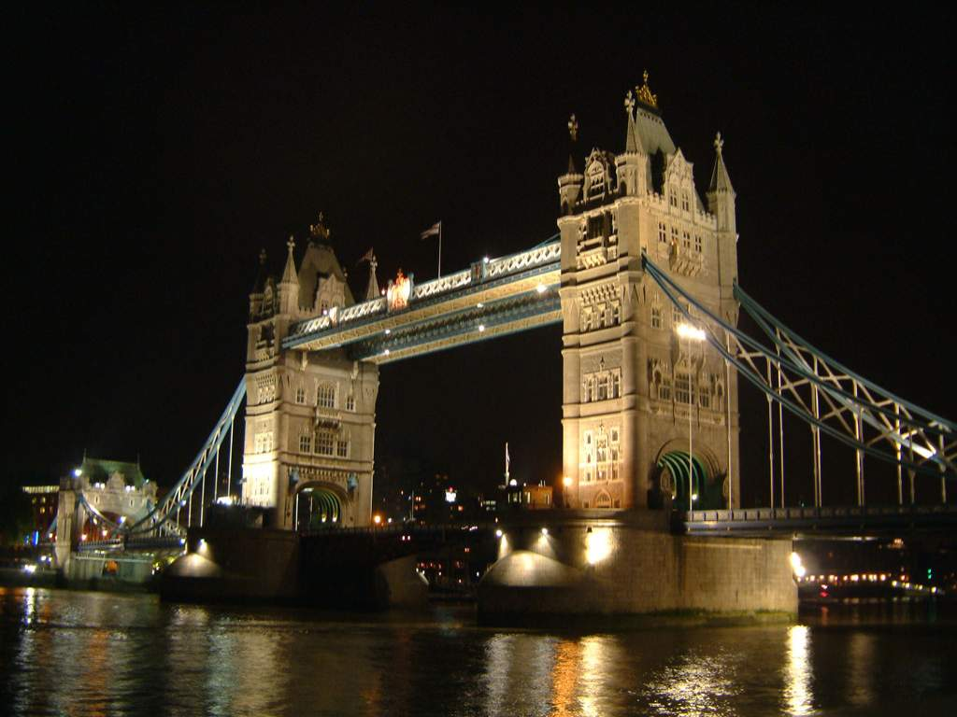
Tower Bridge

Slide 10
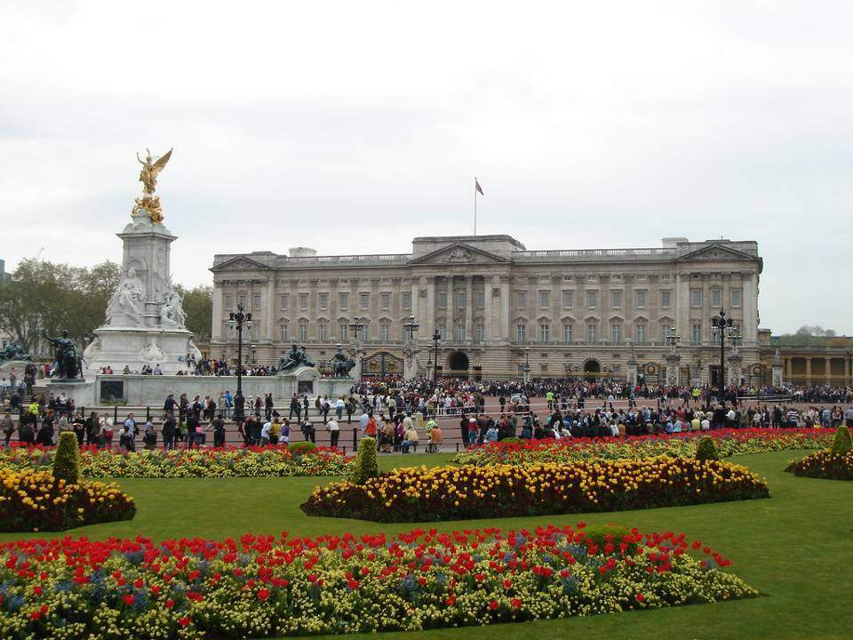
Buckingham Palace

Slide 11
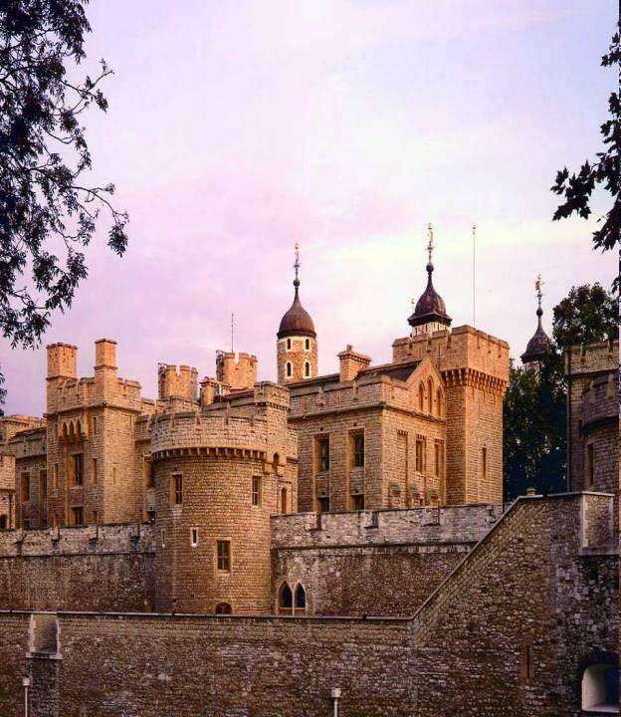
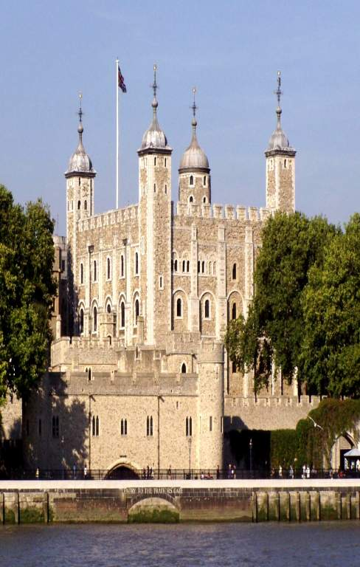
Tower of London

Slide 12
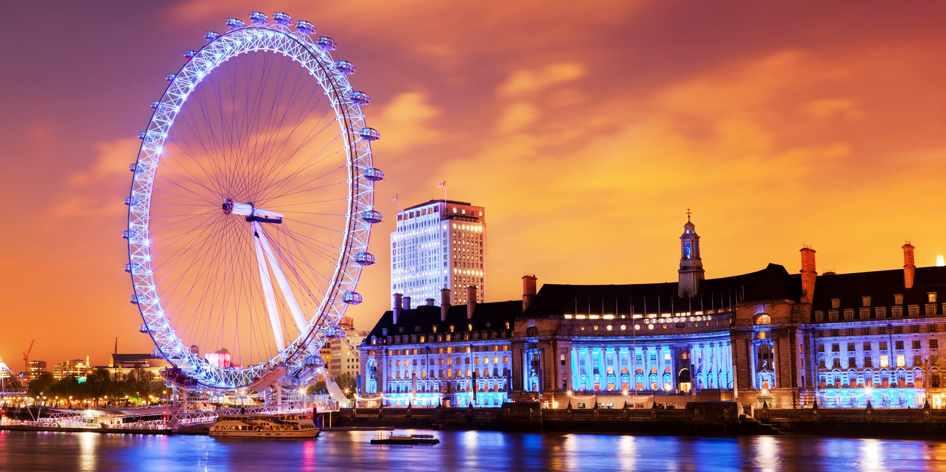
The London Eye

Slide 13
Hamleys ['hæmlɪz] Хамліз
More than [mɔː ðæn ] більш ніж
Thousand [ˈθaʊz(ə)nd] тисяча
Toyshop [ˈtɔɪʃɒp] магазин іграшок
Madame Tussaud’s[məˈdɑːm təˈsɔːdz]
Мадам Тюссо
Waxwork[ˈ wækswɜːk] воскова фігура
A lot of – багато
Regent’s park [ˈriːdʒ(ə)nt] парк Ріджентс

Slide 14
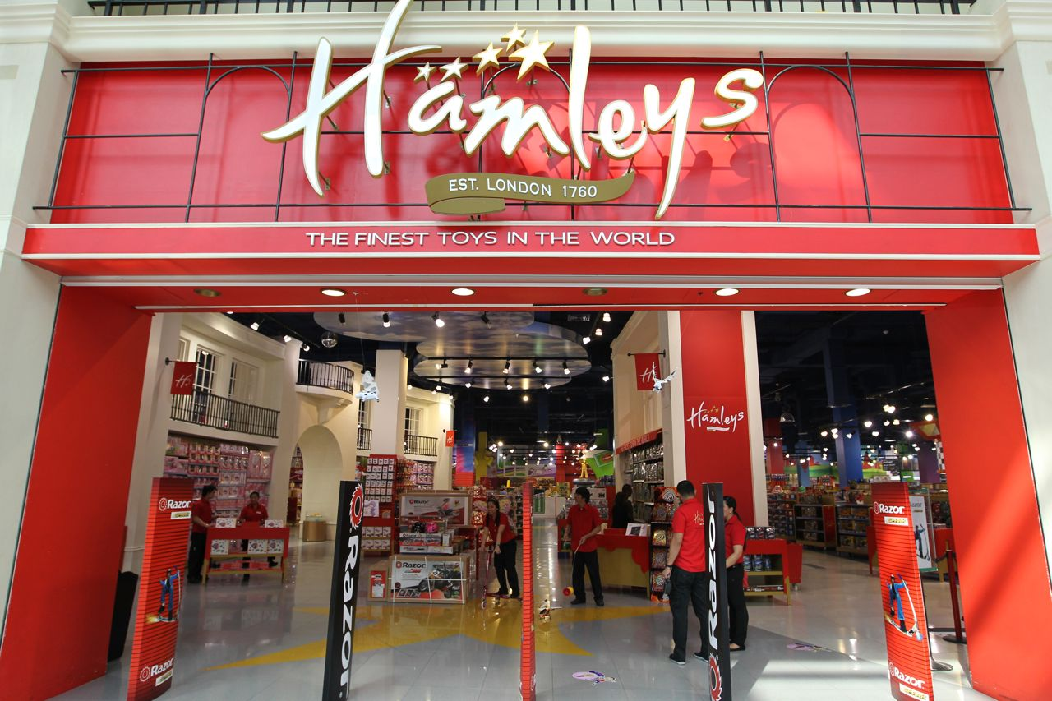
Hamleys is the biggest toyshop in London. There are more than 50,000 toys.

Slide 15
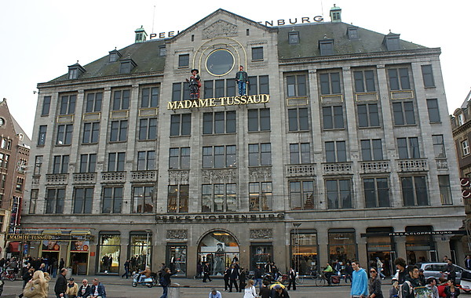
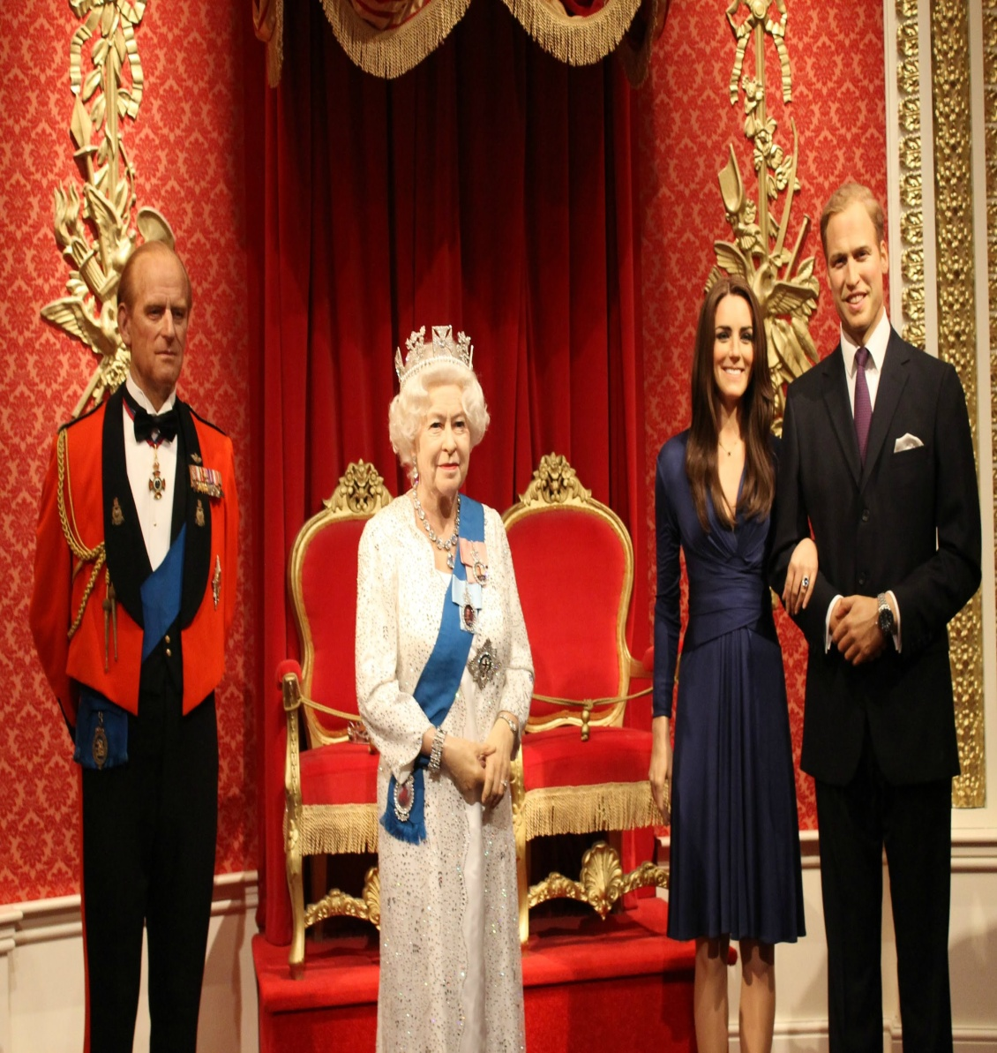
Madam Tussaud’s is the most famous waxwork museum. There are wax models of the famous people.

Slide 16
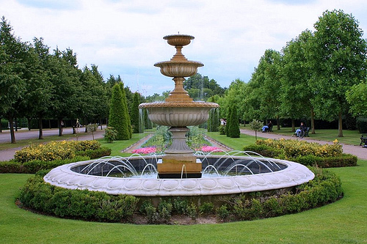
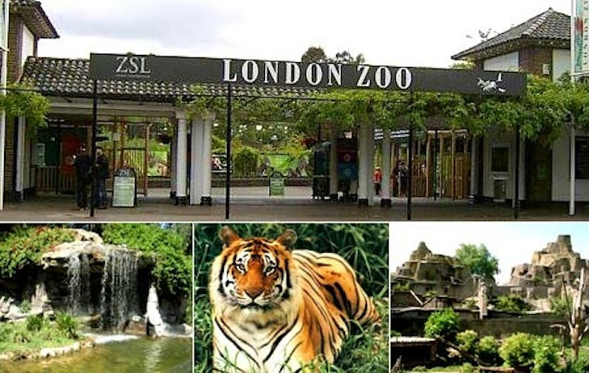
There are a lot of parks in London. But Regent’s Park is the most famous. There is a Zoo.

Slide 17

Pair work

Slide 18
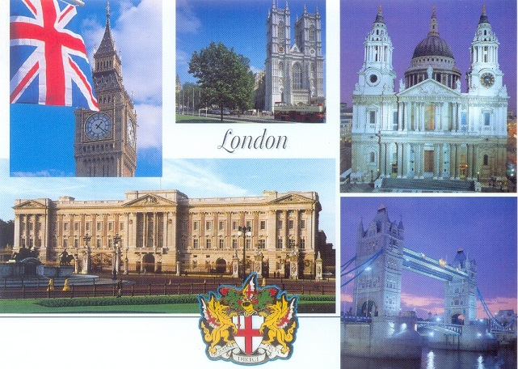
London Quiz

Slide 19
1. Big Ben is ….
a)a bridge
b)a museum
c)a clock

Slide 20
2. Hamleys is …
a castle
a toyshop
a clock

Slide 21
3. The London Eye is…
a wheel
a palace
a shop

Slide 22
4.Madam Tussaud’s is…
a wheel
a clock
a museum

Slide 23
5. The Tower of London is…
a museum
a park
a clock

Slide 24

Puzzle

Slide 25
London

Slide 26
I want to see … because…

Slide 27


