Slide 1
My house.
The rooms of my house.

Slide 2
Objectives:
Practical: - to revise and practice lexical units by pupils on the theme “A doll’s house!”;
- to develop speaking, listening, writing, reading skills;
- to introduce and identify parts of house/furniture, colours;
- to identify position of objects;
- to practice structure “There is/are”;
- to revise grammar (articles a/an, the verb to be, prepositions of place in, on, under).
Educational: - to get pupils involved in conversation about parts of house/furniture;
- to increase pupils’ knowledge about parts of house/furniture.
Developing: - to develop pupils’ outlook about parts of house/furniture;
- to develop theatrical pedagogy.

Slide 3
Phonetic warm-up

Slide 4
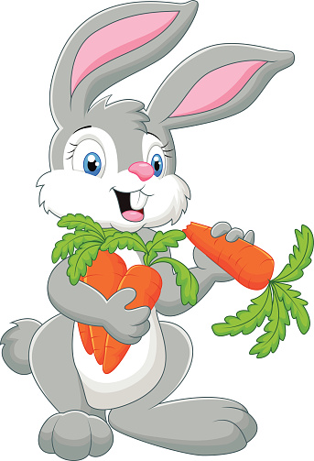
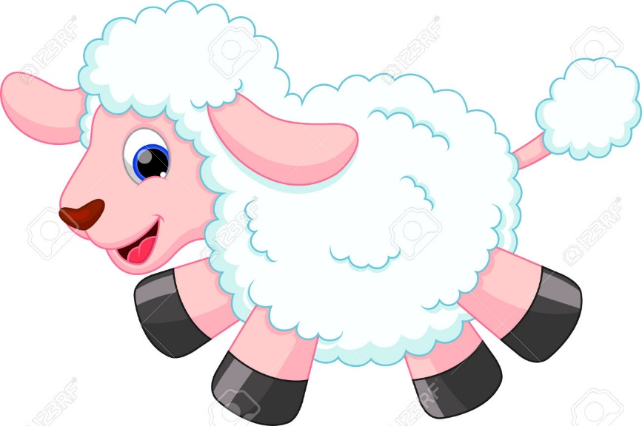
sheep
rabbit

Slide 5
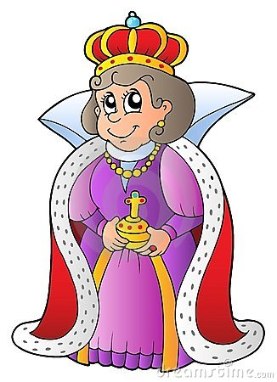

balloon
queen

Slide 6


teacher
pupil

Slide 7

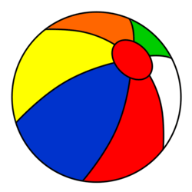
kite
ball

Slide 8
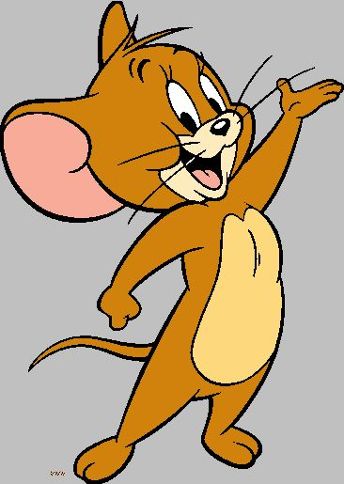

mouse
cheese

Slide 9
Warming up

Slide 10
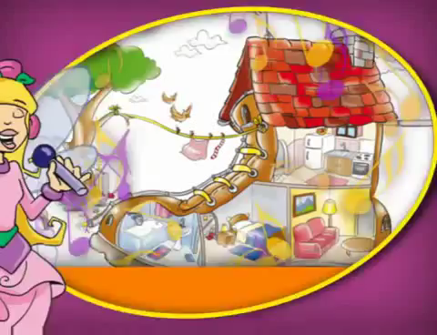

Slide 11
Listening

Slide 12


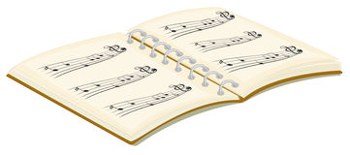
Dialogue 1

Slide 13
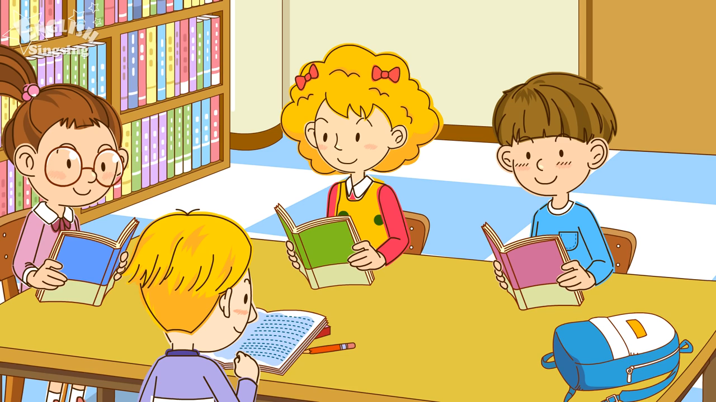

Slide 14

Dialogue 2

Slide 15
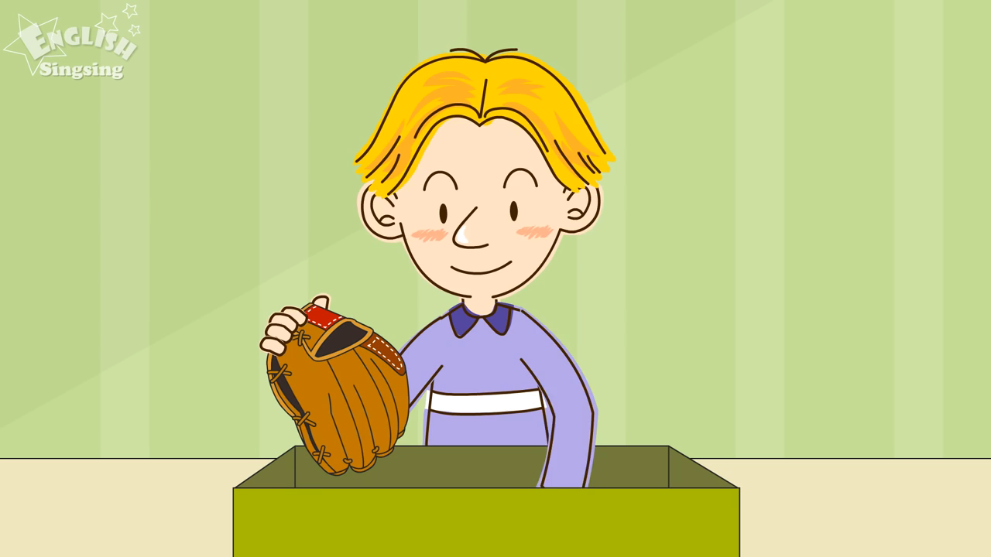

Slide 16

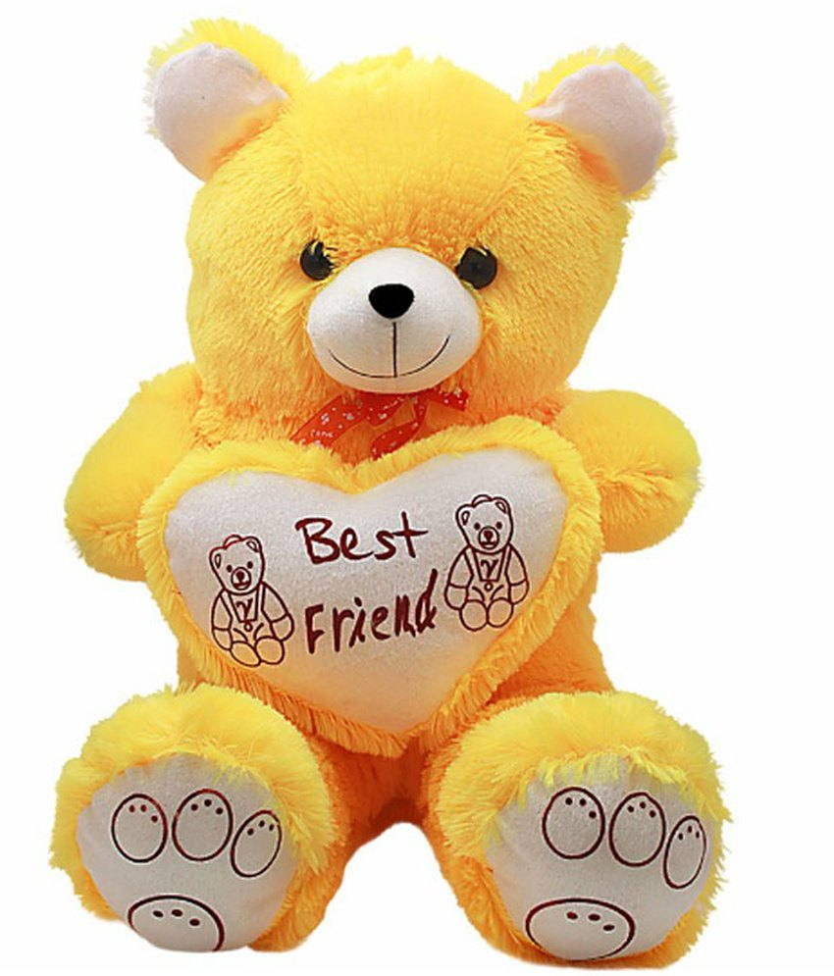
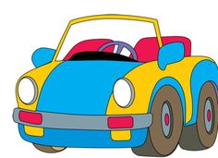
Dialogue 3

Slide 17
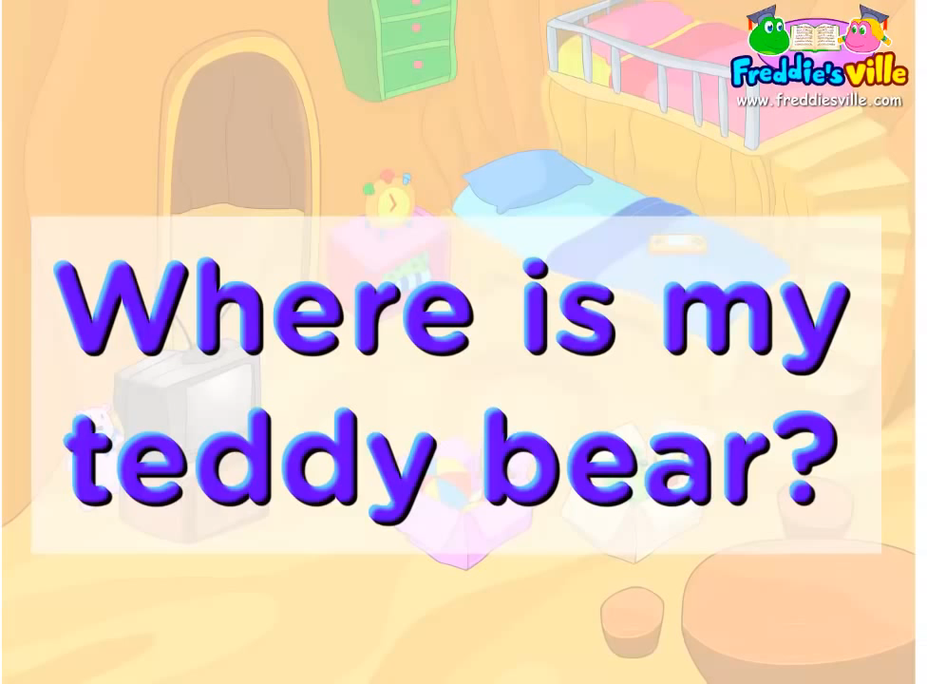

Slide 18
Answer the questions
Where is the music book?
Where is the pencil?
Where is the cap?
Where is the teddy bear?
Where is the robot?
Where is the toy car?

Slide 19
Physical training

Slide 20





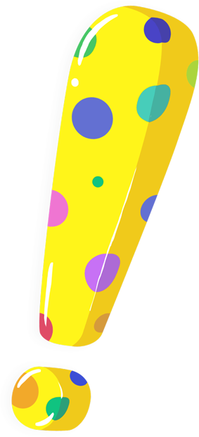

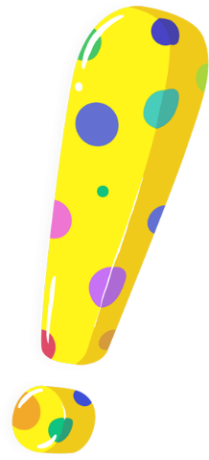




Grammar

Slide 21




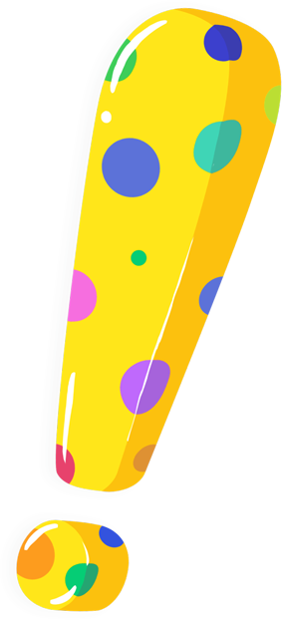


the verb “to be”
I – am they - are
he – is we - are
she – is you - are
it – is

Slide 22



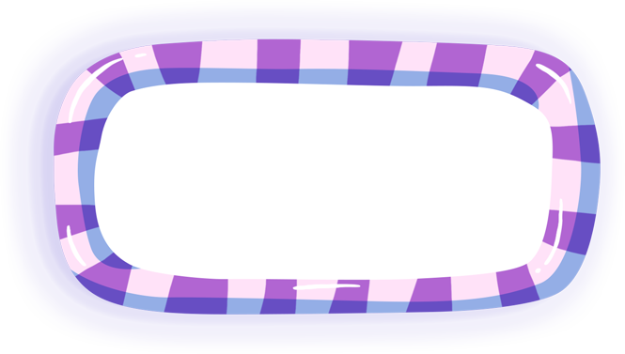



Structure
“There is/are”
Articles a/an

Slide 23
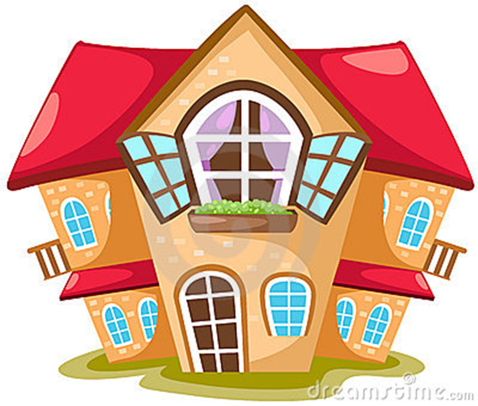
Role play

Slide 24
Have a nice day!
Good bye!

