Slide 1
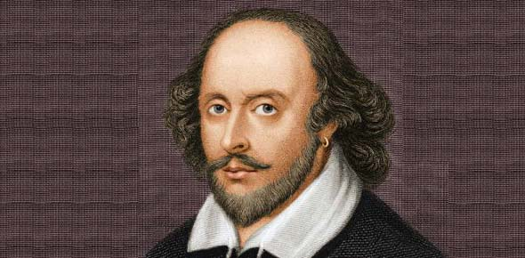
WILLIAM SHAKESPEARE
QUIZ
by Iryna Lesko

Slide 2
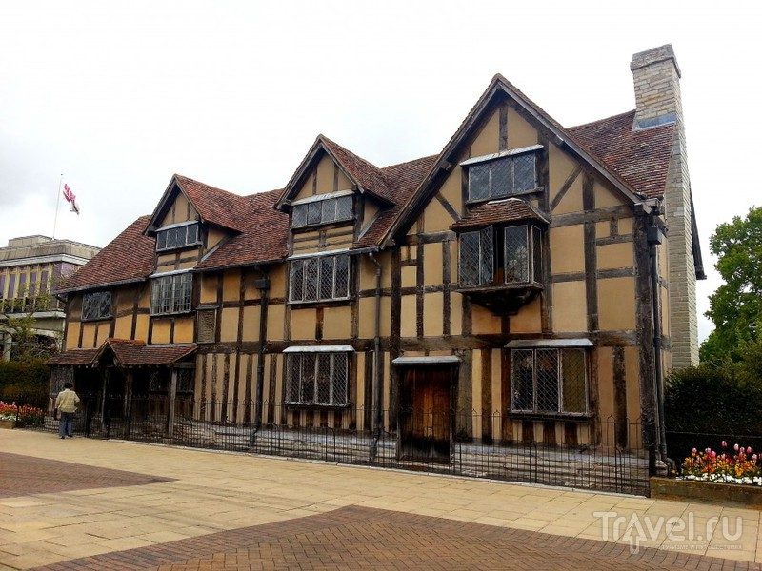
When was William Shakespeare born?
1654
Try Again
1564
Great Job!

Slide 3
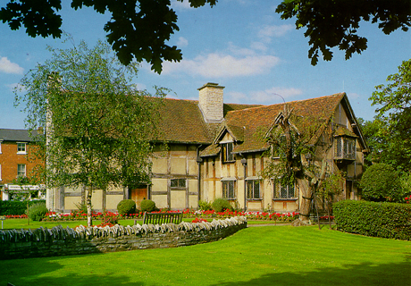

Slide 4
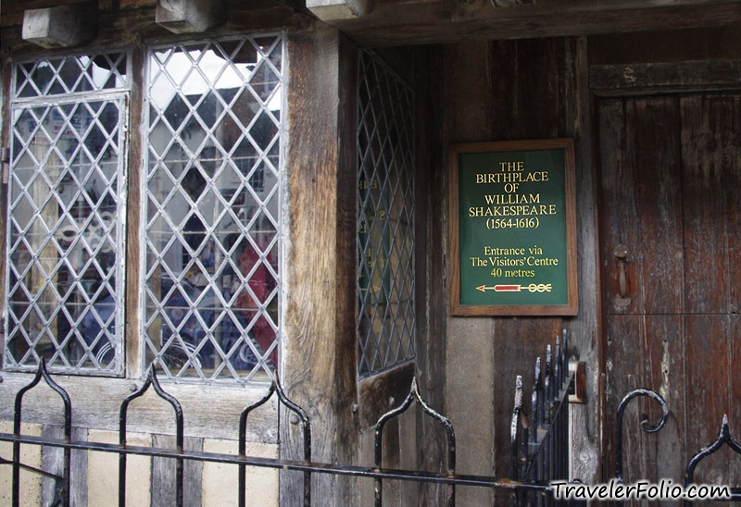
Where was William Shakespeare born?
Stratford-upon-Avon
Great Job!
London
Try Again

Slide 5
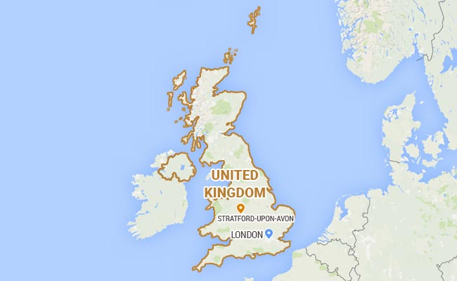

Slide 6
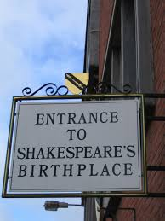
Nowadays the birthplace of
Willim Shakespeare is …
A museum
Great Job!
A hotel
Try Again

Slide 7
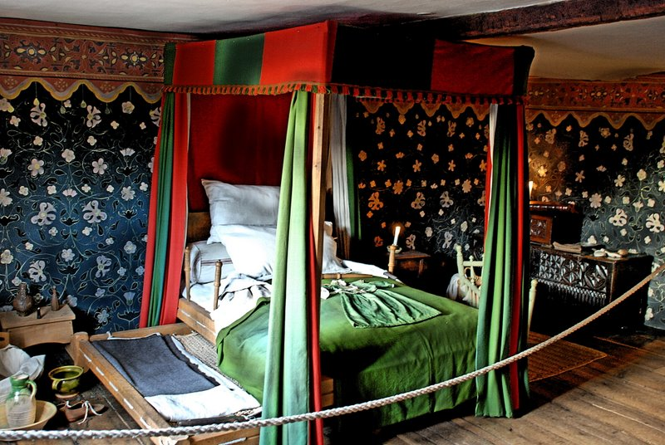

Slide 8
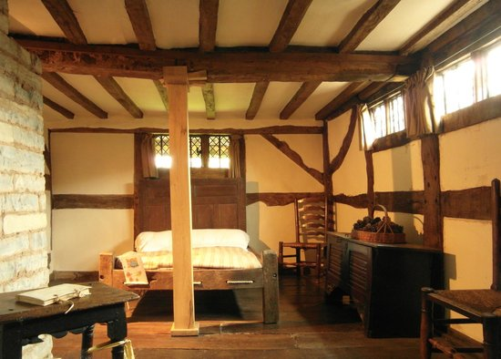

Slide 9
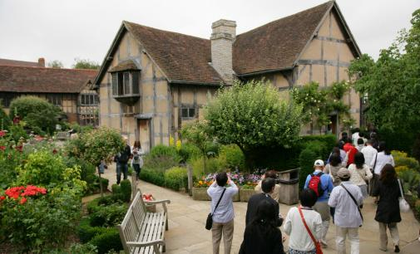

Slide 10
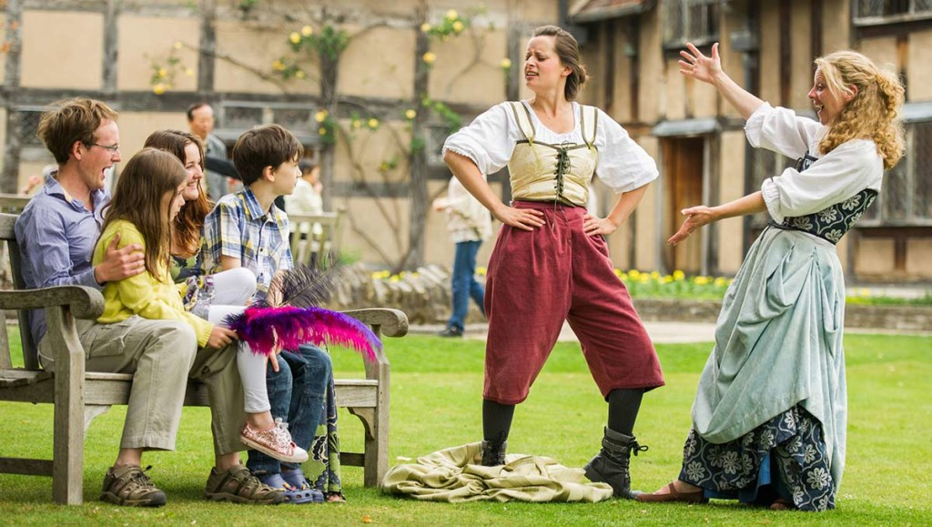

Slide 11
How many sonnets did Shakespeare write?
145
Try Again
154
Great Job!

Slide 12
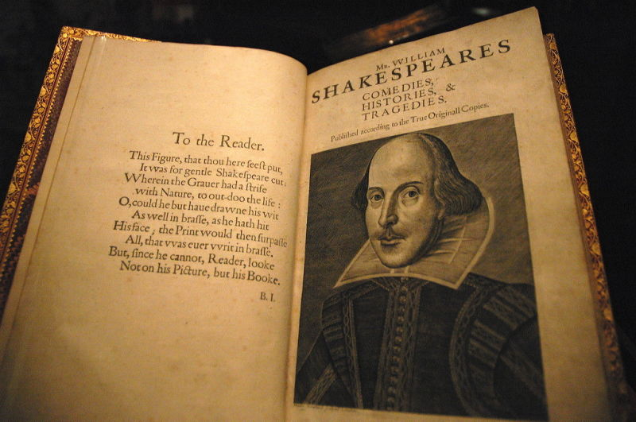

Slide 13
How many plays did
Shakespeare write?
154
Try Again
38
Great Job!

Slide 14
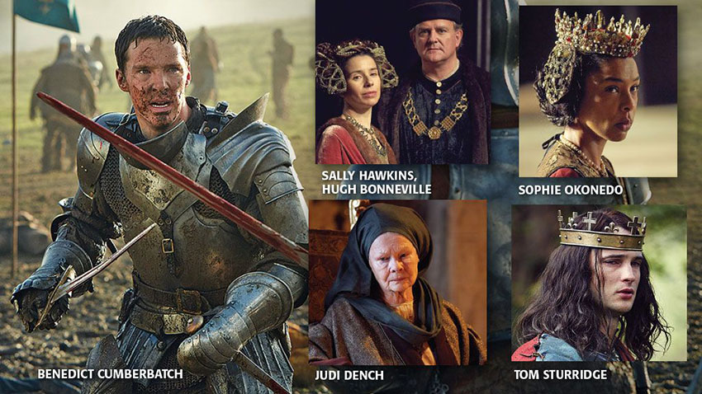

Slide 15
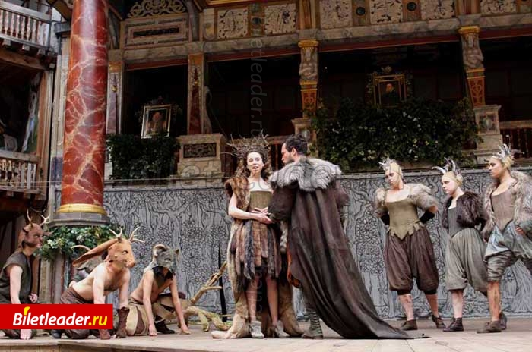

Slide 16
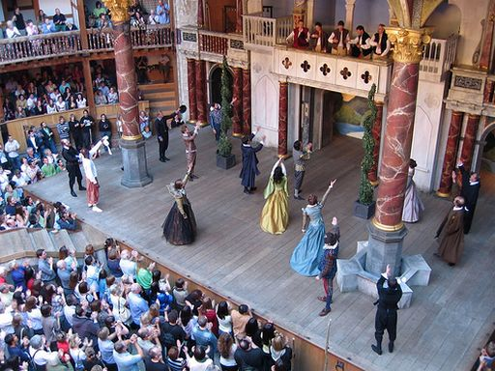

Slide 17
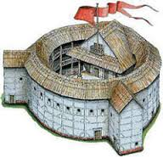
Shakespeare called his theatre …
“Hamlet”
Try Again
‘The Globe’
Great Job!

Slide 18
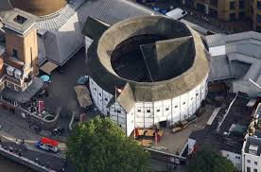
Nowadays many tourists visit this unusual theatre

Slide 19
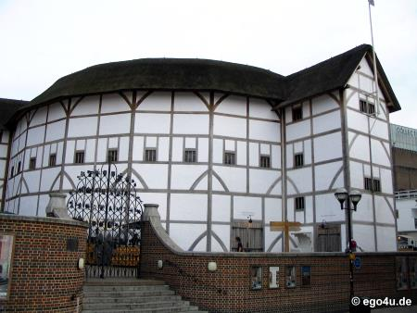

Slide 20
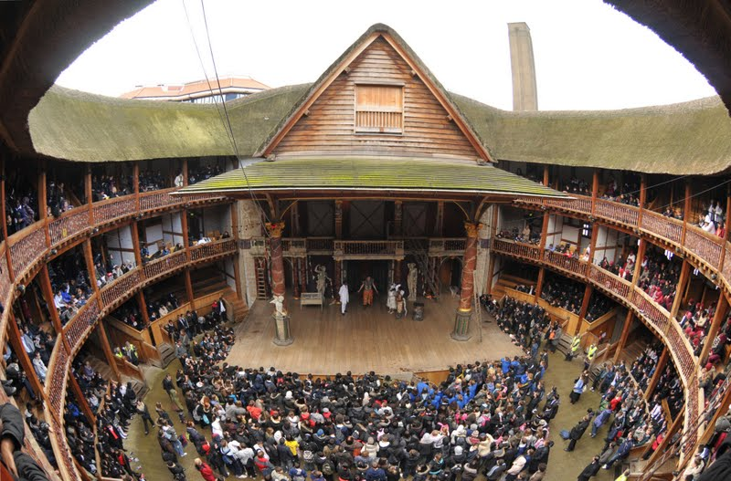

Slide 21
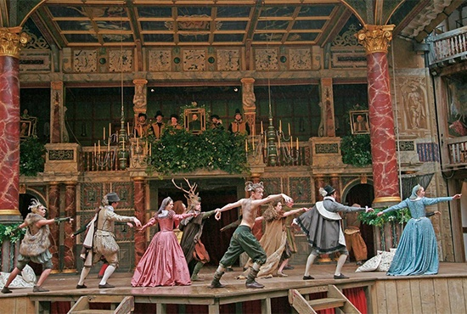

Slide 22
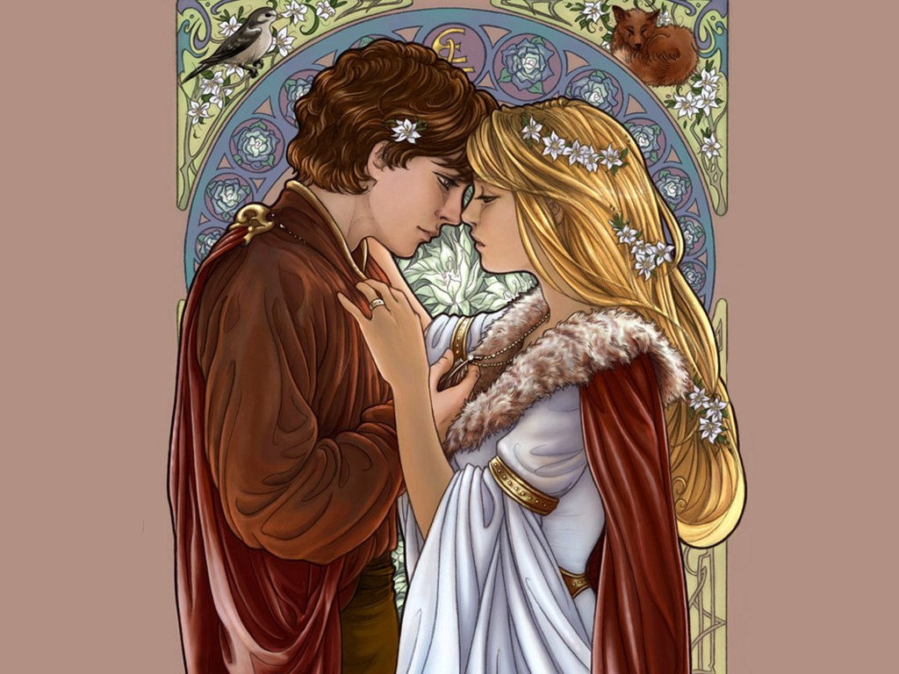
“Romeo and Juliet” is …
A tragedy
Great Job!
A comedy
Try Again

Slide 23
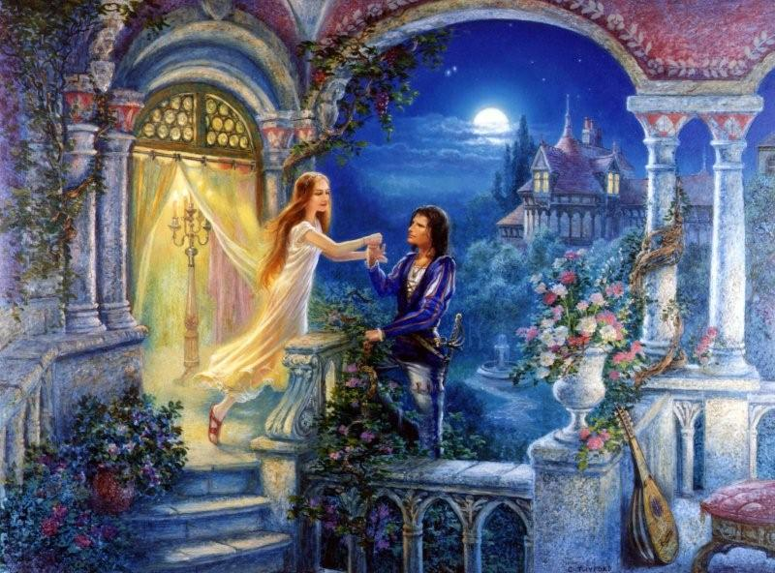
This play inspired a lot of artists …

Slide 24
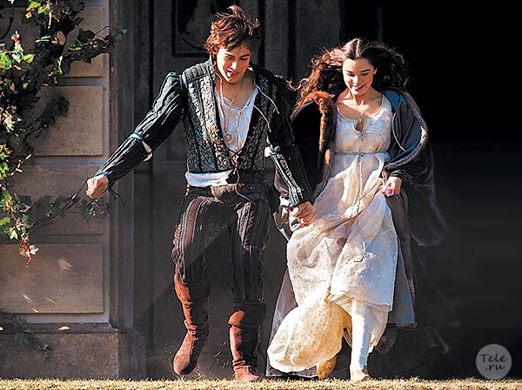
modern directors…

Slide 25
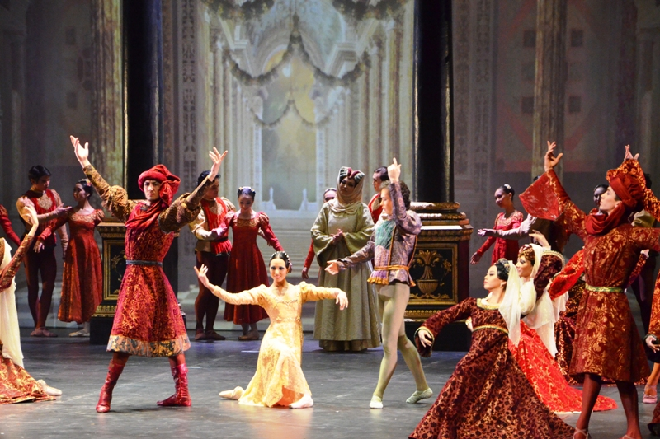
and dancers…

Slide 26
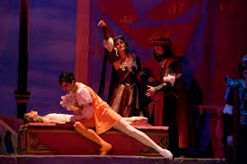

Slide 27
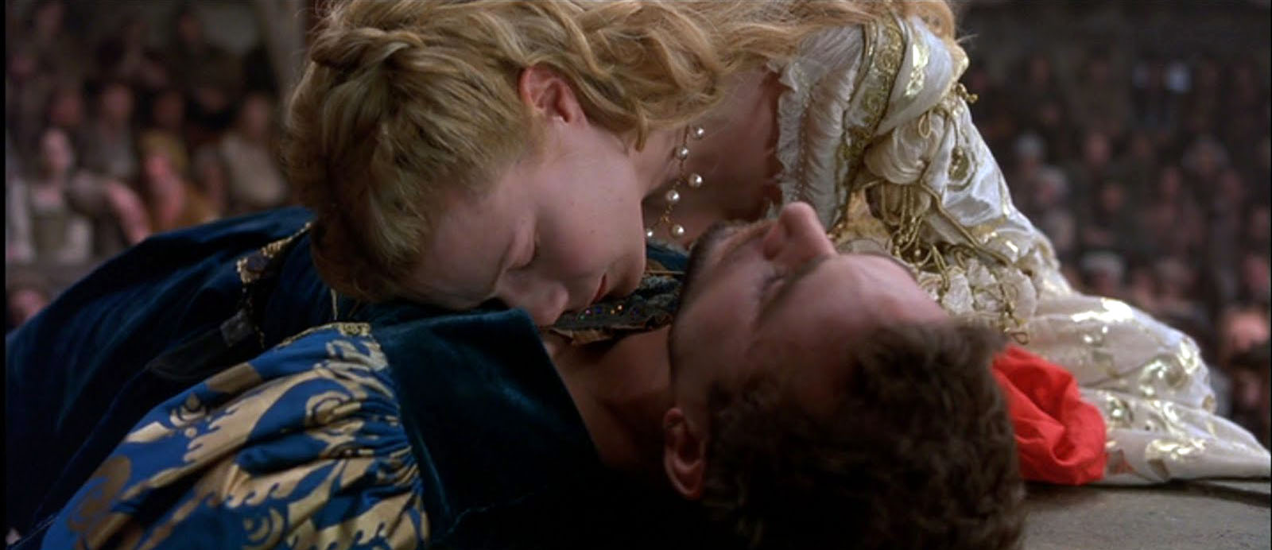

Slide 28
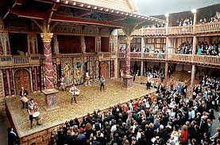
All the part s in Shakespearian plays were acted by …
Men and boys
Great Job!
Women and girls
Try Again

Slide 29
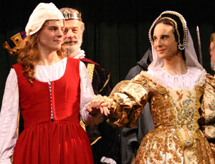

Slide 30
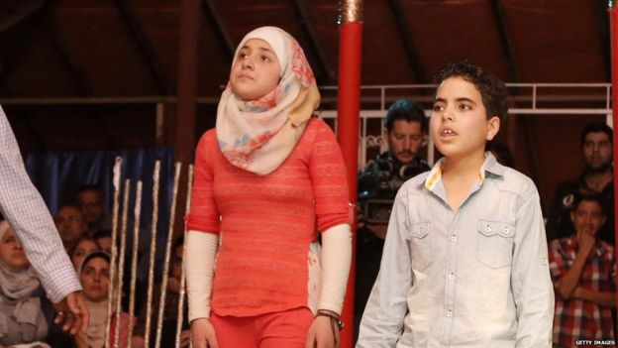

Slide 31
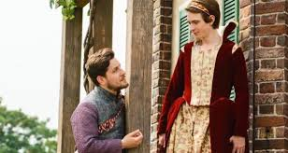

Slide 32
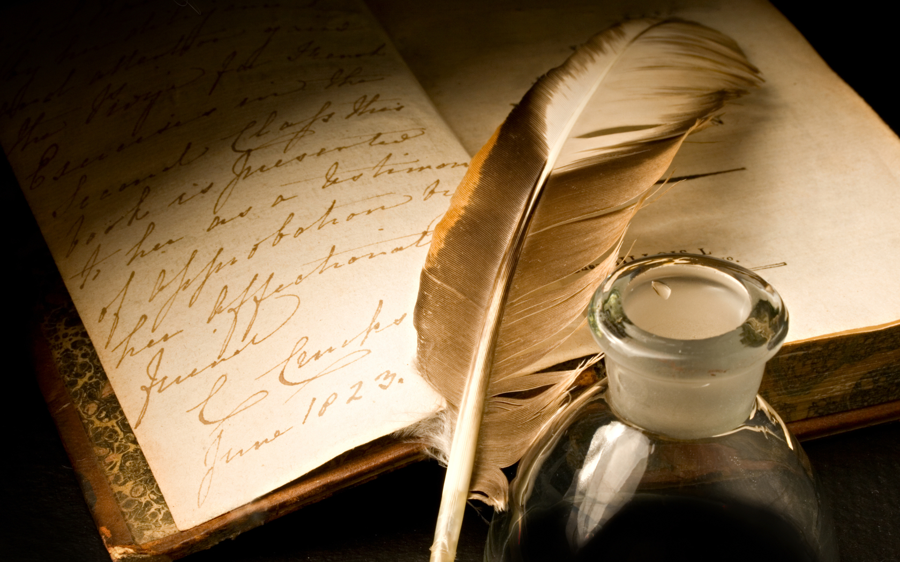
Thank you

