Slide 1
Веселі перерви
у 1 класах

Slide 3
Good morning, good morning,
Good morning to you!
Good morning, good morning,
I am glad to see you!

Slide 5
- Hello, I am Smiley!
- Hello, I am ______!

Slide 9
Aa

Slide 10
ant

Slide 11
Bb

Slide 12
bear

Slide 13
book

Slide 14
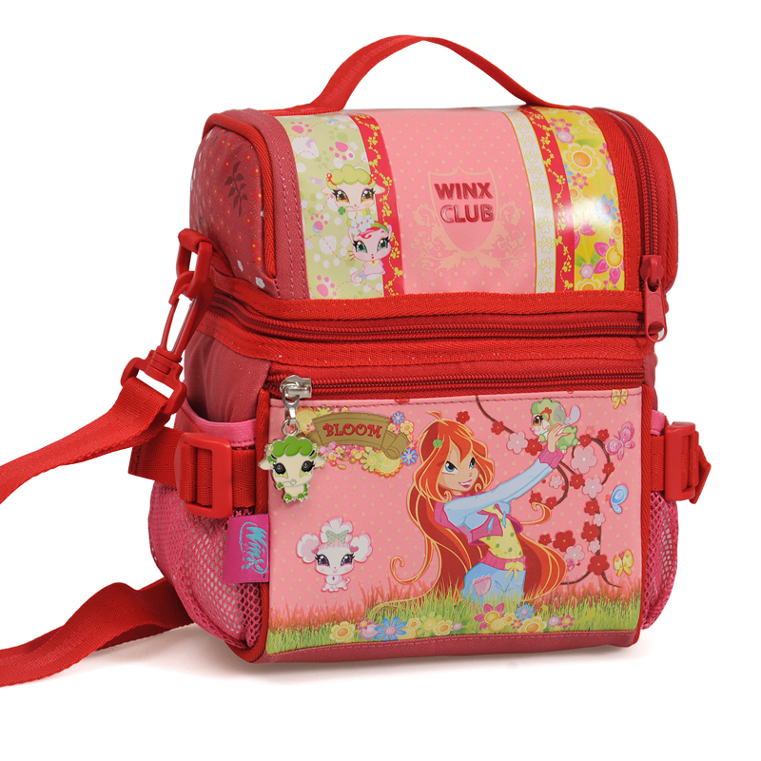
bag

Slide 15
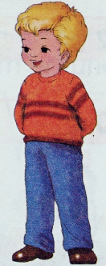
brother

Slide 16
ball

Slide 17
Cc

Slide 18
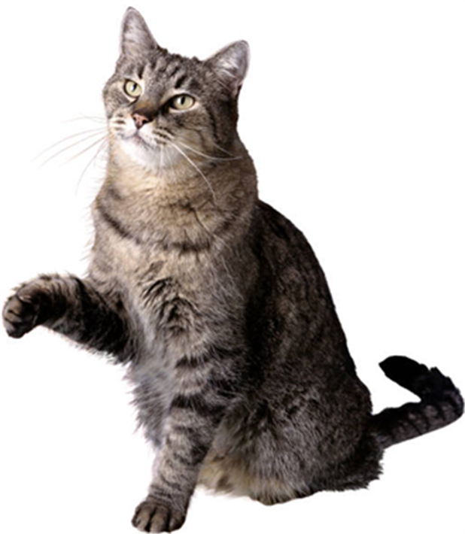
cat

Slide 19
Christmas Tree

Slide 20
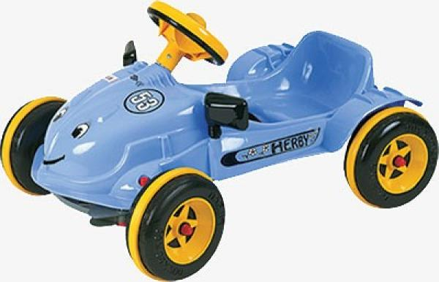
car

Slide 21
Dd

Slide 22
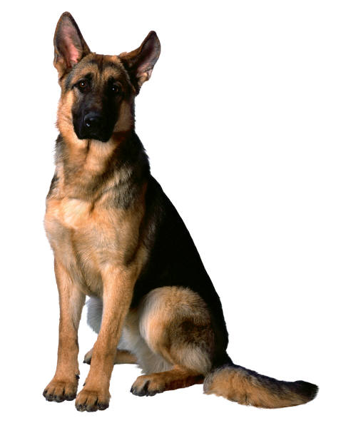
dog

Slide 23
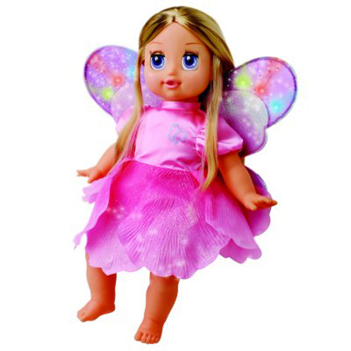
doll

Slide 24
Ee

Slide 25
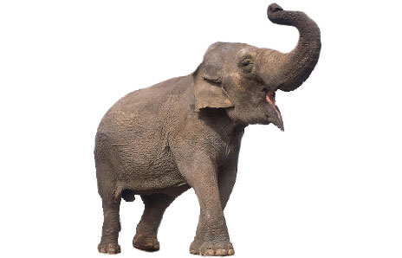
elephant

Slide 26
Ff

Slide 27
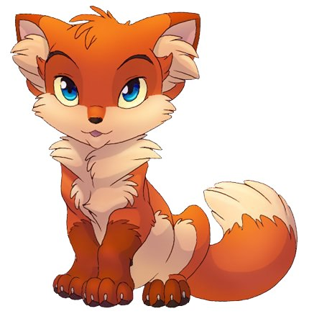
fox

Slide 28
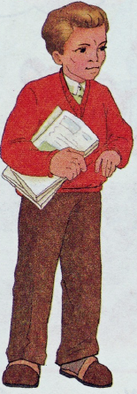
father

Slide 29
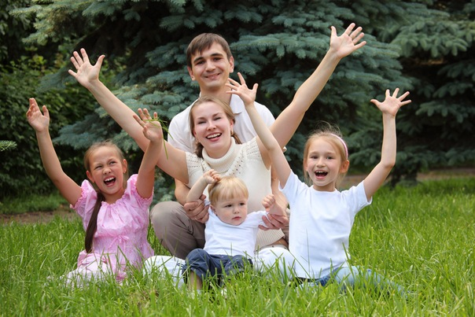
family

Slide 30
Gg

Slide 31
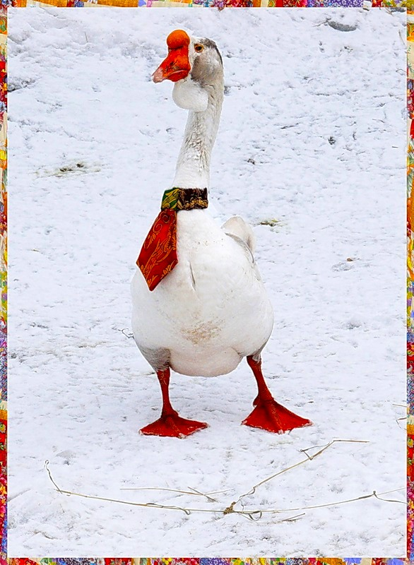
goose

Slide 32
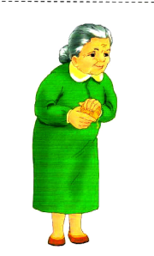
Grandmother

Slide 33
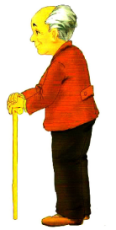
Grandfather

Slide 34
Hh

Slide 35
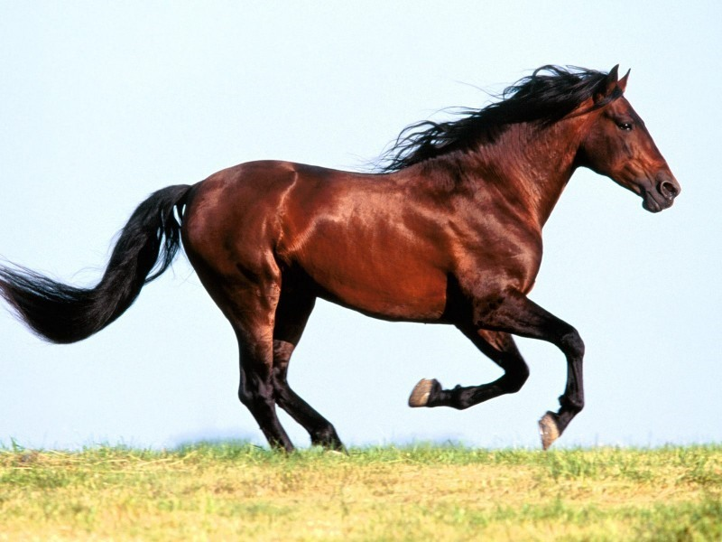
horse

Slide 36
Ii

Slide 37
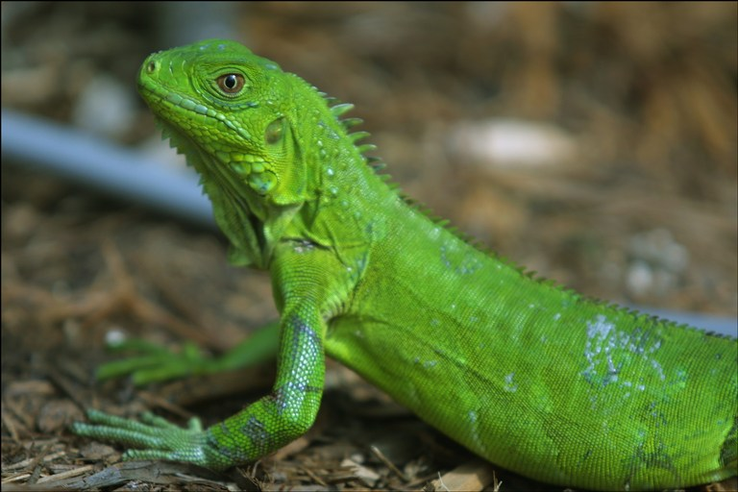
iguana

Slide 38
Jj

Slide 39
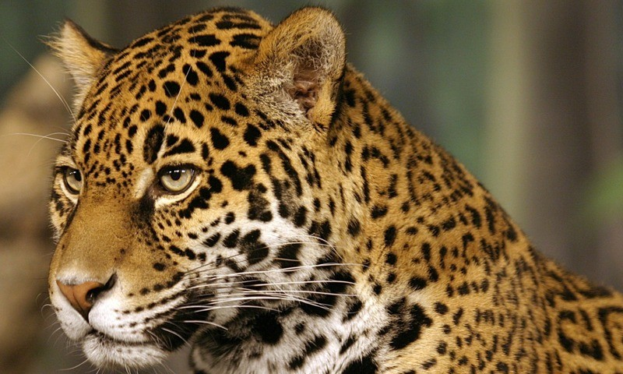
jaguar

Slide 40
Kk

Slide 41
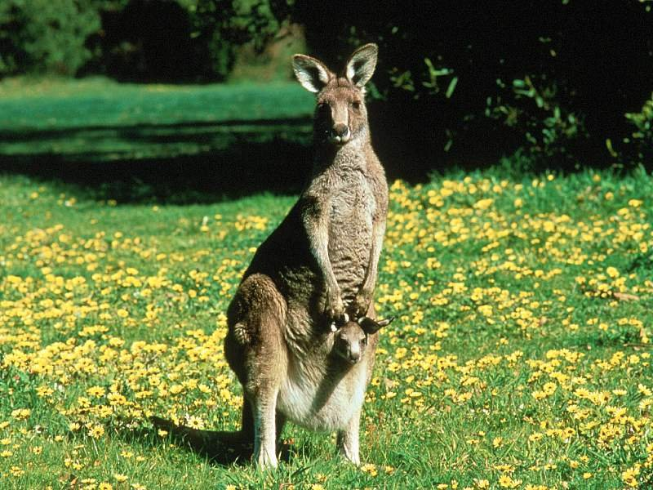
kangaroo

Slide 42
Ll

Slide 43
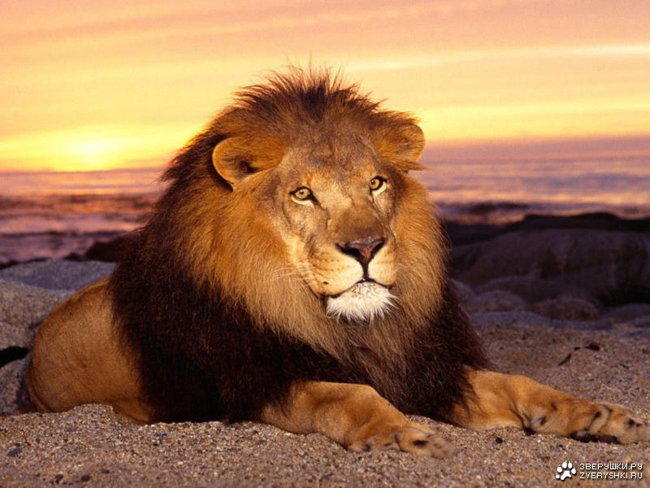
lion

Slide 44
Mm

Slide 45
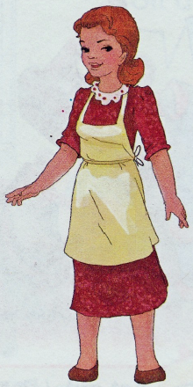
Mother

Slide 46
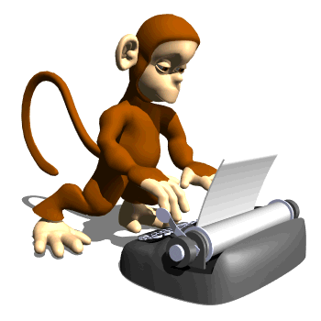
monkey

Slide 47
Nn

Slide 48
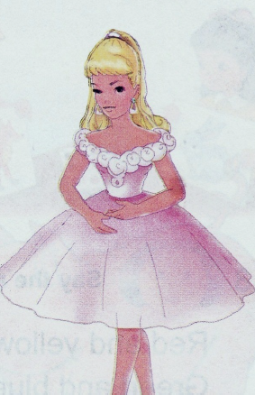
Nina

Slide 49
Oo

Slide 50
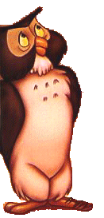
owl

Slide 51
Pp

Slide 52
pencil

Slide 53
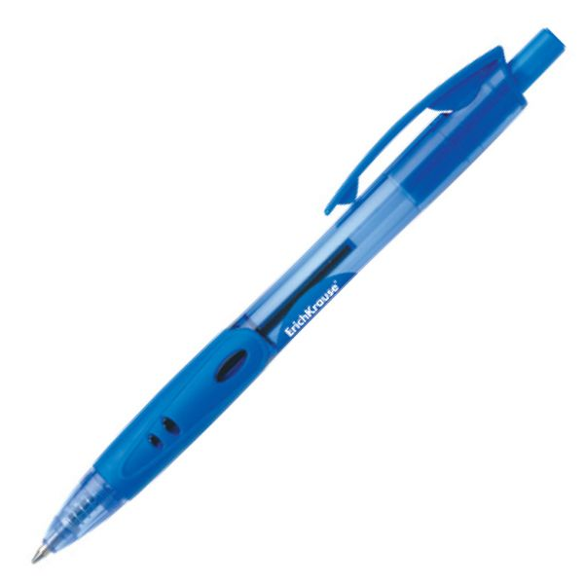
pen

Slide 54
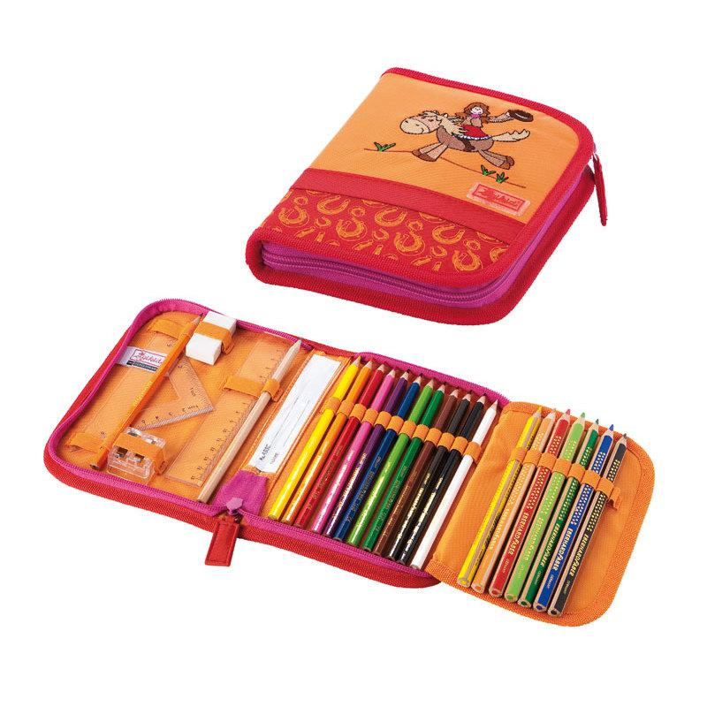
pencil-box

Slide 55
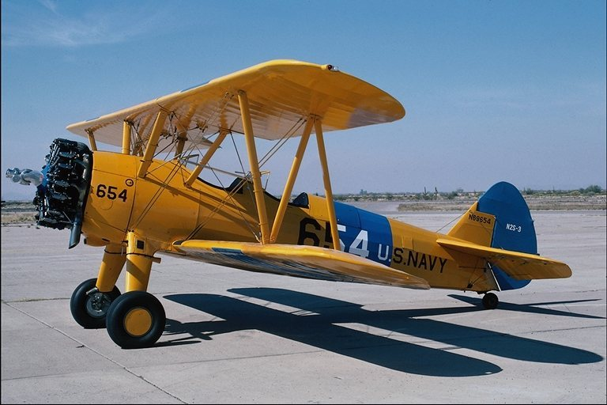
plane

Slide 56
pig

Slide 57
Qq

Slide 58
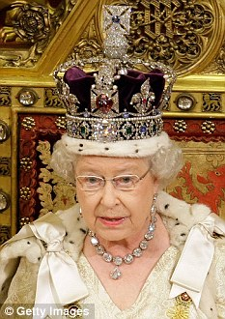
Queen

Slide 59
Rr

Slide 60
rabbit

Slide 61
What is this?- This is a __.

Slide 64
Good-bye!

