Slide 1

Healthy lifestyle

Slide 2

The 1st station –Healthy Food;
The 2nd station – Physical Activities and Personal Care;
The 3rd station – A Consultation of the Doctor.

Slide 3

Health is better…
Early to bed, early to rise …
An apple a day …
A sound mind …
Eat with pleasure…

Slide 4

We ... drink water.
We... eat fast or junk food.
We ... eat a lot of sugar.
We ... prepare food ourselves at home.
We ... eat at night.
We ... eat at least three times a day.
We... drink cold water.
We ... keep to a diet.
We ... drink much lemonade.
We ... eat vegetables and fruit.

Slide 5
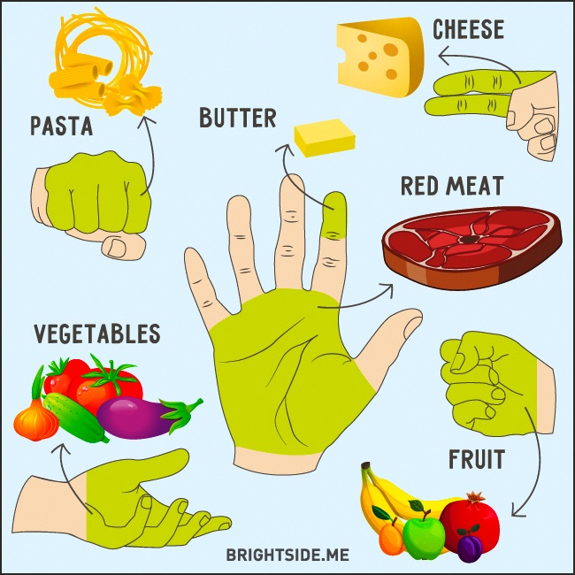


Slide 6

Past Perfect Tense :
1. Jane/looked/wonderful/after/she/to lose/a few kilos.
2. I/to arrange/my visit to the gym/the day before.
3. Tom /to injure/his leg/so /he /not skate /yesterday
4. I/ to lose /so much weight/ because /I/ to begin/ exercising
5. Kate / never/to play/ tennis/ until/ last week.
6.Linda / to want/ a ball/ but/ she/ to receive/ a book.
7. She/to hope/ that/ I/to do/ morning /exercises.
8. He/ to understand/ that/they/ to win / the match.

Slide 7

“Give it a name”:
1.A person who needs a medical help.
2.A person who gives a medical help.
3.A movable organ in the mouth, used.
4.The front of the neck.
5.A muscular organ that pumps blood through the body.
6.An organ of breathing in the chest of a man.
7.A thing you take to recover.
8.A state of being well.
9.A small object designed for easy swallowing, some sort of medicine.

Slide 8

Disagree and correct the sentences:
1. When I have a disease I go to see a teacher.
2. I broke my nose while I was playing chess.
3. A person is healthy when he has got a high temperature.
4. I had a backache, so I went to the dentist.
5. I took medicine because I was well.
6. I have a sore throat , so I drink cold water.
7. My leg is broken and I can play football.
8. Doctors work at school.

Slide 9

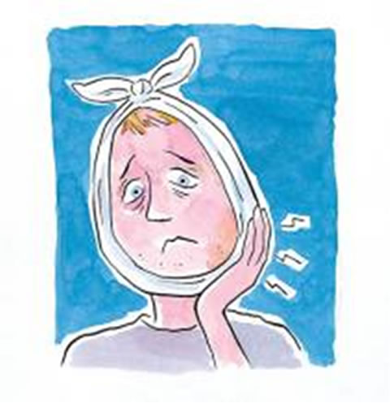
I don`t want to play or to eat sweets. I have a terrible toothache!

Slide 10
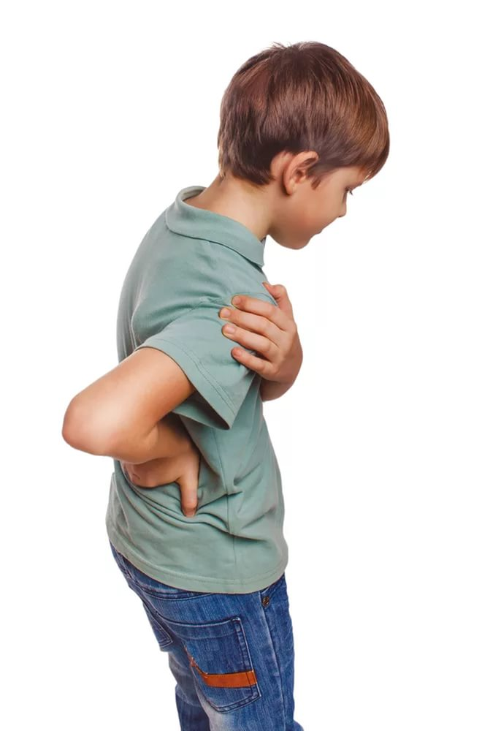

I went to my friend. The road was slippery and I fell down. Now I have a backache.

Slide 11

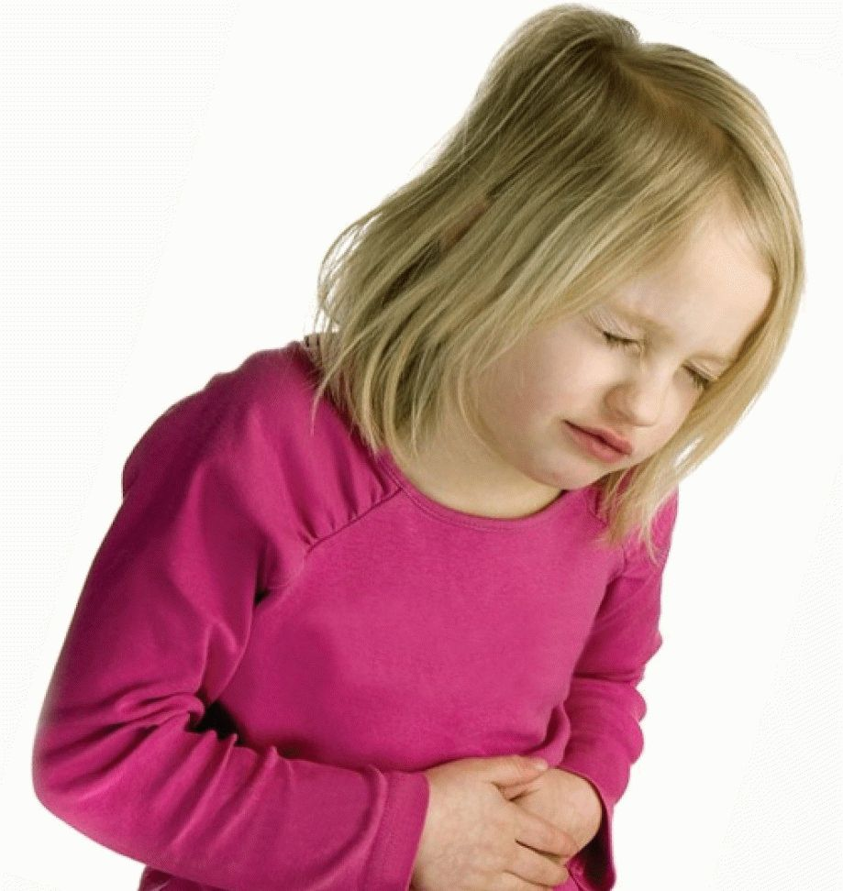
I ate a cake. It was very tasty.
But now I feel that something is wrong with my stomach.

Slide 12
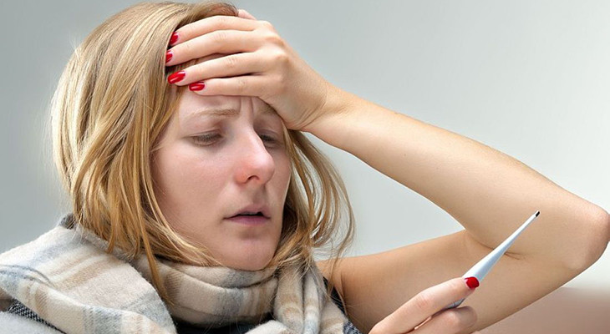

Oh, something is wrong with me!
I have a terrible headache and a running nose!

Slide 13

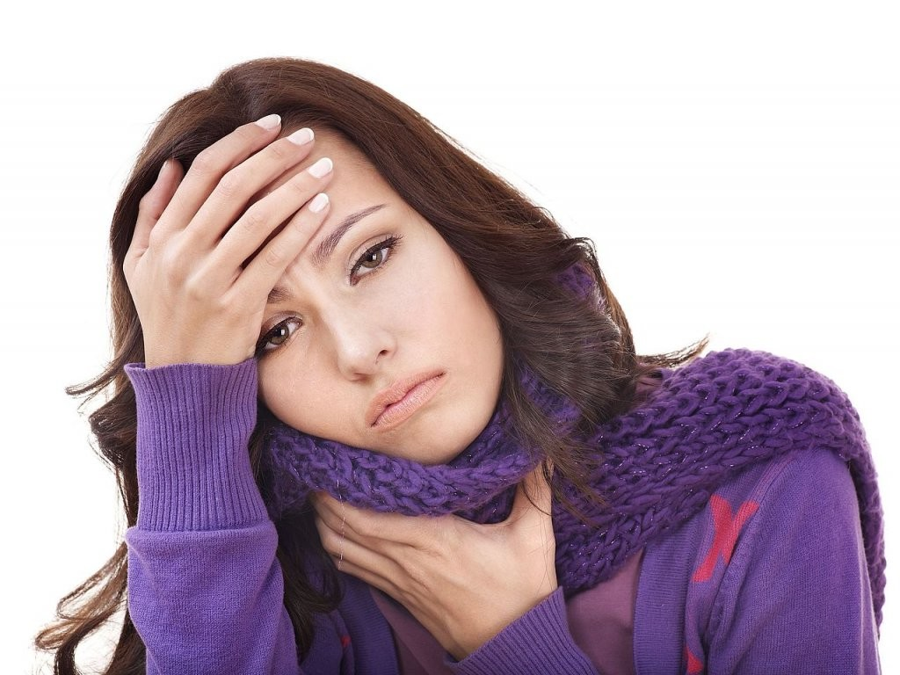
Oh, doctor,
I have a sore throat and a high temperature. Help me!

Slide 14

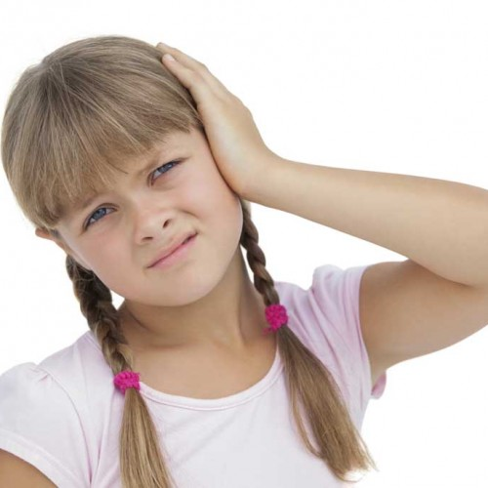
I can hear nothing. My ear hurts.

