Slide 1
Education in britain

Slide 2
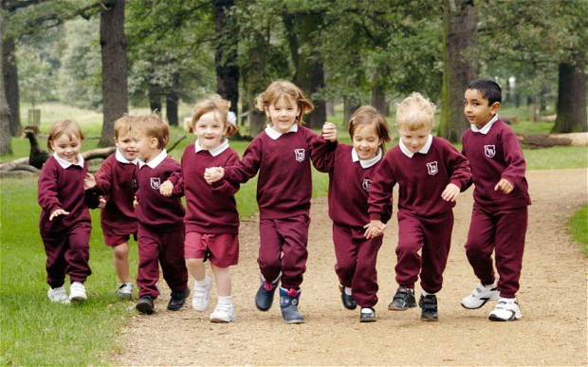
Preschool for children from 2 years 9 months to 4 years

Slide 3
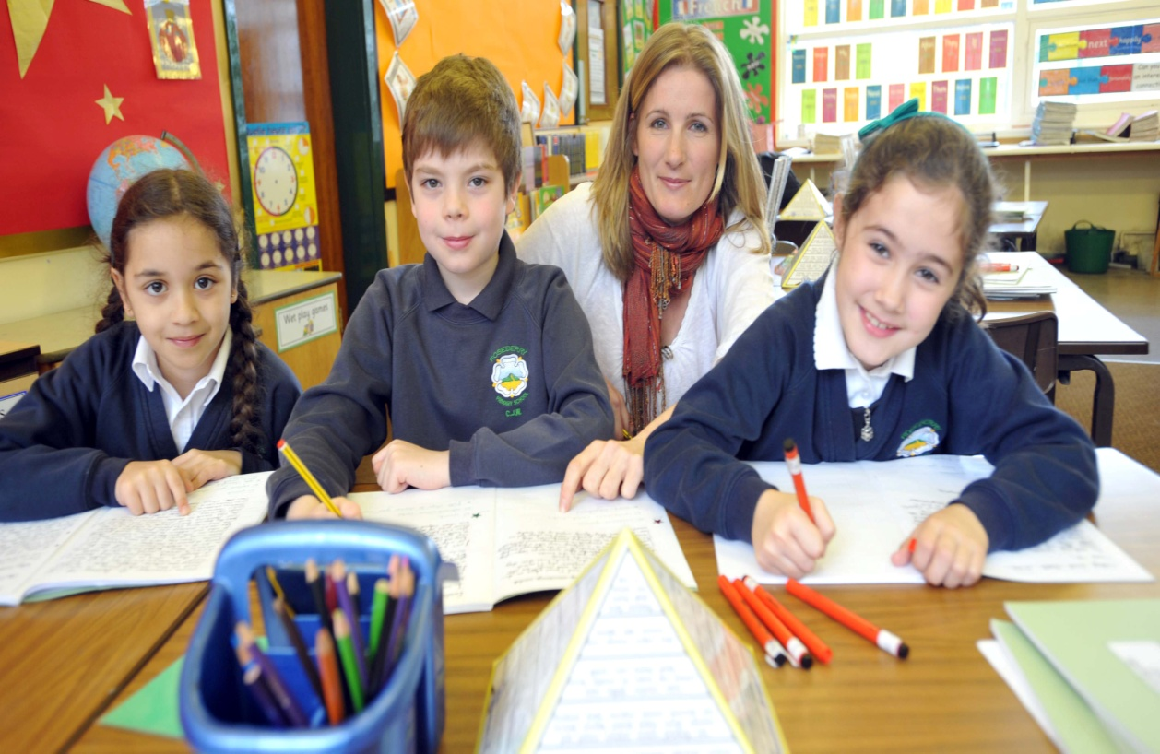
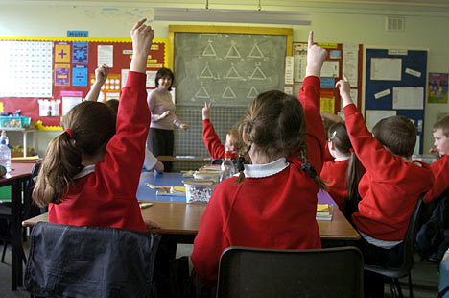
They attend the infant school from 5 to 7 and then junior school until they are 11
P R I M A R Y E D U C A T I O N
All children start primary school by the age of 5. Primary education lasts for six years.

Slide 4
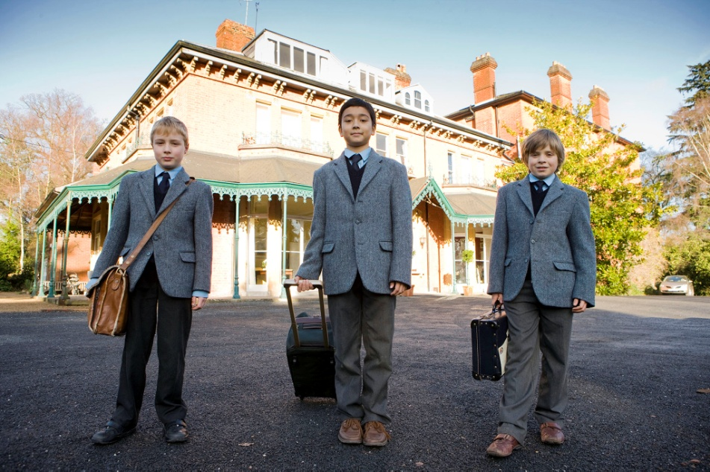
AFter six years of primary education children take exams in core subjects and go to a secondary school.
SECONDARY EDUCATION

Slide 5
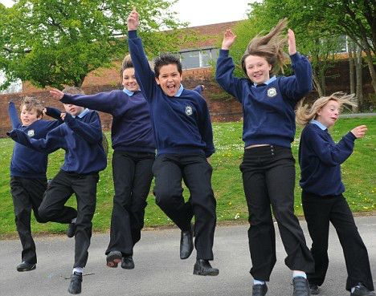
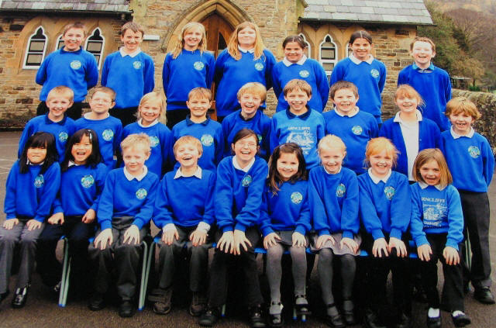

Slide 6
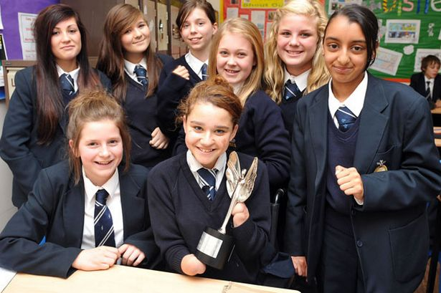
Some people leave secondary school and go to colleges for further education.
Some choose to stay at secondary school for two years more and prepare for a university

Slide 7
HIGHER EDUCATION
Higher education begins at 18 and usually lasts three or four years.
Students go to universities, polytechnics or colleges of higher education.

Slide 8
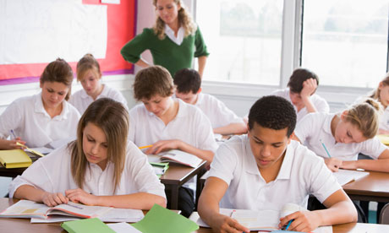
Terminal examinations are held at the end of autumn, spring and summer terms. Only two reexaminations are allowed.

Slide 9
