Slide 1
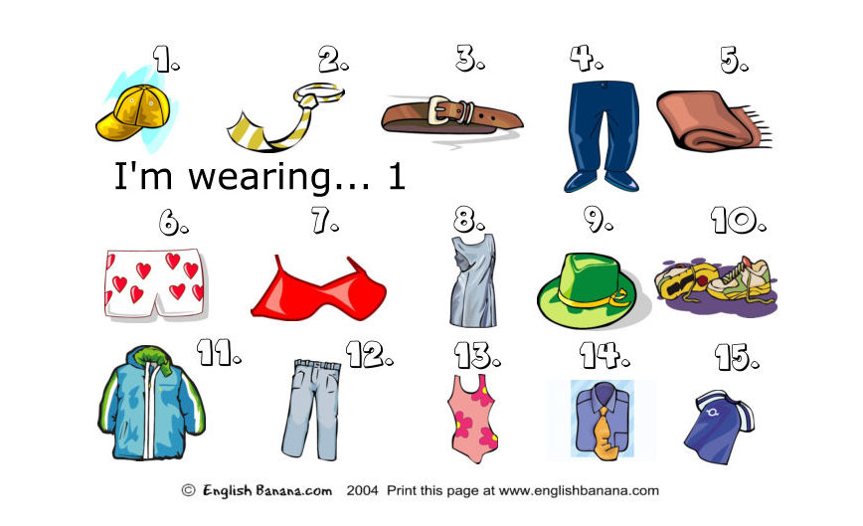
WHAT ARE YOU WEARING?

Slide 2
WARMING UP
Cap and shoes and jeans and blouses,
T-shirt, shorts and dress and trousers.

Slide 3
“Am I right?”
Yes, he/she is a …
No, he/she is not.
He/she is a …

Slide 4
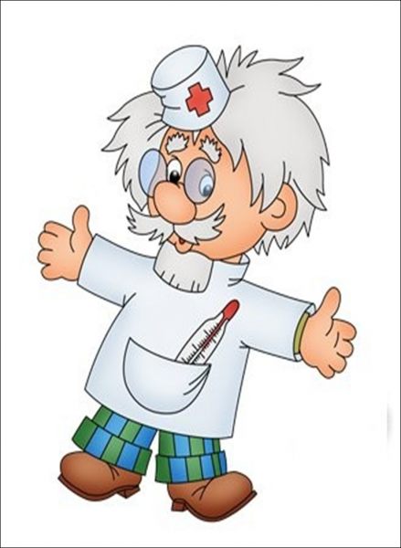

Slide 5


Slide 6
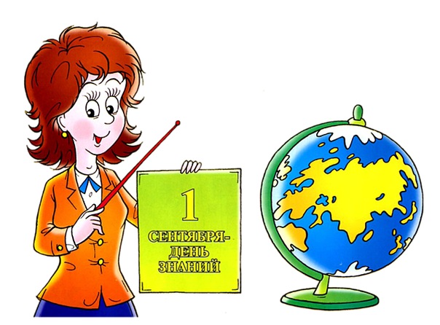

Slide 7
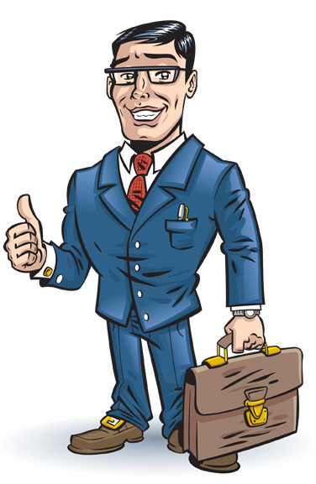

Slide 8
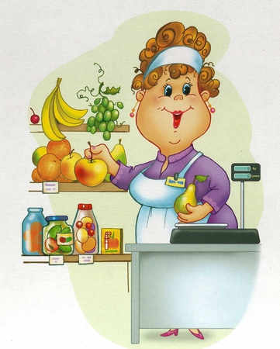

Slide 9


Slide 11
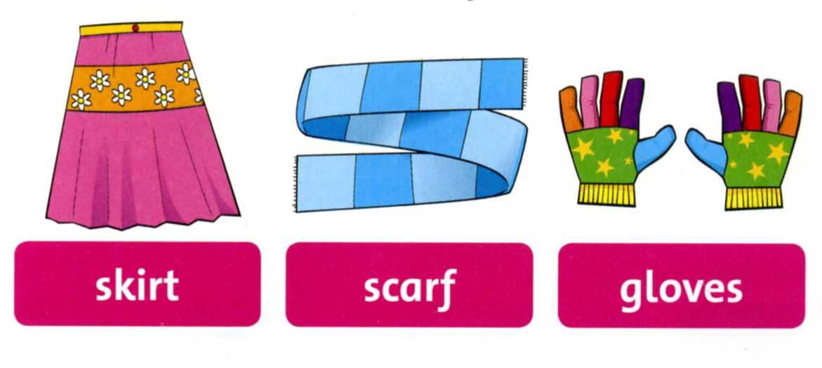
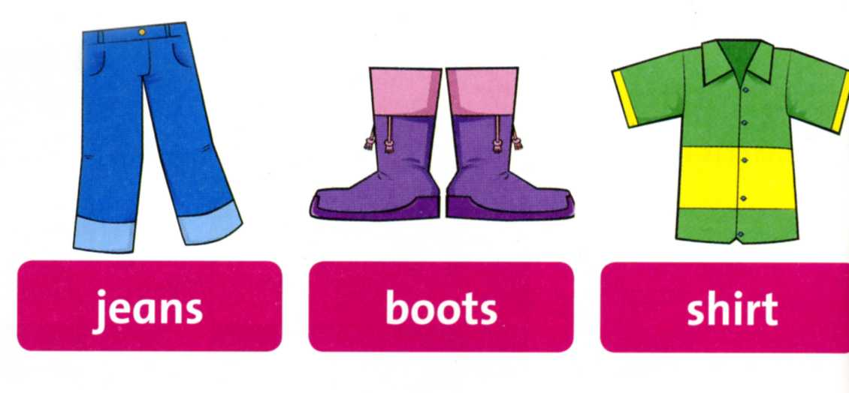
Listen, point and repeat

Slide 12
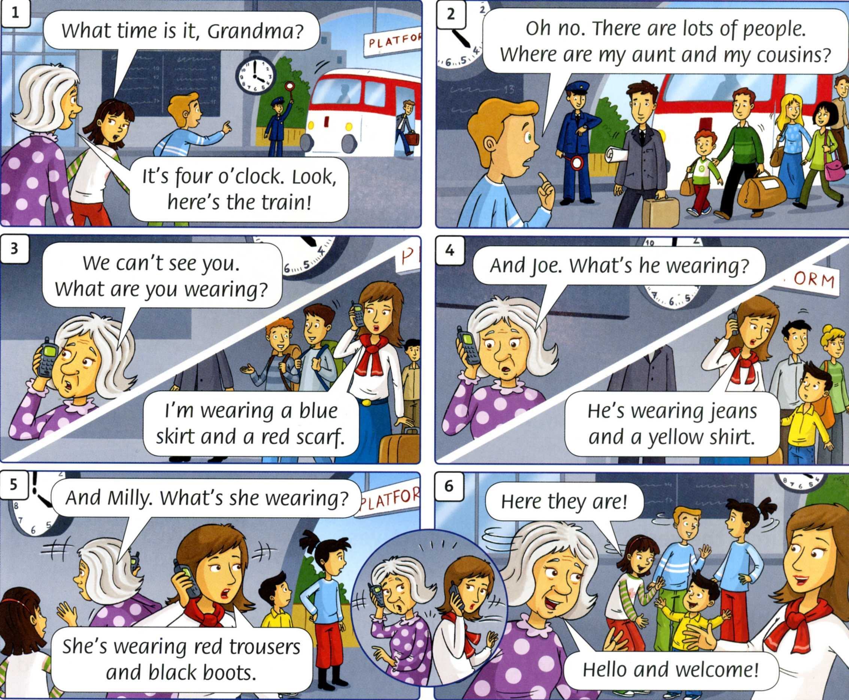

Slide 13
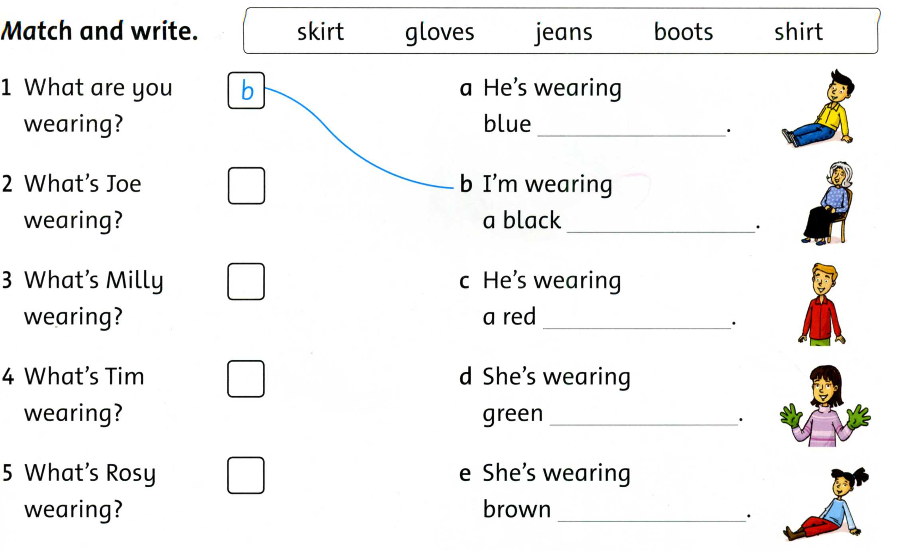

Slide 14
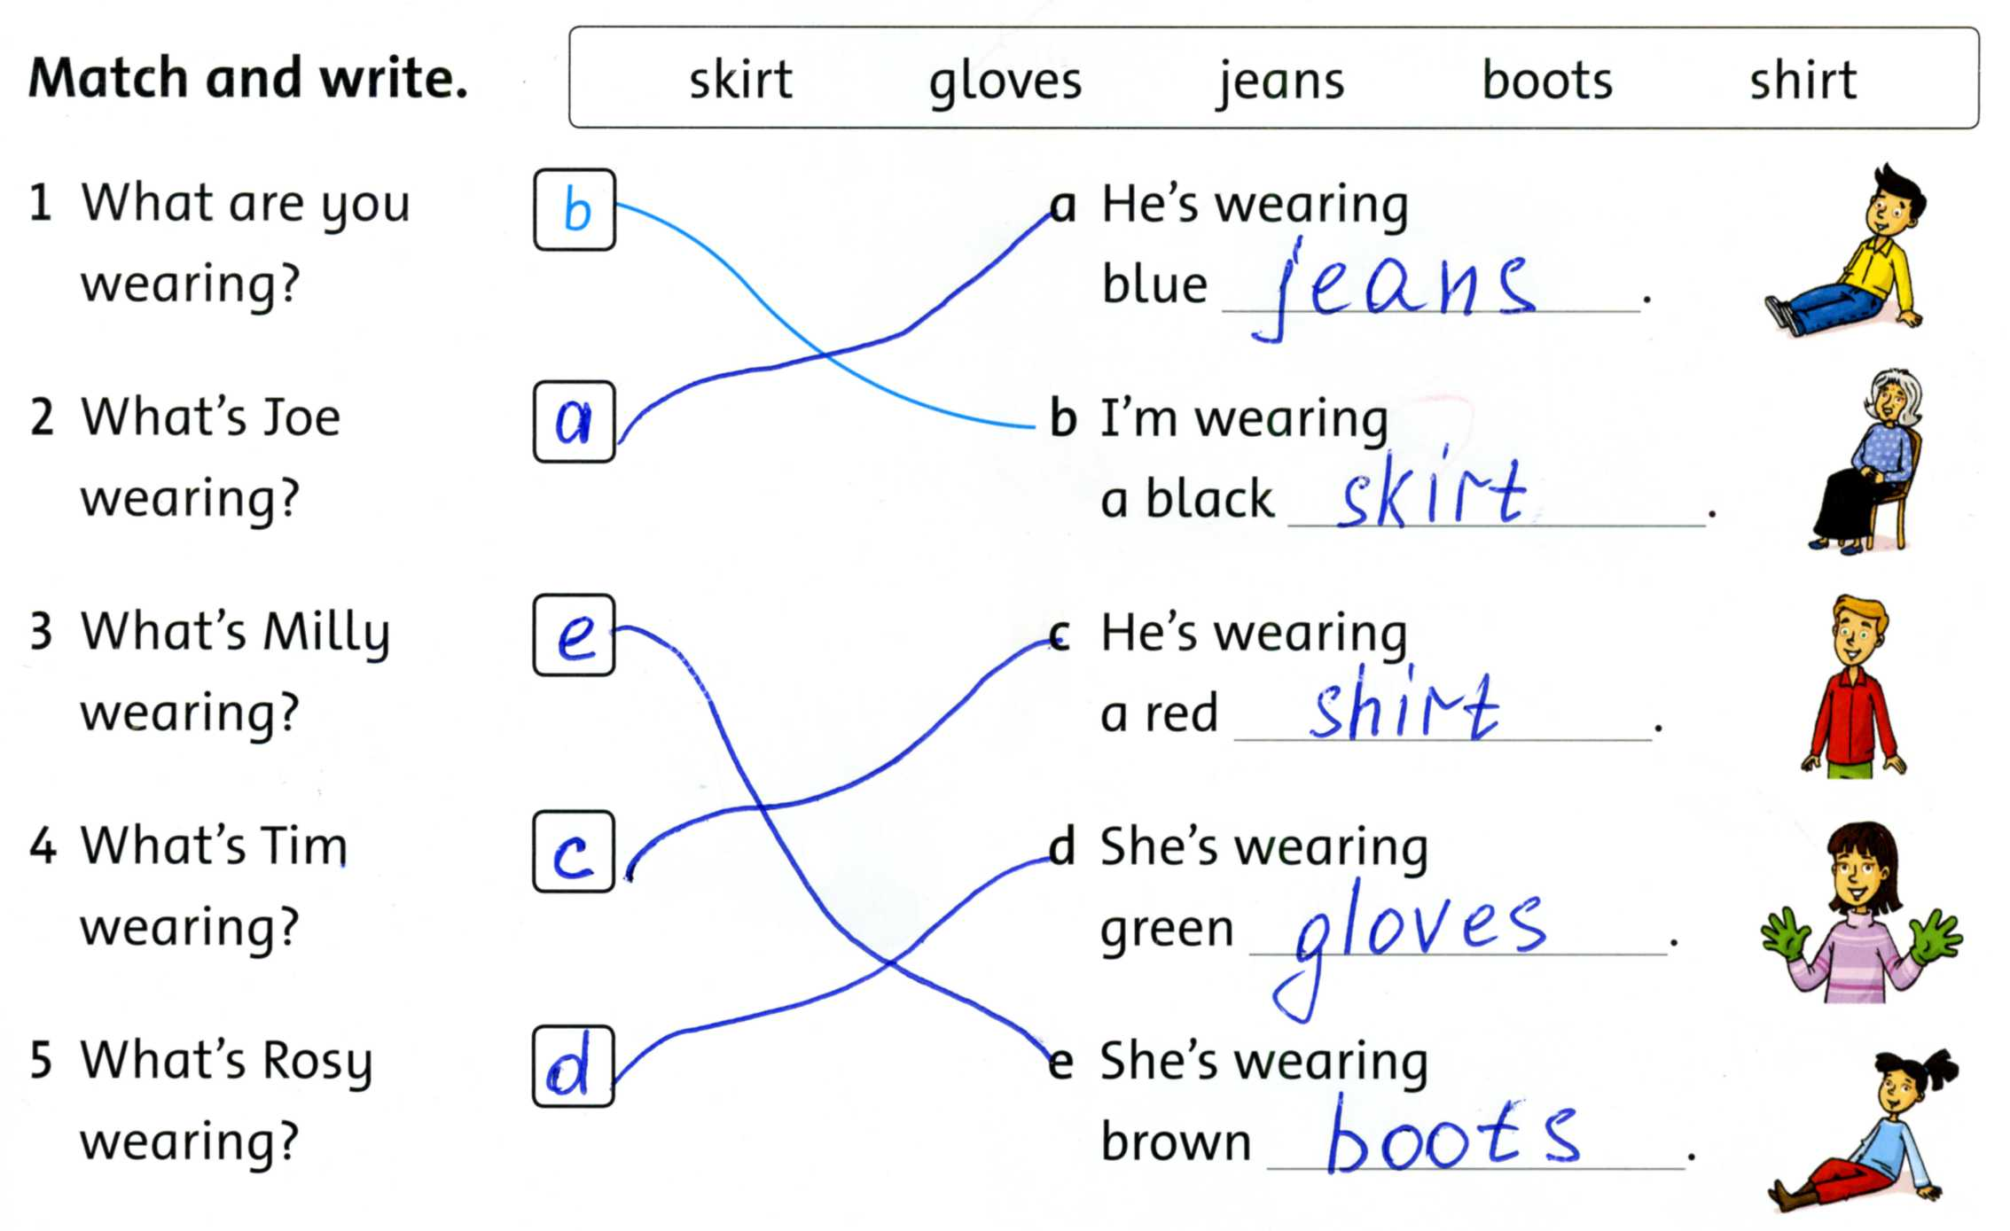

Slide 15

Let’s have some break!!!

Slide 16

CREATIVE TASK
Color this person;
Give him/her name;
Name his/her profession;
Present this person.

Slide 17

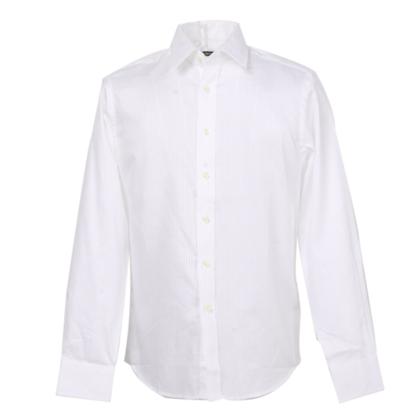
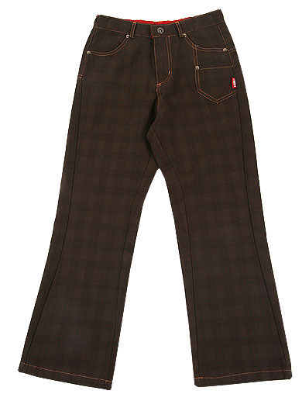
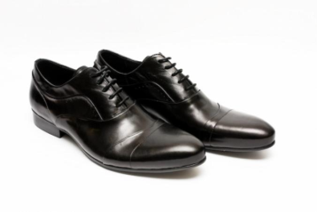
This is a man/woman. His/her name is ___. He/she is a ____. He/she is wearing a ________.

Slide 18
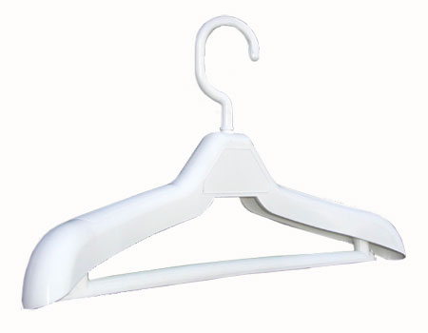
What should we wear?
WINTER
SPRING
SUMMER
AUTUMN

Slide 19
Thank you for your work!
You were brilliant!

