Slide 1
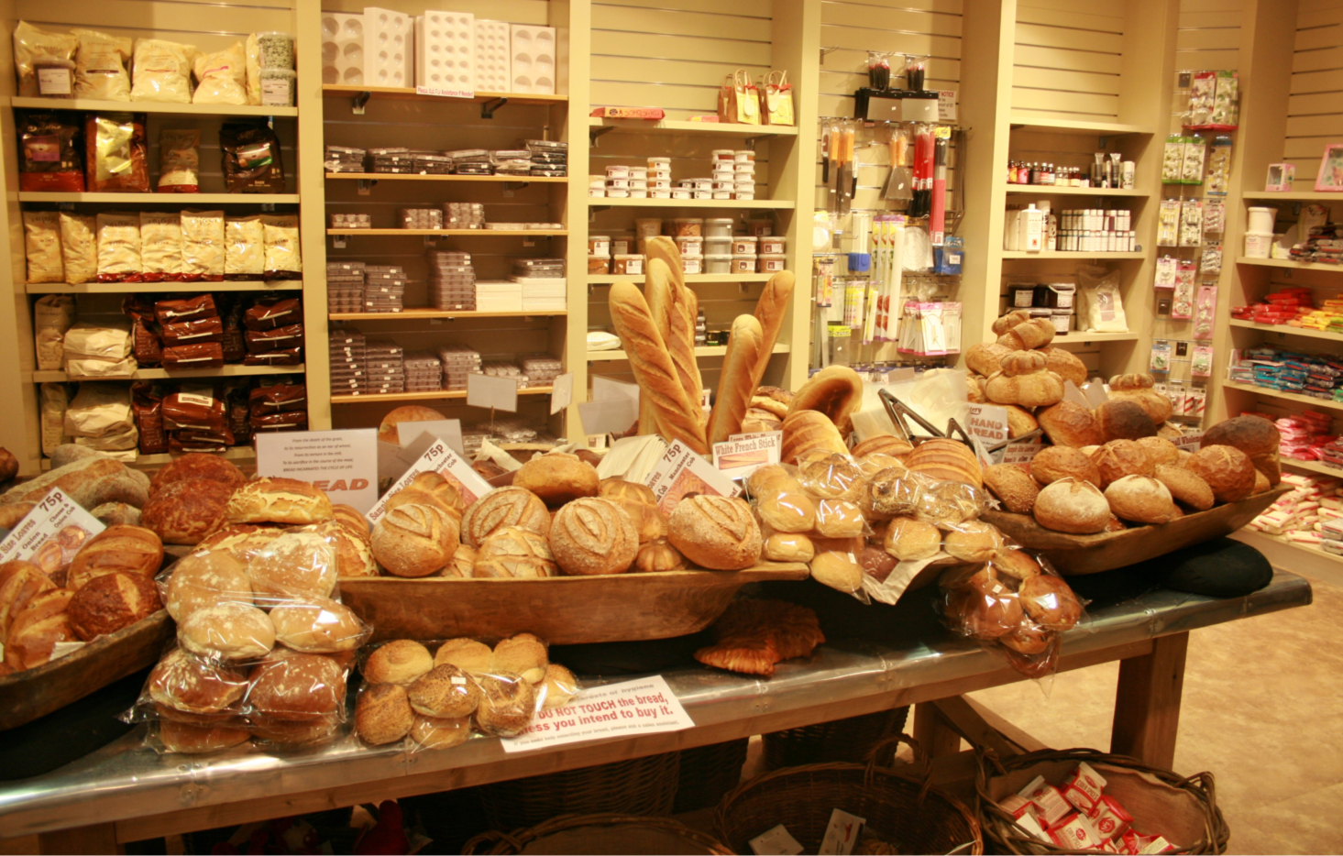
Baker's
Bread
Buns
Bread stick
Roll

Slide 2
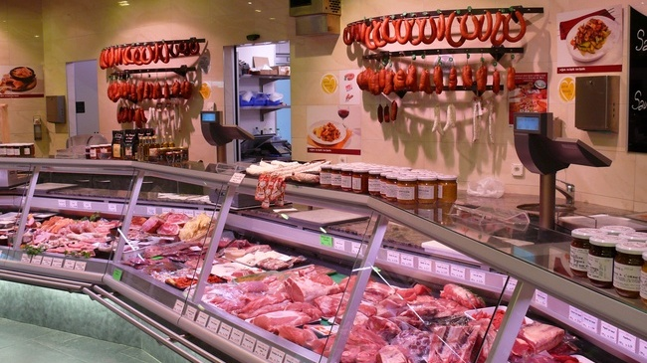
butcher's
Meat
Chicken
Ham
Bacon
Sausages

Slide 3
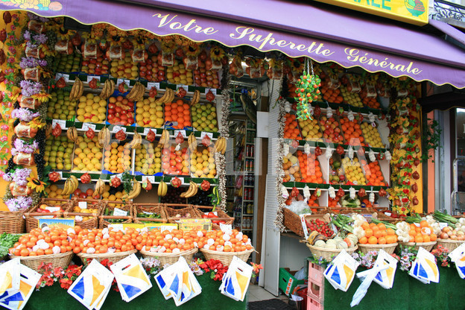
Greengrocer's
Fruit
apples
bananas
oranges
cherries
Vegetables
potatoes
tomatoes
carrots
onions

Slide 4
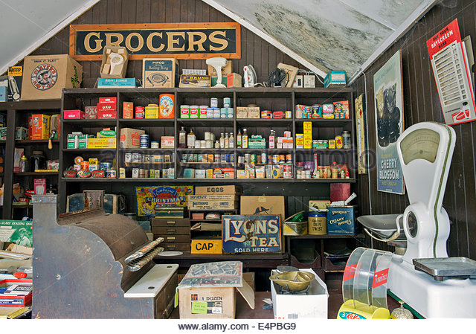
Grocer's
Pasta
Spaghetti
Sugar
Rice
Salt
Flour

Slide 5
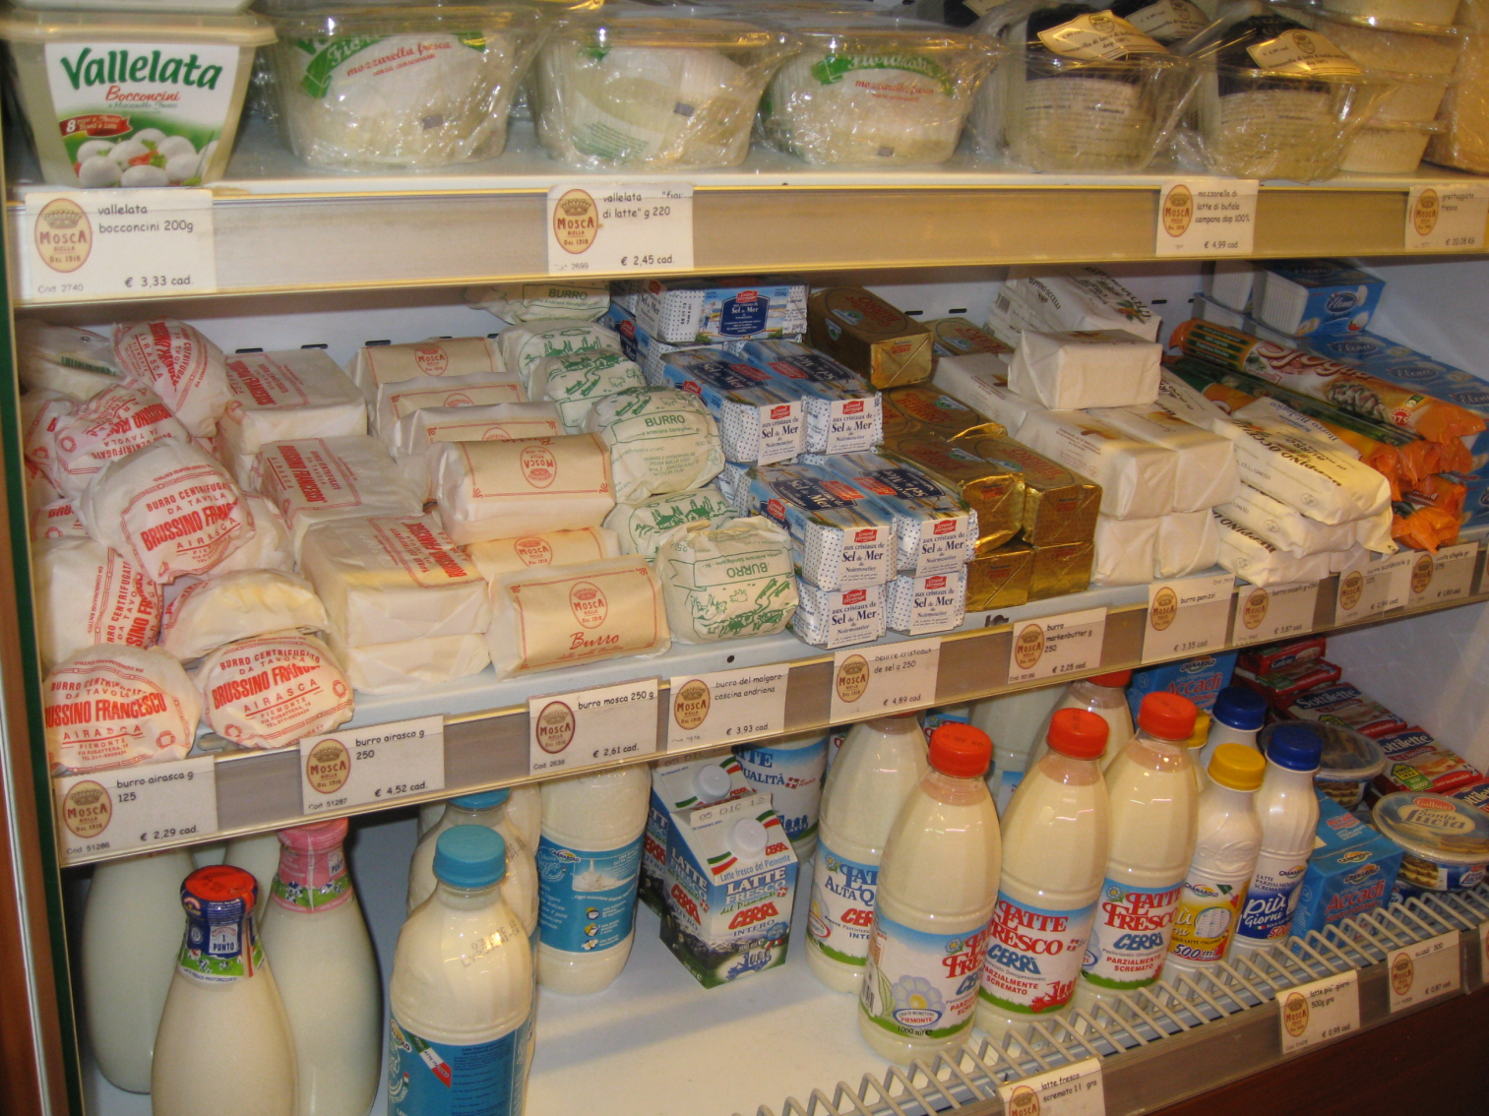
Dairy
Milk
Butter
Cheese
Yoghurt
Curd
Sour cream

Slide 6
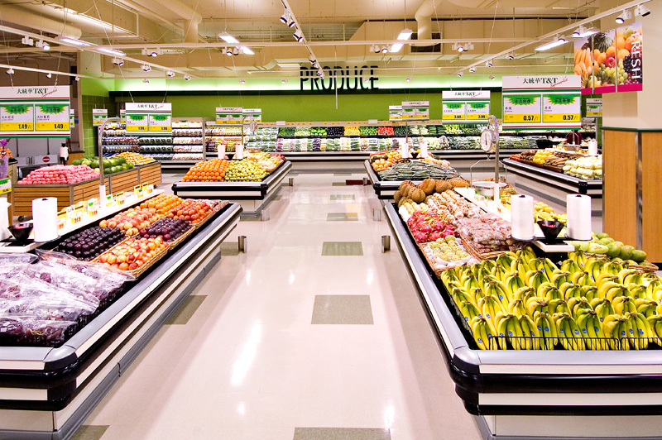
Supermarket
Meat
Fruit
Vegetables
Pasta
Milk
Butter

Slide 7
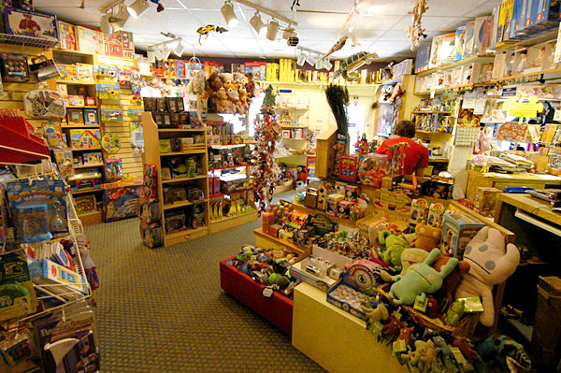
Toy store
Dolls
Teddy bears
Toy cars
Bricks
Table games
balls

Slide 8
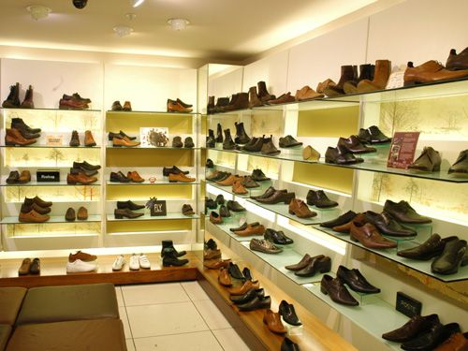
Shoe shop
Shoes
Boots
Sandals
Flip flops
Sneakers

Slide 9
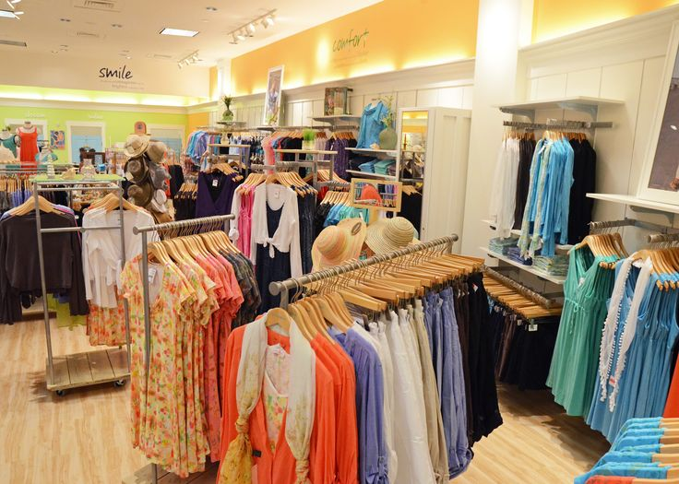
Clothes shop
Dresses
Shirts
Trousers
Jeans
Jackets
Suits

Slide 10
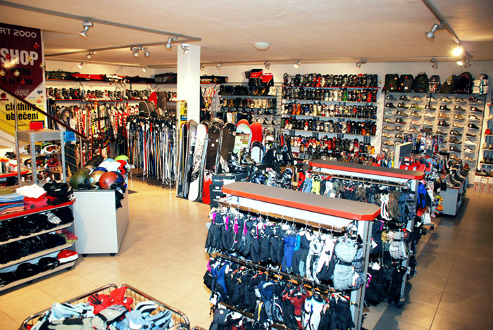
Sport shop
Bikes
Skates
Skies
Trainers
Rackets
balls
Tracksuits

Slide 11
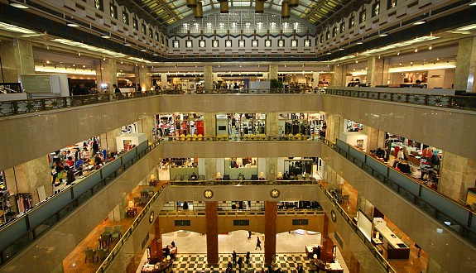
Department store
Clothes
Shoes
Toys
TV sets
Sport goods

