Slide 1


Slide 2


Slide 3
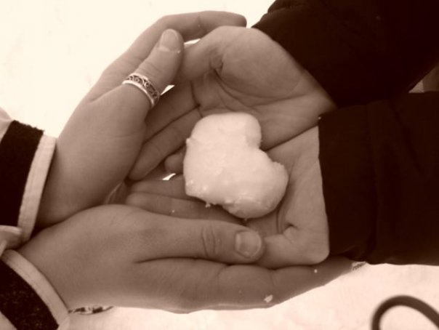
St.Valentine’s Day is 14 February.

Slide 4

Happy Valentine’s Day to…
boys and
girls
friends and colleagues
husbands
and wives

Slide 5


DO YOU KNOW THAT...
QUESTION
ST. Valentine’s Day is celebrated on the…
a)March, 8
b)January, 1
c)February, 14

Slide 6
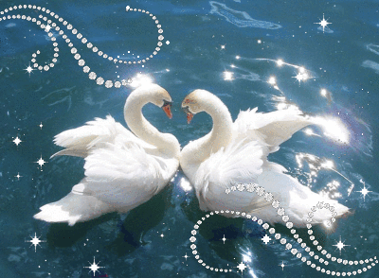
DO YOU KNOW THAT…
QUESTION
VALENTINE WAS…
A king
A priest
God of love

Slide 7

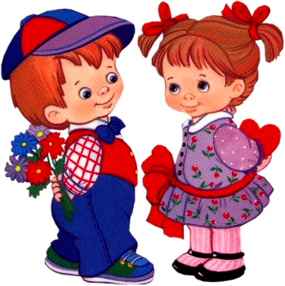
DO YOU KNOW THAT…
QUESTION
ST. VALENTINE’S DAY IS A HOLIDAY OF…
Lovers
Teachers
Soldiers

Slide 8
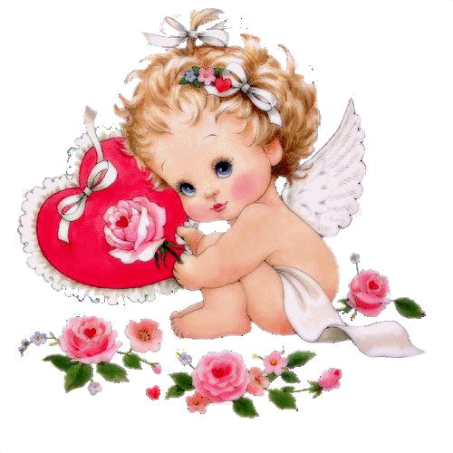
DO YOU KNOW THAT…
QUESTION
VALENTINE’S CARDS HAVE A SHAPE OF…
Star
Flower
Heart

Slide 9

DO YOU KNOW THAT…
QUESTION
THE SYMBOL OF ST.VALENTINE’S DAY IS
A cat
A red rose
A girl

Slide 10

DO YOU KNOW THAT…
QUESTON
VALENTINE WROTE HIS LOVER A LETTER AND SIGNED IT…
“to my sweetheart”
“from your valentine”
“love”

Slide 11
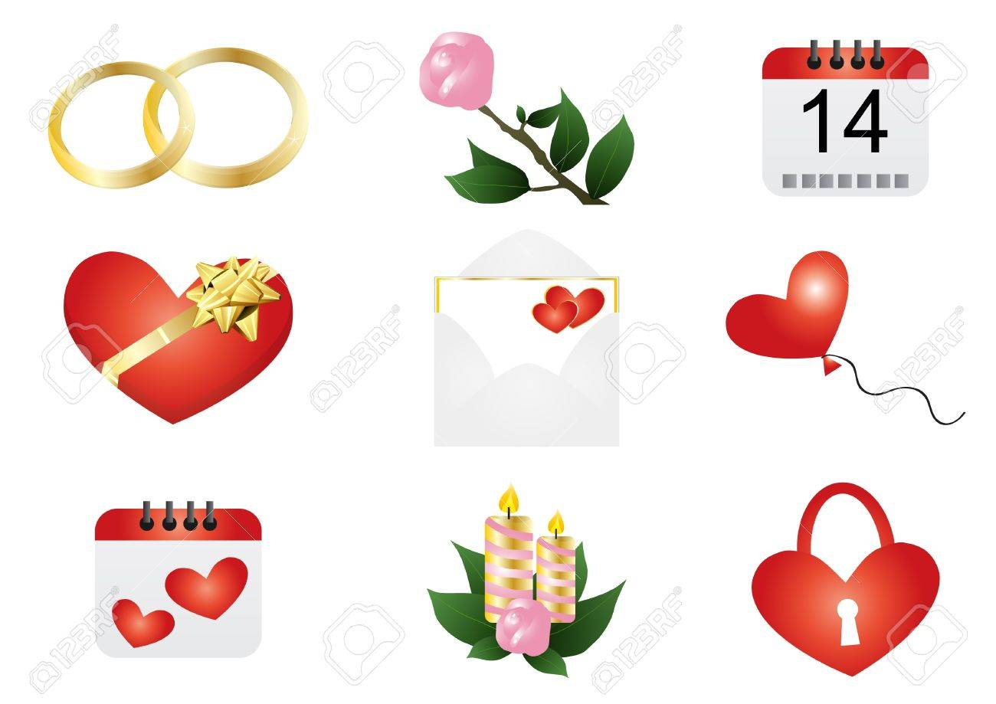

Slide 12
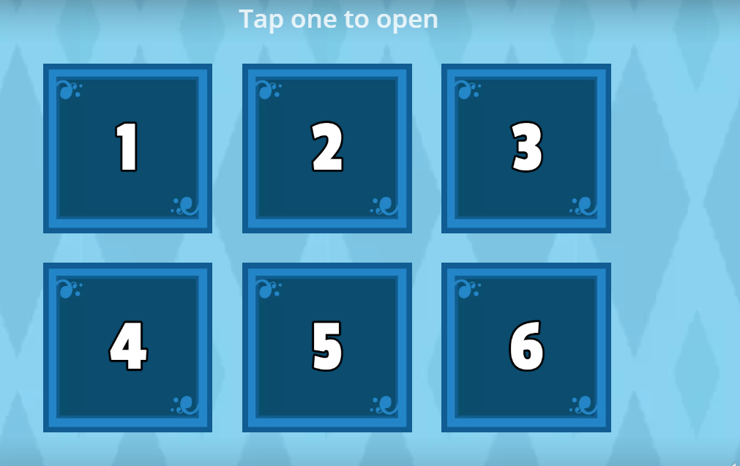
OPEN THE BOX
game for kids online
https://wordwall.net/resource/404928/valentines-day-kids

Slide 13
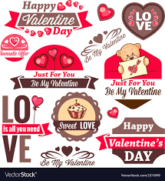
Choose a symbol of St. Valentines Day

Slide 14

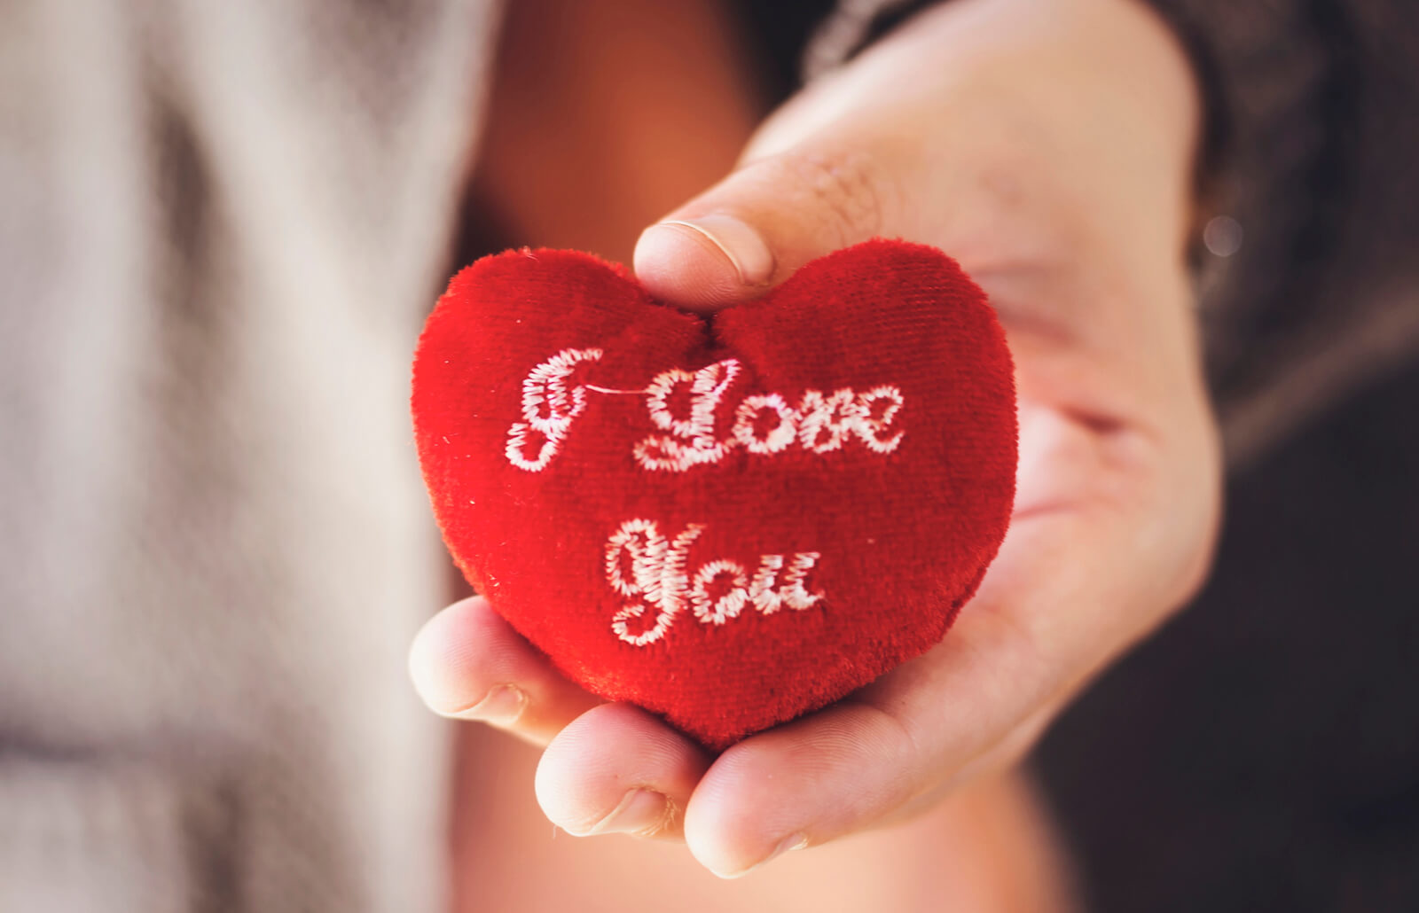
Who do you love?

Slide 15
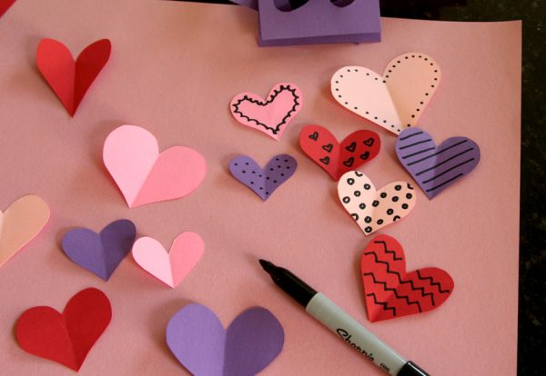

Slide 16


Slide 17
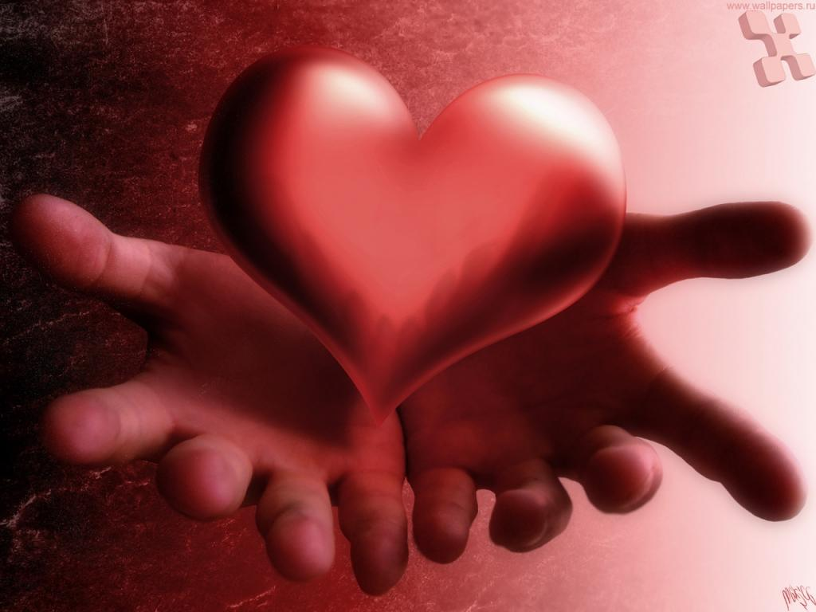
Thank you very much
for your attention!
Good luck!

