Slide 1
When the weather is wet,
we must not fret.
When the weather is warm,
we must not storm.
But be thankful together,
whatever the weather.

Slide 2
When the weather is…. ,
we must not fret.
When the weather is ….,
we must not storm.
But be thankful ……..,
whatever the ……… .

Slide 3

Jane Brown

Slide 6
The weather is | hot cold chilly warm frosty snowy cloudy windy foggy sunny rainy | winter in spring summer autumn

Slide 9
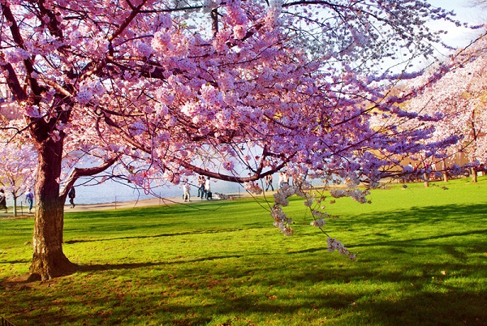
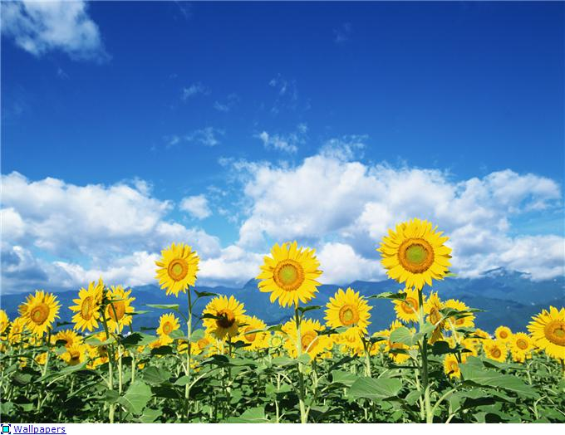
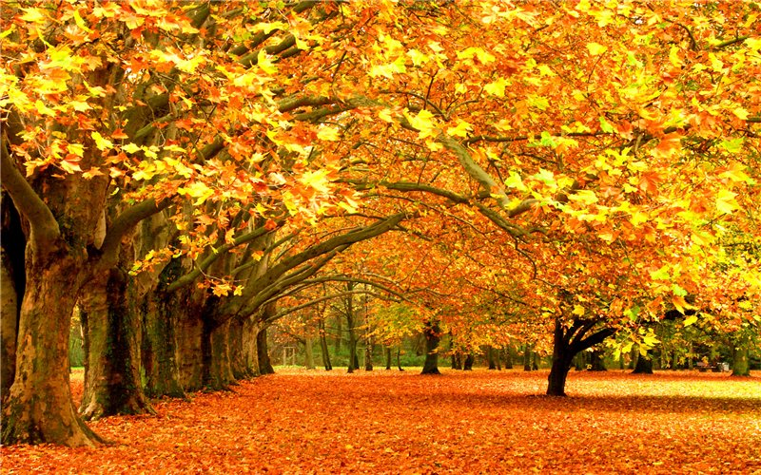
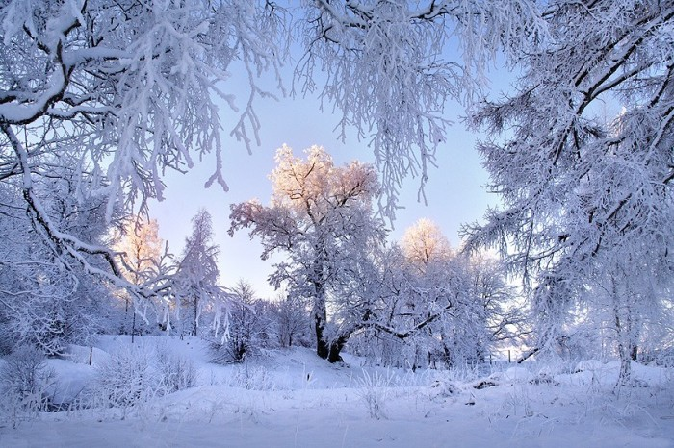

Slide 10
white
beautiful
cold
hot
warm
long
short
days
summer
winter
autumn
season
nights
trees

Slide 11
hot
dry
day
sunny
long
good
white
cloudy
bad
wet
short
black
night
cold

Slide 12
sunny
wet
long
good
white
hot
day

Slide 14
