Slide 1
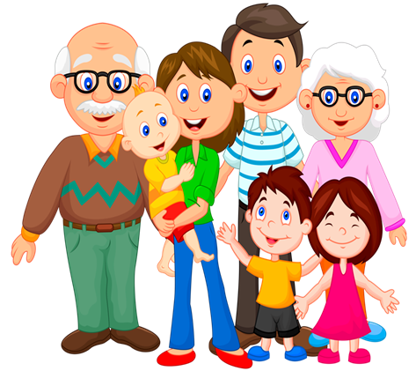
Family Life

Slide 2

Watch and Learn
https://www.youtube.com/watch?v=FHaObkHEkHQ&t=31s
Click here

Slide 3


Match the words with their translations:
1) aunt
2) cousin
3) uncle
4) parents
5) son
6) daughter
A) син
C) тітка
B) батьки
D) донька
E)дядько
F) кузен/кузина
Keys

Slide 4


Check Yourself
Check
Here
1) C
2) F
3) E
4) B
5) A
6) D
Click
here
to sing
https://www.youtube.com/watch?v=lGir6PUN-as

Slide 5



Choose the correct option
1. Your parents’ son is your..
A) brother
B) uncle
C) father
2. Your father and mother are your..
A) grandparents
B) parents
C) children

Slide 6



3. Your father’s wife is your..
A) grandma
B) sister
C) mother
4. Your father’s mother is your..
A) sister
B) aunt
C) grandma
5. Your uncle is your mother’s..
A) brother
B) father
C) child
Keys

Slide 7

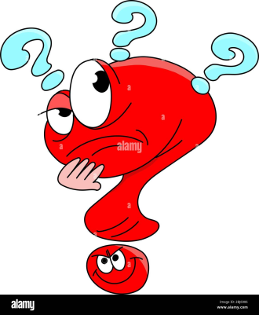
Check Yourself
Check
Here
1) A
2) B
3) C
4) C
5) A
Guess Game
https://www.youtube.com/watch?v=zxePnzWRfvQ

Slide 8
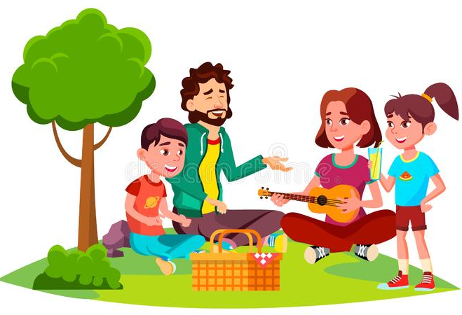
Read the text
My name is Dan. I am eight years old. My family is very friendly. We live in a big house. I have got a mother, a father and a sister. My sister’s name is Tina. She is my best friend. She is ten. We like to play, to draw, to run and jump, to watch cartoons and to read good books. My family and I often go to the park. We like to have
small picnics there.
We like to play different games,
to talk and to sing.

Slide 9

Mark if the sentences are
True or False
1) My family lives in a big flat.
2) I have got a mother, a father and a brother.
3) My sister is my best friend.
4) My family and I often go to the park.
5) We like to play, to have picnics
and to sing together.
Keys

Slide 10
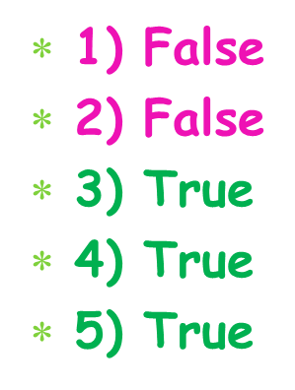




Check Yourself
Check
Here
https://www.youtube.com/watch?v=XqZsoesa55w
Have
Fun!
https://www.youtube.com/watch?v=ubmiT8JKeRU

Slide 11
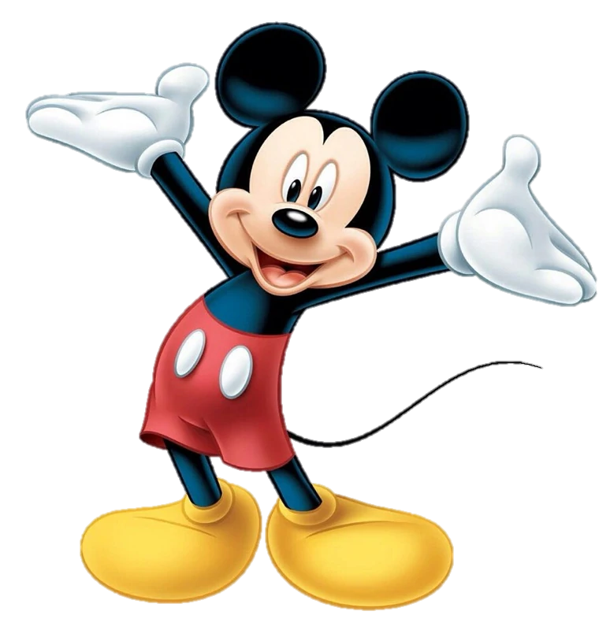
Thank you for your work!
Have a
great
day!

