Slide 1
Can you..?

Slide 2
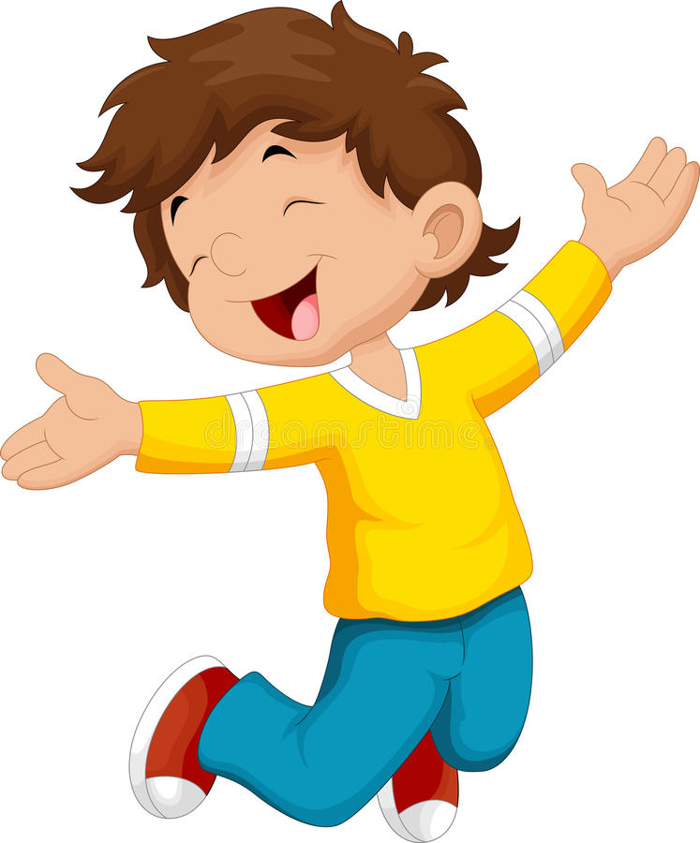
jump

Slide 3
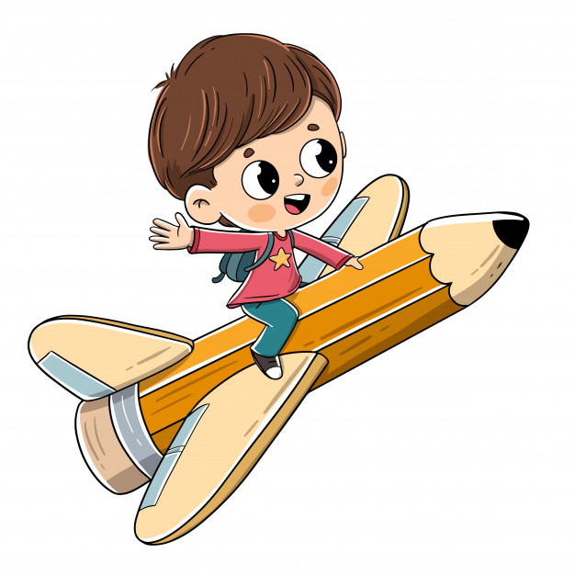
fly

Slide 4
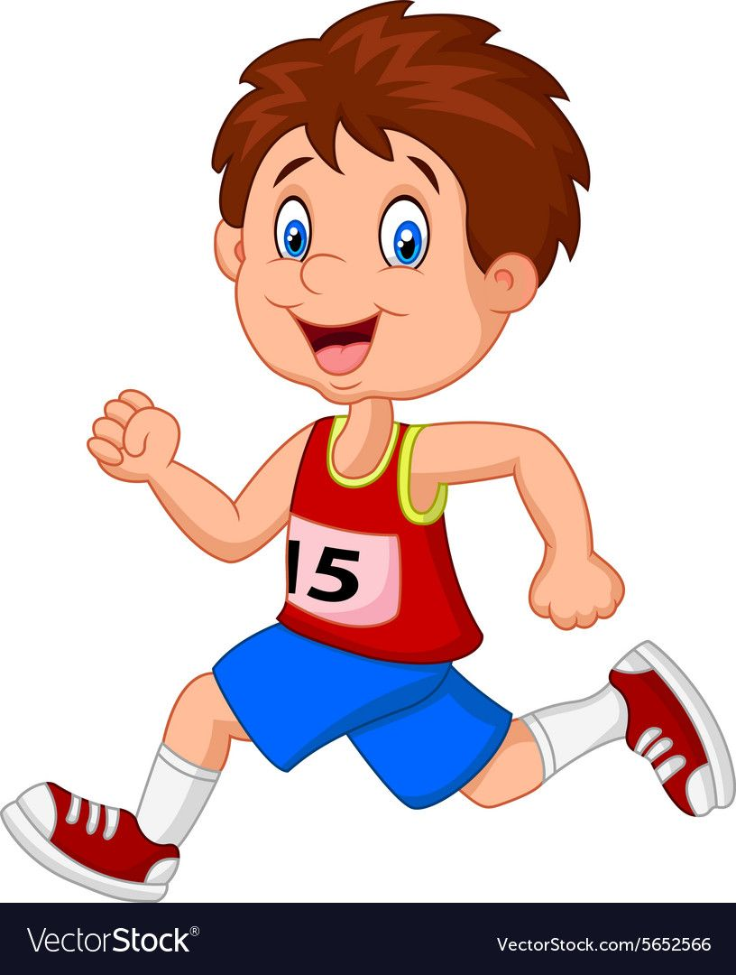
run

Slide 5
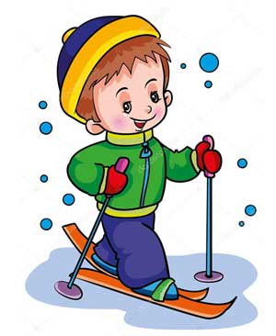
ski

Slide 6
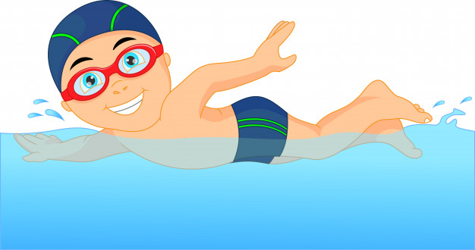
swim

Slide 7
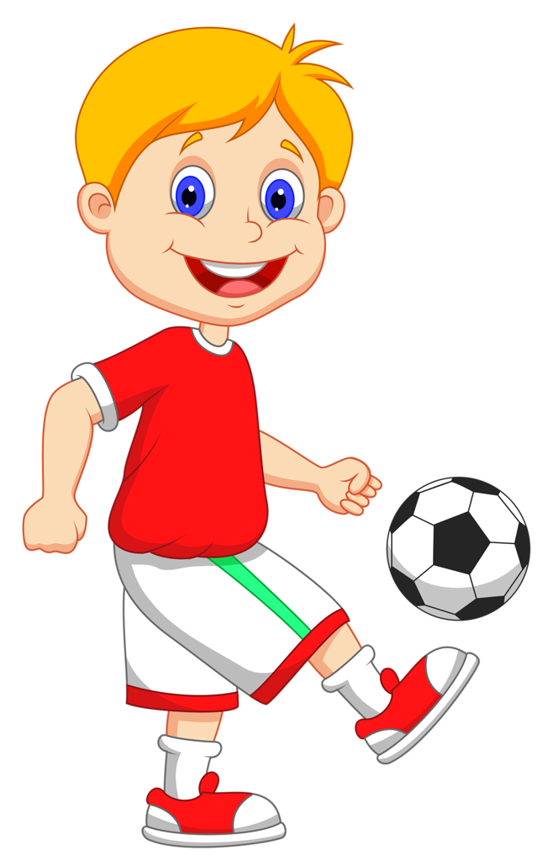
play football

Slide 8
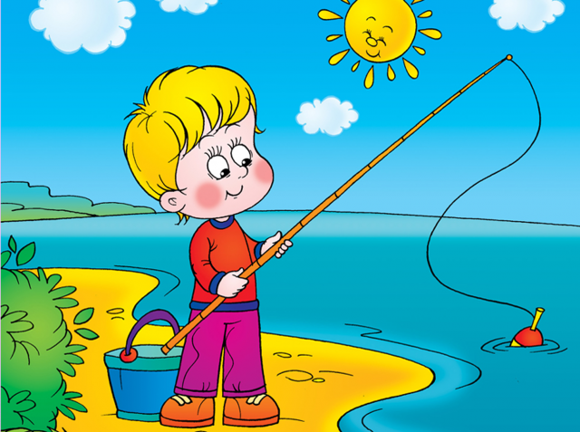
fish

Slide 9
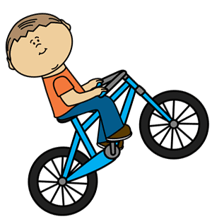
ride a bike

Slide 10
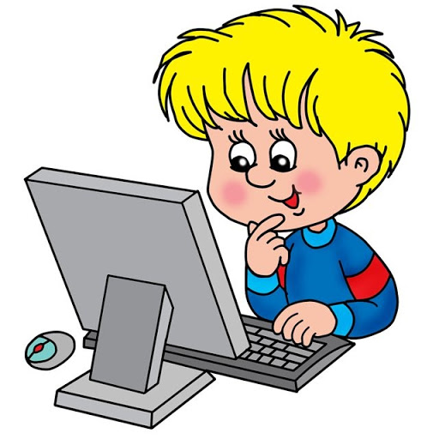
play computer

Slide 11
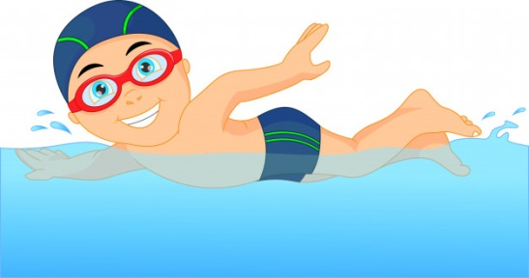

Slide 12
I can… - Я можу…
Can you..? – Можеш ти..?
Yes, I can. - Так
No, I can’t. – Ні.

Slide 13
Can you ?
Can you ?
Can you ?

Slide 14
Can you ?
Can you ?
Can you ?

Slide 15
Can you ?
Can you ?
Can you ?

Slide 16
Can you..? – Yes, I can/No, I can’t
fly
jump
run
fish
swim
play computer
games
play
football
ride a bike
ski

