Slide 1
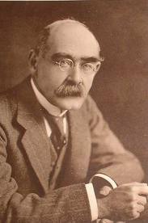
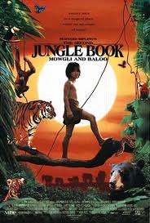
Rudiard Kipling “If…” and “The Jungle Book”.

Slide 2
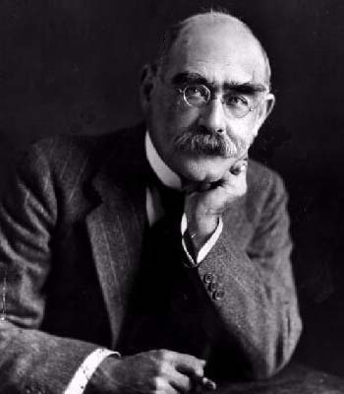
Rudyard Kipling
Born: Died: Place of Birth: Place of Death: Parents:
1865
1936
Bombay, India
England
John & Alice Kipling

Slide 3
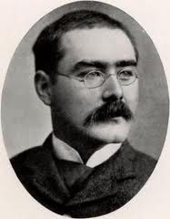
Rudyard Kipling
1892, Married:
Two daughters:
One son:
1910 :
1907:
Caroline Balestier
Josephine & Elsie
John (died in WWI)
poem “If…”
the Noble Prise

Slide 4
Interesting facts about R.Kipling
Rudyard Kipling was named after Rudyard Lake.
He lived with foster parents, who beat and bullied the boy.
By the age of 11, Kipling was on the verge of a nervous breakdown.
By the age of 32, he was the highest paid writer in the world.
He lost two children: Josephine and John

Slide 7
1. Check all the statements that are true, according to the poem.
a. You should always be calm.
b. You should neither lie nor hate.
c. Always look your best and speak in a very wise manner.
d. It’s all right to dream but act on reality.
e. Realize that you will have both good and bad in your life.
f. When you feel stressed, take some time off.
g. Adopt to the ways of people in higher social positions.
h. If you lost everything, you could never start over.
j.If you lost your strength, you would regain it.
j. If you could follow this advice, you would be a strong and excellent man.
True
True
False
True
True
False
False
False
True
True

Slide 10
Characters: (in alphabetical order)
· Akela – An Indian Wolf
· Bagheera – A (black) panther
· Baloo – A Sloth Bear
· Father Wolf – The Father Wolf who raised Mowgli as his own cub
· Grey brother – One of Mother and Father Wolf's cubs
· Kaa – Indian Python
· Mowgli – Main character, the young jungle boy
· Raksha – The Mother wolf who raised Mowgli as her own cub
· Shere Khan – A Royal Bengal Tiger
· Tabaqui – An Indian Jackal

Slide 11
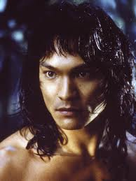
Mawgli

Slide 12
Akela
Head of the wolf council. He is a good ruler and a true friend to Mowgli

Slide 13
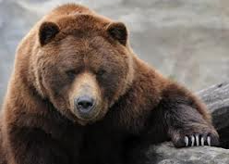
Baloo
Mowgli’s best friend

Slide 14
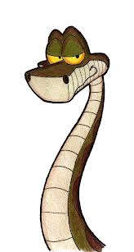
Rock Python Snake
Not evil; just has a different method of hunting

Slide 15
Shere Khan
Feared for his power, but he is not respected

Slide 16
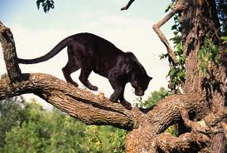
Black panther.
Mowgli’s friend and tutor.

Slide 17
Match animals with their names
Animal Name
Boy Baloo
Jackal Shere Khan
Snake Mowgli
Mother Wolf Tabaqui
Panther Akela
Bear Raksha
Tiger Kaa
Head Wolf Bagheera

Slide 18
Choose the correct answer
1. Baloo is a _____.
a [ ] man b [ ] wolf c [ ] bear d [ ] kite
2. Baloo and Bagheera _____ Mowgli.
a [ ] teach b [ ] fight c [ ] kill d [ ] ride
3. The _____ always make plans and forget them later.
a [ ] wolves b [ ] monkeys c [ ] people in the village d [ ] buffaloes
4. Kaa is a _____ and he can do a dangerous dance.
a [ ] monkey b [ ] jackal c [ ] python d [ ] bear
5 Shere Khan wants to _____ Mowgli.
a [ ] save b [ ] help c [ ] kill d [ ] buy
6 Baloo teaches Mowgli how to _____.
a [ ] speak the languages of the jungle b [ ] speak to people
c [ ] build a house d [ ] read and write

Slide 19
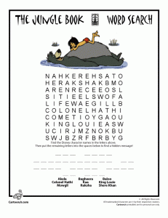

Slide 21
Answer the questions
What did Mother and Father Wolf name the baby that crawled into their cave?
Why do you think they called him “Little Frog”?
What price did Bagheera pay to allow Mowgli to stay with the pack?
Why did Sher Khan want to kill Mowgli?
What is the Red Flower?
Who has come to help Mowgli kill Sher Khan?
Who tried to steal the tiger skin from Mowgli?
How did the story finish?

