Slide 1
Weather and Seasons

Slide 2
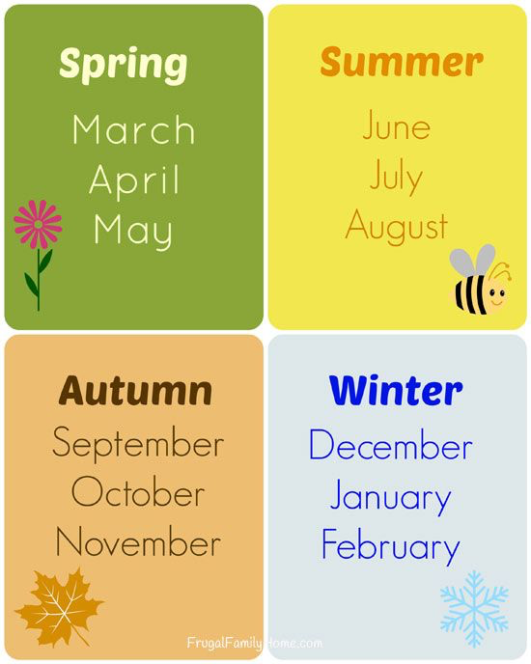
How many seasons are there in a year?
How many months are there in
a season ?
How many month are there in a year ?
What season is it now?
_

Slide 3
[I] - sunny, rainy, frosty, cloudy, slippery, windy, foggy, snowy. [k] - cold, cloudy, clean. [r] - slippery, rainy, bright, frosty.

Slide 4
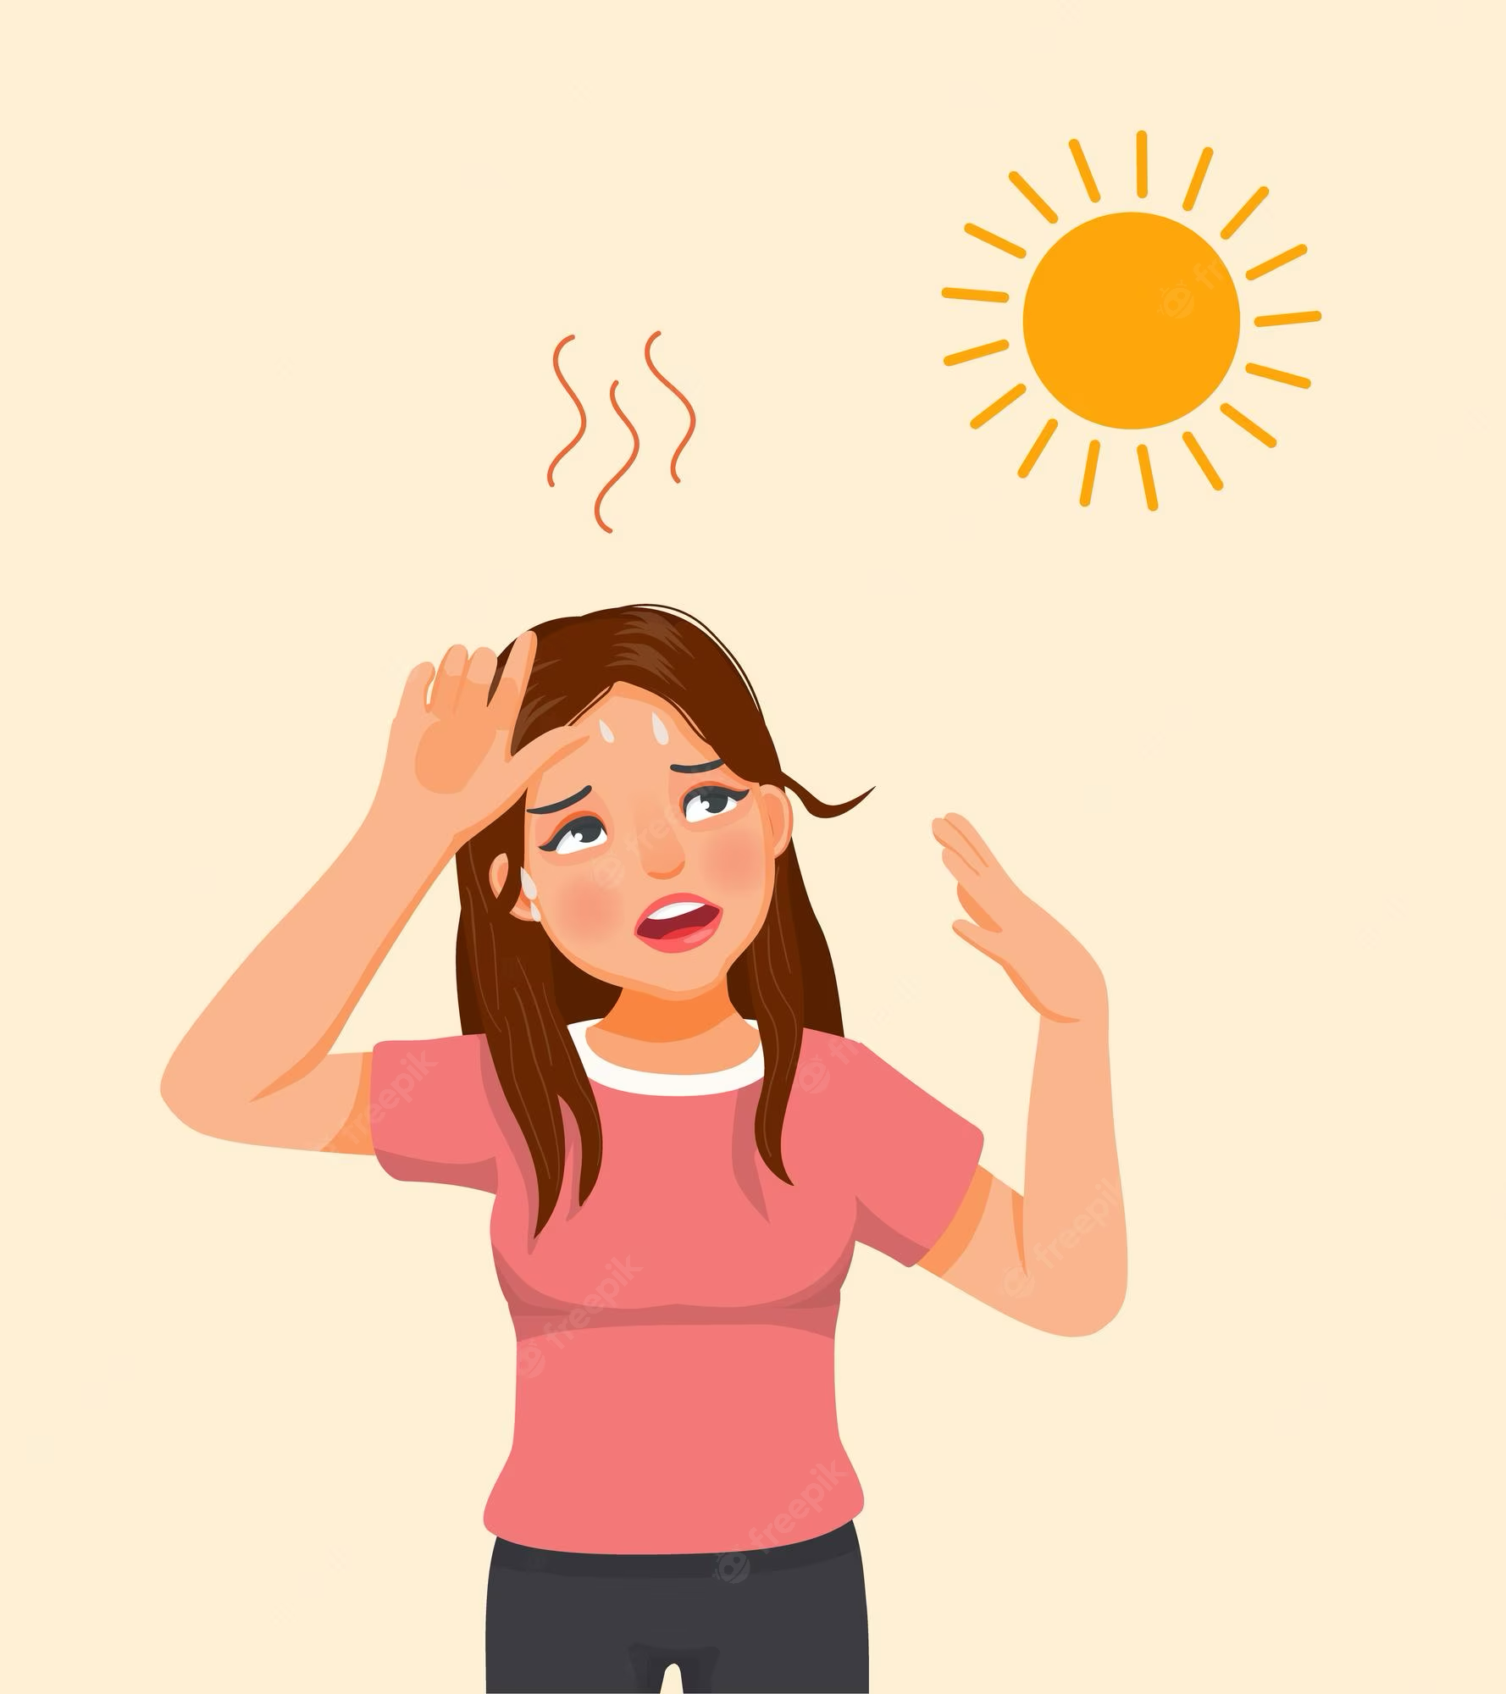

Slide 5
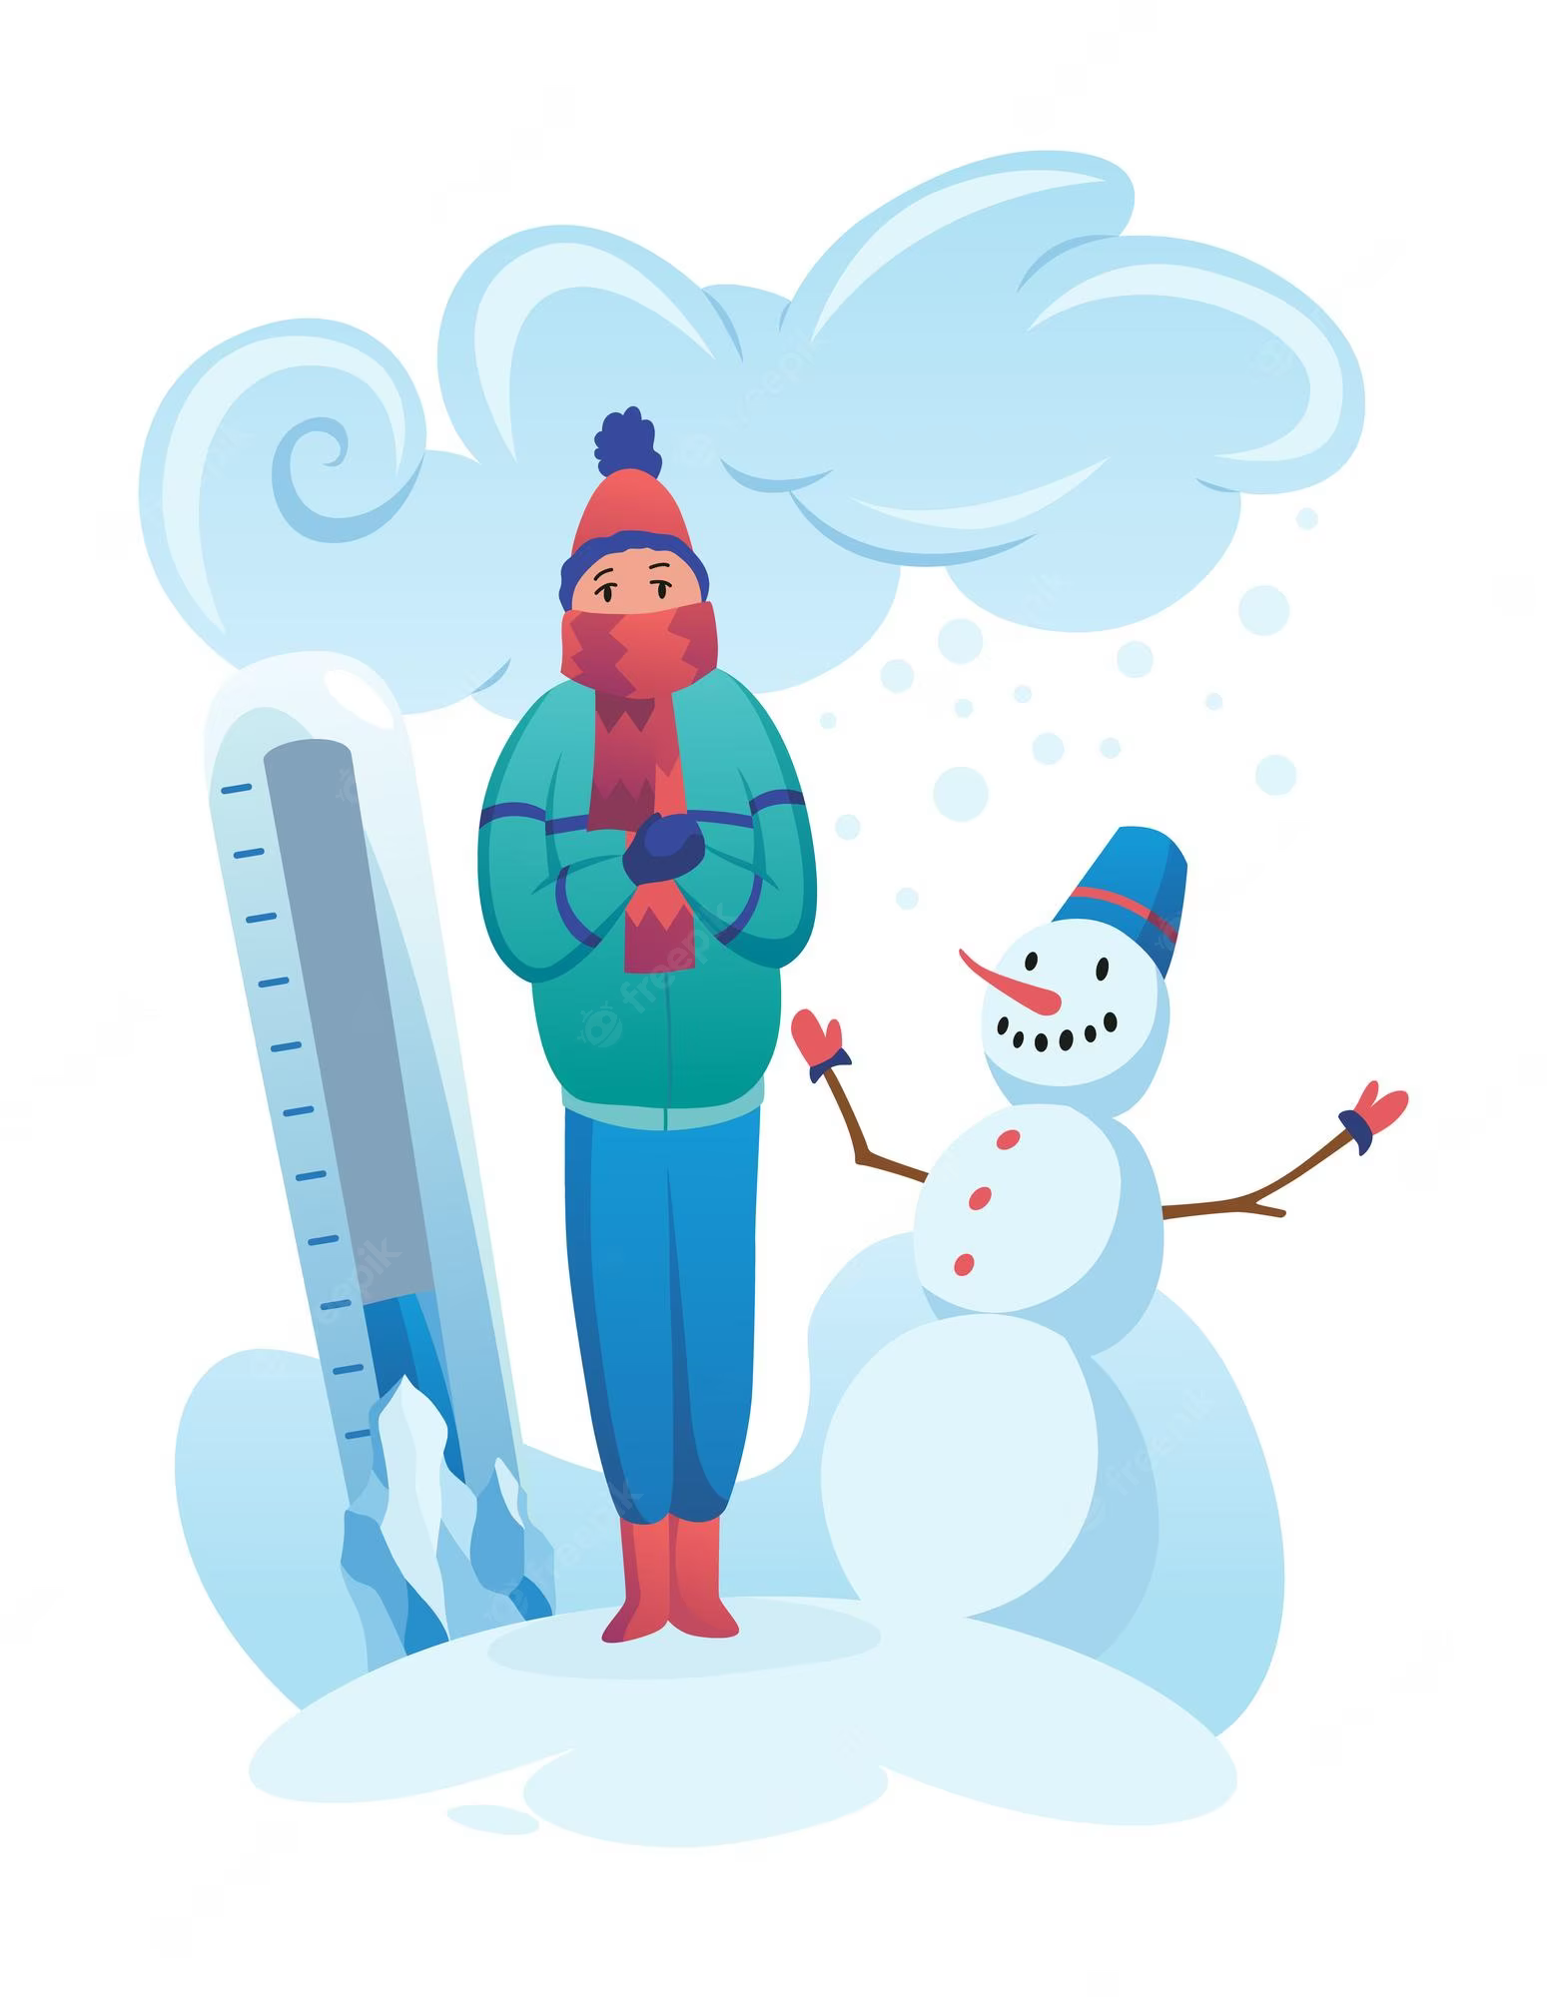

Slide 6
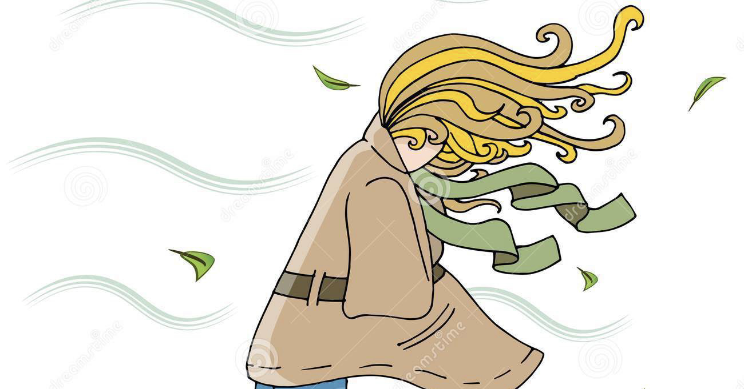

Slide 7
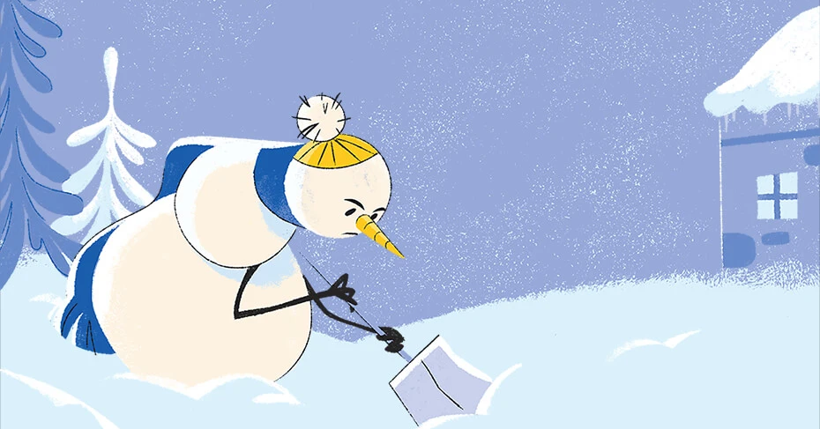

Slide 8
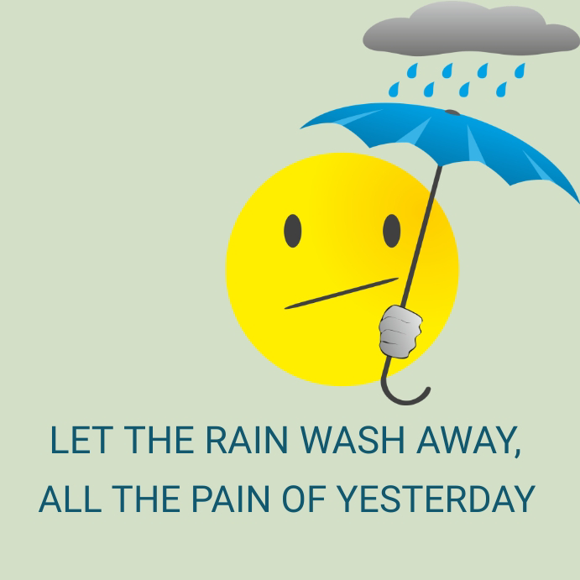

Slide 9
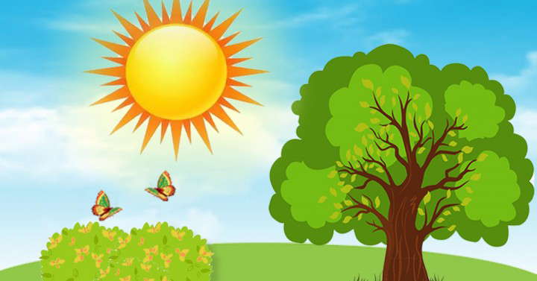

Slide 10
In this season the days are short and the nights are long. It often snows. The trees are white with snow. Some animals sleep. It is cold. But children like this season because they can make snowmen and sledge, ski, skate and play snowballs.

Slide 11
It is a very beautiful season. The weather is often warm. It is not hot. There is a lot of water in the streets because the snow is melting. Birds come back and sing their beautiful songs. The trees and grass are green. The days become longer.

Slide 12
It is hot. The trees and grass are green. There are a lot of flowers in the parks and gardens. They are blue, yellow, red and pink. Children can play outdoors all day long. They have the longest holidays.

Slide 13
It isn’t a warm season. Sometimes it is cold and foggy. It often rains. The trees are colorful. Their leaves are green, yellow, orange, red and brown. There are a lot of fruit and vegetables so it is a tasty season. Children begin to go to school.

Slide 14
Say TRUE or FALSE:
It is cold in summer.
In winter some animals sleep.
School begins in autumn.
It is hot in summer.
There are a lot of fruit and vegetables in winter.
It is rainy in autumn.
Children have holidays in summer and in winter.
Birds come back in summer.
Autumn is a tasty season.
There are a lot of flowers in summer.

