Slide 1
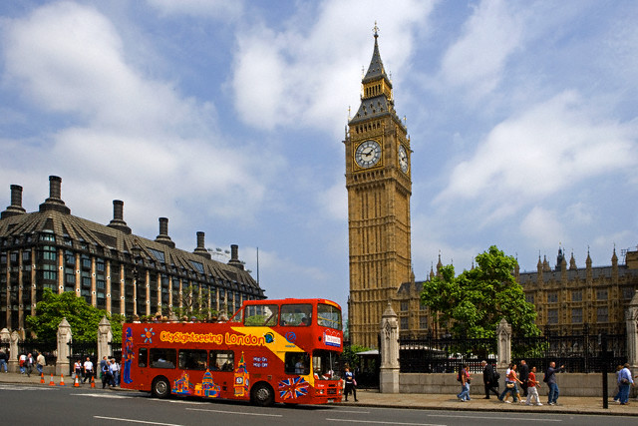
« Do you know English ?»
Brain Ring

Slide 2
Round 1
The first contest is to act out the dialogues. Members of the team should act out the dialogues for the class . You can have 1-5 points for the acting.

Slide 3
Round 2
The second contest is to make posters and present them . You can have 1-5 points for the poster. Our jury judge you .

Slide 4
Round 3
The contest is
« Do you know English? ».
You have to answer the questions and do different tasks . For every right answer you will get 1 point to your score.

Slide 5
1) Make up words using letters The topic is “Family” You have only 3 minutes to do it. You can have 1 point for answer
The team “Dragons ”
1) tehmor
2) streis
3) daghuert
4) ntau
The team “ Stars”
1)aterfh
2)elucn
3)bothrer
4)ons

Slide 6
The team “Dragons ”
1) mother
2) sister
3) daughter
4) aunt
The team “ Stars”
1)father
2)uncle
3)brother
4)son

Slide 7
2) Complete the sentences. You can have 1 point for answer

Slide 8
1)My mother’s father is my_____________

Slide 9
1)My mother’s father is my grandfather

Slide 10
2) My sister’s brother is my_________

Slide 11
2) My sister’s brother is my brother

Slide 12
3)My uncle’s son is my ___________

Slide 13
3)My uncle’s son is my cousin

Slide 14
4)My mother’s sister is my___________

Slide 15
4)My mother’s sister is my aunt

Slide 16
5) My father’s father is my ____________

Slide 17
5) My father’s father is my grandfather

Slide 18
6)My mother’s brother is my__________

Slide 19
4)My mother’s brother is my uncle

Slide 20
3)Make up sentences. You have only 3 minutes to do it. You can have 1 point for answer.
The team “Dragons
1)is/a/It/big/cat/black.
2)very/a/That/big/is/apple.
3) pen/a/black/is/It.
4) has/grey/cat/Oleh/a.
The team “ Stars”
1)a/This/family/is/happy.
2) dog/is/black/This/a.
3) is/a/red/It/dress.
4) a/Ann/has/dog/red.

Slide 21
The team “Dragons
1)It is a big black cat.
2) That is a very big apple.
3)That is a black pen.
4)Oleh has a grey cat.
The team “ Stars”
1)This is a happy family .
2)This is a black dog.
3)It is a red dress.
4)Ann has a red dress.

Slide 22
4) Find and circle the word in the chain. You can have 1 point for the task You have 2 minutes
The team “Dragons ”
penreddressfamilyhappybuscatdogpet
2. The team “ Stars”
badgoodfamilyyardlittlecuppetfoxcow

Slide 23
English people usually have milk and cereal, toast with jam, tea, coffee, eggs, tomatoes, bread for breakfast.
The English have sandwiches, fresh food, convenience food, pudding, roast beef for lunch.
The English have fish, meat, vegetables, pasta for dinner.

Slide 24
6) Contest for the captains. Answer the questions.
Where do you live?
What season is it now?
How old are you?
What is the weather today?
What month is it now?
How many people in your family?

Slide 25
7)Listen to the text and draw

Slide 26
Ann has a big black cat and a little red dog. A cat is in her room. A dog is in her room too. A dog has a little ball.

Slide 27
Round 4
Act out the plays.
“The mitten”
‘’Little round bun’’

Slide 28
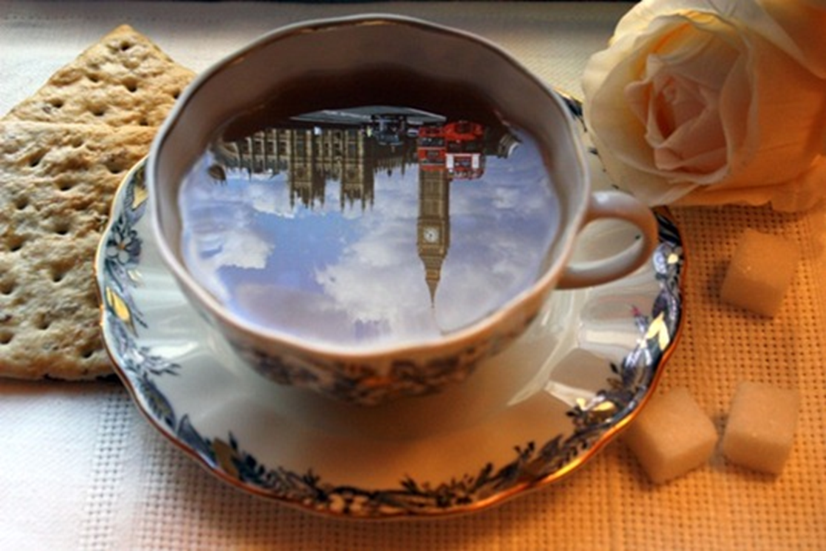
The end

Slide 29
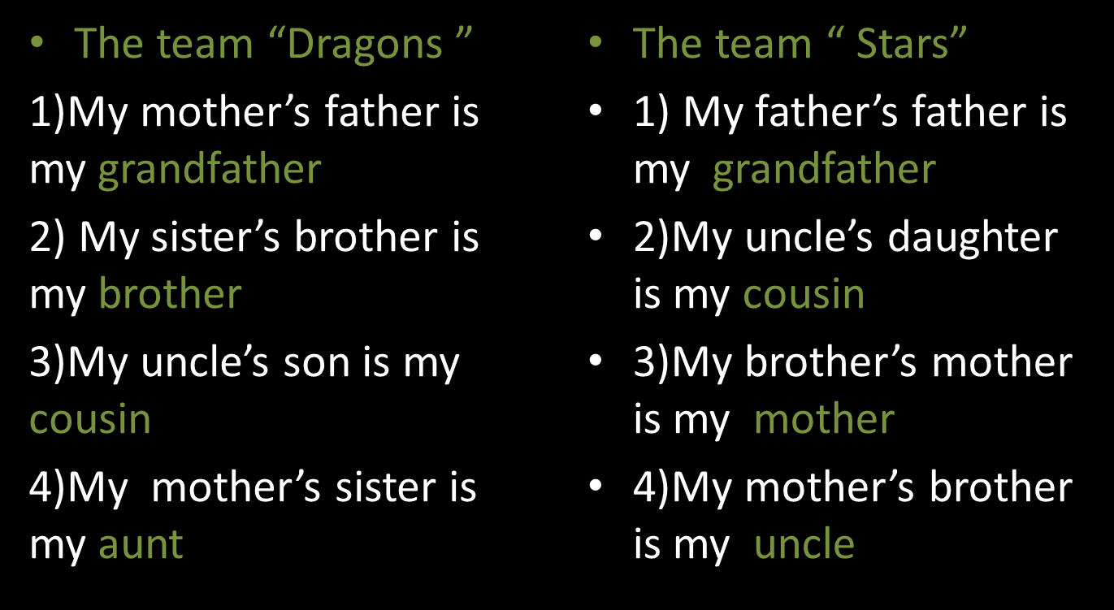

Slide 30
2) Complete the sentences. You have only 3 minutes to do it. You can have 1 point for answer
The team “Dragons ”
1)My mother’s father is my_____________
2) My sister’s brother is my_________
3)My uncle’s son is my ___________
4)My mother’s sister is my___________
The team “ Stars”
1) My father’s father is my ____________
2)My uncle’s daughter is my____________
3)My brother’s mother is my__________
4)My mother’s brother is my__________

Slide 31
1) Make up words using letters The topic is “Family” You have only 3 minutes to do it. You can have 1 point for answer
The team “Dragons ”
1) tehmor ________________
2) streis _________________
3) Daghuert ______________
4) ntau __________________

Slide 32
1) Make up words using letters The topic is “Family” You have only 3 minutes to do it. You can have 1 point for answer
The team “ Stars”
1)aterfh _____________________
2)elucn ______________________
3)bothrer _____________________
4)ons_________________________

Slide 33
4) Find and circle the word in the chain. You have 2 minutes
The team “Dragons ”
penreddressfamilyhappybuscatdogpet

Slide 34
4) Find and circle the word in the chain. You have 2 minutes
The team “ Stars”
badgoodfamilyyardlittlecuppetfoxcow

