Slide 1
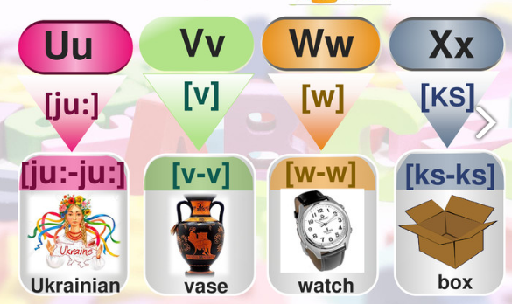

Slide 2
[
v
]
https://www.youtube.com/watch?v=QmHSpXZMuoc

Slide 3
uncle

Slide 4
umbrella

Slide 6
under

Slide 7
Ukraine

Slide 9
Vicky
[
v
]
https://www.youtube.com/watch?v=RSFphmV3Dvg

Slide 10
violet

Slide 12
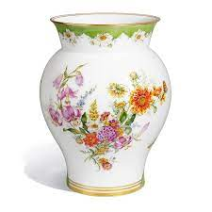
vase

Slide 13
volleyball

Slide 14
vegetables

Slide 15
volcano

Slide 16
victory

Slide 18
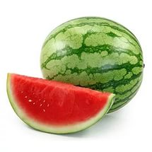
[
w
]
https://www.youtube.com/watch?v=Ib_u75rbY4E

Slide 19
water

Slide 20
wolf

Slide 21
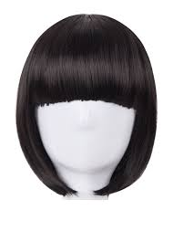
wig

Slide 23
window

Slide 24
winter

Slide 25
watch

Slide 27
Xx
[
]
https://www.youtube.com/watch?v=htN20Y5WDVw

Slide 28
six

Slide 29
box

Slide 30
fox

Slide 31
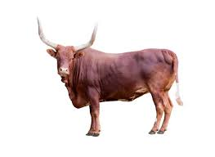
ox

Slide 33
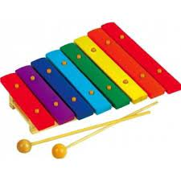
xylophone

Slide 34
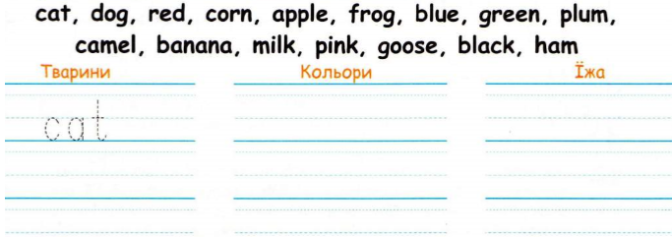
Розподіли слова у відповідні групи

