Slide 1
Presentation: Group 1 project
English in the New Context. Grades 7 - 9
2023

Slide 2
Our group
We are:
1.Olena Rafalska
2.Liubov Ivanenko
3.Iryna Bilohurska
4.Aliona Tsupko

Slide 3
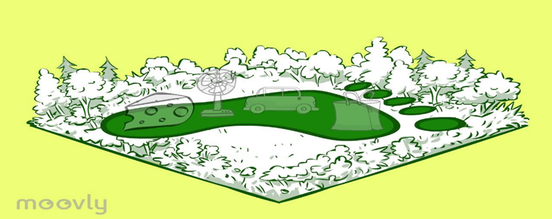
Class: 8th grade
Level: B1
Topic: Planet Earth
Subtopic: Ecological footprints

Slide 4
Aims

Slide 5
Aims & Outcomes
Aims: --
to raise students’ awareness about ecological problems and develop their responsibility for the future of our planet;
to develop students’ 4C skills through the engaging interactive tasks;
to practice using digital skills through the use of different online apps and platforms;
to encourage students’ autonomy by introducing a flipped home-assignment.
By the end of the lesson students will be able to:
to use active vocabulary on the topic ‘environment’;
to identify why some objects are bad for the environment;
to make a list of ideas about how they could reduce ecological footprints;
to talk about the future and ecology.

Slide 6
Aims & Outcomes
Digital literacy:
Communication: pair-work (students exchange the main points of the texts from their home-assignment in Break-out rooms), group-work (students discuss their ideas in Break-out rooms).
Information: students use perplexity.ai/ and Google search to find information why some objects are bad for the environment
Production: students use Padlet Wall to post their digital vocabulary item; they also use Jamboard to list their ideas;
Autonomy: Students work in Zoom, which enables them to use all tools there ( annotations, Break-out rooms and Chat), they also do their flipped home-assignment, which also boosts their autonomy
Outcomes:
By the end of the lesson, students practised using active vocabulary on the topic “environment”, identified why some objects are bad for our environment, made a list of ideas about how they could reduce ecological footprints, talked about the future and ecology.
All the aims were achieved by the end of this lesson.

Slide 7
Overview

Slide 8
Overview
Before the lesson students:
read the text in Student’s Book and get basic information on the topic do a follow-up activity in Google Form, learn the basic vocabulary in Quizlet, make a video dictionary for one item and upload it onto Padlet Wall.
While the lesson students:
do a research on the most harmful thing to the environment discuss the texts, watch the video,make up a list of ideas.
After the lesson students:
do a project work: infographics and give their feedback in Google Form

Slide 9
Rationale

Slide 10
Rationale
The problem of the environment is vital today as it has never been before. That is the reason why we have chosen this topic for our lesson. Our main aim
of the lesson is to raise students’ awareness about ecological problems and develop their responsibility for the future of our planet.
The structure of the lesson enhances students’ understanding of the topic, making them active citizens of the planet Earth. The choice of activities boosts students’ vocabulary activating it in pair and group communication.
The set of digital tools engages students in the learning process, providing the opportunity for the development of students’ 4C skills and digital literacy during remote lesson.

Slide 11
The lesson

Slide 12
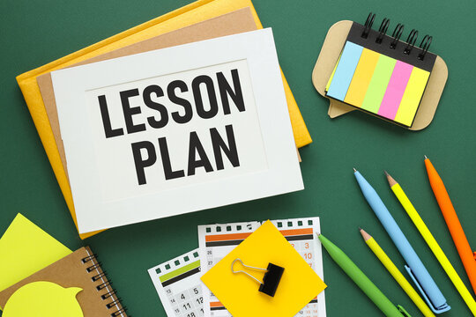
The lesson
The procedure of the lesson is the following:
Before the lesson ( Individual work): students fulfill flipped home-assignment

Slide 13
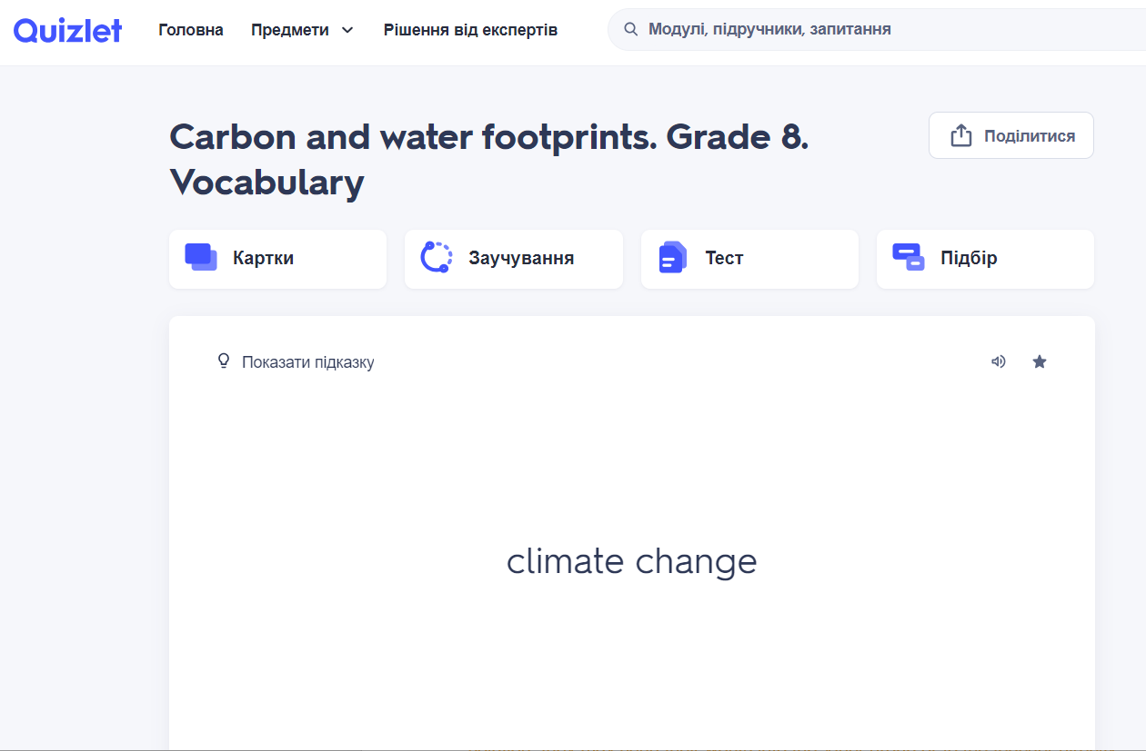
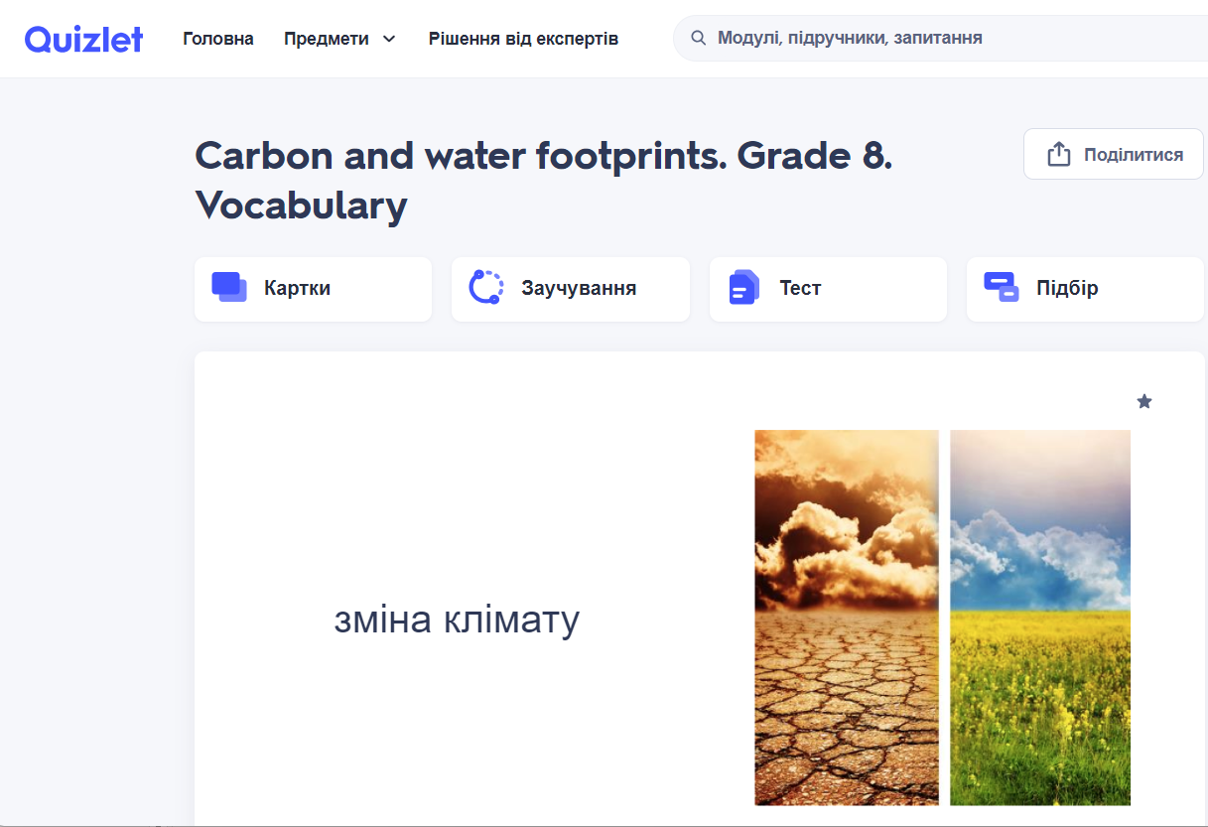

Slide 14
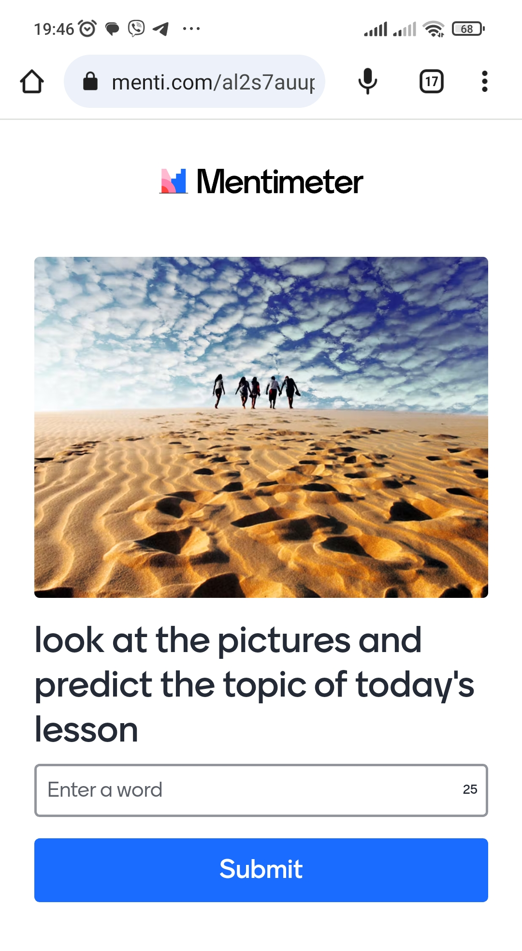
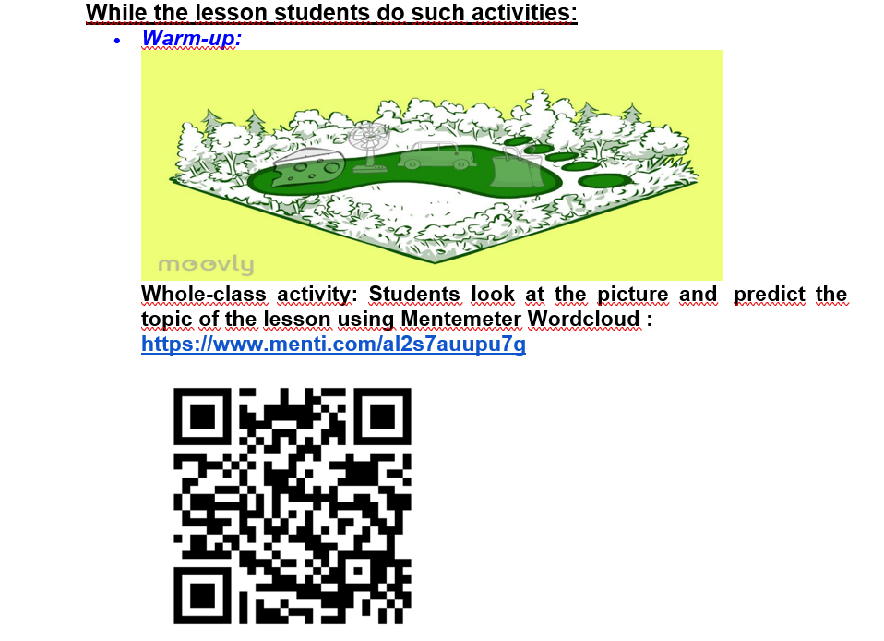
While the lesson students do such activities:

Slide 15
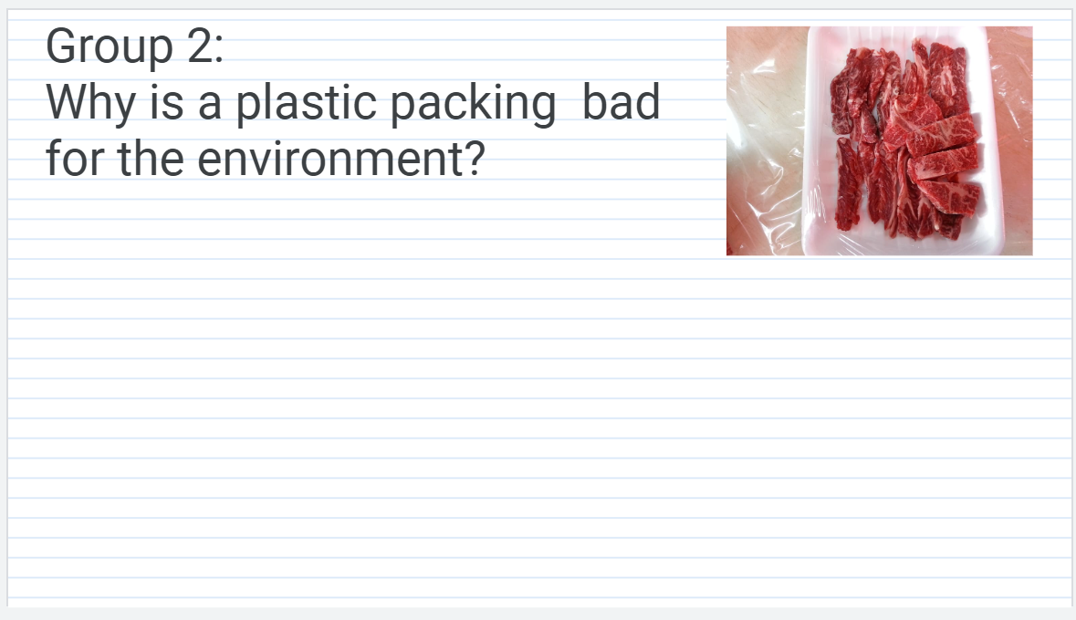
Lead-in activity: students work in groups and do research about the most harmful object using AI tool, Mentimeter and Jamboard;

Slide 16
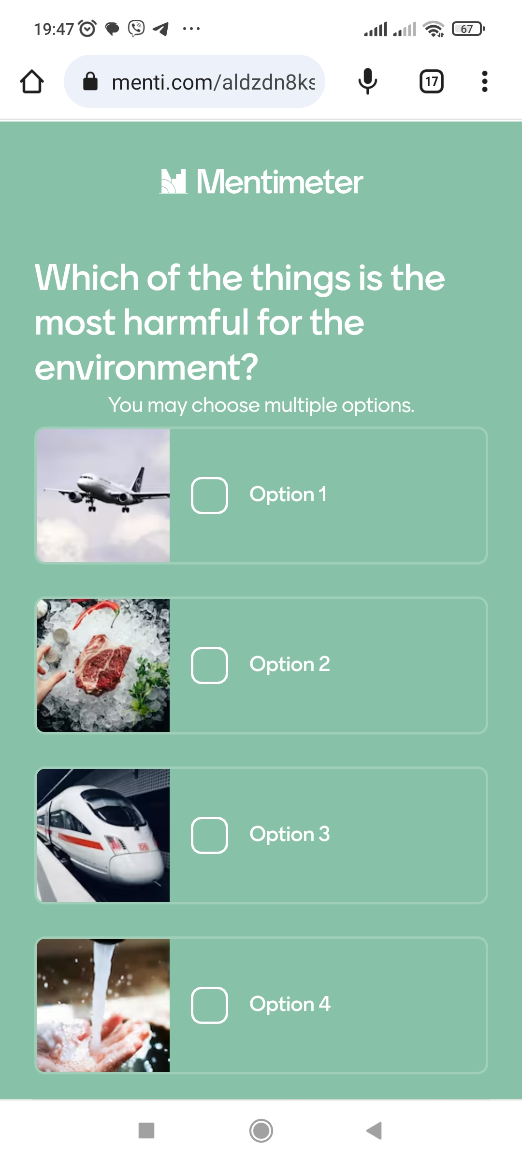
Lead-in activity: students work in groups and do research about the most harmful object using AI tool, Mentimeter and Jamboard;

Slide 17
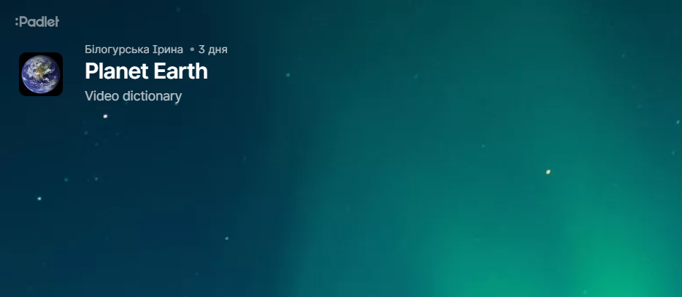
Checking home-assignment: teacher presents students’ video dictionary items using Padlet Wall;

Slide 18
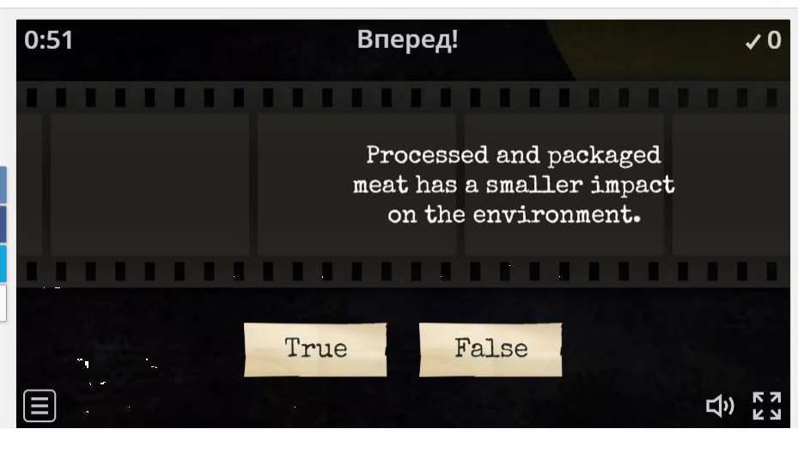
Speaking: students work in pairs, discussing the text , and do a follow-up activity using Wordwall;

Slide 19
Time to move: students dance using Justdance app;

Slide 20
Watching video:
-
-While-watching task: students
do a fill-in-the-gaps exercise in the
Student’s book;

Slide 21
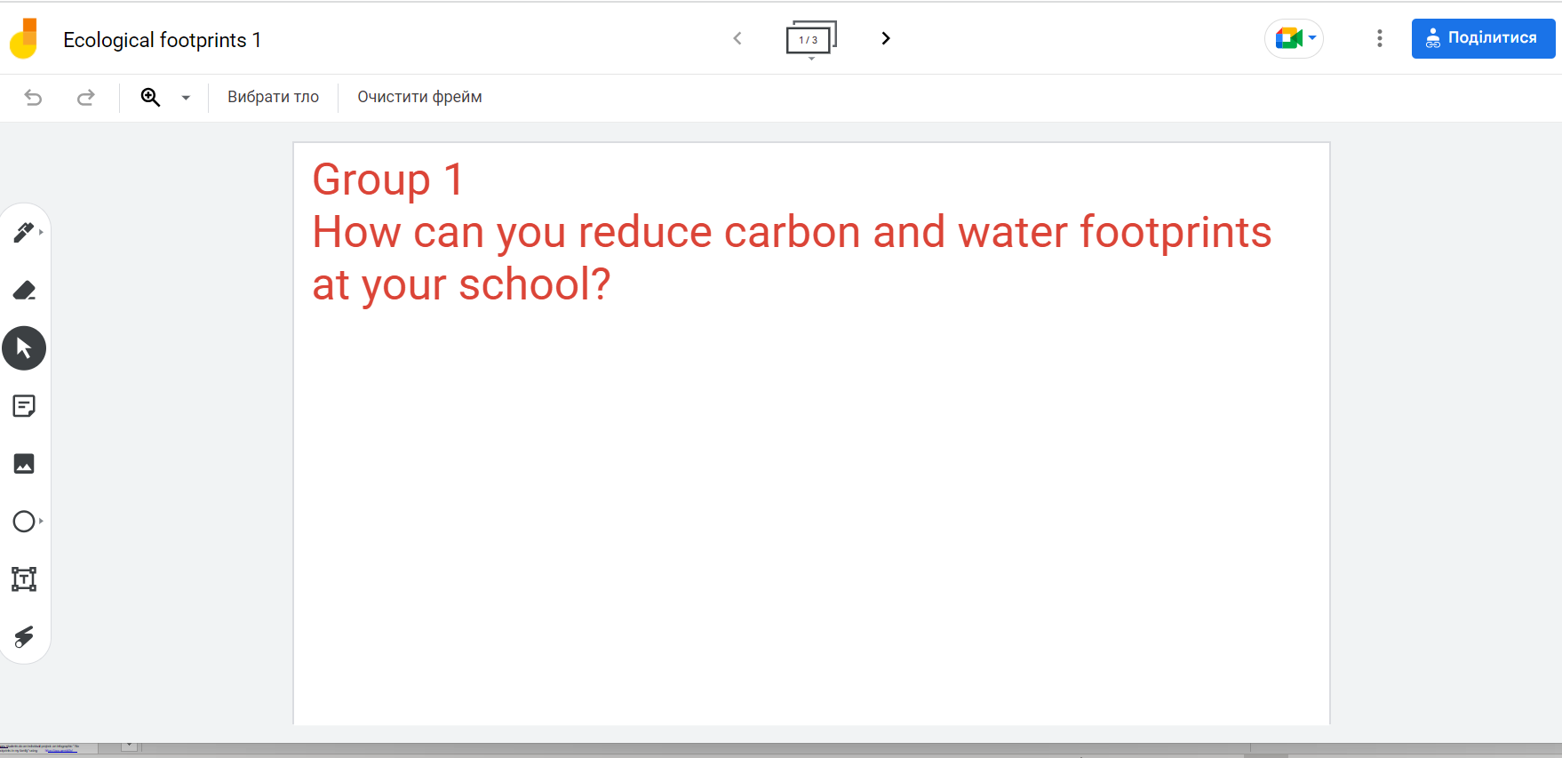
Watching video:
- Post-watching task:
* students work in the same groups,
they add the ideas from the video
to their lists, using Jamboard;
https://jamboard.google.com/d/1AOoJKf4isEhdPmA29cfpAnLJ4oo_VQIqibQOJFEOOlc/edit?usp=sharing
* Speaking: students present their ideas
on how to reduce ecological footprints.

Slide 22
After the lesson:
*students do an individual-project: an infographic “ No ecological footprints in my family” using https://app.genial.ly/
* they also complete feedback on the lesson in Google Form.
https://docs.google.com/forms/d/e/1FAIpQLSc3Y6cgbaO3-aRo1ZcVfLyPeyj9C83uRJ2Ckn6HPvqY1dhjSA/viewform?usp=sharing

Slide 23
Reflections & Analysis

Slide 24
Reflections
The students worked actively in pairs and small groups, they got a lot of meaningful information from the text and the video, they understood the main issues, they showed their ability to answer the questions, discuss the problems of the texts, make the list of ideas of reducing ecological footprints. They used a lot of digital tools to achieve the main aims.
Doing the research on the Internet, completing the sentences after watching the video were the most successful.
The students were able to do the research about the pictures, to think critically over the information from the Internet using research links, to find and formulate the ideas from the video and do the fill-in-the-gaps exercise correctly, to produce creative ideas about how they can reduce ecological footprints in the future.
The students were thrilled to work with AI Tool, they also enjoyed expressing their ideas with Mentimeter.
Some students couldn’t follow the link and express their point of view in Mentimeter voting because of the slow Internet connection.
There were too many digital activities and the lesson was a bit overloaded. Perhaps, it would be better to include one Jamboard and one Mentimeter activity not two.
The duration of the lesson was more than 45 minutes.It took more time to organize discussions in pairs and small groups in breakout rooms, the students couldn’t join them quickly.

Slide 25
Outcomes

Slide 26
Outcomes
students raised awareness about ecological problems and developed their responsibility for the future of our planet;
students developed 4C skills through the engaging interactive tasks;
students practiced using digital skills through the use of different online apps and platforms;
students developed their autonomy by fulfilling a flipped home-assignment.
students used active vocabulary on the topic ‘environment’;
students identified why some objects are bad for the environment;
students made a list of ideas about how they could reduce ecological
footprints;
students talked about the future and ecology.

Slide 27
Action points

Slide 28
Action points
Next time we would plan the lesson more carefully,
paying more attention to timing.
We would include only one Mentimeter and one Jamboard activity.
While planning a remote lesson the teacher should find balance between digital and non-digital tools.
We should always have a plan B for problematic situations.

