Slide 1
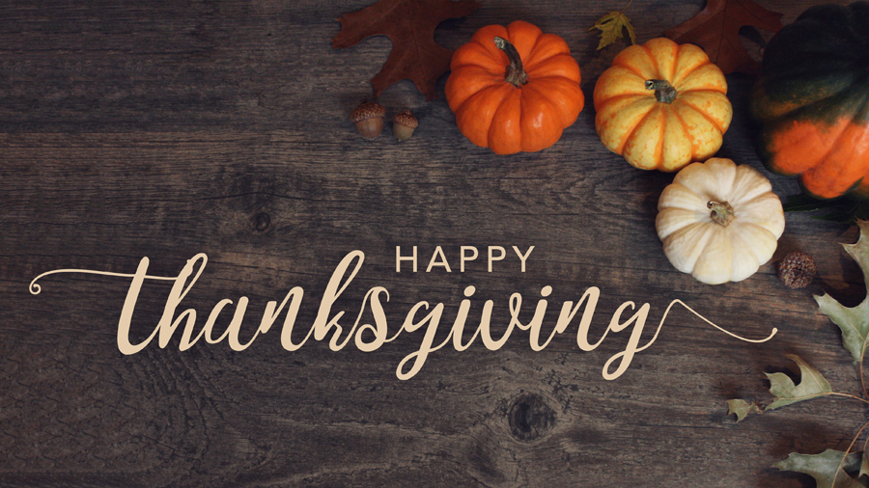
Thanksgiving Day
Це фото; автор: Невідомий автор; ліцензія: CC BY-NC-ND

Slide 2
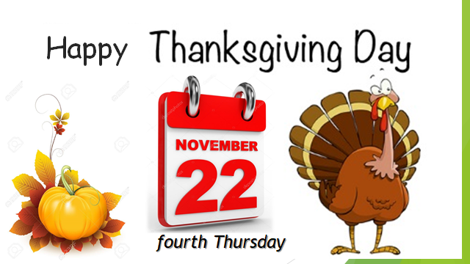
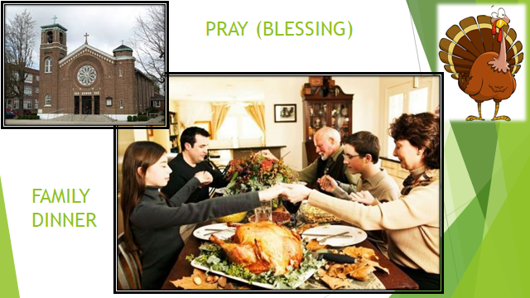
The fourth Thursday of November is the
Thanksgiving Day. There is no more American
festival like Thanksgiving. Americans associate this day with the opening up new lands.
For 27% of Americans is this day the most favouritЕ one. There are several traditions, connected with day. First of all it is a family holiday. Each family member goes to church. Then they gather together at the table and eat the traditional dish of the day-turkey.

Slide 3
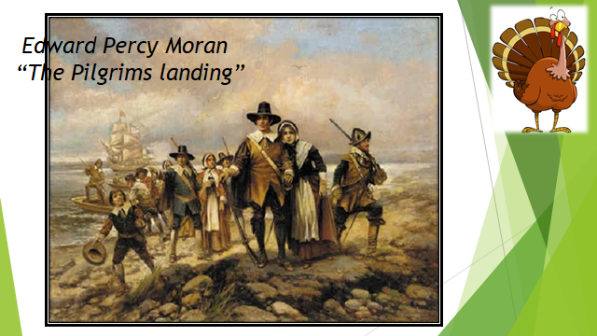
The first Thanksgiving Day was celebrated by
Pilgrims in 1621. They come from England for religious freedom. They sailed from Plymouth, England, on September, 16, 1620. Their ship was called “the Mayflower”. They landed at Plymouth Rock(скала), in Massachusetts, on December 26, 1620. The first winter was a terrible time. There was much sickness and starvation(голодування).
Native Indians taught the Pilgrims how to plant, to fish, to hunt and how to survive(виживати) in America. The crops(врожай) did well, and in the fall of 1621 the Pilgrims had a great harvest. They were very thankful and decided to celebrate with a feast(бенкет, застілля). The Pilgrims invited their Indian friends to share this Thanksgiving feast.

Slide 4
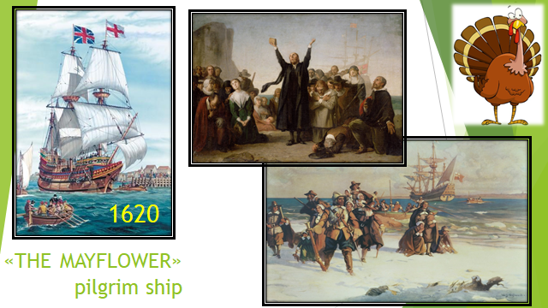
Thanksgiving Day comes on 4th Thursday in
November. It’s a legal holiday celebrated throughout(всюди) the USA.
People of all faiths(вірування) celebrate this day. They give thanks for the many good things in their lives. This is a family holiday.
Families come together from near and far. In some places special religious services(служби) are held(проводяться) in the morning. Then comes the traditional feast.
Turkey with stuffing(начинка) is the main dish. It is served with sweet potatoes, cranberry(журавлина, калина), sauce, and pumpkin pie. Apple cider is the drink of the day.

Slide 5
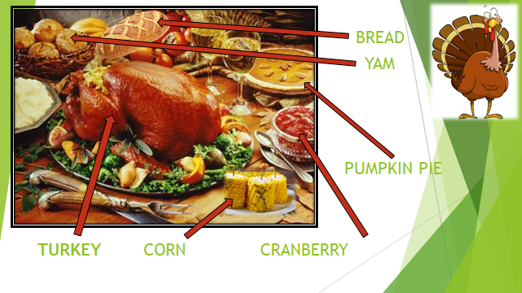
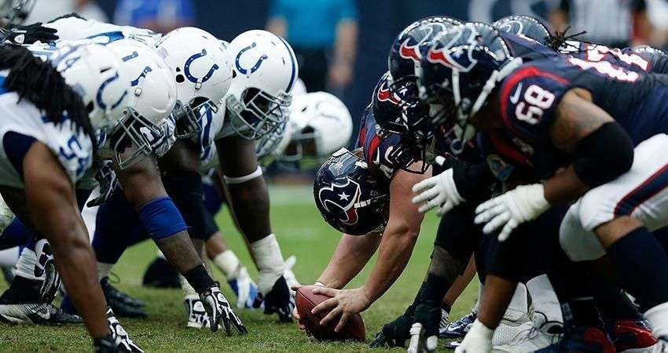
Football is the most popular game on the day.
In many schools the Thanksgiving game is the
most important one of the year. Usually there are several football games to watch on TV.
Macy’s department store holds its annual(щорічний) Thanksgiving Day Parade in New York City. Celebrities, floats(плавці), bands(гурти) and balloons shaped like story book and cartoon characters(герої) appear in the parade. Santa Claus arrives at the end. His coming marks the beginning of the Christmas Season.

Slide 6
Happy Thanksgiving! Vocabulary Word List
America autumn blessings bread celebrate colonists cook corn cranberry delicious dessert dinner eat family feast harvest holiday home Indians Mayflower meal | Америка Осінь Благословення Хліб Святкувати Колоністи Готувати Кукурудза Журавлина Смакота Десерт Обід Їсти Родина Бенкет Врожай Свято Дім Індіанці Мейфлавер Їжа | native New World November parade pie Pilgrims Plymouth Pray pumpkin religion stuffing thanks Thanksgiving Thursday tradition travel turkey vegetables yams ship | Корінний Новий Світ Листопад Парад Пиріг Пілігрими Племот Молитися Гарбуз Релігія Начиняти Вдячність Подяка Четвер Традиція Подорож Індичка Овочі Солодка картопля корабель

Slide 7
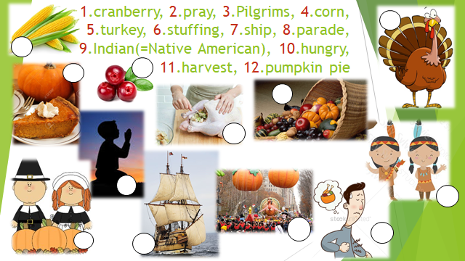
.
1. Is Thanksgiving a national holiday?
No
Yes
2. What were the travelers who settled in the Plymouth Colony called?
a. Pilgrims
b. Indians
3. What is the symbol of the holiday?
a. Turkey
b. Pumpkin Pie
4. Translate the sentence into Ukrainian:
-Thanksgiving is my favorite holiday.
-My pumpkin pie was gobbled up (поглинута, знищена) in the blink of an eye-

Slide 8
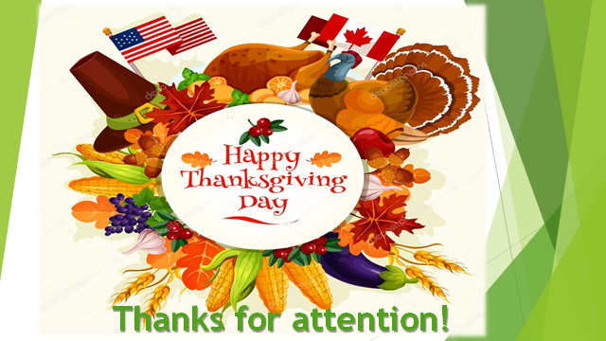
There are many things
I am thankful for.
I can find them near and far.
There are many things
I am thankful for.
Let me tell you what they are:
I am thankful for
Good food to eat,
I am thankful for my family,
I am thankful for all my friends,
And I’m thankful for being me

Slide 9

I am thankful for YOUR JOINING TO OUR EDUCATIONAL HOUR!!!
You hold a dear place in my heart, and during this Thanksgiving, you remain in my heart and prayers all around the year.
I hope all good things in life are yours, not just on Thanksgiving, but throughout the entire year as well.

