Slide 1
My Room

Slide 2
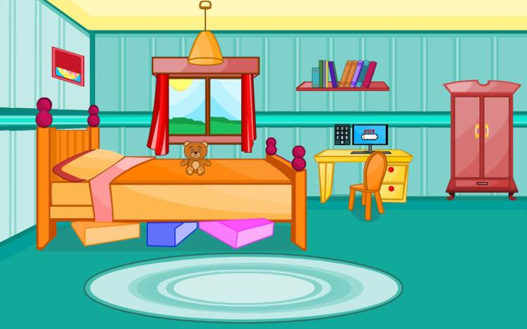
It is “My Room”
Yes, we are going to talk about our rooms and the things in our rooms. We are going to do many interesting exercises. Today we are going to make a project of the room we have to revise some words, preposition of places and at the end of the lesson you’ll present your projects about your rooms.

Slide 3

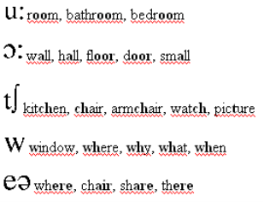
Фонетична зарядка

Slide 4
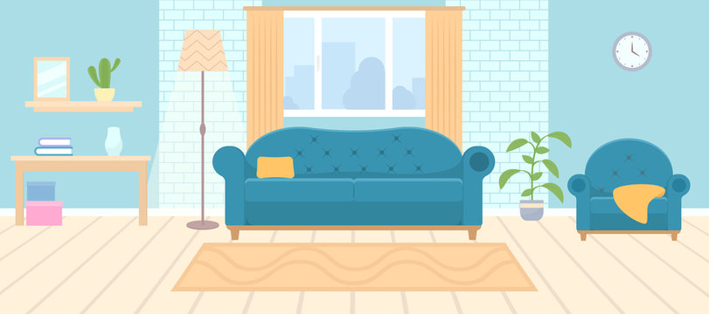
Lets guess the riddles
It is a room, where you can have a rest, watch TV, read books there. What room is this?

Slide 5
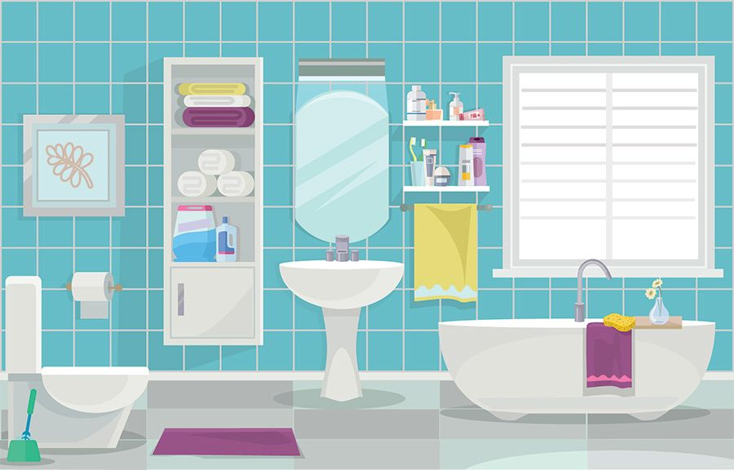
It is a room, where you can wash your hands, your face, clean your teeth, take a shower there. What room is this?

Slide 6
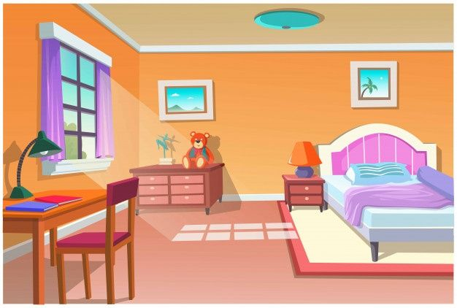
It is a room, where you can sleep there. What is this?

Slide 7
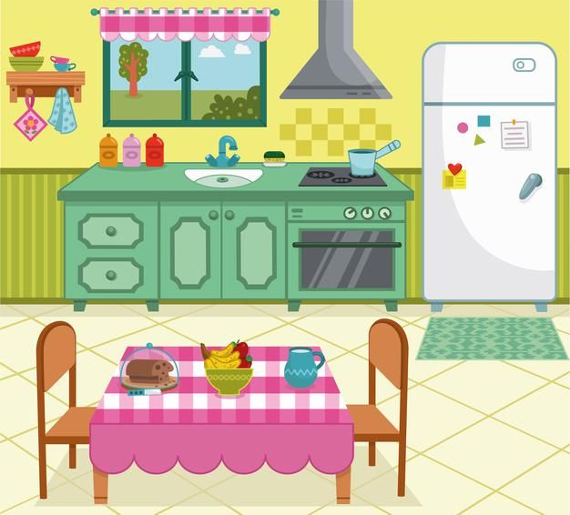
It is a room, where you can cook meals in this room. What room is this?

Slide 8
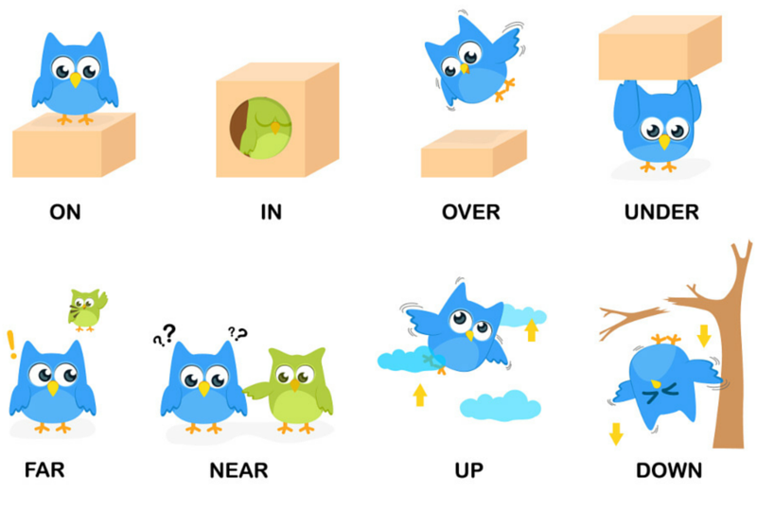

Slide 9
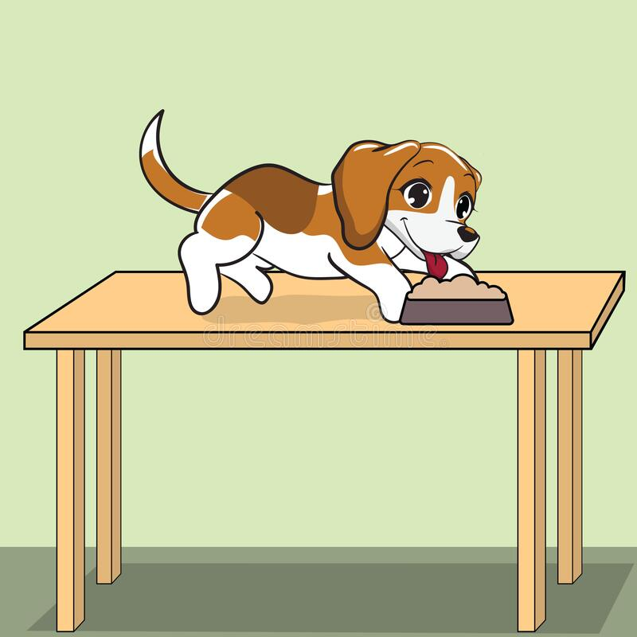
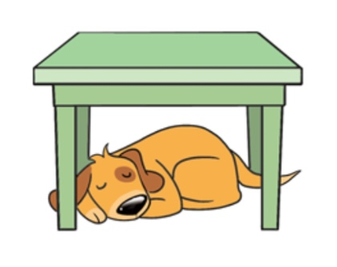
Where is the dog?

Slide 10
Your task is to make up the sentences
two chairs, There are, next to the desk.
on the desk, a lamp, There is.
a clock, above the bed, There is.
a sofa, There is, in front of the bookcase.

Slide 11
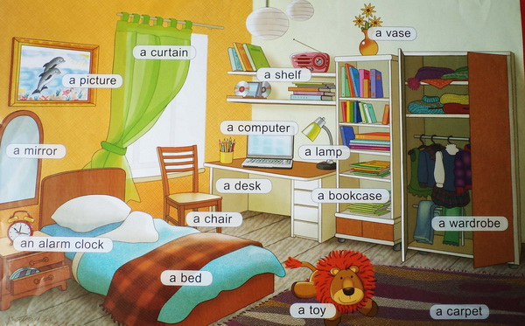
My Room

Slide 12

Home Task
Your task is to tell about your house and your room.

Slide 13

Do you like our lesson today?
Thank you for your work.

