Slide 1
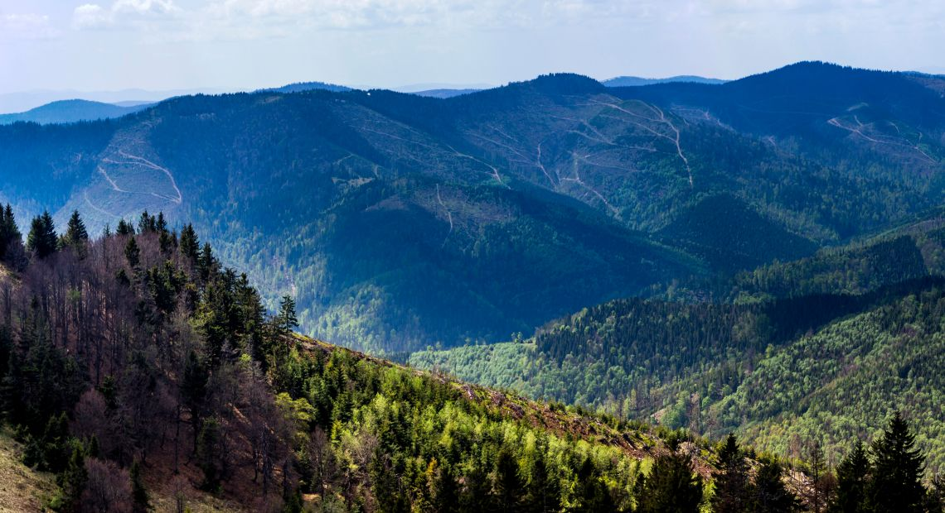
National parks and reserves
of Ukraine

Slide 2
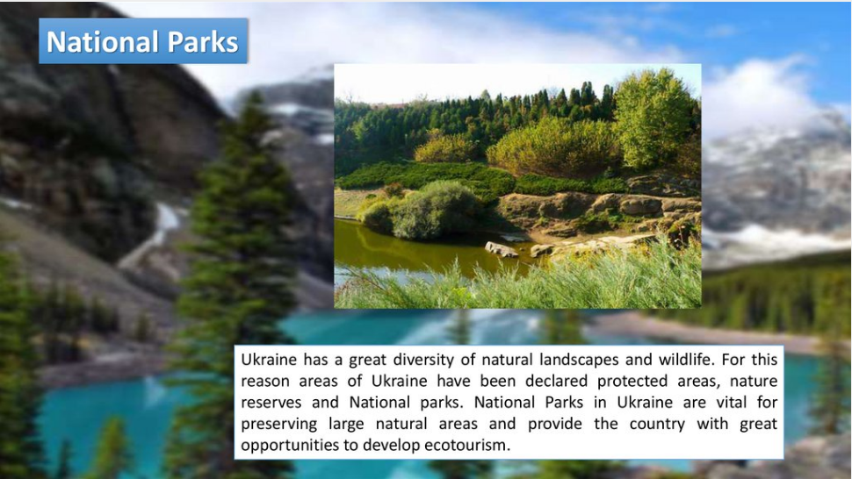

Slide 3
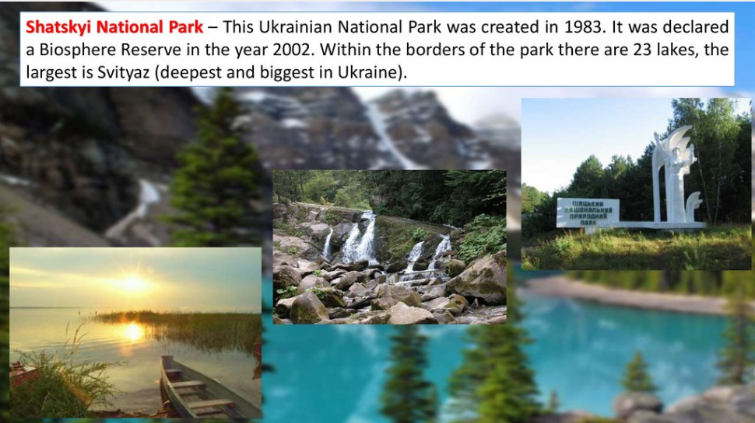

Slide 4
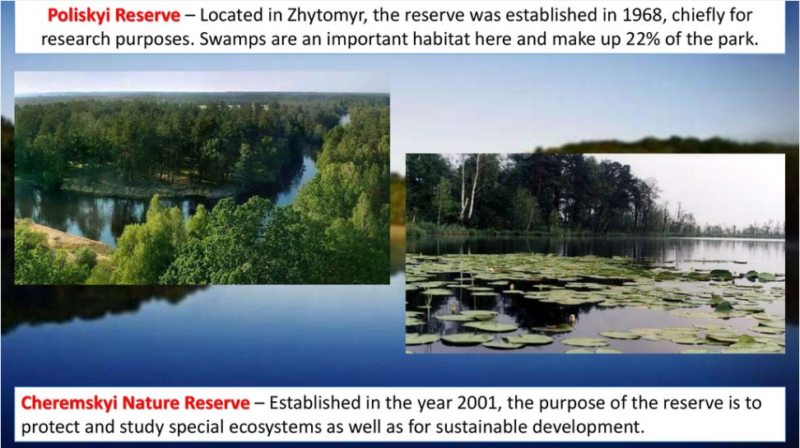

Slide 5
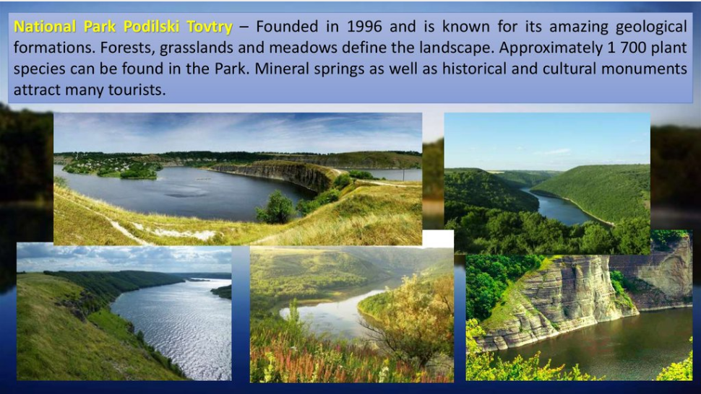

Slide 6
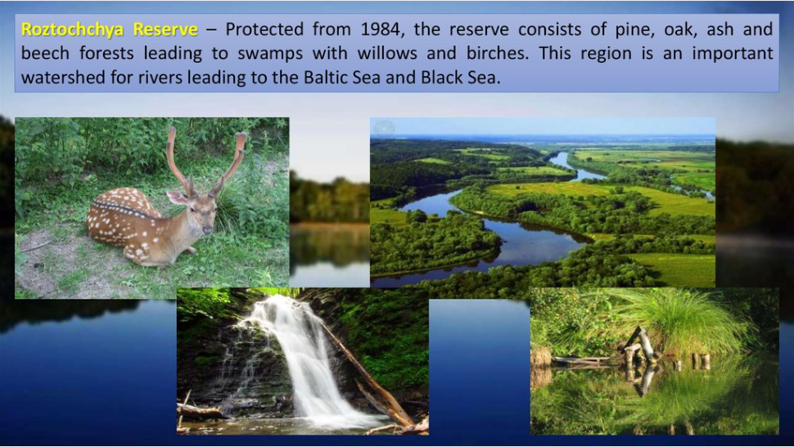

Slide 7
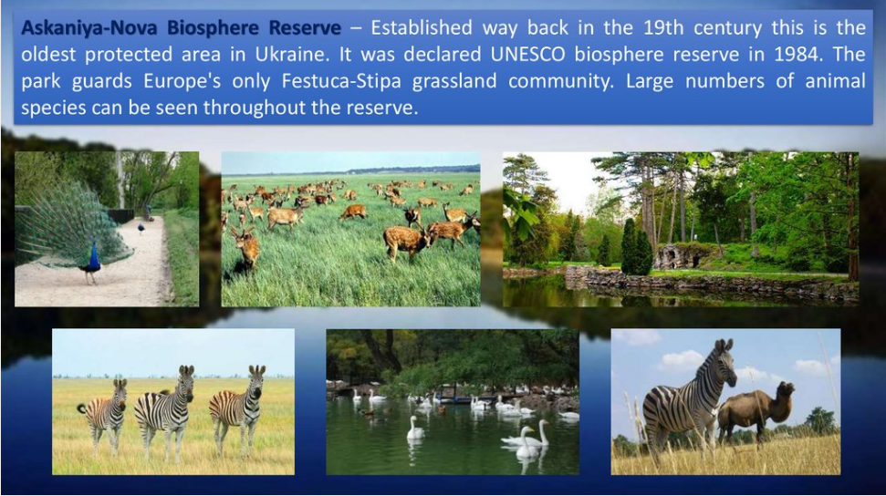

Slide 8
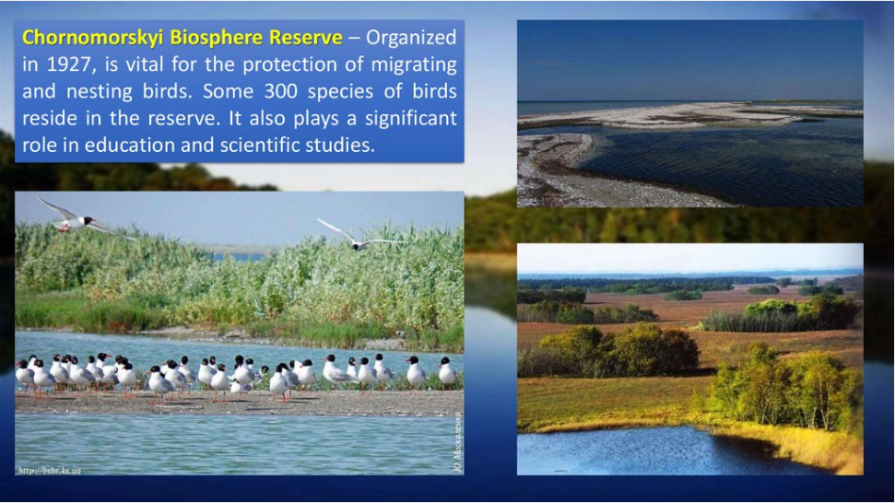

Slide 9
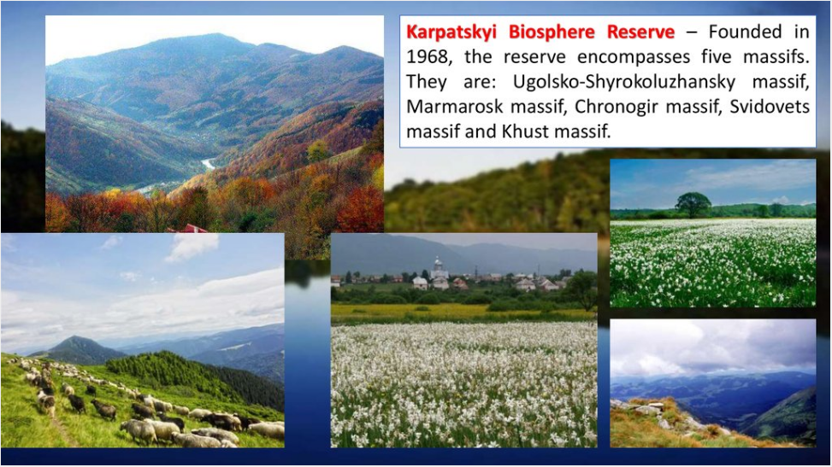

Slide 10
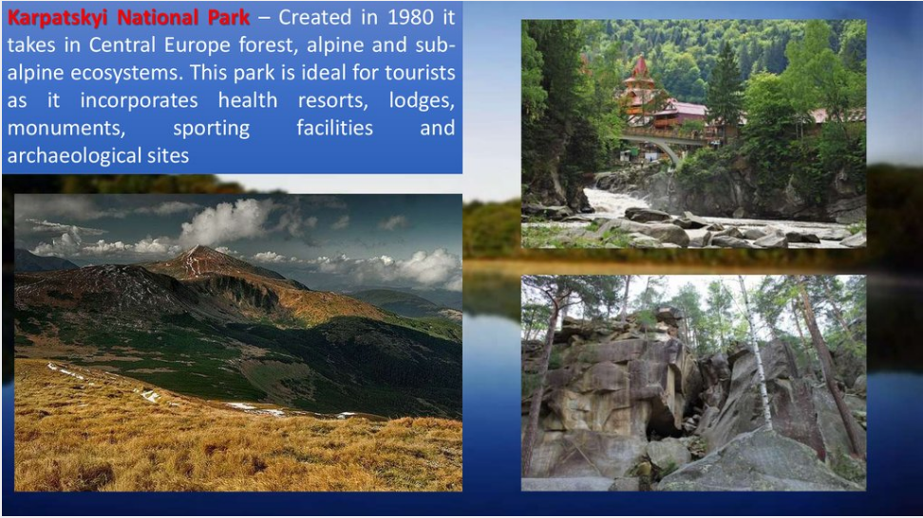

Slide 11
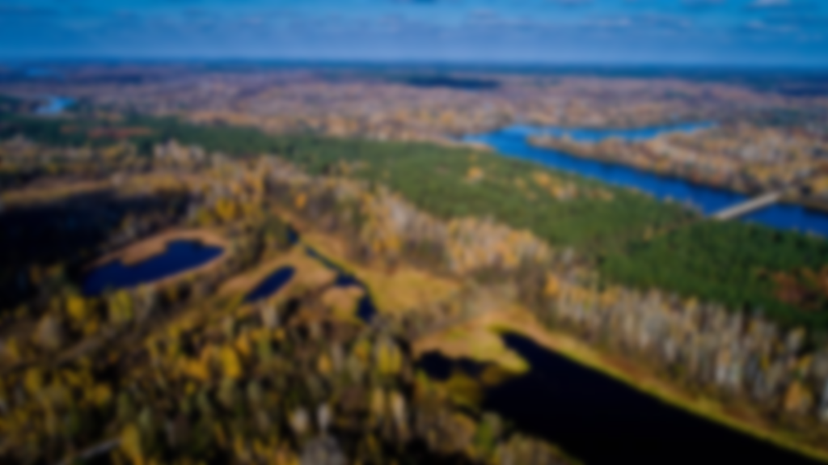
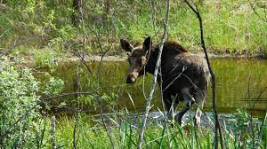
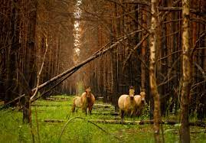
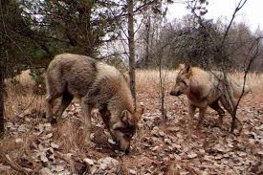
CHORNOBYL RADIATION AND ECOLOGICAL BIOSPHERE RESERVE
Uniqueness: this reserve appeared as a result of the anthropogenic catastrophe and demonstrates a post-apocalyptic period , the disappearance of man with absolute domination of animals and plants.
Founded in 2016 , this biosphere reserve is the youngest and biggest in Ukraine. According to the scientists, there are more than 400 species of animals, birds and fish in the reserve, including those found in the Red Book. Among them, Przewalski's Horse, wolves, lynx, bears, elks, white-tailed eagles. Most of them are typical for the European forest; therefore, they are extremely important for all European scientists

Slide 12
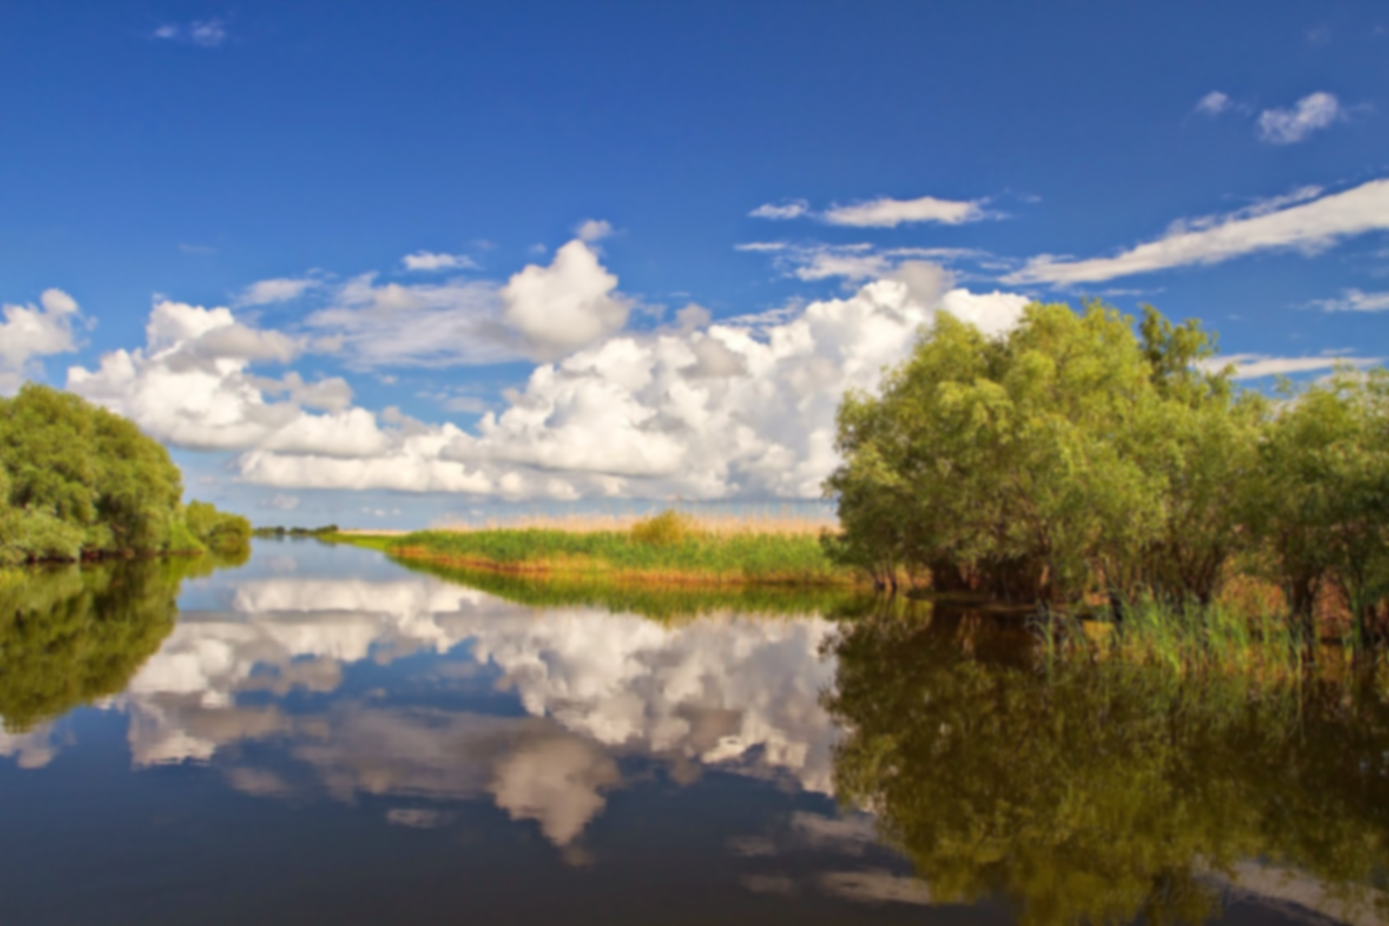
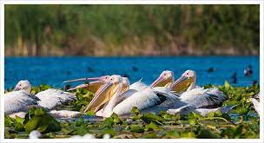
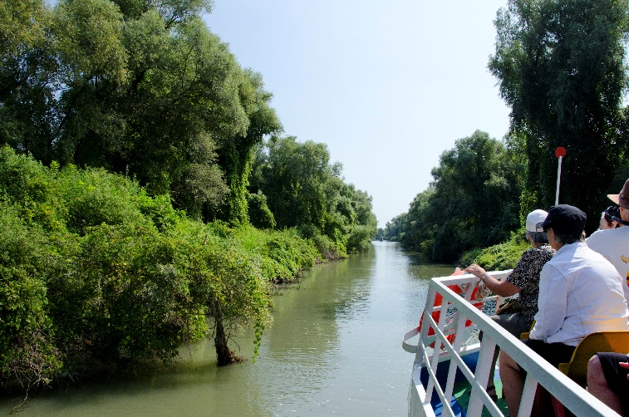
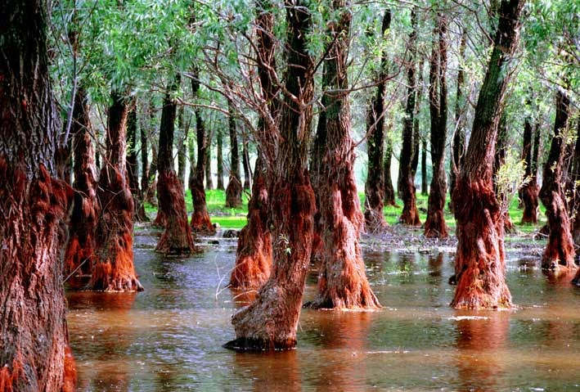
Uniqueness : Ukraine looks after processes of the continuous formation of the delta on the reserved territory. As a result, the Danube reserve automatically includes all newborns – islands, spit, etc – and its territory becomes bigger each year. In addition, among the insect species identified on the restricted area, seven were new to science.
Founded in 1927 , this reserve is headquartered in the town of Vylkove, situated on water arteries and is called Ukrainian Venice. Among the mammals to be found in the springhead of the Sasyk Reservoir, there are such species as ridge, fox, raccoon dog, badger, stone marten, pies, wood harrow, common carp, European mink, hare, grass squirrel, ordinary hamster, muskrat, and others.

