Slide 1
Відкритий урок. 2-А клас. Підготувала вчитель англійської мови Легка В.О

Slide 2
Seasons
and
Weather

Slide 3
Good morning,
dear friends!

Slide 4
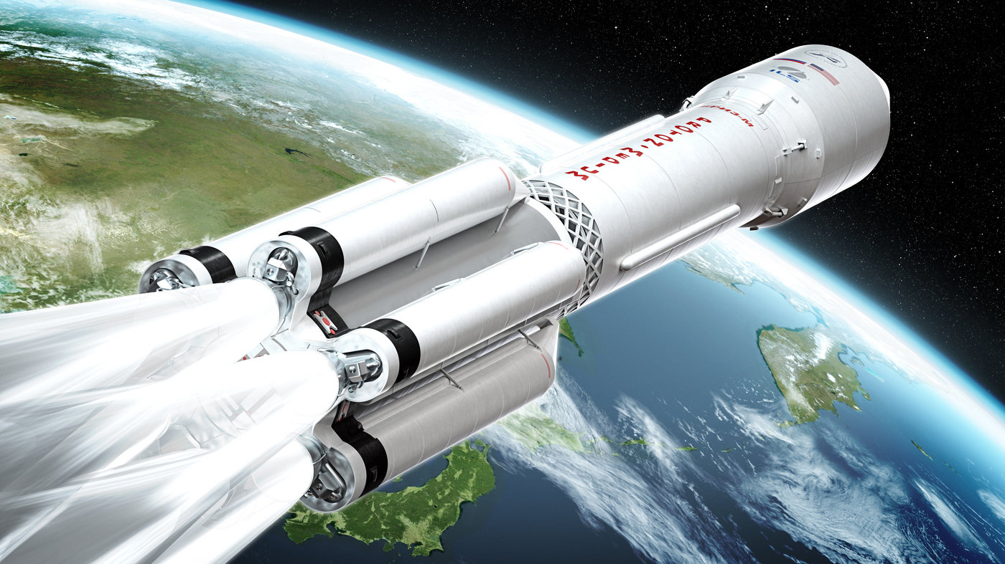

Slide 6
SEASONS OF THE YEAR
SPRING

Slide 7
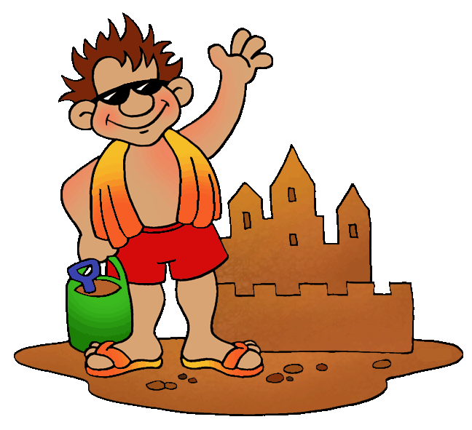
SEASONS OF THE YEAR
SUMMER

Slide 8
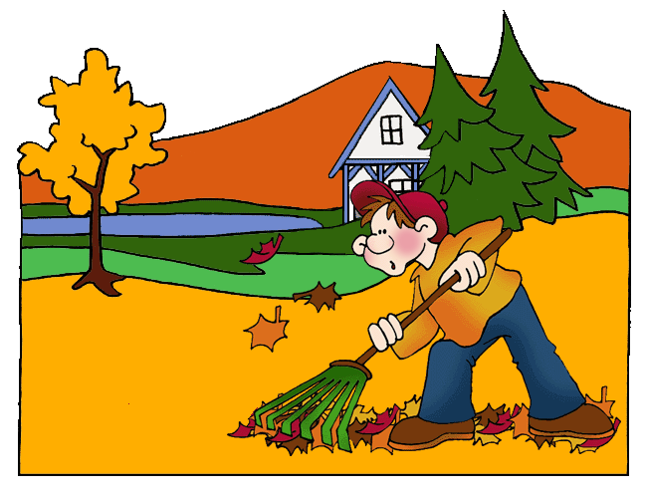
SEASONS OF THE YEAR
AUTUMN

Slide 9
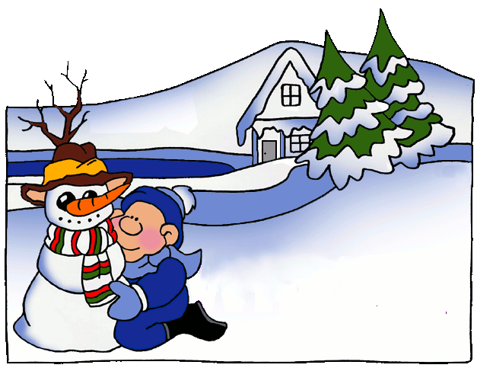
SEASONS OF THE YEAR
WINTER

Slide 11
Spring is green, Summer is bright, Autumn is yellow, Winter is white.

Slide 13
Do you like…..?
Yes, I do
No, I don’t
My favourite season is….

Slide 14
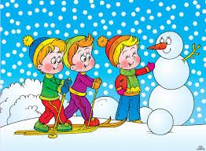
Make a snowman – ліпити сніговика
Children – діти
Bright – яскравий

Slide 17
Good luck!
Have a nice day!

