Slide 1

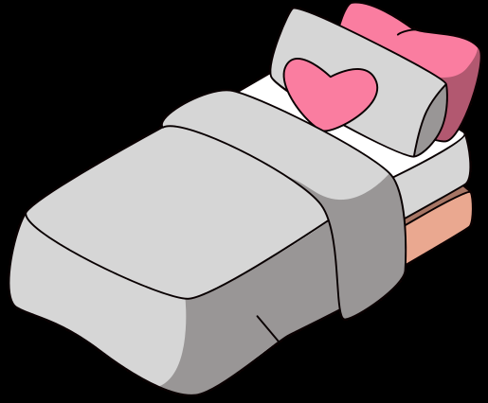
GRAMMAR
There is
There are

Slide 2


There is
однина

Slide 3
There is
однина
a
a bed

Slide 4

s
There is
однина
a
a bed

Slide 5
bed
s
There are
множина
a

Slide 6
There are
множина
two
a
bed
s

Slide 7
There is
no

Slide 8
There is
no
There is no bed in my house.

Slide 9
There are
no

Slide 10
There are
no
There are no beds in my house.

