Slide 1


Please access a copy of NHD’s new teacher guide on the flash drive OR at www.nhd.org/library-congress-tps.
All materials from today’s workshop are posted at: tinyurl.com/NHD-RhodeIsland-21

Slide 2


Engaging Students in the NHD Process
Lynne O’Hara, Director of Programs, NHD

Slide 3

Welcome / Introductions

Slide 4
Agenda – Wednesday, October 27, 2021
Time | Goal
4:30-4:45 | Welcome, orientation, introductions
4:45-5:00 | What is NHD? Why should you use this in your classroom?
5:00-5:30 | Theme 2022 Deep Dive: Debate & Diplomacy in History: Successes, Failures, Consequences
5:30-5:40 | Break
5:40-6:00 | Selecting a Topic and Building a Research Plan
6:00-6:20 | Tips for Researching at the Library of Congress **Guided Research Homework
6:20-6:30 | Shameless Plugs and Upcoming Opportunities

Slide 5
Agenda – Wednesday, November 3, 2021
Time | Goal
4:30-4:45 | Welcome back, questions on searching the Library of Congress
4:45-5:30 | Primary Source Analysis (O-R-Q method)
5:30-5:40 | Break
5:40-6:00 | Setting up a Historical Claim or Thesis
6:00-6:20 | A-R-E Triangles
6:20-6:30 | Questions & Answers

Slide 6
Part One: What is National History Day?

Slide 7

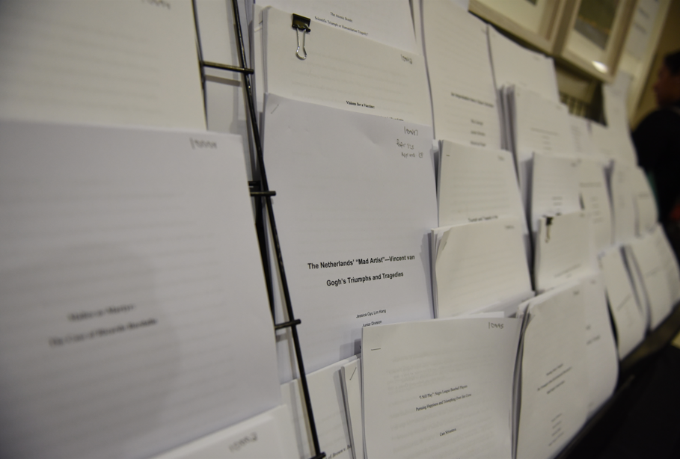

Papers

Slide 8
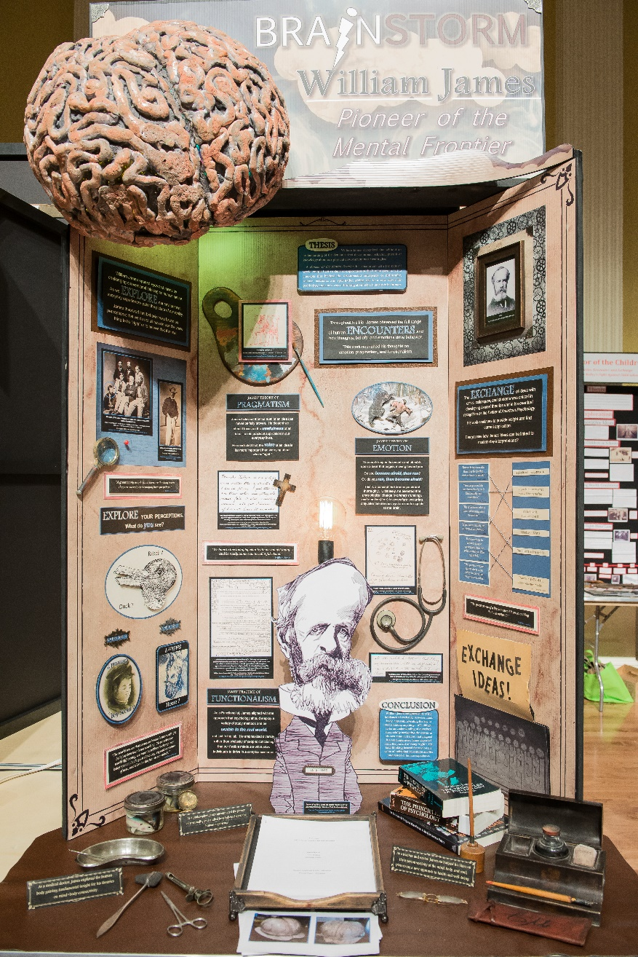
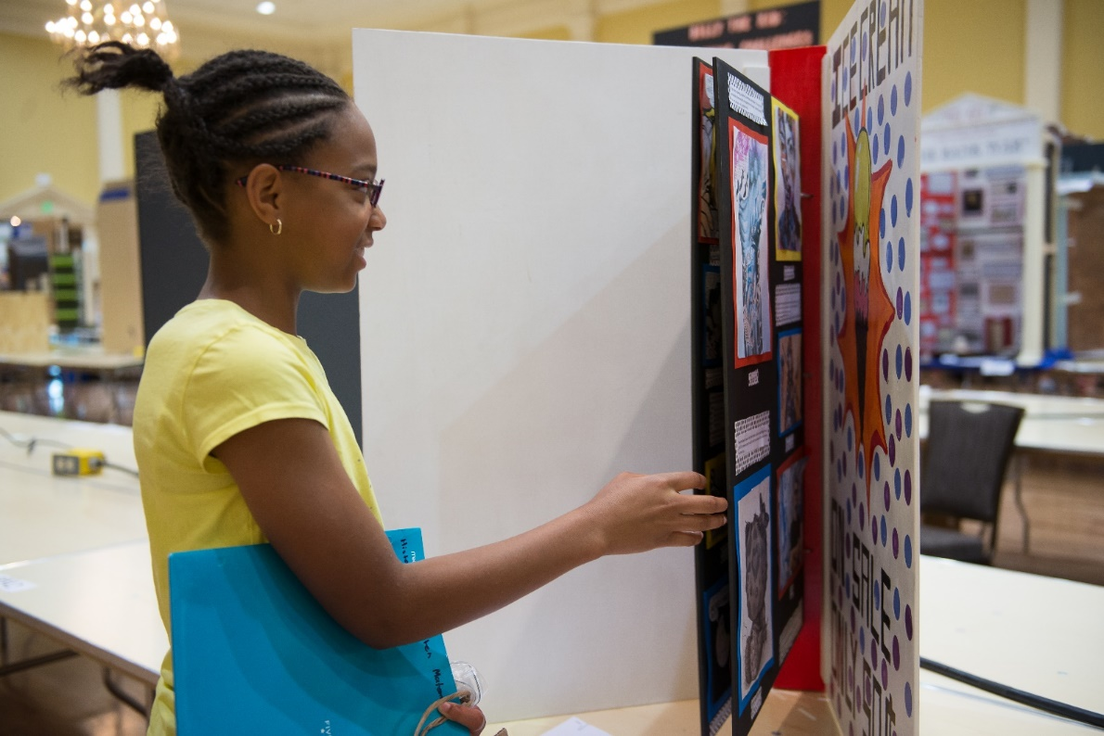
Exhibits

Slide 9


Documentaries

Slide 10
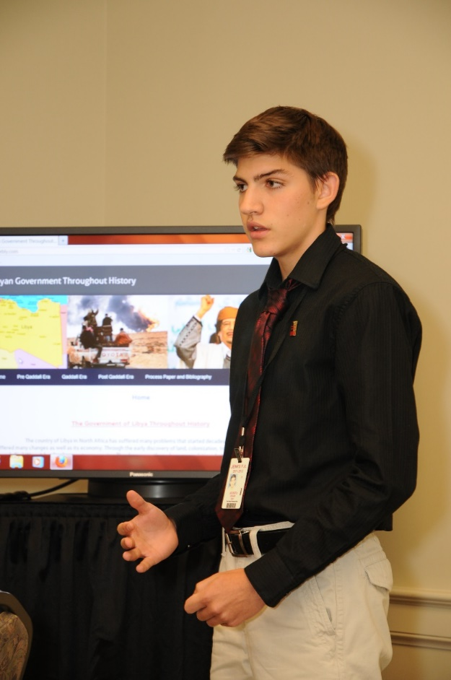
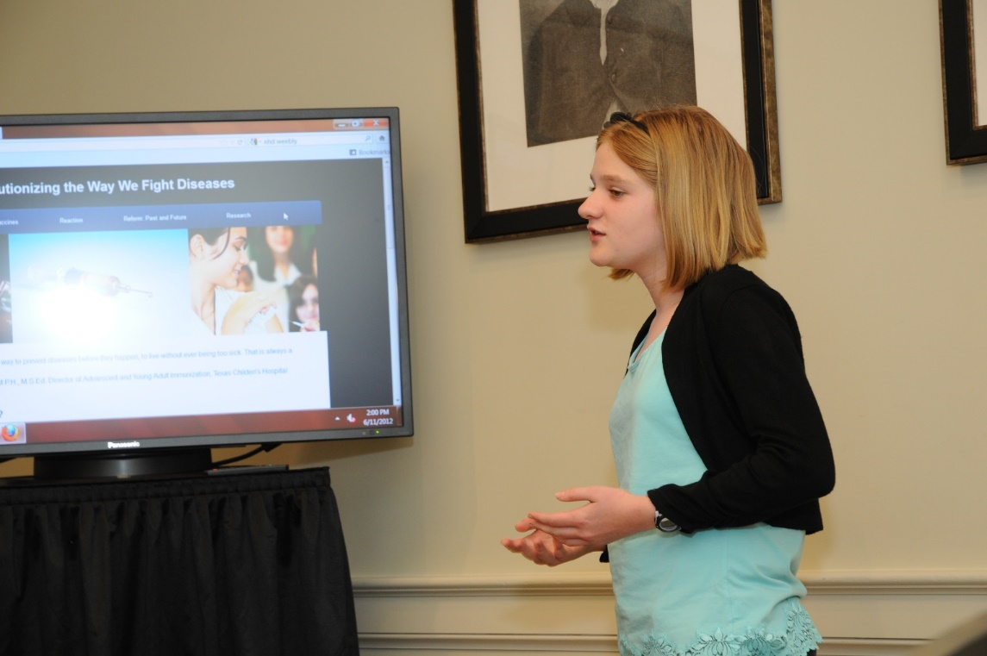
Websites

Slide 11
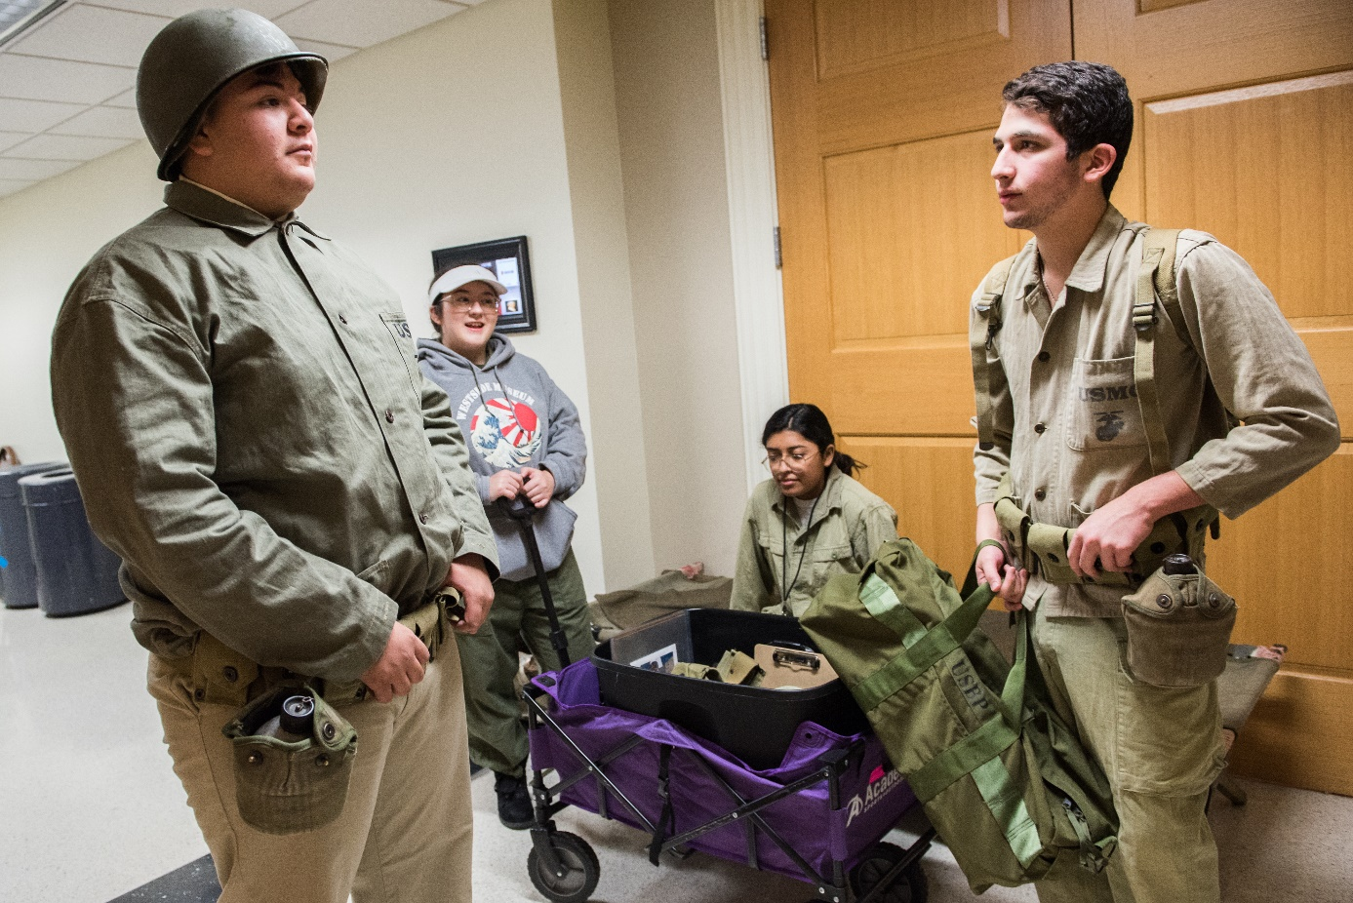
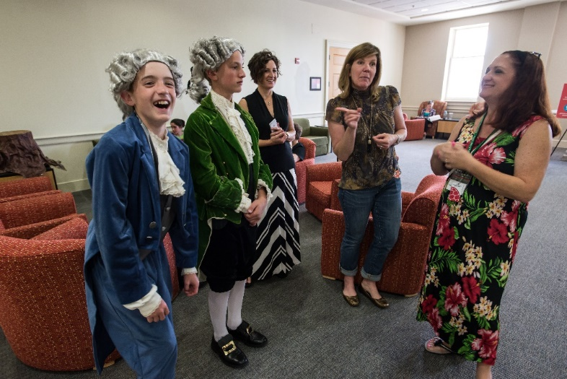
Performances

Slide 12


Slide 13

Part Two: 2022 NHD Theme Deep Dive
NHD.org/theme

Slide 14


NHD Theme Resources
NHD.org/theme

Slide 15
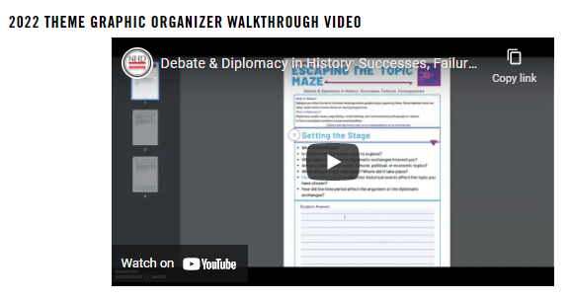
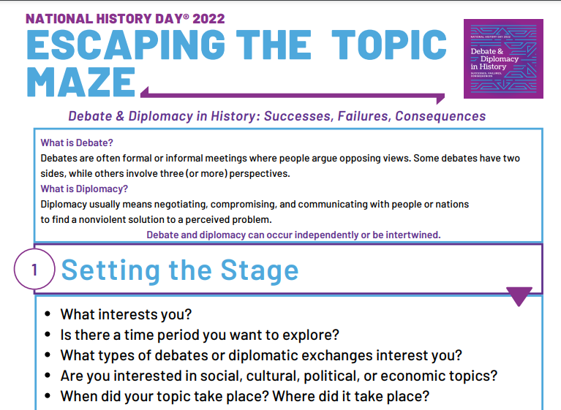
NHD Theme Resources
NHD.org/theme

Slide 16


NHD National Theme Resources
NHD.org/theme

Slide 17


Slide 18

Debate

Slide 19

Diplomacy

Slide 20

Who’s at the table?

Slide 22
Political | Economic | Religious | Social | Intellectual | Artistic | Military

Slide 23
Debate
Diplomacy

Slide 24
Diplomatic Action
Debate

Slide 25
Debate
Bigger Debate?
Diplomacy

Slide 26


Slide 27

Lewis Hine, Breaker boys working in…, January 1911
Library of Congress (2018676223)

Slide 28
Part Three: Selecting a Topic and Building a Research Plan

Slide 29


Part Three: Selecting a Topic and Building a Research Plan

Slide 30

Part Three: Selecting a Topic and Building a Research Plan

Slide 31

Building a Research Plan

Slide 32
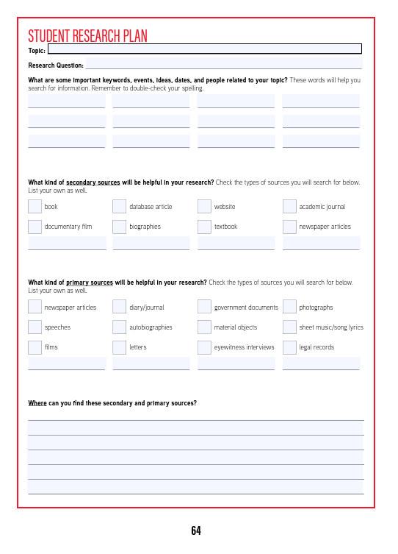
Building a Research Plan
Page 64 in the Teacher’s Guide (PDF page 66)
OR
Rhode Island resource folder (tinyurl.com/NHD-RhodeIsland-21)

Slide 33

What can I find in the Library?

Slide 34




Slide 35
Tips for Searching

Slide 36


Slide 37


Slide 38


Slide 39


Slide 40


Slide 41
A sort by relevance will give you the sources most likely to be helpful.
A sort by date or title will put the sources in chronological or alphabetical order, which is less helpful when you begin searching.

Slide 42

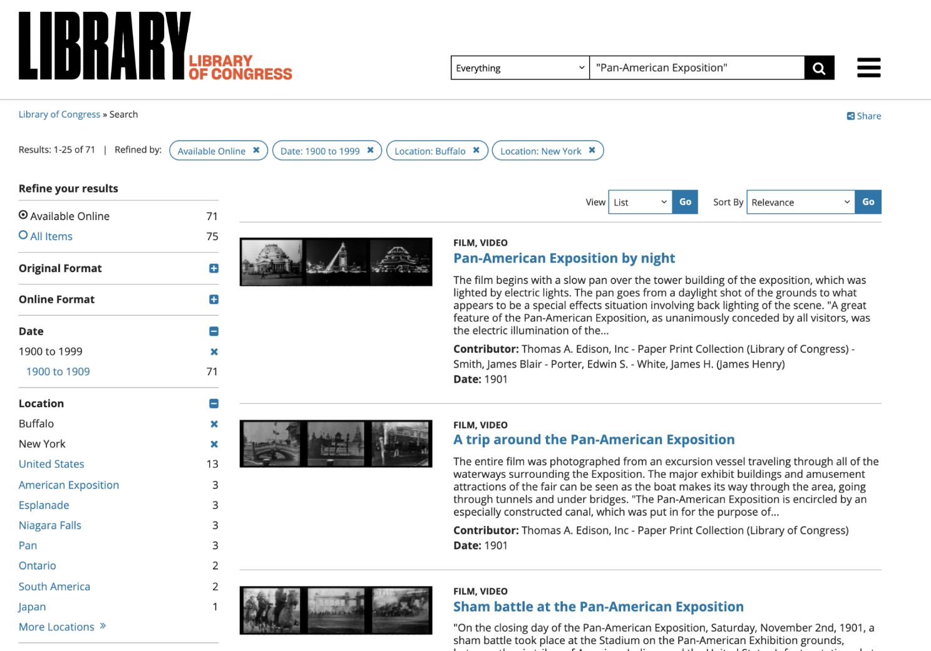

Slide 43
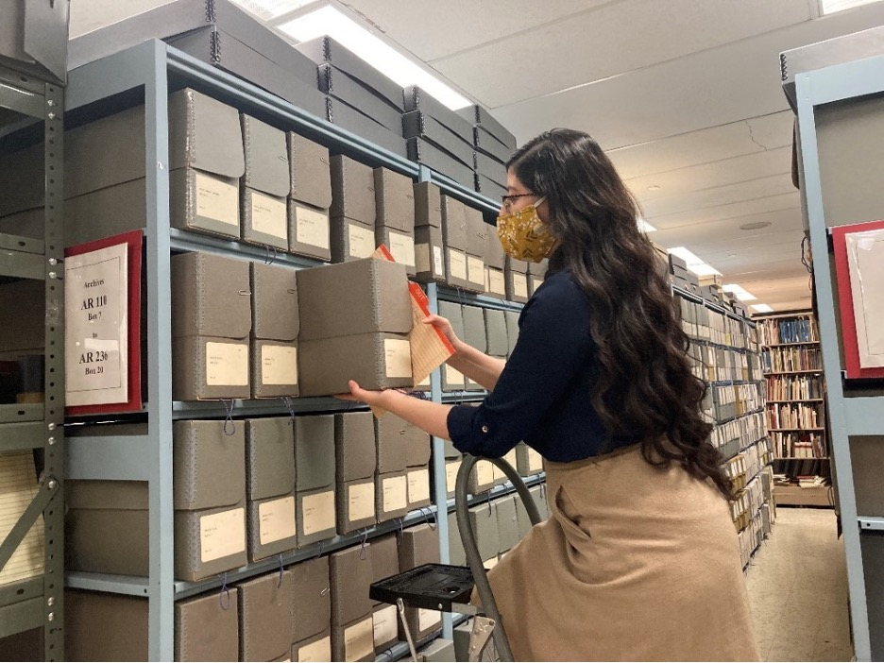

Slide 44
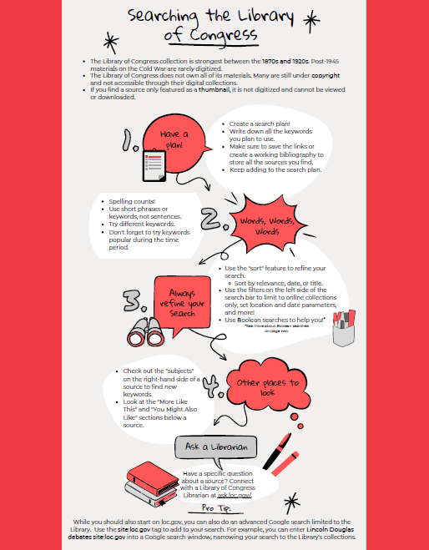
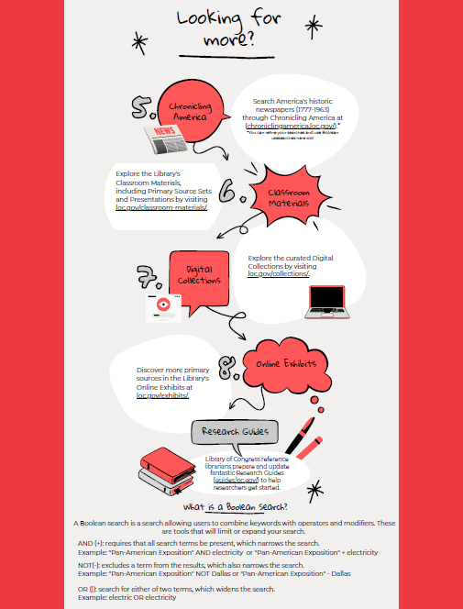

Slide 45

Student & Teacher Institutes
NHD.org/SSF2022

Slide 46

Historical Argumentation Webinar Series
NHD.org/PD

Slide 47


Classroom Materials
NHD.org/women-history
NHD.org/WWI

Slide 48


Classroom Materials
NHD.org/250
NHD.org/library-congress-tps

Slide 49


