Slide 1


Please access a copy of NHD’s new teacher guide on the flash drive OR at www.nhd.org/library-congress-tps.
All materials from today’s workshop are posted at: tinyurl.com/NHD-RhodeIsland-21

Slide 2
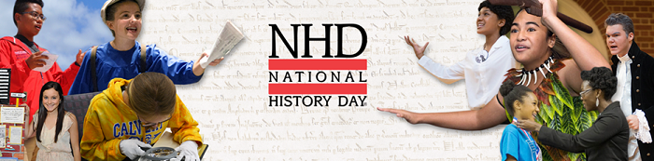

Engaging Students in the NHD Process (Part Two)
Lynne O’Hara, Director of Programs, NHD

Slide 3

Welcome Back / Questions on Searching the Library of Congress

Slide 4
Agenda – Wednesday, November 3, 2021
Time | Goal
4:30-4:45 | Welcome back, questions on searching the Library of Congress
4:45-5:30 | Primary Source Analysis (O-R-Q method)
5:30-5:40 | Break
5:40-6:00 | Setting up a Historical Claim or Thesis
6:00-6:20 | A-R-E Triangles
6:20-6:30 | Questions & Answers

Slide 5
Primary Source Analysis
Observe
Reflect
Question

Slide 6
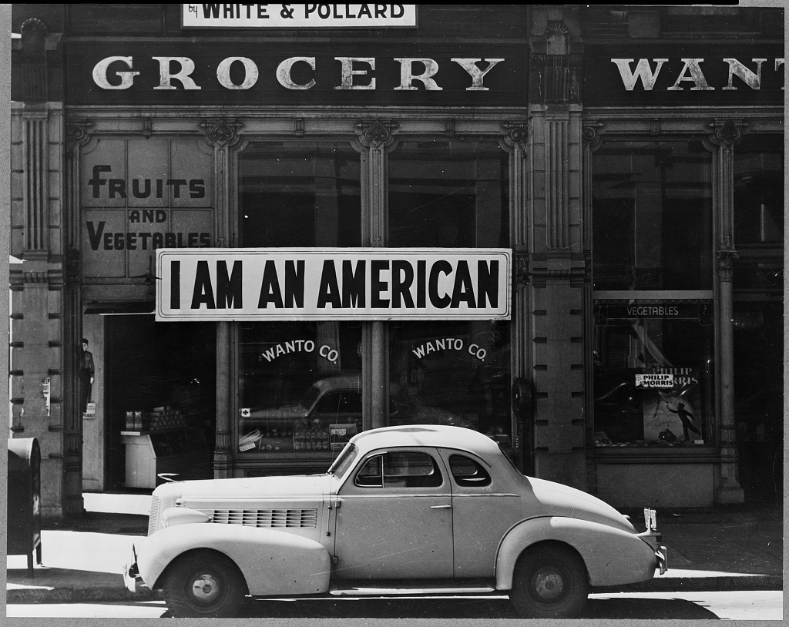
Library of Congress (2004665381)

Slide 7

Photographer: Dorothea Lange
Date: March 1942
Location: Oakland, California
Library of Congress access number: 2004665381
Title: Oakland, Calif., Mar. 1942. A large sign reading "I am an American" placed in the window of a store, at [401 - 403 Eighth] and Franklin streets, on December 8, the day after Pearl Harbor. The store was closed following orders to persons of Japanese descent to evacuate from certain West Coast areas. The owner, a University of California graduate, will be housed with hundreds of evacuees in War Relocation Authority centers for the duration of the war
Access: https://loc.gov/item/2004665381
Library of Congress (2004665381)

Slide 8
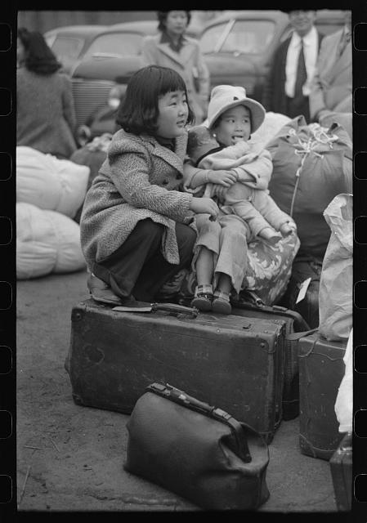
Library of Congress (2017744878)

Slide 9
Photographer: Russell Lee
Date: April 1942
Location: Los Angeles, California
Library of Congress access number: 2017744878
Title: Los Angeles, California. The evacuation of the Japanese-Americans from West Coast areas under U.S. Army war emergency order. Japanese-American children waiting for a train to take them and their parents to Owens Valley
Access: https://loc.gov/item/2017744878
Library of Congress (2017744878)

Slide 10



Slide 11
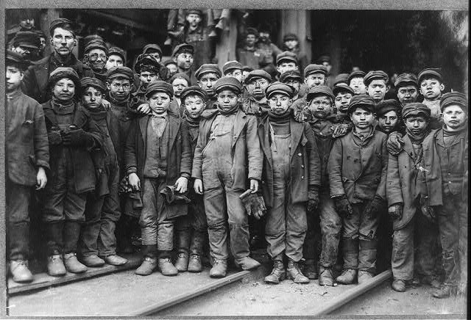
Lewis Hine, Breaker boys working in…, January 1911
Library of Congress (2018676223)

Slide 12

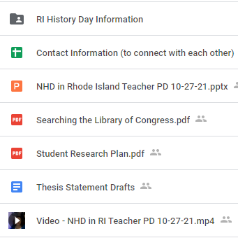
Thesis Statements Matter
Go to tinyurl.com/NHD-RhodeIsland-21
Find the file called “Thesis Statement Drafts”
Rough out a thesis.

Slide 13
Lynne’s Four Elements of a Good Thesis Statement
Clearly State Your Topic

Slide 14
Lynne’s Four Elements of a Good Thesis Statement
Clearly State Your Topic
Define your Parameters

Slide 15
Lynne’s Four Elements of a Good Thesis Statement
Clearly State Your Topic
Define your Parameters
Explicit Connection to the NHD Theme

Slide 16
Lynne’s Four Elements of a Good Thesis Statement
Clearly State Your Topic
Define your Parameters
Explicit Connection to the NHD Theme
Be an Argument, not a Statement of Fact

Slide 17
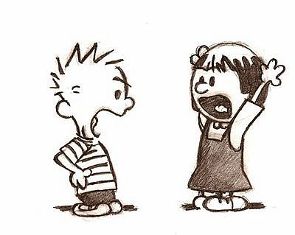
Setting up an Argument

Slide 18
Argument
Reasoning
Evidence to support

Slide 19
Argument: I want to get a new bike
Because I’m very responsible
My room is clean
I get up for school on time by myself
I babysit my younger sister
I’ve got good grades in school
I’m too tall to ride my old bike

Slide 20
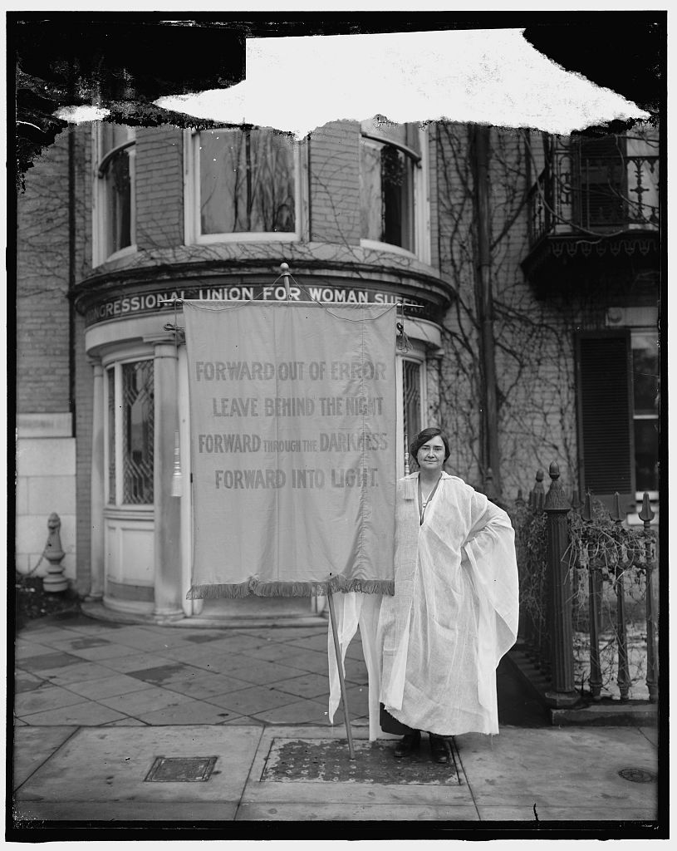
Library of Congress (2016855154)

Slide 21
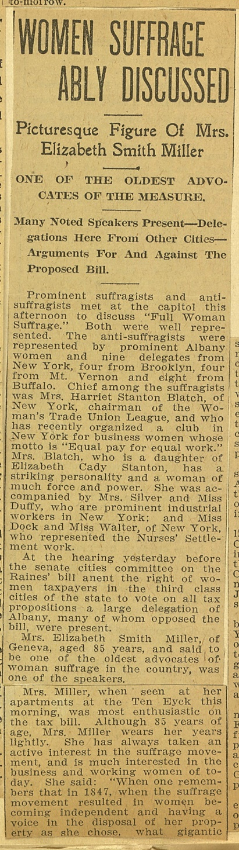
Library of Congress (rbcmiller004001)

Slide 22
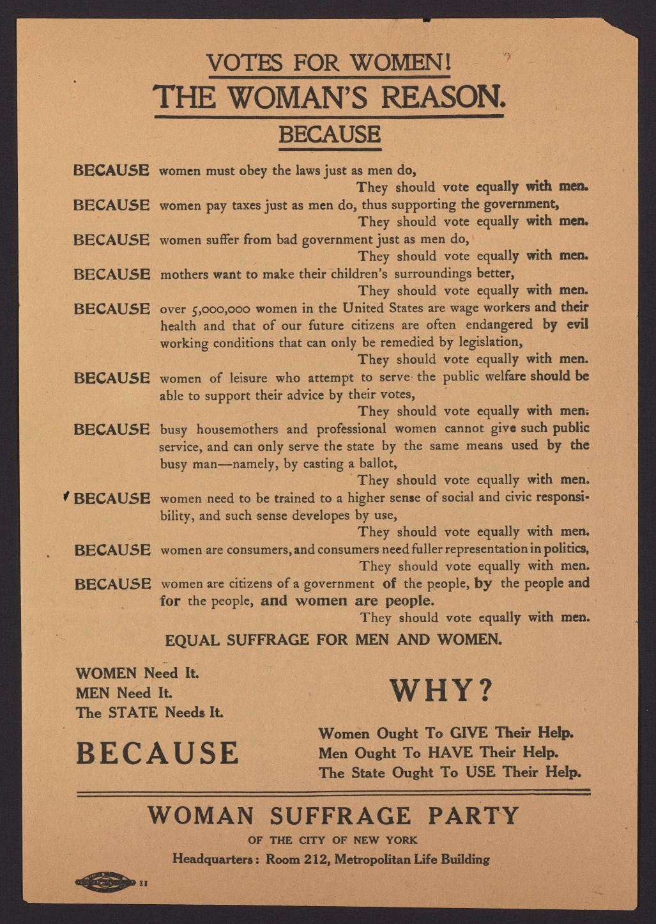
Library of Congress (rbcmiller004037)

Slide 23
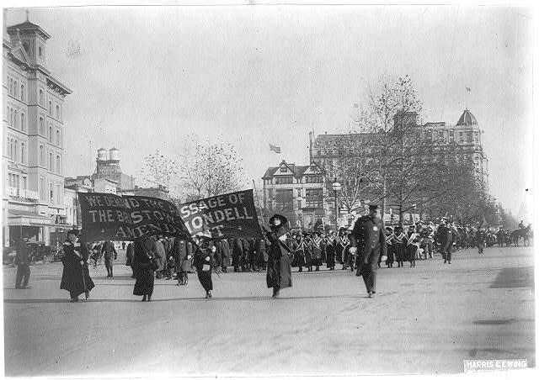
Enclosure: Fliers supporting women's suffrage
Library of Congress (2013648106)

Slide 24
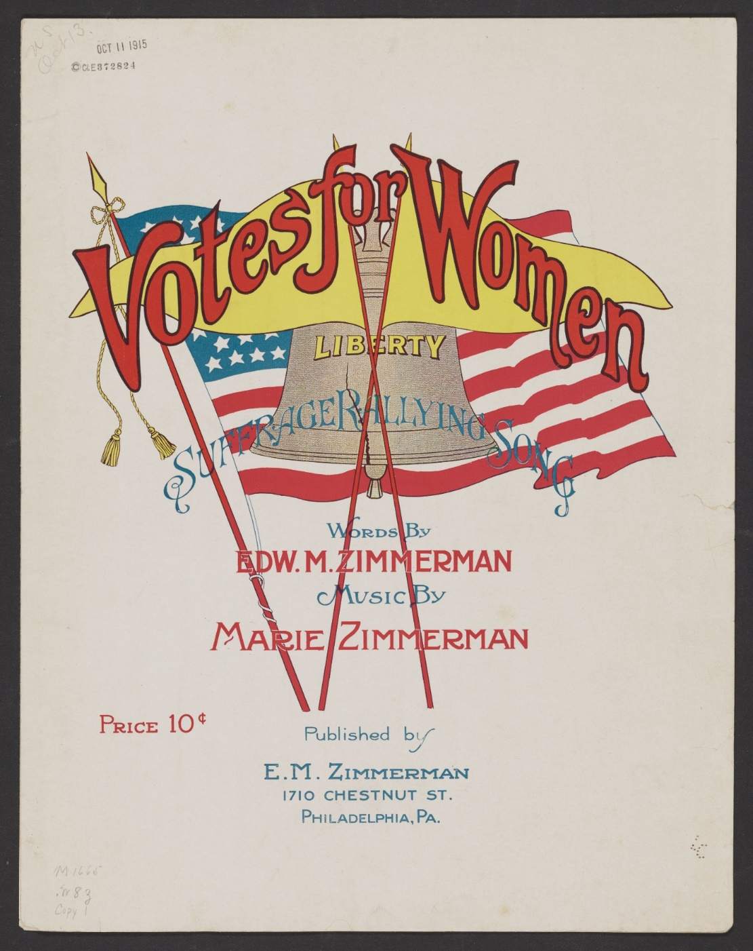
Library of Congress (2017562229)

Slide 25
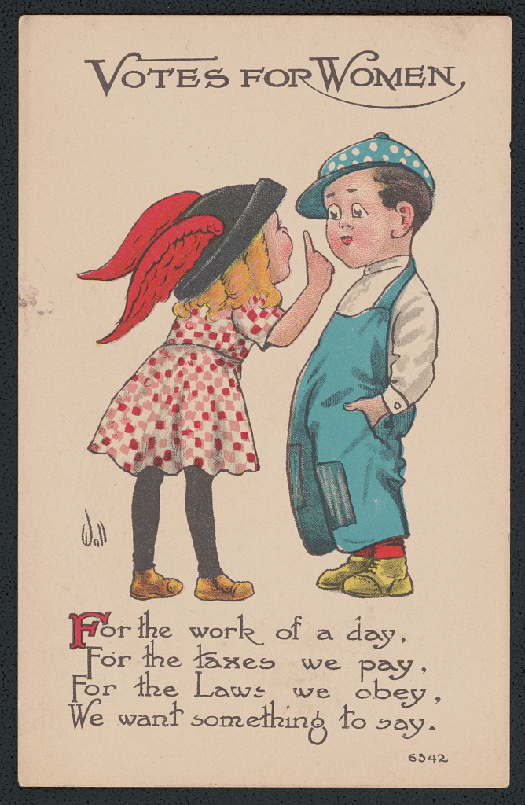
Library of Congress (ds.13244)

Slide 26
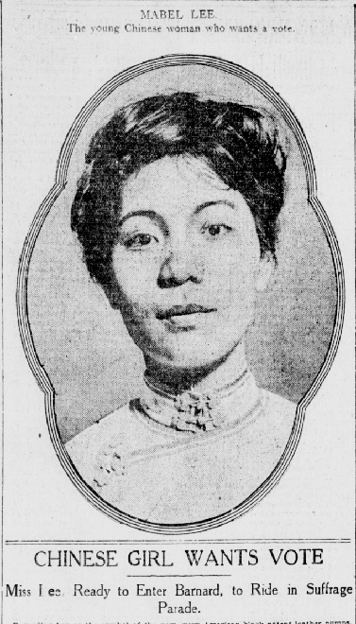
New-York Tribune, April 13, 1912, Chronicling America, Library of Congress

Slide 27
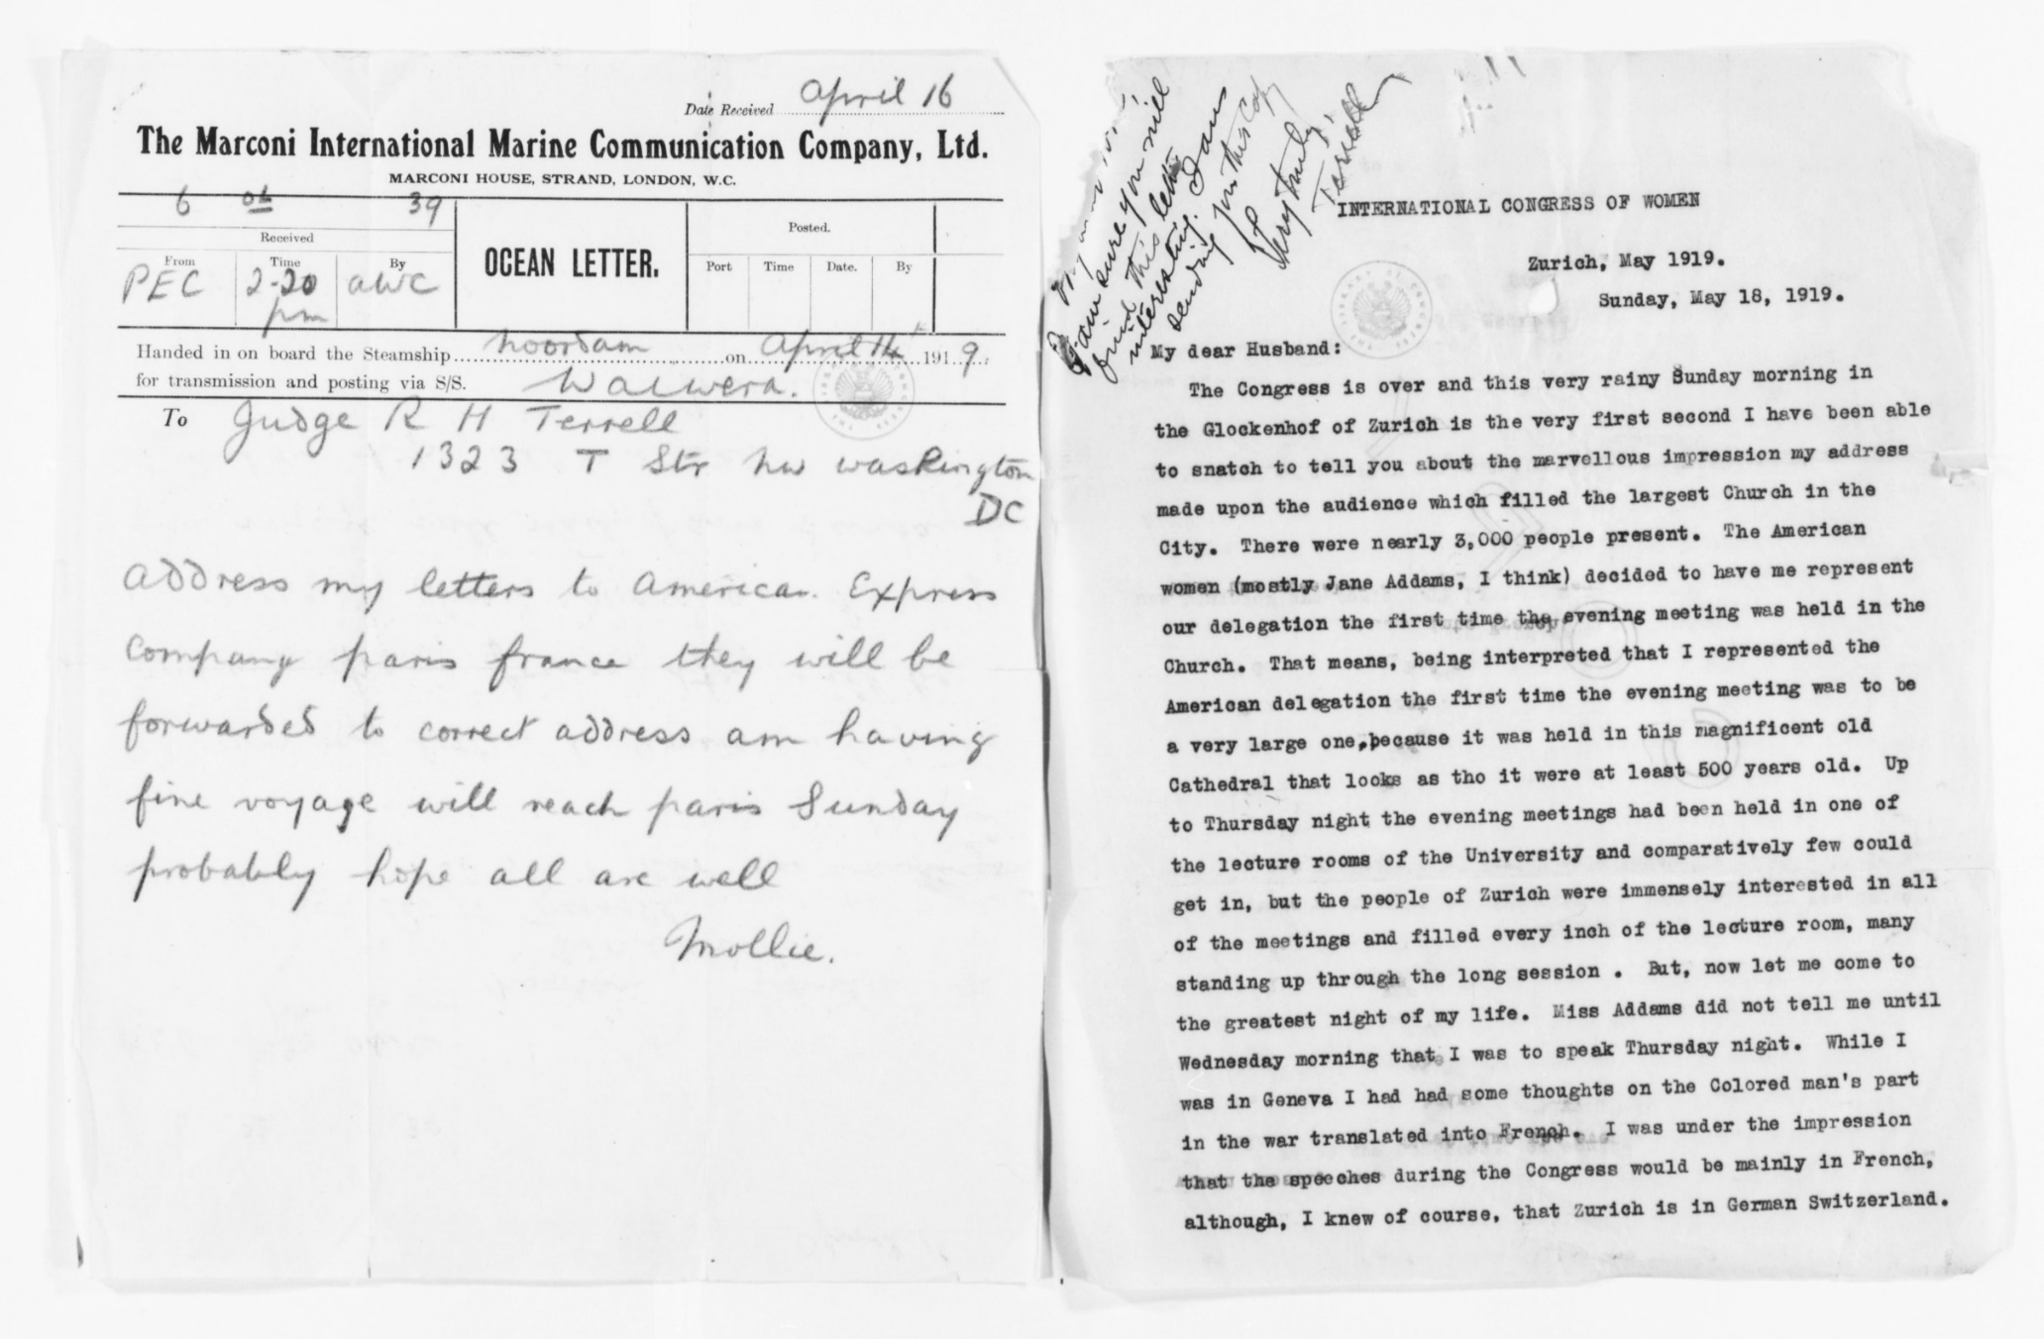
Mary Church Terrell to her husband, Robert H. Terrell,
May 18, 1919
Library of Congress (Mary Church Terrell Papers)

Slide 28
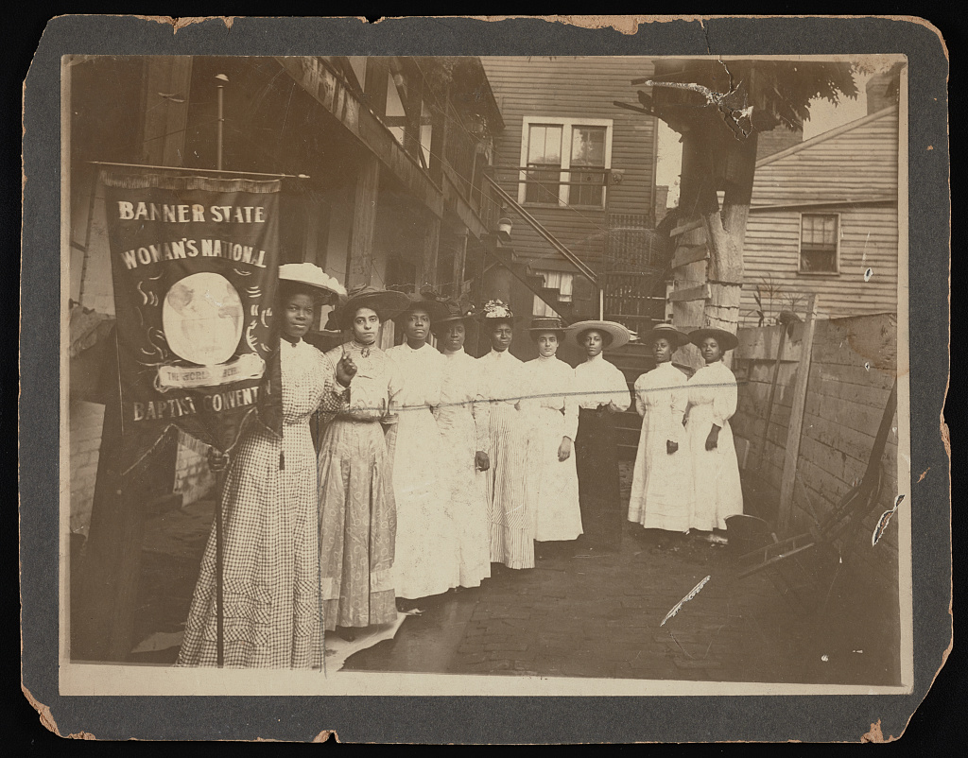
Library of Congress (93505051)

Slide 29
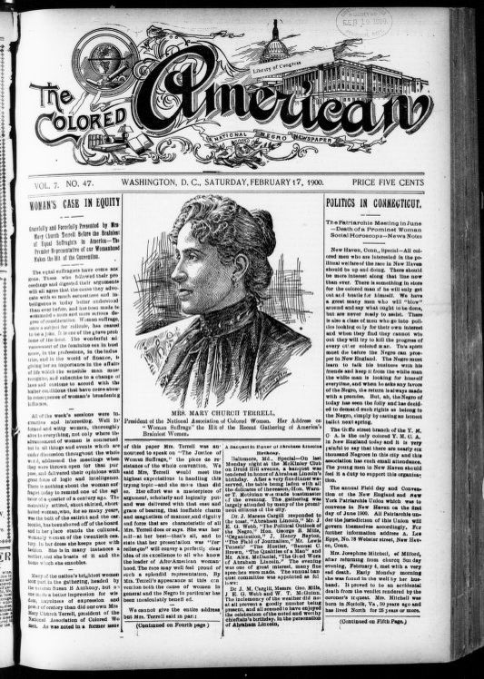
The Colored American, February 17, 1900, Library of Congress (sn83027091)

Slide 30
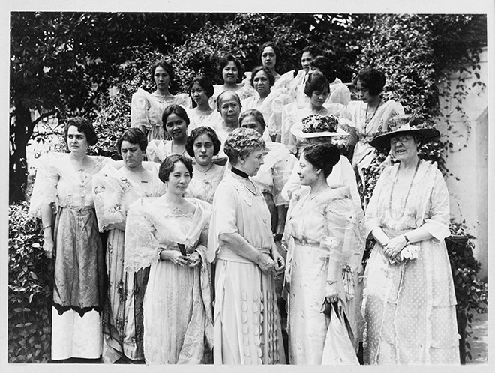
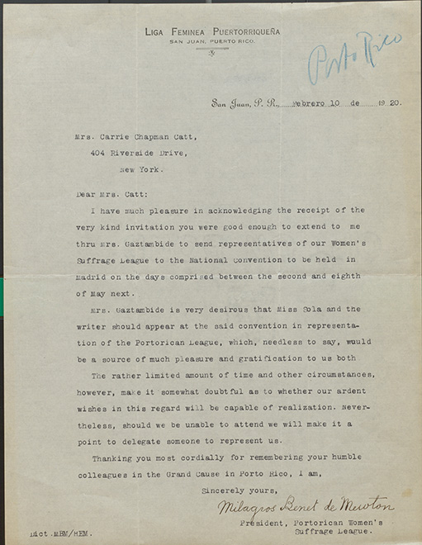
Library of Congress (92519740)
Milagros Benet de Newton to Carrie Chapman Catt, February 10, 1920
Library of Congress (NAWSA Records)

Slide 31

Evidence → Thesis
NOT
Thesis → Evidence

Slide 32
Parades
Protests in Washington, D.C.
Women active in the political process (speeches, flyers, etc.)
Using the popularity of newspapers, accounts of imprisonment
Songs
Postcards
Flags
African American women in the parades
Did not address barriers to voting (Jim Crow, citizenship barriers)
U.S. territories
Actively seeking a public debate
Used diplomatic means to appeal to more people
Left the needs of the women of color off the debate floor

Slide 33
Thesis: From 1900 to 1920, national leaders of the women’s suffrage movement actively sought a public debate, which led to the passage of the Nineteenth Amendment. Leaders used diplomatic means to appeal to a wide variety of women. However, they ignored the needs women of color left many of out of the debate and unable to vote.

Slide 34
Thesis: From 1900 to 1920, national leaders of the women’s suffrage movement actively sought a public debate, which led to the passage of the Nineteenth Amendment. Leaders used diplomatic means to appeal to a wide variety of women. However, they ignored the needs women of color left many of out of the debate and unable to vote.
Set the topic
Set the parameters
Clearly connect to the theme
Be an argument, not a statement of fact

Slide 35
Thesis: From 1900 to 1920, national leaders of the women’s suffrage movement actively sought a public debate, which led to the passage of the Nineteenth Amendment. Leaders used diplomatic means to appeal to a wide variety of women. However, they ignored the needs women of color left many of out of the debate and unable to vote.
Set the topic
Set the parameters
Clearly connect to the theme
Be an argument, not a statement of fact

Slide 36
Thesis: From 1900 to 1920, national leaders of the women’s suffrage movement actively sought a public debate, which led to the passage of the Nineteenth Amendment. Leaders used diplomatic means to appeal to a wide variety of women. However, they ignored the needs women of color left many of out of the debate and unable to vote.
Set the topic
Set the parameters
Clearly connect to the theme
Be an argument, not a statement of fact

Slide 37
Thesis: From 1900 to 1920, national leaders of the women’s suffrage movement actively sought a public debate, which led to the passage of the Nineteenth Amendment. Leaders used diplomatic means to appeal to a wide variety of women. However, they ignored the needs women of color left many of out of the debate and unable to vote.
Set the topic
Set the parameters
Clearly connect to the theme
Be an argument, not a statement of fact

Slide 38
Thesis: From 1900 to 1920, national leaders of the women’s suffrage movement actively sought a public debate, which led to the passage of the Nineteenth Amendment. Leaders used diplomatic means) to appeal to a wide variety of women. However, they ignored the needs women of color left many of out of the debate and unable to vote.
Set the topic
Set the parameters
Clearly connect to the theme
Be an argument, not a statement of fact

Slide 39
Parades
Protests in Washington, D.C.
Women active in the political process (speeches, flyers, etc.)
Using the popularity of newspapers, accounts of imprisonment
Songs
Postcards
Flags
African American women in the parades
Did not address barriers to voting (Jim Crow, citizenship barriers)
U.S. territories
Actively seeking a public debate
Used diplomatic means to appeal to more people
Left the needs of the women of color off the debate floor

Slide 40
Argument: Leaders actively sought a public debate
Because they wanted to create situations to bring attention to their cause and pass the Amendment
Parade photographs (1913, 1917) – women as iconic images, workers (teachers, garment workers, college graduates)
Protests in D.C. / outside White House – demanding change, embarrassing the President (Kaiser Wilson)
Flyers – engaging people in public
Terrell letter – giving speeches in Europe

Slide 41
Argument: Leaders used diplomatic means
Because they wanted appeal to a broader variety of people
Newspaper account – women speaking and writing
Newspaper article in The Colored American – making the case to publications targeting sub-groups of Americans
Postcards / Sheet Music – integrating into popular culture and children’s culture
Photograph – African American women at National Baptist convention – discussed in religious setting

Slide 42
Argument: Leaders left women of color out of the debate
Because they didn’t prioritize their needs over the desire to pass the Equal Rights Amendment
Racism in the movement – issues with African American delegates in the parades, caving to pressure from Southern women’s groups
Did not understand barriers to voting for African Americans (Jim Crow) and new citizens (Mabel Lee)
Did not address needs of women in most of the U.S. territories

Slide 43

Student & Teacher Institutes
NHD.org/SSF2022

Slide 44
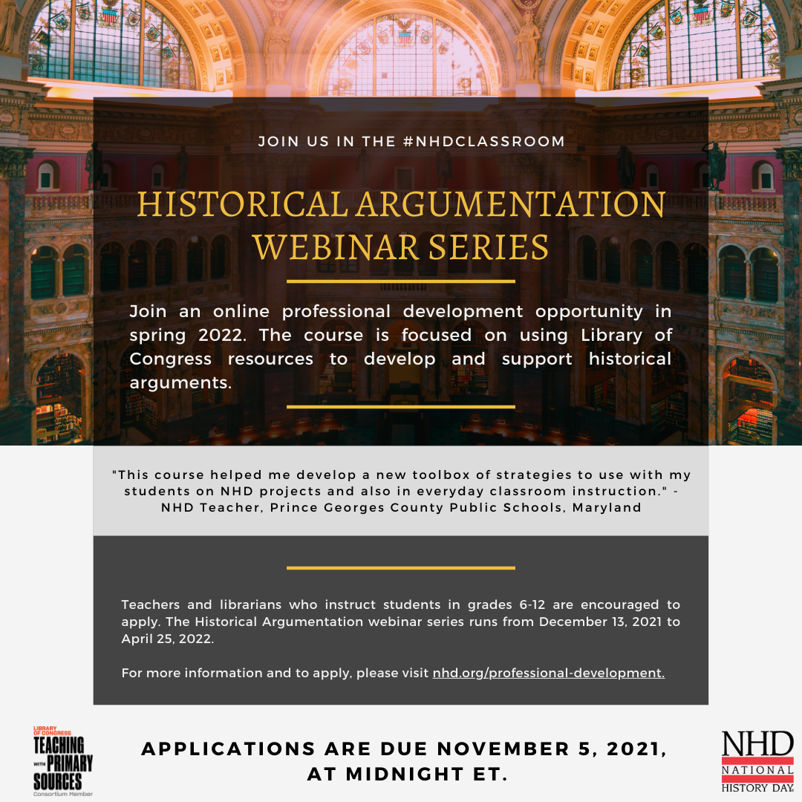
Historical Argumentation Webinar Series
Application deadline is Friday, November 5!
NHD.org/PD

Slide 45


Classroom Materials
NHD.org/women-history
NHD.org/WWI

Slide 46


Classroom Materials
NHD.org/250
NHD.org/library-congress-tps

Slide 47


