Slide 1
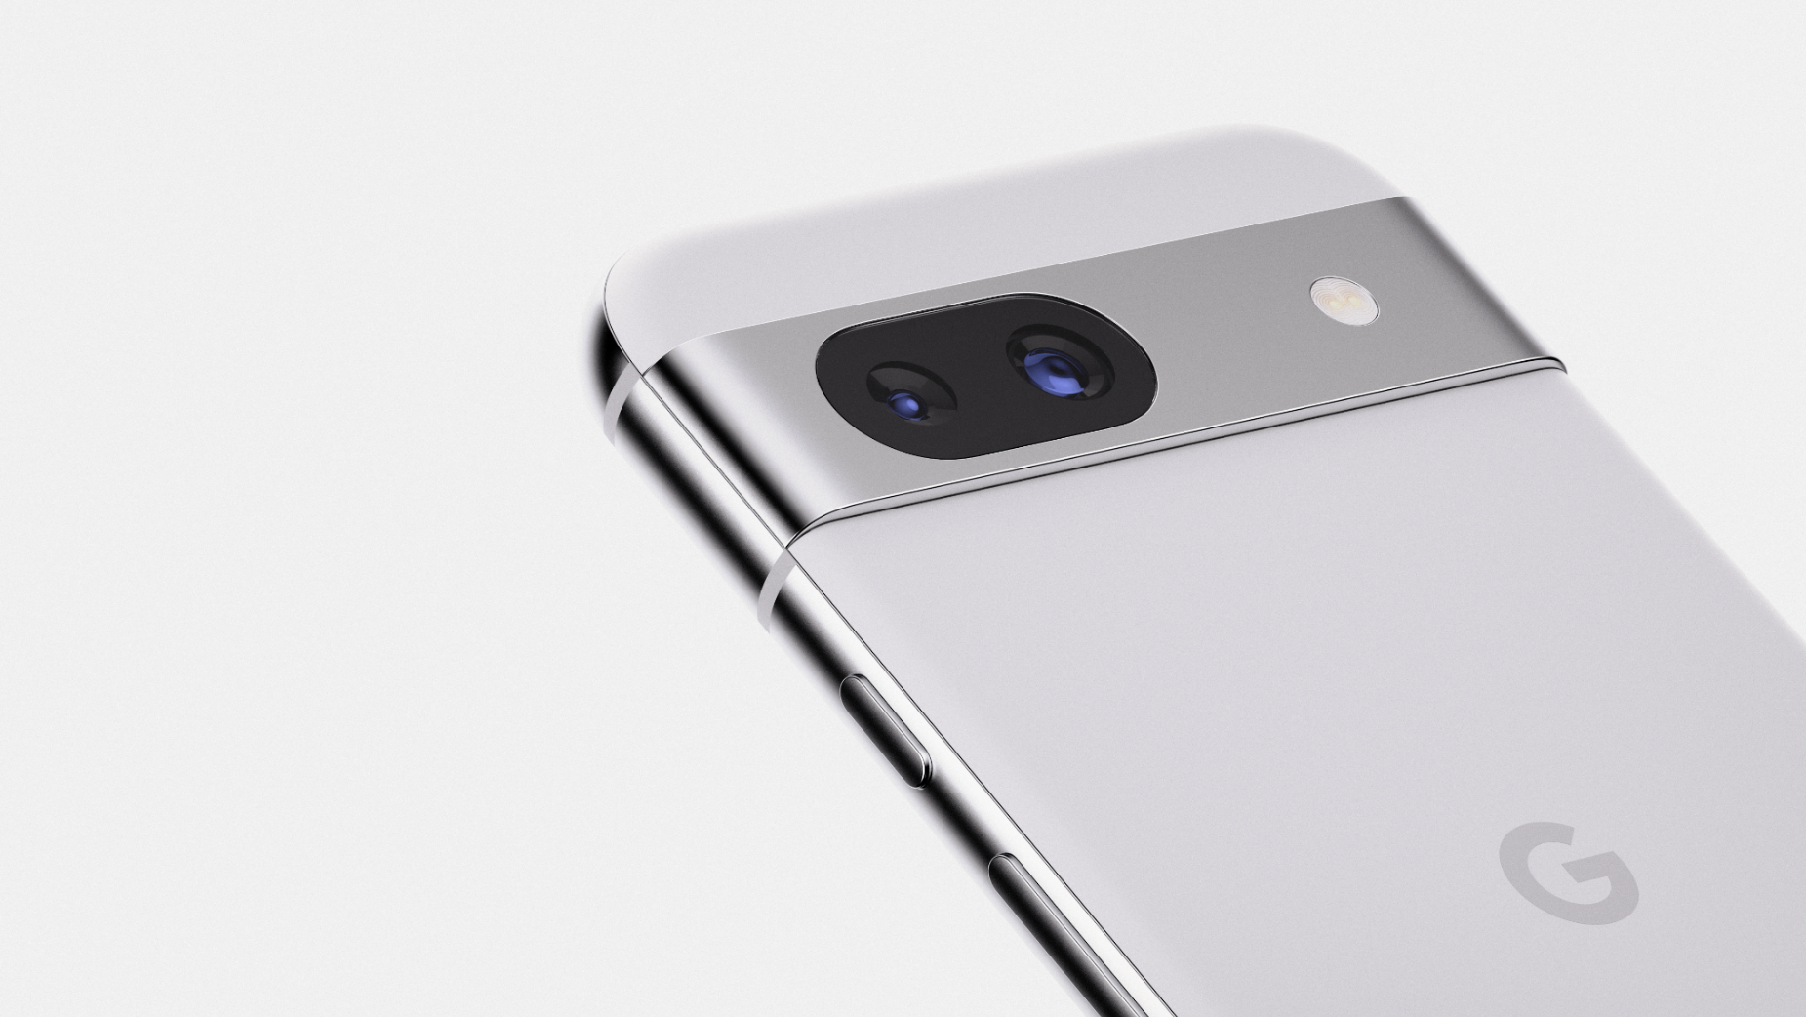
Pixel 8a
Recycling Guide
Version 2.0

Slide 2
google_logo
Environmental
sustainability at Google
At Google, operating in an environmentally sustainable way has been a core value from our beginning.
As our business has evolved to include the manufacturing of electronic products, we’ve continually expanded our efforts to improve each product’s environmental performance and minimize Google’s impact on the world around us.
This report details how recyclers can disassemble the Pixel 8a to recover raw materials.
To provide feedback or for questions about this guide, please email Recycling@Google.com.
Who is this Guide for?
This guide is intended for professional recyclers who are trained in electronics recycling and understand the risks involved with doing so. This recycling guide is not intended in any way to serve as repair instructions.
Please follow all relevant local-federal regulations and applicable international standards for electronic recycling as you follow this guide.

Slide 3
google_logo
Table of Contents
Topic | Location
Components Requiring Selective Treatment | Slide 4
How Best to Approach Device End-of-Life | Slide 5
General Personal & Environmental Safety | Slide 6
Battery Safety | Slide 7
Expanded View of Device | Slide 9
Location of Battery | Slide 10
Screw Map | Slide 11
Material Constituents of Device | Slide 12
Recommended Tools | Slide 13
Processing Steps | Slides 14 - 28
Frequently Asked Questions | Slide 29

Slide 4
google_logo
Directive 2012/19/EU Annex VII Components Requiring Selective Treatment
Substance or Component | Location | Removal Instructions
Display & Cover Glass Cover glass and organic light-emitting diode (OLED) display if the surface is greater than 100 cm² | Main Display | Step 7
PCB Printed circuit board if the surface area is greater than 10 cm² | Main Logic Board This device employs a mid-frame architecture. MLB is located within the device enclosure and can be accessed through the back cover. | Steps 1 - 9
PCB Printed circuit board if the surface area is greater than 10 cm² | OLED FPC Organic light-emitting diode flexible printed circuit | Step 7
Battery | Battery Battery is located within the device enclosure and can be accessed through the back cover. | Steps 1 - 6
Charger External electric cables | Charge Cable External charging cable is removable. | Step 1
The Google Pixel smartphone contains the following materials and components as listed in Annex VII in the European Union WEEE (recast) Directive 2012/19/EU.

Slide 5

google_logo
Give Your Device New Life
Before you recycle this device to recover materials, please consider whether the useful lifespan of this device can be extended in other ways.
Repair your device
Trade-In your device
Link
Link
Sell your device
Google Mail-In
Take-Back Program
Link
Link
Recycle Properly
Again, this guide is intended for technicians and operators who are trained in electronics recycling and understand the risks involved with electronic recycling.
If you are not trained, equipped and capable of properly recycling this device, please use Google’s complementary take back program.

Slide 6

google_logo
Personal Safety
Operators should always wear personal protective equipment (PPE) including protection from thermal events, fires and hazardous materials.
Hand protection
Protective Clothing
Eye protection
Burn Protection
Breathing protection
HazMat Protection
Environmental Health & Safety
Operate in a safe, well-ventilated environment. Follow safety and ergonomic best practices. Outfit your workspace with fire and hazardous material mitigation equipment.¹
Ergonomics
Fire Equipment
Ventilation
HazMat Equipment
Training
Always remember to ensure strict compliance with all local applicable health and safety rules.

Slide 7

google_logo
Battery Safety
Improper disassembly can be dangerous—especially if individuals are unfamiliar with safety critical components, such as lithium ion batteries.
Discharge Battery
Do not inhale hazardous fumes
Do not damage battery
Be fully prepared for thermal runaway
Battery must be carefully handled, and can be dangerous when damaged.
Fully discharge device battery before attempting disassembly.
Never bend, dent or puncture battery.
Do not use tools that may accidentally damage battery.
Store batteries in a safe environment to prevent inadvertent damage.
Take care not to store large quantities of batteries together.
Take care to prevent shorting of battery terminals.
If a battery begins to vent or a thermal runaway occurs, immediately cover in sand or use gloves and tongs to place battery in a fire safe.
Other Battery Handling Tips

Slide 8
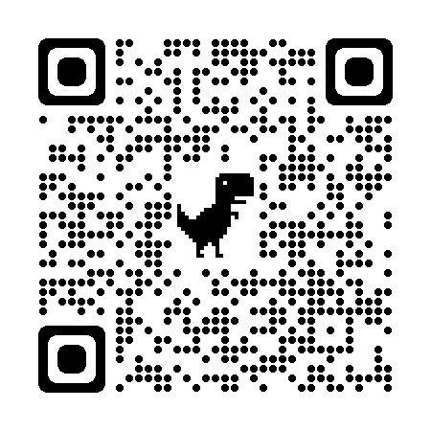
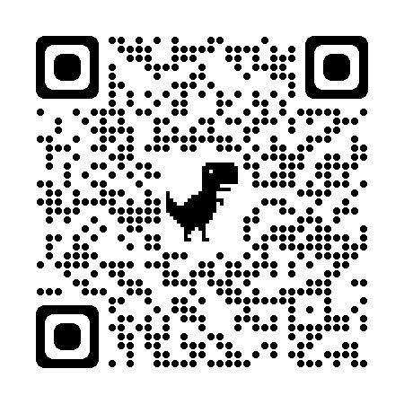
google_logo
Battery Transport
and Storage Safety
Follow regulations and best practices for lithium-ion battery safety.
Here are some resources that may help recyclers.
Topic | Resource
Damaged, Defective or Recalled (DDR) lithium cell batteries Learn how to identify a lithium cell battery that may be swollen, damaged, defective or recalled. Follow all Department of Transportation guidelines. This QR code links to a PDF file from the United States Department of Transportation entitled “Understanding the Risks of Damaged, Defective or Recalled (DDR) Lithium Batteries”
Transporting Lithium Batteries This QR code links to a webpage from the United States Department of Transportation entitled “Transporting Lithium Batteries”
Link
Link
Device Specific Warnings
Pixel 8a contains a class 1 laser module
The design of the device incorporates optics and protective housing such that there’s no access to a level of laser radiation above class 1 during normal use or approved servicing.
Laser modules in this product comply with 21 CFR 1040.10 and 1040.11, except for conformance with IEC 60825-1 Ed. 3., as described in Laser Notice No. 56, dated May 8, 2019.
Use of controls or adjustments or performance of procedures other than those specified herein may result in hazardous radiation exposure.
Laser module:
Made in Austria. ams AG, Tobelbader Str. 30, 8141 Oberpremstätten, Austria.
Caution

Slide 9
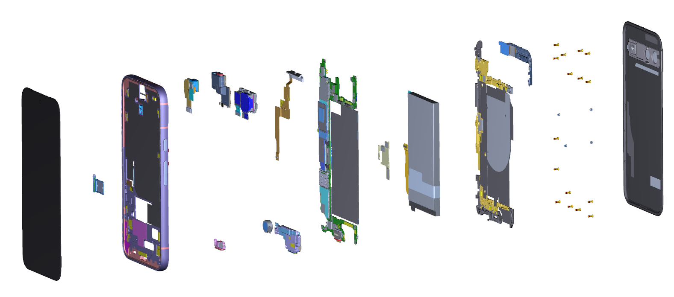
google_logo
15
Pixel 8a: Expanded view
12
13
14
5
9
3
4
8
1
6
11
7
10
2
17
16
18
Pixel 8a Part ID
1 | ⬤ Display | 8 | ⬤ mmWave module | 15 | ⬤ Back cover
2 | ⬤ SIM tray | 9 | ⬤ Logic board | 16 | ⬤ Bottom speaker
3 | ⬤ Enclosure | 10 | ⬤ B2B stamping plate | 17 | ⬤ Vibrator
4 | ⬤ Front camera | 11 | ⬤ Battery | 18 | ⬤ Mic 1
5 | ⬤ Top speaker | 12 | ⬤ Inner housing
6 | ⬤ Rear camera and holder | 13 | ⬤ Antenna housing
7 | ⬤ mmWave FPC | 14 | ⬤ Screw

Slide 10
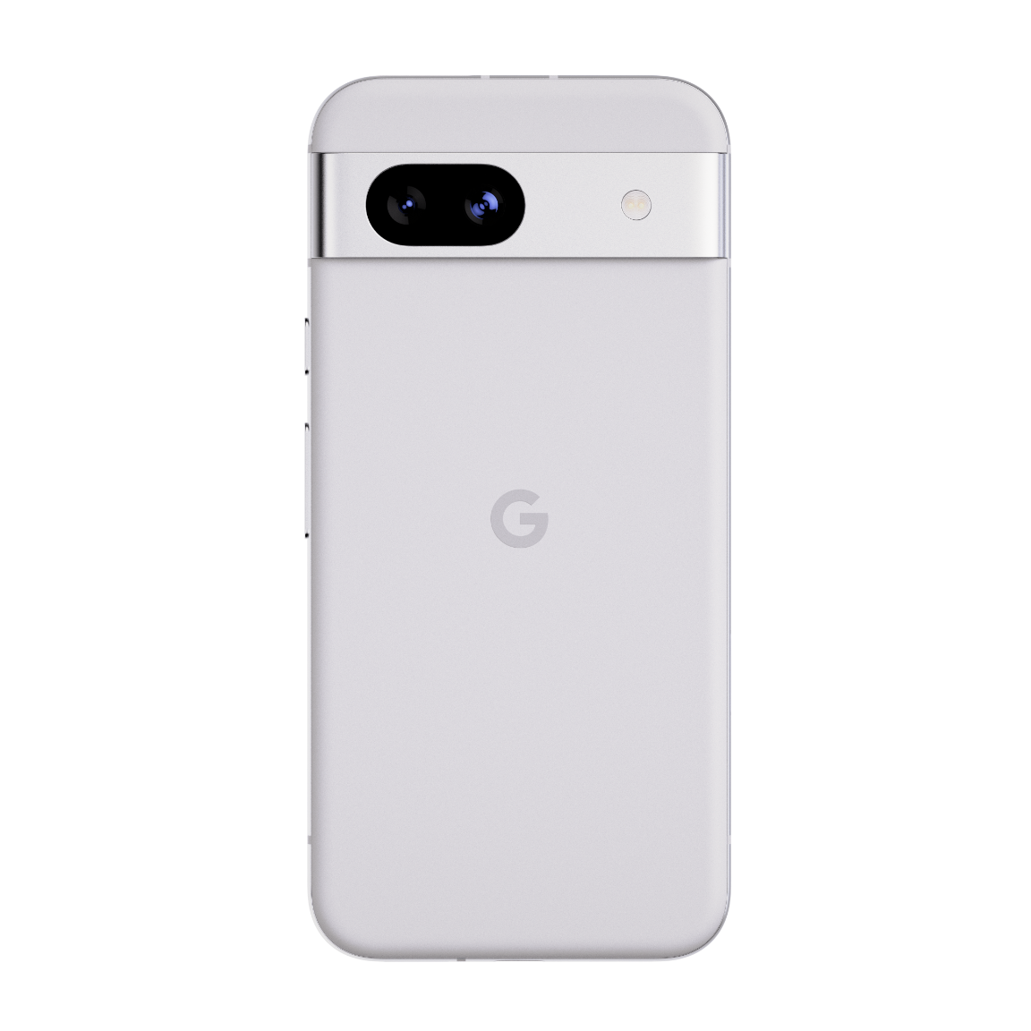
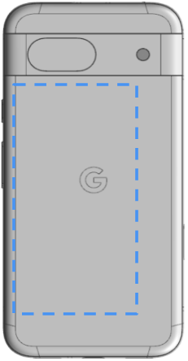
google_logo
Battery Location(s)
There is one lithium-ion lithium cobalt battery located in this device.
The approximate location of the battery is outlined.

Slide 11
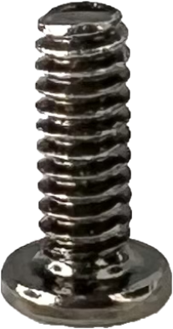
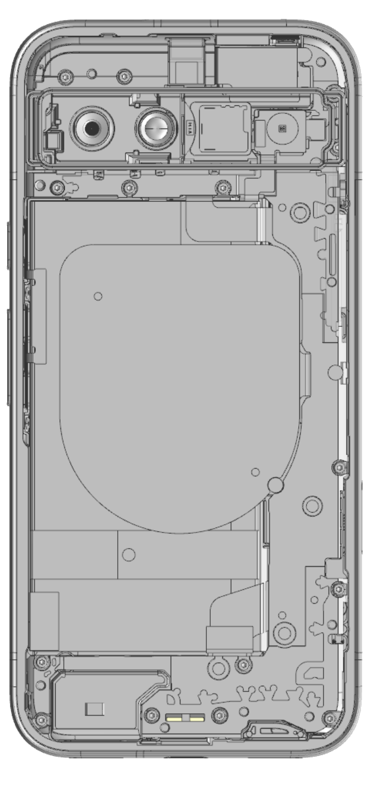
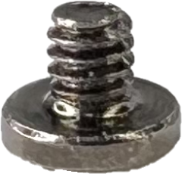
google_logo
Screw map
These are the screws used in the Pixel 8a:
Screw
G250-05370-00
Screw
G250-06929-01
Note
This is what the device looks like once the back cover is removed.

Slide 12
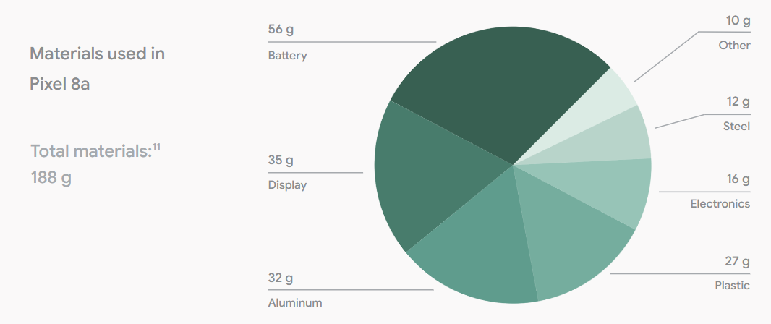
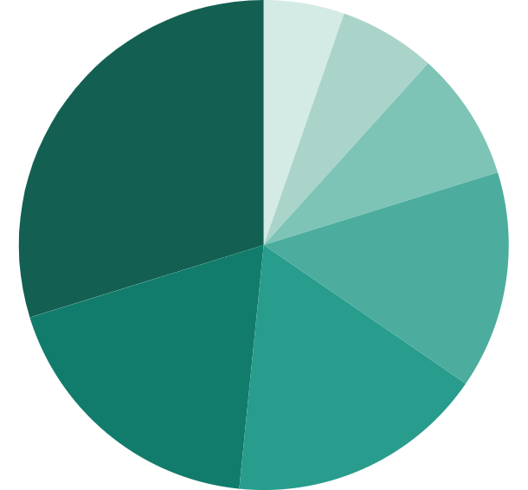
google_logo
What materials can be found in this device?
[PDP Material Image]

Slide 13
google_logo
What Tools Are Recommended to Disassemble This Device?
Flat Head Screwdriver
Prying Implement
Pliers
99.9% Isopropyl Alcohol
Torx IP 3 Driver
Universal disassembly shim or miniature pry tool
SIM Card Tray Ejector Pin
Heat Gun, Heat Pad or Heating Tools

Slide 14
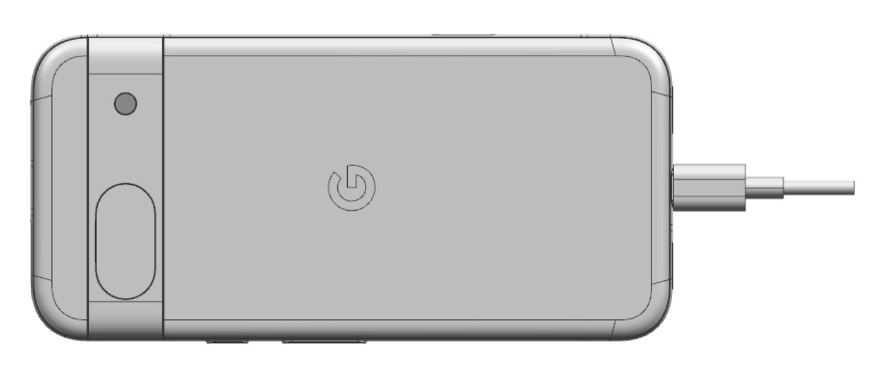
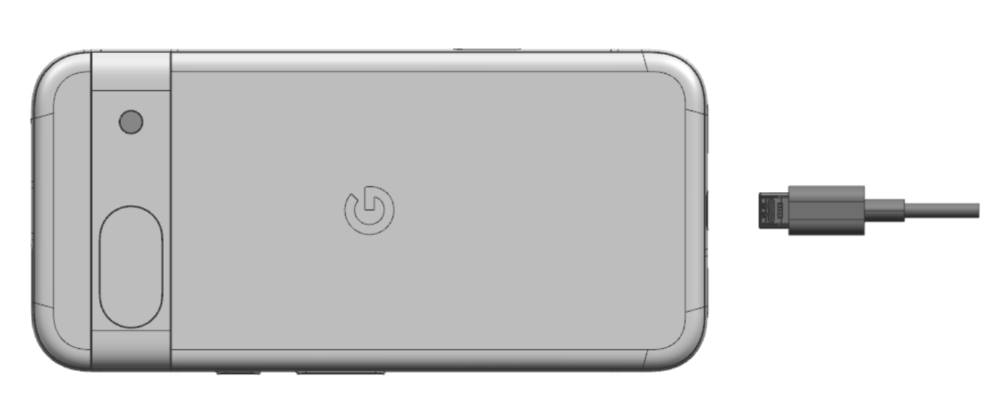
google_logo
05/2024
01
Remove Charge Cable
Turn off device. Unplug Charge cable and allow the device to drain battery charge.
Target Recyclable Materials:
Copper

Slide 15
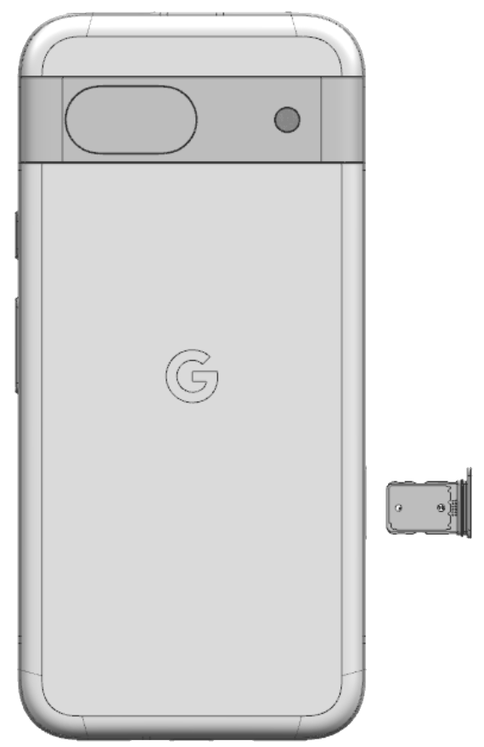
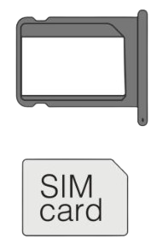
google_logo
02
Remove SIM Tray
Use Small Push Pin Ejector.
Steel Tray
Gold coating on SIM Card

Slide 16
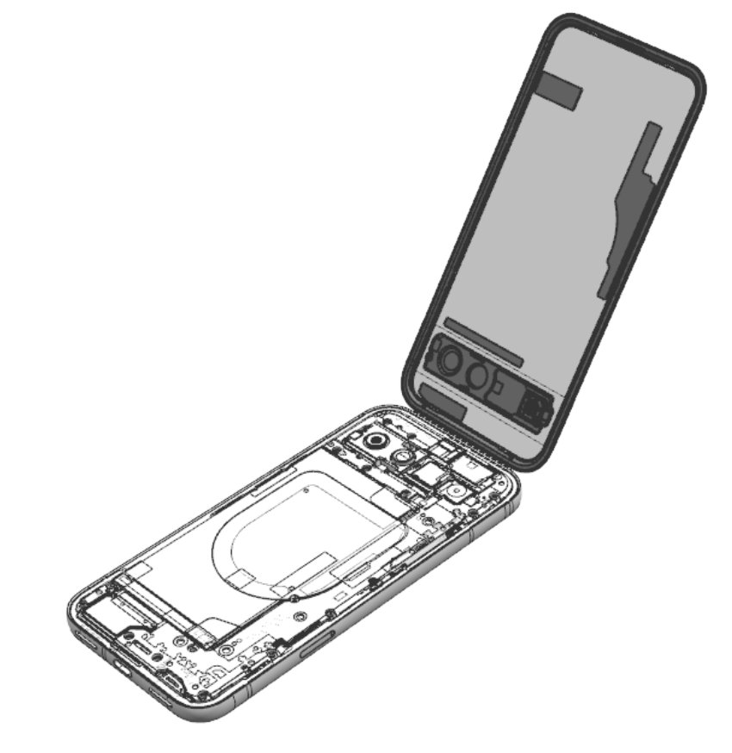
google_logo
03
Remove Back Cover
If possible, heat device to loosen adhesive. Use prying device with thin edge to lift back cover off of the enclosure.
Target Recyclable Materials:
Aluminum Visor
67% Recycled Plastic Cover
Note
Do not insert prying device too far into device as doing so may damage the battery pack.

Slide 17
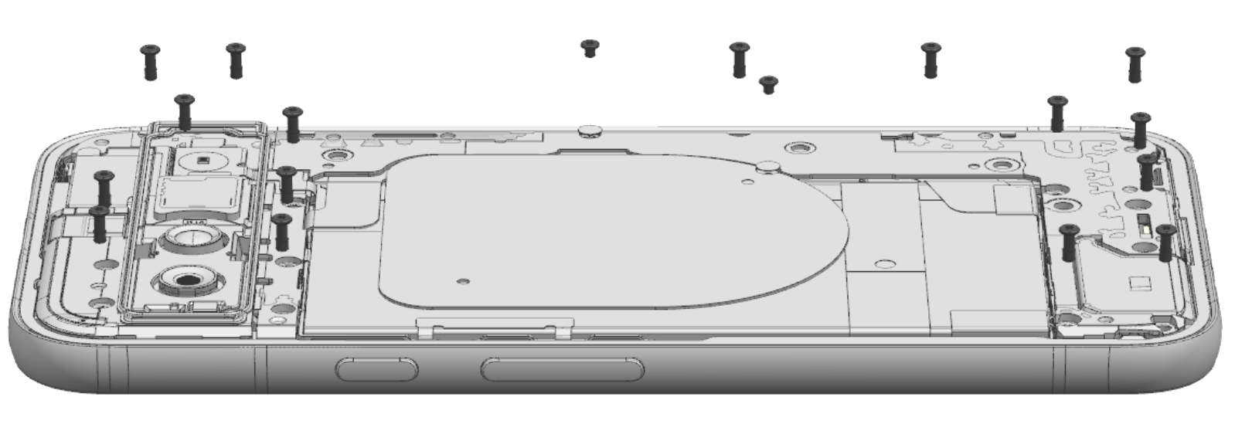
google_logo
04
Remove Screws
Use a screwdriver to remove the 17 screws that secure the inner and antenna housing to the logic board.
Screw
G250-05370-00
Screw
G250-06929-01

Slide 18
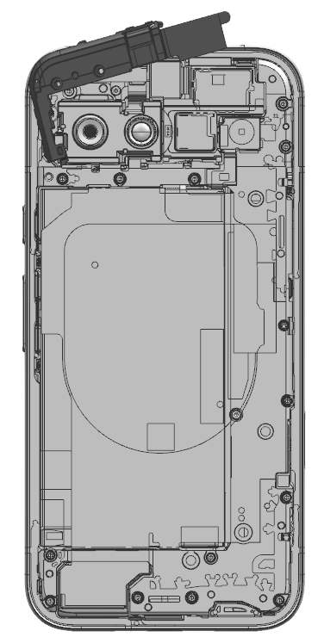
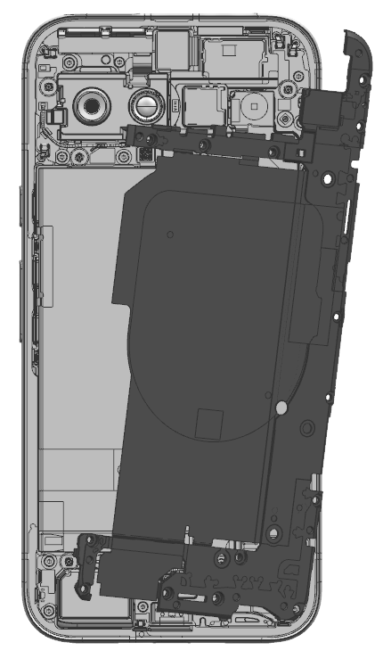
google_logo
05
Remove Inner Housings
Unscrew the inner housings
Target Recyclable Materials:
Aluminum Alloy

Slide 19
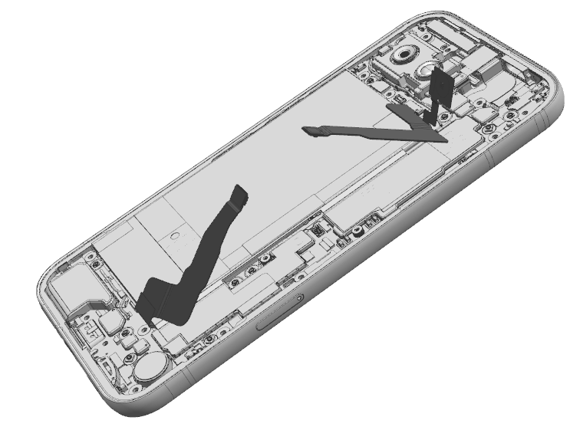
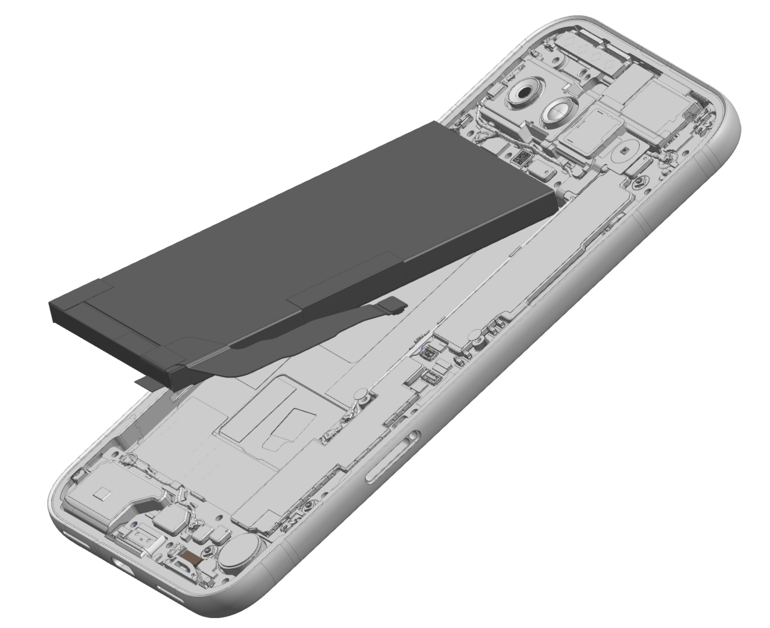
google_logo
06
Remove Battery
Although some recyclers may pry the battery out, we recommend first heating the adhesive under the battery to 158℉ (70 ℃) to weaken the adhesive bond. We recommend a duration of 10 minutes on the hot plate. Use caution. The heating plate is a hot surface and it could cause burns.
Alternatively, a recycler could apply 99.9% isopropyl alcohol under the battery to compromise the adhesive.
Battery must be recycled with specialized processes such as pyrometallurgy or hydrometallurgy.
Target Recyclable Materials:
Cobalt
Lithium
Nickel
Copper
Precious Metals
Gold plating on flex cable

Slide 20
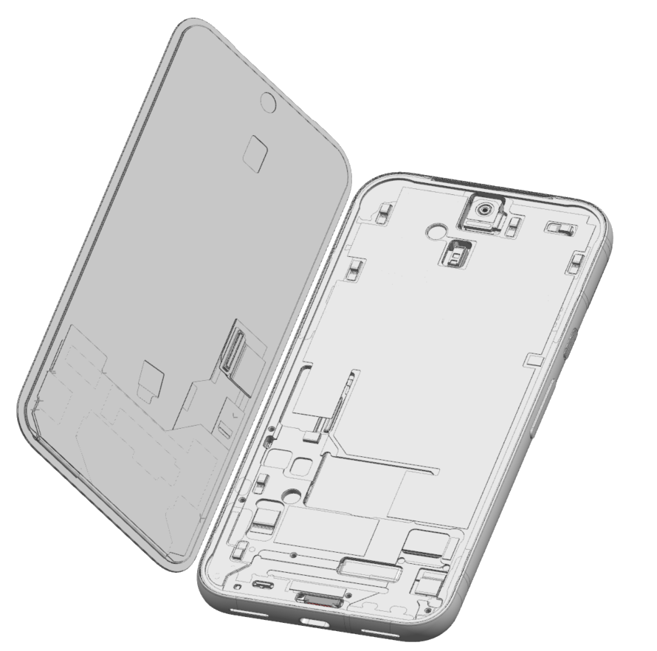
google_logo
07
Remove Display & Cover Glass
If possible, heat device to loosen adhesive. Use prying device with thin edge to lift back cover off of the enclosure.
The display also includes a number of flexible printed circuit boards, which can be pried off.
Target Recyclable Materials:
Glass
Copper Film Backing
Copper Display Flex Cable
Steel
Gold plating on flex cable
Note
Wear protective gloves and safety glasses when handling damaged parts.

Slide 21
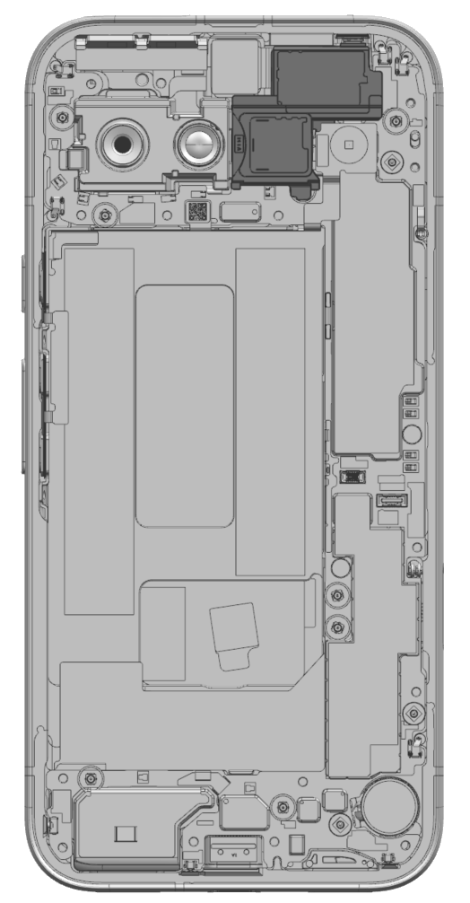
google_logo
08
Top Speaker
Remove the one screw that secures the top speaker to the logic board.
Use prying tool to lift up the top speaker.
Target Recyclable Materials:
Neodymium (Rare Earth Element) Magnets in Speaker

Slide 22
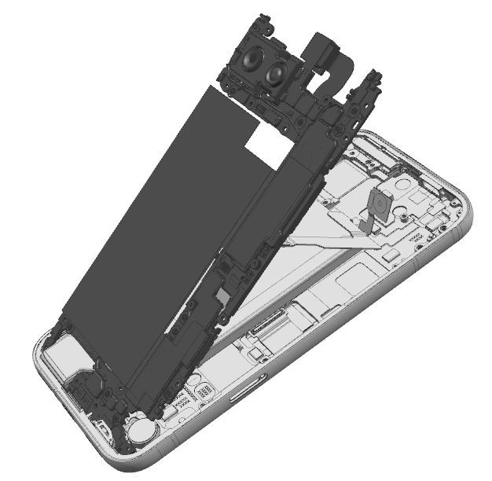
google_logo
09
Main Logic Board
Use Prying tool, if necessary, to lift the main logic board and components out of enclosure.
This component includes small quantities of a number of notable materials that could be recovered, including:
Target Recyclable Materials:
Copper
Precious metal coatings
Silicone
Neodymium (Rare Earth Element) Magnets in Wide Rear Cam

Slide 23
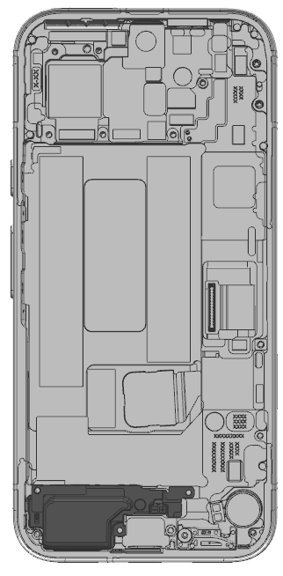
google_logo
10
Bottom Speaker
Remove the one screw that secures the top speaker to the logic board.
Use prying tool to lift up the top speaker.
Target Recyclable Materials:
Neodymium (Rare Earth Element) Magnets in Speaker

Slide 24
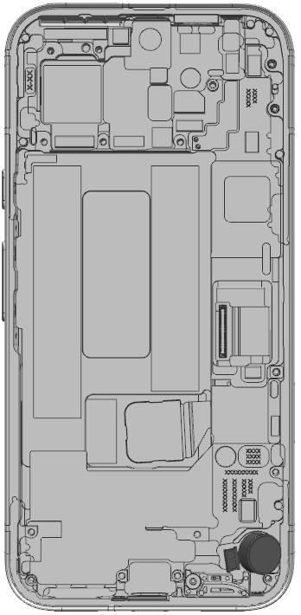
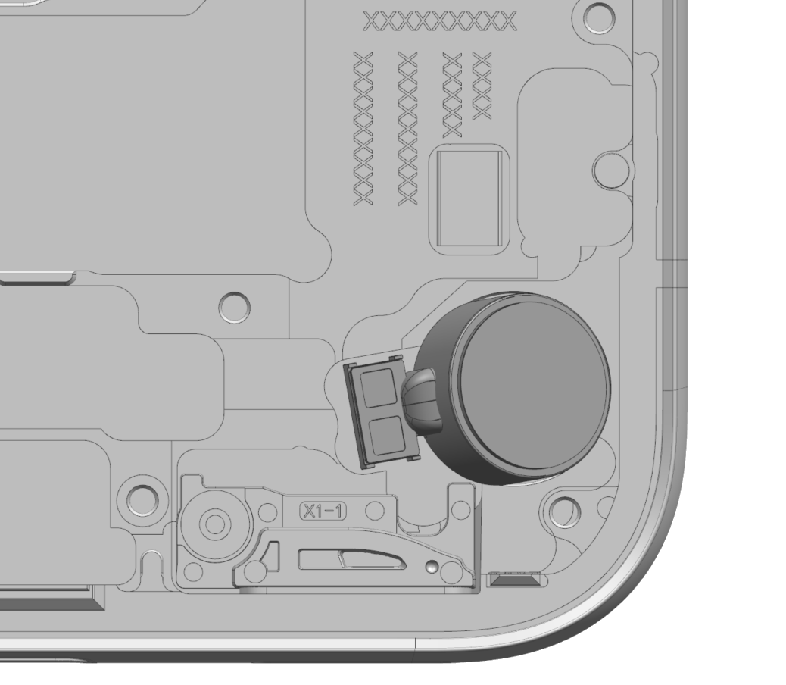
google_logo
11
Haptics / Vibrator
Use the prying tool to remove the vibrator cylinder from the enclosure.
Target Recyclable Materials:
Neodymium (Rare Earth Element) Magnets in Speaker
Steel
Copper

Slide 25
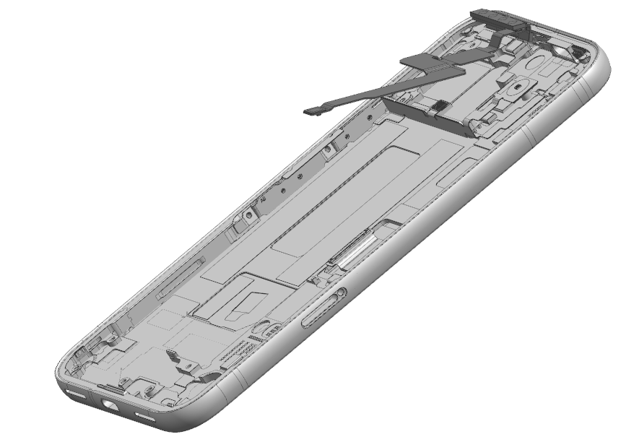
12
MMWave+IF FPC
A recycler may wish to remove the MMWave+IF FPC module from the enclosure.
Here the MMWave+IF FPC module is highlighted.

Slide 26
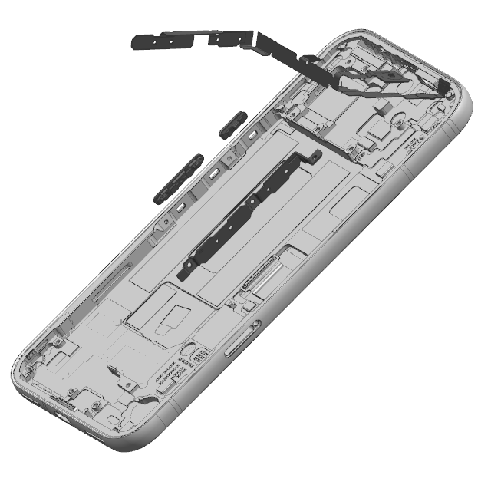
13
Side key assembly
A recycler may wish to remove the Side key assembly from the enclosure.
Here the Side key assembly is highlighted.

Slide 27
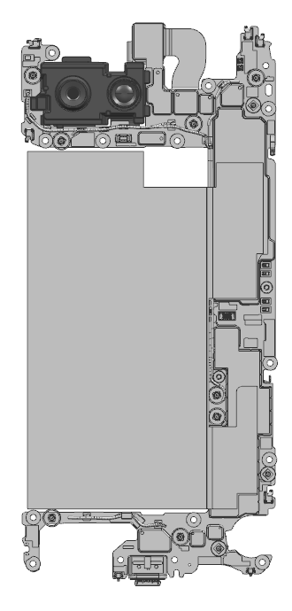
google_logo
14
Back Camera
A recycler may wish to remove the back camera module from the main logic board.
Here the back camera module is highlighted.

Slide 28
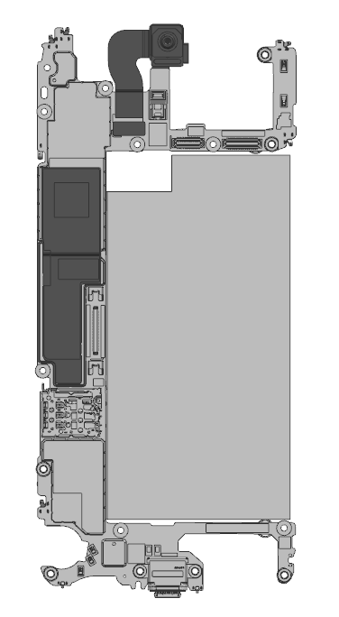
google_logo
15
Front Camera
A recycler may wish to remove the front camera module from the main logic board.
Here the front camera module is highlighted.

Slide 29


google_logo
Frequently Asked Questions
Questions | Answer
Is there information related to repair? | This recycling guide is for professional recyclers and is not intended in any way to serve as repair instructions. For repair information or access to repair manuals, please visit: https://store.google.com/magazine/repaircenter
Does Google offer spare parts to recyclers to refurbish or repair smartphones? | This recycling guide is for recyclers and is not intended in any way to serve as instructions to test, refurbish or repair. For access to Pixel spare parts, please visit: https://www.ifixit.com/Parts/Google_Phone
How long does it take on average to recycle this device? | Recycling times vary widely and depend on the how thoroughly the device is disassembled for material recovery and the specific tools and operational processes employed. To follow the steps in this guide, we estimate the device processing time will take approximately 1:30 - 5:00 minutes for a well-trained recycling technician.
What hazards might there be when disassembling a device? | The main hazards related to the end-of-life processing of this device are: Damaging the battery in such a way that a thermal runaway occurs; Broken glass causing cuts or abrasions; Chemical inhalation–especially if thermal runaway occurs and Exposure to the class 1 laser module
Link
Link

