Slide 1
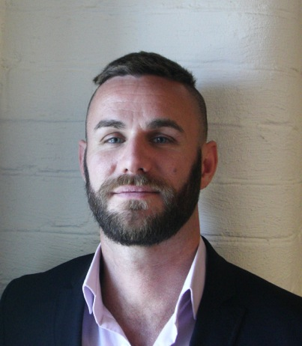
Fritidsresor increased sales from generic keywords by 23% with Dynamic Search Ads
Fritidsresor, an advanced advertiser from the travel segment, used DSA to increase their conversions from generic search terms by 23% at a 13% lower CPA.
“DSA is an easy way to increase reach in a highly competitive and fast moving industry”
Soliman Herrera Johansson
Online Sales Manager, Fritidsresor
Source : Google data, April 2013

