Slide 1
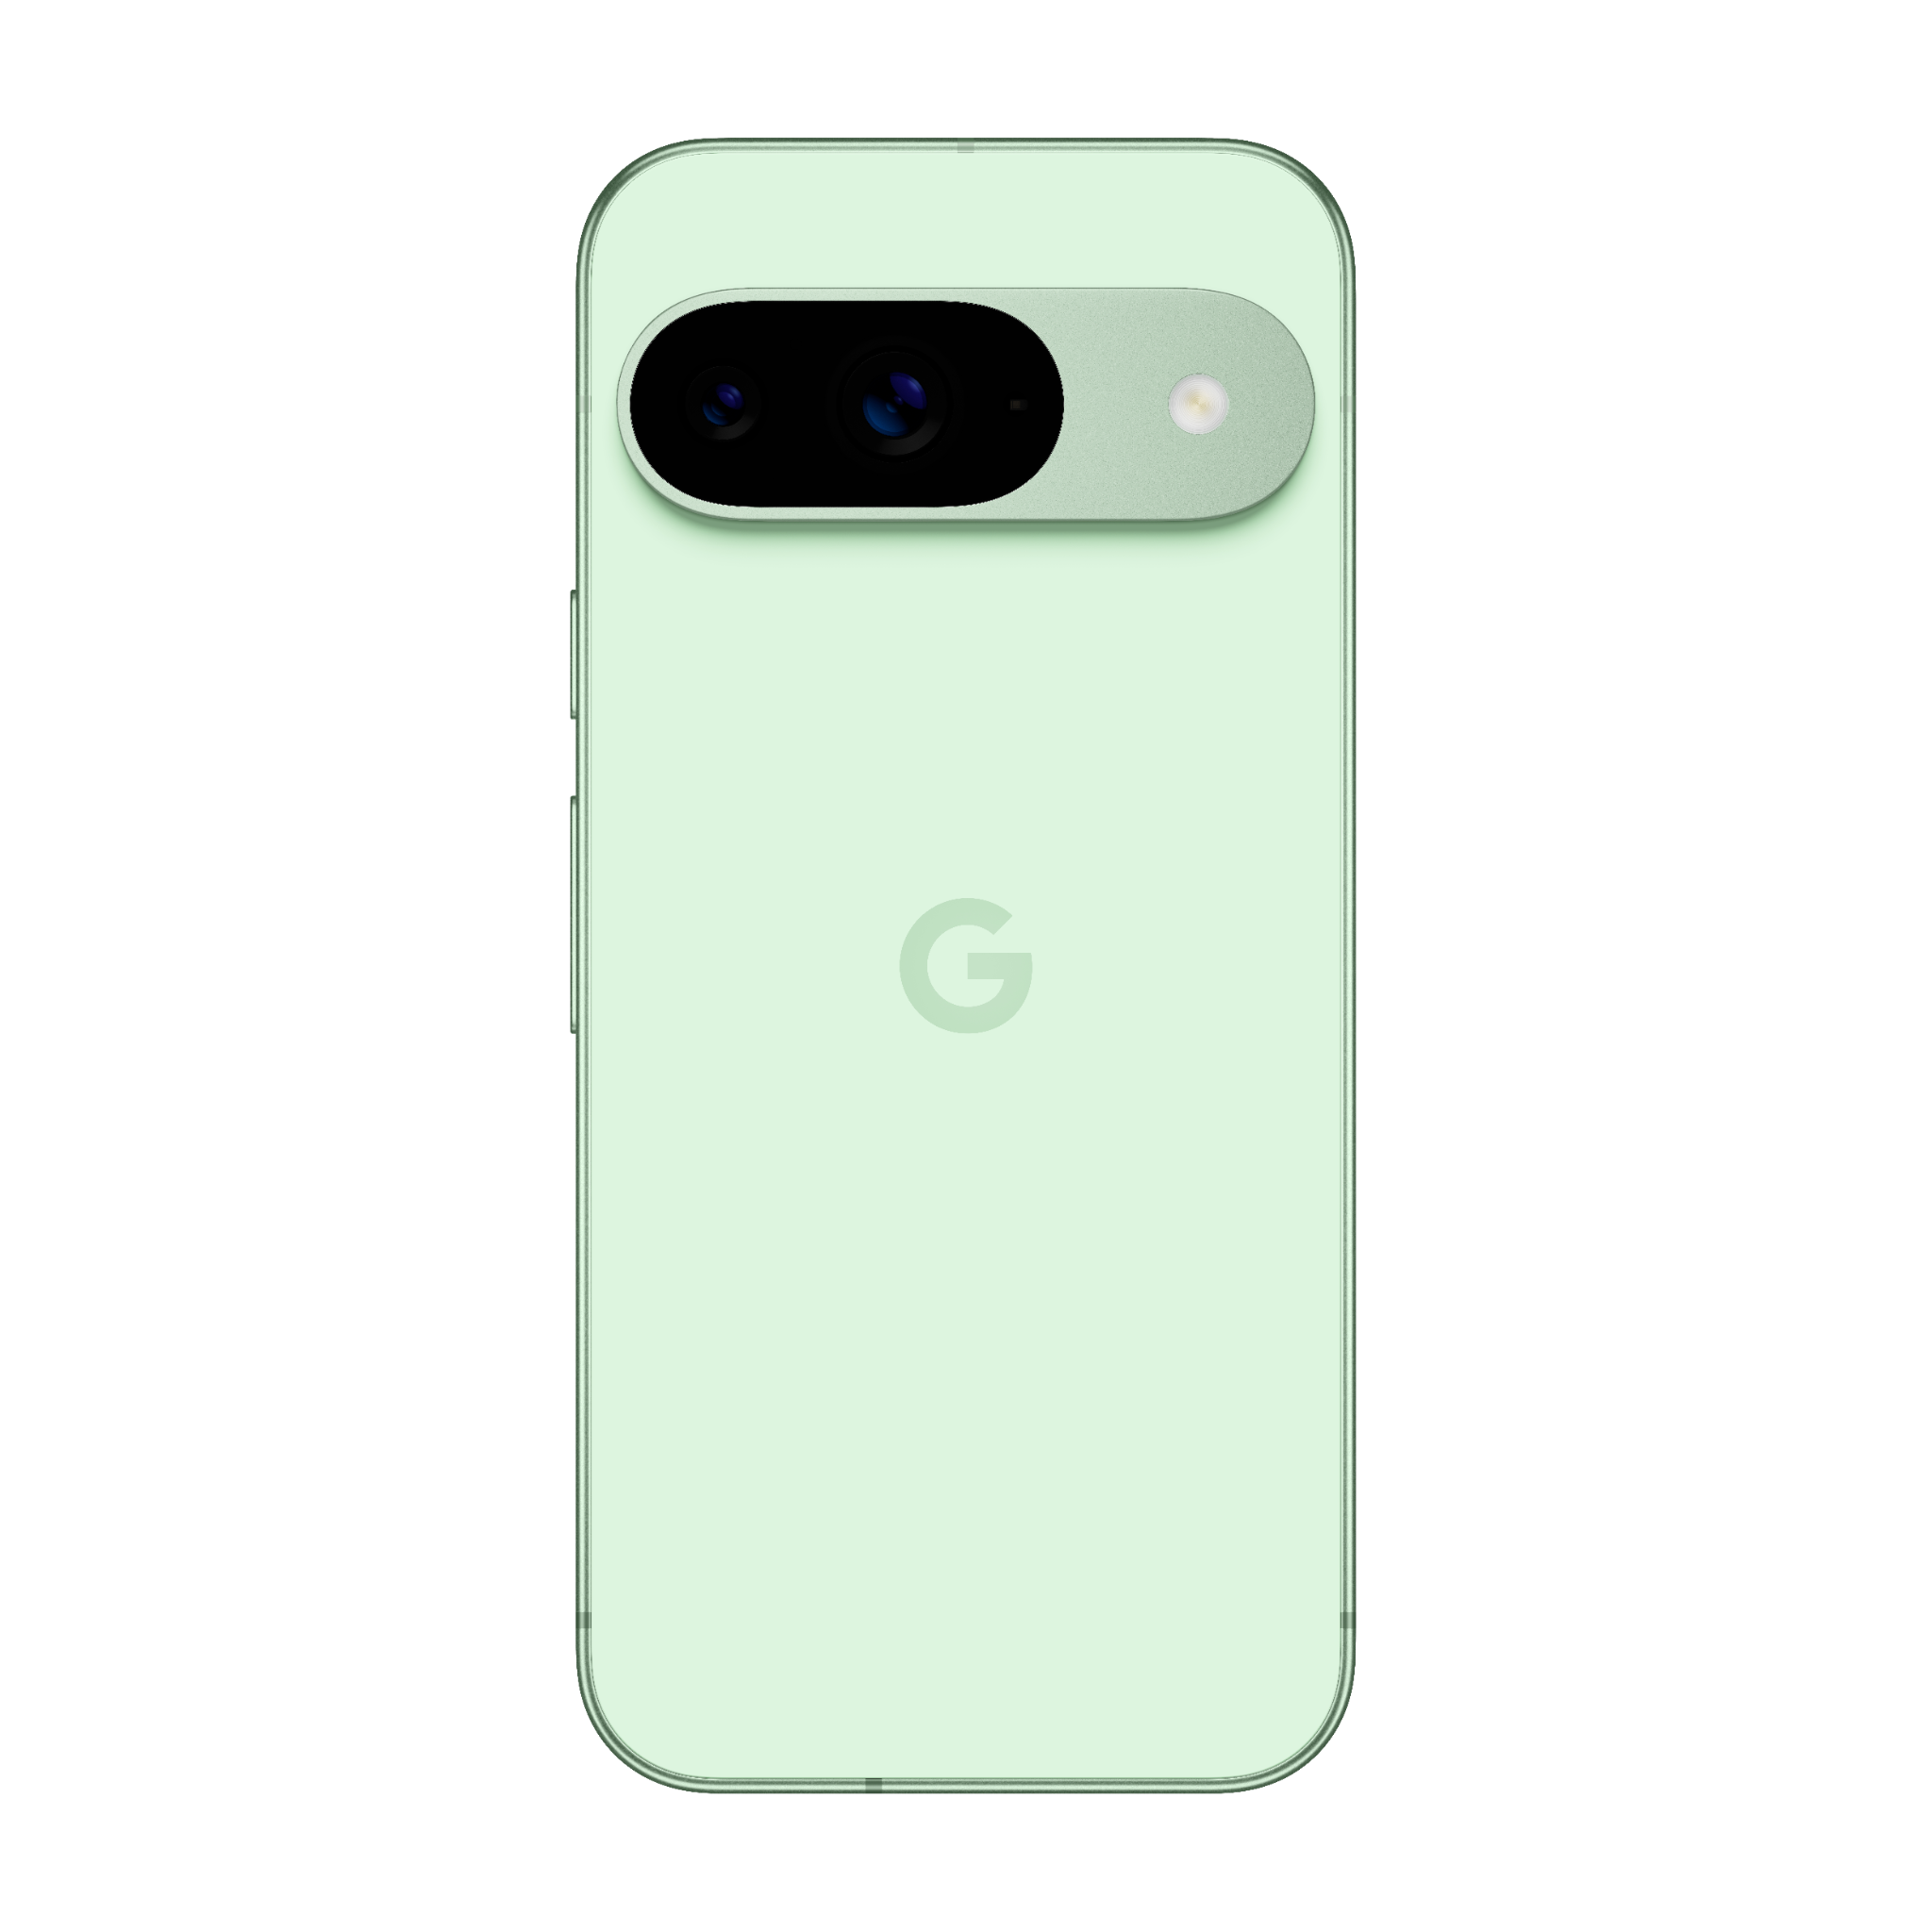
Pixel 9
Recycling Guide
Version 1.0

Slide 2
google_logo
Environmental
sustainability at Google
At Google, operating in an environmentally sustainable way has been a core value from our beginning.
As our business has evolved to include the manufacturing of electronic products, we’ve continually expanded our efforts to improve each product’s environmental performance and minimize Google’s impact on the world around us.
This report details how recyclers can disassemble the Pixel 9 to recover raw materials.
To provide feedback or for questions about this guide, please email Recycling@Google.com.
Who is this Guide for?
This guide is intended for professional recyclers who are trained in electronics recycling and understand the risks involved with doing so. This recycling guide is not intended in any way to serve as repair instructions.
Please follow all relevant local-federal regulations and applicable international standards for electronic recycling as you follow this guide.

Slide 3
google_logo
Table of Contents
Topic | Location
Components Requiring Selective Treatment | Slide 4
How Best to Approach Device End-of-Life | Slide 5
General Personal & Environmental Safety | Slide 6
Battery Safety | Slide 7
Expanded View of Device | Slide 9
Location of Battery | Slide 10
Screw Map | Slide 11
Material Constituents of Device | Slide 12
Recommended Tools | Slide 13
Processing Steps | Slides 14 - 31
Frequently Asked Questions | Slide 32

Slide 4
google_logo
Directive 2012/19/EU Annex VII Components Requiring Selective Treatment
Substance or Component | Location | Removal Instructions
Display & Cover Glass Cover glass and organic light-emitting diode (OLED) display if the surface is greater than 100 cm² | Main Display | Step 8
PCB Printed circuit board if the surface area is greater than 10 cm² | Main Logic Board This device employs a mid-frame architecture. MLB is located within the device enclosure and can be accessed through the back cover. | Steps 1 - 11
PCB Printed circuit board if the surface area is greater than 10 cm² | OLED FPC Organic light-emitting diode flexible printed circuit | Step 15 - 16
Battery | Battery Battery is located within the device enclosure and can be accessed through the back cover. | Steps 1 - 7
Charger External electric cables | Charge Cable External charging cable is removable. | Step 1
The Google Pixel smartphone contains the following materials and components as listed in Annex VII in the European Union WEEE (recast) Directive 2012/19/EU.

Slide 5

google_logo
Give Your Device New Life
Before you recycle this device to recover materials, please consider whether the useful lifespan of this device can be extended in other ways.
Repair your device
Trade-In your device
Link
Link
Sell your device
Google Mail-In
Take-Back Program
Link
Link
Recycle Properly
Again, this guide is intended for technicians and operators who are trained in electronics recycling and understand the risks involved with electronic recycling.
If you are not trained, equipped and capable of properly recycling this device, please use Google’s complementary take back program.

Slide 6
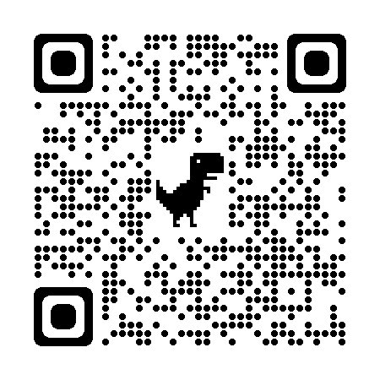
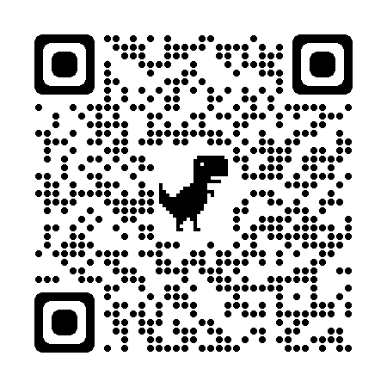

google_logo
Battery Transport
and Storage Safety
Follow regulations and best practices for lithium-ion battery safety.
Here are some resources that may help recyclers.
Topic | Resource
Damaged, Defective or Recalled (DDR) lithium cell batteries Learn how to identify a lithium cell battery that may be swollen, damaged, defective or recalled. Follow all Department of Transportation guidelines. This QR code links to a PDF file from the United States Department of Transportation entitled “Understanding the Risks of Damaged, Defective or Recalled (DDR) Lithium Batteries”
Transporting Lithium Batteries This QR code links to a webpage from the United States Department of Transportation entitled “Transporting Lithium Batteries”
Link
Link
Device Specific Warnings
Pixel 9 contains a class 1 laser module
The design of the device incorporates optics and protective housing such that there’s no access to a level of laser radiation above class 1 during normal use or approved servicing.
Use of controls or adjustments or performance of procedures other than those specified herein may result in hazardous radiation exposure.
Caution

Slide 7
google_logo
Personal Safety
Operators should always wear personal protective equipment (PPE) including protection from thermal events, fires and hazardous materials.
Hand protection
Protective Clothing
Eye protection
Burn Protection
Breathing protection
HazMat Protection
Environmental Health & Safety
Operate in a safe, well-ventilated environment. Follow safety and ergonomic best practices. Outfit your workspace with fire and hazardous material mitigation equipment.¹
Ergonomics
Fire Equipment
Ventilation
HazMat Equipment
Training
Always remember to ensure strict compliance with all local applicable health and safety rules.

Slide 8

google_logo
Battery Safety
Improper disassembly can be dangerous—especially if individuals are unfamiliar with safety critical components, such as lithium ion batteries.
Discharge Battery
Do not inhale hazardous fumes
Do not damage battery
Be fully prepared for thermal runaway
Battery must be carefully handled, and can be dangerous when damaged.
Fully discharge device battery before attempting disassembly.
Never bend, dent or puncture battery.
Do not use tools that may accidentally damage battery.
Store batteries in a safe environment to prevent inadvertent damage.
Take care not to store large quantities of batteries together.
Take care to prevent shorting of battery terminals.
If a battery begins to vent or a thermal runaway occurs, immediately cover in sand or use gloves and tongs to place battery in a fire safe.
Other Battery Handling Tips

Slide 9
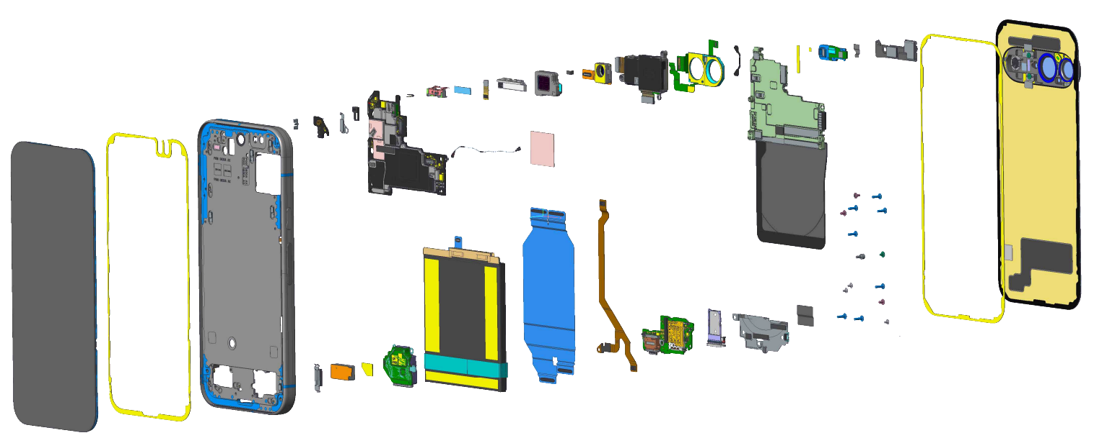
Pixel 9: Expanded view
google_logo
729
30
22
23
24
25
26
27
28
29
19
20
21
14
15
16
17
9
10
12
13
5
6
7
8
2
3
18
1
11
4
32
31
35
34
33
41
40
38
37
36
39
Pixel 9 Part ID
1 | Display module | 8 | P-sensor foam | 15 | mmWave module | 22 | Flam left tape | 29 | BG adhesive | 36 | RJ flex
2 | Display adhesive | 9 | Logic board | 16 | Top speaker | 23 | NFC/WLC cowling | 30 | BG Sub | 37 | DJ flex
3 | Enclosure | 10 | FCAM FoF | 17 | Top speaker FoF | 24 | Adhesive BG SC | 31 | Screw | 38 | Battery
4 | Display cowling | 11 | Cable | 18 | TIM SOC | 25 | Adhesive flam FSS | 32 | DJ flex tape | 39 | Bottom speaker
5 | Speaker clip | 12 | Heatsink-mmWave | 19 | FCAM | 26 | Flam FSS flex | 33 | CLB cowling | 40 | Vibrator pad
6 | ANT4 board | 13 | mmWave tim | 20 | RCAM | 27 | FSS flex tape | 34 | SIM tray | 41 | Vibrator
7 | ANT4 cowling | 14 | mmWave flex | 21 | LDAF flex | 28 | Top cowling | 35 | Chin board

Slide 10
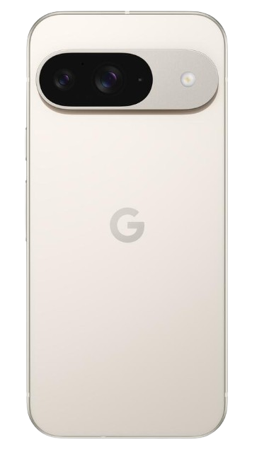
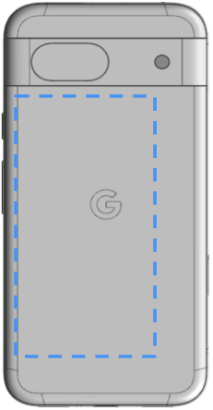
google_logo
Battery Location
There is one lithium-ion cobalt battery located in this device.
The approximate location of the battery is outlined.

Slide 11
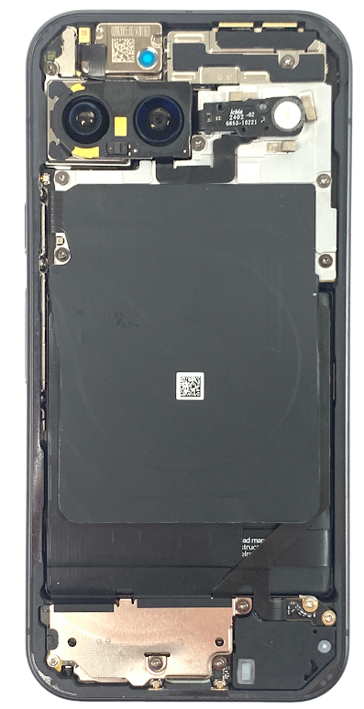
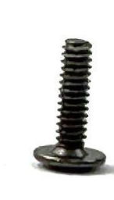

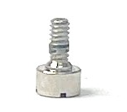
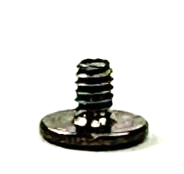
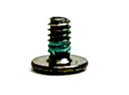


Screw map
1.5
1.0
1.5
1.8
These are the screws used in the Pixel 9:
1.8
Screw
G250-07204-00
Torx Plus 3IP
Screw
G250-07189-00
Torx Plus 3IP
Screw
G250-07197-00
Torx Plus 3IP
Screw
G250-07191-00
Torx Plus 3IP
Screw
G250-07322-00
Standoff 2.5 mm
1.8
1.8
1.5
1.8
1.8
1.8
- Not hidden
- Hidden
1.8
1.5
Note
This is what the device looks like once the back cover is removed.
1.5
1.8
1.5

Slide 12
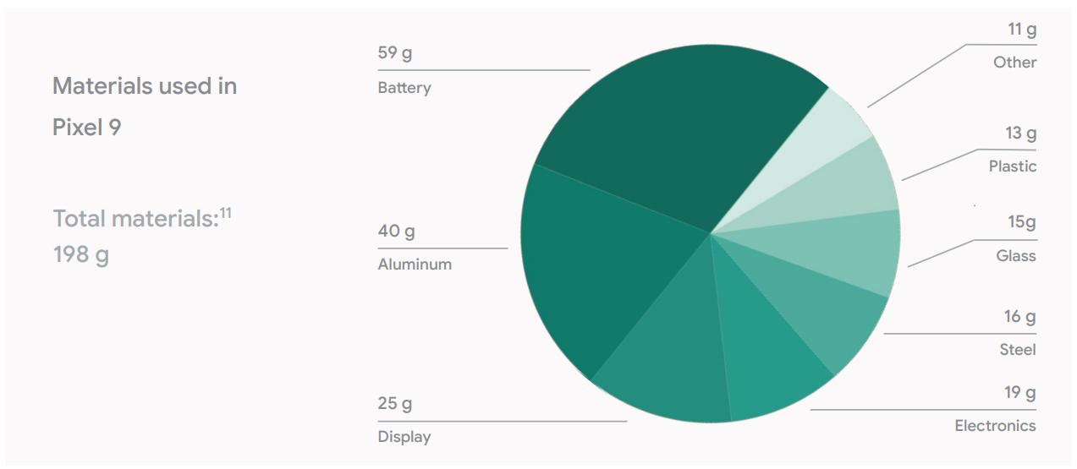
google_logo
What materials can be found in this device?

Slide 13
google_logo
What Tools Are Recommended to Disassemble This Device?
Flat Head Screwdriver
Prying Implement
Pliers
99.9% Isopropyl Alcohol
Torx IP 3 Driver
Universal disassembly shim or miniature pry tool
SIM Card Tray Ejector Pin
Heat Gun, Heat Pad or Heating Tools

Slide 14
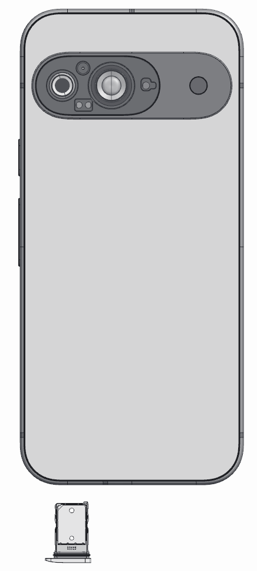
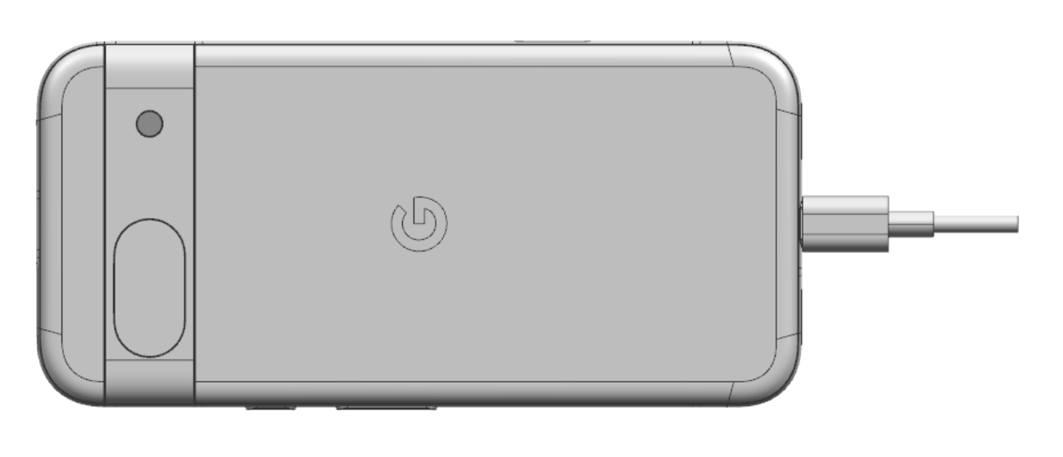
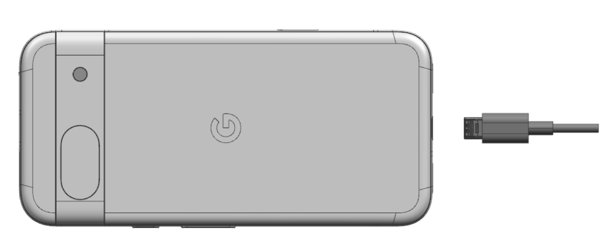
google_logo
05/2024
01
Remove Charge Cable
Turn off device. Unplug Charge cable and allow the device to drain battery charge.
Target Recyclable Materials:
Copper in Cable

Slide 15
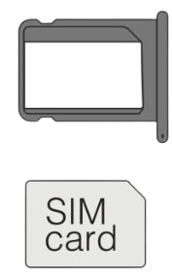
google_logo
02
Remove SIM Tray
Use Small Push Pin Ejector.
Aluminum and plastic SIM Tray
Gold coating on SIM Card

Slide 16
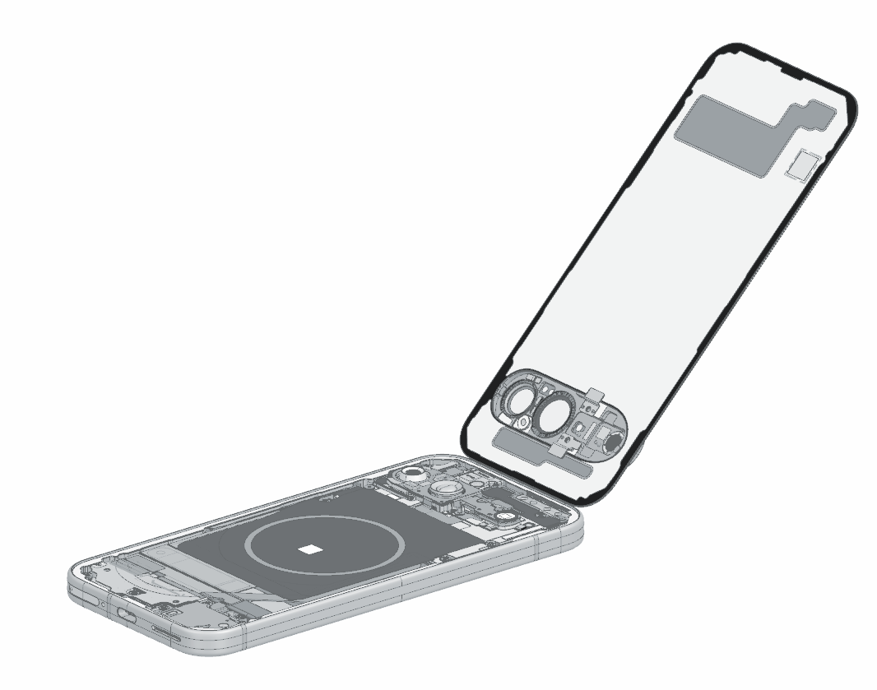
google_logo
03
Remove Back Cover
If possible, heat device to loosen adhesive. Use prying device with thin edge to lift back cover off of the enclosure.
Target Recyclable Materials:
Aluminum Visor
Back Glass
Note
Do not insert prying device too far into device as doing so may damage the battery pack.

Slide 17
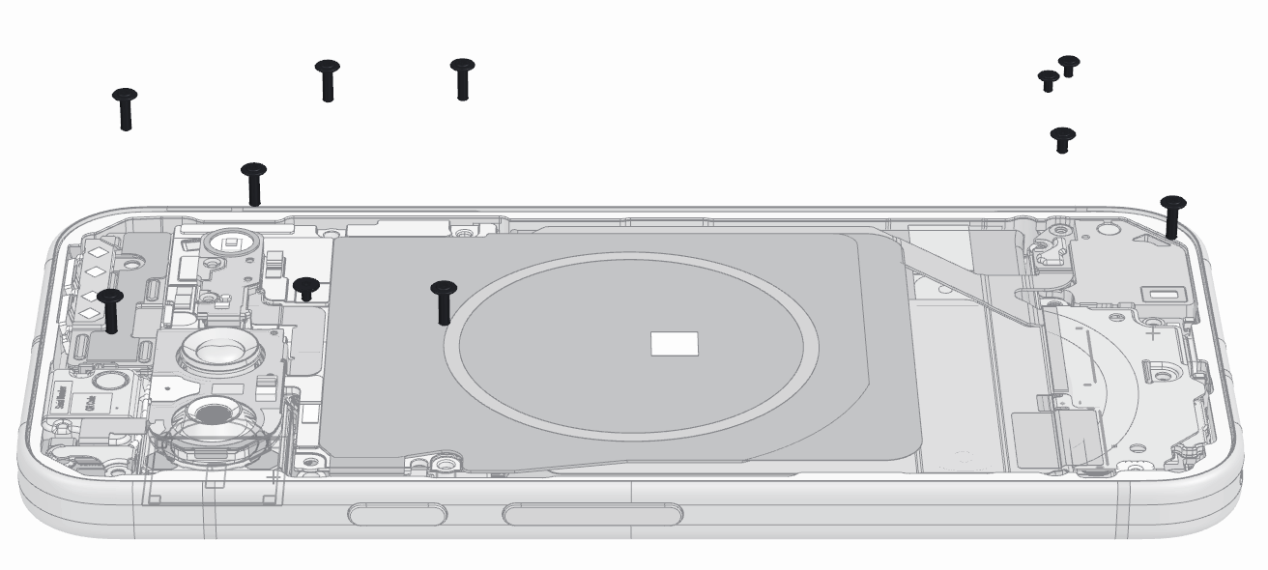
google_logo
04
Remove Screws
Use a screwdriver to remove the 11 screws that secure the inner and antenna housing to the logic board.

Slide 18
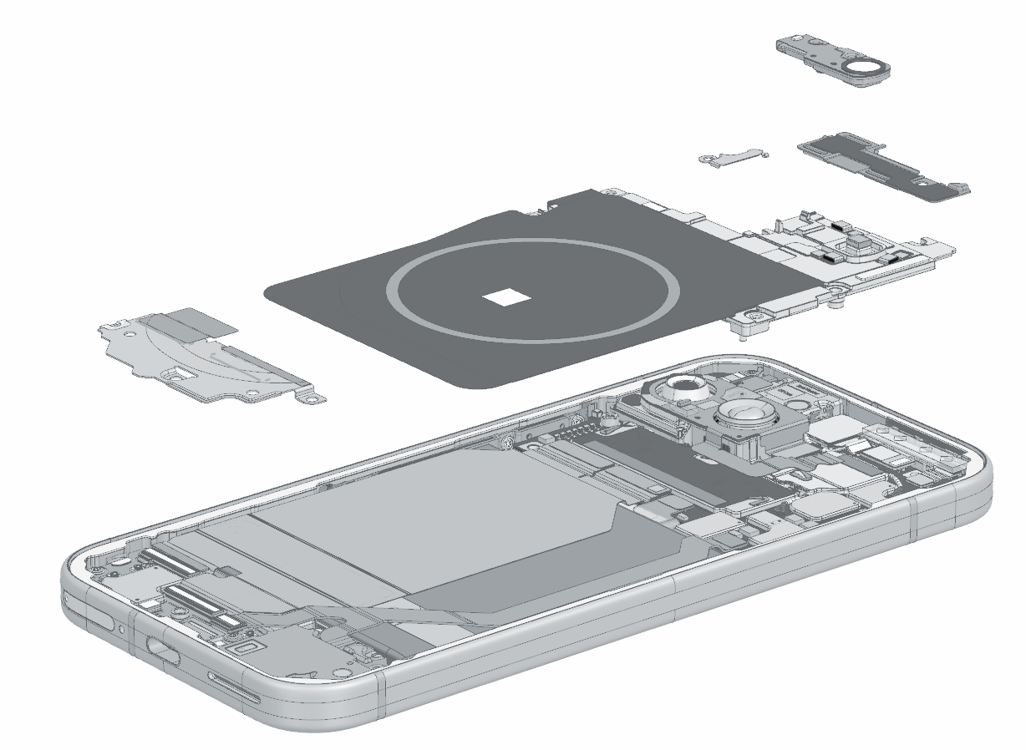
google_logo
05
Remove Cowlings and NFC Coil
5
1
1
Disconnect FSS flex with from the NFC/WLC cowling
Remove the NFC/WLC cowling
Remove NFC
Remove the CLB cowling
Remove the ANT4 cowling
Target Recyclable Materials:
Copper Wireless Charging Coil
SUS 316 Stainless Steel (ANT4 cowling)
SUS 304 Stainless Steel (CLB cowling)
3
2
2
3
4
4
5

Slide 19
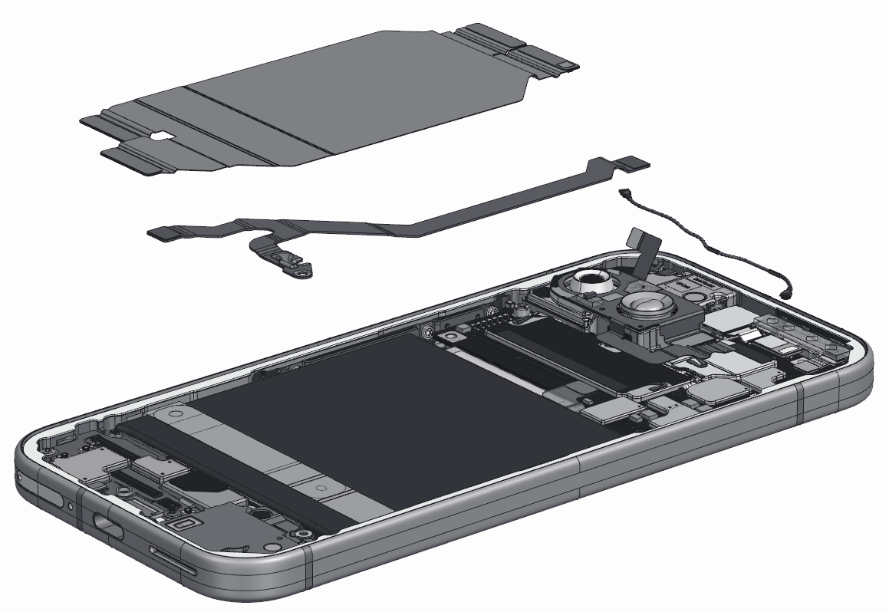
google_logo
06
Remove Flex Cables
1
1
Detach four DJ flex connectors from the logic board and the chin board.
Detach two RJ flex connectors from the logic board and the chin board.
Detach the LDAF flex connector from the ANT4 board with the ESD spudger.
Loosen the cable from the ANT4 board and the logic board with the ESD spudger.
Detach the battery connector from the logic board.
Target Recyclable Materials:
Gold plating on connectors of flex cable
Copper Flex Cable
2
2
3
4
3
5
4
5

Slide 20
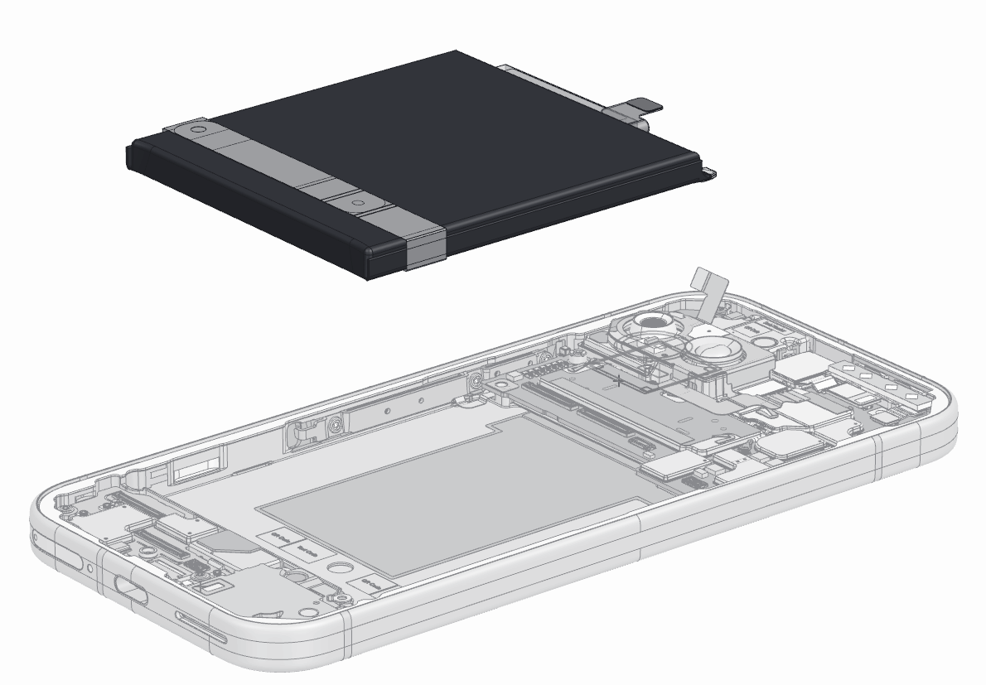
google_logo
07
Remove Battery
Although some recyclers may pry the battery out, we recommend first applying 99.9% isopropyl alcohol under the battery to compromise the adhesive.
Alternatively, a recycler could heat the adhesive under the battery to 158℉ (70 ℃) to weaken the adhesive bond. We recommend a duration of 10 minutes on the hot plate. Use caution. The heating plate is a hot surface and it could cause burns.
Battery must be recycled with specialized processes such as pyrometallurgy or hydrometallurgy.
Target Recyclable Materials:
Cobalt
Lithium
Nickel
Copper
Precious Metals
Gold plating on connectors of flex cable

Slide 21
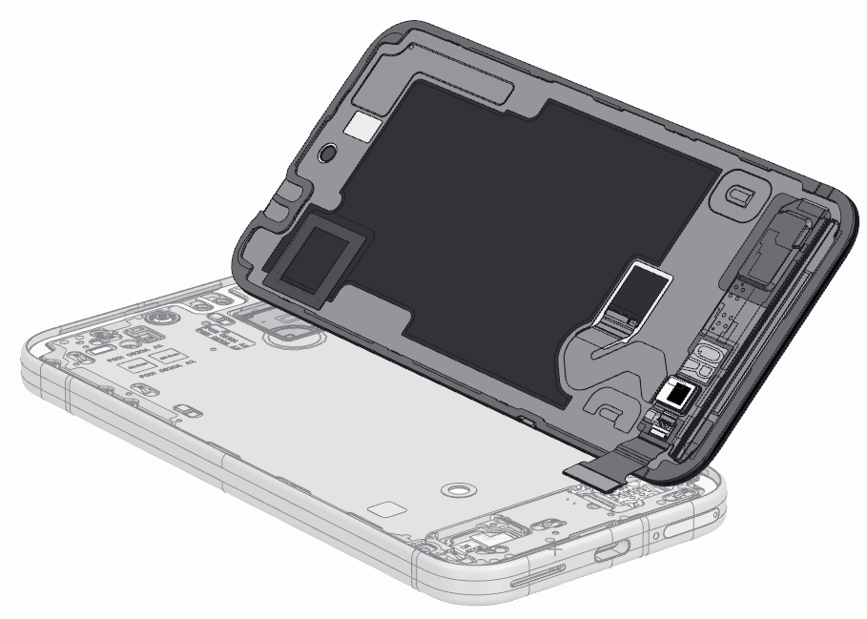
google_logo
08
Remove Display & Cover Glass
If possible, heat device to loosen adhesive. Use prying device with thin edge to lift back cover off of the enclosure.
The display also includes a number of flexible printed circuit boards, which can be pried off.
Target Recyclable Materials:
Glass
Copper Film Backing
Copper in Display Flex Cable
Steel
Gold plating on flex cable Connector
Note
Wear protective gloves and safety glasses when handling damaged parts.

Slide 22
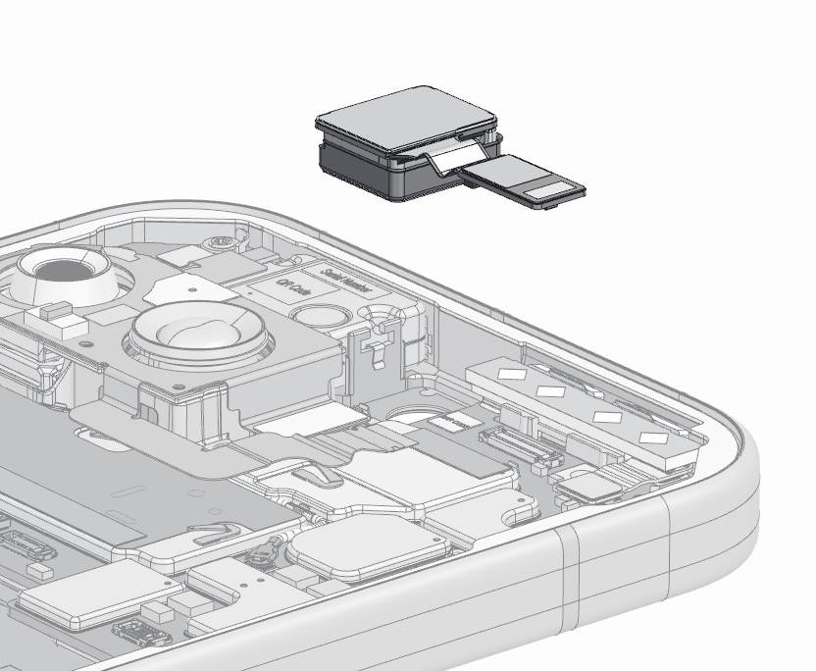
google_logo
09
Front Camera
A recycler may wish to remove the front camera module from the main logic board.
Here the front camera module is highlighted.
Target Recyclable Materials:
SUS (sheet) Front Cam Backer
Minimal Amount (0.06 g) Rare Earth Element in Front Cam Magnet
Gold plating on flex cable Connector

Slide 23
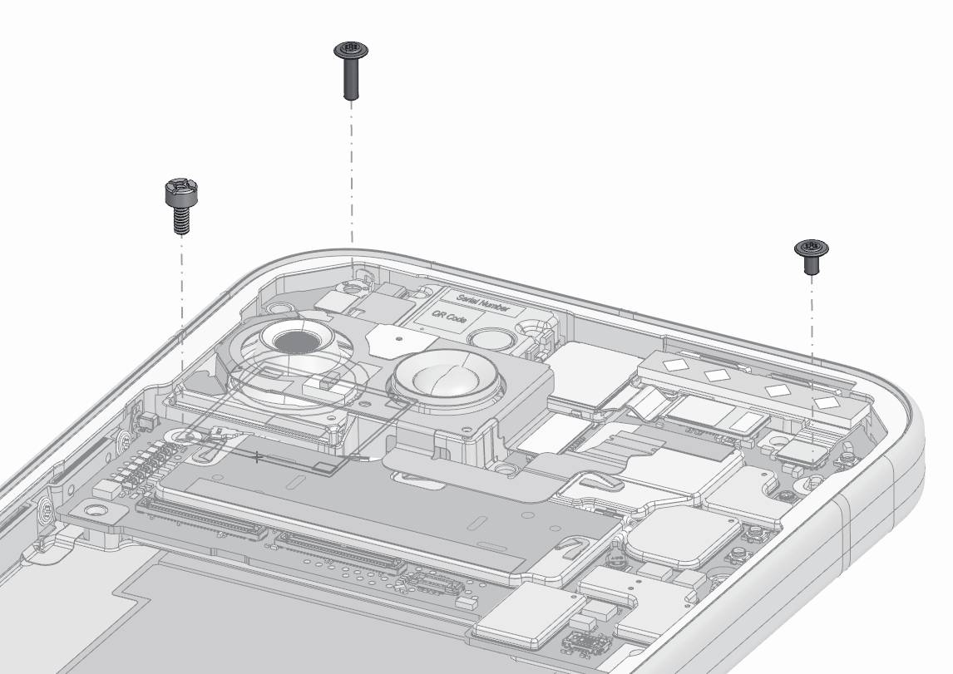
google_logo
10
Remove MLB Screws
Remove the logic board screw with the torx plus 3IP screwdriver.
Remove the logic board screw with a standoff 2.5 mm screwdriver.
1
1
2
2
1

Slide 24
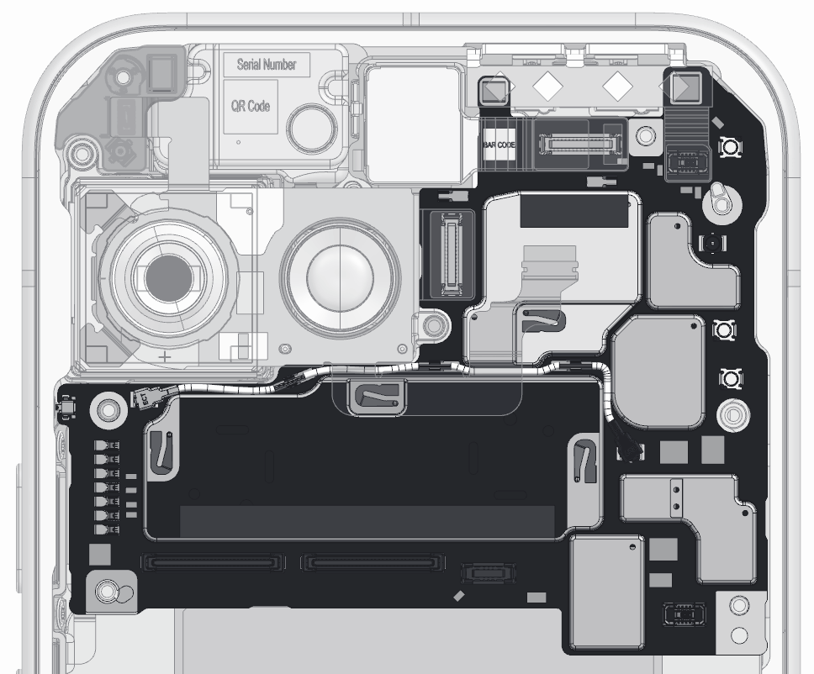
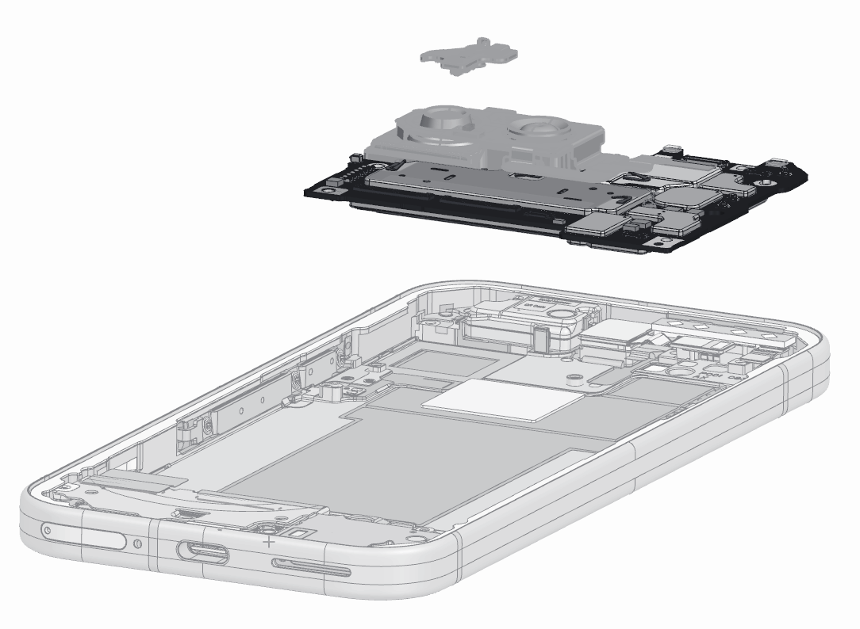
google_logo
11
Main Logic Board (and ANT4 board)
Use Prying tool, if necessary, to lift the main logic board and components out of enclosure.
This component includes small quantities of a number of notable materials that could be recovered, including:
Target Recyclable Materials:
Copper
Precious metal coatings
Silicone

Slide 25
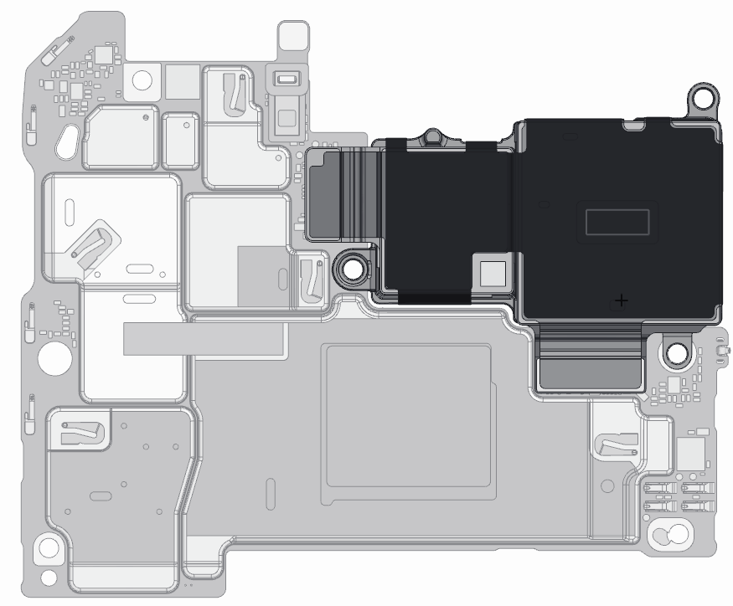
google_logo
12
Rear Camera
Detach two rear camera flex connectors and lift module off of MLB.
Target Recyclable Materials:
SUS (sheet) Rear Cam Backer
Minimal Amount (0.13 g) copper
Minimal Amount (0.30 g) Rare Earth Element in Front Cam Magnet
Gold plating on flex cable Connector
Neodymium (Rare Earth Element) Magnets in Wide Rear Cam

Slide 26
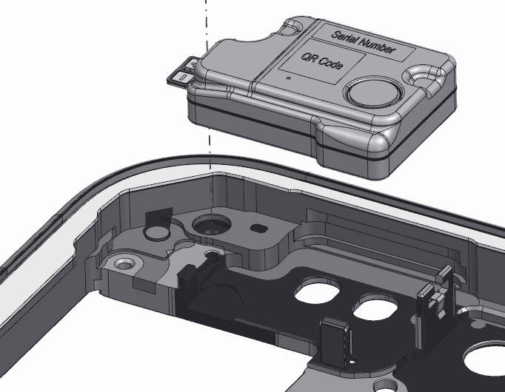
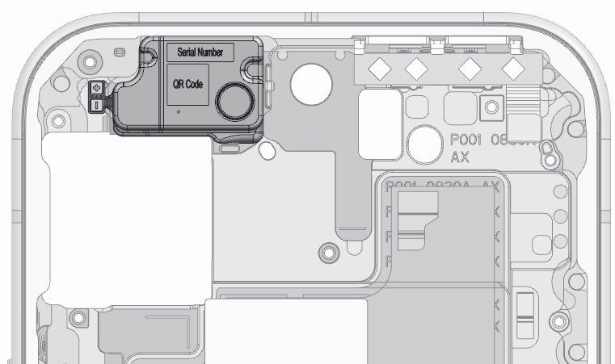
google_logo
14
Top Speaker
Use prying tool to lift up the top speaker.
Target Recyclable Materials:
Neodymium (Rare Earth Element) Magnets in Speaker
Steel Casing

Slide 27
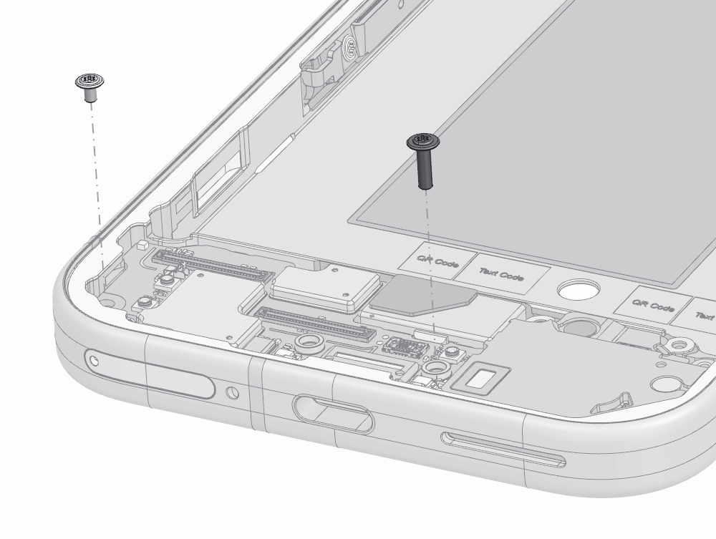
google_logo
15
Remove Screws Chin Board
Remove the two screws that secure the chin board to the enclosure.

Slide 28
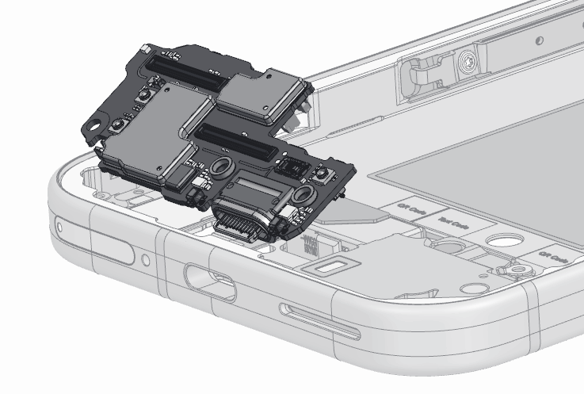
google_logo
16
Remove Chin Board
Push the chin board by hand from the CG side and remove the chin board.
Target Recyclable Materials:
Copper
Precious metal coatings
Silicone

Slide 29
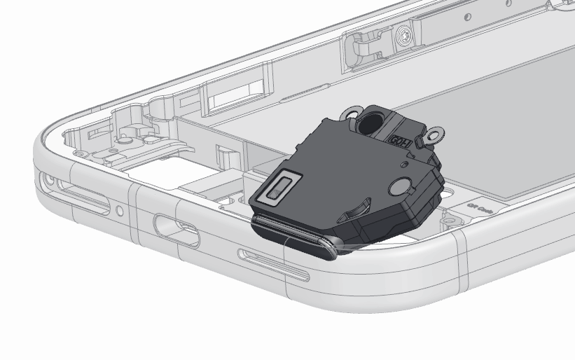
google_logo
17
Remove Bottom Speaker
Push the bottom speaker by hand from the CG side and remove it.
Target Recyclable Materials:
Neodymium (Rare Earth Element) Magnets in Speaker
Polycarbonate Casing
Sheet Steel (internal)

Slide 30
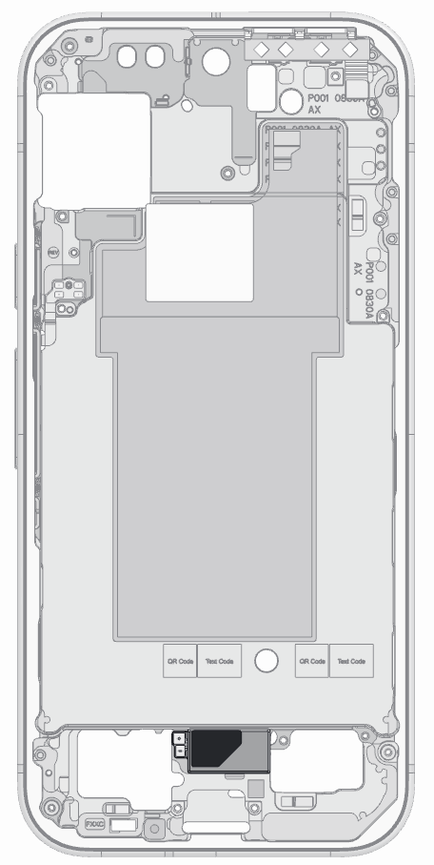
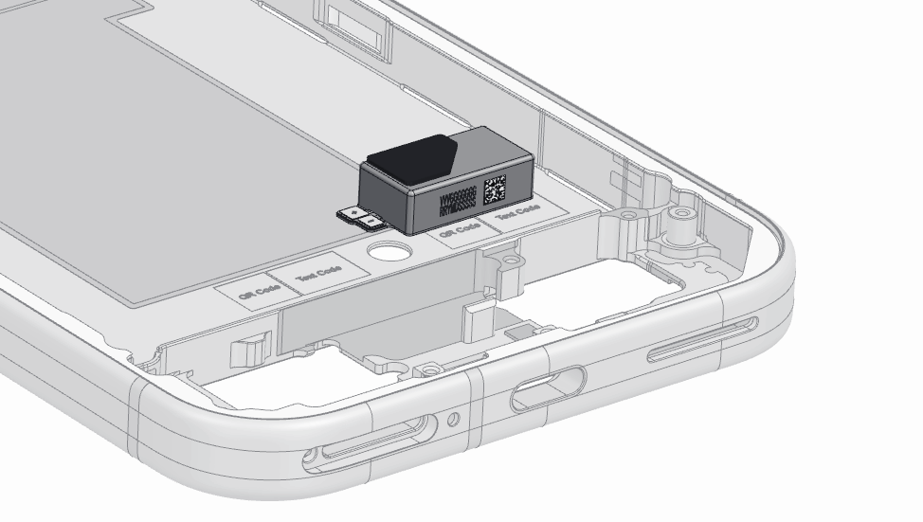
google_logo
18
Haptics / Vibrator
Use the prying tool to remove the haptics vibrator from the enclosure.
Target Recyclable Materials:
Neodymium (Rare Earth Element) Magnets in Speaker
Tungsten Alloy in vibrator mass
SUS (sheet)
Copper

Slide 31
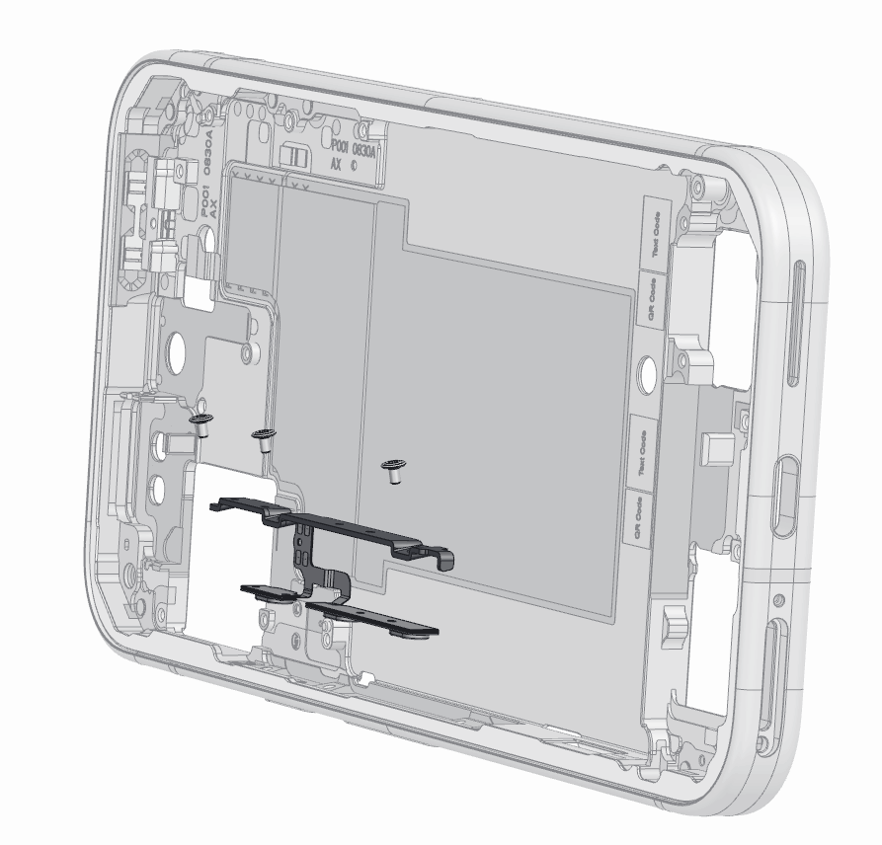
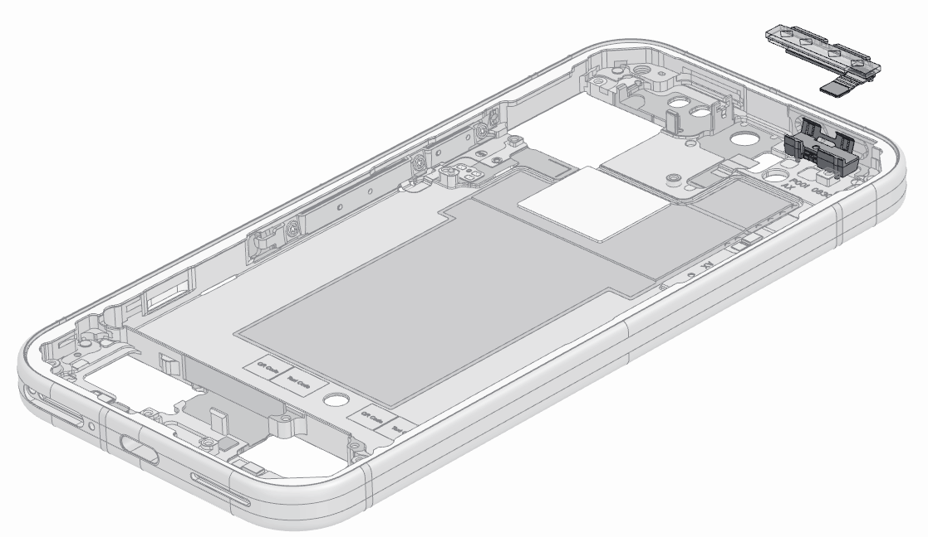
19
Other (Side Key and Heat Sink)
Remove side key screws and pry out the FPCA flex cable, keys and bracket.
Pry out mmWave heat sink.
Target Recyclable Materials:
SUS (304) Steel
Copper
Aluminum (heatsink)
1
2
1
2

Slide 32

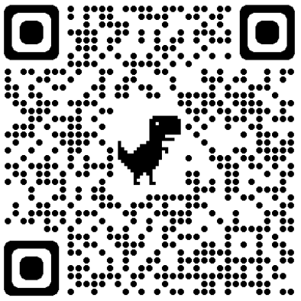
google_logo
Frequently Asked Questions
Questions | Answer
Is there information related to repair? | This recycling guide is for professional recyclers and is not intended in any way to serve as repair instructions. For repair information or access to repair manuals, please visit: https://store.google.com/magazine/repaircenter
Does Google offer spare parts to recyclers to refurbish or repair smartphones? | This recycling guide is for recyclers and is not intended in any way to serve as instructions to test, refurbish or repair. For access to Pixel spare parts, please visit: https://www.ifixit.com/Parts/Google_Phone
How long does it take on average to recycle this device? | Recycling times vary widely and depend on the how thoroughly the device is disassembled for material recovery and the specific tools and operational processes employed. To follow the steps in this guide, we estimate the device processing time will take approximately 1:30 - 5:00 minutes for a well-trained recycling technician.
What hazards might there be when disassembling a device? | The main hazards related to the end-of-life processing of this device are: Damaging the battery in such a way that a thermal runaway occurs; Broken glass causing cuts or abrasions; Chemical inhalation–especially if thermal runaway occurs and Exposure to the class 1 laser module
Link
Link

