Slide 1
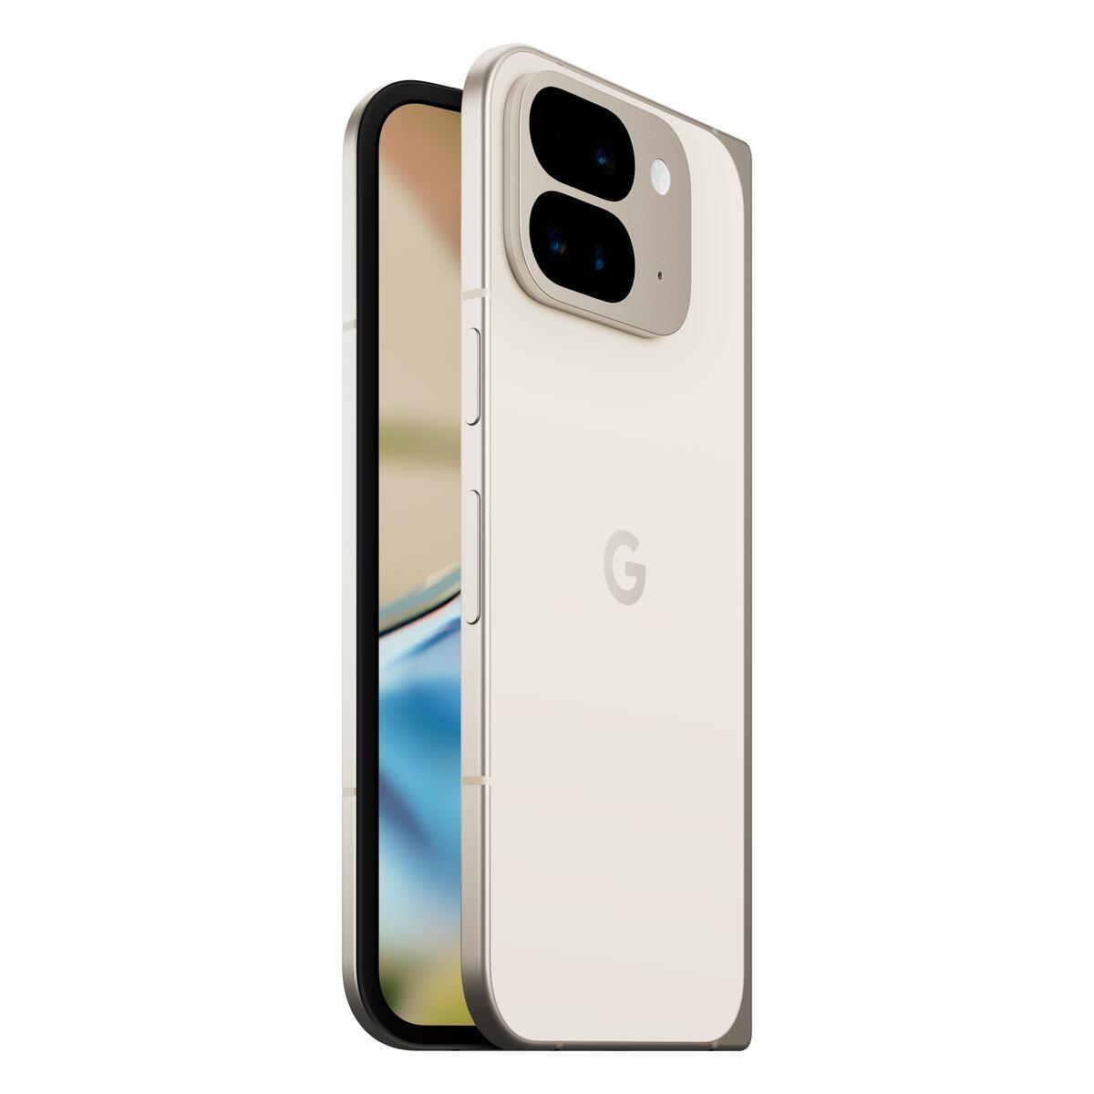
Pixel 9 Pro Fold
Recycling Guide
Version 1.0

Slide 2
google_logo
Environmental
sustainability at Google
At Google, operating in an environmentally sustainable way has been a core value from our beginning.
As our business has evolved to include the manufacturing of electronic products, we’ve continually expanded our efforts to improve each product’s environmental performance and minimize Google’s impact on the world around us.
This report details how recyclers can disassemble the Pixel 9 Pro Fold to recover raw materials.
To provide feedback or for questions about this guide, please email Recycling@Google.com.
Who is this Guide for?
This guide is intended for professional recyclers who are trained in electronics recycling and understand the risks involved with doing so. This recycling guide is not intended in any way to serve as repair instructions.
Please follow all relevant local-federal regulations and applicable international standards for electronic recycling as you follow this guide.

Slide 3
google_logo
Table of Contents
Topic | Location
Components Requiring Selective Treatment | Slide 4
How Best to Approach Device End-of-Life | Slide 5
General Personal & Environmental Safety | Slide 6
Battery Safety | Slide 7
Expanded View of Device | Slide 9
Location of Battery | Slide 10
Screw Map | Slide 11
Material Constituents of Device | Slide 12
Recommended Tools | Slide 13
Processing Steps | Slides 14 - 28
Frequently Asked Questions | Slide 29

Slide 4
google_logo
Directive 2012/19/EU Annex VII Components Requiring Selective Treatment
Substance or Component | Location | Removal Instructions
Display & Cover Glass Cover glass and organic light-emitting diode (OLED) display if the surface is greater than 100 cm² | Main Display | Step 3 and Step 15
PCB Printed circuit board if the surface area is greater than 10 cm² | Main Logic Board This device employs a mid-frame architecture. MLB is located within the device enclosure and can be accessed through the back cover. | Steps 1 - 10
PCB (Other) Printed circuit board if the surface area is greater than 10 cm² | OLED FPC Organic light-emitting diode flexible printed circuit | Step 1 - 12
Battery | Battery Battery is located within the device enclosure and can be accessed through the back cover. | Steps 1 - 8
Charger External electric cables | Charge Cable External charging cable is removable. | Step 1
The Google Pixel smartphone contains the following materials and components as listed in Annex VII in the European Union WEEE (recast) Directive 2012/19/EU.

Slide 5

google_logo
Give Your Device New Life
Before you recycle this device to recover materials, please consider whether the useful lifespan of this device can be extended in other ways.
Repair your device
Trade-In your device
Link
Link
Sell your device
Google Mail-In
Take-Back Program
Link
Link
Recycle Properly
Again, this guide is intended for technicians and operators who are trained in electronics recycling and understand the risks involved with electronic recycling.
If you are not trained, equipped and capable of properly recycling this device, please use Google’s complementary take back program.

Slide 6

google_logo
Personal Safety
Operators should always wear personal protective equipment (PPE) including protection from thermal events, fires and hazardous materials.
Hand protection
Protective Clothing
Eye protection
Burn Protection
Breathing protection
HazMat Protection
Environmental Health & Safety
Operate in a safe, well-ventilated environment. Follow safety and ergonomic best practices. Outfit your workspace with fire and hazardous material mitigation equipment.¹
Ergonomics
Fire Equipment
Ventilation
HazMat Equipment
Training
Always remember to ensure strict compliance with all local applicable health and safety rules.

Slide 7

google_logo
Battery Safety
Improper disassembly can be dangerous—especially if individuals are unfamiliar with safety critical components, such as lithium ion batteries.
Discharge Battery
Do not inhale hazardous fumes
Do not damage battery
Be fully prepared for thermal runaway
Battery must be carefully handled, and can be dangerous when damaged.
Fully discharge device battery before attempting disassembly.
Never bend, dent or puncture battery.
Do not use tools that may accidentally damage battery.
Store batteries in a safe environment to prevent inadvertent damage.
Take care not to store large quantities of batteries together.
Take care to prevent shorting of battery terminals.
If a battery begins to vent or a thermal runaway occurs, immediately cover in sand or use gloves and tongs to place battery in a fire safe.
Other Battery Handling Tips

Slide 8
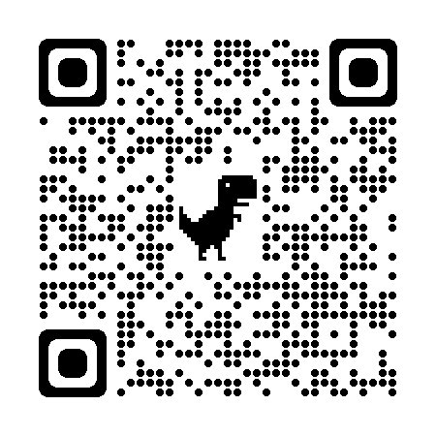

google_logo
Battery Transport
and Storage Safety
Follow regulations and best practices for lithium-ion battery safety.
Here are some resources that may help recyclers.
Topic | Resource
Damaged, Defective or Recalled (DDR) lithium cell batteries Learn how to identify a lithium cell battery that may be swollen, damaged, defective or recalled. Follow all Department of Transportation guidelines. This QR code links to a PDF file from the United States Department of Transportation entitled “Understanding the Risks of Damaged, Defective or Recalled (DDR) Lithium Batteries”
Transporting Lithium Batteries This QR code links to a webpage from the United States Department of Transportation entitled “Transporting Lithium Batteries”
Link
Link
Device Specific Warnings
Pixel 9 Pro Fold contains a class 1 laser module
The design of the device incorporates optics and protective housing such that there’s no access to a level of laser radiation above class 1 during normal use or approved servicing.
Use of controls or adjustments or performance of procedures other than those specified herein may result in hazardous radiation exposure.
Caution

Slide 9
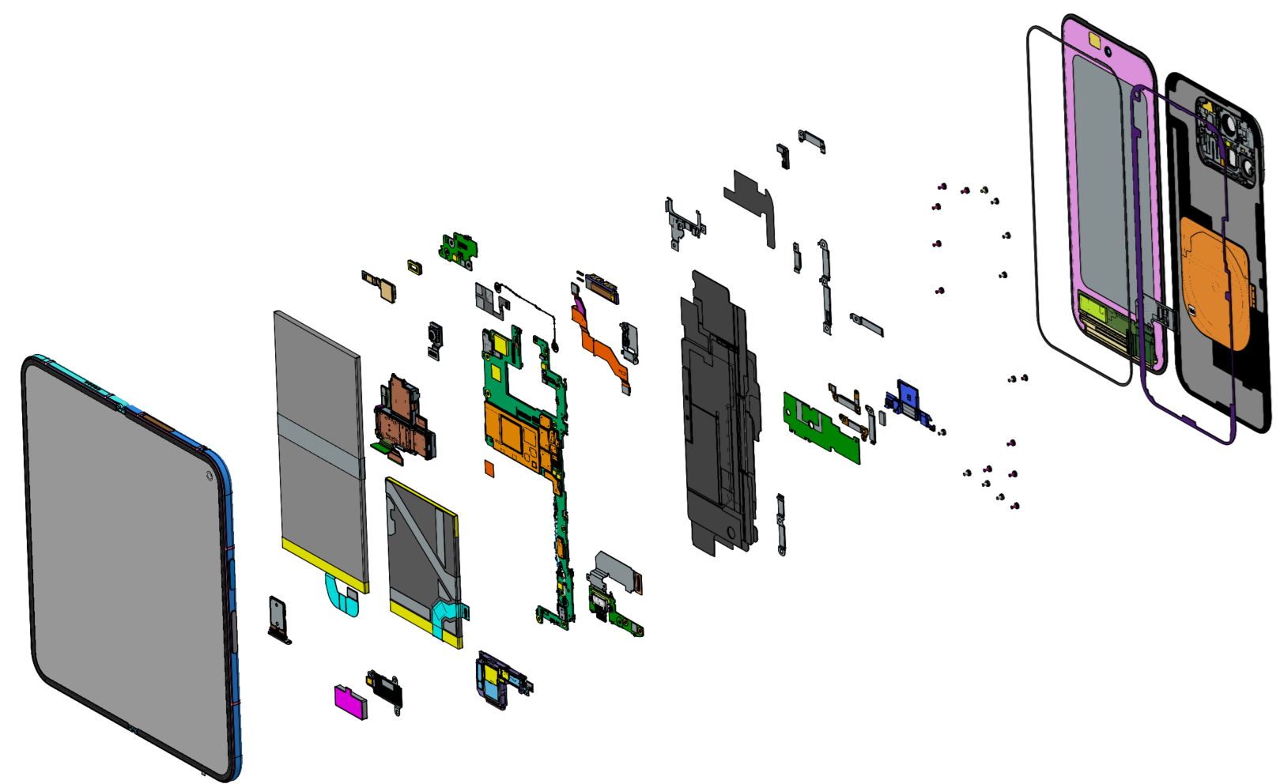
Pixel 9 Pro Fold part ID
Pixel 9 Pro Fold: Expanded view
38
36
39
16
40
15
7
13
29
6
41
11
4
9
26
8
30
35
2
5
12
10
33
31
3
28
27
34
42
32
37
1
24
14
25
23
17
21
22
18
19
20
1 | ⬤ Inner display sub | 8 | ⬤ UWB | 15 | ⬤ Graphite sheet top SPK | 22 | ⬤ USB board | 29 | ⬤ Base top bridge cowling | 36 | ⬤ OD PSA
2 | ⬤ Flip battery | 9 | ⬤ Coaxial cable | 16 | ⬤ OD rubber | 23 | ⬤ Logic board | 30 | ⬤ Base bottom bridge cowling | 37 | ⬤ BG PSA
3 | ⬤ Rear camera | 10 | ⬤ IF FPC | 17 | ⬤ SIM tray | 24 | ⬤ FPS mylar | 31 | ⬤ OD cowling | 38 | ⬤ OD sub
4 | ⬤ Outer FCAM | 11 | ⬤ mmWave module | 18 | ⬤ Vibrator | 25 | ⬤ Base battery cowling | 32 | ⬤ Flip bottom bridge cowling | 39 | ⬤ BG sub
5 | ⬤ Inner FCAM | 12 | ⬤ FCAM cowling | 19 | ⬤ Vibrator cowling | 26 | ⬤ BG cowling | 33 | ⬤ Flip battery cowling | 40 | ⬤ Flip top bridge cowling
6 | ⬤ PL rubber | 13 | ⬤ mmWave cowling | 20 | ⬤ Bottom speaker | 27 | ⬤ Lower board | 34 | ⬤ OD cowling FOF | 41 | ⬤ 5G B2B sponge
7 | ⬤ Upper board | 14 | ⬤ Graphite sheet MLB | 21 | ⬤ Base battery | 28 | ⬤ Rubber support | 35 | ⬤ Screw | 42 | ⬤ OD left bottom FOF

Slide 10
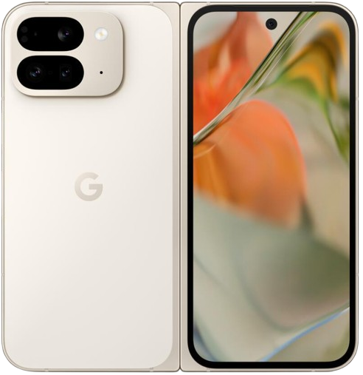
google_logo
Battery Location
There are two lithium-ion cobalt batteries located in this device.
The approximate location of these batteries is outlined.

Slide 11
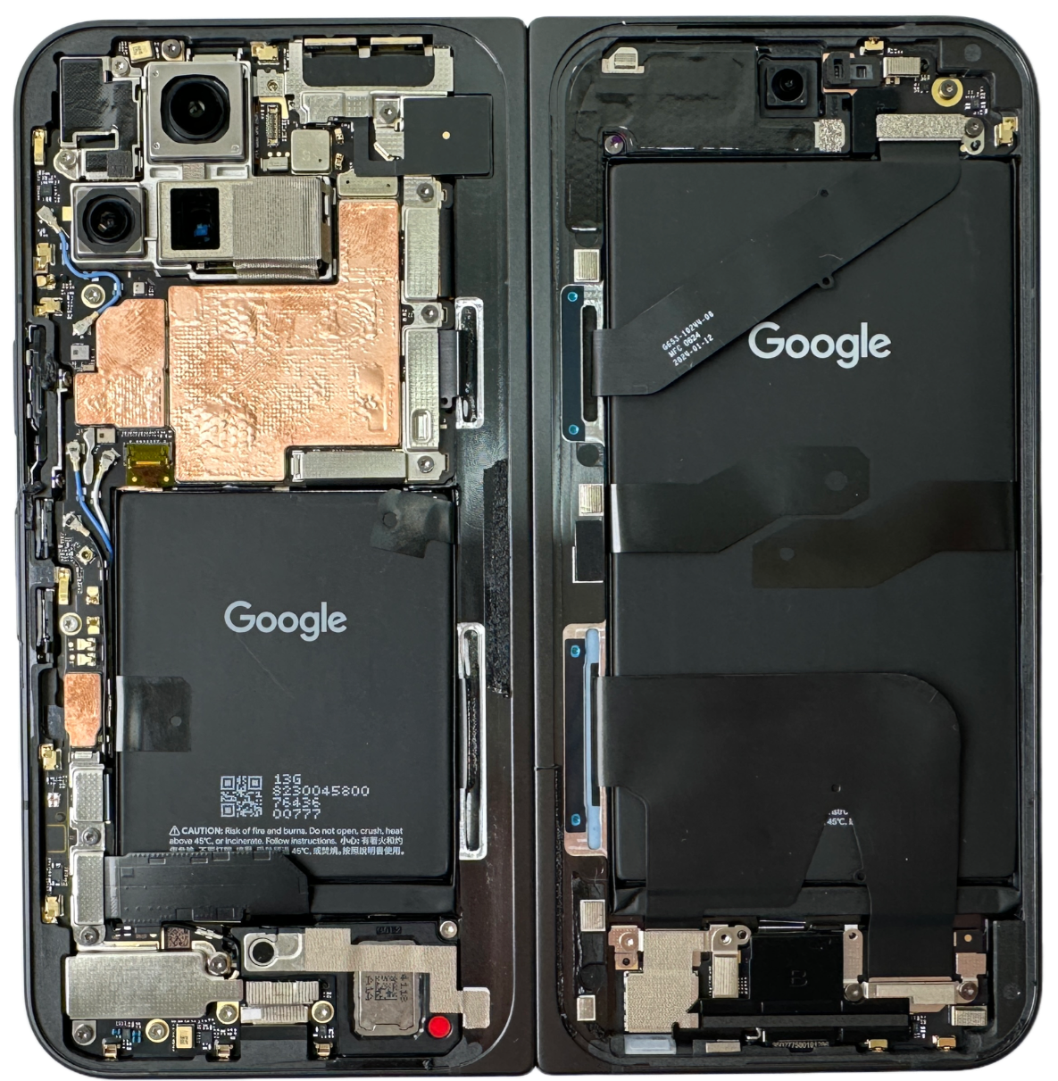
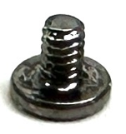
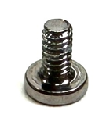
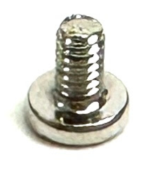

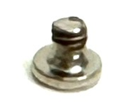

Screw map
These are the screws used in the Pixel 9 Pro Fold:
Screw
G250-06985-01
Torx Plus 3IP
Screw
G250-06988-01
Torx Plus 3IP
Screw
G250-06989-01
Torx Plus 3IP
Screw
G250-07521-00
Torx Plus 3IP
Screw
G250-06986-00
Torx Plus 3IP
- Not Hidden
Note
This is what the device looks like once the back cover and outer display are removed.
- Hidden

Slide 12
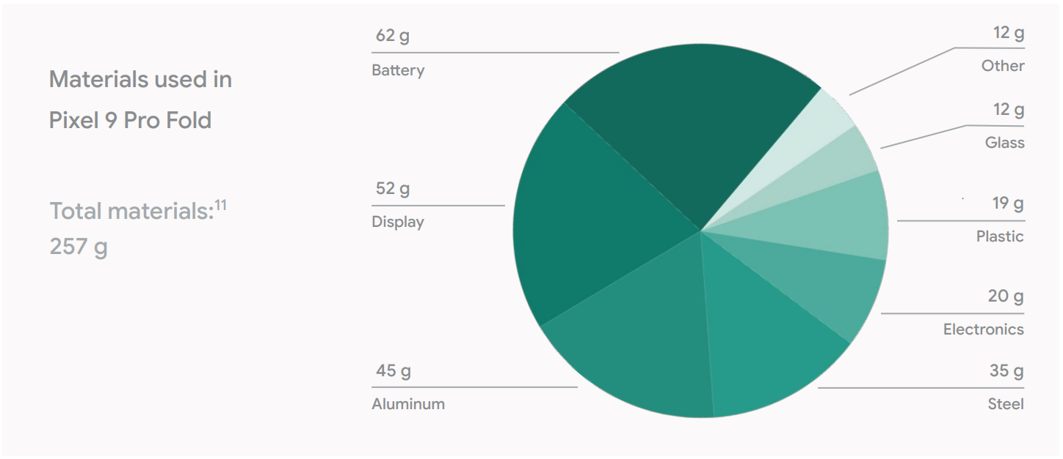
google_logo
What materials can be found in this device?

Slide 13
google_logo
What Tools Are Recommended to Disassemble This Device?
Flat Head Screwdriver
Prying Implement
Pliers
99.9% Isopropyl Alcohol
Torx IP 3 Driver
Universal disassembly shim or miniature pry tool
SIM Card Tray Ejector Pin
Heat Gun, Heat Pad or Heating Tools

Slide 14
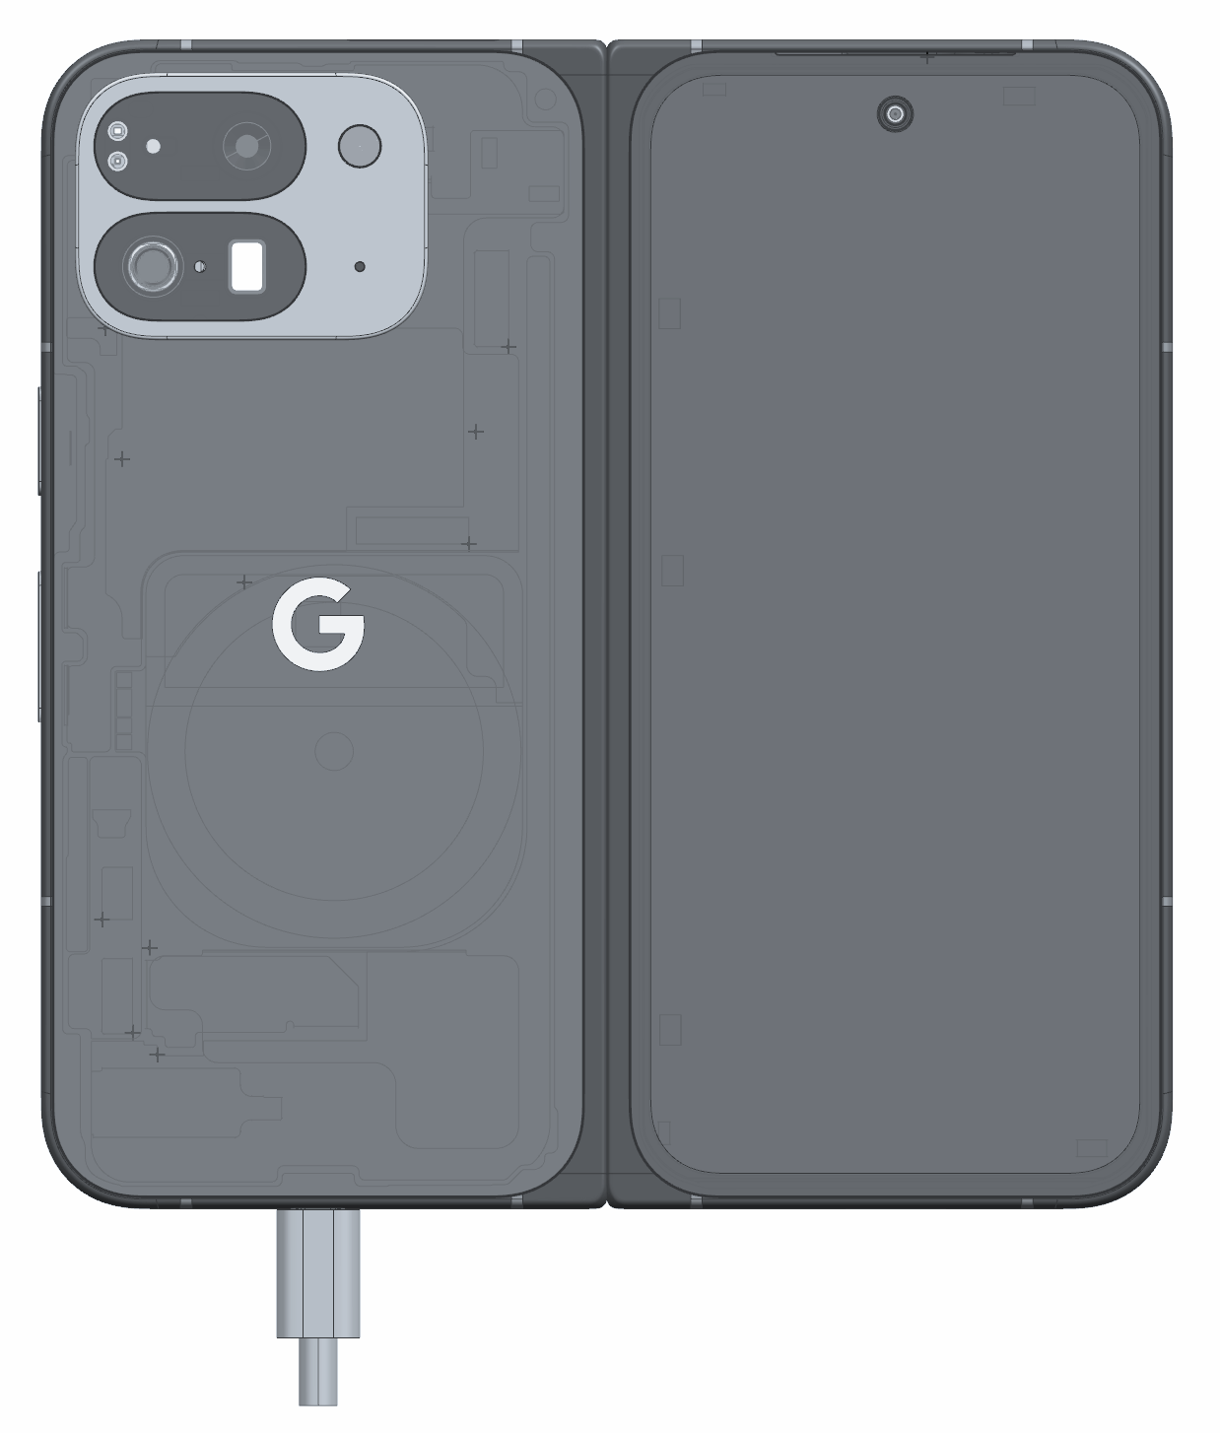
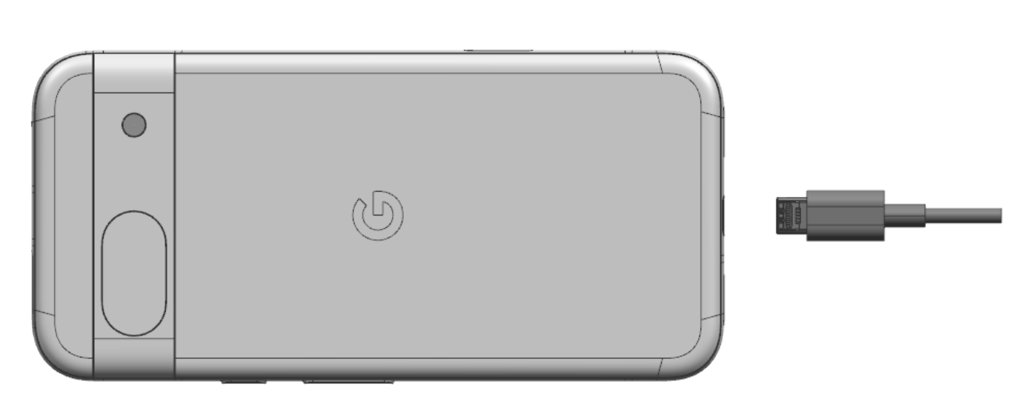
google_logo
01
Remove Charge Cable
Turn off device. Unplug Charge cable and allow the device to drain battery charge.
Target Recyclable Materials:
Copper in Cable

Slide 15
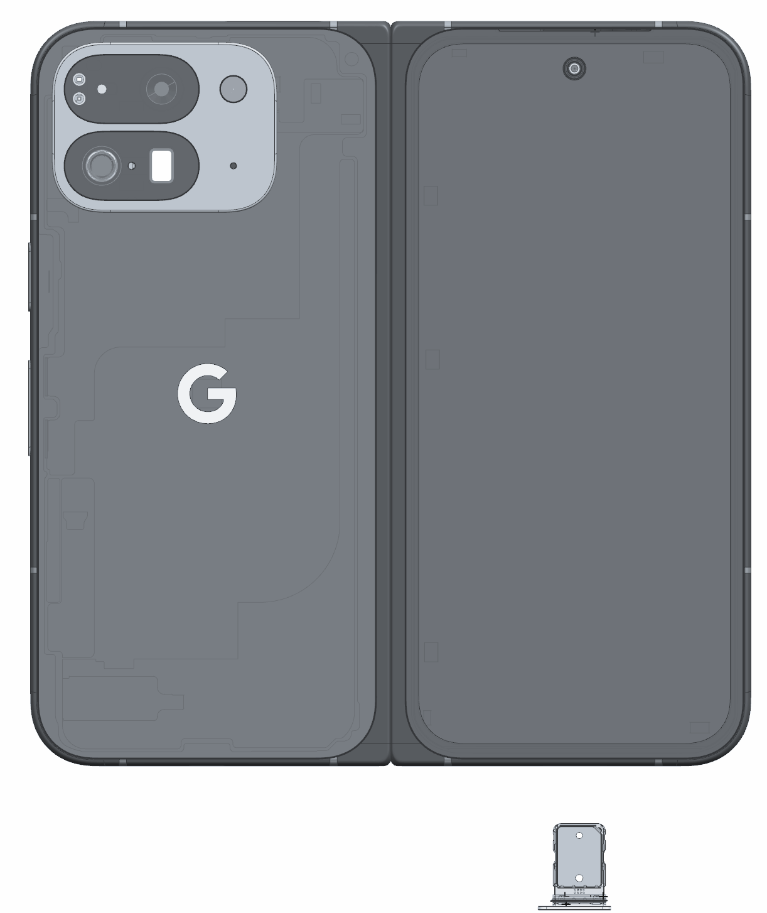
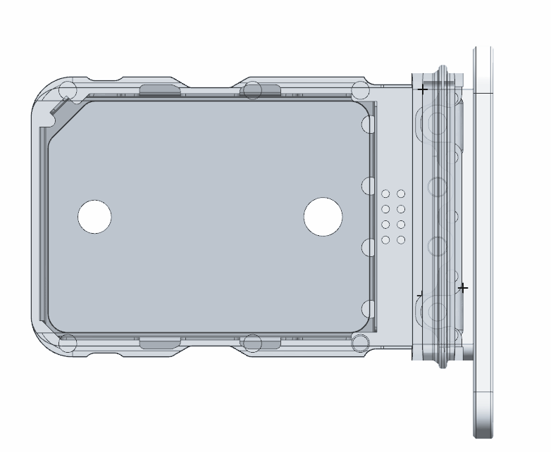
google_logo
02
Remove SIM Tray
Use Small Push Pin Ejector.
Aluminum/ injection SIM Tray
Gold coating on SIM Card
sim
card

Slide 16
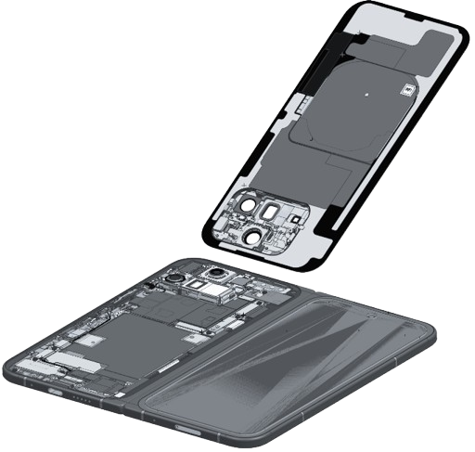
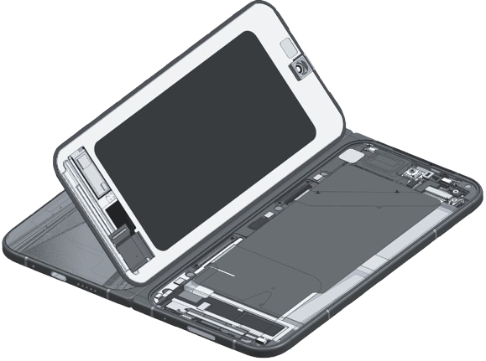
google_logo
03
Remove Back Cover and Outer Display
If possible, heat device to loosen adhesive. Use prying device with thin edge to lift back cover off of the enclosure. Do the same with outer display.
Target Recyclable Materials:
Aluminum Visor
Glass
Copper (charging coil)
Note
Do not insert prying device too far into device as doing so may damage the battery pack.

Slide 17
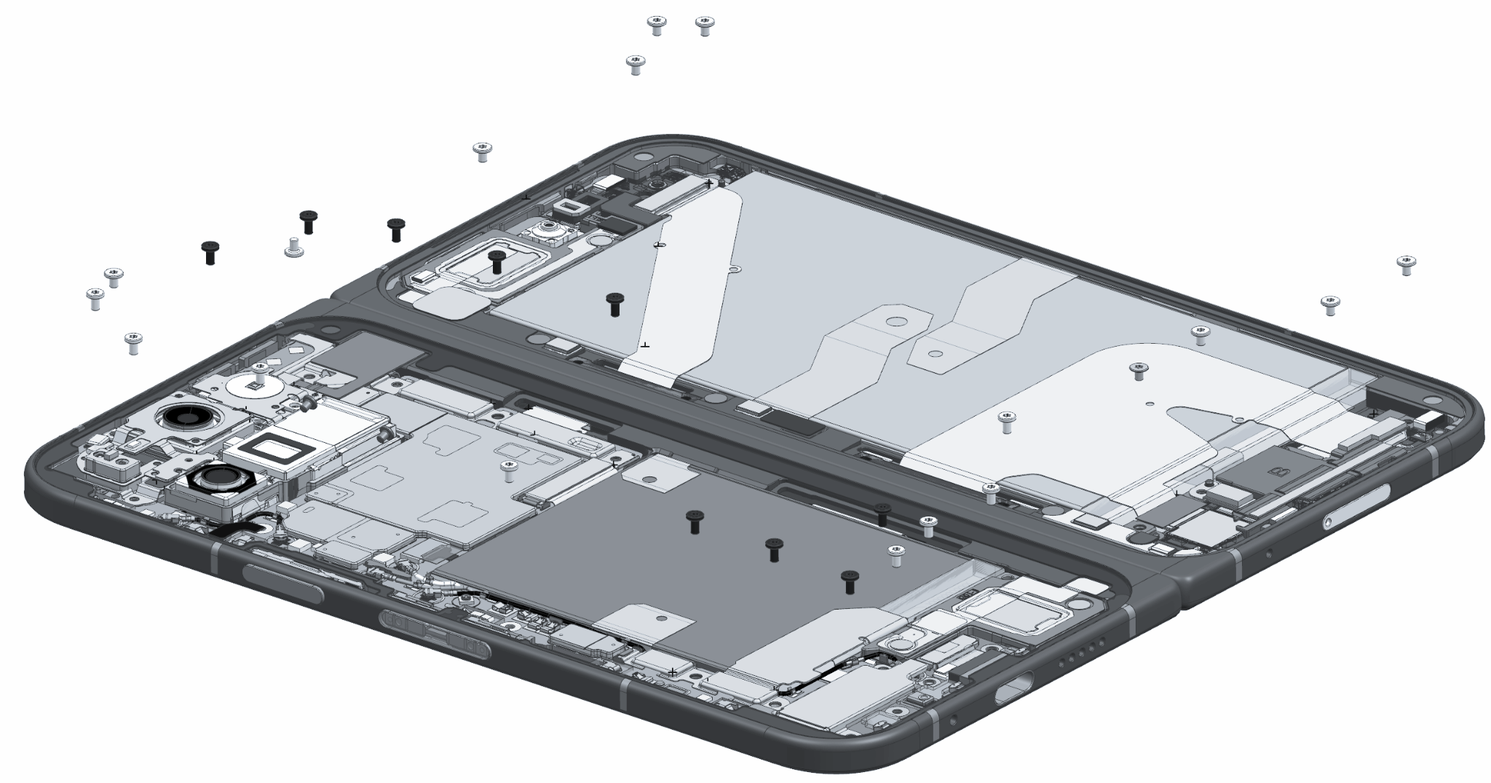
google_logo
04
Remove Screws
Tear off graphite sheet covering the MLB.
Using a Torx Plus 3IP screwdriver, remove the 26 visible screws
Target Recyclable Materials:
SUS Steel

Slide 18
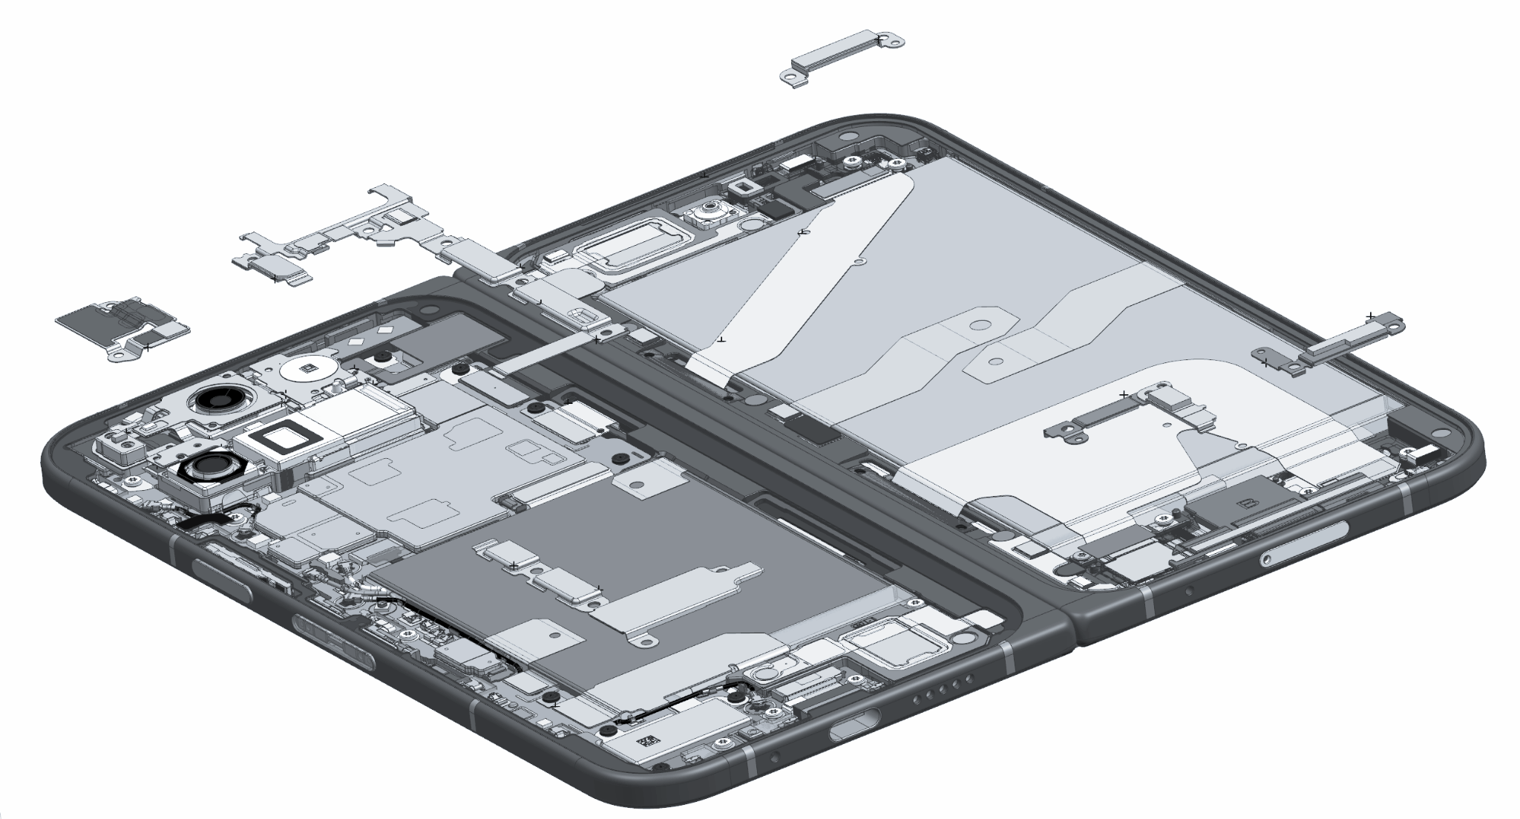
google_logo
05
Remove Cowlings
10
1
Remove the FCAM cowling.
Remove the flam FPC cowling.
Remove the mmWave cowling.
Remove the base top bridge cowling.
Remove bottom bridge cowling.
Remove the base battery cowling.
Remove the vibrator cowling.
Remove the flip battery and OD FOF cowlings
Flip bottom bridge cowling
Flip top bridge cowling
3
2
4
1
2
9
3
5
4
8
5
6
6
7
7
8
9
10

Slide 19
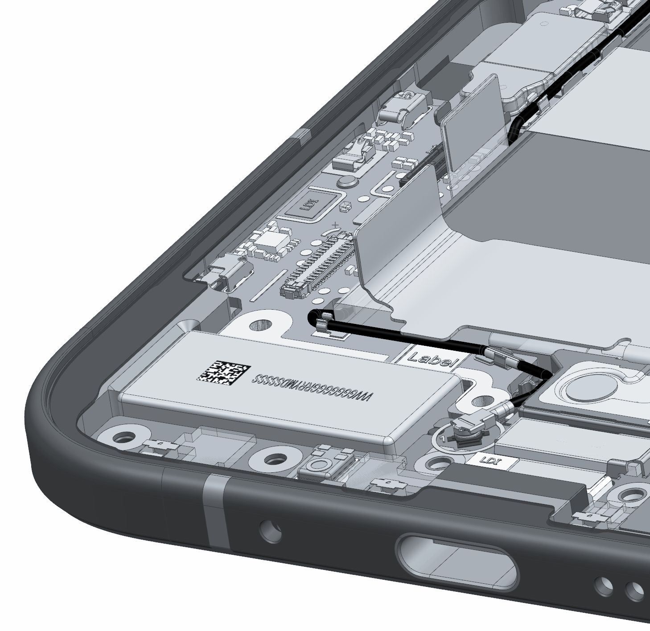
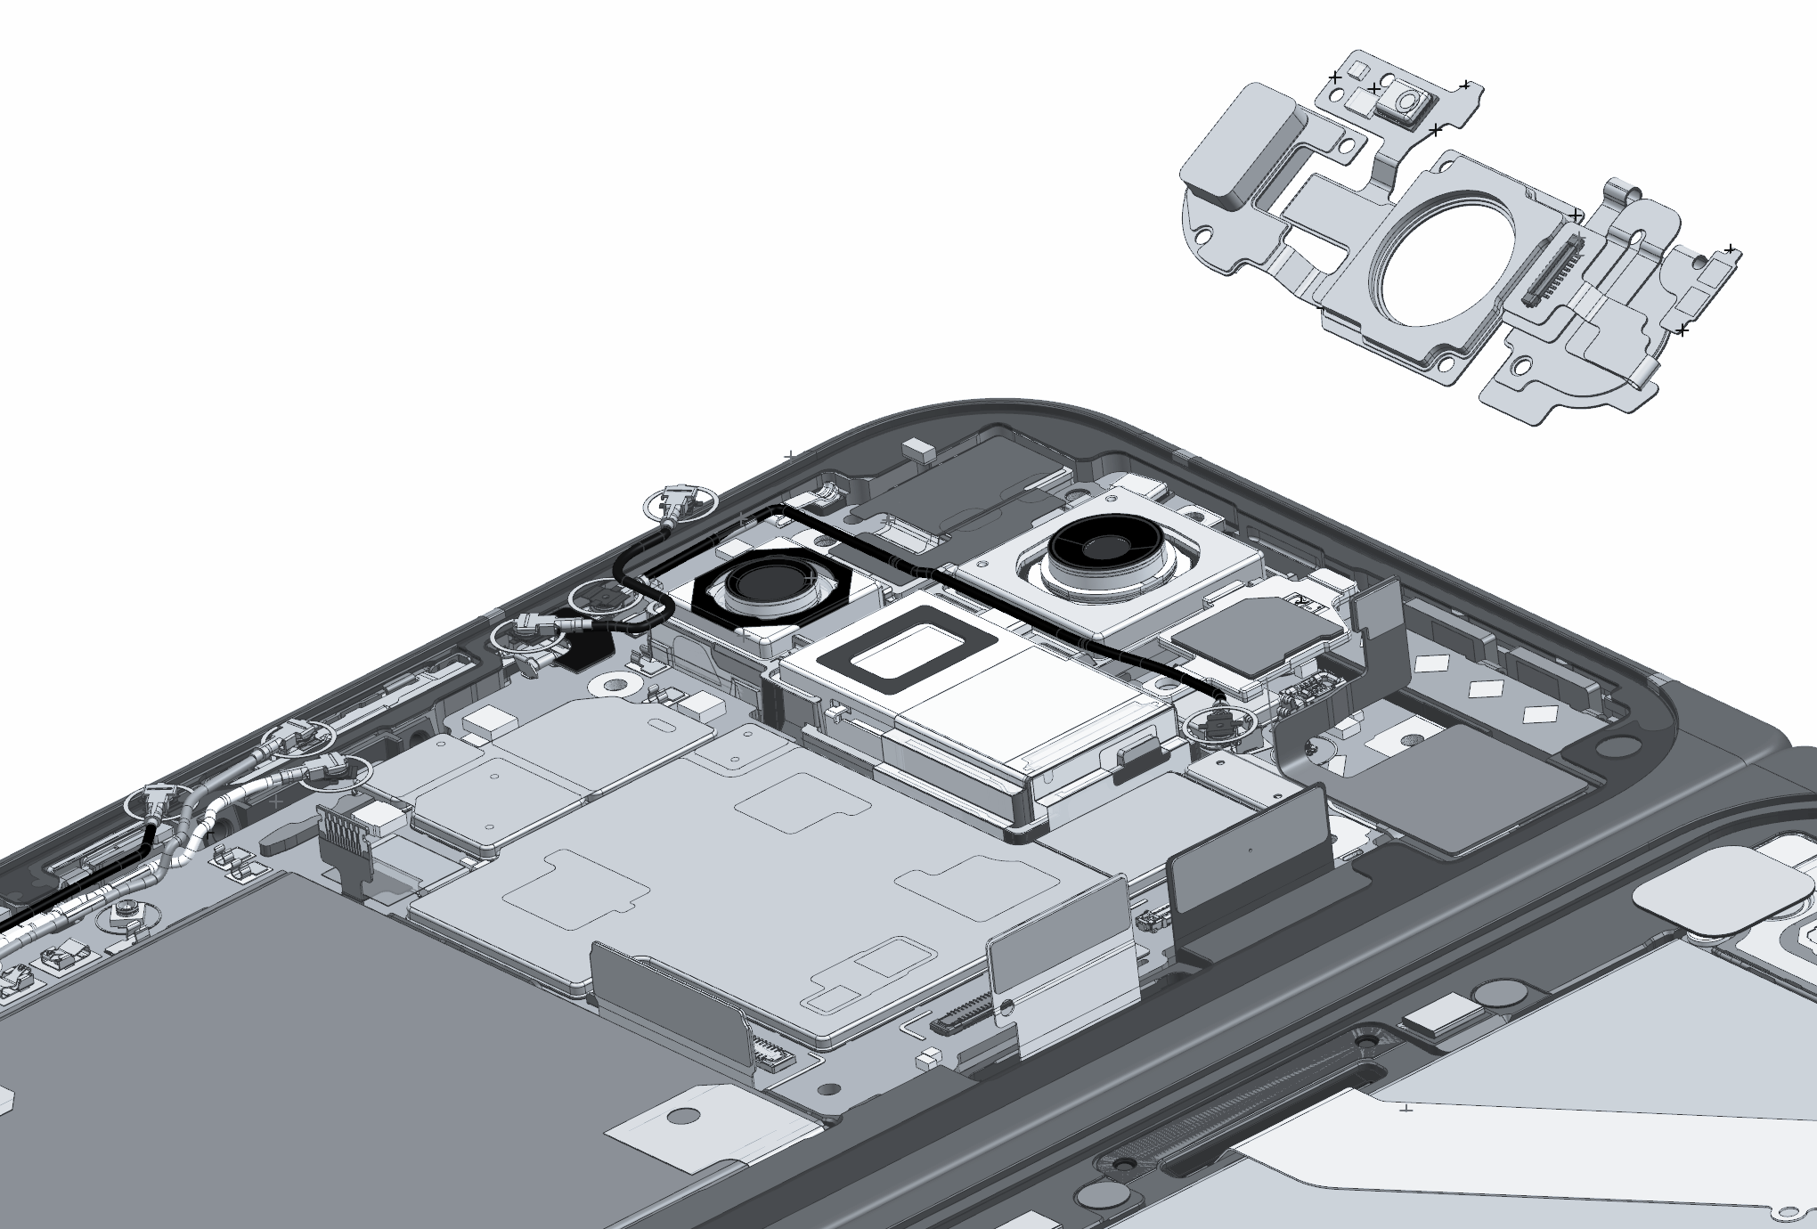
google_logo
06
Remove Flex Cables
1
2
1
Detach the base battery B2B connector and the USB board B2B connector from the logic board.
Disconnect the bottom bridge FPC B2B connector from the logic board
Detach and remove the UWB flex connector from the logic board
Disconnect the top bridge FPC B2B connector and the inner display B2B connector.
Remove the yellow mylar from the FPS. Open the black zif connector and remove the FPC.
Target Recyclable Materials:
Gold plating on flex cable
Copper Flex Cable
2
3
3
4
5
4
5

Slide 20
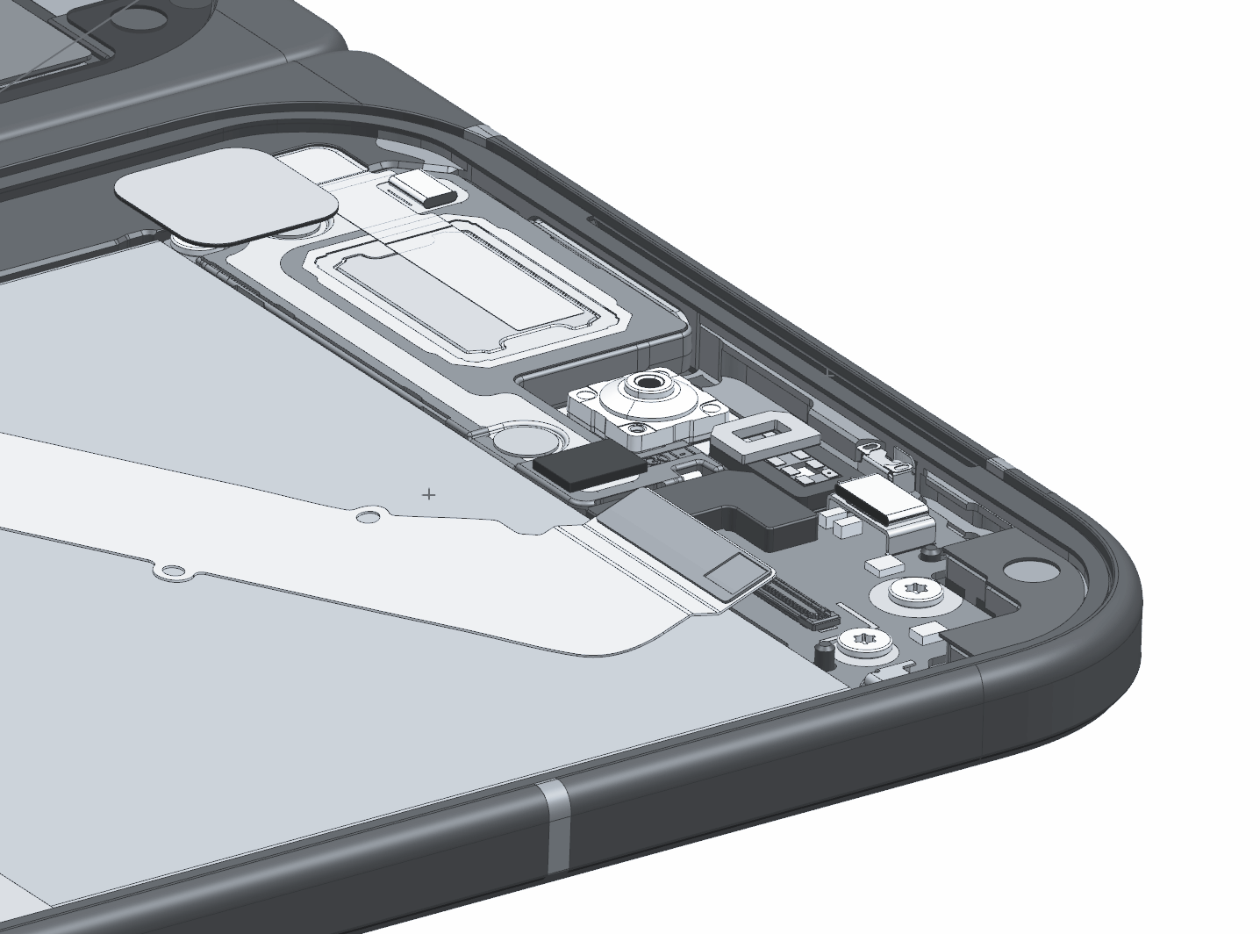
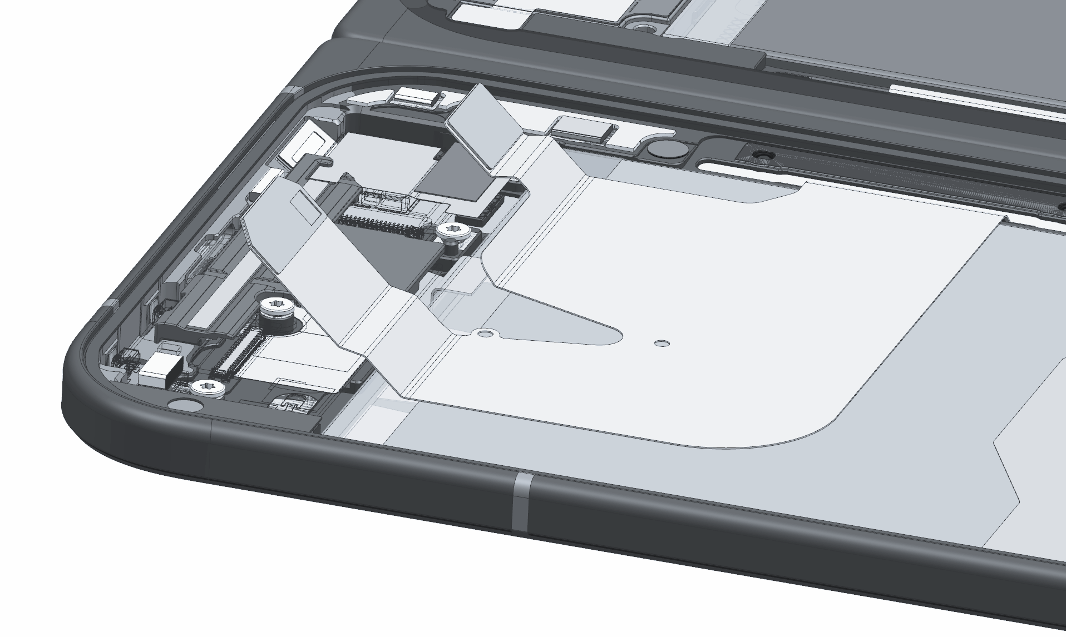
google_logo
07
Remove Flex Cables on Flip Side
3
Detach the flip battery B2B connector
Detach the flip bottom bridge B2B connector
Detach the flip top bridge B2B connector
1
2
3
1
2

Slide 21
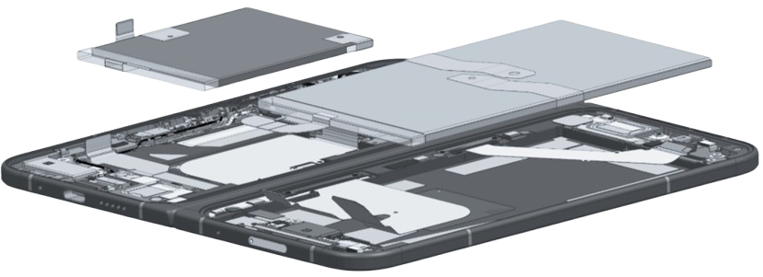
google_logo
08
Remove Base & Flip Batteries
Although some recyclers may pry the battery out, we recommend first applying 99.9% isopropyl alcohol under the battery to compromise the adhesive.
Alternatively, a recycler could heat the adhesive under the battery to 158℉ (70 ℃) to weaken the adhesive bond. We recommend a duration of 10 minutes on the hot plate. Use caution. The heating plate is a hot surface and it could cause burns.
Battery must be recycled with specialized processes such as pyrometallurgy or hydrometallurgy.
Target Recyclable Materials:
Cobalt
Lithium
Nickel
Copper
Precious Metals
Gold plating on connectors of flex cable

Slide 22
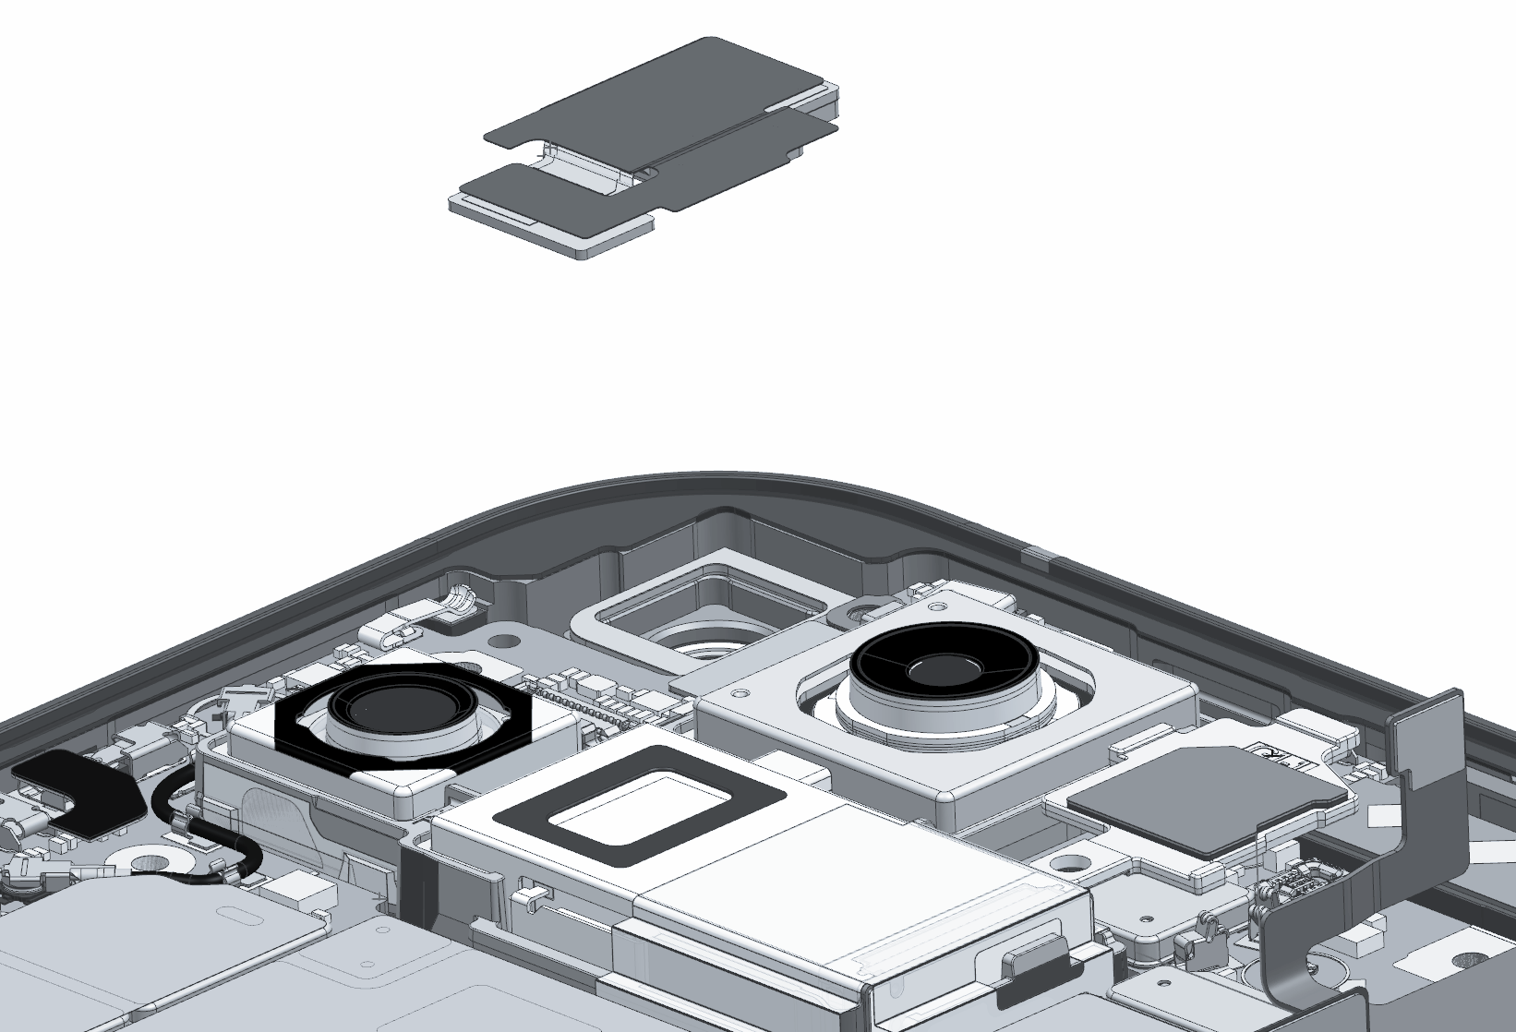
google_logo
09
Base Front Camera
Detach the inner FCAM connector from the logic board. Remove FCAM.
Target Recyclable Materials:
SUS (sheet) Front Cam Backer
Minimal Amount Rare Earth Element in Front Cam Magnet

Slide 23
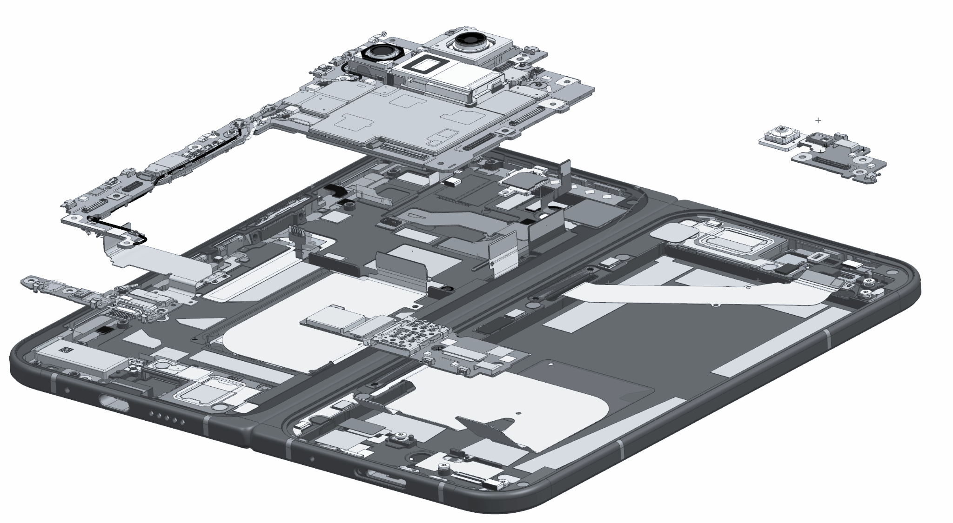
google_logo
10
Remove Logic Boards
1
1
Use Prying tool, if necessary, to lift the main logic board and components out of enclosure from the base side
Remove the lower board from the upper right corner.
Remove the upper board on the flip side
Pry up and remove the USB board
These components include small quantities of a number of notable materials that could be recovered, including:
Target Recyclable Materials:
Copper
Precious metal coatings
Silicone
Neodymium (Rare Earth Element) Magnets in Wide Rear Cam
3
2
3
4
4
2

Slide 24
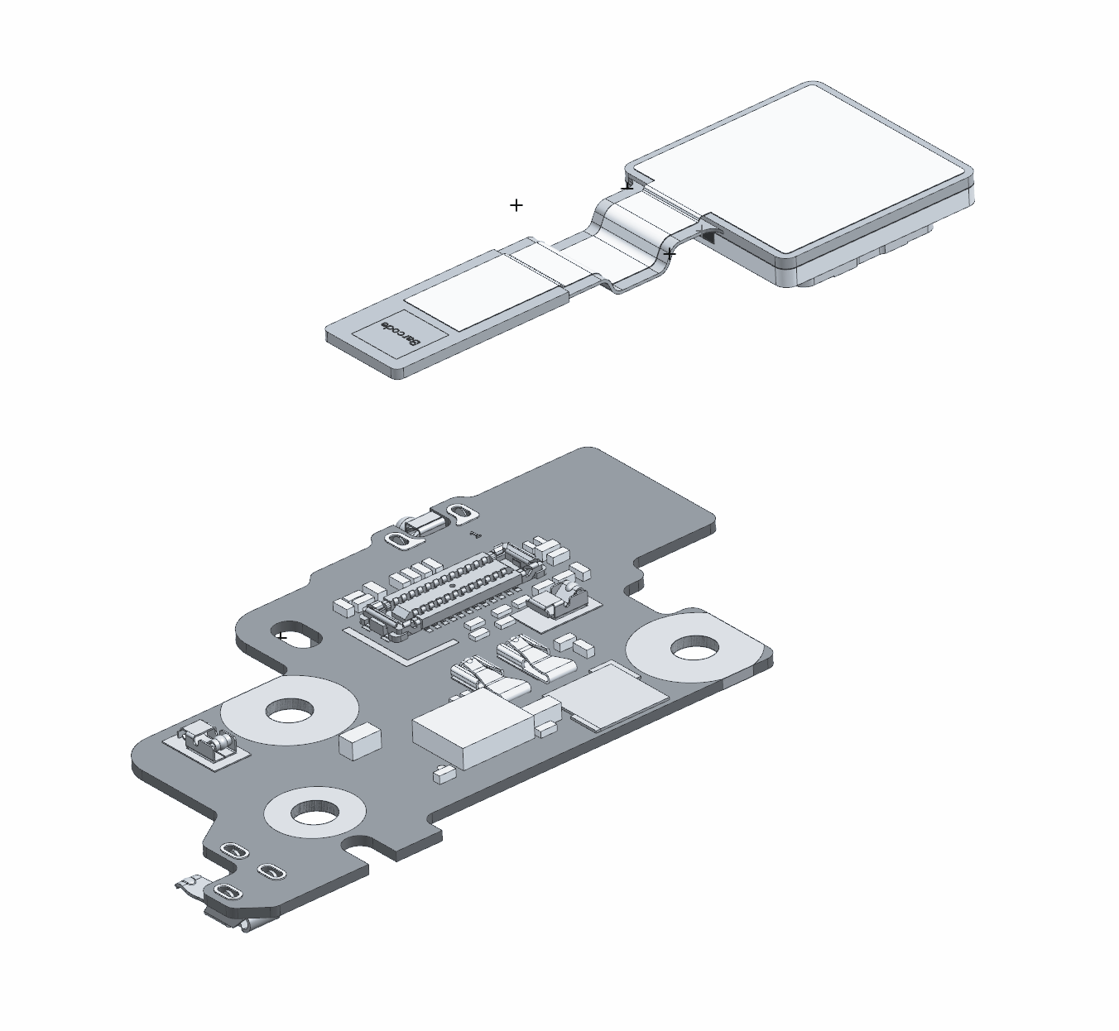
google_logo
11
Outer Front Camera
Detach the outer FCAM connector from the upper logic board. Remove FCAM.
Target Recyclable Materials:
Copper foil
Precious metal coatings
Neodymium (Rare Earth Element) Magnets in FCAM.

Slide 25
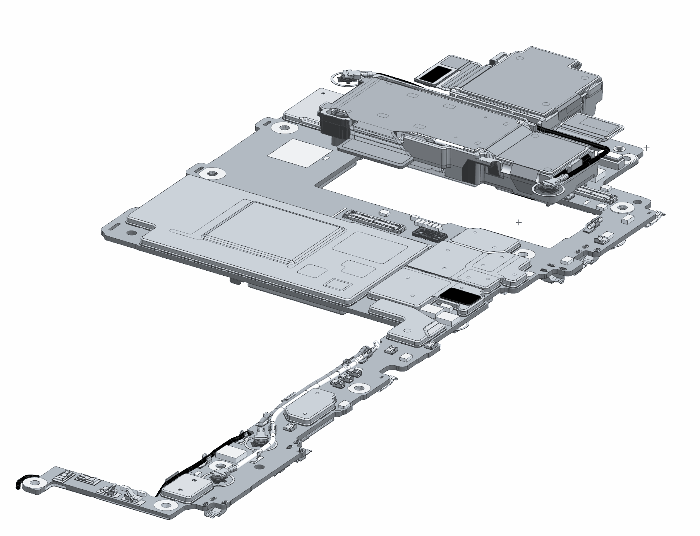
google_logo
12
2
1
Remove Rear Camera
2
1
Remove the two RCAM coaxial cable ANT3 connectors from the logic board.
Loosen the three rear camera connectors and disconnect from the logic board.
Pull Rear Camera off of logic board.
Target Recyclable Materials:
SUS (sheet) Rear Cam Backer
Minimal Amount Copper
Minimal Amount Rare Earth Element in Front Cam Magnet
Gold plating on flex cable
2
1
2

Slide 26
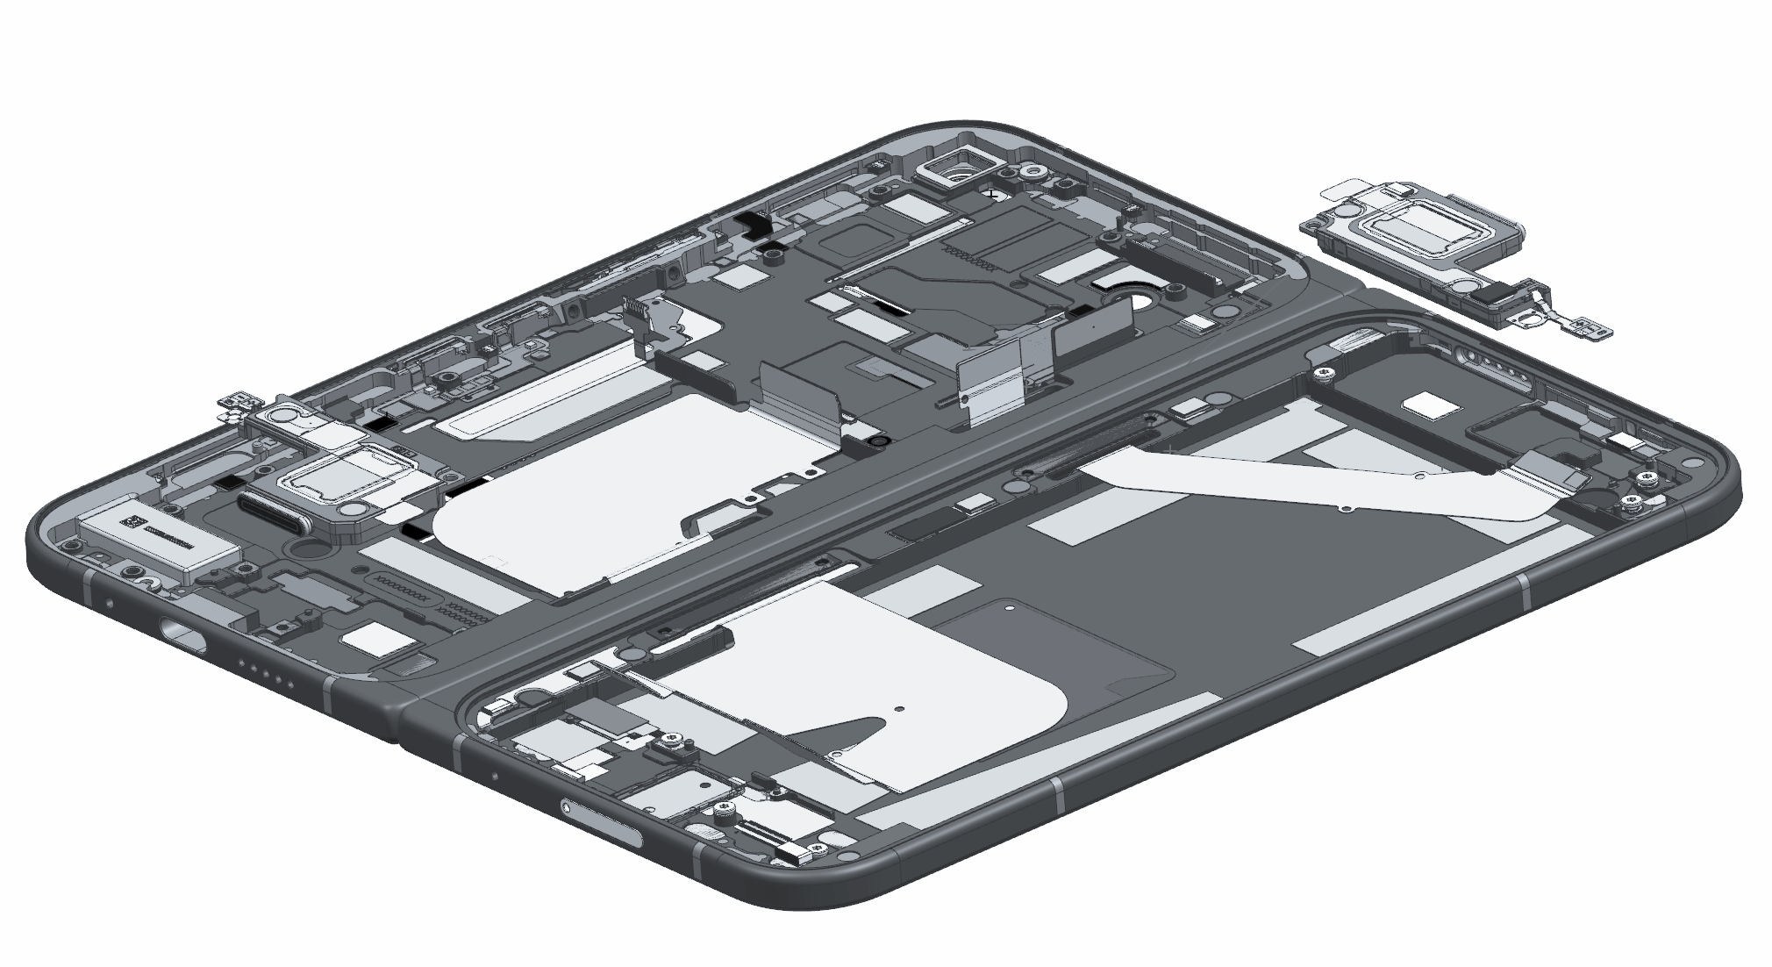
google_logo
13
Top & Bottom Speaker
1
1
Peel up the graphite sheet covering the top speaker
Insert the spudger to pry up the top speaker
Insert the spudger to pry up the bottom speaker
Target Recyclable Materials:
Neodymium (Rare Earth Element) Magnets in Speaker
2
2
3
3

Slide 27
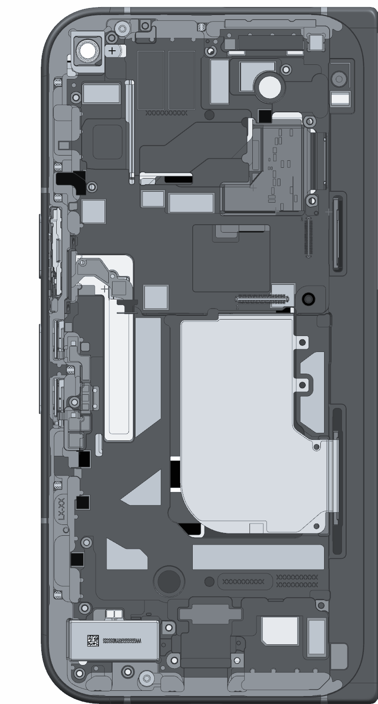
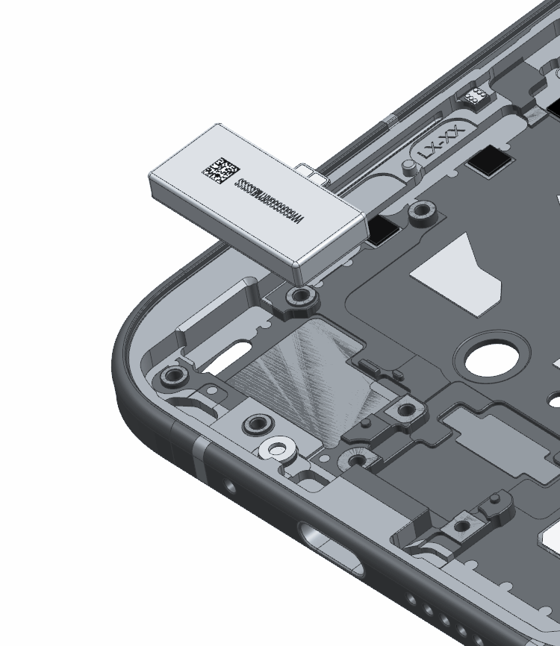

google_logo
14
Haptics / Vibrator
Apply Isopropyl Alcohol to loosen vibrator adhesive. Use the prying tool to remove the haptics vibrator from the enclosure.
Target Recyclable Materials:
Neodymium (Rare Earth Element) Magnets in Speaker
SUS (sheet)
Copper

Slide 28
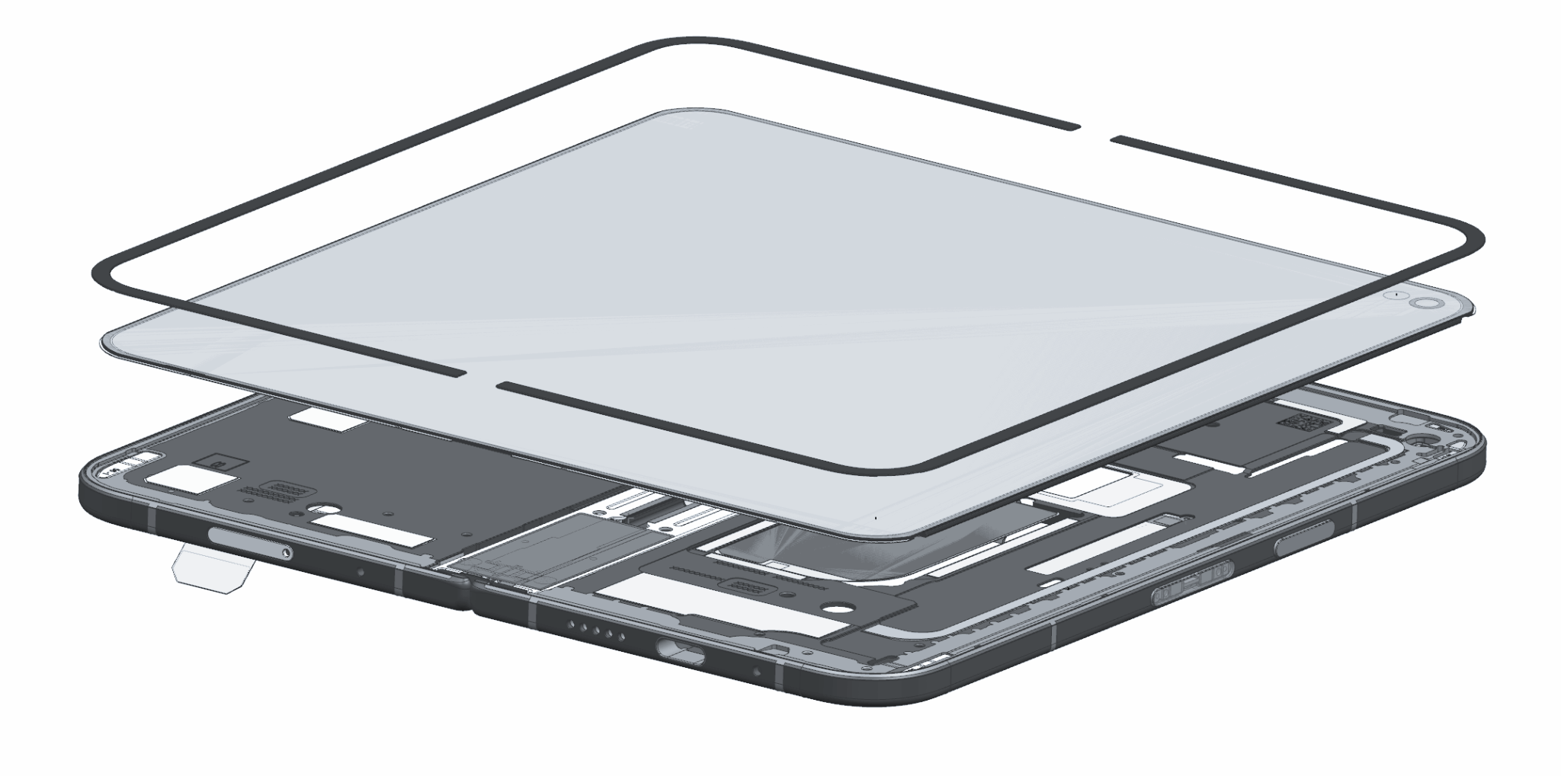
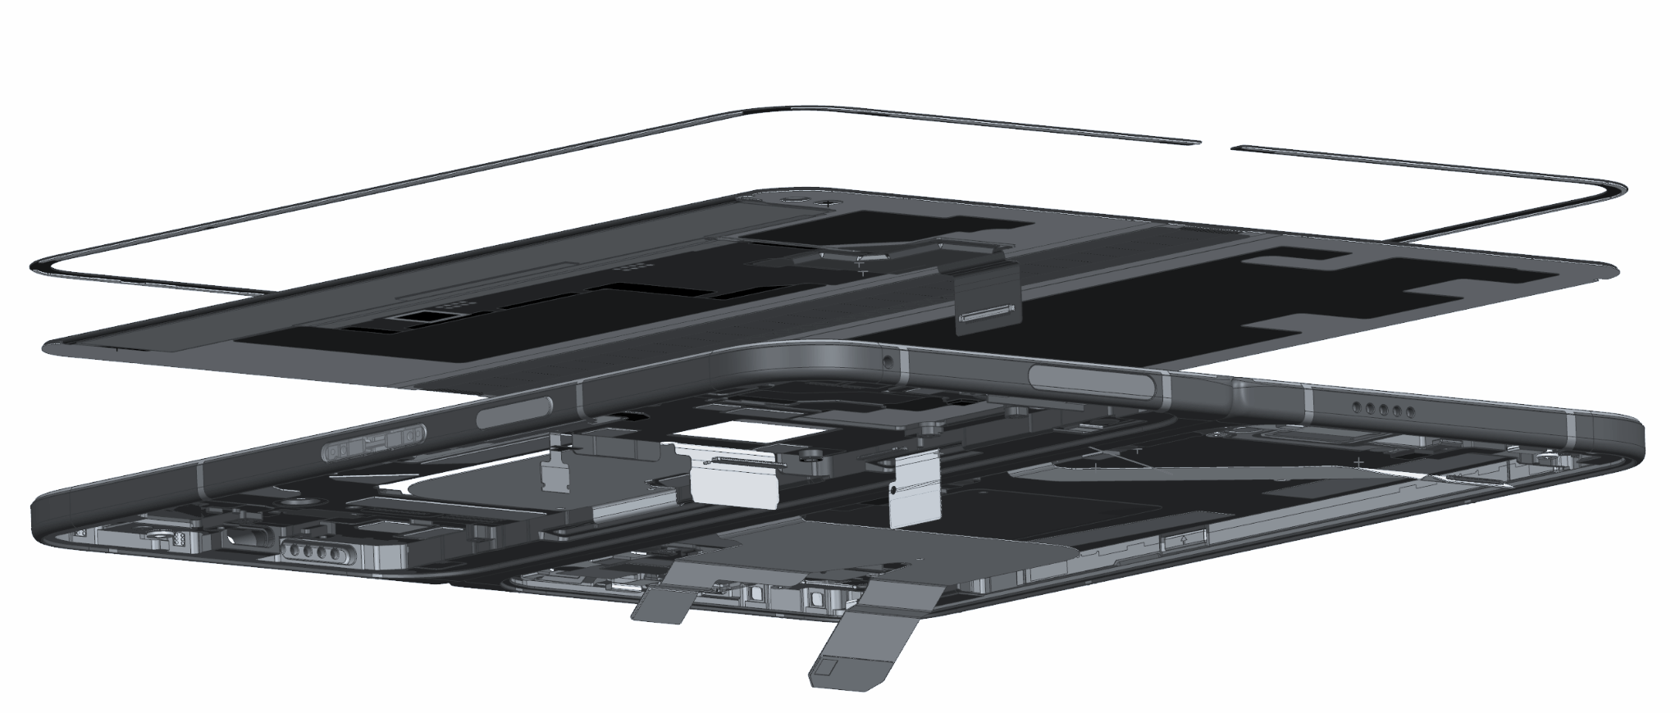
google_logo
15
Remove Display & Cover Glass
If possible, heat device to loosen adhesive. Use prying device with thin edge to lift back cover off of the enclosure.
The display also includes a number of flexible printed circuit boards, which can be pried off.
Target Recyclable Materials:
Glass
Copper Film Backing
Copper Display Flex Cable
Steel
Gold plating on flex cable
Note
Wear protective gloves and safety glasses when handling damaged parts.

Slide 29


google_logo
Frequently Asked Questions
Questions | Answer
Is there information related to repair? | This recycling guide is for professional recyclers and is not intended in any way to serve as repair instructions. For repair information or access to repair manuals, please visit: https://store.google.com/magazine/repaircenter
Does Google offer spare parts to recyclers to refurbish or repair smartphones? | This recycling guide is for recyclers and is not intended in any way to serve as instructions to test, refurbish or repair. For access to Pixel spare parts, please visit: https://www.ifixit.com/Parts/Google_Phone
How long does it take on average to recycle this device? | Recycling times vary widely and depend on the how thoroughly the device is disassembled for material recovery and the specific tools and operational processes employed. To follow the steps in this guide, we estimate the device processing time will take approximately 1:30 - 5:00 minutes for a well-trained recycling technician.
What hazards might there be when disassembling a device? | The main hazards related to the end-of-life processing of this device are: Damaging the battery in such a way that a thermal runaway occurs; Broken glass causing cuts or abrasions; Chemical inhalation–especially if thermal runaway occurs and Exposure to the class 1 laser module
Link
Link

