Slide 1
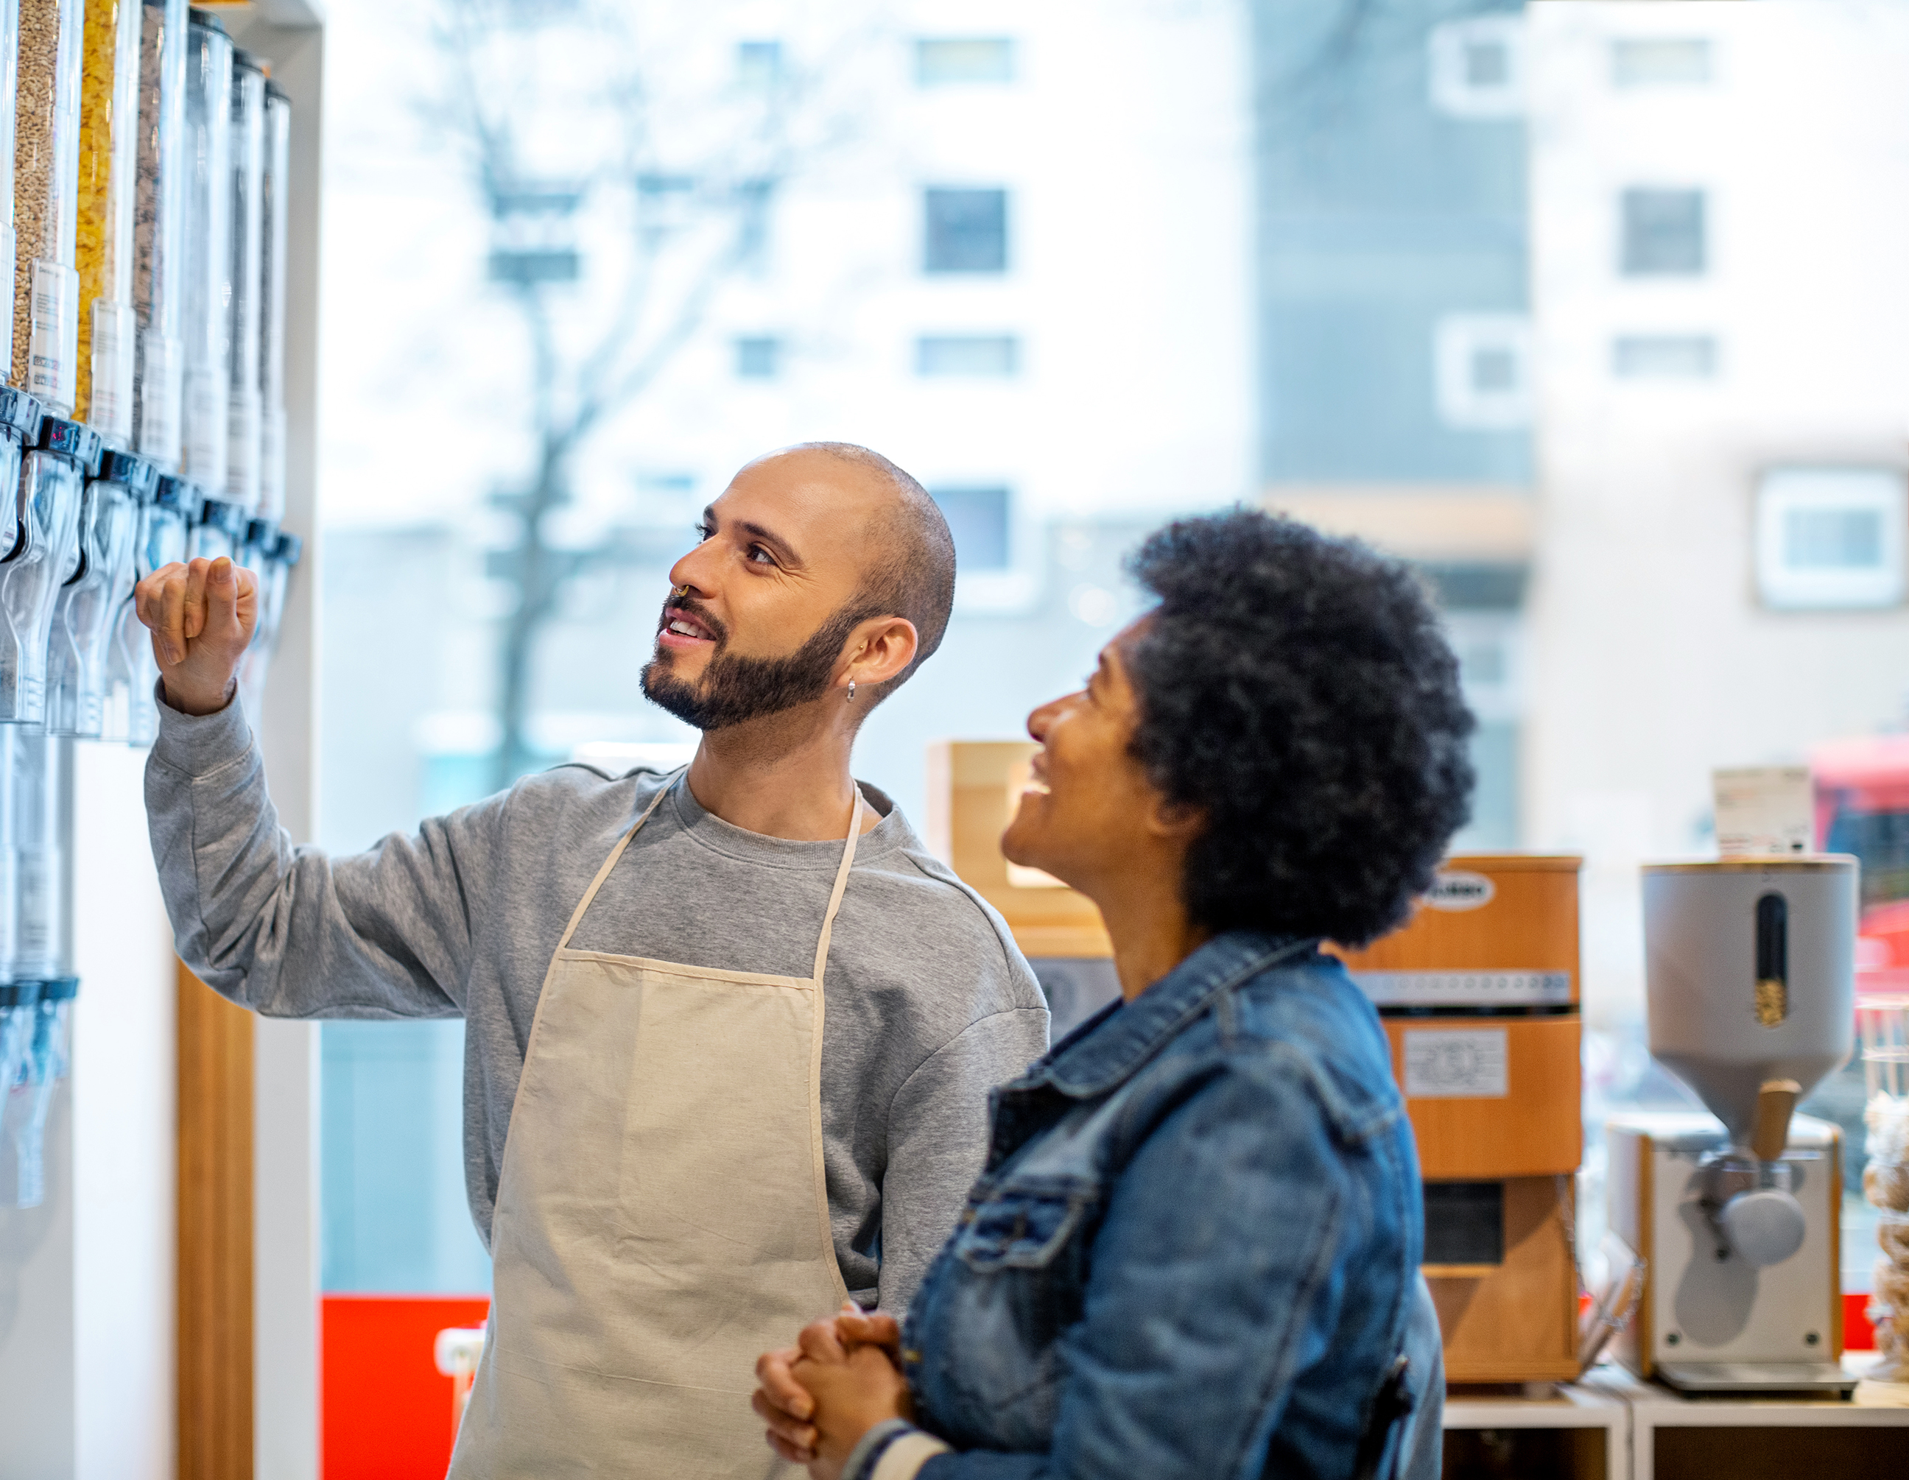
Building Better Customer Relationships
The Why and How

Slide 2
!
Building Better Customer Relationships
Welcome
As you come in please make sure your name is on your screen as well as your preferred pronouns.
She/Her He/Him They/Them
You will be sent a private message in the text with a number. Please put that number in your name as well.
Once you have done this put an emoji in the chat of how you are feeling today.
Make yourself comfortable. Get a coffee or cup of tea.
Notes:
This slide will be up as people are coming in before the session actually starts starts. This time doesn’t count towards the seat time.
Timing 2 minutes-
[This is the entrance slide, so you will be welcoming people as they come in. You will repeat parts of this as more people enter]
Say: Welcome everyone. As you enter if you will just read the screen there are some directions on what to do. Make sure your screen says your name and if you would like to put your preferred pronouns. You will be getting a direct message with a number to add to your name on your screen. Please get a cup of coffee or tea and a comfortable spot while we are waiting for everyone to join. We will start at [enter start time] [Repeat this as more people enter, approximately every 2 minutes.}
Do: Stop screensharing so everyone can see you as you welcome then.
Say: Hello everyone. Welcome to Building Better Customer Relationships. I am so glad you all are here. I want to respect your time so as I see it is [enter time] we will go ahead and get started. If you haven’t already if you will please look in the chat screen. Our producer has sent you a number. If you will add that number to your screen name. We will use this today for some activities. A little bit about myself.
Producer: As the learners are coming in send them a number in a private message.
Advance slide

Slide 3
About Me
I am [insert info to share]
[write what your position is]
Notes:
2 minutes
This slide will need to be edited by the presenter to personalize the training.
Say: The information you want to share.
Also have the producer share.
Advance Slide

Slide 4
Agenda
Intro/welcome
Our why
Goals
How relationships help.
Scenarios for strategies to build relationships.
Kahoot
Session Wrap-Up
Notes:
1 min.
Do: Read the agenda on the slide.
Say: Let’s do a quick ice breaker before we get started. We are going to do a quick Would you rather. I will show you the image. You choose which one you would rather have or do and type it into the box. Then I will use your number that you were given when you came in to call on someone. Any questions?
Ok here we go.
Advance slide

Slide 5
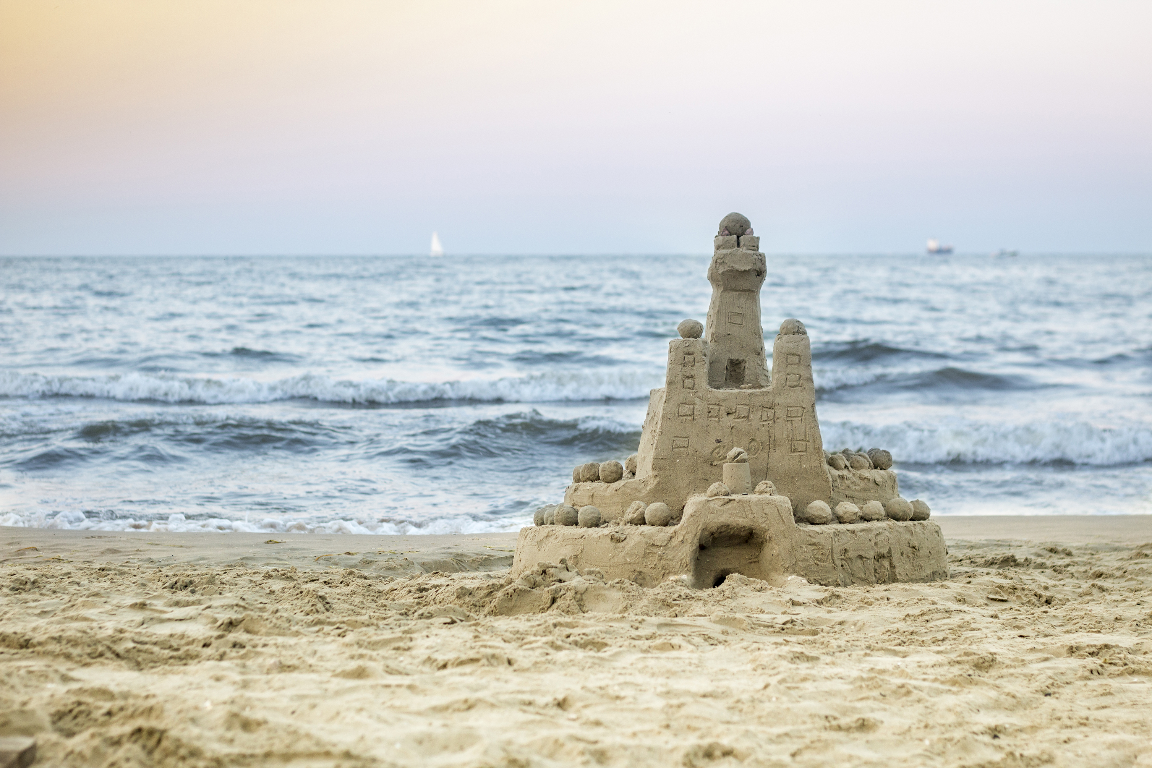
Would you rather?
2
1
Notes:
30 seconds
Do: Click to make each choice appear. Ask for volunteers or choose a number.
Say: Would you rather, go to the mountains or go to the beach? Put your answer number in the chat. When you share tell us which one you would choose and why.
Advance slide

Slide 6
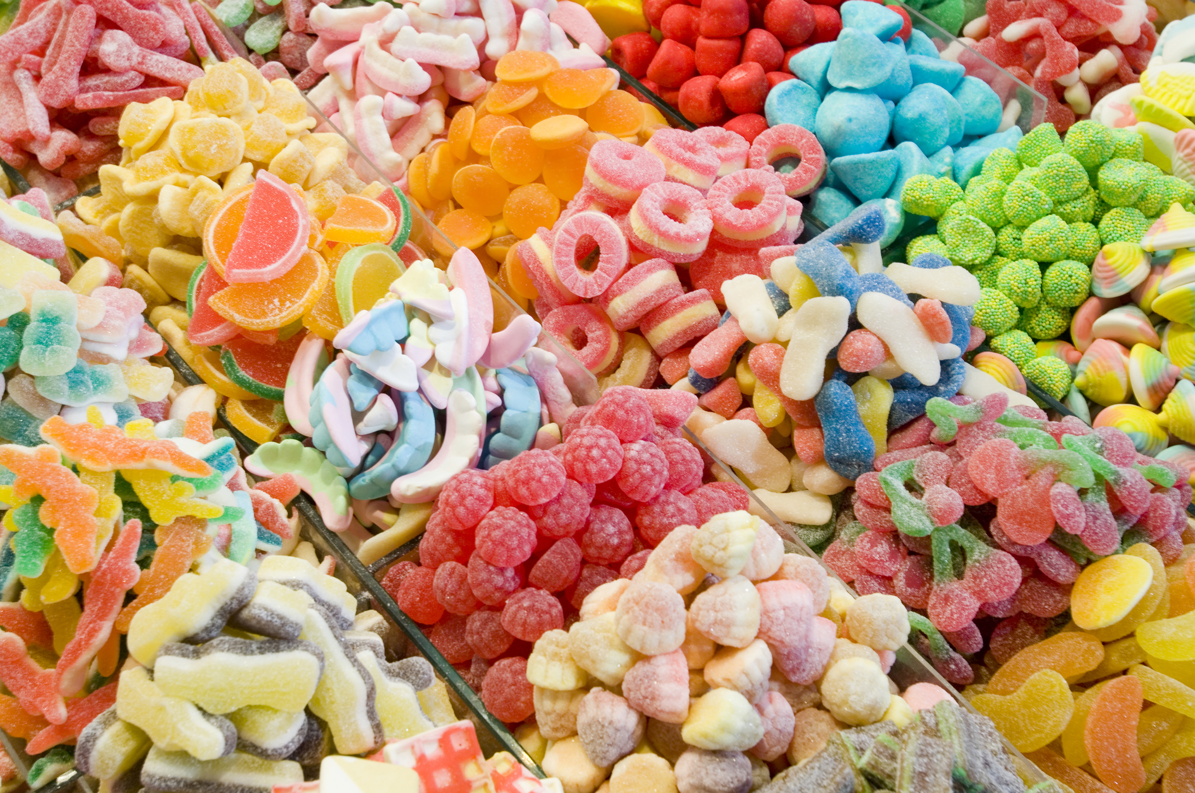
Would you rather?
2
1
Notes:
30 seconds
Do: Click to make each choice appear.
Say: Would you rather, eat ice cream or drink a milkshake? Put your answer number in the chat. When you share tell us which one you would choose and why.
Let’s switch gears before we all get too hungry.
Advance Slide

Slide 7
Building better customer relationships
Our Why
“A lot of people have fancy things to say about customer service, but it’s just a day-in, day-out, ongoing, never-ending, persevering, compassionate kind
of activity.”
– Christopher McCormick, CEO of L.L Bean
Notes:
2 min.
Do: Read the quote on the slide.
Say: This is our why. Customer relationships are the backbone to our company. If we aren’t doing well with our relationships, then we aren’t doing well as a company.
Advance slide

Slide 8
Building better customer relationships
Notes:
1 min.
Say: Over the last year, we have seen our customer service rating drop 5% based on post-interaction surveys. Our customers do not feel connected to us, or feel we care as much about them as they used to. We want to increase our customer service rating by10% over the next to years, which will allow us to surpass where we were. This is why we are here today to talk about how we can build better customer relationships. Let’s see what our learning goals will be.
Advance Slide

Slide 9
Learning Objectives
Identify the 3 main reasons why good customer relationships are so important to cultivate.
Recognize 3 different strategies to help build better customer relationships.
Explain what actions an employee should take in a scenario to build better customer relationships.
Notes:
2 min.
Say: Today we are going to be talking about how we can build better customer relationships with our customers. Our goals today are.
Do: Click to reveal each objective. Read each objective as they appear.
Advance slide

Slide 10
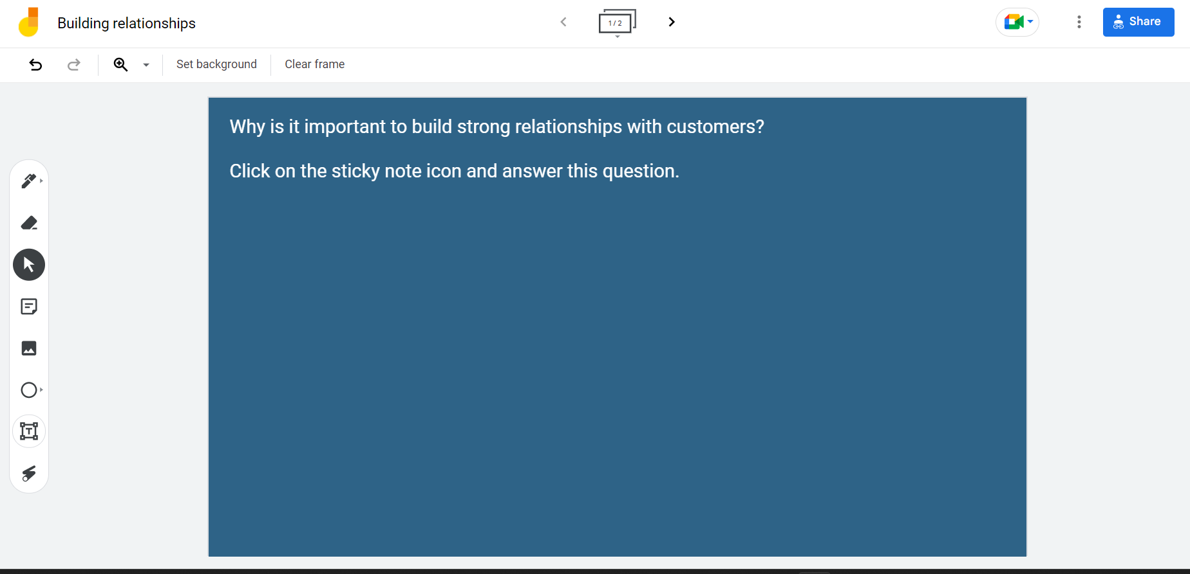
Why Is This Important?
Notes:
6 min: That includes explanation and time for them to write on their jamboard
Say: Before we start looking at why it’s so important to build good customer relationships let’s see where your thinking is on this right now. We are going to go to a Jamboard. If you haven’t ever been to Jamboard before it’s just a wall to put sticky notes on. You will click on the link we are getting ready to post in the chat. Then look at the top and make sure you are on slide one. As we move on and use this again you will need to click to the second slide. Then click to get a sticky note. On your sticky note write why you think it is important for businesses to have strong relationships with their customers.
Do: Click to make the jamboard come up
Click to draw a circle around the top of the jamboard picture explaining which slide to be on. Also, click to draw the circle to show where the sticky notes are.
[While looking at the Jamboard]
Do: Switch to screenshare the jamboard and call on 1-3 people depending on time to share why they thought building relationships was important.
Give everyone 1 minute to read through what was written.
Wait 30 seconds after asking if anyone wants to share if no one does just randomly choose a number and call it out.
Say: Take one minute to read over everyone’s sticky notes.
Do I have anyone who wants to share what they wrote, or comment on what someone else wrote?
Now keeping all these great ideas in mind let’s look at three main reasons why building good customer relationships is so important.
Producer notes: Put the link to the jamboard in the chat when the presenter talks about it.
https://jamboard.google.com/d/1QAnLdxXvdgXUVDZY3jSDF7kfvRp76JCk1hOOfS42y5s/edit?usp=sharing
Leave screenshare of jamboard and advance slide

Slide 11
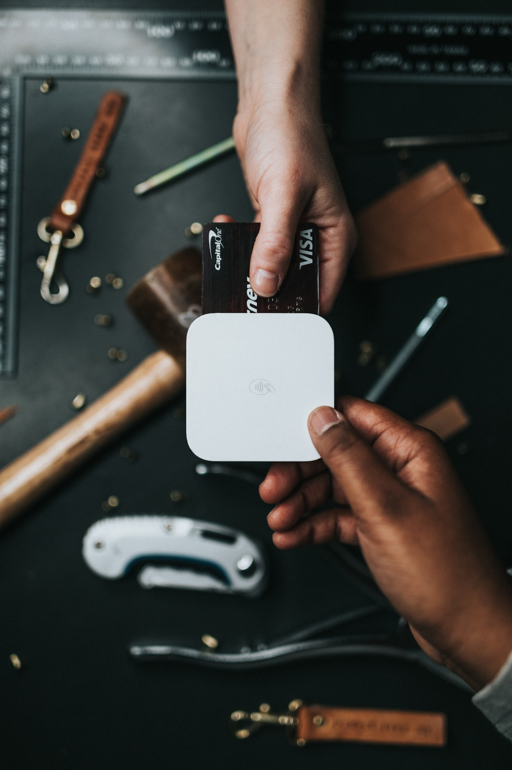
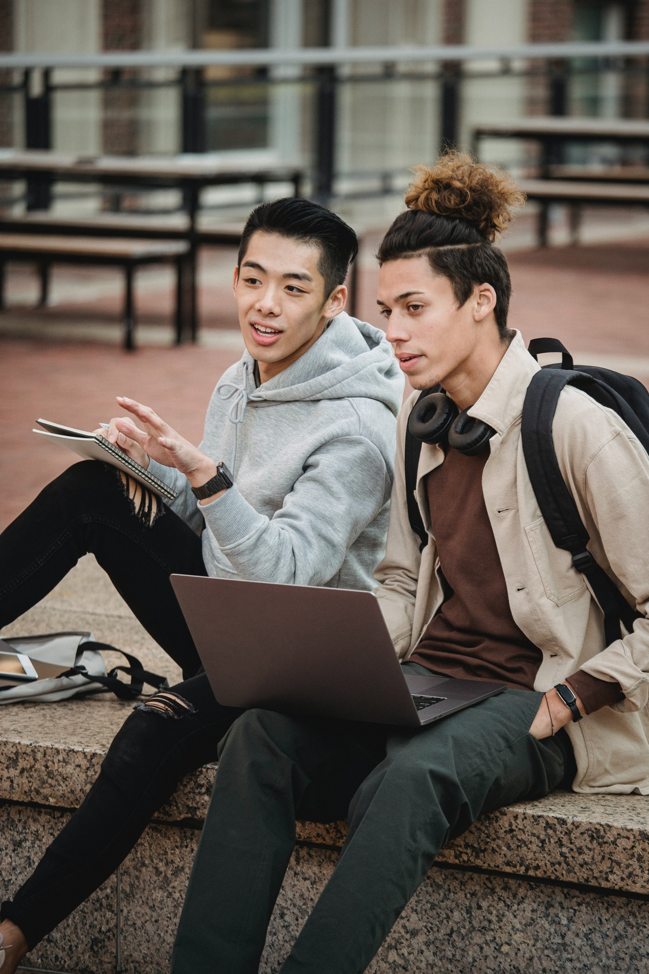
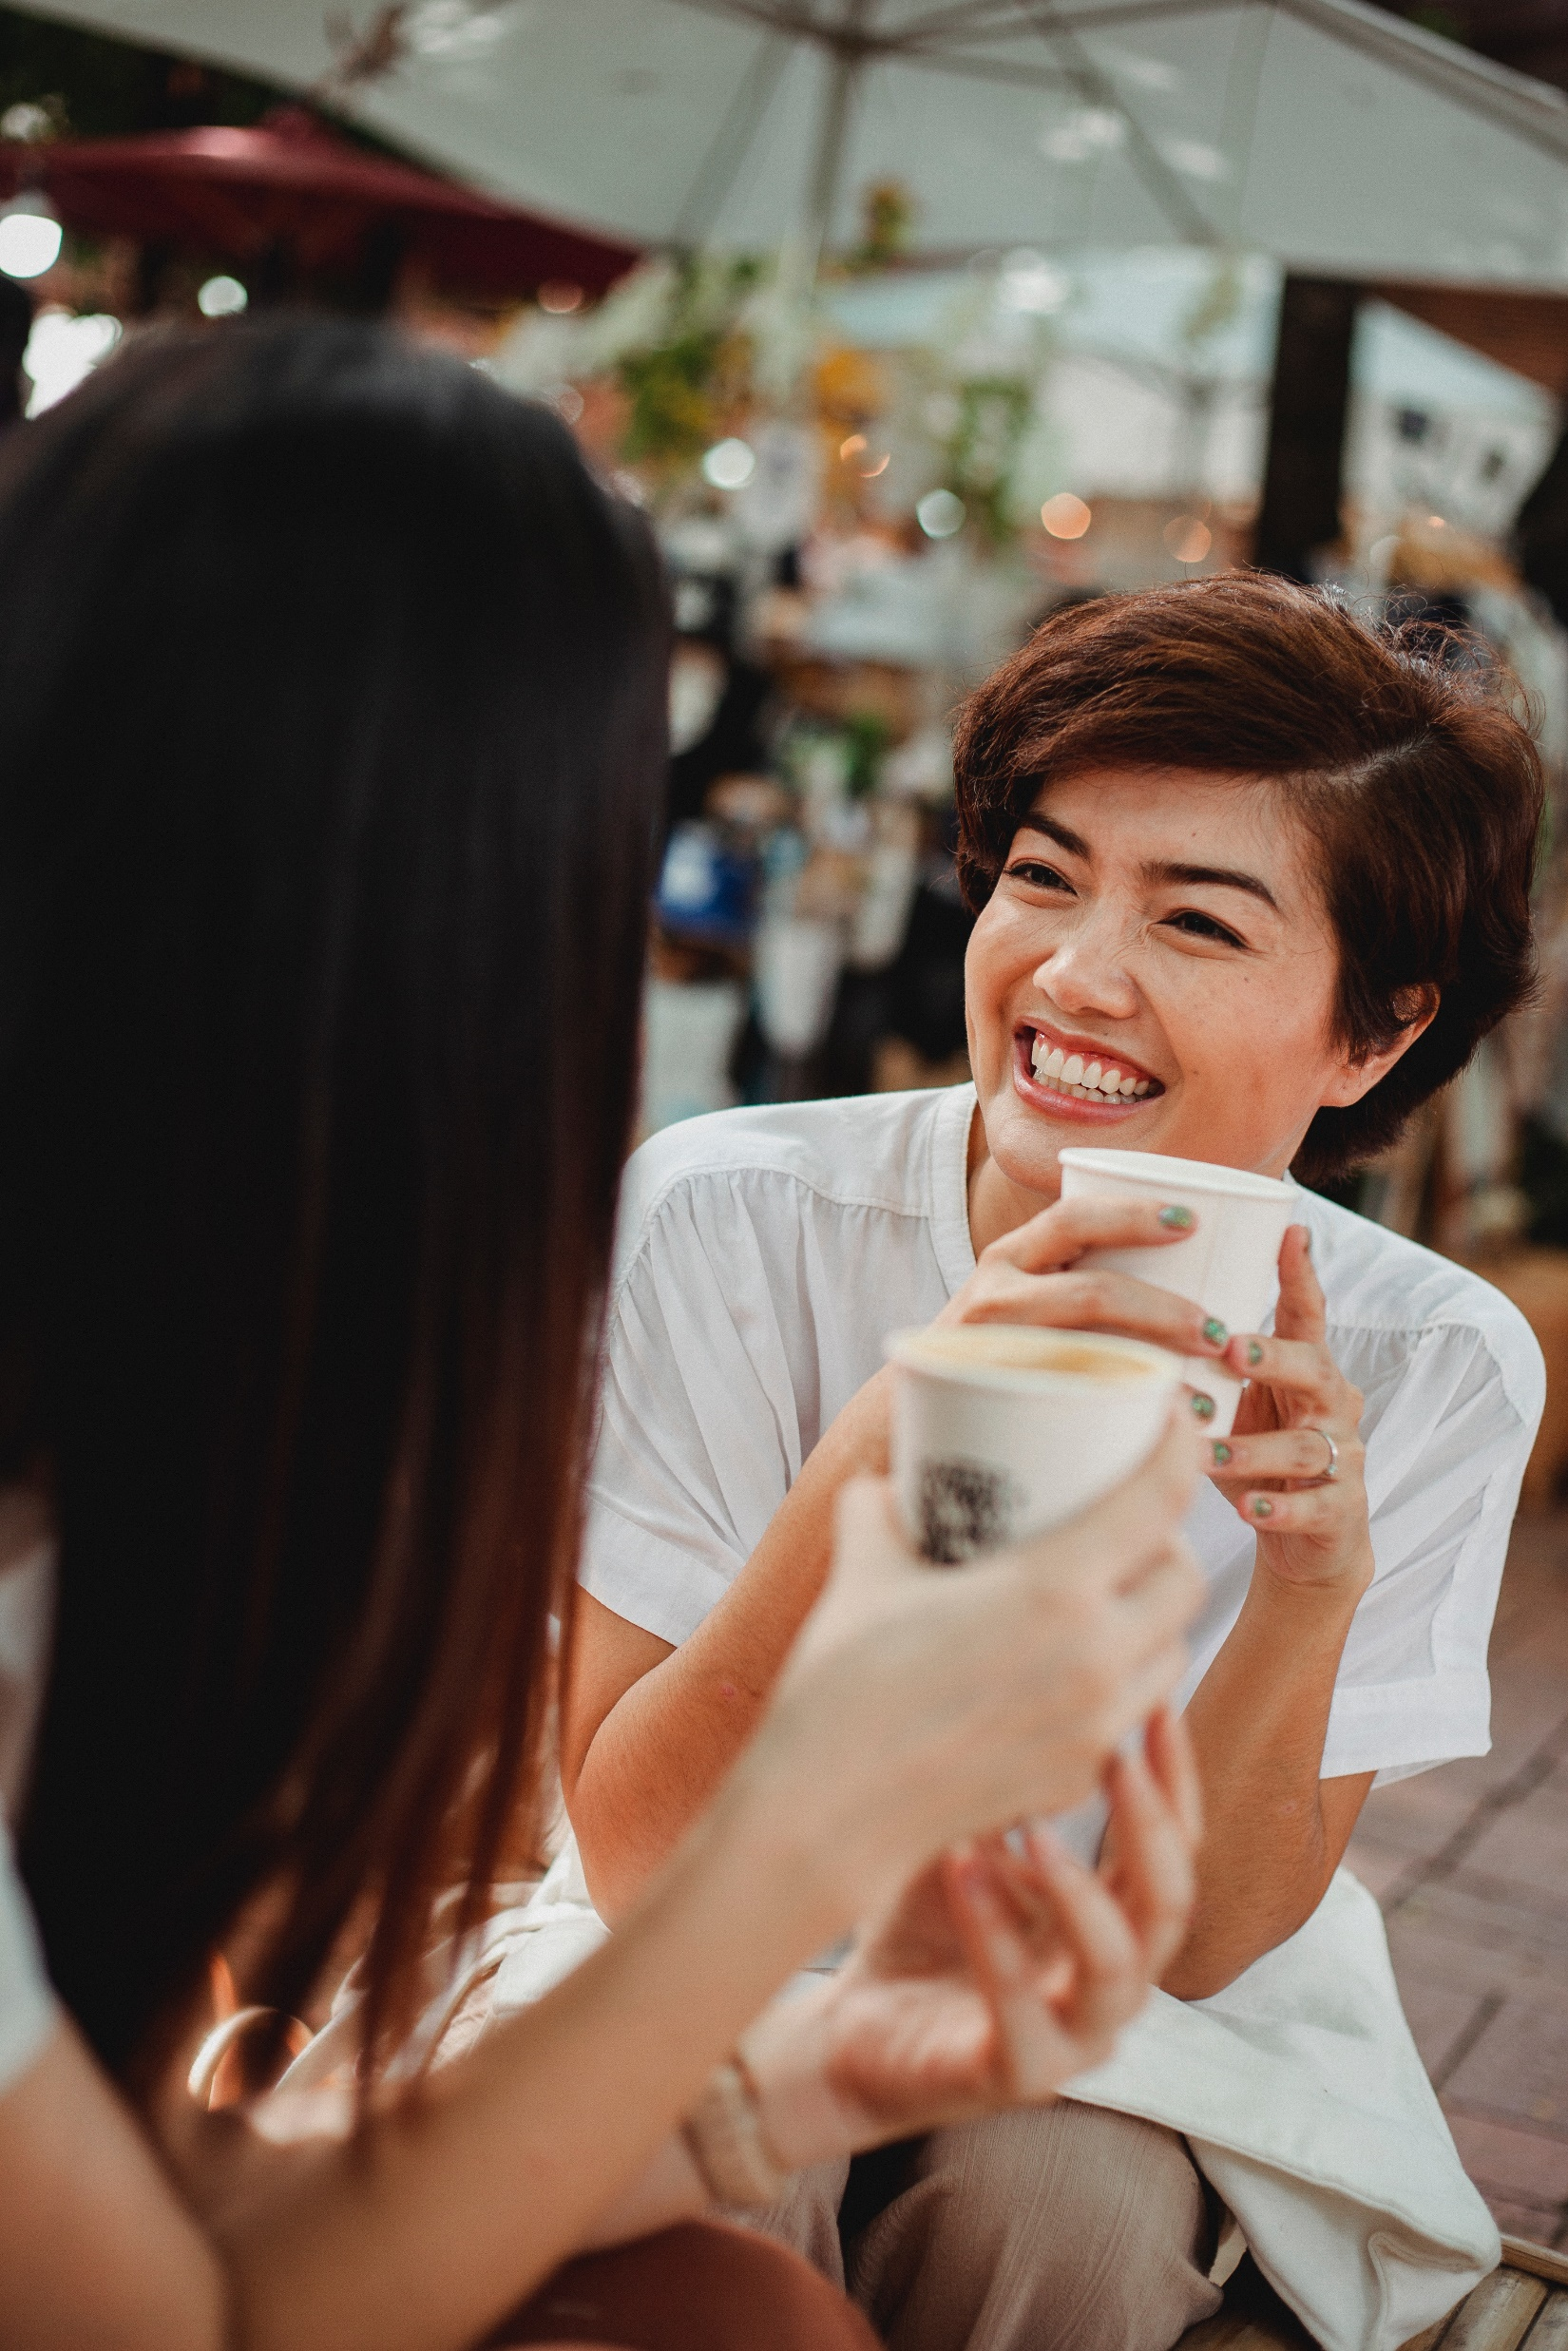
Notes:
1 min.
Say: There are three main reasons building good customer relationships are important. The first reason is good customer relationships increase customer retention.
Do: Click to reveal Increase Customer Retention when you say that.
Slide will advance when you click.

Slide 12
Increase Customer Retention
Notes:
1 min.
Say: You have a 60-70 percent chance of selling new items to an existing customer versus a 5-20 percent chance of selling something to a new customer. That’s a huge difference.
Do: Click to make the graph appear.
Advance slide

Slide 13
Increase Customer Retention
Marketing
Notes:
2 min.
Say: The second reason building strong customer relationships is important is for marketing purposes. Word of mouth remains the oldest and most powerful method of promoting products or services. People often make purchasing decisions based on recommendations from friends and family. They trust the opinions and experiences of those they know and are more inclined to choose a company that has received positive feedback from someone they trust. Establishing a positive reputation through satisfied customers increases the likelihood of attracting new customers and fostering loyalty among existing ones.
Advance slide

Slide 14
Increase Customer Retention
Marketing
Customer Satisfaction
Notes:
2 min.
Say: The third reason building strong customer relationships is important is because of customer satisfaction.
Simply put, happy customers come back! Unhappy customers don’t. We talked earlier about how you are 60-70% more likely to be able to sell new items to an existing customer. That is only true if the customer had a positive experience. How they feel about working with us, or the product that they received is extremely important. If they are not a satisfied customer, then they won't have a positive word of mouth or come back again.
Advance slide

Slide 15
Why Is This Important?
New Thoughts:
Notes:
5 min
Say: Now that we have gone over why it is so important let’s see if it changed any of your thinking. Go back to the jamboard. We are putting the link in the chat again if you need it. Add one thing that has changed or that you added to your understanding of why building good customer relationships is so important. Remember your sticky notes are on the side and you want to be on slide one still.
Advance slide
Producer notes: Put the link to the jamboard in the chat when the presenter talks about it.
https://jamboard.google.com/d/1QAnLdxXvdgXUVDZY3jSDF7kfvRp76JCk1hOOfS42y5s/edit?usp=sharing
Advance slide

Slide 16
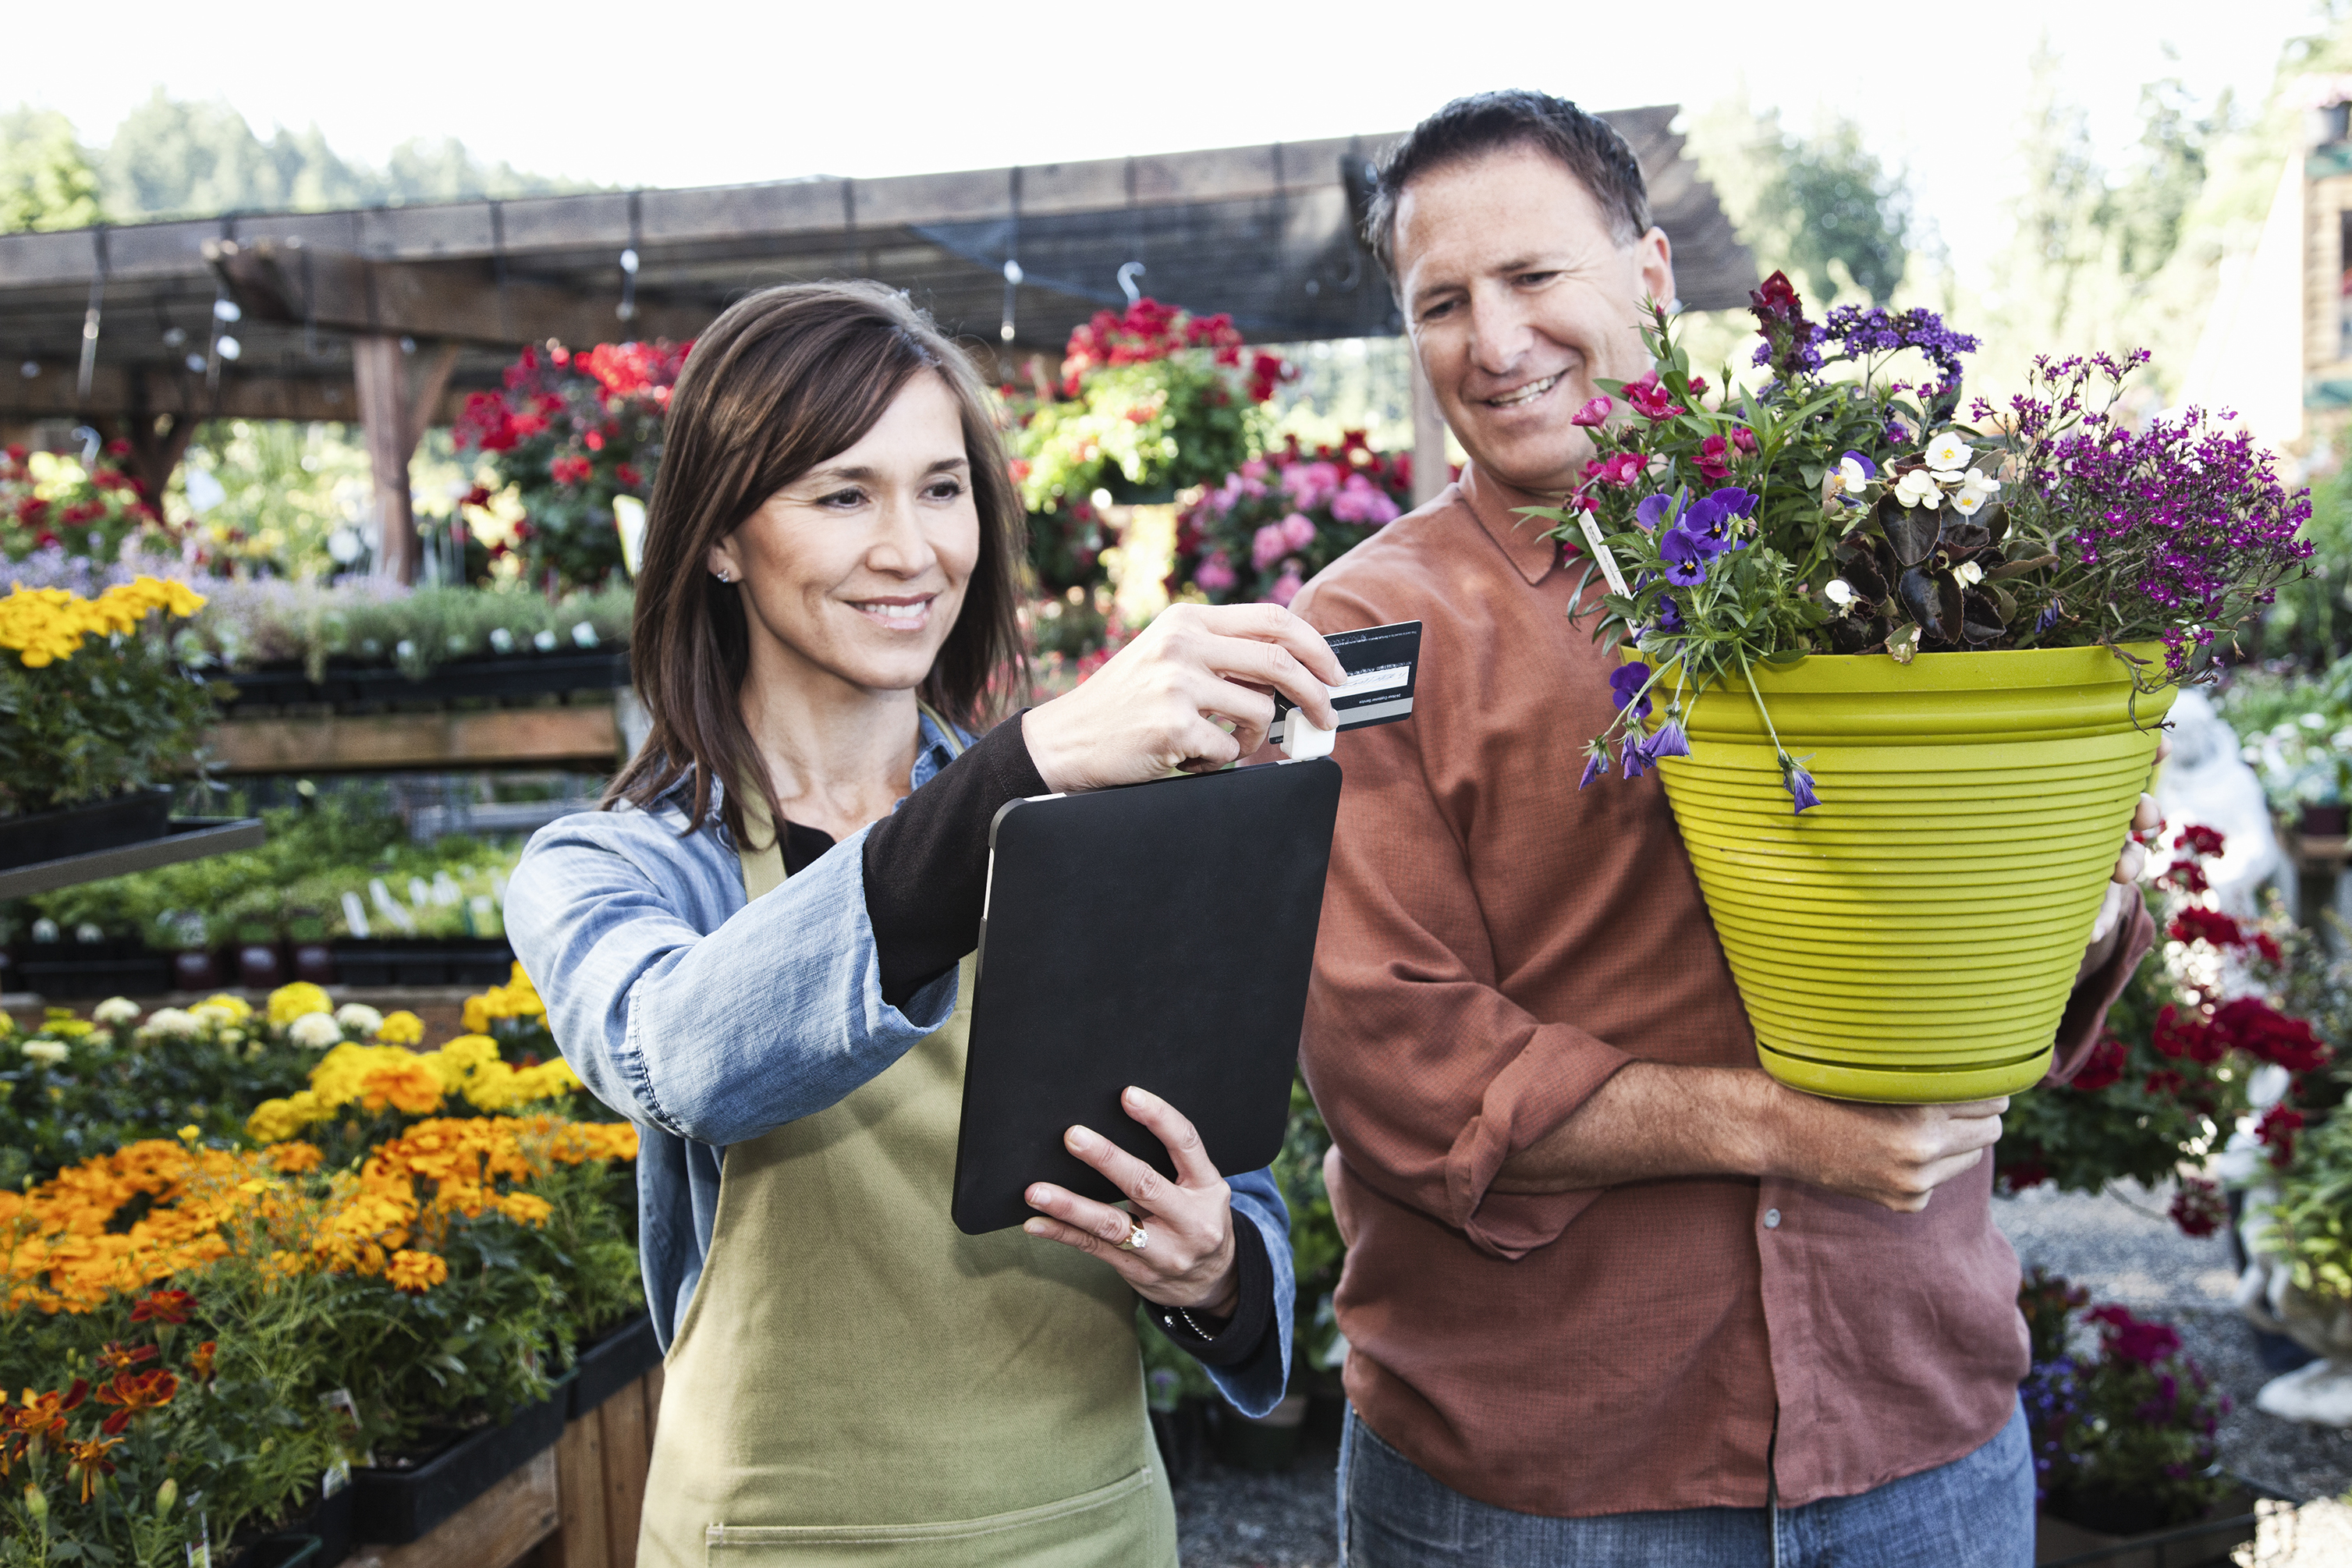
3 Easy Ways to
Build Relationships
Notes:
1 min.
Say: Now that we know the why behind building good customer relationships let’s look at the how. We are going to look at 3 ways that we can build better relationships with our customers.
Advance slide

Slide 17
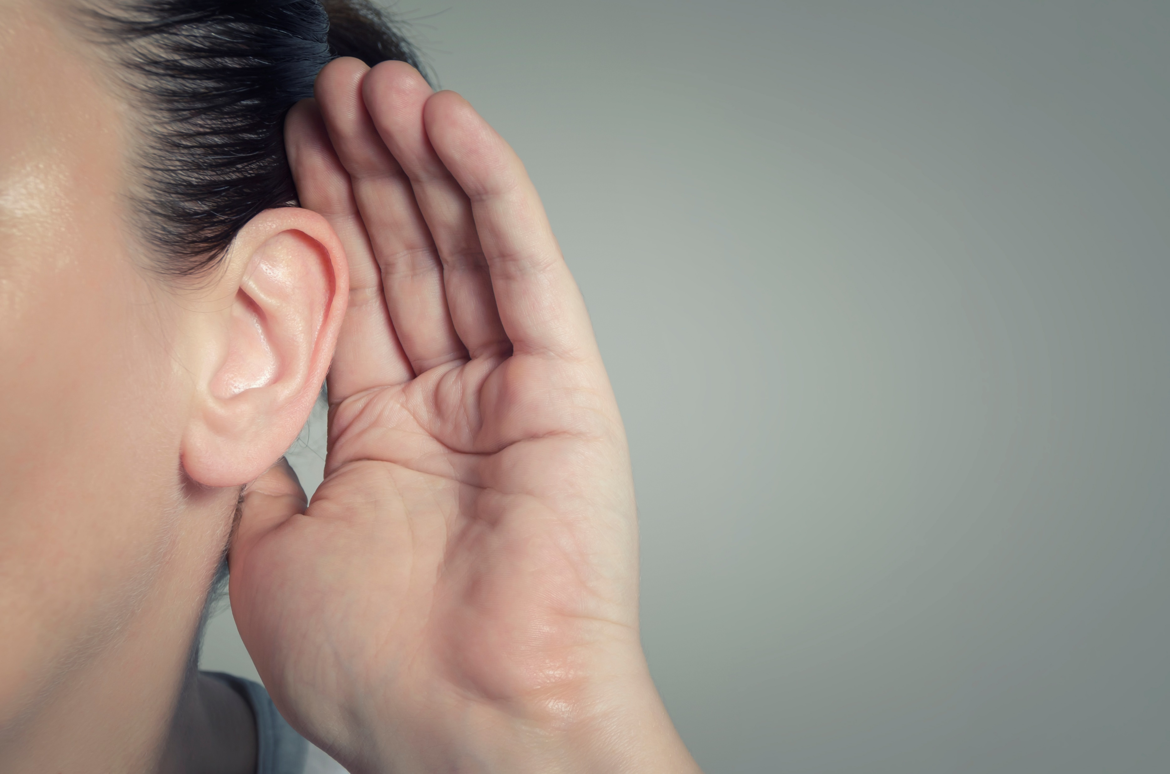
1. Make sure your customers feel heard
Rephrase what the person said.
Acknowledge their feelings.
Apologize for the issue.
Notes:
2 min.
Say: The first strategy to build better customer relationships is to make your customer feel heard. People need to feel like you are listening to them. It makes them feel acknowledged, important, and like they matter.
Ways to do this are to, rephrase what the person says
Acknowledge how it made them feel
and apologize for the issue.
Do: Click to reveal each bullet point
Advance slide

Slide 18
Rephrase what the person said.
Acknowledge their feelings.
Apologize for the issue.
Notes:
1 min. [ 1 min set up and video]
Say: We are going to watch a scenario of a person NOT making sure their customer is feeling heard.
As you are watching think about what Tom could do differently in this instance to build a better relationship with his customer. When it is done you will be going into breakout rooms to discuss how Tom could have handled the situation differently.
Do: Play the video.
Do: Make sure you have all the breakout rooms speak.
Advance to the next slide after discussion

Slide 19
Breakout Rooms
Discuss how Tom could have handled the situation in a way that would have built a better relationship with the customer.
Choose someone to be the speaker to report back when we come back together on what you discussed.
Notes:
7 min. [5 min. in breakout rooms, 2 min. debrief]
You are going to go into breakout rooms to discuss how Tom could have handled this in a way that would have built a better relationship with the customer. Choose one person from your group to discuss. We will come back together and share in 5 min.
Producer: Open the breakout rooms. Send out a one minute warning. Close the breakout rooms. Stop screen sharing for debriefing.
Debrief: When everyone returns to the main room Start the discussion. Say: I hope you all had some good discussions in your breakout rooms. When I call your break out room number if you will share what you and your team discussed Tom could have done differently.
[When everyone is finished sharing] Make sure in the discussion the three main points, rephrase what the person says, acknowledge how it made them feel, and apologize for the issue.
Advance the slide

Slide 20
2. Build genuine connections
Notes:
1 min.T
Say: The second strategy to building stronger relationships is to make genuine connections with your customers. The helps them feel more connected to the brand and you. This can be done in many easy ways. Simply asking how their day is going. Maybe you can notice something in their profile you could connect too, where they live, that they just had a birthday, that your grandfather has the same name, how is the weather where they are. Maybe you hear their dog bark and you ask about it. Anything that shows interest in their life.
Do: Click to reveal each picture as you mention them.
Advance slide

Slide 21
Making Genuine Connections
Notes:
1 min set up and video,
Say: Now let’s watch Tom as he misses a chance to make a genuine connection with his customer. He gets a call from a customer asking when she needs to renew her subscription.
Do:
Play the video.
Stop screen sharing for debriefing.
Producer: Open back up the breakout groups. Send out a one-minute warning to break out rooms with a reminder to have a speaker prepared to share. Close breakout rooms after 3 min.
Debrief: When everyone returns to the main room Start the discussion. I can’t wait to hear the great ideas you have for how Tom could have handled this differently. As before when I call your breakout room number if you will share what you and your team discussed Tom could have done differently.
[When everyone is finished sharing] Make sure in the discussion the three main points, rephrase what the person says, acknowledge how it made them feel, and apologize for the issue.
Do: Make sure you have all the breakout rooms speak. Make sure in the discussion groups have given an example of how he could have made a connection while on the phone. If not add this in to your discussion.
Advance to the next slide after discussion

Slide 22
Breakout Rooms
Discuss how Tom could have handled the situation in a way that would have made a genuine connection with the customer.
Choose someone to be the speaker to report back when we come back together on what you discussed.
Notes:
5 min. [3 min. in breakout rooms, 2 min. debrief]
We will go back to our breakout rooms and discuss what he could have done better, and how he could have made a genuine connection, very quickly.
Choose one person from your group to discuss. We will come back together and share in 3 min.
Producer: Open the breakout rooms. Close the breakout rooms. Stop screen sharing for debriefing.
Debrief: When everyone returns to the main room Start the discussion. Say: I hope you all had some good discussions in your breakout rooms. When I call your break out room number if you will share what you and your team discussed Tom could have done differently. Make sure they have addressed what we went over in slide 20. (Maybe you can notice something in their profile you could connect too, where they live, that they just had a birthday, that your grandfather has the same name, how is the weather where they are. Maybe you hear their dog bark and you ask about it. Anything that shows interest in their life.)
[When everyone is finished sharing] Make sure everyone has shared a way to make a connection.
Advance the slide

Slide 23
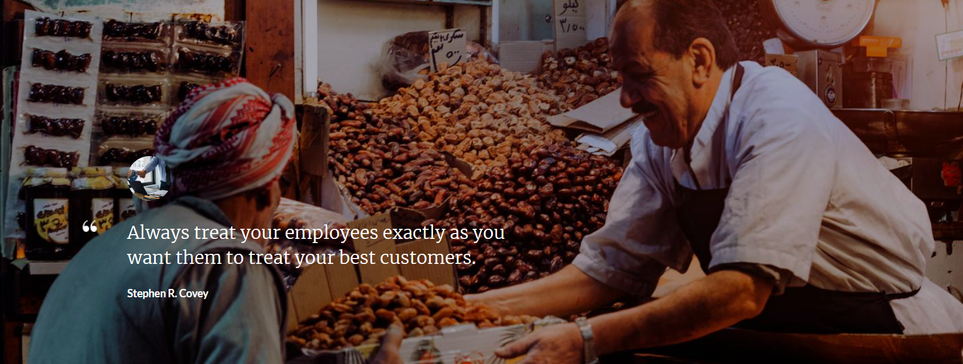
3. Begin with colleagues and staff
Notes:
1 min.
Say: Everything we have talked about today begins with your colleagues and your staff first. This quote by Stephen Covey fit this perfectly, Always treat your employees exactly as you want them to treat your best customers. If you want your staff to make your customers feel heard, they need to see what that looks like. If you want them to show genuine concern for your customer. You need to show genuine concern for them.
Advance slide

Slide 24
Making Genuine Connections with
colleagues and staff
Notes:
1 min set up and video,
Say: In the next scenario we will see how Tom and his co-worker could apply the last to strategies we just learned; making people feel heard and building genuine connections in the office first.
Do: Play the video. Stop screen sharing for debriefing. Make sure in the discussion groups have given an example of how he could have made a connection while on the phone.
Debrief: When everyone returns to the main room Start the discussion. What did your groups say that Tom and his co-worker could have done to build stronger relationships. As before when I call your breakout room number if you will share what you and your team discussed.
[When everyone is finished sharing] Make sure in the discussion has touched on the fact that they need to implement the strategies they have learned to use with their customers with each other.
Producer: Get the breakout rooms set up. Send out a one-minute warning to break out rooms with a reminder to have a speaker prepared to share. Close the breakout rooms after 3 minutes.
Advance to the next slide after discussion

Slide 25
Breakout Rooms
Discuss how Tom and his co-worker could have handled the interaction in a way that would have built a better relationship with each other.
Choose someone to be the speaker to report back when we come back together on what you discussed.
Notes:
5 min. 3 min breakout rooms, 2 min. debrief]
Say: We will go back in our breakout rooms one more time. Make sure you create an example of what Tom and his co-worker could have done to apply our strategies we just learned. One person from each group will share. You will have 3 minutes.
Producer: Open the breakout rooms. Close the breakout rooms. Stop screen sharing for debriefing.
Debrief: When everyone returns to the main room Start the discussion. Say: I hope you all had some good discussions in your breakout rooms. When I call your break out room number if you will share what you and your team discussed Tom and his co-worker could have done differently.
[When everyone is finished sharing] Make sure everyone has shared a way to make a connection.
Advance the slide

Slide 26
Kahoot!
Notes:
5 min.
Say: Now that we have learned why it is important to build good customer relationships, and some strategies to do it let’s see what you remember. We are going to play a 5 question Kahoot. We will send you the link in the chat for the kahoot. When you sign in use your first and last name. This is how we will track your attendance so make sure that you use your correct name. I will put the questions up and then you will choose the answer.
Do: Wait until everyone is logged in.
Start the game.
Go over the answers after people have answered them.
Producer: Put the link to the kahoot in the chat. www.Kahoot.it Pull up the Kahoot game to screnshare. Put the Kahoot in teacher present mode to do as a whole group.
Game Pin: 62122
Discussion after the answers: Say:
Question 1: Building customer relationships is the best way to ensure customer retention.
Question 2: This is False, You can create a connection with a customer in less than one minute.
Quesiton 3: Acknowledging feelings and rephrasing what someone has said are the best ways to make someone feel heard.
Question 4: They don’t need to know if you are having a bad day, find something positive to connect with them.
Quesiton 5: Building relationships starts with your work community. If employees see how relationships are being built with them and their colleagues then they will be able to see how to do that with their customers.
Advance slide

Slide 27
Summary
Customer relationships are important.
They don’t have to take long to build.
They start with your employees
and coworkers.
Notes:
1 min.
Say: Are big takeaways are (read the screen)
As you go back to work today think about one way that you could implement one of these strategies into your day. Thank you so much for spending your time with us today. I will be here for about 5 minutes if you have any questions. If not you are free to go.
Exit slide

