Slide 1
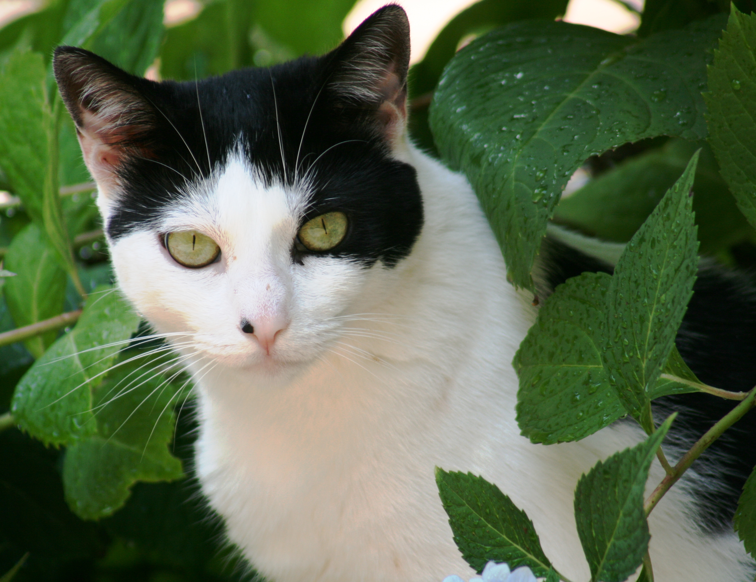
Welcome to composition for photography!
Tammy Legg
photo: T. Legg
Focal point, rule of thirds, perspective, color

Slide 2

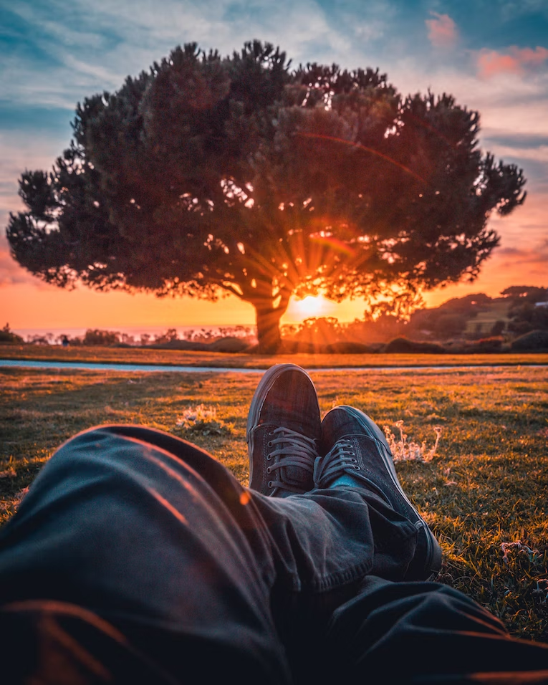
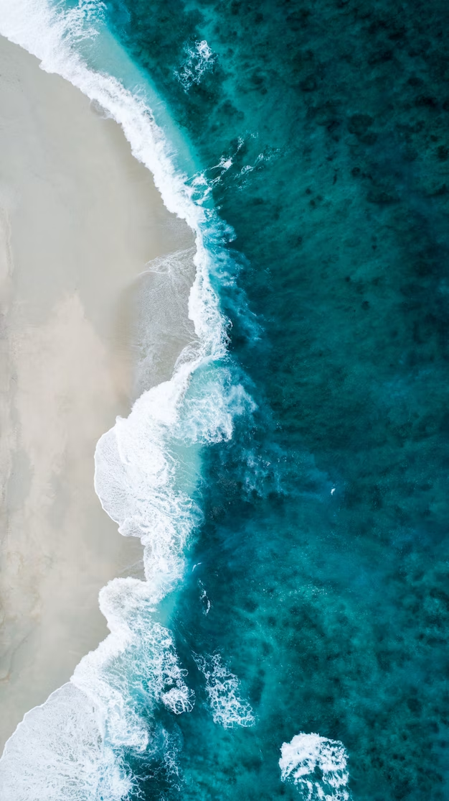

Learning objectives
Leading lines, symmetry, focal point
Focal point, leading lines, color
Bird’s eye view, color
Symmetry, leading lines, focal point
Cell phones today have such high-quality cameras that owning a traditional camera is often unnecessary. But are your photos as good as they could be? Learning a few simple rules can take your photos from ordinary…to extraordinary!
In this course you will:
Identify the rules of photo composition, and
Differentiate between examples of the rules of composition

Slide 3

The Five Rules of composition
Focal point
Rule of thirds
Perspective
Symmetry
Color
Focal point, rule of thirds, perspective, color

Slide 4

Introduction
Mentimeter poll question: please go to https://www.menti.com/alyw5yfyig5j and answer the poll question…or scan the QR code.
Results will be shared in the chat!
I know the rules of photo composition.
Yes, I’m an expert!
I know a little, but I could use more info.
I know nothing, Jon Snow.

Slide 5

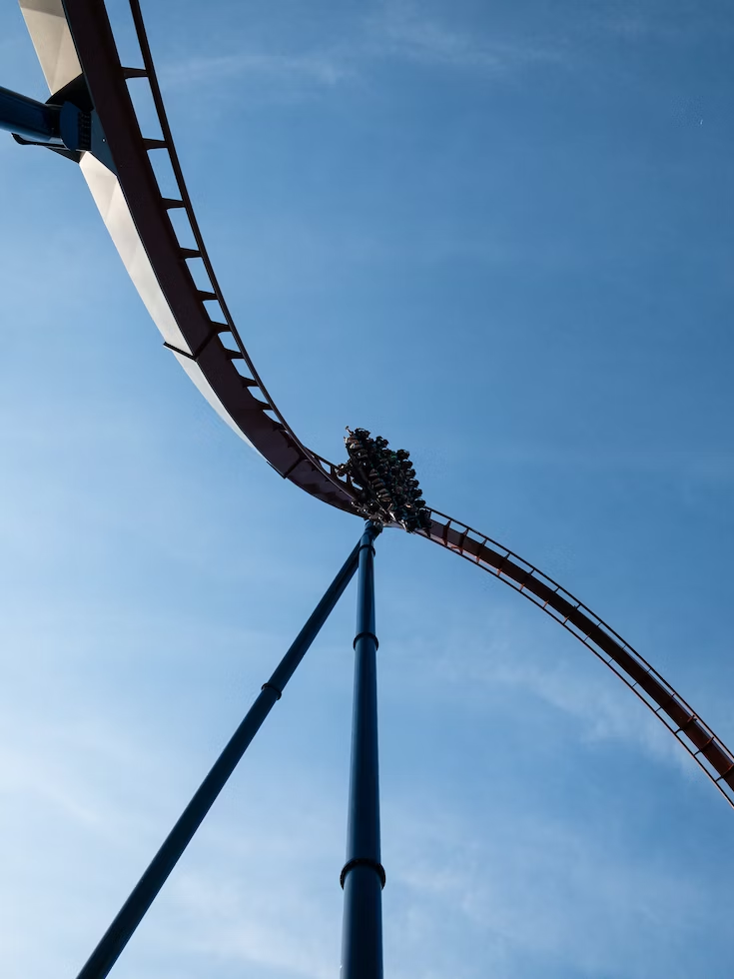
1. Focal point
Create a focal point:
Declutter the background
Fill the frame (crop “dead” space and unnecessary details, like feet)
Depth of field: blur the background

Slide 6
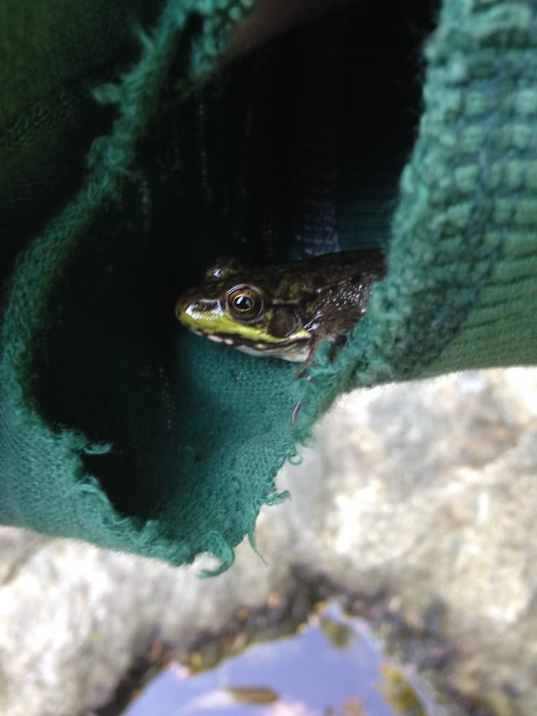
Activity 1
Please take yourself off mute and explain how this photo creates a focal point. Please be specific.

Slide 7

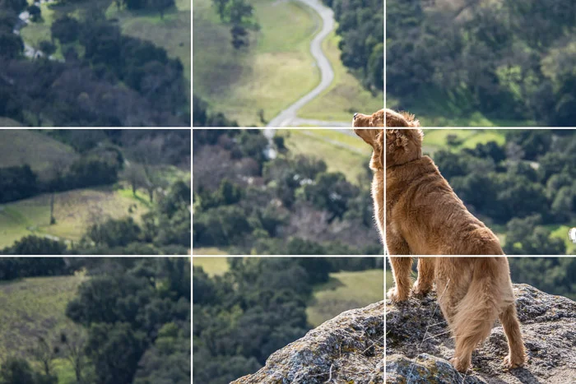
2. Rule of Thirds
Pretend a tic-tac-toe box is laid over the photo
Subject should be in the left or right third of the image, ideally where the lines cross

Slide 8
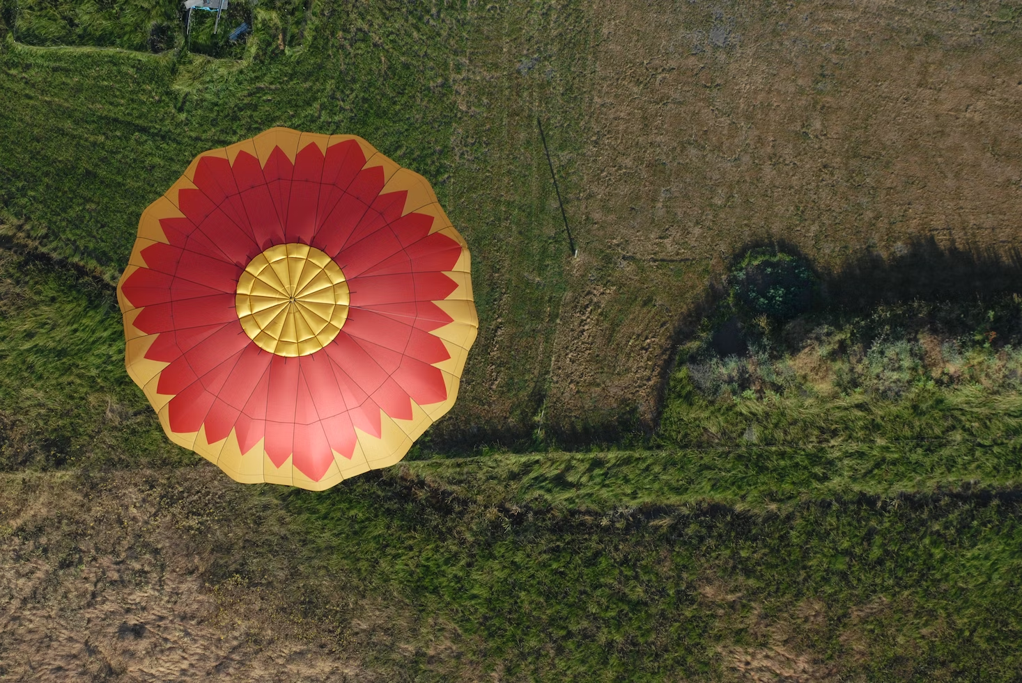
Activity 2
On google jamboard [click https://jamboard.google.com/d/1w3oEfeWFKVZUgbUiTABx6Nqjr9FclZFcrlSchhrTOOI/edit?usp=sharing], use one of the pen or marker tools to circle where the focal area is on the image to the right.
Does it follow the rule of thirds? Answer in the chat.

Slide 9

3. Perspective
Bird’s eye view: shoot from above
Worm’s eye view: shoot from below
Get on your subject’s level (pets, children)
Diagonal lines/angles
Leading lines
Shoot horizontally AND vertically

Slide 10

Activity 3
Find a photo online that illustrates one of the concepts of perspective. Post the photo on the google jamboard https://jamboard.google.com/d/1lM2_ktCrCytv8zTmsJZVSIWrlDo7pBptEla77A4SQHM/edit?usp=sharing. Use the marker or pen tool to write the concept under the photo you posted.

Slide 11
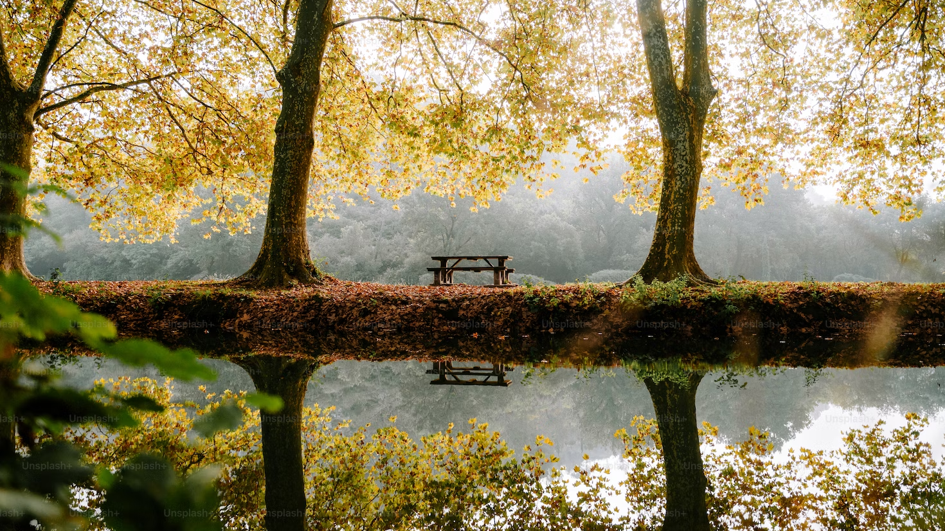
4. Symmetry
When equal parts of the photo mirror each other (also known as repetition)
Makes a photo feel balanced

Slide 12

Activity 4
In the chat, explain how this photo (or the previous photo) shows symmetry.

Slide 13

5. Color
Strong contrast
KISS: keep it simple
Blocks of 2, 3 or 4 colors look best
Color wheel: complementary colors
Reference website: https://www.thetradeshownetwork.com/trade-show-blog/your-guide-to-colors-color-theory-the-color-wheel-how-to-choose-a-color-scheme

Slide 14
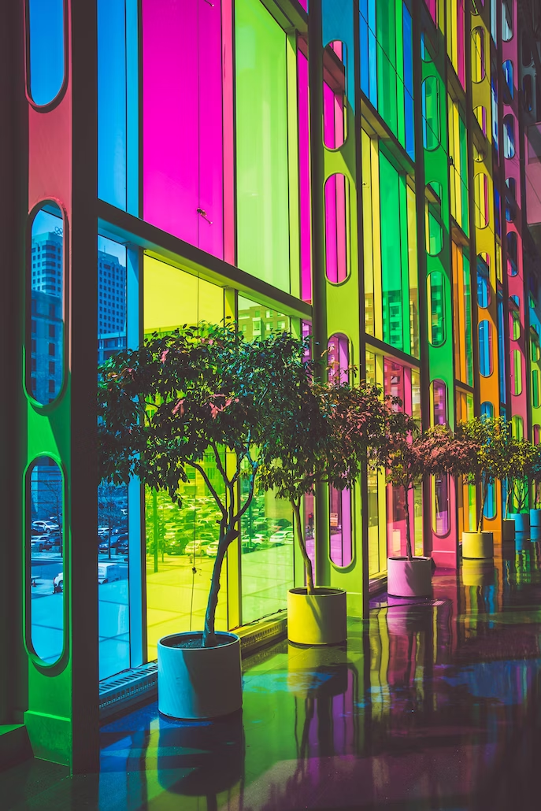


Activity 5
In breakout rooms, discuss what makes these photos good examples of the use of color. You have ten minutes. When we return, one person from each room will explain the room’s reasoning live. Please discuss the following in your rooms:
Group 1: Dubois-Robert photo
Group 2: Katzki photo
Group 3: Barbalis photo
Chris Barbalis
Felix Dubois-Robert

Slide 15
Knowledge Check: let’s see what you learned!
Directions: please choose the best answers.
1. Which of the following is not one of the rules of composition?
Color
Perspective
Rule of thirds
Focal lens length
Focal point
2. Which of the five rules of composition means a mirror image or repetition?
Color
Perspective
symmetry
Rule of thirds
Focal point

Slide 16
Knowledge Check: Answers
How did you do??
1. Which of the following is not one of the rules of composition?
Color
Perspective
Rule of thirds
Focal lens length
Focal point
2. Which of the rules of composition means a mirror image (or repetition)?
Color
Perspective
symmetry
Rule of thirds
Focal point

Slide 17
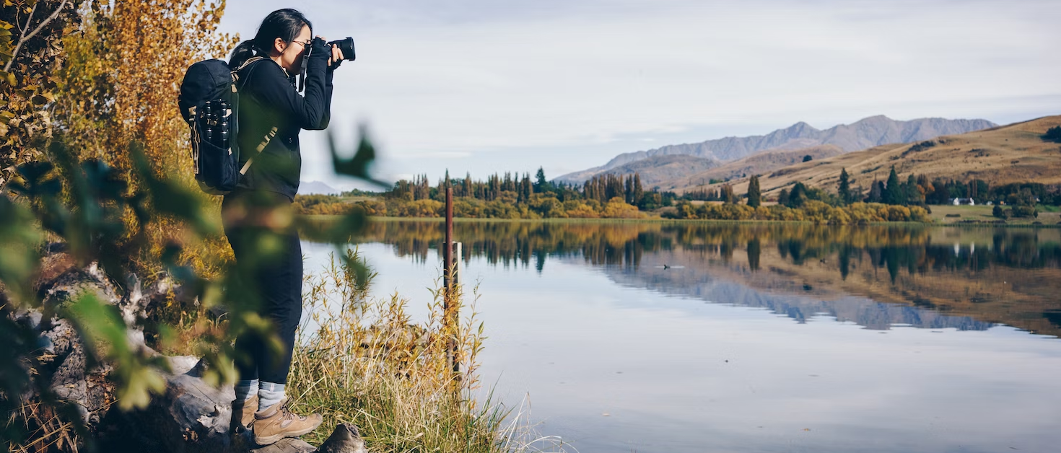
Congratulations!
In this course you:
Identified the rules of photo composition, and
Differentiated between examples of the rules of composition

Slide 18

You’re now ready to take great photos! Thank you—I hope you enjoyed the course!
Tammy Legg
tammylegg7@gmail.com

