Slide 1

Time
Management

Slide 2


Audio
Raise Your Hand

Slide 3

Introductions

Slide 4

What strategies or habits did you employ that contributed to your success?

Slide 5
Learning Objectives
To recognize benefits of time management
To identify causes of time-related issues
To identify different methods of time management

Slide 6
“Time is what we want most, but what we use worst.”
- William Penn

Slide 7

Benefits
of
Time Management

Slide 8
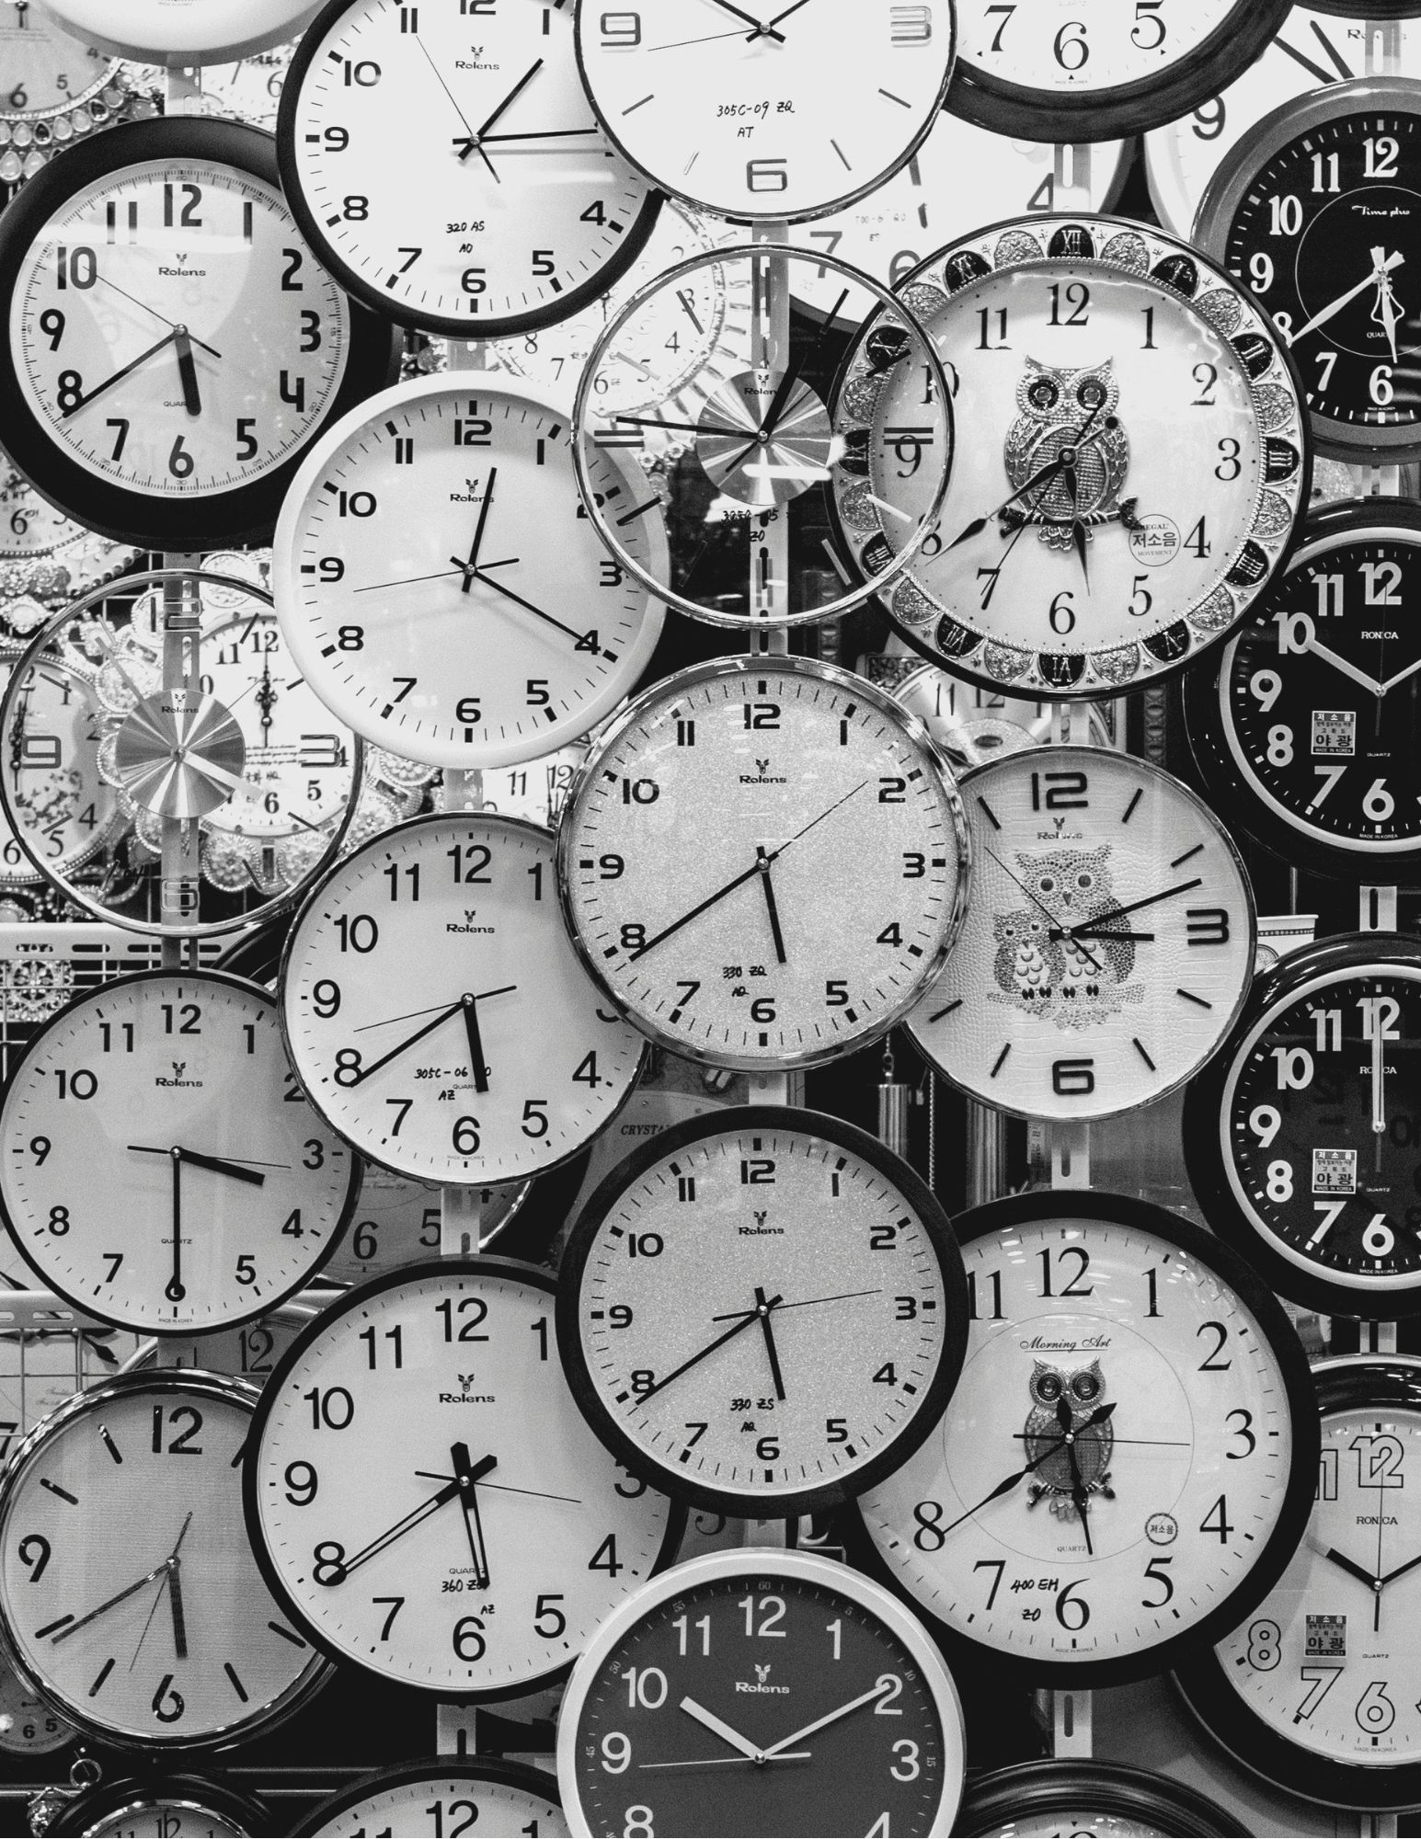
Improved
Productivity
Reduced
Stress
Healthier Work-Life Balance
Improved Decision-Making
Increased
Goal Achievement

Slide 9
Improved
Productivity
Reduced
Stress
Healthier Work-Life Balance
Improved Decision-Making
Increased
Goal Achievement

Slide 10
Improved
Productivity
Reduced
Stress
Healthier Work-Life Balance
Improved Decision-Making
Increased
Goal Achievement

Slide 11
Improved
Productivity
Reduced
Stress
Healthier Work-Life Balance
Improved Decision-Making
Increased
Goal Achievement

Slide 12
Improved
Productivity
Reduced
Stress
Healthier Work-Life Balance
Improved Decision-Making
Increased
Goal Achievement

Slide 13

Discussion

Slide 14
Causes
Of
Time-Related Issues

Slide 15
Procrastination
Lack of Prioritization
Interruptions and Distractions
Ineffective Planning

Slide 16
Procrastination
Lack of Prioritization
Interruptions and Distractions
Ineffective Planning

Slide 17
Procrastination
Lack of Prioritization
Interruptions and Distractions
Ineffective Planning

Slide 18
Procrastination
Lack of Prioritization
Interruptions and Distractions
Ineffective Planning

Slide 19

Discussion

Slide 20
Methods
of
Time Management

Slide 21
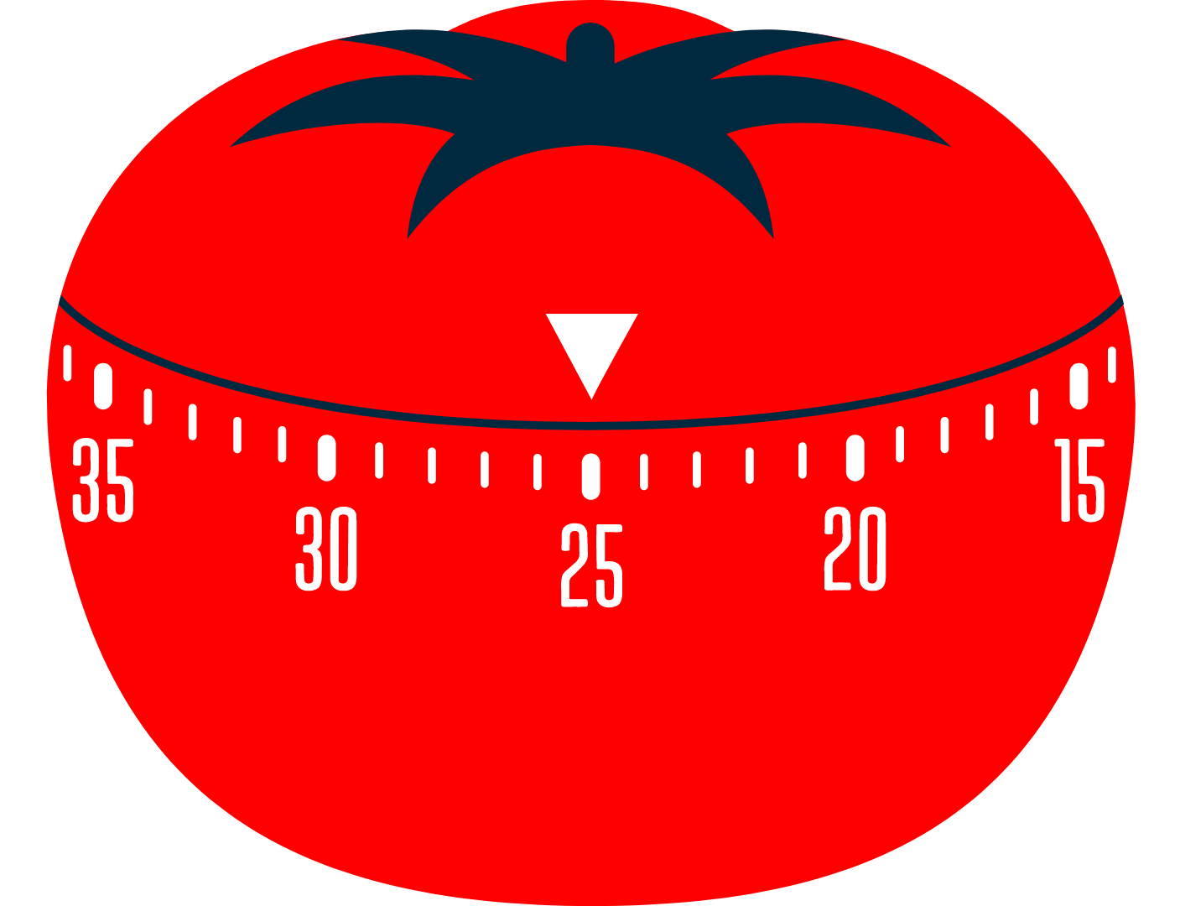
Pomodoro Technique
1. Choose a task you want to work on.
2. Set a timer (traditionally 25 minutes, but it can be adjusted) for one Pomodoro.
3. Work on the task until the timer rings.
4. Take a short break (typically 5 minutes).
5. Repeat the process. After completing four Pomodoros, take a longer break (15-30 minutes).

Slide 22
Eisenhower Matrix
Urgent
Not Urgent
Do:
Tasks with deadlines or consequences
Schedule:
Tasks with unclear deadlines that contribute to long-term success
Important
Delegate:
Tasks that must get done but don’t require your specific skill set
Delete:
Distractions and unnecessary tasks
Not Important

Slide 23

Eat That Frog!

Slide 24
Time Blocking
Identify Tasks and Activities
Adapt and Adjust
Categorize Tasks
Time Blocking
Include Breaks
Assign Time Blocks
Stick to the Schedule

Slide 25
Identify Tasks and Activities
Adapt and Adjust
Categorize Tasks
Time Blocking
Include Breaks
Assign Time Blocks
Stick to the Schedule

Slide 26
Identify Tasks and Activities
Adapt and Adjust
Categorize Tasks
Time Blocking
Include Breaks
Assign Time Blocks
Stick to the Schedule

Slide 27
Categorize Tasks
Identify Tasks and Activities
Assign Time Blocks
Time Blocking
Adapt and Adjust
Stick to the Schedule
Include Breaks

Slide 28
Assign Time Blocks
Categorize Tasks
Stick to the Schedule
Time Blocking
Identify Tasks and Activities
Include Breaks
Adapt and Adjust

Slide 29
Stick to the Schedule
Assign Time Blocks
Include Breaks
Time Blocking
Categorize Tasks
Adapt and Adjust
Identify Tasks and Activities

Slide 30
Include Breaks
Stick to the Schedule
Adapt and Adjust
Time Blocking
Assign Time Blocks
Identify Tasks and Activities
Categorize Tasks

Slide 31
Adapt and Adjust
Include Breaks
Identify Tasks and Activities
Time Blocking
Stick to the Schedule
Categorize Tasks
Assign Time Blocks

Slide 32
Break-Out Room
Discuss which time management technique you currently use or which technique you might try and why.

Slide 33
Game Time
Kah
oot!

Slide 34

Conclusion
Benefits of Time Management
Causes of Time-Related Issues
Methods of Time Management

Slide 35
Q & A
Session

Slide 36

Final Assessment

