Slide 1
Module 11: Building and implementing a cIP roadmap
EVM TRAINING MODULES
Notes:
https://docs.google.com/presentation/d/1WPMg8mB6uvgEj5X6KP7aqBPHBELG5FgqIbcMkKnTTko/edit?usp=sharing

Slide 2
Facilitator objectives
Hidden slide
Desired Results: Module 11
Knowledge: [What I KNOW and can explain to others] Knows the purpose of the cIP and its existence as part of a national process to improve iSC, of which EVM is one ingredient Knows the steps to continuous improvement Knows how cIP integrates with national processes, including fiscal processes within a country Knows their role and responsibilities | Skills: [What I can effectively DO] Translating EVM assessment results into prioritized actions Create a cIP timeline |  | Mindsets: [What I UNDERSTAND that I incorporate into how I make decisions and take actions.] Understands the importance of the cIP (personally and country wide) Country ownership (be an advocate for your country)
Evaluation / Fluency Drill: Case study: Local stakeholders Case study: Tailored cIP template Timeline mapping: Milestones, and sequencing with cIP process
Brief countries on what building and implementing a continuous Improvement Plan (cIP) entails.
Notes:
Module 11 Final PPT presentation (English): (1) why a cIP is necessary, (2) examples from countries, (3) how to build a cIP, (4) for the CMT: deciding approach, timing and responsibilities

Slide 3
Agenda
Introduction
cIP purpose & opportunities
Local actions, national impact
Managing the cIP process
Continuity through local actions

Slide 4
cIP purpose & opportunities

Slide 5

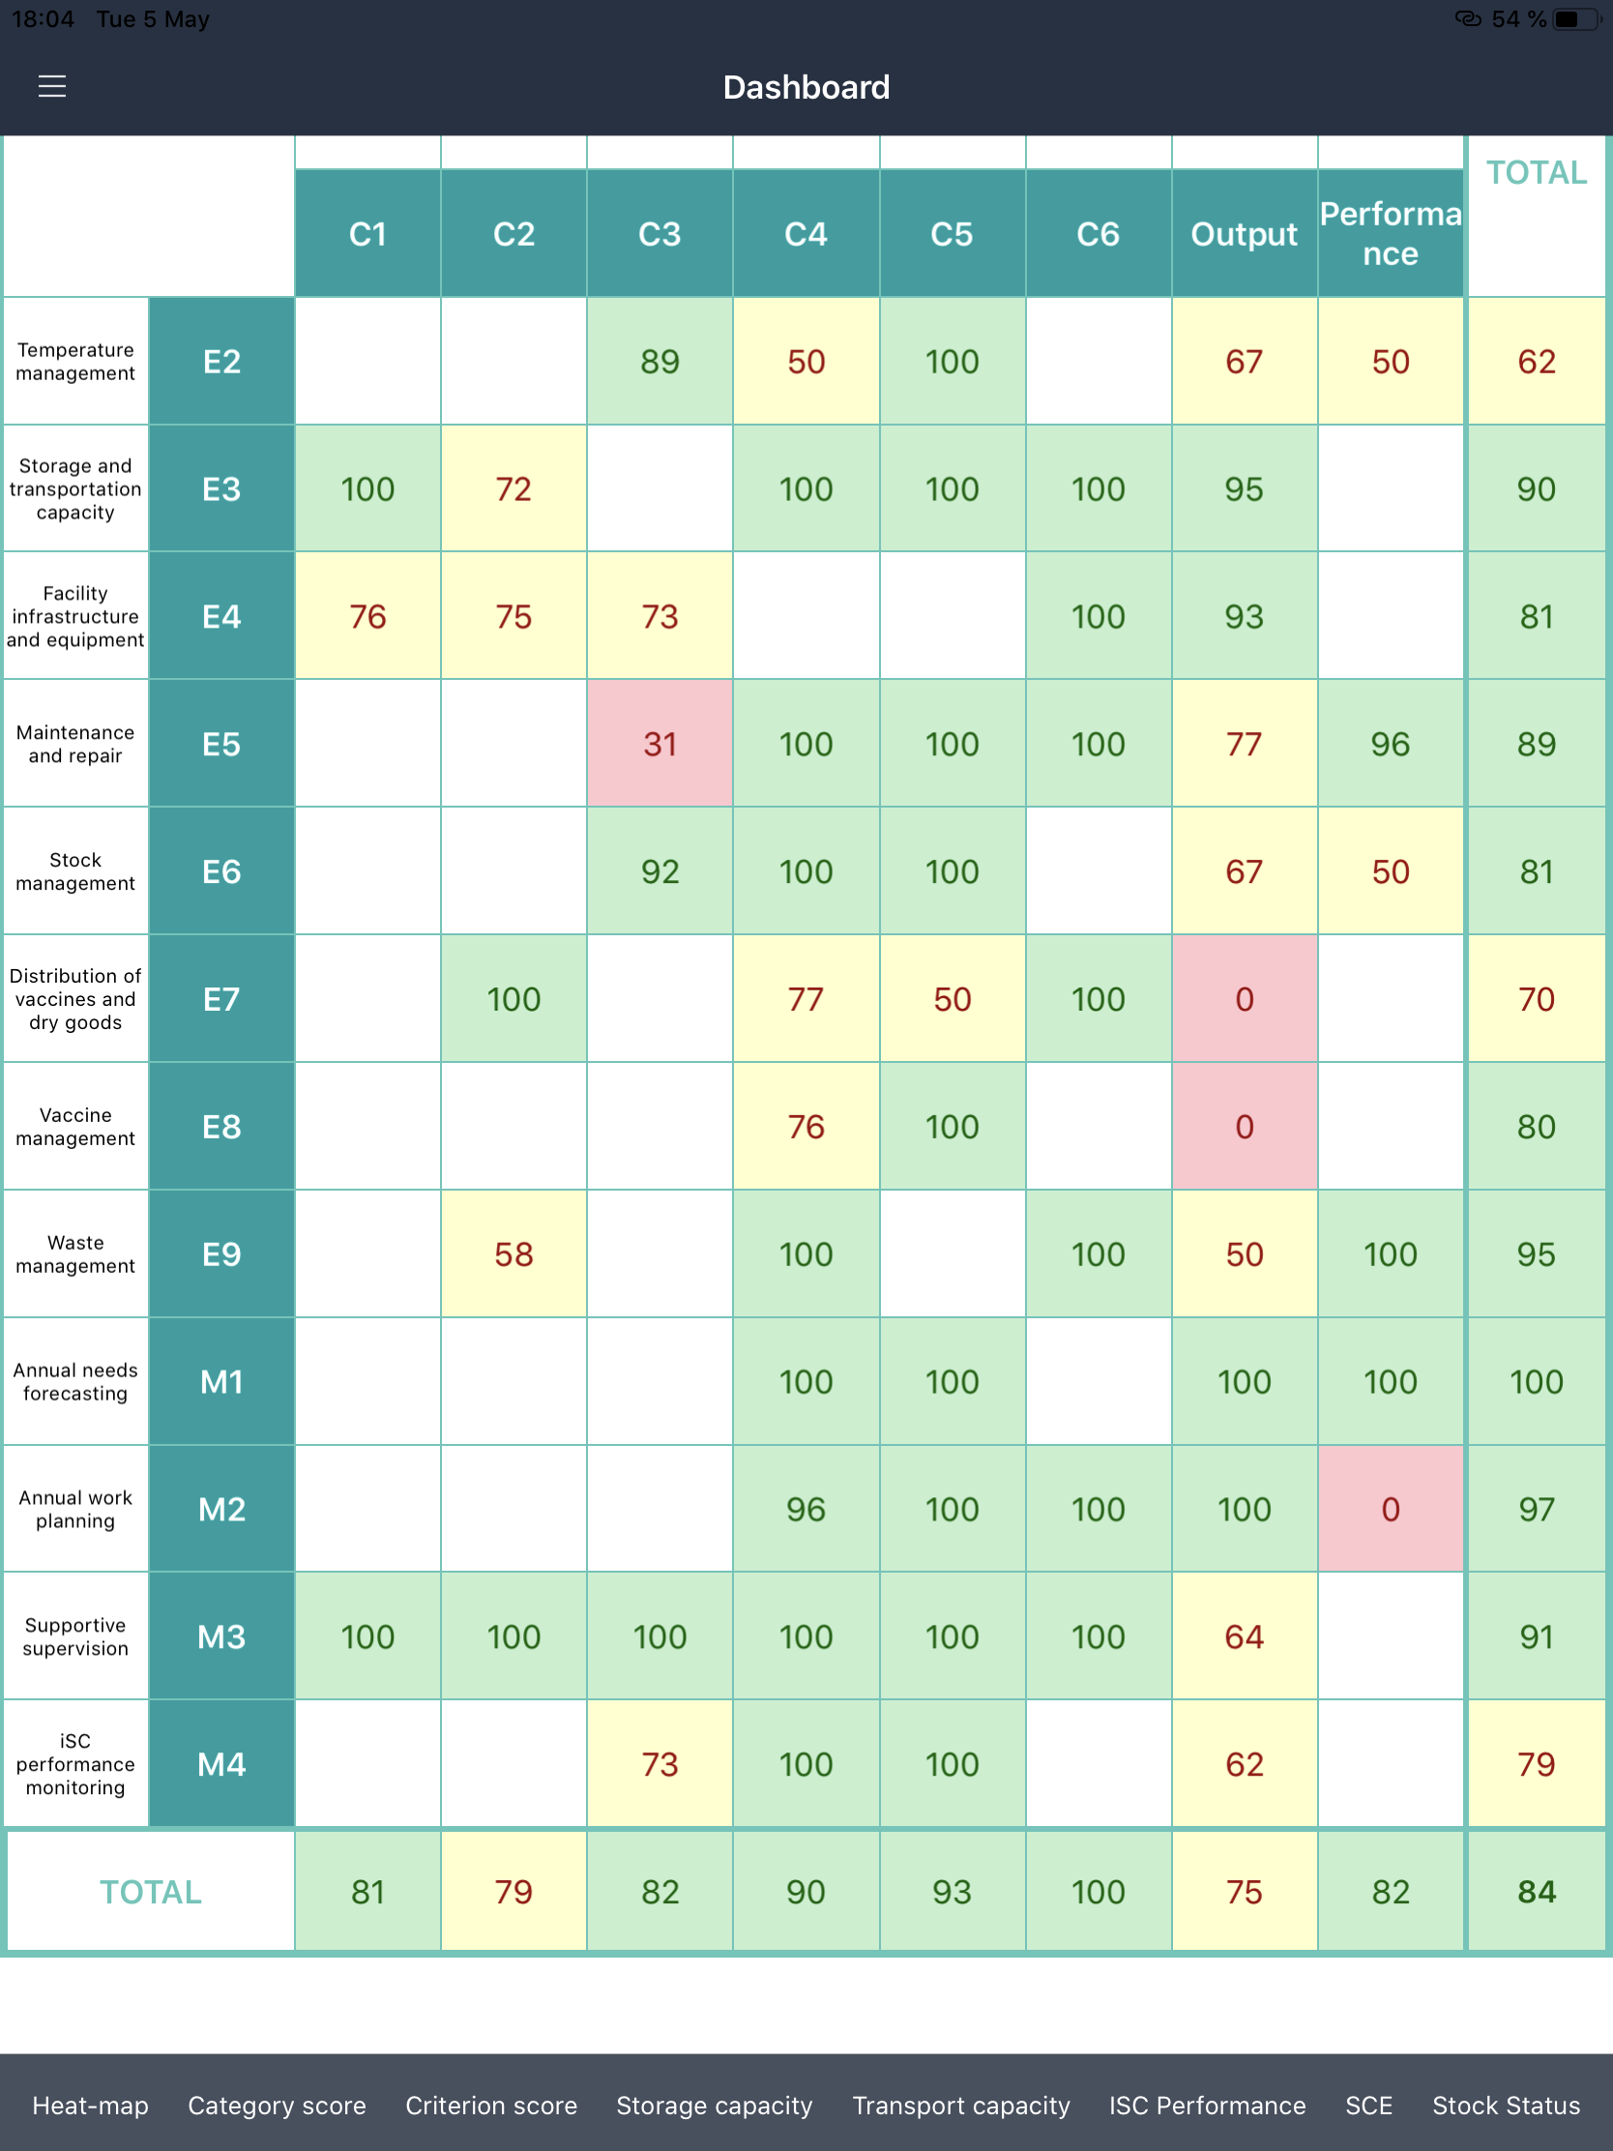
An automated
starting point
cIP purpose & opportunities
NATIONAL PLAN
Analyzing the results of an EVM assessment is one ingredient to building a continuous improvement process (cIP) - an important part of a more ambitious national plan.
The actions and inactions behind the data is used to create a strategic improvement roadmap that complies with WHO technical standards and country iSC objectives.
cIP
EVM
Notes:
EVM assessments are focused on performance scores organized along the nine EVM criteria.
This data also helps programmes focus on discrete tasks.

Slide 6



Visionary and pragmatic
cIP purpose & opportunities
availability
The final cIP roadmap will set achievable strategic objectives based on an in-depth analysis of bottleneck root causes.
It provides solutions at the right level for sustainable improvements to make sure vaccines are available:
at the right time and place
in the right condition
at the right cost
quality
efficiency
Notes:
catalyse evidence-based change in countries
The EVM initiative has progressed significantly from being associated with an assessment tool.
It has been transformed to help national programmes make major health systems strengthening
investments work as intended – to address the underlying systemic bottlenecks to iSC
performance.

Slide 7
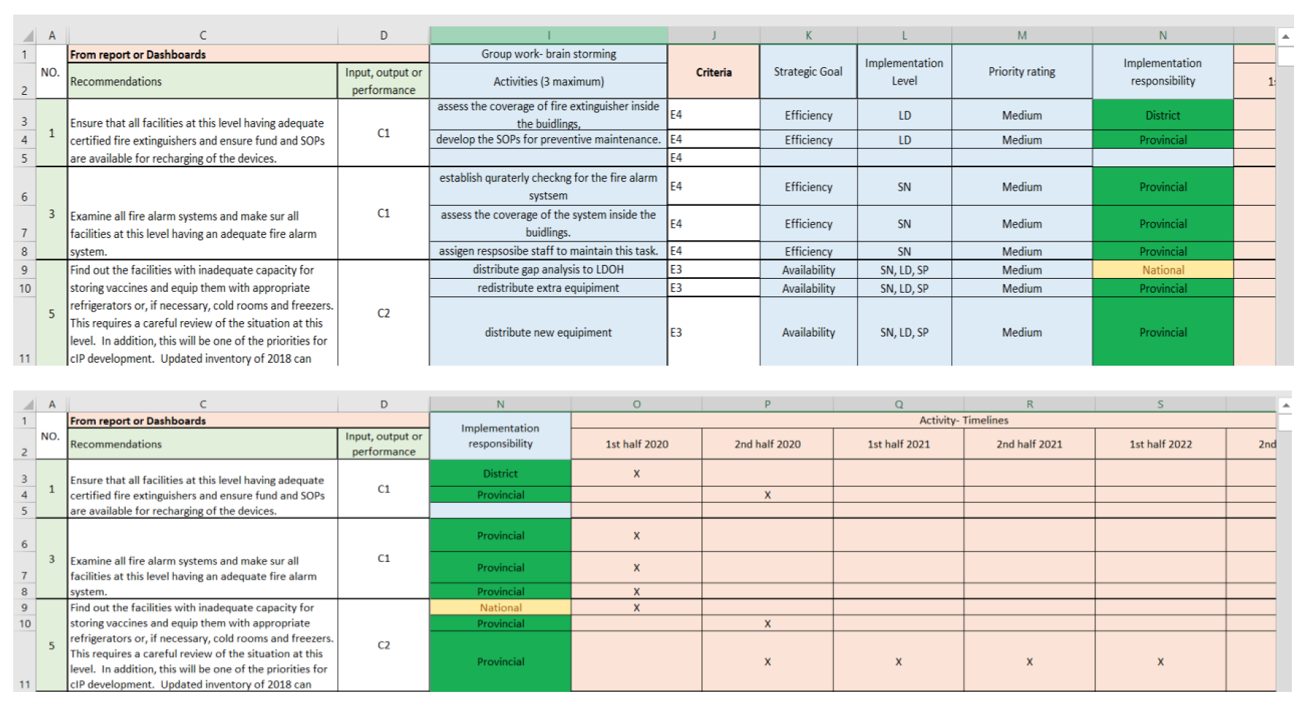
What is the cIP and what does it look like.
cIP purpose & opportunities
The cIP is an Excel document with a list of actions the country is committing to do to improve the ISC, along with the cost ($ amounts next to each line item that have been signed off by the key decision-makers), who is going to do it as well as timelines for tracking.
See a full example
Notes:
The team in the country took the initial draft of the tool presented by UNICEF- HQ experts and further developed to fit the Iraqi context and the country vision of how should exercise elaborate.
The cIP template was designed as an Excel format in six sections.

Slide 8
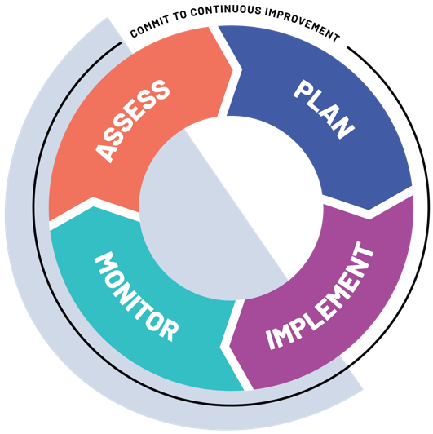
Start with the end goal in mind
cIP purpose & opportunities
There is little point in conducting an EVM assessment without first committing to the entire improvement process.
Before we start preparing for the assessment we should be thinking about the cIP itself (workshop, report, and implementation).
Notes:
EVM starts with an assessment that identifies strengths and weaknesses along the supply chain, informing a plan for implementing improvements and monitoring ongoing performance.

Slide 9
A process,
not just a plan
cIP purpose & opportunities
Collect and review evidence to identify iSC strengths, weaknesses, opportunities, and bottlenecks
Create vision, strategy and operational plan for iSC improvement
There are four steps to the comprehensive approach: assess, plan, implement and monitor.
The cIP accounts for everything after the initial assessment. This process leads to a cycle of continuous improvement — one with agility to update alongside learning and innovation.
Monitor implementation, measure progress toward outcomes
Disseminate plan, ensure funding and put plan into operation
Notes:
EVM starts with an assessment that identifies strengths and weaknesses along the supply chain, informing a plan for implementing improvements and monitoring ongoing performance.

Slide 10




The key advantages of a cIP
cIP purpose & opportunities
The cIP combines a robust situation analysis with evidence-based improvements and a monitoring and evaluation framework to track progress.
Investment case for iSC
Integrated with the broader health system
Prioritized actions based on evidence and available funding
Monitored and measured through joint ownership
Notes:
Strategic and actionable: By using the cIP as an investment case for iSC, immunization staff can pool government and donor resources and TA from partners to address country priorities that already have strong links to multi-year national EPI programme and national health sector plans. In this way, the cIP benefits the country directly, beyond any donor-related consideration.
Integrated with the broader health system: Ensures that planning for iSC is not carried out in isolation but in conjunction with the EPI programme and other government stakeholders at all levels, including subnational governance bodies, ministries of finance, departments responsible for human resources, and information and communication technologies.
Prioritized based on evidence and available funding: sometimes a few interventions “win” full financing while others “lose” and receive far less support. Win/lose scenarios are often based on vested interests, status quo, or donor preferences, rather than a transparent assessment of evidence and cost-effectiveness and can undermine efforts to conduct evidence-based planning.
Focused on implementation through joint ownership: articulate how implementation will be monitored or measured.
The cIP uses a monitoring and evaluation (M&E) framework that helps us understand our baseline, make our improvements and track our progress.
Through the comprehensive EVM framework, the continuous cycle of EVM improvement, supply chain optimization and innovation will ultimately lead to immunization supply chains that are:
• Designed to maximize efficiency, effectiveness, agility and responsiveness to the needs of today’s and tomorrow’s immunization programmes;
• Robust enough to continually adapt to and comply with WHO/UNICEF recommended practices, minimum standards and policies;
• Adopting known cost-effective technological and systems solutions that support coverage and equity improvement objectives;
• Operated by skilled health care workers managing the supply chain with key performance indicators;
• Adequately funded using health system strengthening resources.

Slide 11

Reaching the full potential of EVM
cIP purpose & opportunities
“The objective of the continuous Improvement Plan is to improve supply chain management in a way that promotes sustainability. We want the cIP to really help us get things done and solve the root causes of the problems in our supply chain management.”
GLOBAL TEAM MEMBER INTERVIEW
From 2010-2014, completion of the EVM assessment led to increased country knowledge of iSC strengths, weaknesses, and best practices. However, limited improvement occurred.
In 2015 a four-step strategy for continuous immunization supply chain improvements, quality management, optimization and innovation was developed.*
*WHO/UNICEF. 2020 Strategy for Immunization Supply Chain and Logistics Strengthening
Notes:
https://www.who.int/immunization/programmes_systems/supply_chain/EVM-JS_final.pdf
Knowing the strengths and weaknesses is not enough
By 2014, the EVM initiative was hailed by the global
immunization community as an important success story for
WHO and UNICEF. Over 70 low- and lower-middle-income
countries had assessed the strengths and weaknesses of
their immunization supply chains, and technical assistance
from WHO and UNICEF was provided to countries to
develop improvement plans. In addition, the EVM initiative
was an opportunity to refresh health workers’ knowledge
of vaccine management best practices.
Unfortunately, due to a lack of resources to implement
improvement plans, limited improvement occurred in
countries. Many of these challenges still exist and prevent
the EVM initiative from reaching its full potential to
strengthen national immunization supply chains worldwide;
to support capacity building in supply chain management;
and to be leveraged as a knowledge exchange platform
among countries, as initially envisaged by its designers

Slide 12
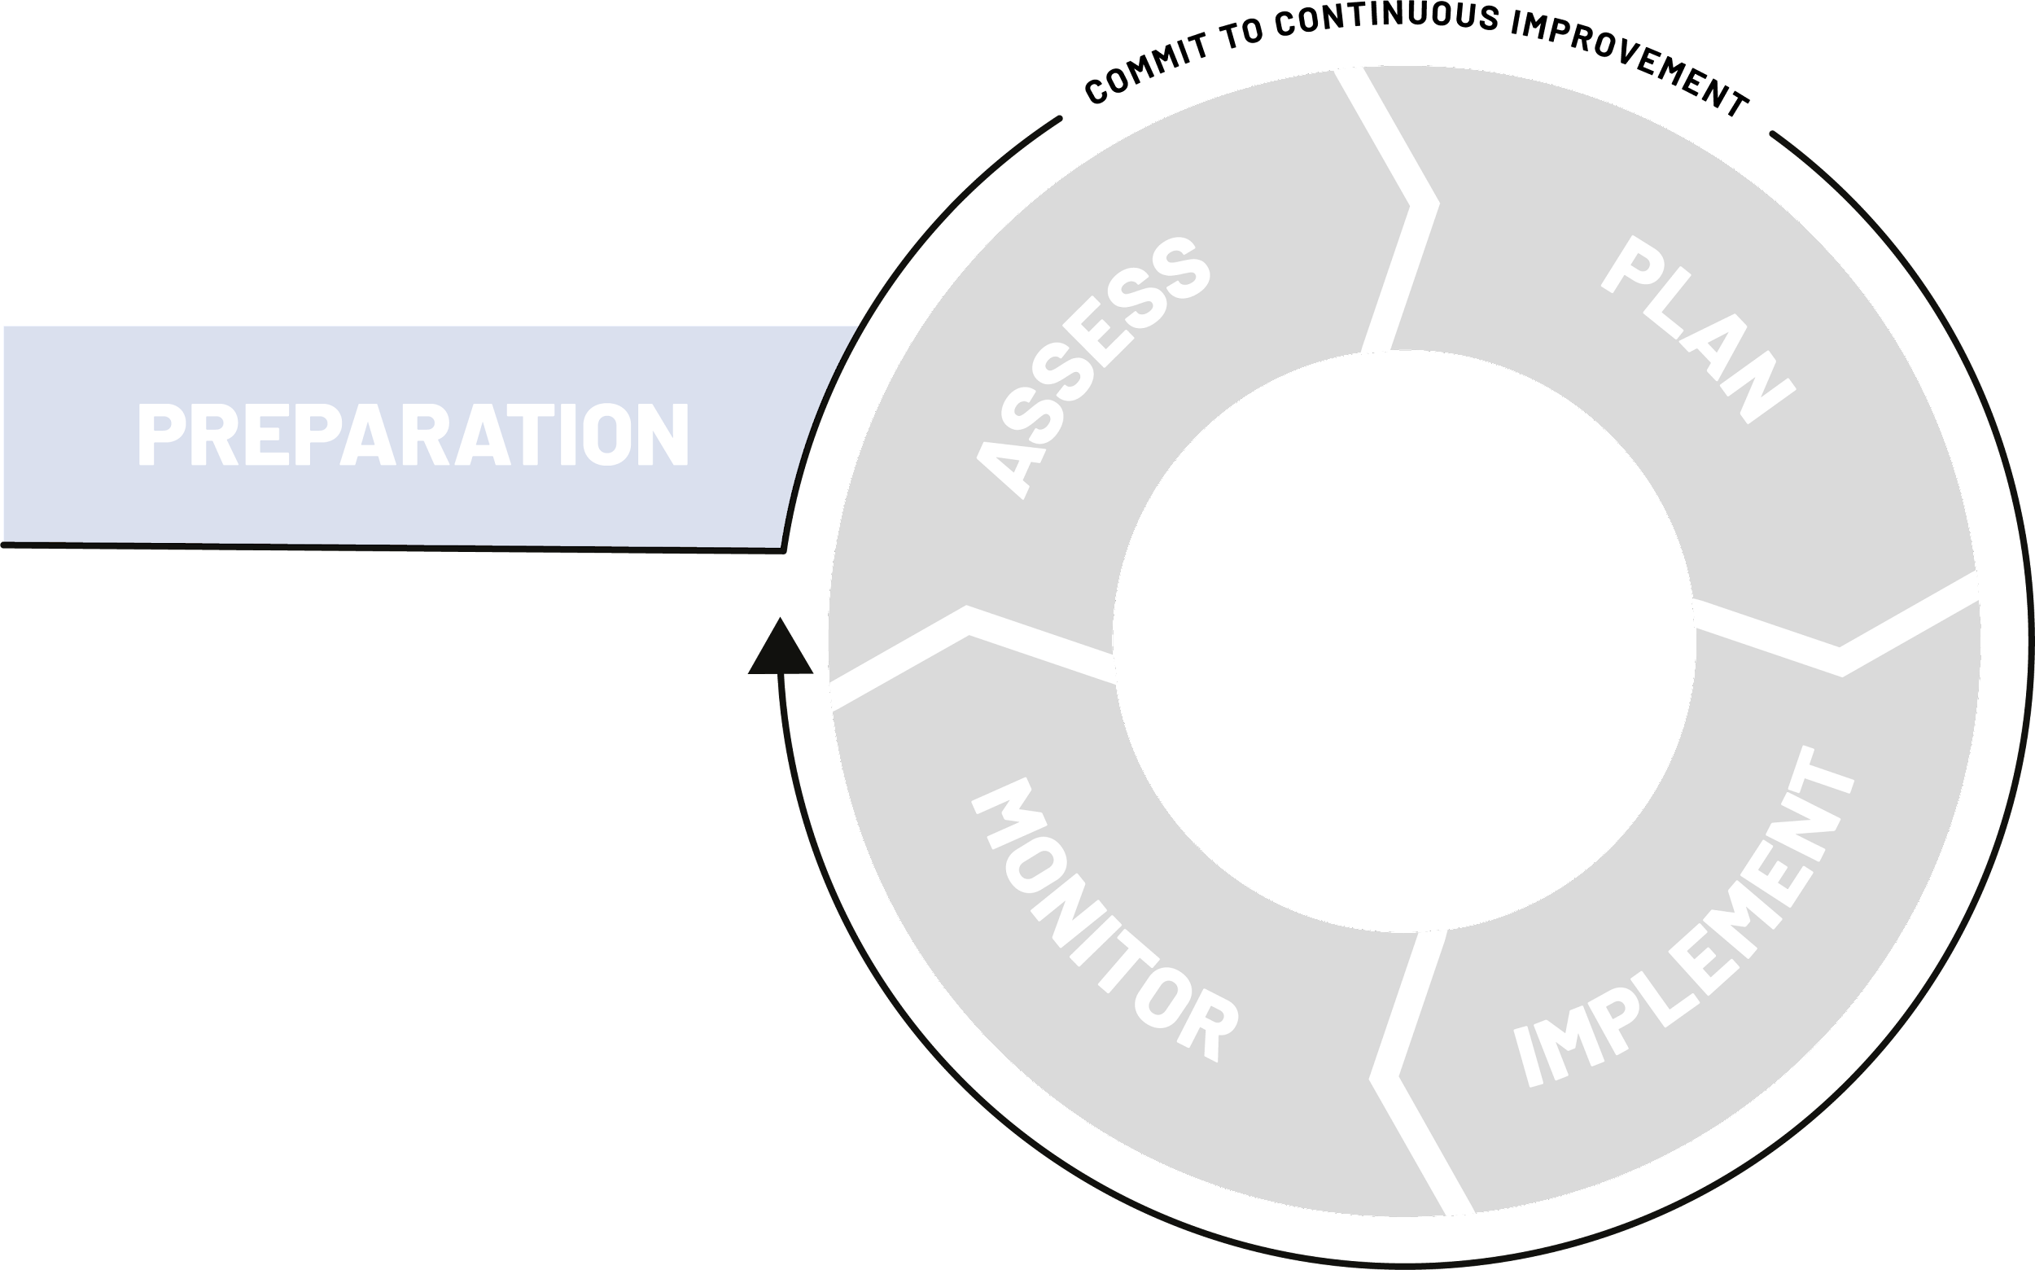
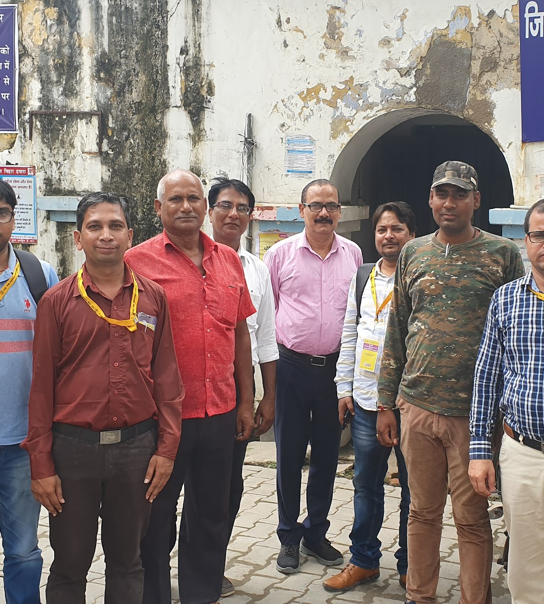
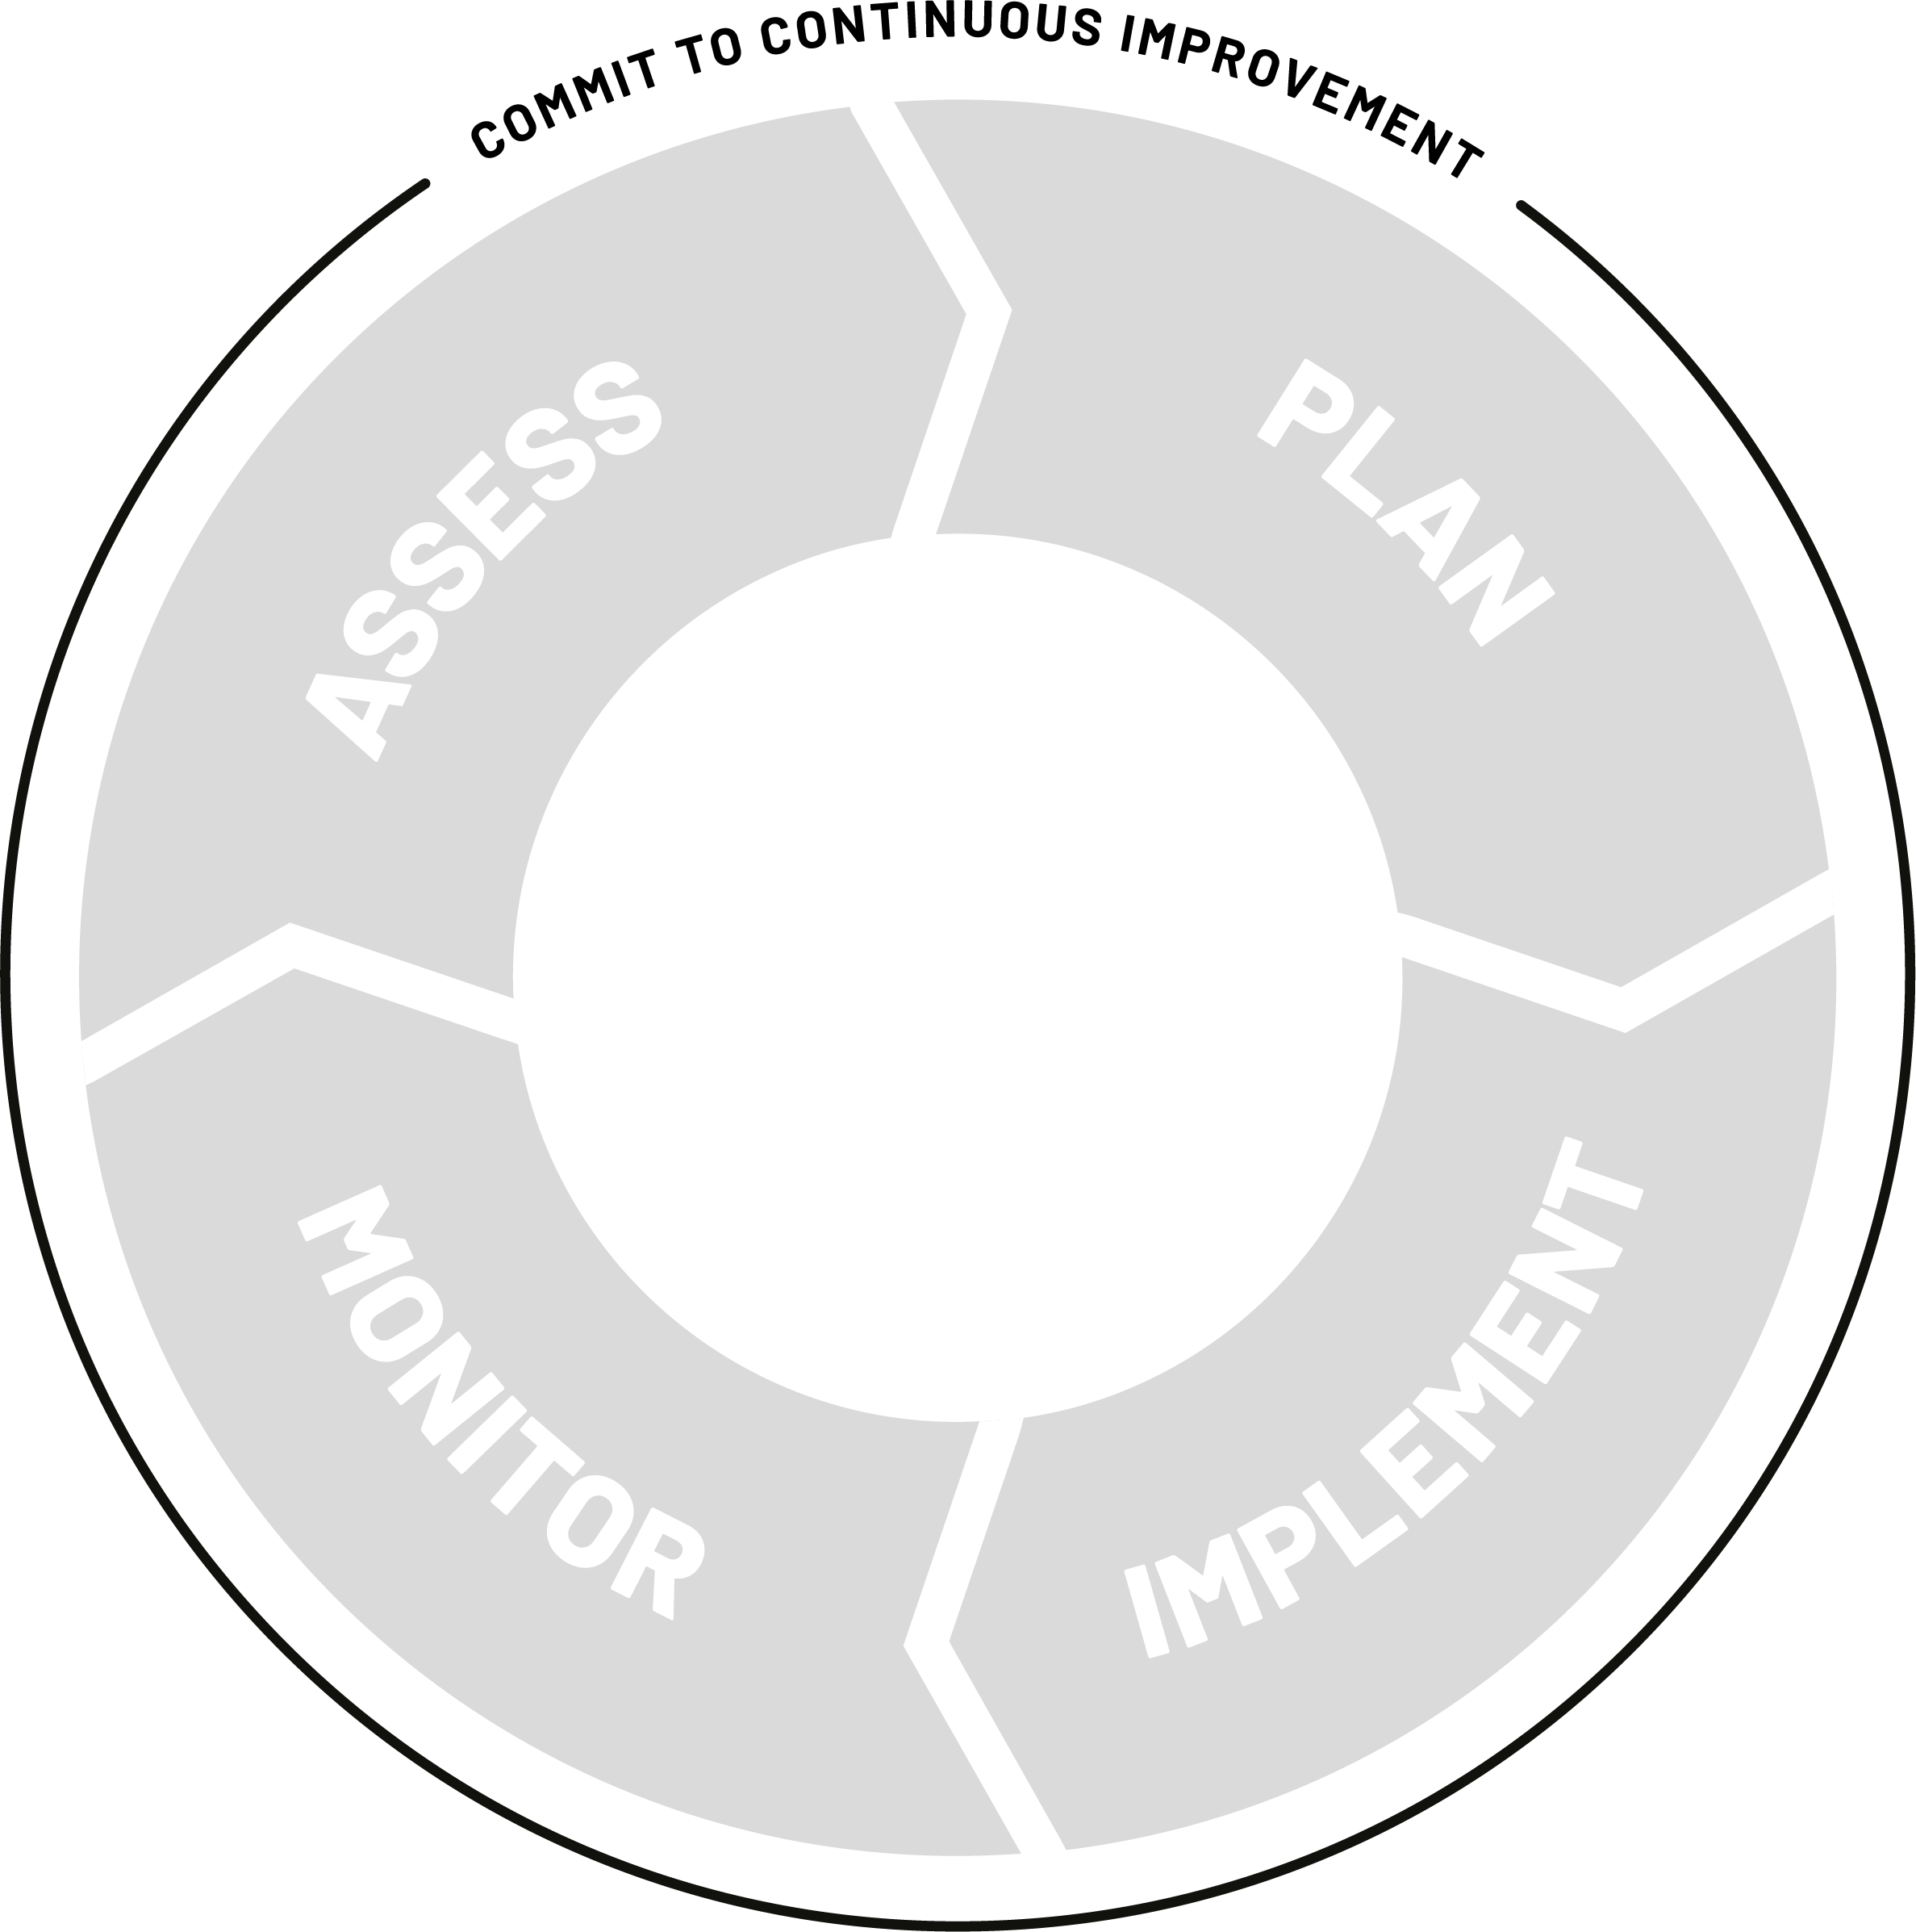
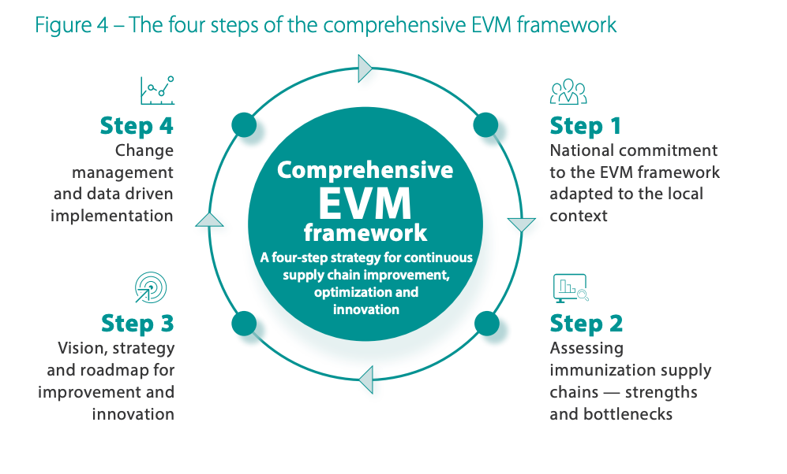
Country ownership + commitment
cIP purpose & opportunities
The first step is to unite national stakeholders, influencers, and decision-makers to rally behind a shared vision for the country’s immunization supply chain, in alignment with national immunization health system strengthening priorities. This country ownership will enable the comprehensive EVM framework to be adapted to the local context.
1
preparation
Notes:
Sierra Leone example: The team invited non-EPI district administrative chiefs (might be province depending on country-size) that are in charge of hiring EPI staff to planning meeting. Did a rundown of process, results, and KPIs to measure improvement. They pooled management indicators (like down time of equipment) to measure system. Crash course for them in understanding immunization – and what their responsibilities are, and how it links to budgets.

Slide 13
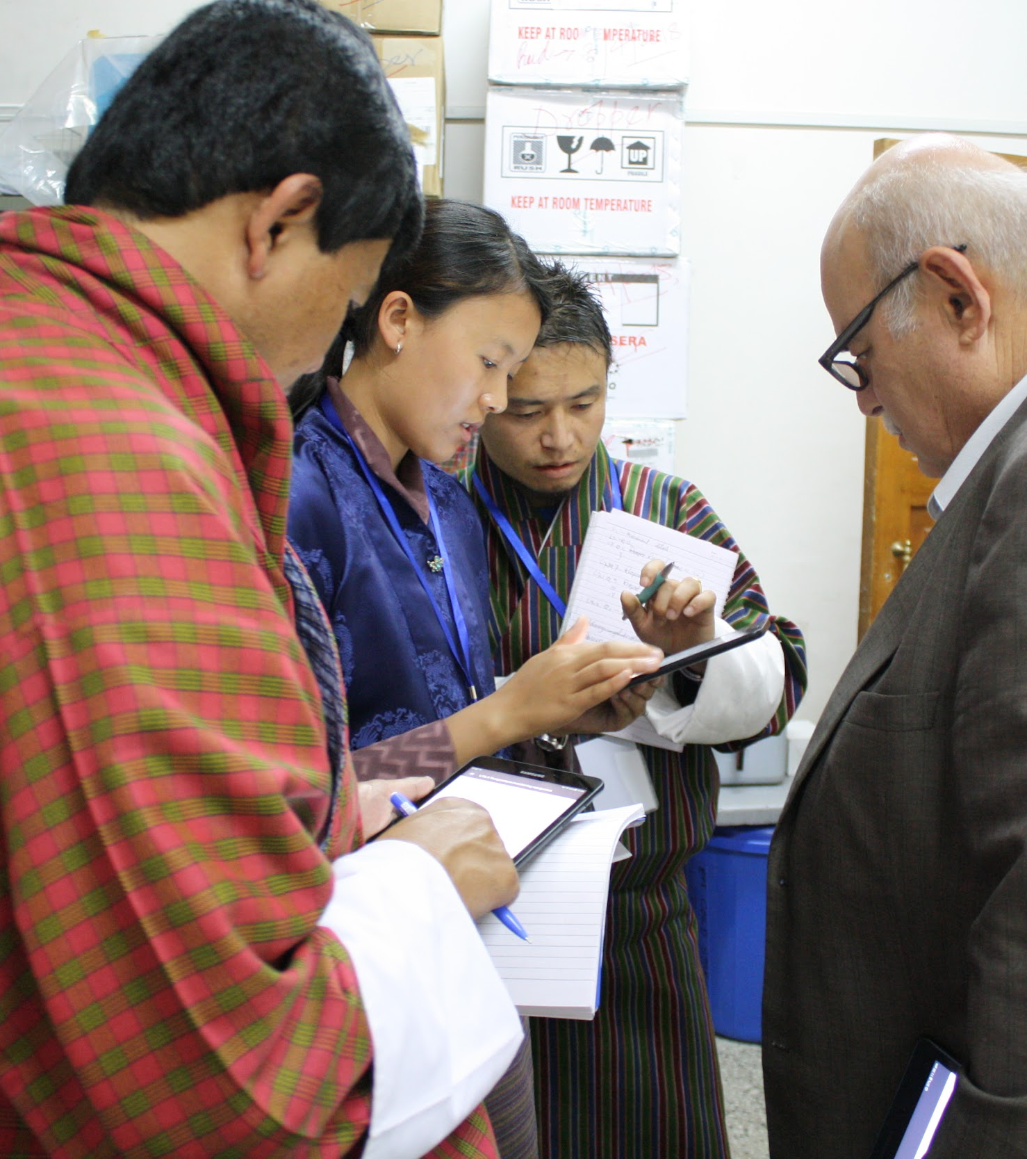
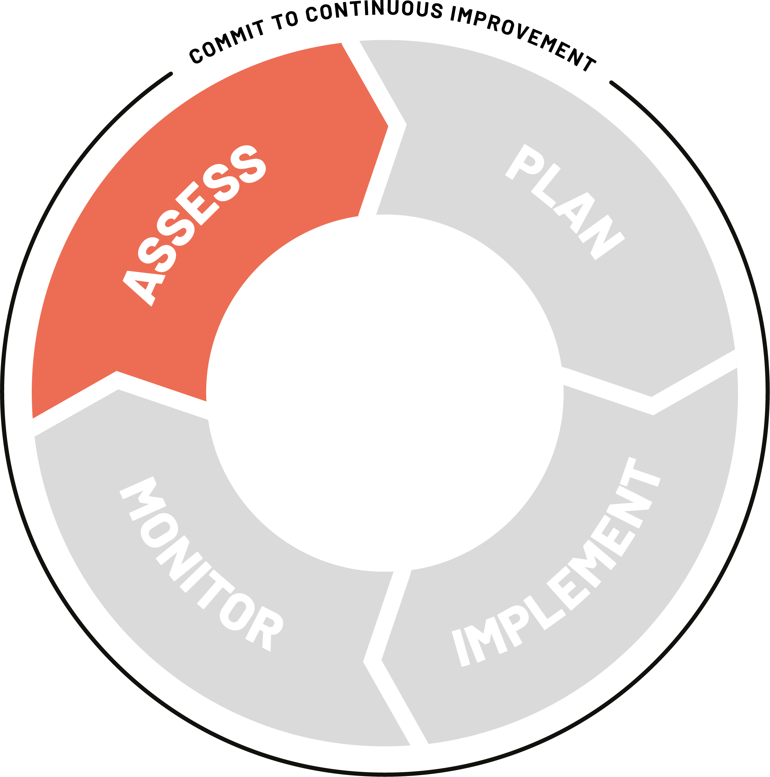
Conduct an EVM assessment
cIP purpose & opportunities
The second step is to conduct comprehensive situational and bottleneck analyses of supply chain fundamentals:
Readiness for new vaccines
Expand, rehabilitate and optimize the cold chain system
Temperature management and control
Efficient supply networks and distribution models
Skills and competencies of human resources
2
Notes:
The second step is to assess the performance of a country’s immunization supply chain by conducting comprehensive situational and bottleneck analyses. Generating the right evidence on strengths, weaknesses, bottlenecks and root causes in a national immunization supply chain is the foundation upon which an evidence-based strategy and supply chain improvement plan can be formulated. To achieve this, WHO and UNICEF are developing the next generation of EVM assessment. The new EVM assessment package will allow for a deeper review of supply chain fundamentals, and will enable countries to more easily formulate a comprehensive supply chain improvement plan based on these insights. The assessment package will enable countries to:
• Review supply chain readiness for new vaccines;
• Identify how to expand, rehabilitate and optimize the cold chain system;
• Improve temperature management and control to safeguard vaccines;
• Design more efficient supply chain networks and distribution models;
• Enhance the skills and competencies of human resources for logistics and improve overall supply chain management.

Slide 14
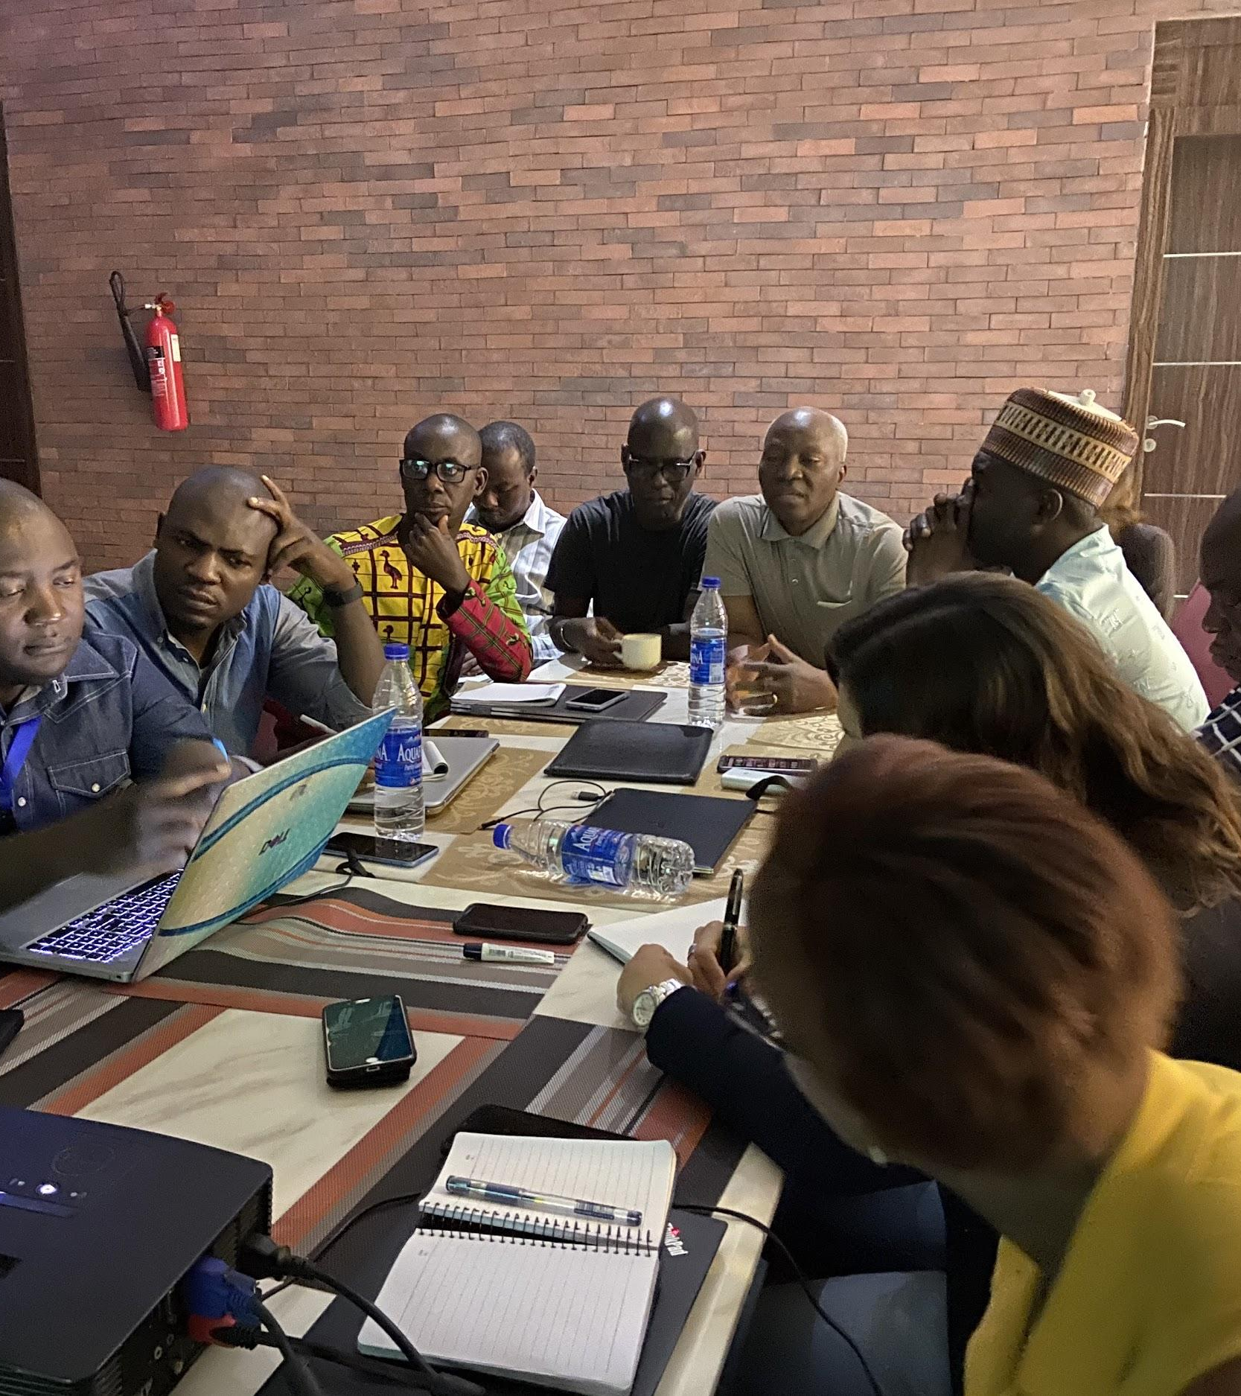
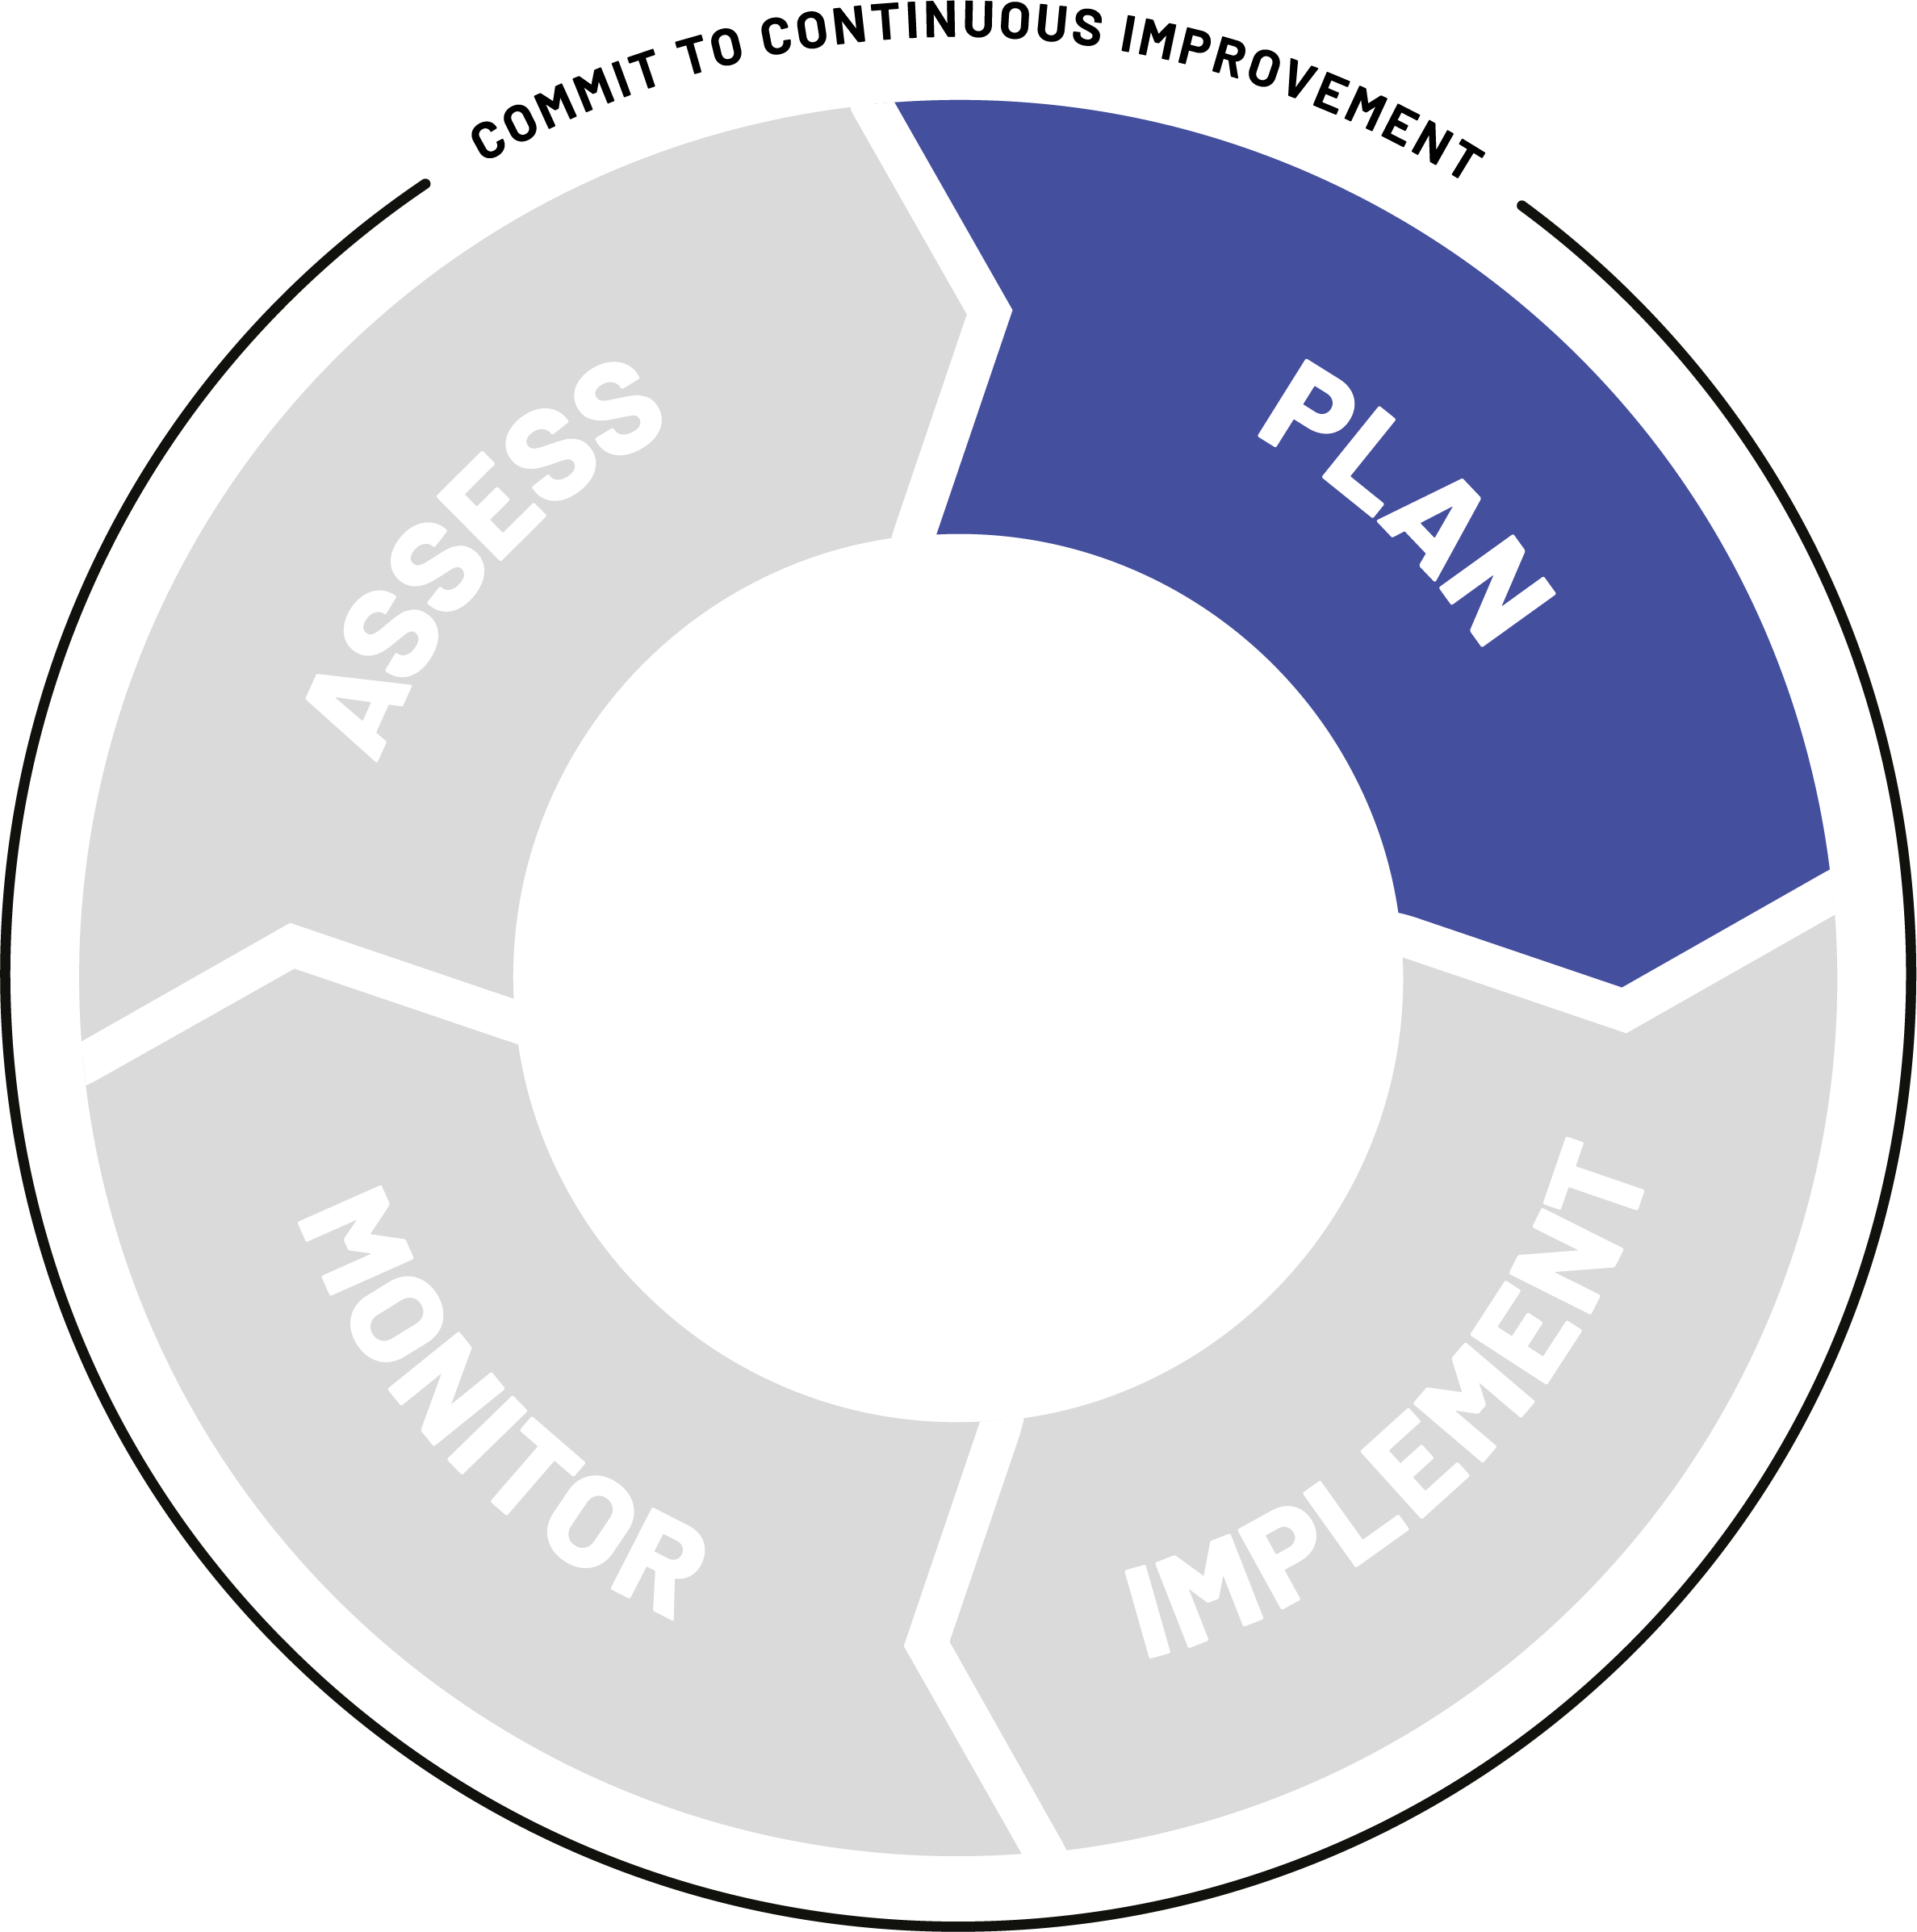
Do the cIP
cIP purpose & opportunities
The third step is to develop a vision and detailed operation cIP plan. The EVM assessment will be the primary ingredient.
The plan outlines: interventions (that will improve the red cells of your EVM assessment), milestones, activities, responsibilities, funding requirements, timeline to address bottlenecks, monitoring and evaluation framework to measure progress
3
Notes:
The third step combines the political momentum supportive of change (Step 1) and the findings from baseline assessments (Step 2) to develop a multi-year strategy with a vision and a detailed operational plan that is aligned with key objectives of the national immunization programme. This visionary and yet pragmatic plan will set achievable strategic objectives, and be based on an in-depth analysis of bottleneck root causes to provide solutions at the right level for sustainable improvements. The supply chain strategies set the overall orientation and national priorities for the following five years and outline linkages with comprehensive multi-year plans (cMYPs) and health system strengthening strategies. The operational plan will detail the prioritized game-changing interventions, milestones, activities, responsibilities, funding requirements and timeline to address current and future supply chain bottlenecks. The improvement strategy and plan will include a monitoring and evaluation framework to measure progress towards immunization supply chain targets and goals against baseline assessment indicators (from Step 2)

Slide 15
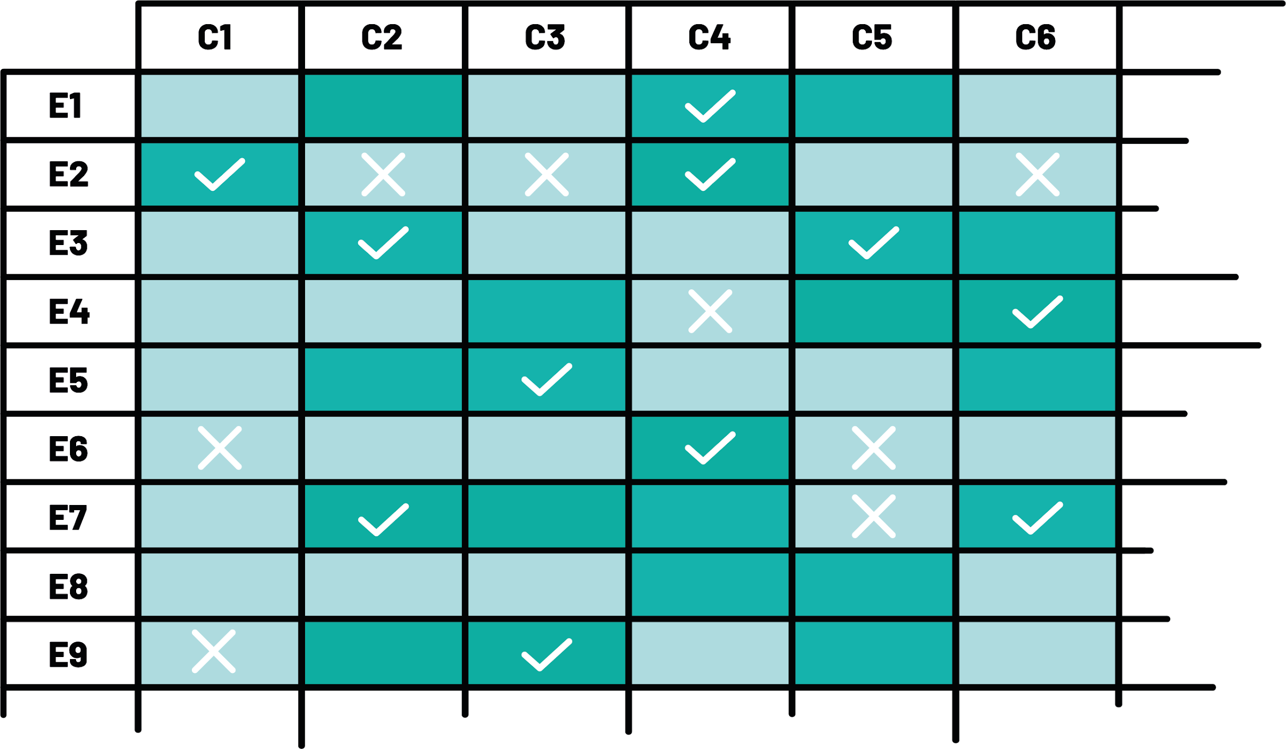
From areas for improvement to actions
cIP purpose & opportunities
> 80%
The EVM assessment results are generated against an intuitive and comprehensive framework to reveal weaknesses and leverage points. This allows corresponding strategies and actions for each key performance indicator.
Each action listed in the cIP should be associated with the relevant areas for improvement identified in the EVM assessment (it may be a single requirement or a category).
ROADMAP FOR IMPROVEMENTS
EVM RESULTS
Notes:
Once the high-level indicators have been decided, iSC systems performance, in terms of the six essentials, represents an intuitive and comprehensive way of organizing the cIP along the six corresponding strategies that contribute to the attainment of the performance indicators.
E1 Vaccine arrivals
E2 Temperature management
E3 Storage and transportation capacity
E4 Facility infrastructure and equipment
E5 Maintenance and repair
E6 Stock management
E7 Distribution of vaccines and dry goods
E8 Vaccine management
E9 Waste management
M1 Annual needs forecasting
M2 Annual work planning
M3 Supportive supervision
M4 iSC performance monitoring
R1 Infrastructure management
R2 Equipment management
R3 IT systems management
R4 Human resources management
R5 Knowledge management
R6 Financial resources management
ST Strategic planning

Slide 16
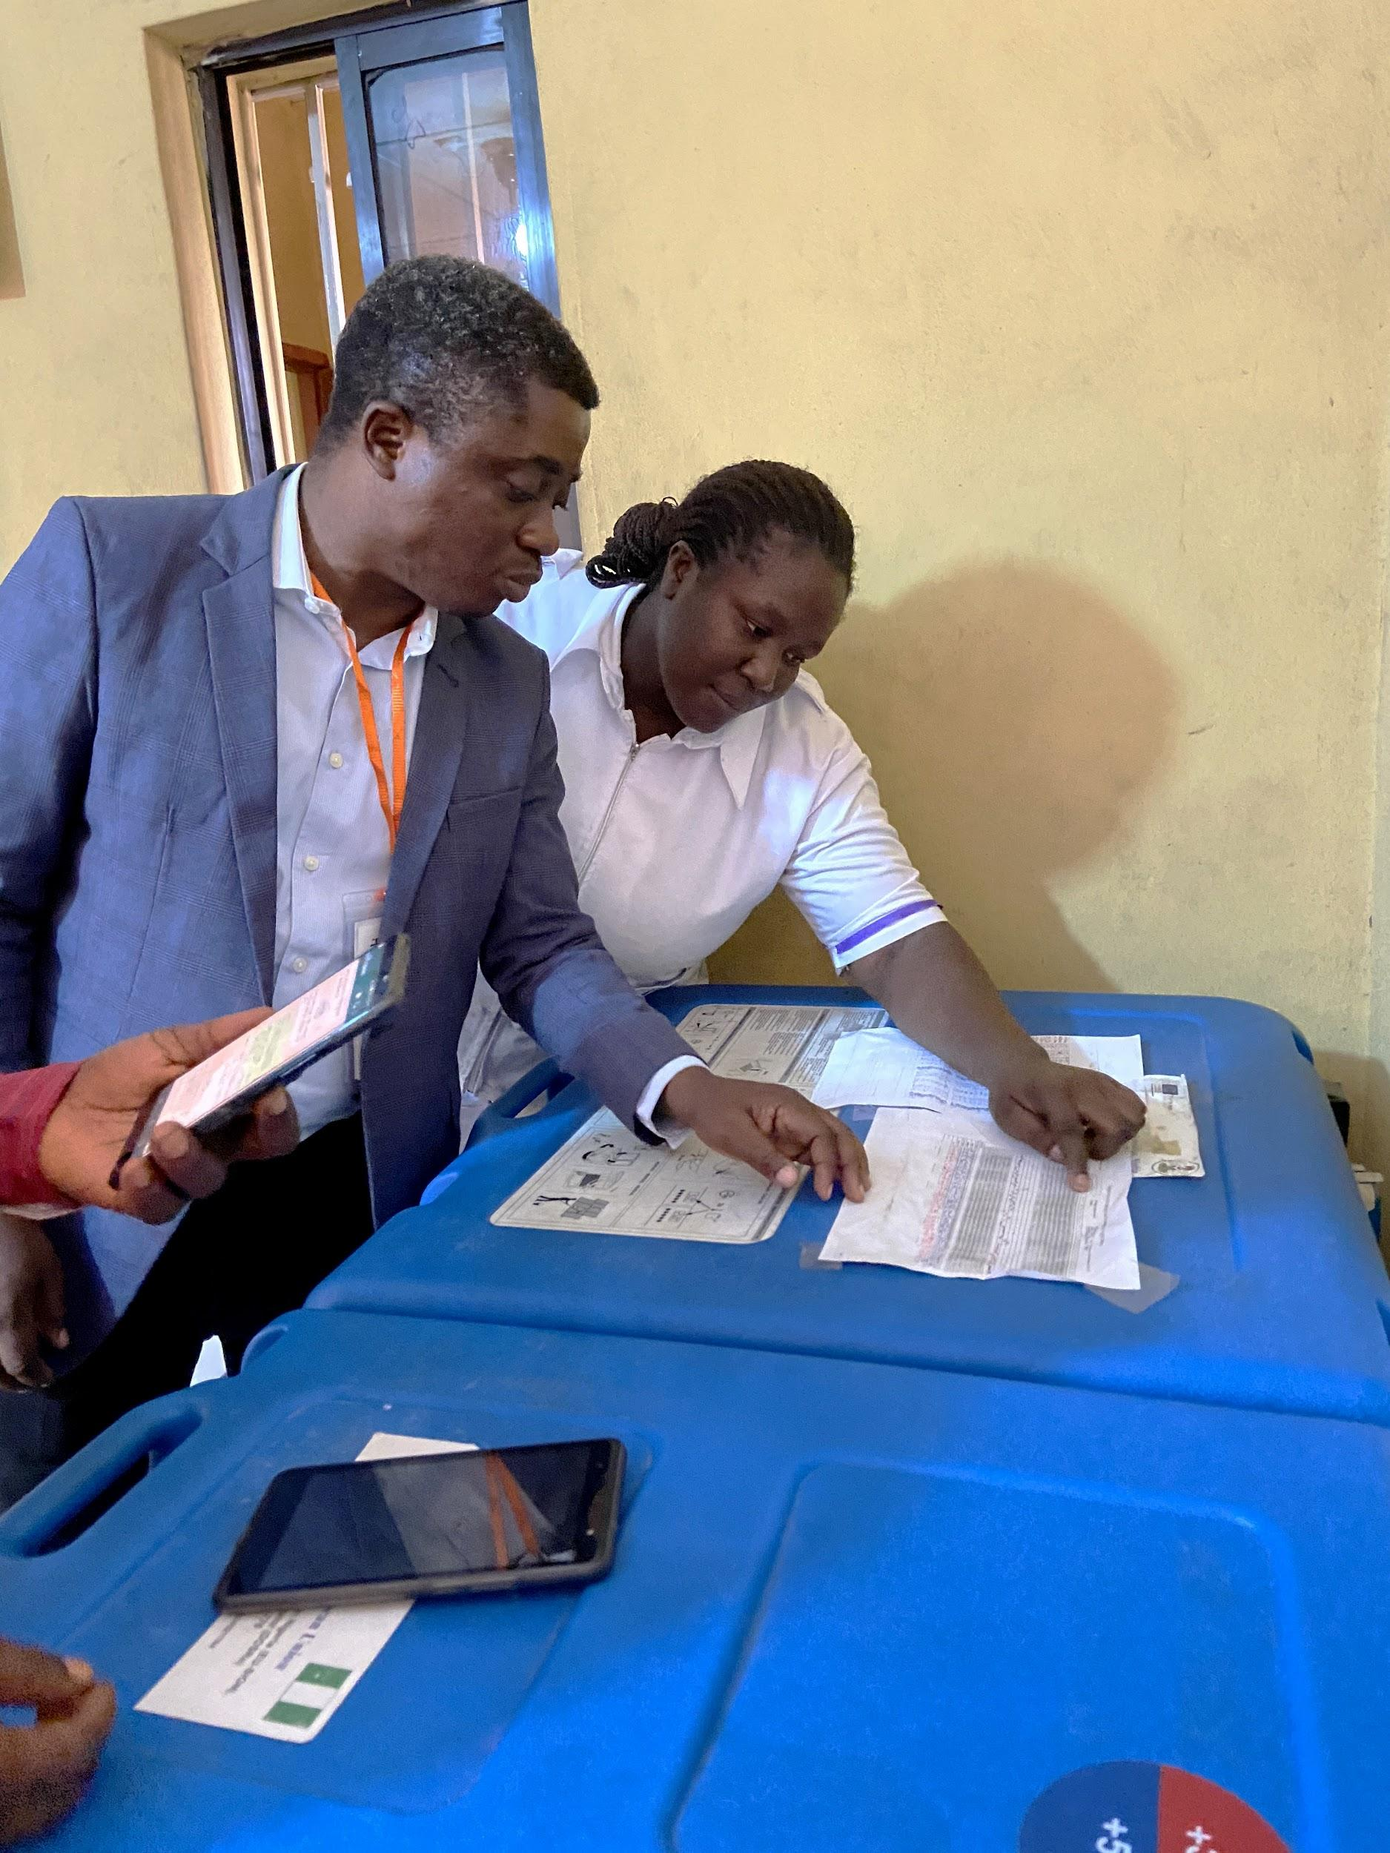

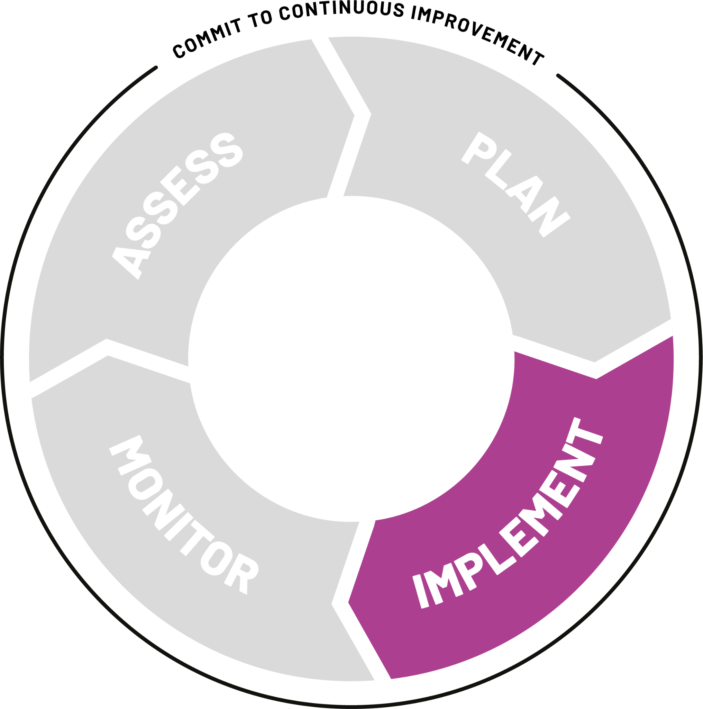
Implementation and change
cIP purpose & opportunities
The fourth step is to check that all the actions listed in the cIP are being implemented.
At different levels of the supply chain, from national to local, implement the operational improvement plan.
4
Notes:
The fourth step is to implement the operational improvement
plan, review and report progress against planned activities
on an annual basis, and monitor implementation outputs
and outcomes defined in the monitoring and evaluation
framework. Linked to Step 1, WHO and UNICEF will support the
establishment or strengthening of a national logistics working
group to oversee and monitor the implementation of the
operational plan and coordinate technical assistance.
WHO and UNICEF are developing new guidance materials and
offering technical assistance on how to establish a functional
national logistics working group, how to monitor and evaluate
the implementation of the improvement plan, and how to
establish a data dashboard for data-driven management and
improvement. In addition, WHO and UNICEF are also supporting
innovative peer-to-peer mentoring platforms and workshops to
facilitate the exchange of experiences, promising practices and
lessons learnt among countries

Slide 17
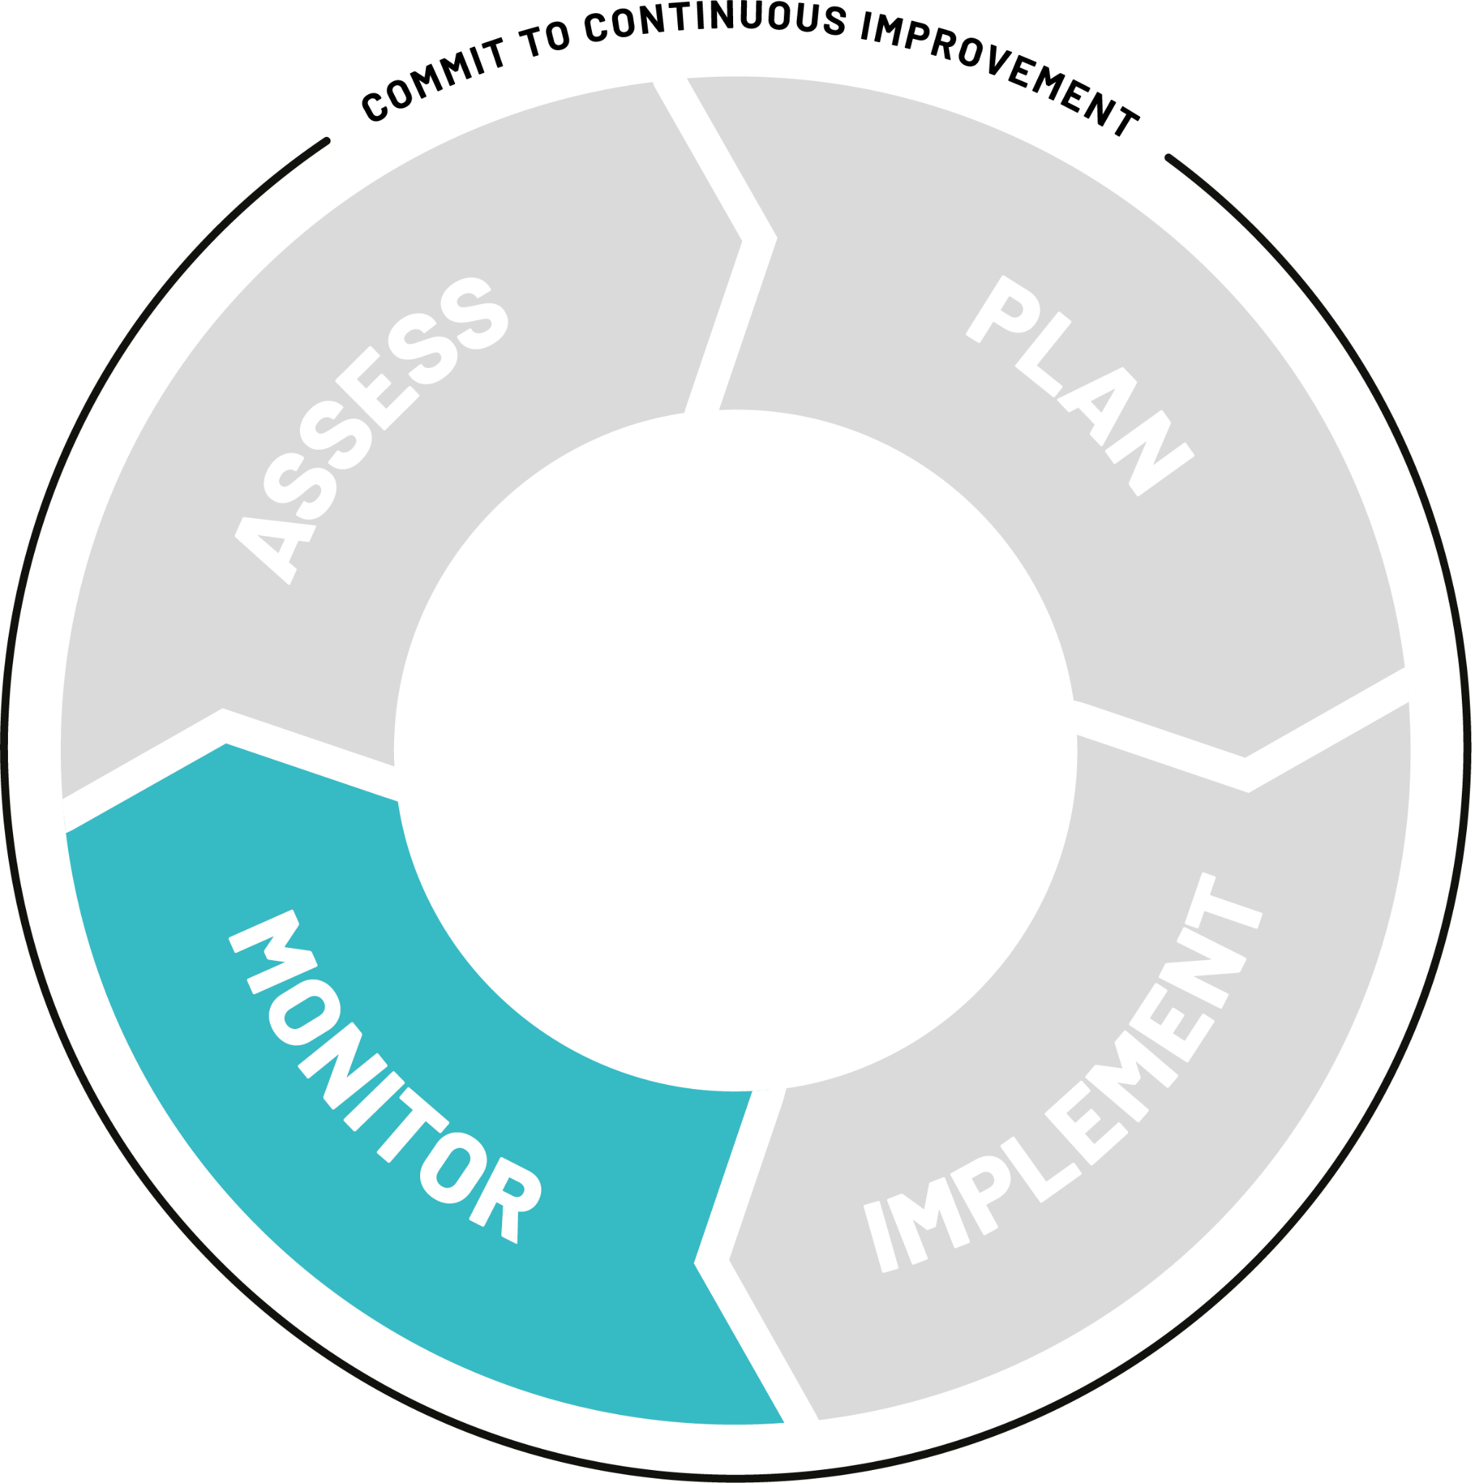
Monitor and validate
cIP purpose & opportunities
The fourth step is to validate that the changes you want to achieve through the implementation tasks listed in the cIP have been successful.
Review and report progress against planned activities and monitor outputs and outcomes. These can be validated by conducting targeted assessments.
Whatever the impact of the cIP there should be a plan to re-assess in 3-5 years.
5
Notes:
"Monitor" step includes "validation", in other words validating that the changes you want to make by doing a task (listed in the cIP) have been successful. This enables us to bring the utility of conducting a targetted assessment. For example, if a task in the cIP relates to particular geographical area or to a particular aspect of the ISC, the task can be validated by conducting a targetted assessment for that specific task.
It is also not clear here how the process is circular (going from Monitor and back to Assess). We need to explain that whatever the impact of the cIP (either the tasks worked or they didn't) there should be a plan to re-assess in 3-5 years.

Slide 18
The continuous improvement process enables countries to critically analyze successes and improve identified weaknesses.
cIP purpose & opportunities

Slide 19
Local actions, national impact

Slide 20







Everyone has a stake in the improvement process
Local actions, national impact
HEALTH
WORKER
FACILITY MANAGER
ICT
SUPPORT
The cIP is a participatory exercise, it is not simply a national plan, it needs to include province/state decision-makers as well as the key national people: EPI managers, cold chain managers, public health focal points, and key decision makers — both local and national.
TECHNICAL PARTNER
EVM
ASSESSOR
EVM
MANAGER
EVM
LEADER
Notes:
The EPI workforce is the first to learn what does not work, and has the clearest insights into which actions effectively address each challenge within their programme context.
Aligning continuous growth – continuous learning – of the EPI workforce at all levels with the process of continuous improvement of the iSC system, is the essential element that makes the coalition for sustained
excellence in iSC whole. The EPI workforce is the first to learn what does not work, and often has the clearest insights on how to make it work in the programme context. Participatory models that empower and give implementers a stake in the design and implementation of iSC improvement plans are being embraced increasingly by countries, centralized and devolved contexts alike.
Every person who is a part of the system is responsible for the results at a national level.
Every facility manager, health worker, driver, supply chain manager, etc. play a part in determining what the results of a national assessment are as well as how we are going to improve those results.

Slide 21
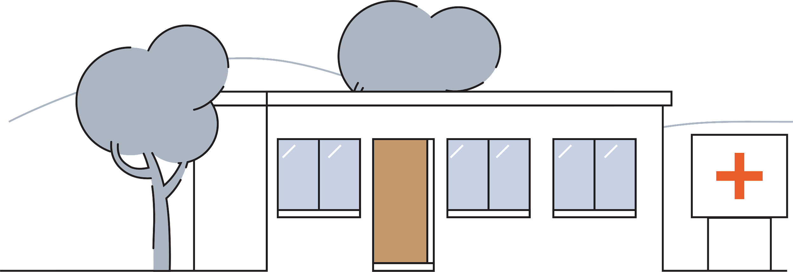
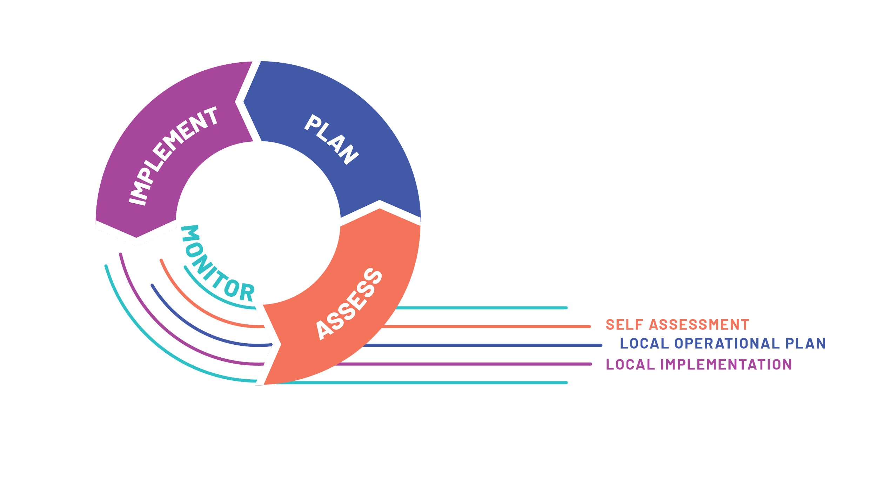
Local is where improvements happen
Local actions, national impact
The EVM assessment data and subsequent cIP actions are not abstract, they are based on local data points.
In order to create lasting change, we need to make plans and improvements at a local level and involve stakeholders from all levels.
Notes:
Create a local operational plan, implement it locally, conduct a self assessment and ask yourself: did I improve? If so, how much? If not, what did I do wrong? And then start again.

Slide 22
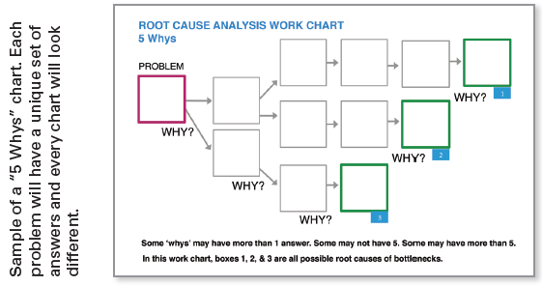
Identifying local root causes behind the data
Local actions, national impact
WHY?
WHY?
WHY?
WHY?
WHY?
1
The purpose of an root cause analysis is to find out what happened, why it happened, and determine what changes need to be made.
During a cIP working session, participants from each locality can help to interpret the results and dashboards — diagnosing both the root of the problem and the starting point for action.
PROBLEM
2
3
Notes:
Benefits of drilling down in data to local root causes.
The purpose of an root cause analysis is to find out what happened, why it happened, and determine what changes need to be made.
There can be several root causes behind each problem, including demand side factors, supply side factors, issues related to quality, and the enabling environment.
Each level of the supply chain, including subnational zones or districts, will have tailored inputs — and therefore tailored improvement actions.
The analysis must specify:
• The problem
• The root-cause of the problem – noting that there could be several root causes for an
identified problem, for example demand side factors, supply side factors, issues related
to quality, and the enabling environment
• Strategies to address the problem

Slide 23
WHY?
WHY?
WHY?
Insufficient funding allocated to procure vehicle spare parts
Many vehicles are broken down
Spare parts not available
1
Spare parts procurement process is not based on programme needs forecast
There aren’t any transport vehicles available to take technicians to health centres
There is a lack of vehicles for all programs
2
Other programs use the vehicles
3
No coordination among different programs on when vehicle can be made available to non-iSC technicians
4
Notes:
Benefits of drilling down in data to local root causes.
The purpose of an root cause analysis is to find out what happened, why it happened, and determine what changes need to be made.
There can be several root causes behind each problem, including demand side factors, supply side factors, issues related to quality, and the enabling environment.
Each level of the supply chain, including subnational zones or districts, will have tailored inputs — and therefore tailored improvement actions.
The analysis must specify:
• The problem
• The root-cause of the problem – noting that there could be several root causes for an
identified problem, for example demand side factors, supply side factors, issues related
to quality, and the enabling environment
• Strategies to address the problem

Slide 24
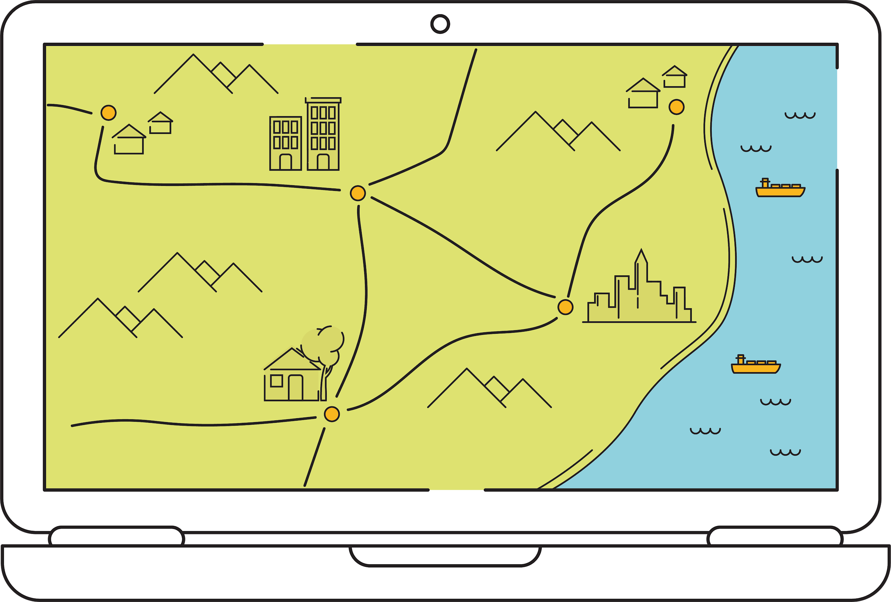
The result is a national health system strengthening
Local actions, national impact
Looking at both local root causes and national results encourages problems to be addressed at a health systems level, collaborating with other departments. The inclusive process ensures that planning for iSC is not carried out in isolation, but in conjunction with departments of financing, human resources, and information management systems.
Notes:
Ensures that planning for iSC is not carried out in isolation but in conjunction with the EPI programme and other government stakeholders at all levels, including subnational governance bodies, ministries of finance, departments responsible for human resources, and information and communication technologies.

Slide 25
Example: Including local stakeholders
Local actions, national impact
Sierra Leone flow of cIP workshop and techniques
Coopera-tive learning
SESSION 1
Strategic vision
Expert panel
SESSION 2
EVMA results
In Sierra Leone, administrative district chiefs were included in the cIP workshop. Their participation was critical to onboarding them in the discussions of priorities, strategies, and performance indicators. This provided both momentum and a broad starting consensus for the cIP.
Brain- storm
Group work
SESSION 3
Solutions to address iSC issues
SESSION 5
M&E of cIP implementation
Collabor-ative
dialogue
Group work
SESSION 4
Strategic activities (Roadmap)
SESSION 6
Coordination of cIP implementation
SESSION 7
cIP
Read the case study
Notes:
Full text: In Sierra Leone, the EPI organized a half-day workshop in Freetown for national and subnational
MoH and administrative chiefs from all districts. During the workshop, participants examined past EVM
performance and discussed how improvements along the six iSC essentials could improve availability,
quality, and efficiency of the immunization programme. In the end, participants had a clear vision and a
shared understanding of the EVM approach. The decision to include administrative district chiefs was
critical to onboarding them in the discussions of priorities, strategies, and performance indicators,
particularly in this context where subnational EPI staff are subordinate to the administrative district
chain of command. A month later, after a new EVM assessment report was presented, there was already a
broad consensus – and a momentum – for developing a cIP that was subsequently linked to the Gavi HSS
financing process.

Slide 26
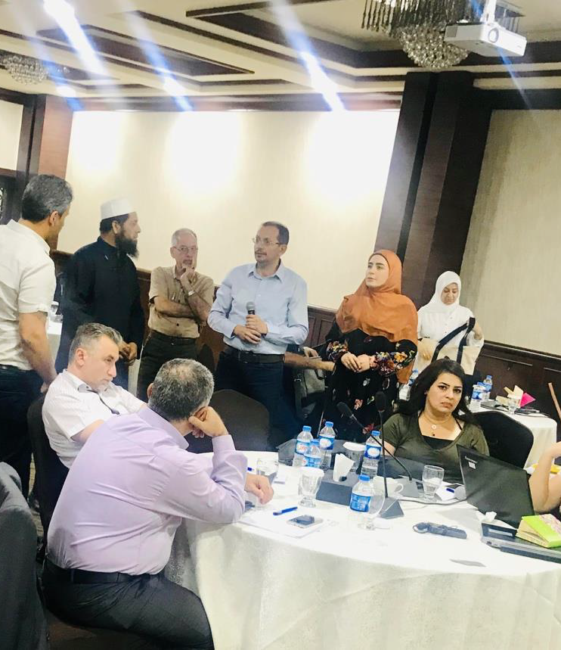
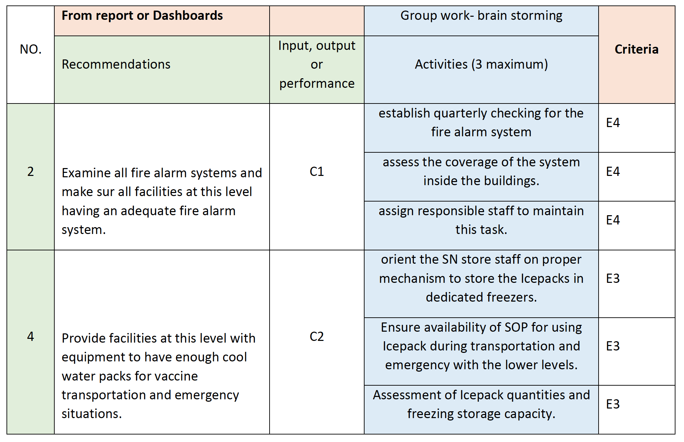
Example: Tailoring the template
Situation analysis sheet
Group work template
cIP zones/ country
cIP for each subnational zone
Target assessments comparison Sheets (2020,2021,2022)
Cov per year
Local actions, national impact
The Iraqi improvement plan development was designed to be a bottom-up practice where all governorates in any particular zones take the initial action plan and further localize based on their needs, capacities, and resources.
Governorates identified the timeline, allocation of support, and monitoring mechanism to address each gap.
Read the case study
Notes:
The team in the country took the initial draft of the tool presented by UNICEF- HQ experts and further developed to fit the Iraqi context and the country vision of how should exercise elaborate.
The cIP template was designed as an Excel format in six sections.

Slide 27
The continuous improvement process enables individuals to formulate their goals and track their progress as well as improving the iSC at a national level.
Local actions, national impact

Slide 28
Managing the cIP process
3
FOR THE CMT TRAINING ONLY

Slide 29
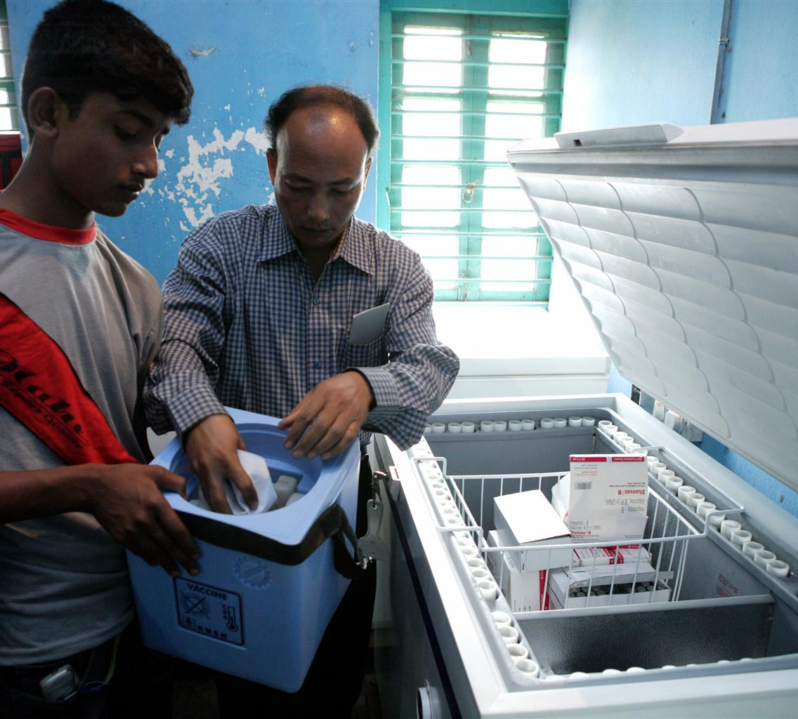
Commit to a cIP plan
The cIP process
“Timeliness is key. Make sure you build your cIP at the right time. Don’t miss out on [financial] opportunities .”
Time is a strategic instrument to align team energy, ability and funding.
Key timing considerations:
Consider funding opportunities during the initial planning process to ensure the cIP is ready before important dates.
Avoid doing the cIP right after the EVMA - participants will be exhausted and will not be able to give it the attention it requires.
Avoid waiting too long after the EVMA to build the cIP - findings should still be relevant and people should still be motivated.
Notes:
Time is a strategic instrument to align team energy, ability and funding.
Getting the timing of the cIP right is essential to maintain momentum and benefit from funding opportunities.
Initial recommendations:
Avoid doing the cIP right after the EVMA - participants will be exhausted and will not be able to give it the attention it requires.
Avoid waiting too long after the EVMA to build the cIP - findings should still be relevant and people should still be motivated.
Consider funding opportunities during the initial planning process to ensure the cIP is ready before important dates.

Slide 30
Set key milestones for the full process
Preparation Milestones
Finalise country set-up (vaccine schedule, location)
Prepare and agree on budget
Prepare and schedule the Facilitator Training and Assessor Training
Formalize the cIP governance
Preparation Milestones
Practice during Assessor Training
Practice assessment 2
Practice assessment 3
Conduct a landscape analysis
Train stakeholders on data analysis
Assessment Milestones
Prepare and schedule the National Assessment
Launch the National Assessment
Close the National Assessment
Debrief the National Assessment
Plan/Implement/Monitor Milestones
Analyze the data
Schedule a cIP working session
Determine the cIP template + roadmap
Distribute and socialize the cIP improvement plan
Plan to monitor (through targeted assessments)
Behind an EVM assessment
“With the EVMA you have diagnosed the problem, right after if you are not treating it, then you are not treating the right thing anymore.”
Below are example milestones. Consider the following necessary activities, and how they need to be adapted based on your country’s needs and the objectives.
PREPARATION
ASSESS
PLAN
IMPLEMENT
MONITOR
Notes:
For a clear step-by-step of the full process, refer to the EVM Manager guide.
Flexible timeline: For example, location may assess private sector in parallel to public – but not everyone will do this. Depends on the objective the program wants to achieve. Show options to consider, and how they link to an improvement plan and understanding what is happening in a particular cluster.

Slide 31

Formalize the cIP governance
The cIP process
“Make sure you have the full involvement of the key stakeholders who need to support the process. If you need someone to help you implement, make sure they understand what EVM is and what you will need from them.”
PREPARATION
To build a cIP successfully, important stakeholders must be part of the process from the beginning, to build their knowledge, buy-in and commitment to the initiative.
Include stakeholders who hold interest, decision-making power, and important leadership positions.
Think about institutional partners, technical partners, members of the administration and of the government.
The CMT has ownership of the process — consultants should guide and support country teams, not lead.
At each phase, involve participants from different levels to get the benefit of their diverse perspectives: national, district, and facility levels.
Notes:
The key point here is that for the cIP workshop to be a success (all tasks agreed and signed-off) all the key decision-makers need to be in the room.
Transferring ownership to a country requires breadth and depth in stakeholder selection.
To build a cIP successfully, important stakeholders must be part of the process from the beginning, to build their knowledge, buy-in and commitment to the initiative.
Initial recommendations:
At the very beginning of the process, take time to identify key stakeholders. Include those who hold interest, decision-making power, and important leadership positions.
Build a Country Management Team and encourage them to take ownership of the process — consultants should guide country teams, not lead.
At each phase, involve participants from different levels to get the benefit of their diverse perspectives: national, district, and facility levels.

Slide 32
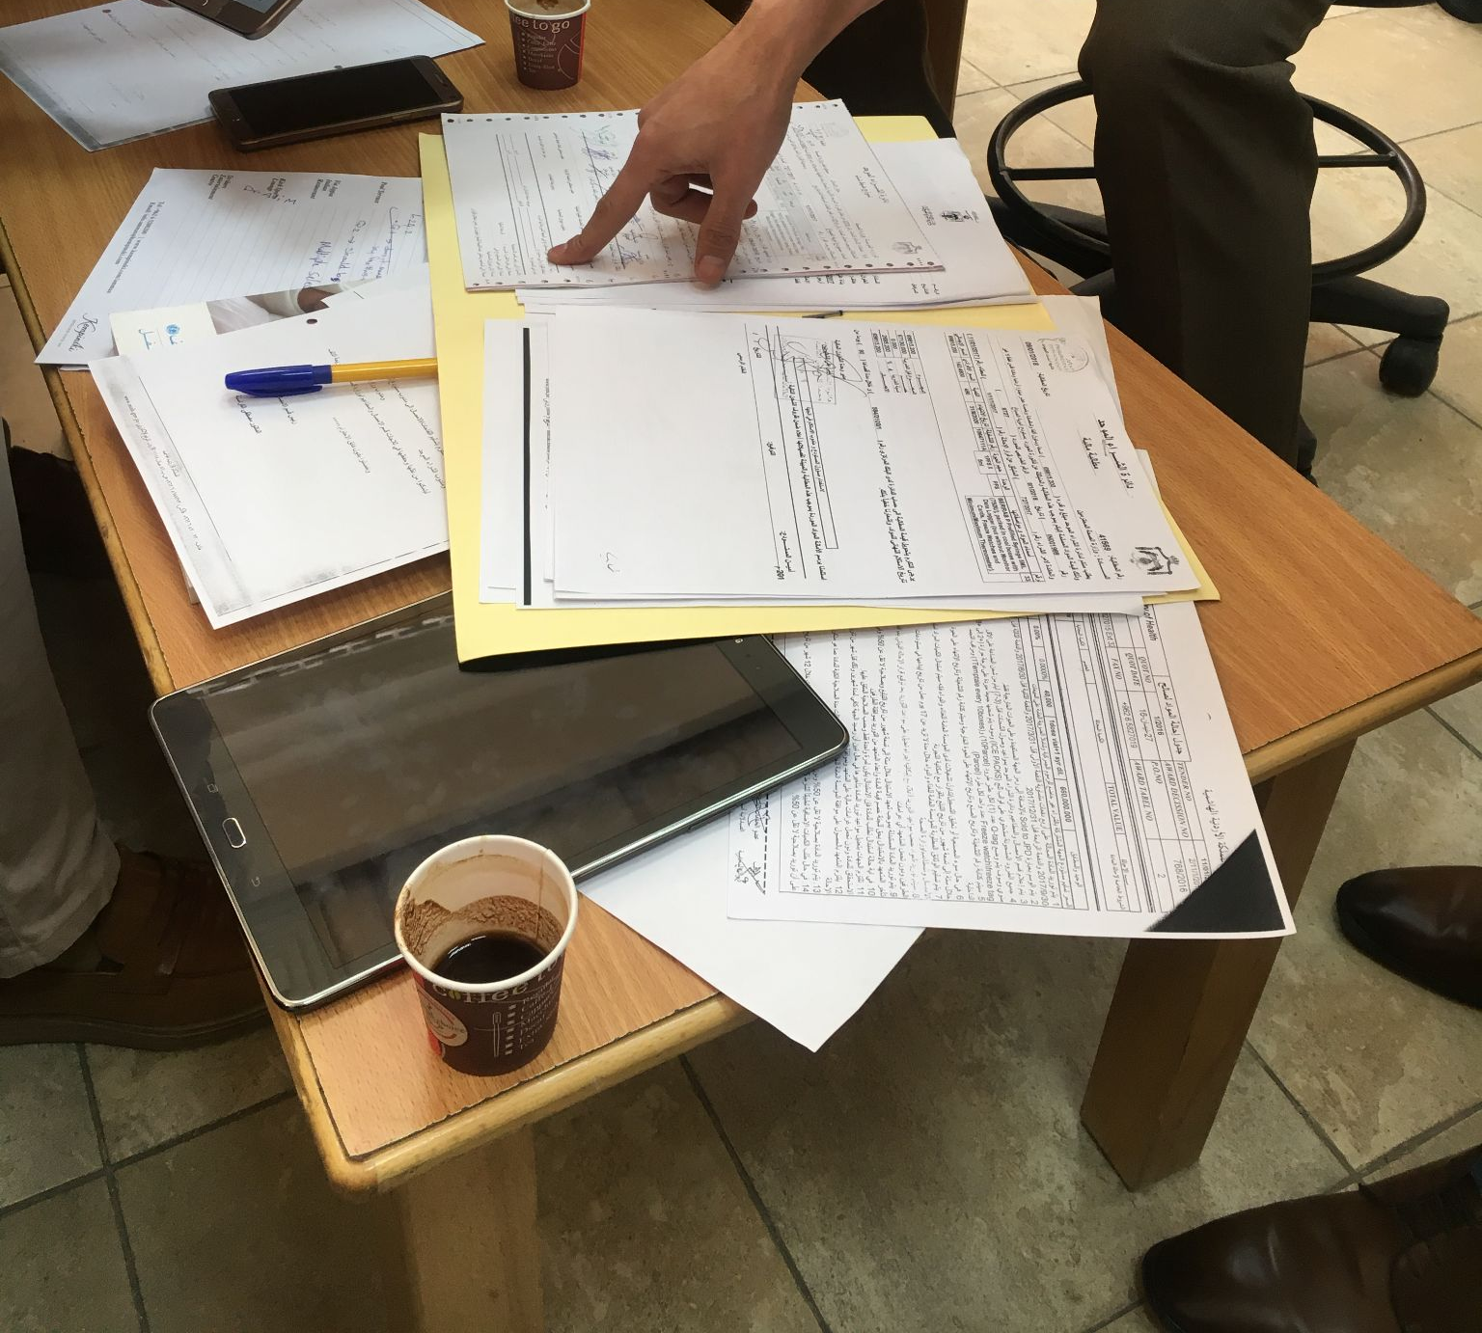
Conduct a landscape analysis
The cIP process
“Come up with a plan that is not siloed but integrated with the major planning processes and planning documents. Look at the past, the present and the future of the country.”
PREPARATION
A successful cIP strengthens the supply chain system as part of the larger health system. To do that, the cIP must consider and align with all the major planning documents. Throughout the cIP process, reference and refer to national improvement strategies and documents.
Conduct a landscape analysis including HSS documents and other relevant assessments/studies.
Review global, regional and national planning documents.
Notes:
For country teams to feasibly implement a strategic plan, it cannot be a separate work stream.
A successful cIP strengthens the supply chain system as part of the larger health system. To do that, the cIP must consider and align with all the major planning documents. Throughout the cIP process, reference and refer to national improvement strategies and documents.
Initial recommendations:
During the landscape analysis review global, regional and national strategy documents: the GAVI plan, the national health strategy, the cMYP, the immunization plan, national HR plans, etc.
In addition to the EVMA, the cIP should be based on other assessments and studies: cold room mapping studies, temperature mapping studies, culture inventories, health sector development plans, system design studies, etc.

Slide 33
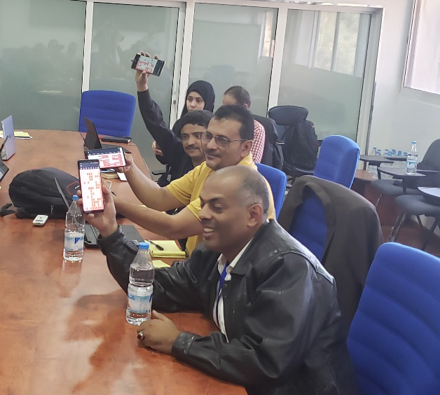
Train stakeholders on data analysis
The cIP process
“If we don’t understand the data then we don’t understand the practical problem, and then we are not solving the right issue.”
PREPARATION
In order to move from assessment to strategic plan, in-depth analysis of the data is imperative — and EPI experts have varying fluency in data analysis. Accurately understanding what the data reveals ensures that the right problems are solved.
Train stakeholders in data analysis and translating root causes into actions.
Augment the EVMA training with a half-day committed to introducing how data can be contextualized and applied to the cIP.
Notes:
While new tools can be of great help, the contextualization and interpretation of data must still be done on the ground.
In order to move from assessment to strategic plan, in-depth analysis of the data is imperative — and EPI experts have varying fluency in data analysis. Accurately understanding what the data reveals ensures that the right problems are solved.
Initial recommendations:
At the end of the EVMA training, add a half day to introduce the concepts and inputs of the cIP to the team who will be working on it at a later stage.
After data collection, hold a 3-day interactive working session for stakeholders from all levels to gain a clear understanding of the underlying, systemic problems and contribute possible solutions.
During the working session, assign clear deliverables to breakout groups to ensure everyone contributes.

Slide 34
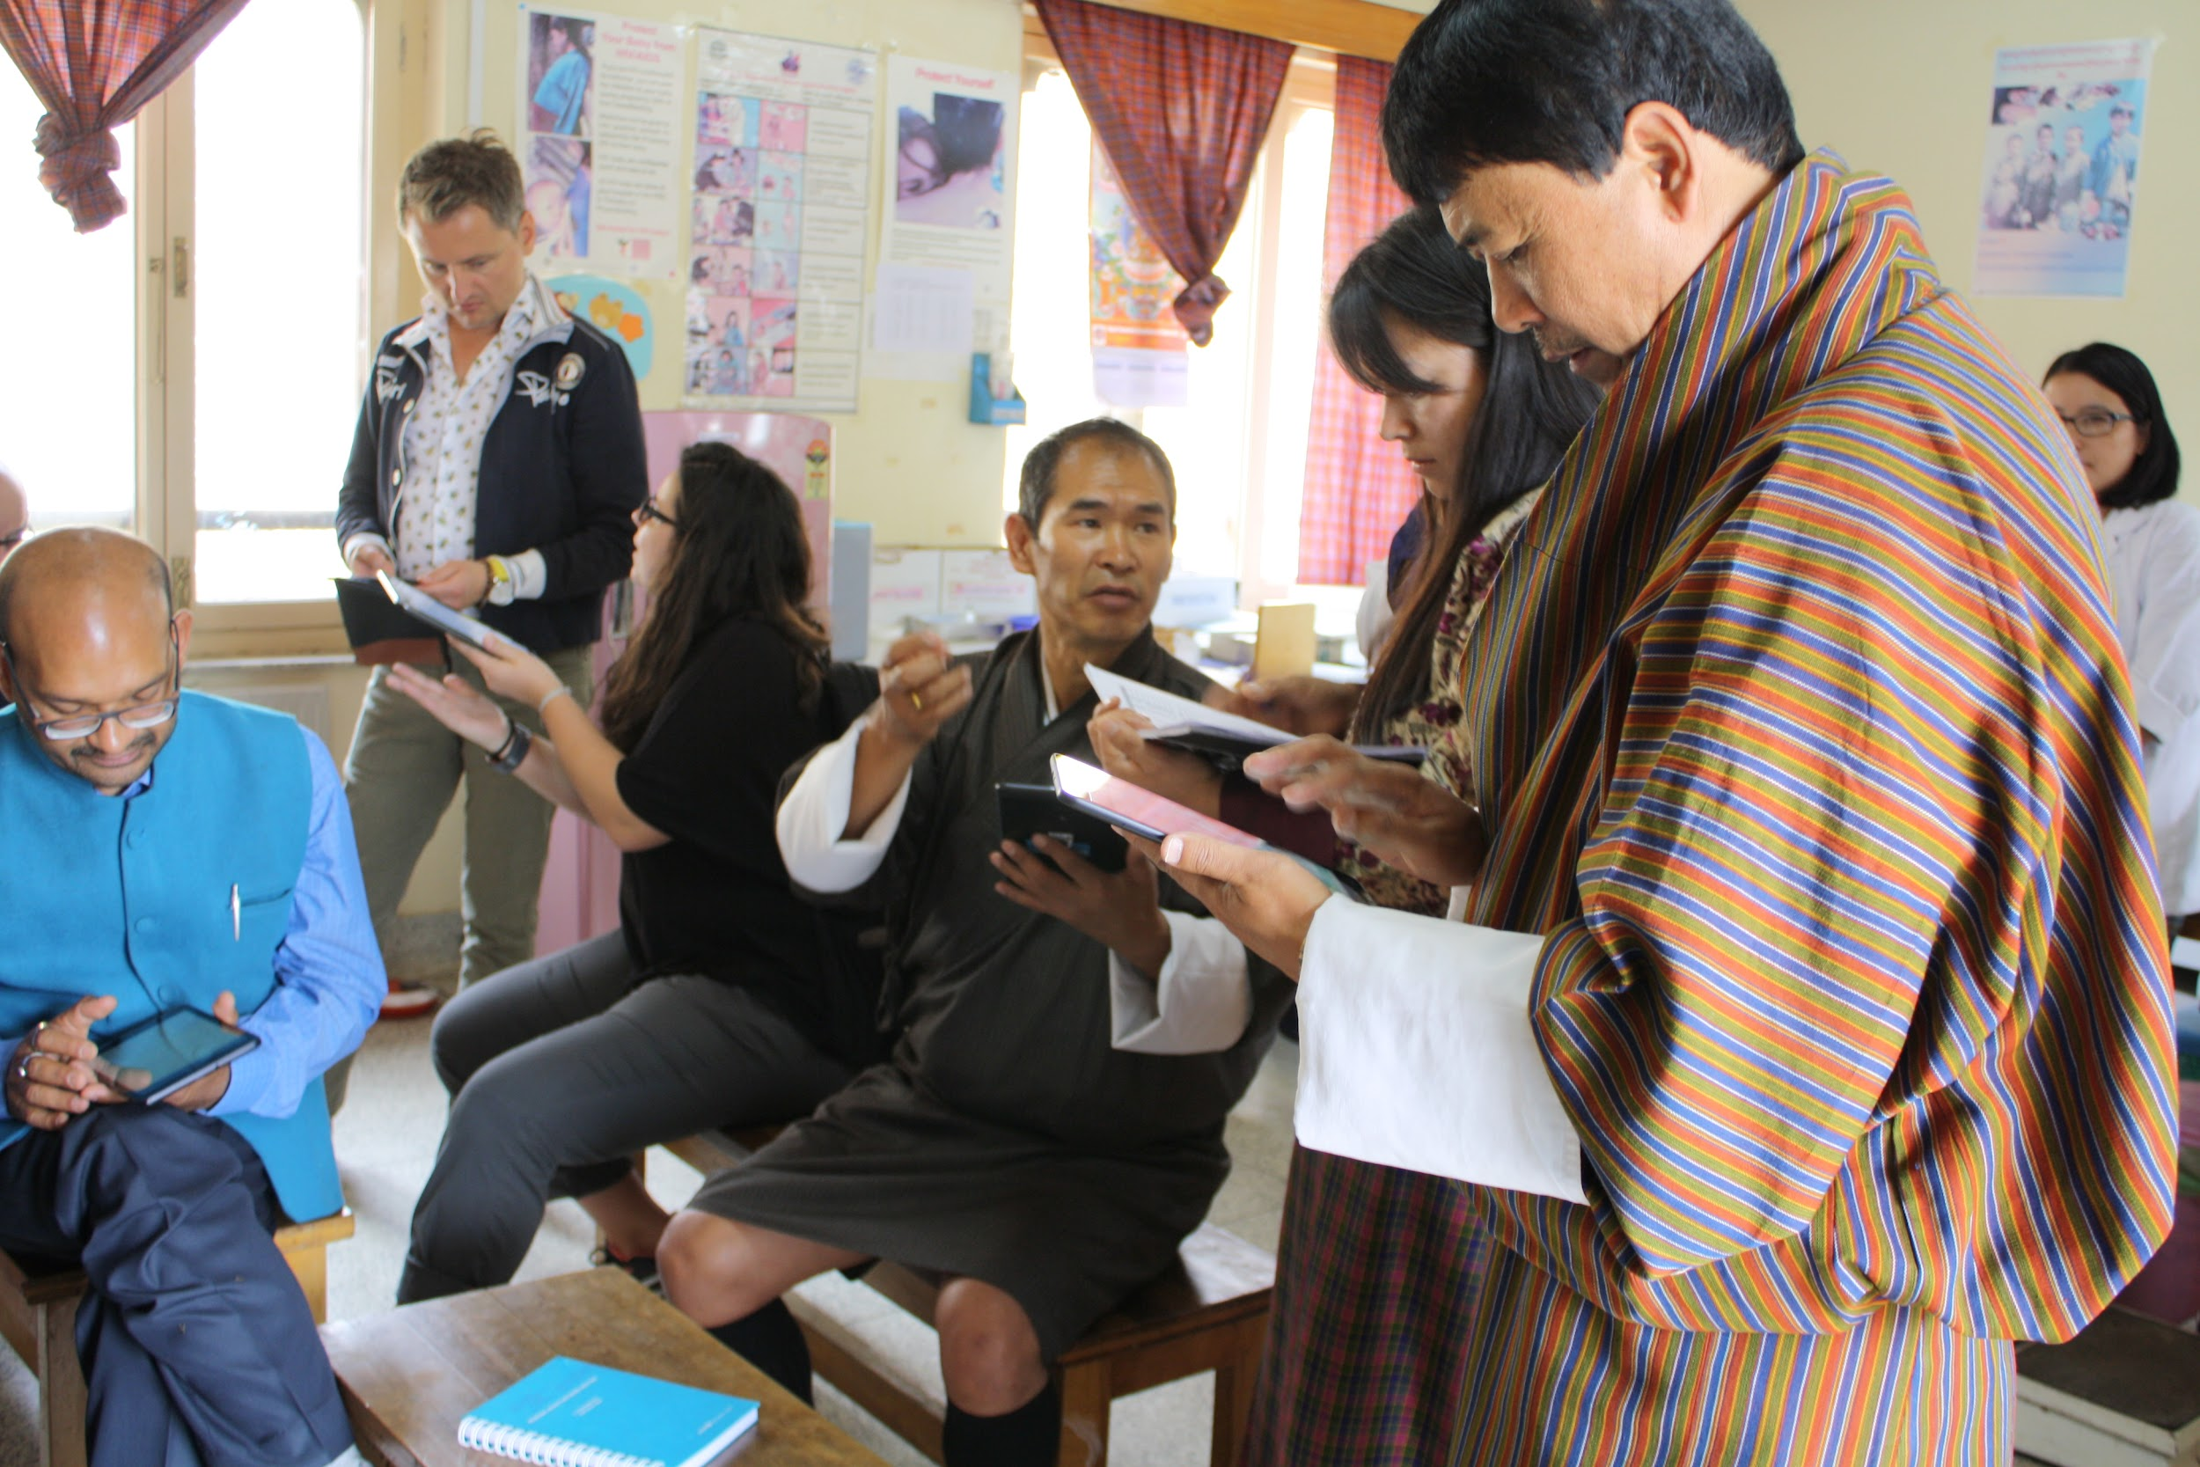
Complete the assessment
The cIP process
ASSESS
Having reliable and local assessment data is a crucial part of the EVM initiative.
Launch the assessment — usually this is a national-level assessment, but it is possible to start smaller (targeted assessments) if the country is not due for a national assessment.
Collate the collected data — this
“If we don’t understand the data then we don’t understand the practical problem, and then we are not solving the right issue.”
Notes:
While the assessment is a crucial part of the EVM initiative, the ultimate goal of the initiative is for countries to improve their national iSC and maintain solutions for years to come.
Initial recommendations:
Incorporate the cIP concept at the very beginning of the planning process.
Introduce the cIP as the objective of the EVM initiative.
Continue to show how the cIP is connected to the assessment throughout the process.

Slide 35
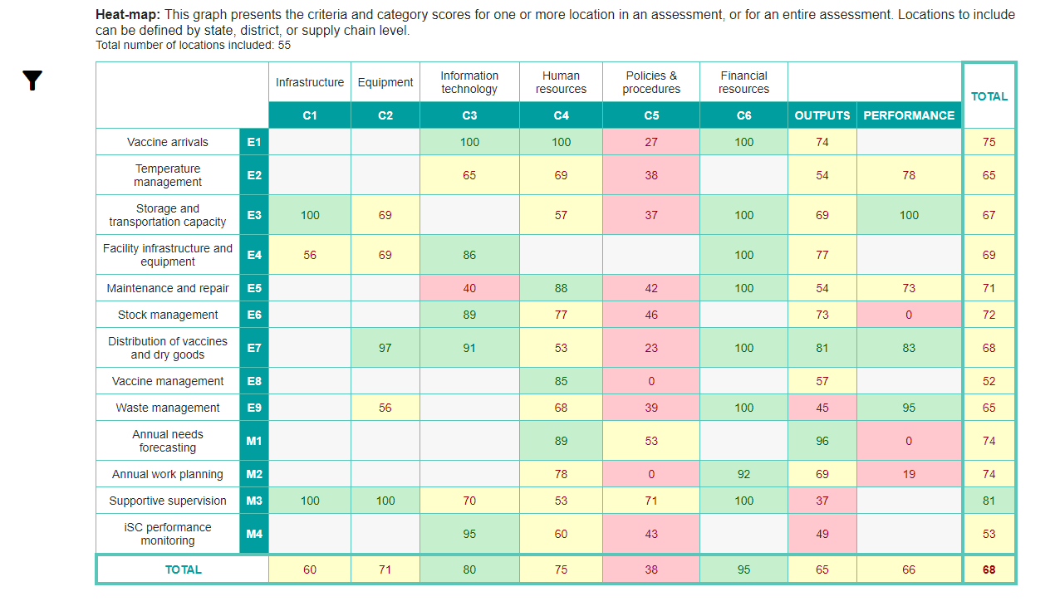
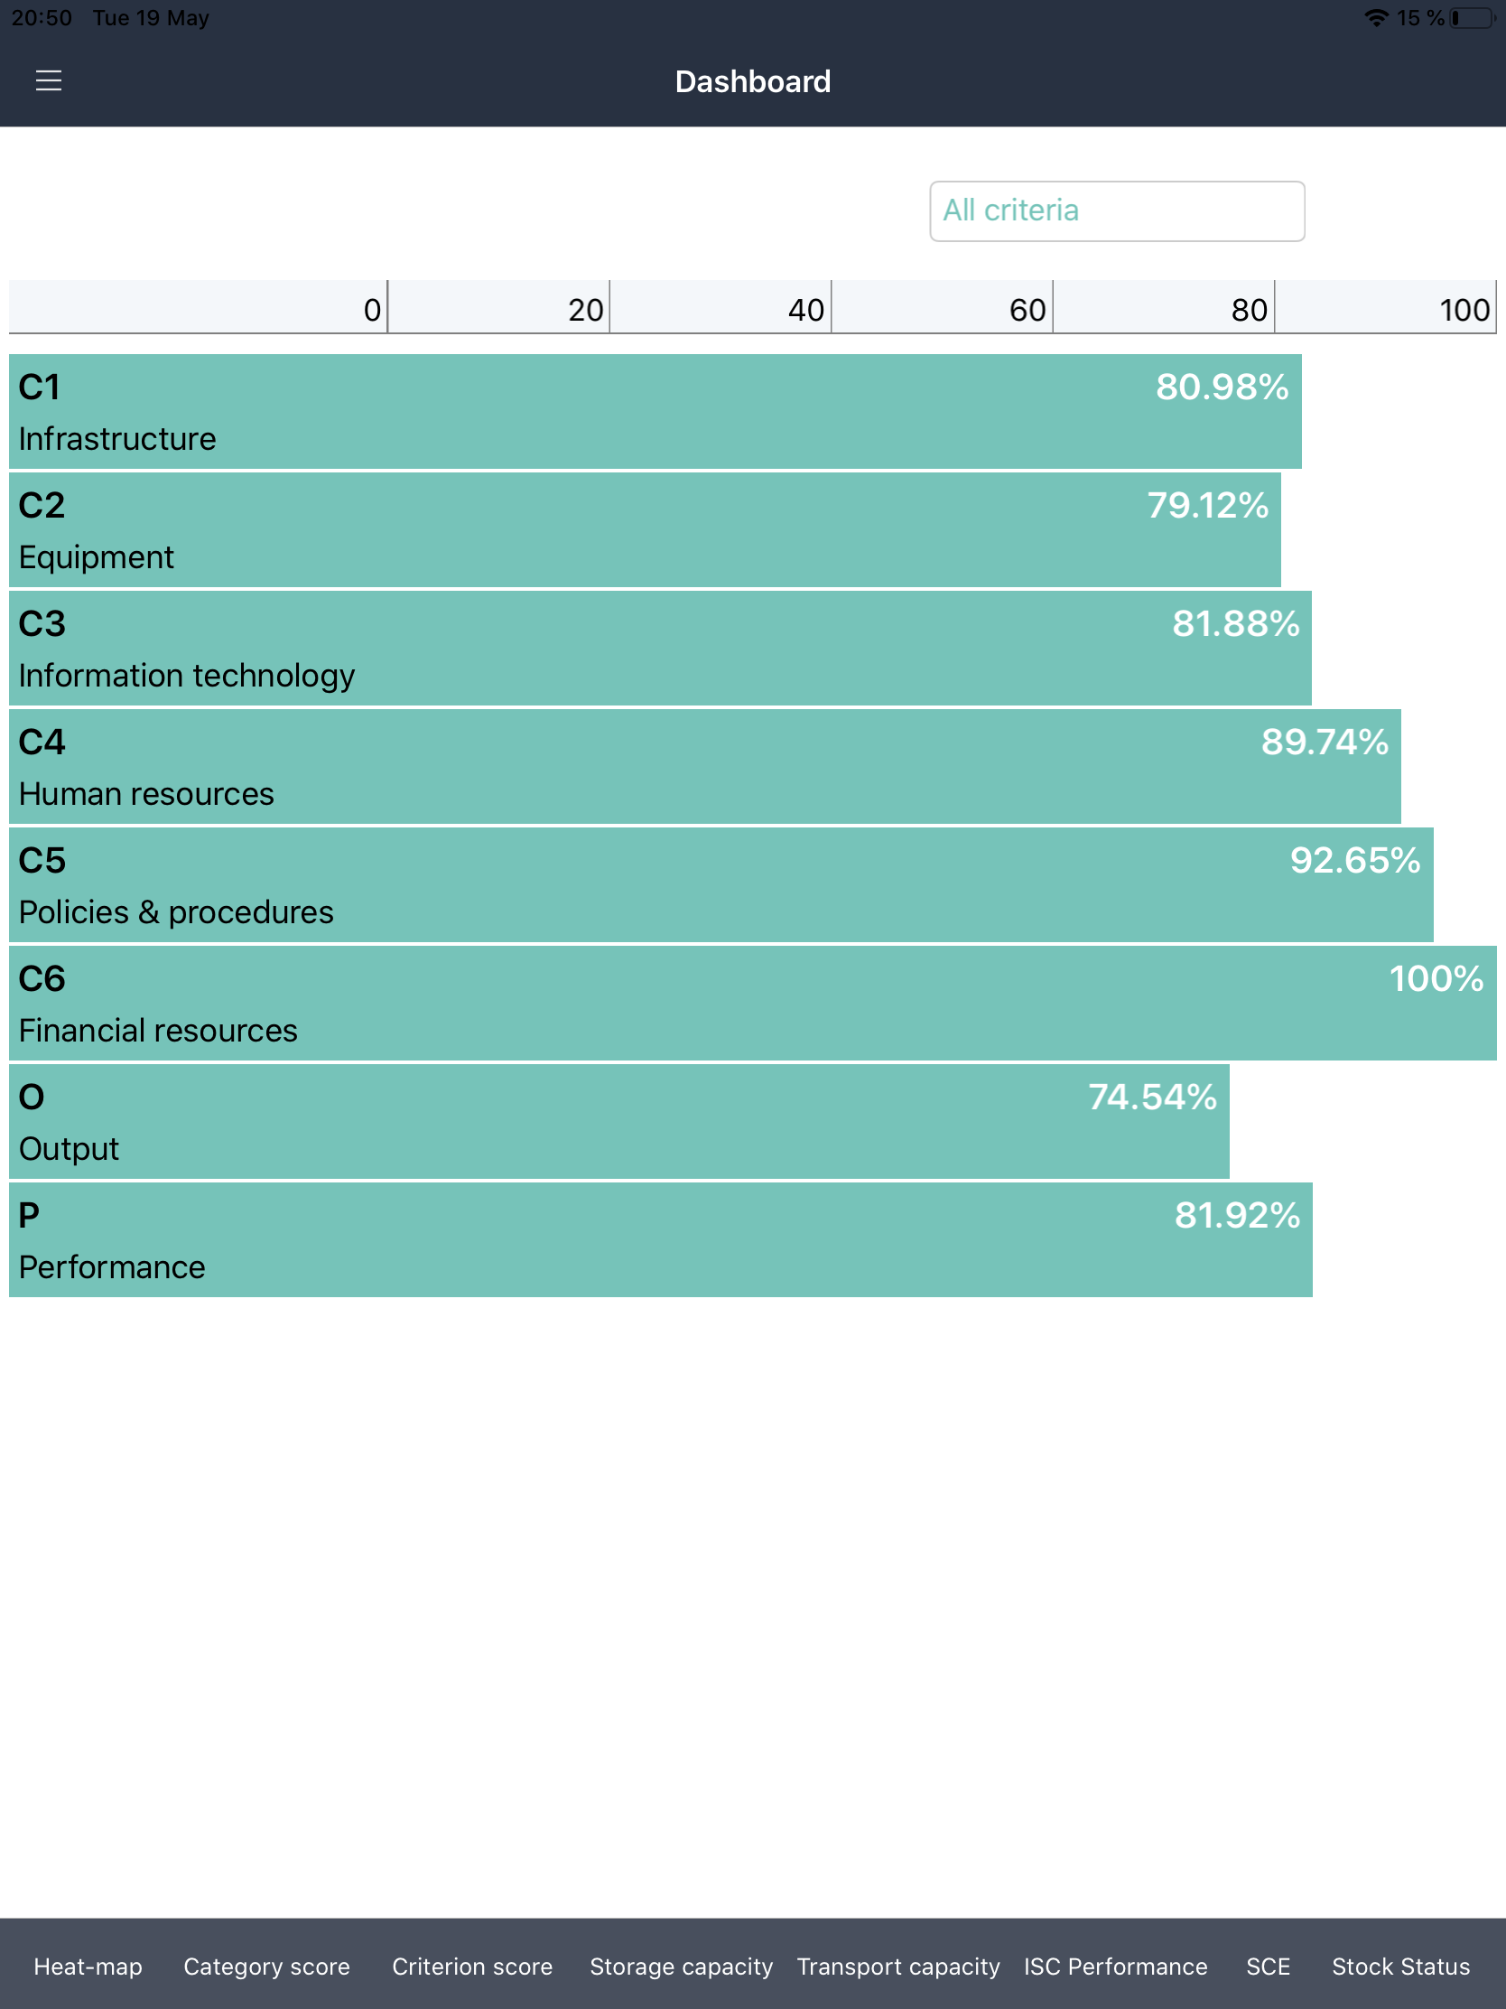
Analyze data
The cIP process
ASSESS
The built-in data visualization and analysis capabilities provide a solid evidence base to investigate root causes driving challenges.
Use one of the reports available on the EVM website to analyze the EVM assessment results.
Prepare a short starting explanation what the numbers reveal about the iSC

Slide 36
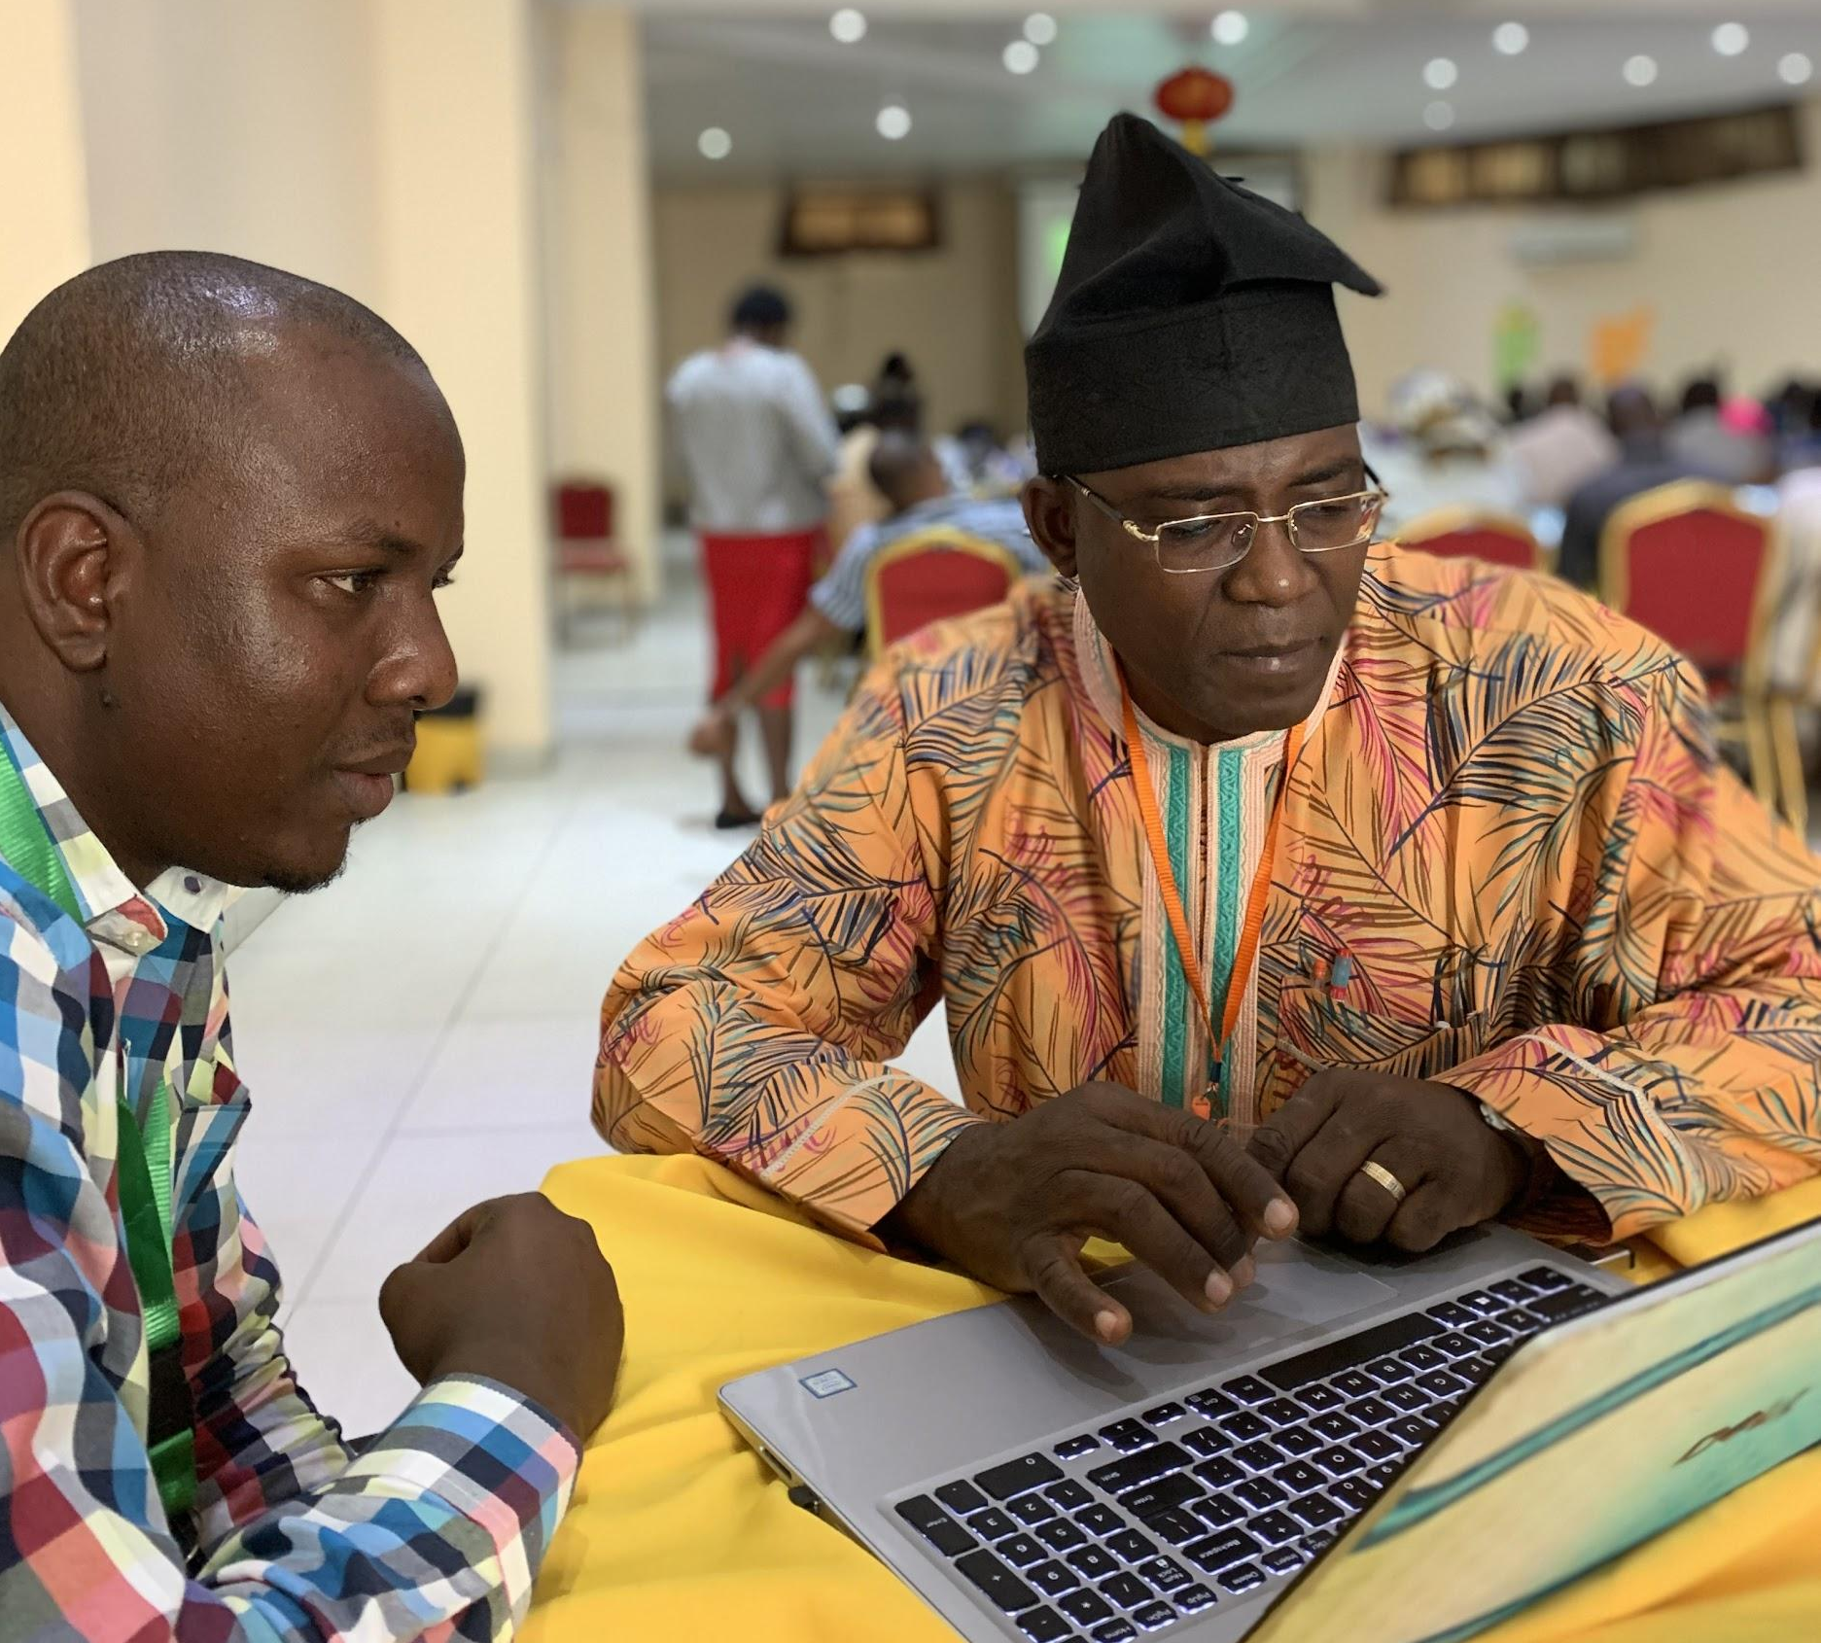
Determine the cIP template + roadmap
The cIP process
“Don’t stick to a template. Use what works for your country.”
PLAN
Countries and contexts are different. What works in one place does not necessarily work everywhere. Build an operational plan based on the outcome of the training.
Use the cIP guidance document as a starting point.
Review the reference cIP template and templates from other countries.
Develop the template and format that works best for your challenges.
Define activities, budget, timing, roles and monitoring framework.
Involve stakeholders who will be using the template in its design to avoid confusion and complications at a later stage.
Notes:
Transferring ownership to a country requires breadth and depth in stakeholder selection.
To build a cIP successfully, important stakeholders must be part of the process from the beginning, to build their knowledge, buy-in and commitment to the initiative.
Initial recommendations:
At the very beginning of the process, take time to identify key stakeholders. Include those who hold interest, decision-making power, and important leadership positions.
Build a Country Management Team and encourage them to take ownership of the process — consultants should guide country teams, not lead.
At each phase, involve participants from different levels to get the benefit of their diverse perspectives: national, district, and facility levels.
Agree on discussion related to the proper way of developing the plans, the costing techniques, the Bottom- up approaches, and the monitoring frameworks
draft of cIP without timeliness and resources evaluations
After the completion of zones template based on the results of the EVMA assessments, it was agreed that governorates will have this draft and to be familiarize with the content before the main workshop
From DD: template that is not strict in the formatting. Give a starting point (summary of key elements at the end or beginning - non negotiables). Rigid table (ex: realistic KPIs, iSC perf indicators). While at the same giving space for tailoring.

Slide 37
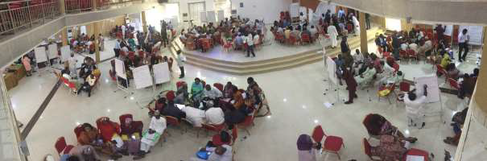
Schedule a cIP workshop
The cIP process
The process of collaboration during a workshop is invaluable to spread ownership, common understanding and capacity to both envision and administer improvements.
PLAN
The cIP workshop is a multi-day, interactive process
where stakeholders review the situation analysis in depth, conduct a rapid assessment of root causes, and define the 5-year vision, goals, objectives, strategies and KPIs to achieve iSC goals.
Ideally set aside 3 days
Invite all stakeholders who have been part of the process since the beginning
Include small group sessions to gain a localized perspective and plenary sessions to contextualize the root causes and bottlenecks
Develop a system of solutions and responses
Gain commitments and goodwill for action
Notes:
The cIP workshop is the occasion to:
• Create a common understanding and language around iSC, and increase outreach, by cocreating
and spreading important ideas among stakeholders.
• Exchange knowledge and synthesise ideas: iSC experts educate those who know less and
raise awareness of global iSC best practices and evidence. Equally, it is the occasion for
country stakeholders to share good practices and experiences that may not have been
widely publicized. Sharing of knowledge helps synthesise new ideas and visions.
• Network and build alliances: the workshop can create or reinforce social connections
that can be instrumental to iSC improvements.
• Cross-pollinate: participants involved in one part of the system, or at different levels find
out what is happening elsewhere and can understand and help with potential
bottlenecks or replicate good practices.
• Strategize and scenario-plan: the workshop can help generate solutions to dilemmas
held by multiple participants, and envision possible futures and how to respond.
• Commit: your workshop is likely to create goodwill for action! It is therefore key to build
the momentum.

Slide 38
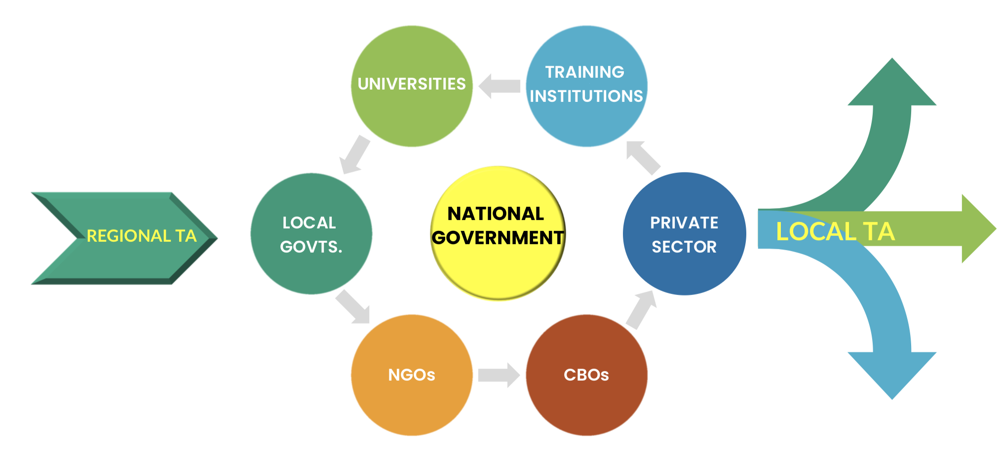
Develop the TA model
The cIP process
“The C stands for continuous. Make sure you review and make necessary changes to your cIP regularly.”
PLAN
The cIP is meant to be regularly reviewed and amended. If the process is too onerous, or the report is only created to fulfill a funding requirement, the goal of ‘continuous’ becomes a reality of ‘starting over’ every 5 years.
Once the improvements that must be implemented and monitored are clear, create a tailored TA model to develop the cIP and accompany its roll-out.
Notes:
involved a national strategic dialogue to ensure political buy-in and an accountability
the purpose of the TA model – to make it easier to repeat

Slide 39
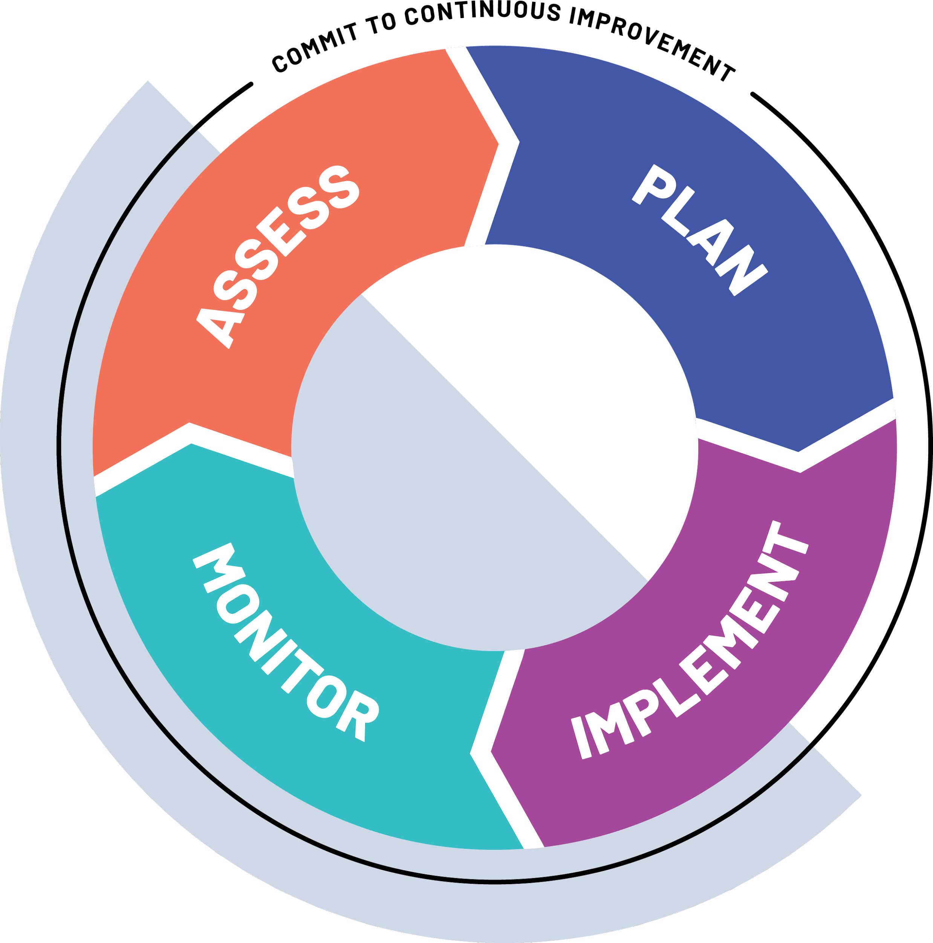
Track progress over time with targeted assessments
The cIP process
MONITOR
Track and monitor implementation bottlenecks and examine the impact of cIP activities
Make time to conduct follow-up targeted assessments every 3-6 months to track progress between national assessments
Adjust action items according to findings
Notes:
An important distinction is that the cIP is not only a document – but also an adaptive process that uses the capability of targeted assessments to be agile beyond 5-year plans and 1-year check-ins.

Slide 40
Planning for continuous improvement from the onset ensures that the work of data collection achieves its full potential of health system strengthening.
Local actions, national impact

Slide 41
Continuity through local actions
4
FOR THE CMT TRAINING ONLY

Slide 42
Leading and facilitating change is an adaptive challenge — country managers must tailor their response to meet their goals.
Local actions

Slide 43
Gateway to improvement
Local actions
Create assessment
After a full national assessment, targeted assessments can be used as a self-assessment: Facilities can use the app to review their practices, equipment and knowledge make improvements at the ground level.
Full
Type
Targeted
Notes:
Keeping momentum after the national assessment
It was explicitly designed for self-assessments by national staff
helps to build capacity prioritize capacity + continuity as the gateway to improvement

Slide 44
Local actions
Assessment parameters can be configured to meet the needs of a country:
Full: use random site selection
Targeted: pick individual locations
National: include all locations in site selection
Subnational: only include locations in specific administrative units (AUs)
Single: make a single random site selection
Multiple: make separate random site selections for each AU
All: All EVM requirements
Partial: Focus on a subset of requirements
Type
Create assessment
Full
Type
Targeted
Range
National
Range
Subnational
Sample
Multiple
Sample
Single
All
Scope
Partial
Scope
Required for validation by EVM Secretariat
Internal EVM self-assessment

Slide 45
Example rollout: Full national and targeted assessments working together
Assessor training and practice: targeted assessment
Conduct full national assessment with representative sample
Complete National cIP Plan with priorities for improvement
Continue monitoring at district or facility level through targeted self- assessments
Contribute to Annual Improvement Plan with targeted interventions
Every 5 years, examine how facility-level improvements affect the full national assessment score
Preparations:
CMT workshop
Facilitator training
Country set-up
Local actions
Year 1
Year 2
Year 3
Year 4
Year 5
Year 6

Slide 46
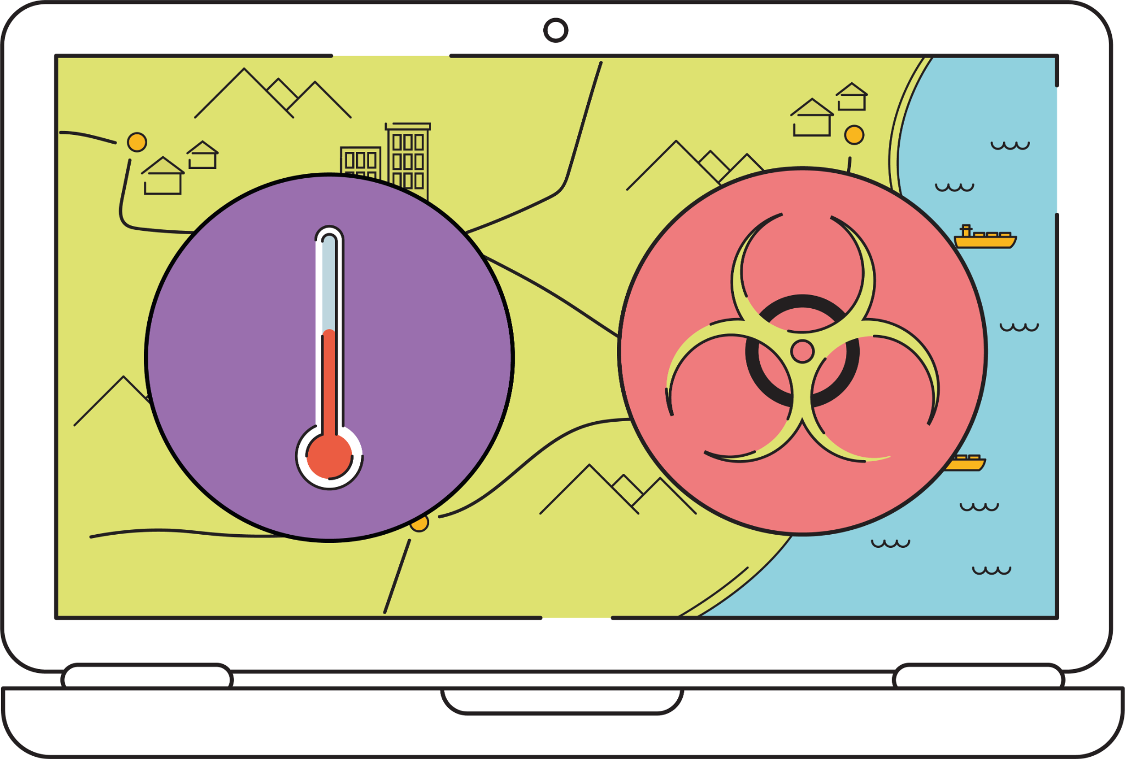
Using targeted assessments
Local actions
When an EVM Report is generated, it helps the country team assess strengths and weaknesses in their current supply chains and gives them the data to develop a case for supply chain investment. They can prioritize and implement a set of interventions that improve the supply chain and continue to monitor their progress against performance metrics until the next national assessment in 5 years' time.
During this period, the country team may use EVM for targeted assessments to deep-dive into geographical contexts, or specific criteria like temperature and waste management. And, finally, by carefully planning and prioritizing actions based on these results, they can expect improved systems performance at a country level when the next national EVM assessment is conducted.

Slide 47
Year 1: full national assessment + cIP
Benefits include:
Address what needs to be improved in the iSC
Task driven view includes small core team
Top-down knowledge management
Validation by EVM Secretariat
Local actions
1
The representative sample size of a full national assessment collects the data needed to form the national cIP.

Slide 48
Years 2-5: Implement then monitor through targeted assessments
Local actions
2
Benefits include:
Assess individual facilities that were not part of national sample
Address how a country needs to be able to improve the iSC
Systemic view includes network of partners
Local knowledge management
Emphasizes dynamic skills and sustainability by building/training local networks
Implement tasks defined in the cIP and then monitor their effectiveness through targeted assessment.
To spread knowledge and maintain both equipment and best practices, facilities can conduct self-assessments or districts/regions can use a subnational representative sample.
Notes:
all facilities. each piece of the machinery gets the same attention. facility level (sample size 1), district level (representative sample), regional level, national level...
Selling capacity dev and learning app.
Targeted assessment --> annual work plans (vs cIP).

Slide 49
Quick exercise
cIP rollout

Slide 50
Exercise: In groups, sketch the ideal sequence and dates for your EVM + cIP rollout
Preparation Milestones
Finalise country set-up (vaccine schedule, location)
Prepare and agree on budget
Prepare and schedule the Facilitator Training and Assessor Training
Formalize the cIP governance
Preparation Milestones
Practice during Assessor Training
Practice assessment 2
Practice assessment 3
Conduct a landscape analysis
Train stakeholders on data analysis
Assessment Milestones
Prepare and schedule the National Assessment
Launch the National Assessment
Close the National Assessment
Debrief the National Assessment
Plan/Implement/Monitor Milestones
Analyze the data
Schedule a cIP working session
Determine the cIP template + roadmap
Distribute and socialize the cIP improvement plan
Plan to monitor (through targeted assessments)
cIP Rollout
PREPARATION
ASSESS
PLAN
IMPLEMENT
MONITOR
Q1
Q2
Q3
Q4

Slide 51
Congratulations on completing module 11!
‹#›

