Slide 1
Integrate Your Amazon Lex Chatbot with Any Messaging Service
Ahmad R. Khan
May 15, 2017

Slide 2
Overview
“Alexa, What is Amazon Lex?”
Amazon Lex Built-in Integrations
Need for Custom Integrations
Going Serverless (AWS Lambda & Amazon API Gateway)
Teach Your Bot How to Text with Twilio SMS
Can we talk? Adding Support for Voice

Slide 3
The Need for Amazon Lex
Conversational Interface
Graphical User Interface
Amazon Lex

Slide 4
Text and Speech Language Understanding
Speech
Recognition
Natural Language
Understanding
Powered by the same Deep Learning technology as Alexa

Slide 5
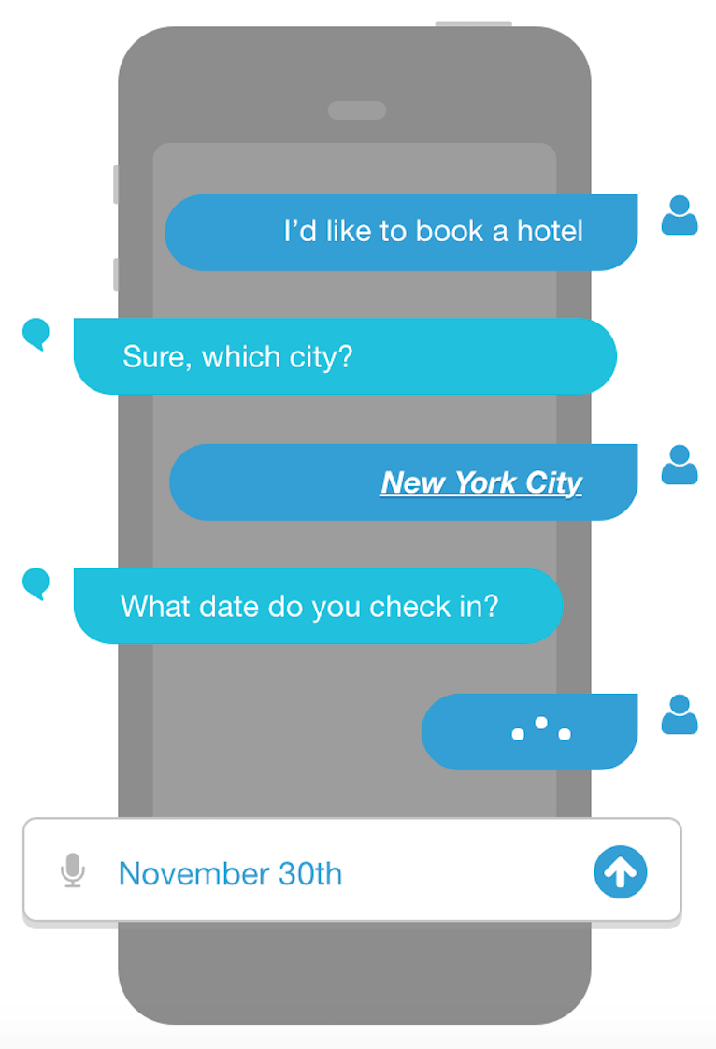
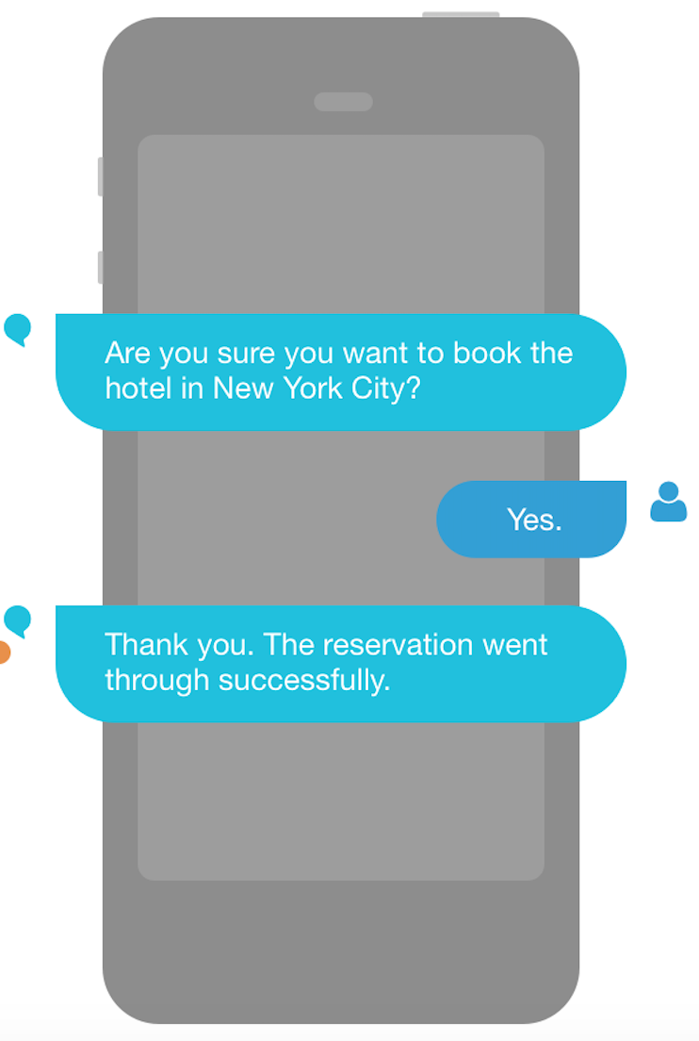
Lex Bot Structure
Intents
An Intent performs an action in response to natural language user input
BookHotel
Utterances
Spoken or typed phrases that invoke your intent
Slots
Slots are input data required to fulfill the intent
Fulfillment
Fulfillment mechanism for your intent

Slide 6
“Book a Hotel”
Book
a
Hotel
Hotel Booking
in
NYC
New York City
“Book a Hotel in
NYC”
Automatic Speech Recognition
Natural Language Understanding
Intent/Slot
Model
Hotel Booking
City | New York City
Check In | Nov 30th
Check Out | Dec 2nd
Utterances
“Can I go ahead with the booking?
Amazon Polly
Confirmation: “Your hotel is booked for Nov 30th”
“Your hotel is booked for Nov 30th”

Slide 7
AWS Lambda
Serverless, event-driven compute service
AWS Lambda = microservice without servers

Slide 8
Components of AWS Lambda
An AWS Lambda function (that you write)
An event source
The AWS Lambda service
The function networking environment

Slide 9
Amazon API Gateway
Fully Managed Service for Your APIs
Create
Configure
Publish
Maintain
Monitor
Secure

Slide 10
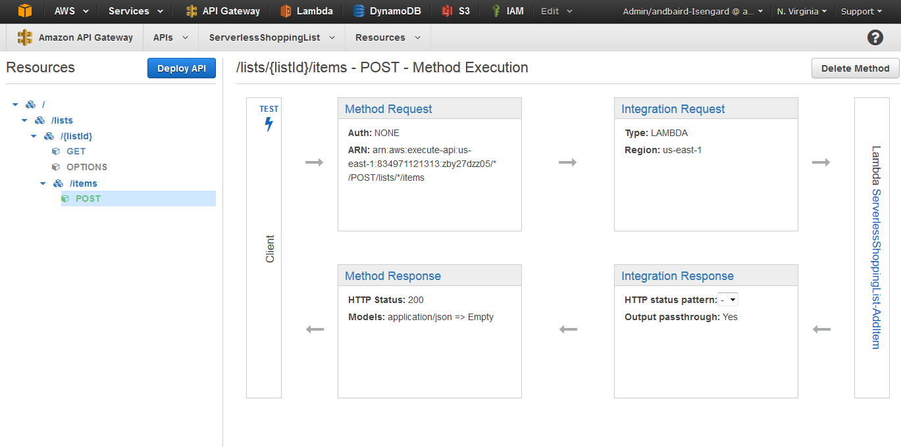

Slide 11
Integrating Amazon Lex with Twilio SMS

Slide 12
Architecture / Message Flow
1
2
3
4
End User
Twilio Programmable SMS
Amazon API Gateway
Lambda Function
Amazon Lex
5

Slide 13
Multi-Bot Design
Amazon DynamoDB
user-id | current-intent | bot | ttl
867-5309 | BookCruise | Cruise-Booking | 1494013599
“Cruise-Booking” Bot
“I want to book a cruise”
“Concierge” Bot
End User
Multiple Messaging Services
Amazon API Gateway
AWS Lambda Function
“Flight-Booking” Bot

Slide 14
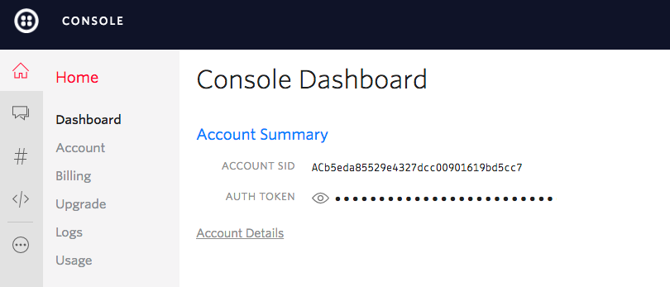
#1: Setting up a Twilio Phone Number
https://www.twilio.com/try-twilio

Slide 15
#2: IAM Policy & the AWS Lambda Function
{
"Version": "2012-10-17",
"Statement": [
{
"Effect": "Allow",
"Action": [
"logs:CreateLogGroup",
"logs:CreateLogStream",
"logs:PutLogEvents"
],
"Resource": [
"*"
]
},
{
"Effect": "Allow",
"Action": [
"lex:PostText"
],
"Resource": [
"*"
]
}
]
}
AWS.config.region = 'us-east-1';
var lexruntime = new AWS.LexRuntime();
var userNumber = twilioSMS.From.replace('+', '');
var params = {
botAlias: process.env.BOT_ALIAS,
botName: process.env.BOT_NAME,
inputText: twilioSMS.Body,
userId: userNumber,
sessionAttributes: {
}
};
lexruntime.postText(params, function(err, data) {
var twimlResponse = new twilio.TwimlResponse();
if (err) {
console.log(err, err.stack); // an error occurred
twimlResponse.message('Sorry, we ran into a problem at our end.');
callback(err, twimlResponse.toString());
} else {
console.log(data); // got something back from Amazon Lex
twimlResponse.message(data.message);
callback(null, twimlResponse.toString());
}
});

Slide 16
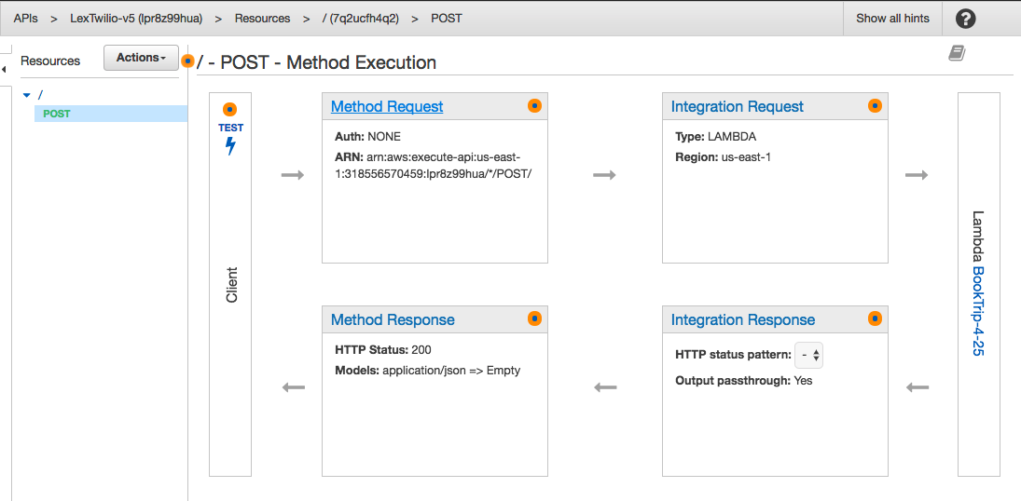
#3: HTTPS Endpoint using Amazon API Gateway

Slide 17
#4: Configuring the Twilio Webhook
https://www.twilio.com/console

Slide 18
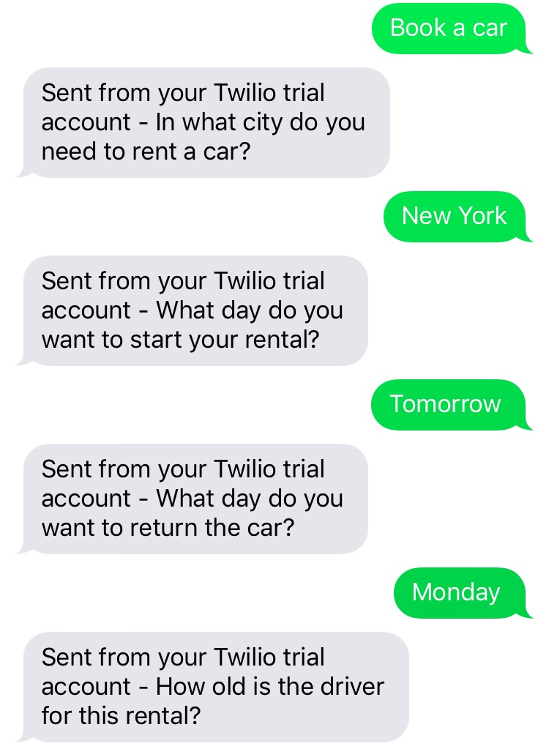
Your bot can now text!

Slide 19
Adding Support for Voice
Amazon Lex can support both Text and Voice
Use the Twilio <record> verb to prompt/record user input
Utilize Amazon Lex’s PostContent API call (instead of PostText)
Accept: text/plain
Convert to TwiML and send back to Twilio

Slide 20
Getting Started
https://console.aws.amazon.com/lex

Slide 21
AWS Chatbot Challenge
Create a chatbot with Amazon Lex and AWS Lambda
Prizes: $10,000 cash, $5,000 AWS credits, re:Invent tickets, more!
Submissions due July 18
awschatbot2017.devpost.com

Slide 22
Get Started: https://aws.amazon.com/lex
Sign up: awschatbot2017.devpost.com
Lex Console: https://console.aws.amazon.com/lex

