Slide 1
Vahvistu vanhempana –project (Inclusion FINLAND KVTL)
Strength and support for parents with learning disabilities and their families

Slide 2
History three projects before us
First two projects gathered information and stories from Families and studies made abroad.
There were group activities for the Families in chosen cities.
The third project aim was to spread the knowledge about recognizing Families and supporting them.
Enemmän otetta omaan elämään (2003 – 2005)
Enemmän otetta ja osallisuutta (2006 – 2009)
Äiti ei pysy kärryille (2010 – 2014)

Slide 3
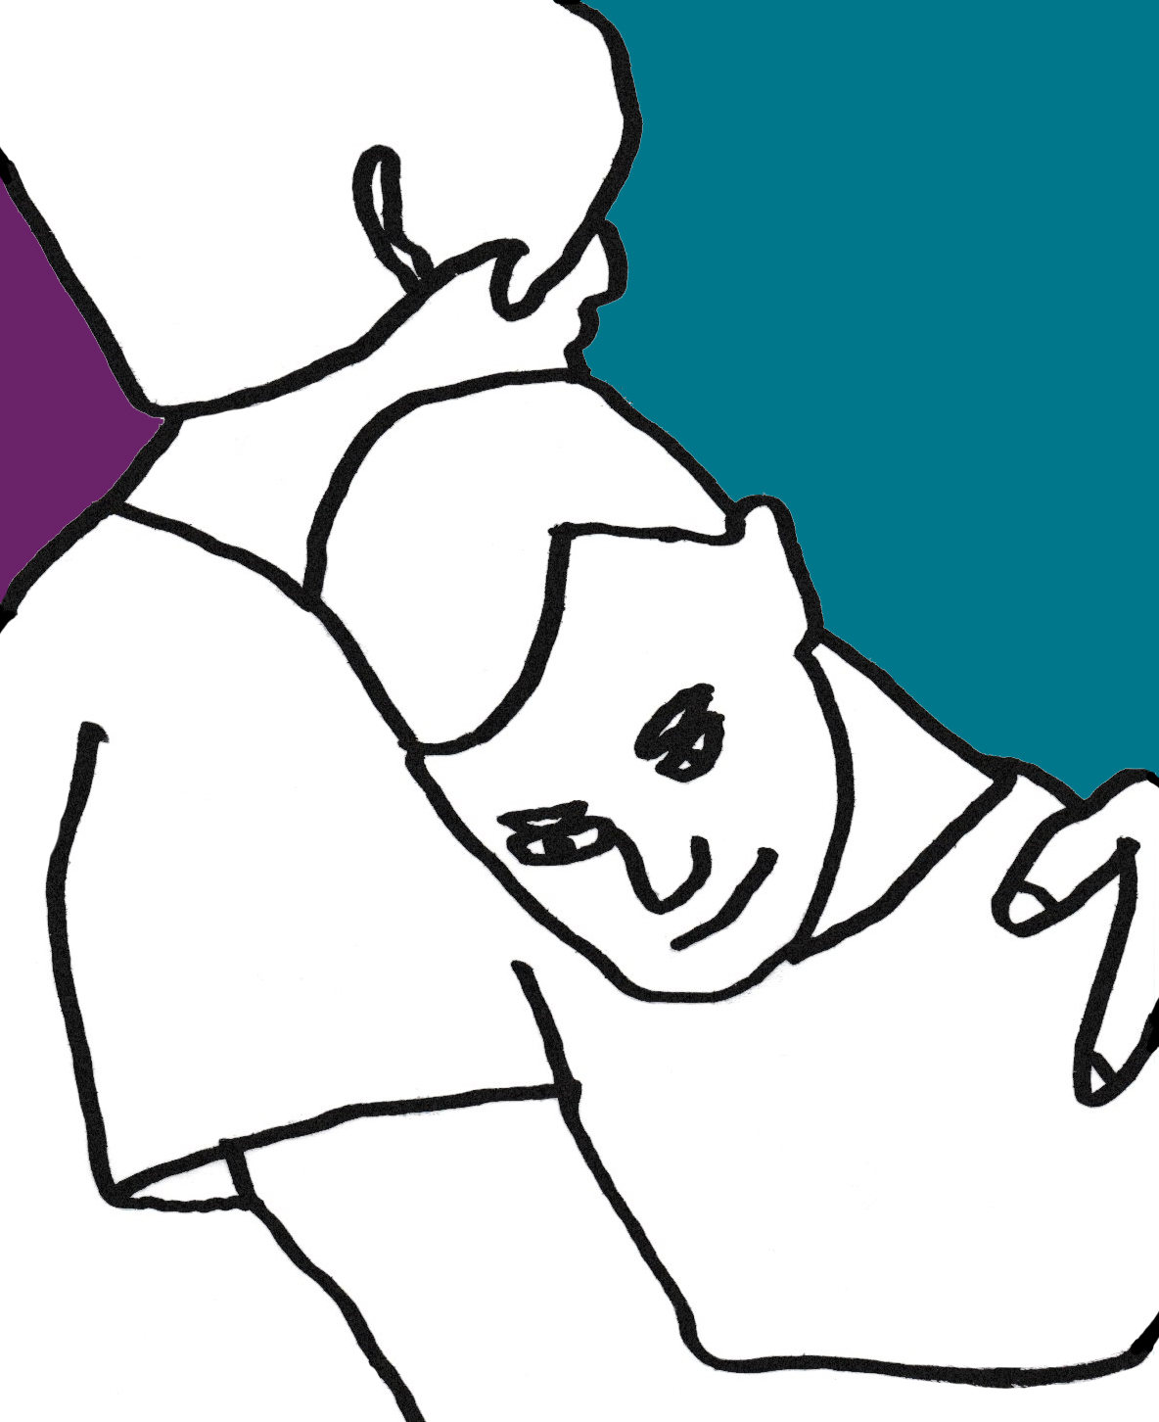
Vahvistu vanhempana (2017 – 2020) - Empower as a parent
First one to focus on parenting skills
The Aim is to create methods for supporting families that will live on in our organisation and network after 2020
Funding Centre for Social Welfare and Health Organisations (STEA)

Slide 4
Vahvistu vanhempana -project objectives
We have viable methods of support for Families in use of our organisation by 2020
that our organisation can use
that other organisation working with these Families can use
This means that the methods of support we create have to be
affordable
accessible
working for the families
become part of our organisations know-how

Slide 5
Vahvistu vanhempana -project objectives
Networking with organisations and professionals that work with Families
Creating a Team of Experts by Experience
We have a team of 5 people at the moment.
We have a grandparent, a family with two toddlers, a single mom of a teenager and a mom whose kids have been taken to custody.
We plan and design our methods of support with the help of their feedback and stories they tell about their life.

Slide 6
What we are creating: Parent-coaching process for 6 months
For families with children under the age of 10.
2 group week-ends in the beginning and at the end of the process
Families set their own goals for the 6 months
We make home visits, keep in touch and support the families in attaining their goals
Possible group meetings and/or online chats during and after the 6-month period

Slide 7
What we are creating: Support-sessions
1 – 5 meetings with us face to face or via internet
solution focused therapeutic discussions whatever is on the parents mind, support to the right services
For the parents and/or whole families and/or people who support them
Can be held together with other professionals as partners

Slide 8
What we are creating: Group meetings and chats online
Will be based on different needs of the families
For example:
parents whose children have been taken in custody; further developing Voikukkia® –peer support group method
adults with learning disabilities who are planning/dreaming about becoming parents
parents of teenagers
Specific support for FASD families

Slide 9
What we base our work on
All methods of support are solution focused and resource oriented
Our frame of reference is socio-emotional learning
We use tools of positive pedagogy

Slide 10
How we will DOCUMENT AND evaluate our work?
Documenting and evaluating working process and themes arising from the Team of Experts by Experience
Collecting and evaluating the stories from families
Systematic process and peer evaluation with 2-3 partners
Common feedback methods used in Solution Focused Therapy and Inclusion Finland KVTL

